Slide 1
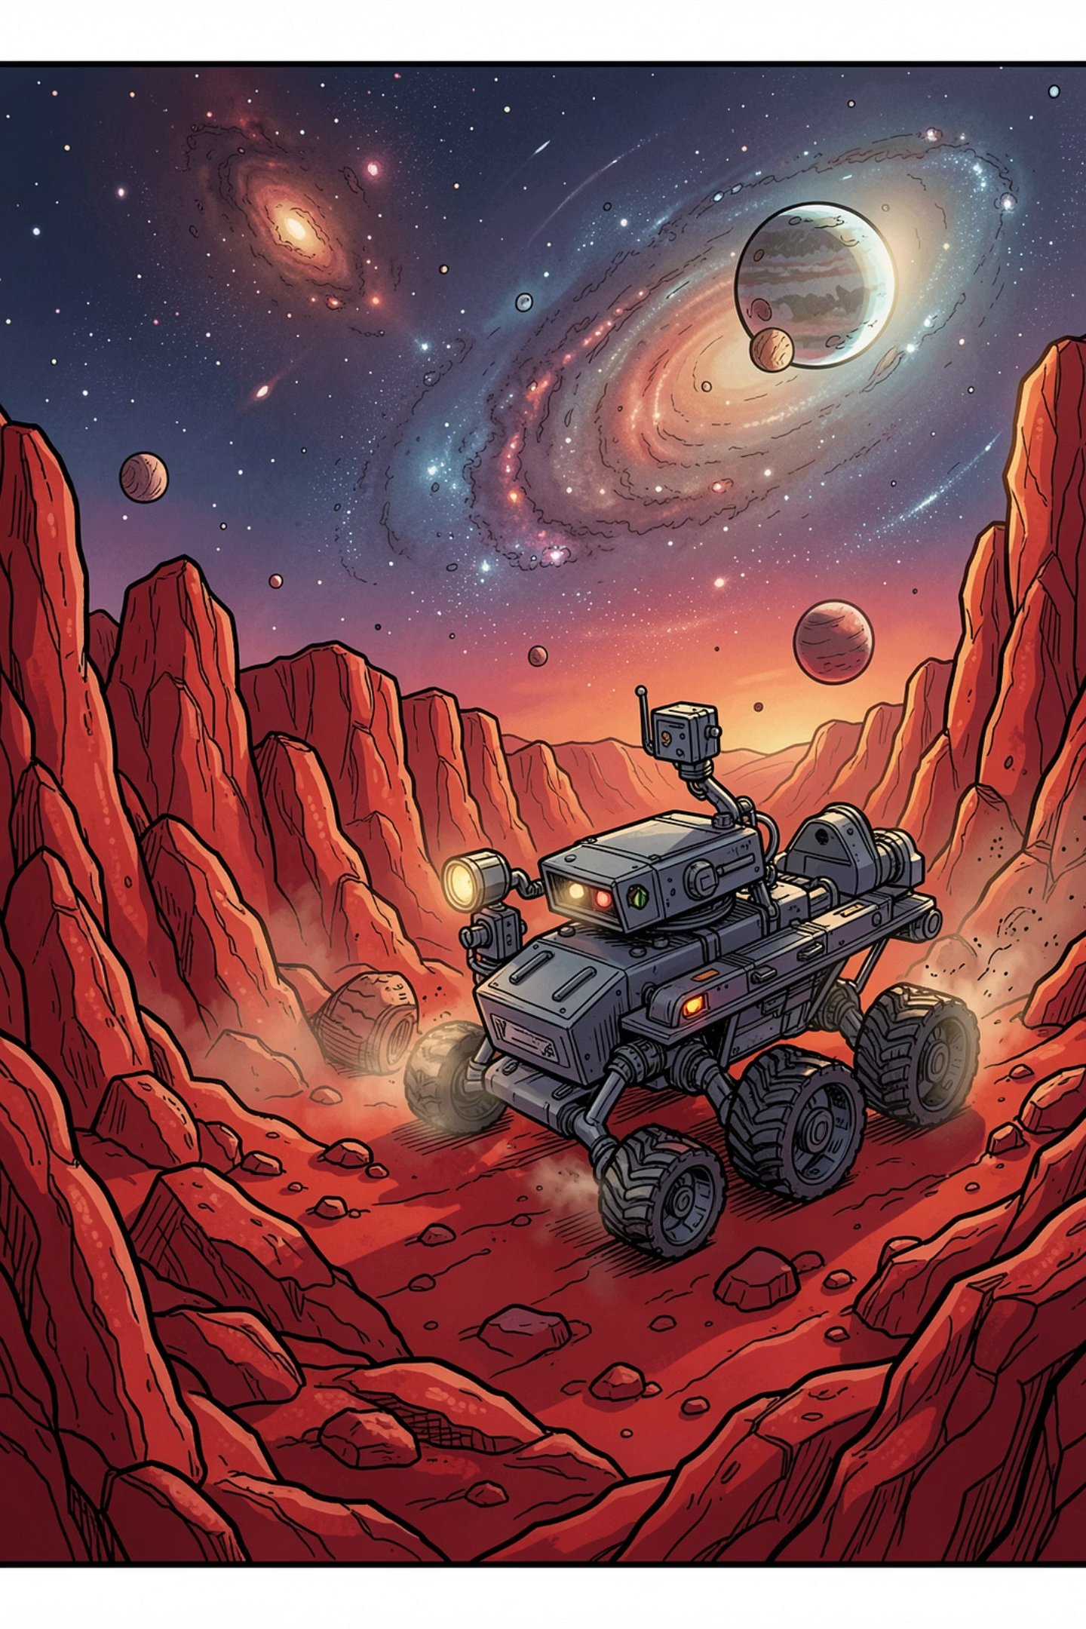

UNIVERSITY OF GENOA Master’s Degree in Robotics Engineering Program Code: 11963 Academic Year: 2025/2026
Planetary Rover
Heterogeneous Multi-Robot Exploration
SUBJECT: Artificial Intelligence for Robotics II (AI4RO2)
STUDENT NAME: HUSSEIN MOHAMED ELNAGGAR STUDENT ID: S8786438
Date: 18/6/2026

Slide 2
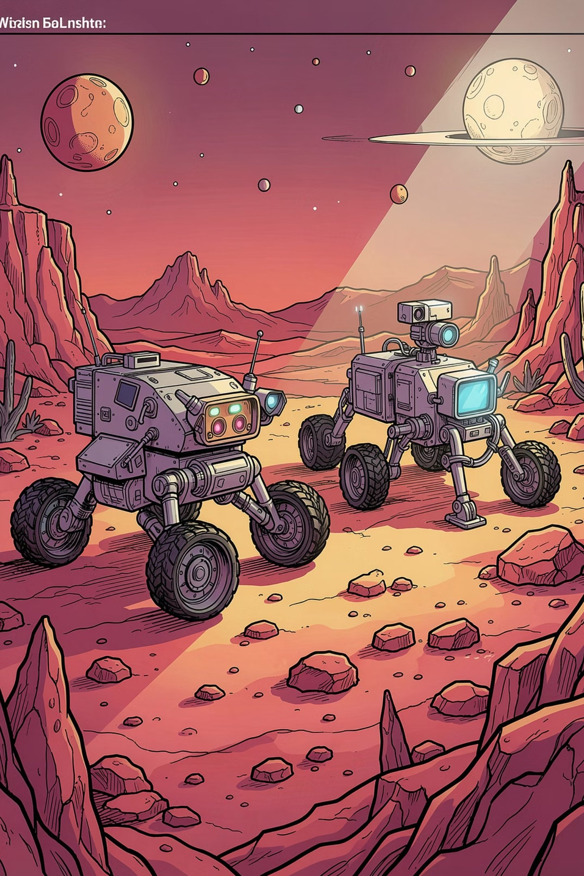
Domain & Planning Problem Overview
Phase 1: Classical STRIPS
Classical planning to validate logical coordination and task allocation between heterogeneous rovers.
Phase 2: PDDL+
Hybrid Dynamical System with continuous time, numeric fluents, and autonomous environmental dynamics.
Multi-agent cooperation emerges organically from spatial and terrain constraints via the can-traverse predicate — no explicit synchronization actions required.

Slide 3

Part 1: Types, Predicates & Actions
Core Predicates
Actions
Terrain types (flat, rough, mixed) gate mobility via can-traverse, avoiding duplicate action definitions.

Slide 4
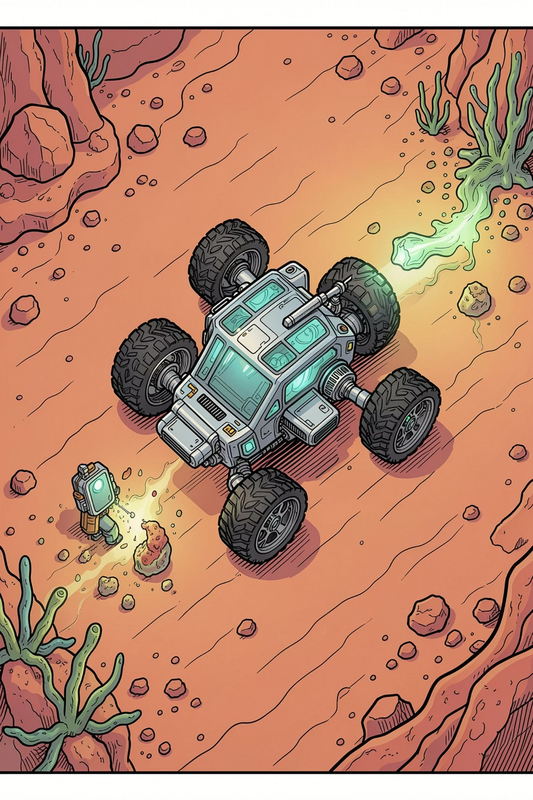
Problems 1 & 2: Single-Robot Scenarios
Problem 1 — Single Sample
Wheeled rover retrieves one sample from flat terrain and delivers to base. ENHSP generates a minimal 4-step optimal plan.
Problem 2 — Multiple Samples
Rover retrieves two samples across expanded terrain. Planner handles repetitive allocation, completing sample_a's full cycle before initiating sample_b retrieval — a 10-step sequential plan.

Slide 5
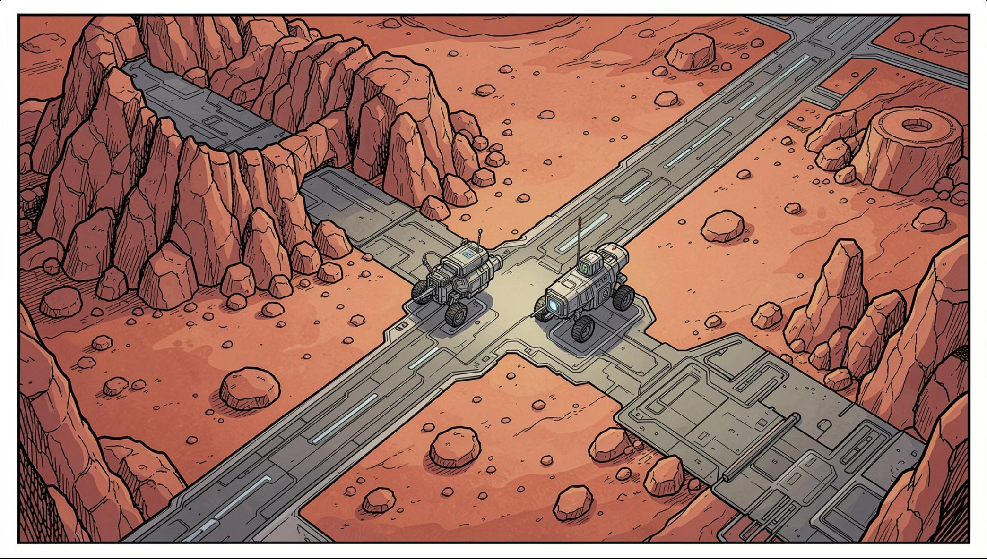
Problem 3: Forced Cooperation
A sample in rough terrain is inaccessible to the wheeled rover; the legged rover cannot traverse flat terrain to base. The planner resolves this via a relay handover at the mixed-terrain transfer_zone.
01
02
Gatherer (Legged)
Courier (Wheeled)
Navigates rough terrain, collects sample, drops at transfer_zone
Collects at transfer_zone, navigates flat terrain to base

Slide 6
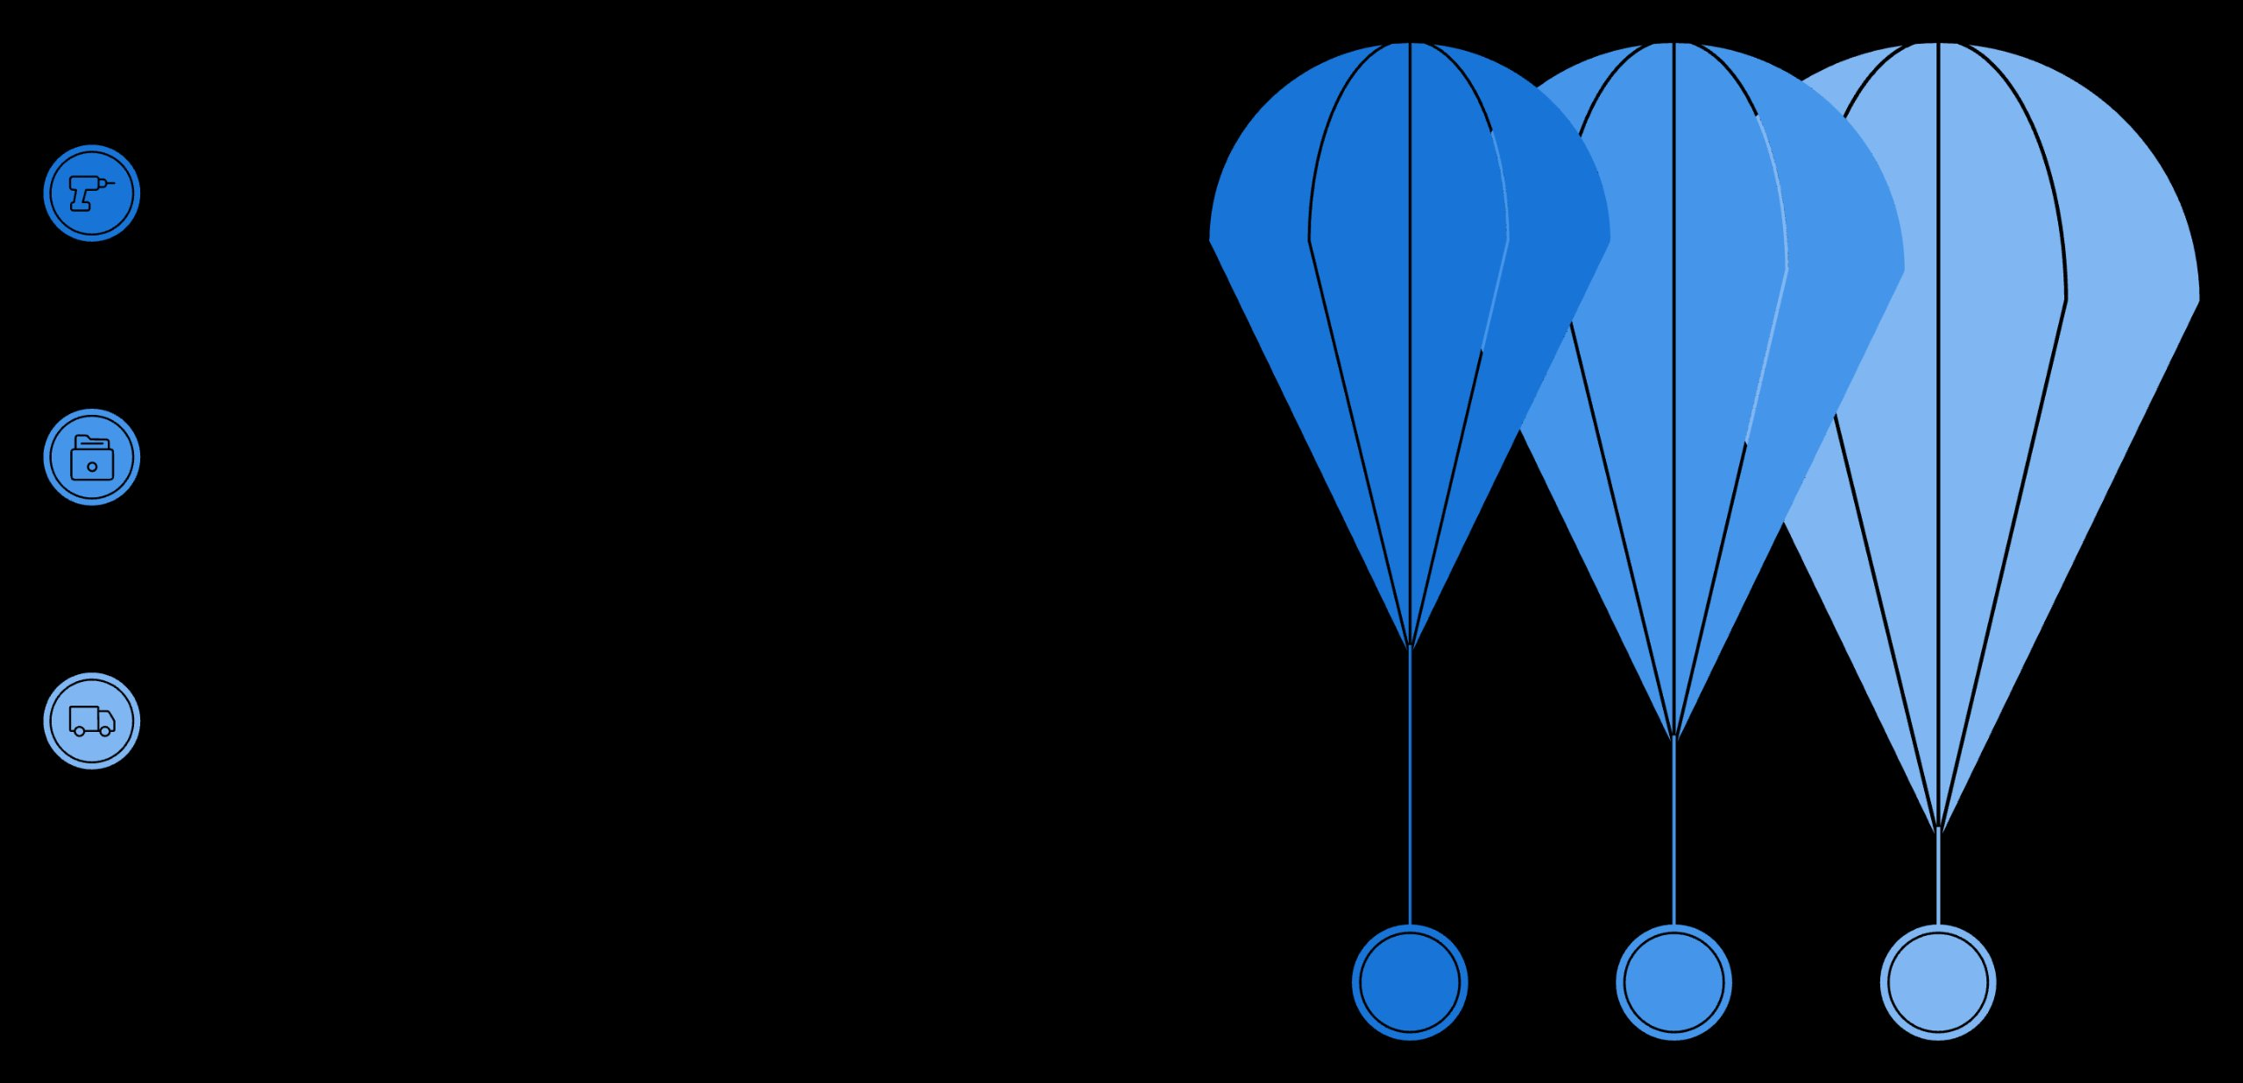
Problem 4: Advanced Coordination
A branched crater network with two samples in disconnected rough zones. The planner distributes workload based entirely on mechanical constraints.
Phase 1 Mining
Legged rover mines north and south craters
Sample Deposit
Deposit collected samples at central hub
Phase 2 Delivery
Wheeled rover shuttles samples hub-to-base
The legged rover acts as a dedicated miner, the wheeled rover as a logistics courier — cooperation emerges purely from terrain constraints.

Slide 7

Part 2: PDDL+ Hybrid Dynamical System
Processes (Continuous)
Events (Autonomous)
Maps-process — distance reduction at speed × #t
accumulate-risk — hazard buildup in rough terrain
recover-risk — risk depletion during rest
risk-failure — fires when risk-level exceeds max-risk, sets is-broken and speed=0
Navigation Design
Durative actions avoided. Navigation split into instantaneous start/end actions modulated by continuous processes.

Slide 8
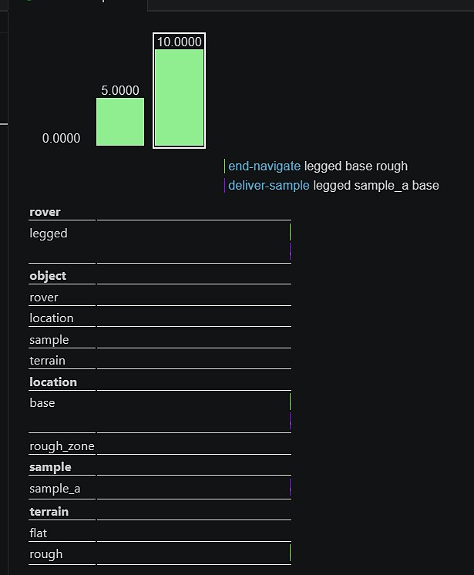
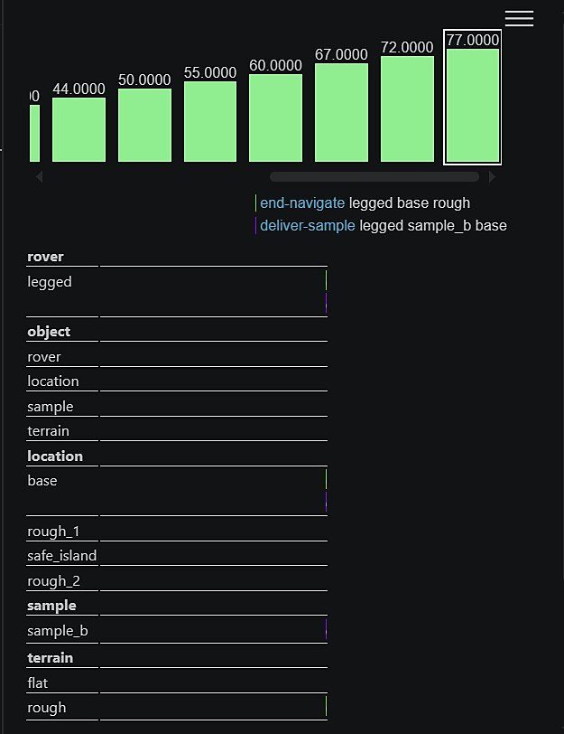
PDDL+ Problems 1 & 2: Continuous Dynamics
Problem 1 — Baseline
Problem 2 — Proactive Risk Mitigation
Single-agent scenario validating distance depletion and risk accumulation. ENHSP synthesized a 16-step plan, 10.0 time units. Risk stayed below threshold — no resting required.
Planner forced to use safe_island for mandatory rest. Each rough leg generates 45 risk; a full round-trip would exceed max-risk (100). The planner autonomously inserted rest phases — a 107-step plan, 77.0 time units.

Slide 9
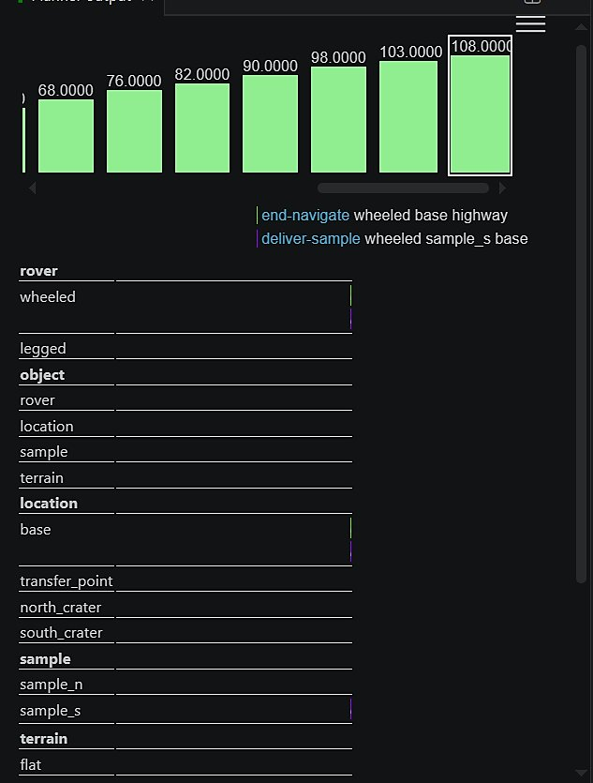
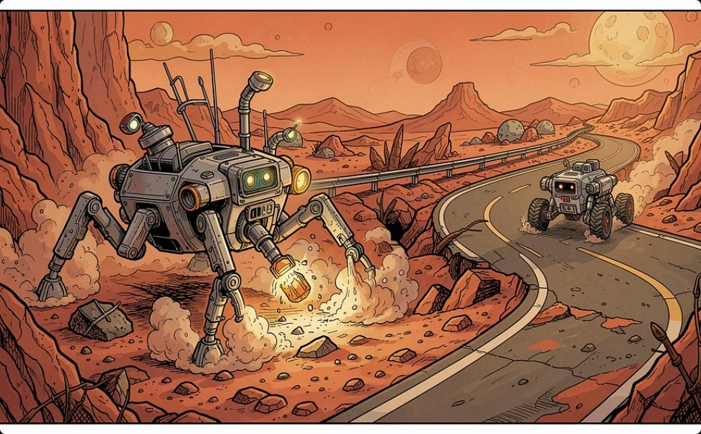
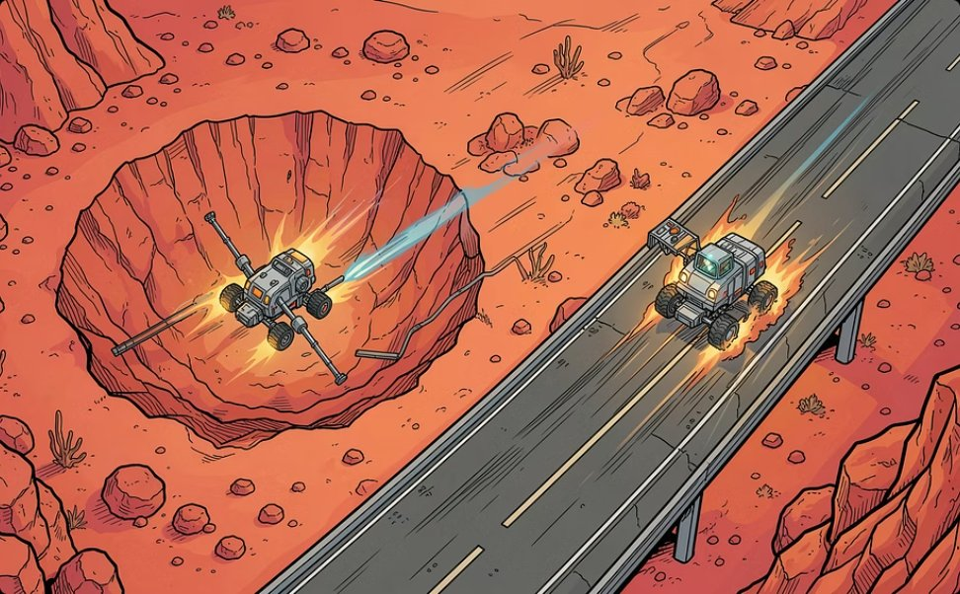
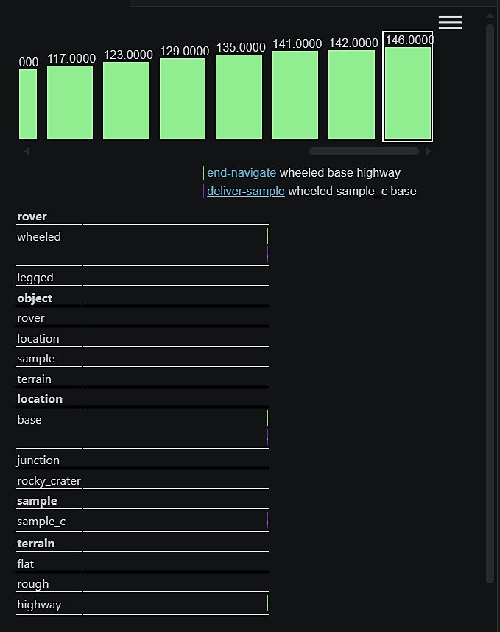
PDDL+ Problems 3 & 4: Multi-Agent Hybrid Plans
Problem 3 — Time-Critical Cooperation
Problem 4 — Scaled Optimization
Legged rover gathers from rough terrain; wheeled rover exploits highway for fast logistics. 202 steps, 146.0 time units.
Concurrent scheduling with (:metric minimize total-time). Maximum parallelization — legged mines while wheeled delivers. 152 steps, 108.0 time units.

Slide 10

Results, Limitations & Conclusion
Key Achievements
Limitations
STRIPS: Emergent cooperation via can-traverse capability encoding
PDDL+: Continuous navigation, risk accumulation, and autonomous risk-failure event
Planner dynamically schedules mandatory rest to prevent systemic failure
PDDL+ temporal state-space explodes with asynchronous parallel agents
TMP Gap: Symbolic terrain abstraction ignores slope gradients, traction, and kinodynamic constraints
Real-world deployment requires integration with geometric motion planners (e.g., RRT)
This work highlights the trade-off between spatial pruning through heterogeneity and temporal state-space explosion in hybrid planning.

