Slide 1
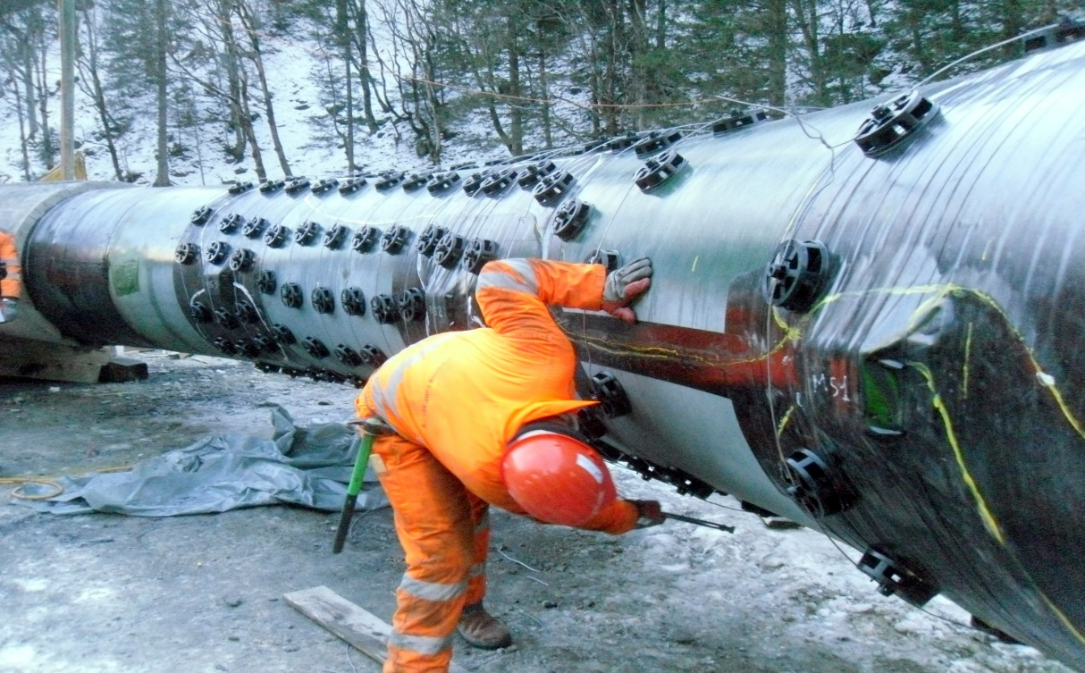
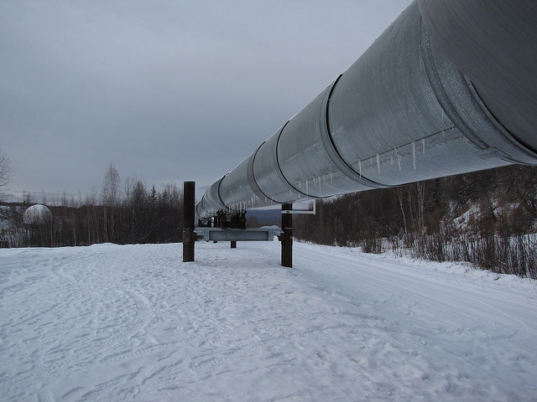
Automate Machine Learning Workflows with Pipelines in Python and scikit-learn

Slide 2

Why Pipeline?
Standaliser the workflows in applied machine learning (simple to automatiser)
Overcome the multi-problems and bug (safety!)
Allow for a linear sequence of data transforms to be chained together culminating in a modeling process that can be evaluated. (rapid!)
Call only fit and predict once on data to fit whole sequence of estimators (simple to use!)

Slide 3
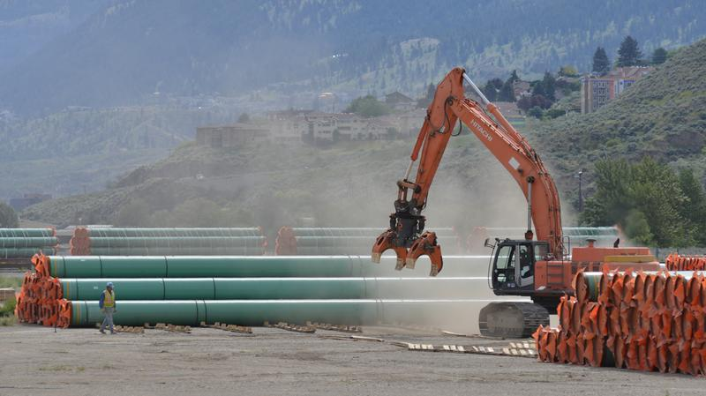
How to use Pipeline?
All estimators in a pipeline, except the last one, must be transformers (i.e. must have a transform method). The last estimator may be any type (transformer, classifier, or regressor).
Pipeline is built using a list of (key, value) pairs, where the key is a string containing the name you want to give this step and value is an estimator object

Slide 4
Pipeline use case
from sklearn.pipeline import Pipeline, FeatureUnion
from sklearn.preprocessing import StandardScaler
from sklearn.svm import LinearSVC
class TypeSelector(BaseEstimator, TransformerMixin):
def __init__(self, dtype):
…
def fit(self, X, y=None):
…
def transform(self, X):
…
class Define_cos_column (BaseEstimator, TransformerMixin):
def __init__(self, dtype):
…
def fit(self, X, y=None):
…
def transform(self, X):
…

Slide 5
What’s BaseEstimator, TransformerMixin, RegressorMixin, ClassifierMixin
class BaseEstimator(object):
def _get_param_names():
…
get_params(self, deep=True):
…
set_params(self, **params):
…
class TransformerMixin (object):
def fit_transform(self, X, y=None, **fit_params):
…
return self.fit(X, y, **fit_params).transform(X)
class RegressorMixin (object):
def score(self, X, y, sample_weight=None):
…
return r2_score(y, self.predict(X)…)
class ClassifierMixin (object):
def score(self, X, y, sample_weight=None):
…
return accuracy_score(y, self.predict(X)…)

