Slide 1
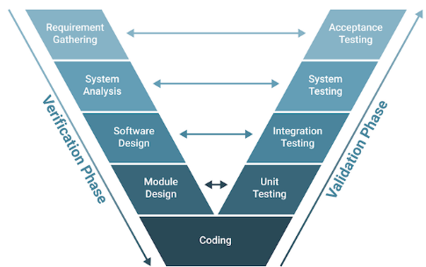
Problem Statement: Multimodal Data Exploitation and Notification Generation using Large Models (LLMs)
GE aims to leverage Large Language Models (LLMs) for multimodal time series data analysis tasks.
Goal: replace traditional coding with natural language queries interaction using LLMs.
The project evaluates LLM capabilities in 3 time series tasks: threshold exceedance, slope calculation, and forecasting.
Model Accuracy, Efficiency, Usability, and Privacy
From:
To:
Requirements
Acceptance
{ simple tasks; data exploitation; fast prototyping …}
Prompts
Testing
LLMs & Tools*
*Minimize / eliminate coding
Notes:
Hello everyone, today we are presenting our GE Capstone project on leveraging Large Language Models, or LLMs, for multimodal data exploitation and notification generation. The ultimate goal is to simplify industrial workflows by replacing traditional coding with natural language queries, enabling fast prototyping and enhanced data utilization.

Slide 2

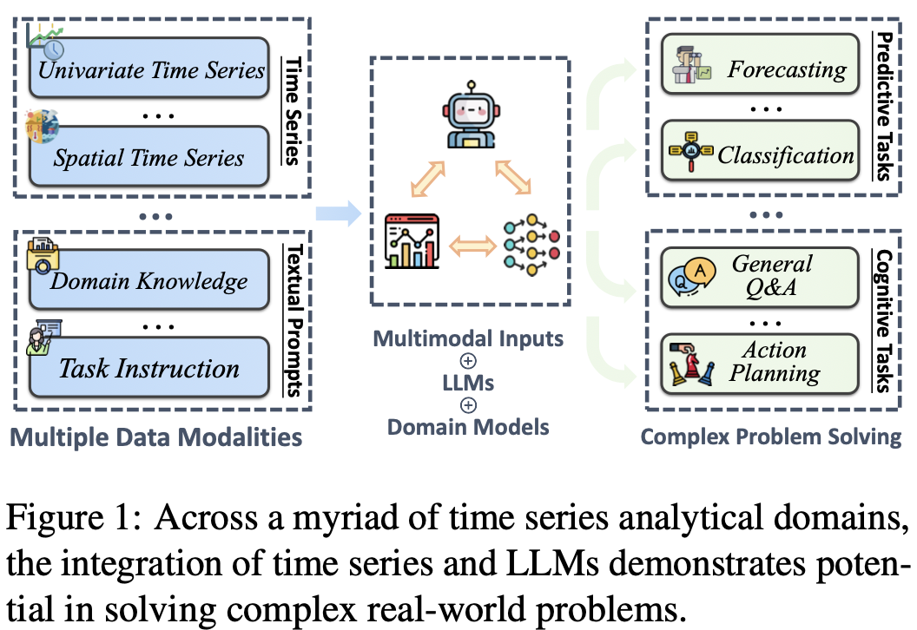
Existing Work and Background
Extensive literature review on LLMs For time series:
- LLMTIME: Tokenize time series as text for zero-shot forecasting.
- TIME-LLM: Use reprogramming & prompt-as-prefix (pap) to align time series with frozen LLMs.
- TIME-MoE: Biggest TS foundation model w/ MOE, computationally efficient, forecasting with any length, achieves SOTA in many tasks
- CHRONOS: Amazon’s TS-FM, Scaling & Tokenize time data as patch, train on T-5 LLM architecture; data augmentation strategy
- TIMERAG: Segment & Cluster TS Data, Build Knowledge Base, Retrieval By Dynamic Time Warping (DTW)
Key takeaways:
- LLMs Are Promising For Time Series Forecasting But Some Face Challenges In Arithmetic Precision
- Most LLMs Models ONLY Focus On ONE TASK, mainly Forecasting; Few Works Explore General Time Series Analysis
- Most DO NOT Provide Prompt-based User Interaction – ONLY Numerical Data ALLOWED – CANNOT DO Multi-Modal Analysis
Notes:
Let’s first look at the existing work in applying LLMs to time series analysis. Our literature review highlights some key models:
LLMTIME and TIME-LLM are relatively older models from 2 years ago that make use of pre-existing LLMs models directly, LLMTIME tokenizes time series as text while TIME-LLM uses reprogramming & prompt-as-prefix to align with frozen LLMs;
TIME-MOE and CHRONOS are recently published pre-trained foundation models, with the first one uses MOE structure while the latter one employs tokenization and patching technique, with its Bolt version released in Dec 2024 improving dramatically in inference time and accuracy than its original version.
The last one basically integrates RAG into time series analysis by building a knowledge base and retrieving data via DTW technique.
Key takeaways are that while LLMs show promise in forecasting, some struggle with arithmetic precision, and most existing work focuses solely on forecasting rather than general time series analysis.
Most importantly, most models do not provide prompt-based user interaction and only numerical data is allowed, so we cannot do multi-modal analysis.

Slide 3
Approach
Dual-objective approach:
- Leverage cutting-edge LLM-based time series models (Chronos) for forecasting.
- Develop prompt-based solutions (other 3 LLMs) to bypass coding for real-world applications.
Selected models: Chronos (Amazon), OpenAI o3-mini, DeepSeek R1, LangChain Pandas Agent.
BENCHMARKING: Chronos against Facebook Prophet, a popular time series model. Other 3 LLM models against GPT 4o.
3 Time series TASKS: Forecasting (predict future value); Threshold Exceedance (detect values cross threshold for anomaly detection); Slope Calculation (determine rate of change over time interval)
Data sources: Microsoft Azure Predictive Maintenance dataset – contains operating conditions (volt, pressure, vibration, rotate) for 100 machines, 876k data points in total; machine maintenance history; machine failure & error record.
Other datasets from DARTS, MONASH, UCI ML REPO are selected for further test & evaluation.
Notes:
To address these challenges, we employ a dual-objective approach. First, we explore cutting-edge time series models for forecasting. Second, we develop prompt-based solutions to eliminate the need for coding in real-world applications.
We selected the following models:
Chronos, Amazon’s time series foundation model; OpenAI o3-mini & the newly released DeepSeek R1 have strong logical reasoning capability; and LangChain Pandas Agent designed for natural language interaction with the agent to write Pandas code.
We benchmark Chronos against Facebook’s Prophet for forecasting, while the other three models are compared against GPT-4o. The 3 core time series tasks we focus on are forecasting, threshold exceedance, and slope calculation.
Dataset we currently use is Predictive Maintenance dataset, which contains operational data as well as maintenance record from 100 machines. Additionally, we’ll test models with datasets from well-established time series data sources like DARTS and Monash.

Slide 4



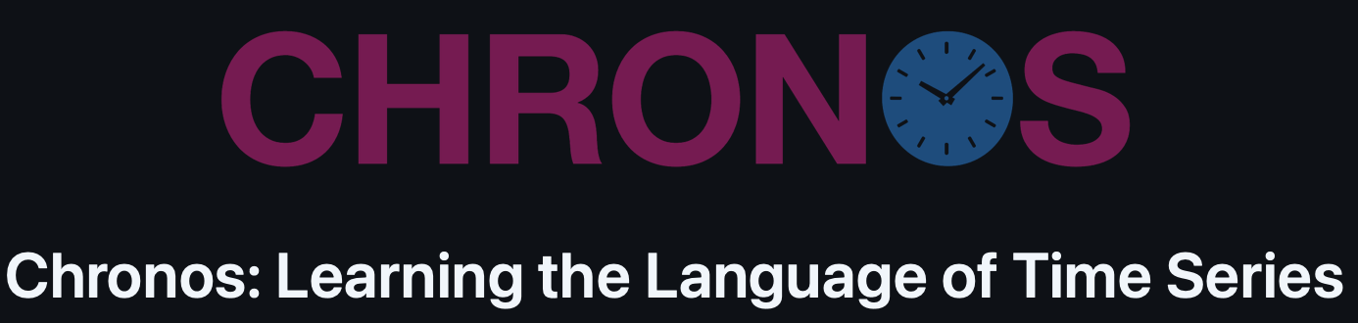
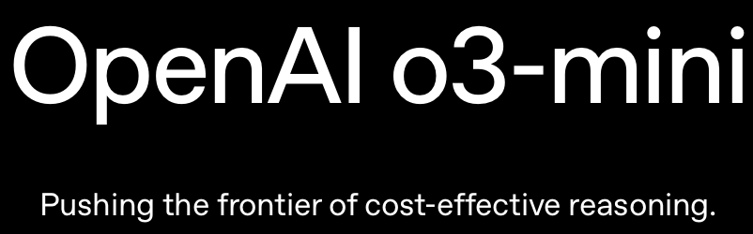
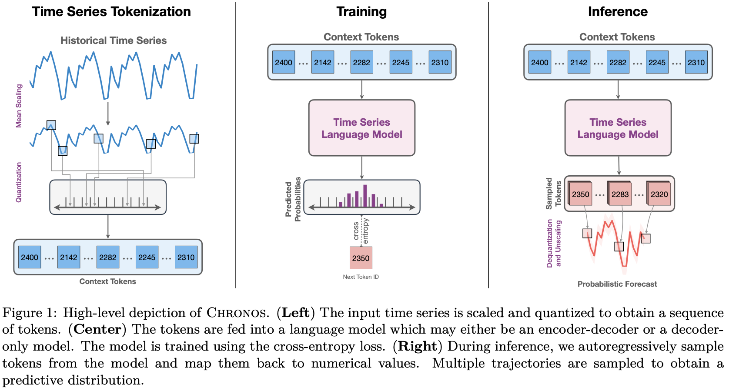


Notes:
Here is a gallery of models we use.

Slide 5
What Does Success Look Like?
Key Performance Indicators (KPIs):
MAE, RMSE, MAPE for forecasting tasks;
MAE, MSE for slope calculation;
Precision/Recall/Accuracy for threshold exceedance;
Computational efficiency and usability of LLMs in an industrial workflow.
Business impact:
Explore the usage of fore-front LLMs models & techniques in time series analysis tasks
Reduce manual effort in coding in industrial applications.
Notes:
To measure success, we use the following key performance indicators:
Except traditional ML metrics like MAE, MAPE, and precision, we also care about model usability, i.e., how user-friendly the model is, as well as its computational efficiency.
From a business perspective, success means reducing manual effort in data analysis and improving predictive maintenance, helping companies optimize asset monitoring and reduce downtime.

Slide 6

Progress So Far
Conducted extensive literature review & background research.
Selected and tested multiple LLMs-based models for time series analysis.
Developed data pre-processing and model evaluation framework for all three tasks.
Initial Test:
Chronos shows promising results in forecasting, super fast during train & inference, enable model fine-tuning using CPU or GPU and we can manually set tuning time (currently only tried CPU)
OpenAI o3-mini performs well in threshold detection but struggles with slope calculation, unstable results with different seeds.
DeepSeek R1 excels at its reasoning ability but have accuracy issues & computational speed dealing with relatively large datasets
LangChain Pandas Agent gives perfect result with only numerical data, having issues when combining with text data
Notes:
So far, we have completed our literature review, selected models, and built a data pre-processing and evaluation framework for our three key tasks.
Chronos delivers strong forecasting performance and allows flexible fine-tuning task-specific using either CPU or GPU.
o3-mini performs well in threshold detection but struggles with slope calculations and produces unstable results across different runs.
DeepSeek demonstrates excellent reasoning abilities but has accuracy and speed limitations when handling large-scale datasets.
LangChain works perfectly with numerical data but has difficulty integrating with text-based inputs.
These insights guide our next steps to refine the models and improve efficiency.

Slide 7
Challenges & Next Steps
Challenges:
Computational inefficiencies: DeepSeek and OpenAI o3-mini struggle with large-scale numerical calculations.
Prompt sensitivity: Small changes in phrasing significantly impact model performance.
Generalizability: Ensuring models perform well across different datasets and time resolutions.
NEXT STEPS:
Expand testing dataset to 100+ for better generalization on all 3 tasks.
Optimize Chronos fine-tuning and explore GPU acceleration.
Improve DeepSeek, OpenAI o3-mini, and LangChain Pandas execution efficiency and stability via prompt engineering; Include text data to interact with models.
Investigate additional LLM capabilities. E.g.: currently assume we have the data for analysis -- use prompting LLMs to generate SQL command for automated data retrieval from the database.
Notes:
Specifically, we still face several challenges:
Computational inefficiencies: Some models struggle with large-scale numerical calculations & cannot integrate with text data well.
Prompt sensitivity: Small wording changes in prompts significantly affect model outputs.
Generalizability: Ensuring consistent performance across different datasets.
Our next steps include:
Try to test more datasets to verify generalizability;
Optimize Chronos fine-tuning using GPU;
Improve execution efficiency and stability for other 3 models and include text data;
If time permits, explore some other related LLMs techniques like automated data retrieval.

