Slide 1
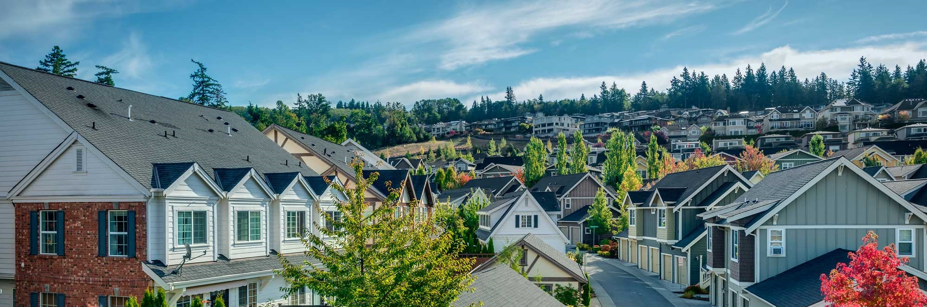
King County Housing Price Modeling Project
DSF-PT7 Phase 2 Group 19

Slide 2
Overview
Context: Homeowners aim to maximize property value through renovations in a competitive real estate market.
Aim: Leverage linear regression modeling to understand how different home renovations impact property value.
Approach:
Analyze historical sales data.
Apply regression techniques to quantify the impact of specific renovation projects on home prices.
Outcome:
Enable homeowners to make data-driven decisions.
Help real estate agents provide expert advice to clients.

Slide 3
Outline
Business Understanding
Data Understanding
Modeling & Validation
Conclusions

Slide 4
Business Understanding
Provide actionable insights to a real estate agency assisting homeowners in buying and selling properties.
Key Objectives:
Develop a Predictive Model:
Create and validate a linear regression model to predict the increase in home value based on renovations.
Quantify the Impact of Renovations:
Analyze historical sales data to determine how different renovations affect property value.

Slide 5
Data Understanding
Dataset: King County House Sales (kc_house_data.csv)
Features (some):
Square footage
Number of bedrooms and bathrooms
Waterfront presence
View quality
Year built
Renovation status
Sale price (dependent variable)
Details: Column descriptions are in the column_names.md file.
Aim: Use this dataset to understand and quantify the impact of various home renovations on property values.

Slide 6
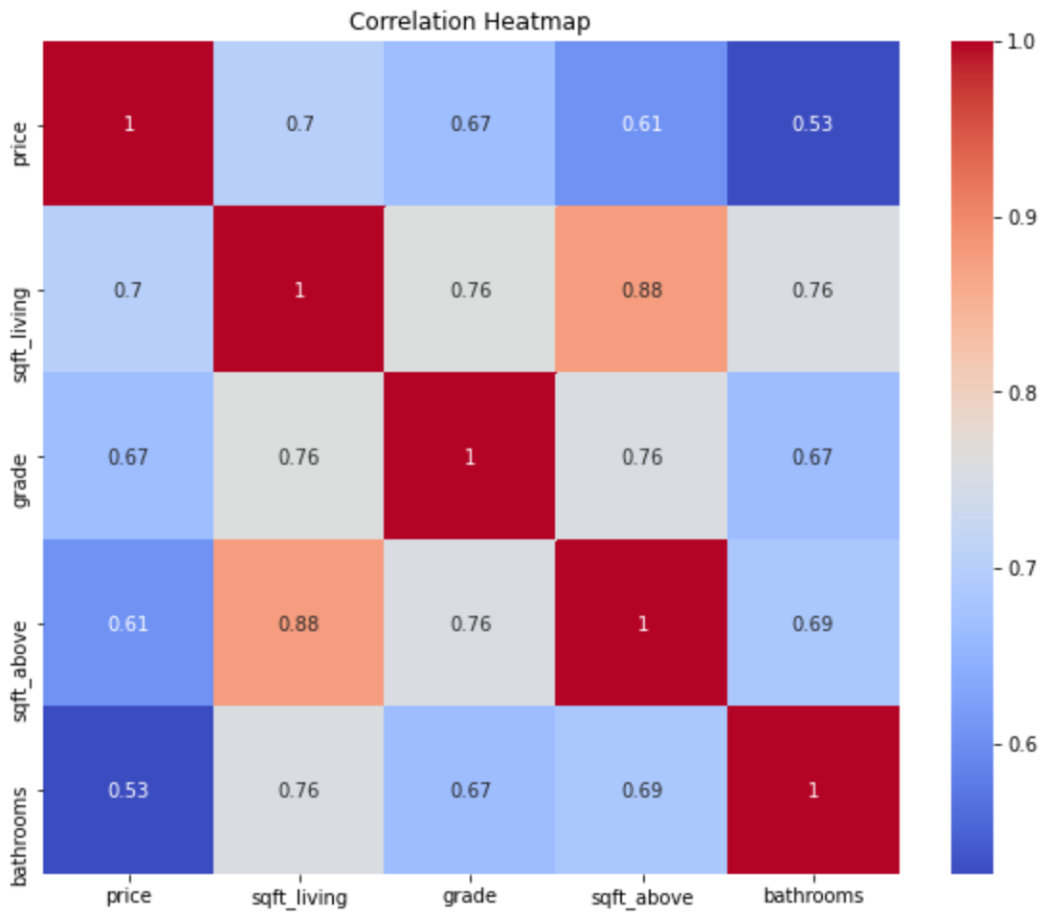
Data Understanding
Features Selected for Modeling:
Chosen based on correlation analysis and domain knowledge for their impact on price and relevance in real estate valuation.
sqft_living (Square Footage of Living Area):
grade (Overall Grade Given to the Housing Unit):
sqft_above (Square Footage Above Ground):
bathrooms (Number of Bathrooms):

Slide 7
Modeling & Validation
Approach: Iterative evaluation to improve model performance based on MAE, MSE, and R².
Initial Models:
Built four models without addressing outliers, multicollinearity, or scaling.
Best initial model (Model 4) included features: sqft_living, grade, bathrooms, sqft_above.
Metrics:
MAE: 129,160
MSE: 27,242,617,861
R²: 0.560
Refinements:
Addressed outliers by capping, improving metrics significantly.
Multicollinearity addressed, but dropping sqft_above did not enhance performance.
Scaling predictors had no significant impact.

Slide 8
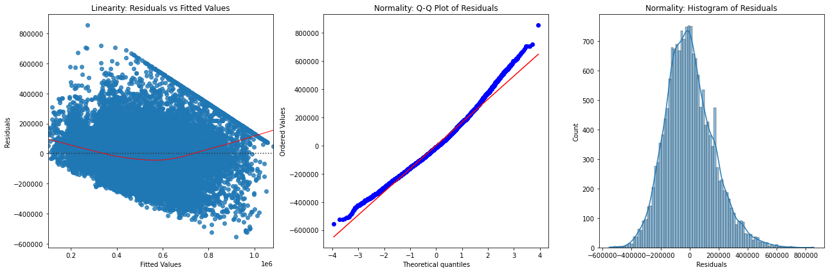
Modeling & Validation
Model 4 Diagnosis
Residuals show a curved pattern, violating linearity. Q-Q plot and histogram indicate deviations from normality, suggesting outliers or skewness. To address this, we log-transformed the dependent variable, scaled predictors, removed outliers, and included bedrooms (correlation with price: 0.31) as additional feature to see if model improves.

Slide 9
Modeling & Validation
Best-Performing Model:
Iteration 2 of Model 4 showed initial diagnosis violations of linearity and normality.
Further refined (Model 5) by: Removing outliers; Scaling predictors; Log transforming price; Adding bedrooms feature
Metrics for Model 5:
MAE: 123,967
MSE: 26,571,843,532
R²: 0.568
Outcome: Model 5 demonstrated the highest accuracy and explanatory power, ensuring a robust and reliable linear regression model for predicting house prices.

Slide 10
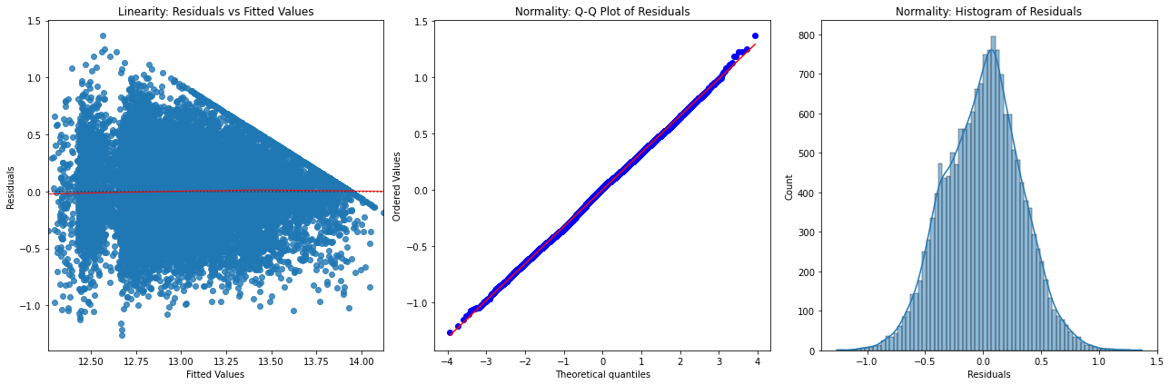
Modeling & Validation
Model 5 Diagnosis
Residuals are more randomly scattered, indicating improved linearity. Q-Q plot shows residuals closely following the red line with minor tail deviations, and the histogram is bell-shaped with reduced skewness and kurtosis, indicating a better approximation of normality.

Slide 11
Conclusions
Robust Predictive Model:
Developed Model 5 predicts home value increase based on key features: sqft_living, grade, sqft_above, bathrooms, and bedrooms.
R²: 0.57 on the test set, explaining 57% of the variance in housing prices.
Strategic renovations can substantially increase property value.
Recommendations
Focus on High-Impact Renovations: Prioritize increasing living area, improving construction quality, and adding functional spaces (bathrooms and bedrooms).
Use the Predictive Model for Client Consultations: Provide data-driven estimates of potential home value increases from specific renovations to help homeowners make informed decisions.
Market Insights: Identify market trends and desirable property features to better position properties and tailor marketing strategies.
Outcome:
Leveraging the model enhances client satisfaction and strengthens the agency's reputation as a knowledgeable and reliable real estate advisor.
Notes:
Focus on High-Impact Renovations: Prioritize increasing living area, improving construction quality, and adding functional spaces (bathrooms and bedrooms).
Use the Predictive Model for Client Consultations: Provide data-driven estimates of potential home value increases from specific renovations to help homeowners make informed decisions.
Market Insights: Identify market trends and desirable property features to better position properties and tailor marketing strategies.

Slide 12
Thank You!
Linet Maz’susa
Tabitha Kariuki
Brian Amani
Collins Ouko
Joseph Ngige

