Slide 1
oPEN Simulation Environment
PENSE

Slide 2
PENSE
PENSE is a simulation framework written in C++ using fully object oriented design patterns and it's designed to be flexible, extendable and portable within itself.

Slide 3
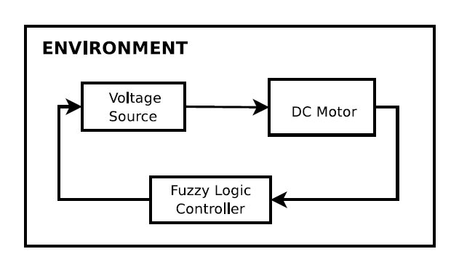
How does it work ?

Slide 4
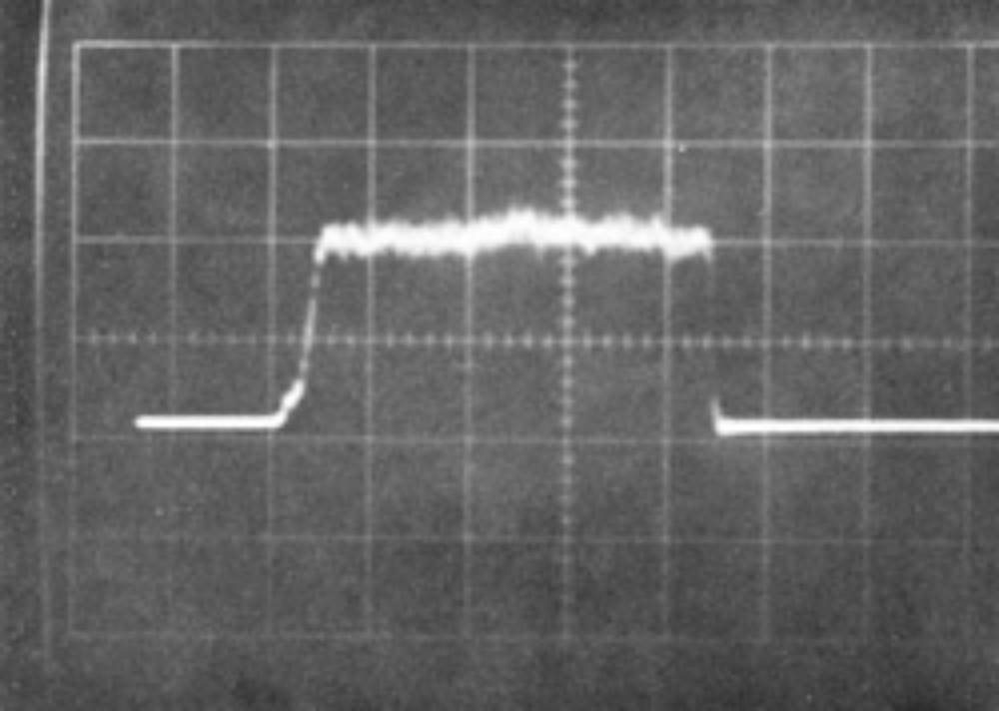

Environments

Slide 5
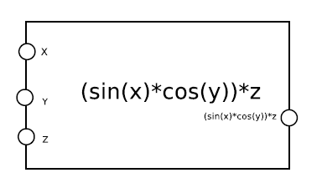
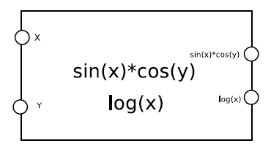
DEVICES

Slide 6
Algorithms
An algorithm is any object derived from base algorithm model.
    takes inputs
    evaluates
    gives output

Slide 7
DEVICE TYPES
SOURCES
PLANTS
CONTROLLERS

Slide 8
SOURCES
being able to be turned ON/OFF
increase/decrease current value

Slide 9
PLANTS
Plants are any device which is supposed to convert some form of energy to another.

Slide 10
CONTROLLERS
All controllers must implement methods for setting a set point and retrieving it.

Slide 11
ALGORITHMS
take inputs for each of the parameters.
evaluate the algorithm for the inputs.
give an output.

Slide 12
POLYNOMIAL BASED
You provide a regular equation string to Polynomial by using computer notations, then Polynomial parses the string, extracts the parameters and get ready for actual work.

Slide 13
FUZZY LOGIC
Fuzzy logic algorithms are relatively a new concept with respect to PID and such traditional controllers.

Slide 14
WHAT IS IT?
In contrast to other algorithms, fuzzy logic's principle is to think like an organic creature; human.

Slide 15
HOW DOES IT WORK ?
Unlike other approaches, in fuzzy logic we define human readable rules to form the target system. For instance assume we want to control the room temperature, first of all we define simple rules:
If the room is hot then cool it down
If the room is normal then don't change temperature much
If the room is cold then heat it up

Slide 16
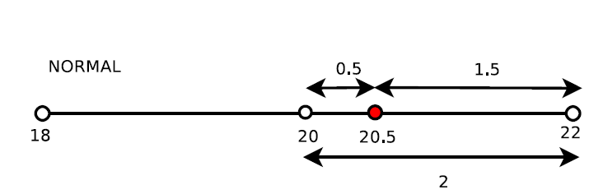
20.5 ºC: This temperature value is member of both normal and hot.
20 ºC: This temperature value is member of only normal.
15 ºC: This temperature value is member of only cold.

Slide 17
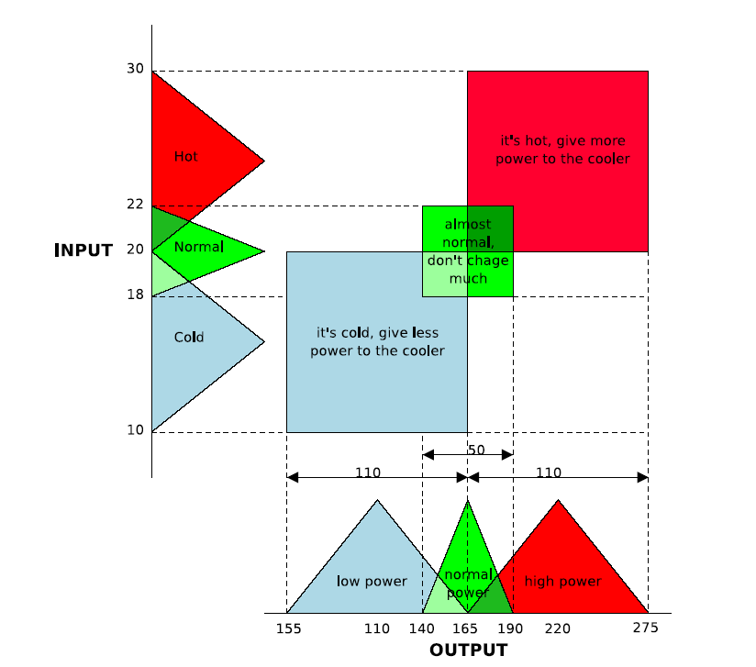

Slide 18
PLANTS
Plants are any devices which drains energy and transform it into another form of energy. A DC motor modell is provided with libpense.

Slide 19
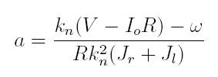

DC MOTOR
Given :
We can also get w:

Slide 20
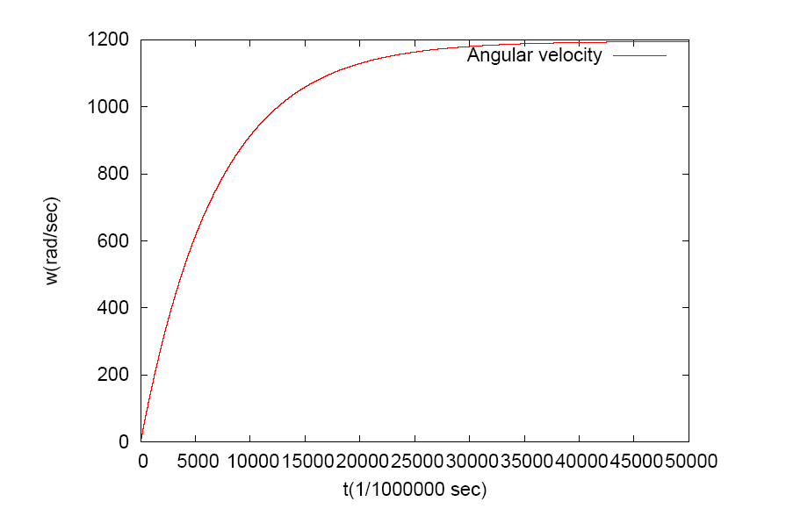
MOTOR VELOCITY – TIME GRAPH

Slide 21
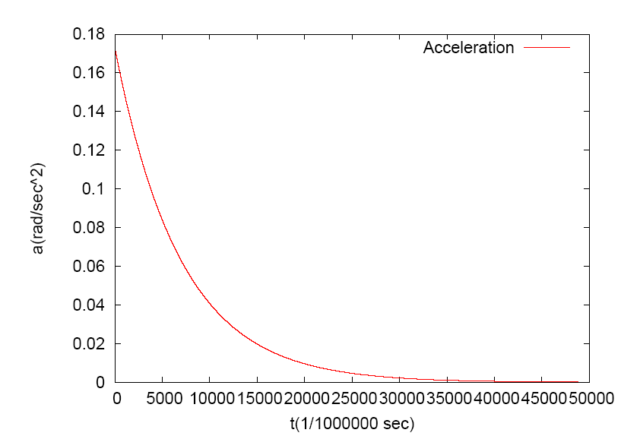
MOTOR ACCELERATION – TIME GRAPH

Slide 22
MOTOR CURRENT – TIME GRAPH

Slide 23
CONTROLLERS
PENSE suggest a common interface for controllers too , you can set a set point for every controller.

Slide 24
FUZZY LOGIC CONTROLLER
One should give a set point and an output range for the controller to be initalized. For instance, one can tell that set point is 500 and output range is 0-12. This means according to the input value fuzzy logic controller will give an output between 0 and 12 to control the device.

Slide 25
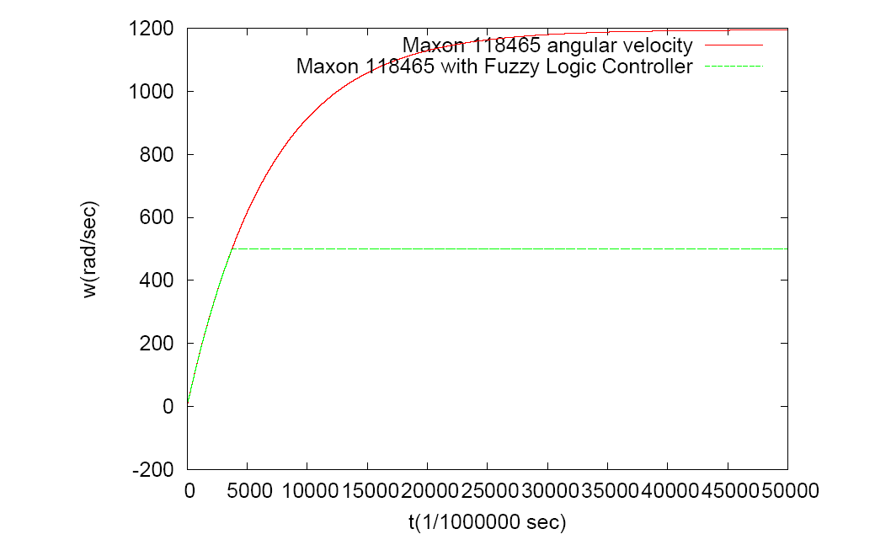
SPEED CONTROL WITH FUZZY LOGIC CONTROLLER

Slide 26
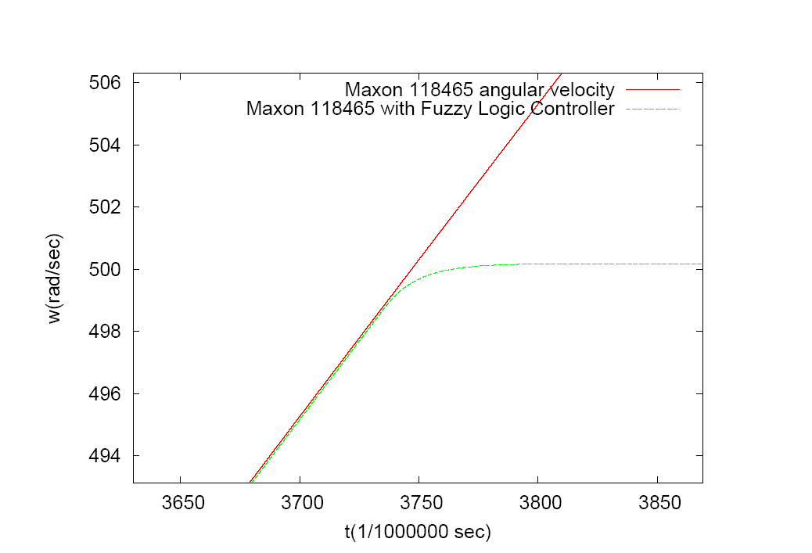
Fuzzy Logic Controller doesn't overshoot the set point and it does not oscillate.

Slide 27
SOURCES
Sources are any device which provides energy to the plants and system.

Slide 28
VOLTAGE SOURCE
A simple voltage source is provided with libpense, which will output the voltage it's been told. Of course this device satisfies the requirements of a source which means it can be turned on or off and value of it can be increased or decreased.

Slide 29
PWM (pulse width modulation)
Actually Pulse width modulation device could be considered as a controller but due to it's nature it ts better as a source so that we can increase/decrease it's value.

Slide 30
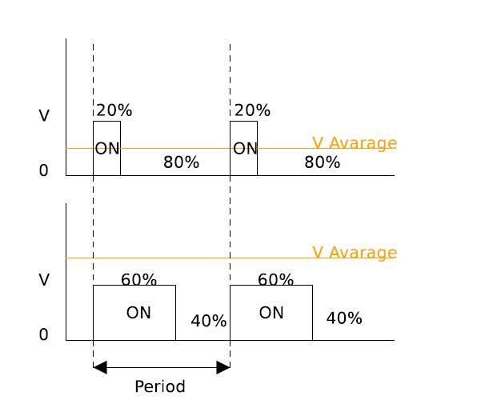
Pulse width modulation

Slide 31
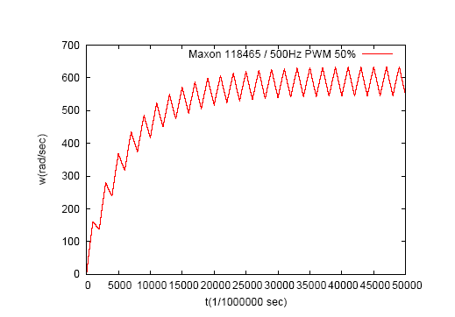
500Hz PWM controlling the motor with 50% duty cycle

Slide 32
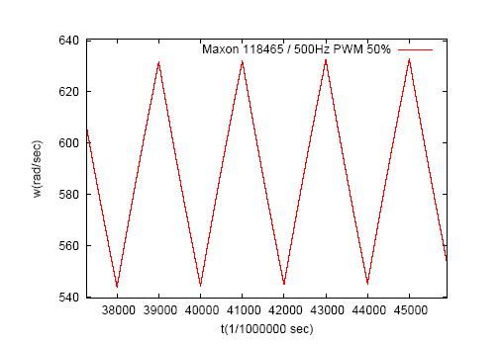
CLOSE UP

Slide 33
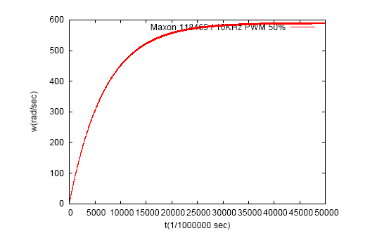
10KHz PWM controlling the motor with 50% duty

Slide 34
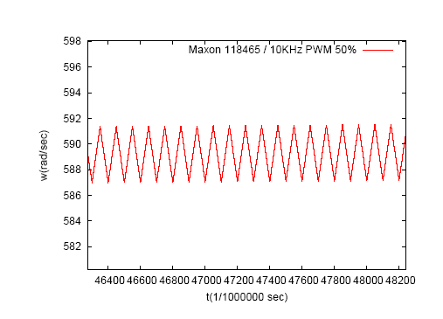
CLOSE UP

Slide 35
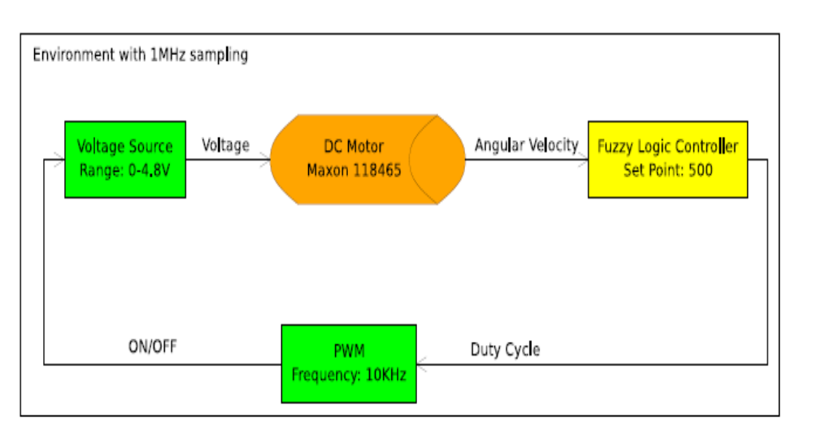
EXAMPLE SYSTEM

Slide 36
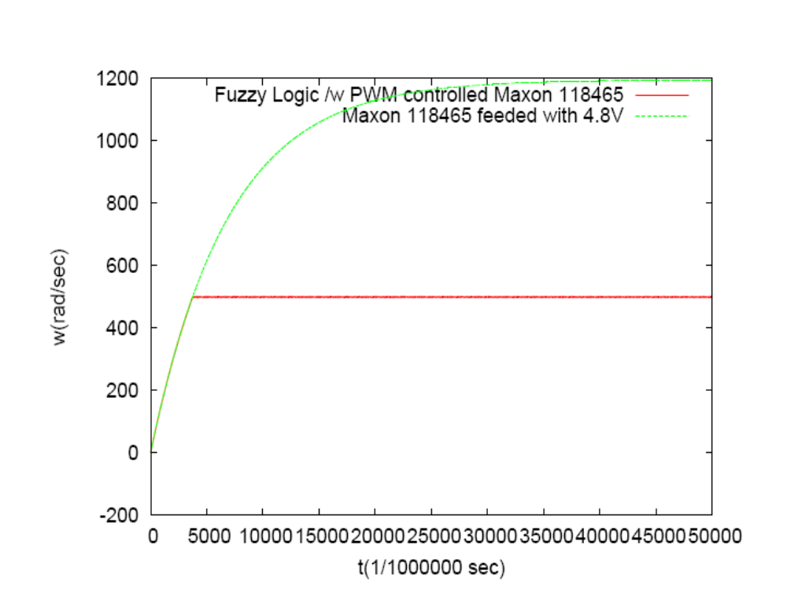

Slide 37
