Slide 1
Tower Defense
Mini Project 2 Package

Slide 2
Before we start,

Slide 3
Demo Date
Date: 6/11 (Tuesday)
Time: 1320-1510
Place: 資電館
Grade: 5%

Slide 4
Announcements
You should have finished installing Allegro5 and set up your IDE on your own computer last semester in I2P course.
If you did not take the course, see the Tutorial and videos.
Our template requires Allegro5 and C++11

Slide 5
Outline
Quick review
Resources
Scenes
Objects & Sprites
Objects & Controls
Template & Code structure
Goal & Grading Policy

Slide 6
Outline
Quick review
Resources
Scenes
Objects & Sprites
Objects & Controls
Template & Code structure
Goal & Grading Policy

Slide 7
Allegro5
A cross-platform library mainly aimed at video game and multimedia programming.
Supported on Windows, Linux, Mac OSX, iPhone and Android.
User-friendly, intuitive C API usable from C++ and many other languages.
Hardware accelerated bitmap and graphical primitive drawing support. (via OpenGL or Direct3D)

Slide 8
Program Flow in Allegro5
Your codes are still sequential.
Initialize → loop (Wait for event → Process event → Draw) → Destroy
Event loop (main loop, message loop)
Wait for Event
Process Event
Draw
Initialize
Destroy
Block until receive
On exit / close

Slide 9
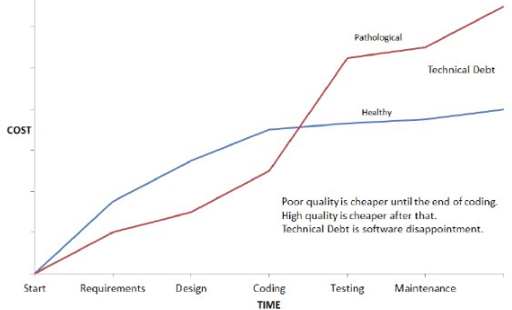
Why change the way we code?
Using a good coding structure or style may develop slower at first, but it will be much easier to modify and maintain.
Source: http://www.critical-logic.com/services/qa-project-management/

Slide 10
Outline
Quick review
Resources
Scenes
Objects & Sprites
Objects & Controls
Template & Code structure
Goal & Grading Policy

Slide 11
Quick demo

Slide 12
Resources Management
Manually loading / destroying resources is unnecessary and causes memory leak if we are not careful enough.
ALLEGRO_BITMAP* img = al_load_bitmap("img.png");
if (!img)
game_abort("failed to load image: img.png");
//...
al_destroy_bitmap(img);

Slide 13
Resources Management
We can ignore resource management when using the wrapped Resources class: more convenient and less error prone.
Resources::GetInstance().GetBitmap("img.png");
//...
// Automatically free resources.

Slide 14
Outline
Quick review
Resources
Scenes
Objects & Sprites
Objects & Controls
Template & Code structure
Goal & Grading Policy

Slide 15
Multiple Scenes
Manually checking which scene to update / draw is redundant and we cannot have same variable names in different scenes.
void game_update(void) {
if (active_scene == SCENE_A) {
//...
} else if (active_scene == SCENE_B) {
//...
} // Maybe we have up to 5 scenes...
}
// The same structure above is also used in `game_draw`, `game_change_scene`, and various events

Slide 16
Multiple Scenes
We can ignore the existence of other scenes and see each scene as independent IScene class: more encapsulation.
class SceneA final : public Engine::IScene {
public:
explicit SceneA() = default;
void Initialize() override;
void Terminate() override;
void Update() override;
void Draw() const override;
};

Slide 17
Outline
Quick review
Resources
Scenes
Objects & Sprites
Objects & Controls
Template & Code structure
Goal & Grading Policy

Slide 18
Objects & Sprites
A simple sprite requires too much code.
void draw_movable_object(MovableObject obj) {
if (obj.hidden) return;
al_draw_bitmap(obj.img, round(obj.x - obj.w / 2),
round(obj.y - obj.h / 2), 0);
}
void game_update() {
for (i = 0; i < MAX_OBJ; i++) {
if (objs[i].hidden) continue;
objs[i].x += objs[i].vx;
objs[i].y += objs[i].vy;
}
}

Slide 19
Objects & Sprites
We can define a class and specify some behaviors of the objects. Then, we can add and forget about it: one-liner for every object.
void SceneA::Shoot(int x, int y) {
AddNewObject(new Bullet(x, y));
}

Slide 20
Outline
Quick review
Resources
Scenes
Objects & Sprites
Objects & Controls
Template & Code structure
Goal & Grading Policy

Slide 21
Objects & Controls
A simple button requires too much code.
void on_mouse_down(int btn, int x, int y) {
if (btn == 1 && pnt_in_rect(x, y, btnX, btnY, btnW, btnH)) {
// Button clicked.
}
}
void game_draw() {
if (pnt_in_rect(mouse_x, mouse_y, btnX, btnY, btnW, btnH))
al_draw_bitmap(img_btn_in, btnX, btnY, btnW, btnH);
else
al_draw_bitmap(img_btn_out, btnX, btnY, btnW, btnH);
}

Slide 22
Objects & Controls
We can ignore the drawing and mouse-in detection. For buttons, we only want to know when it is clicked. Declaring a variable just for the button is also unnecessary: higher abstraction.
void SceneA::BtnOnClick() { // Button clicked. }
void SceneA ::Initialize() {
ImageButton* btn = new ImageButton("img_out.png", "img_in.png", 0, 0);
btn->SetOnClickCallback(std::bind(&SceneA::BtnOnClick, this)));
AddNewControlObject(btn);
}

Slide 23
Outline
Quick review
Resources
Scenes
Objects & Sprites
Objects & Controls
Template & Code structure
Goal & Grading Policy

Slide 24
Quick demo

Slide 25
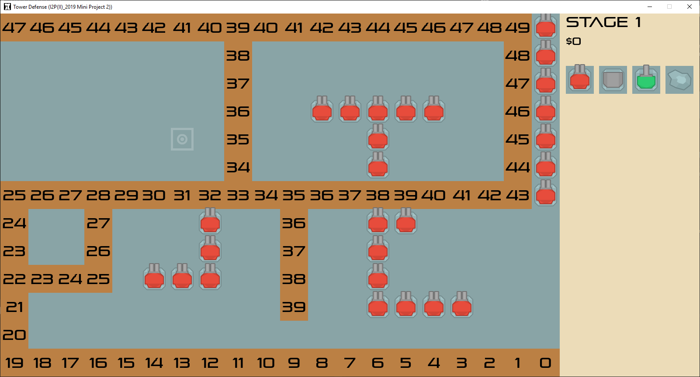
Template Preview (Debug mode)

Slide 26
Template Naming Convention
Usually, C++ uses snake case, but we use camel case here to distinguish between STL and self-defined code.
std::??? (snake_case) → C++11 STL
al_???, ALLEGRO_??? → Allegro5 libraries’ API.
Engine::??? (CamelCase) → Our own defined wrapper ::??? → Classes used in game.

Slide 27
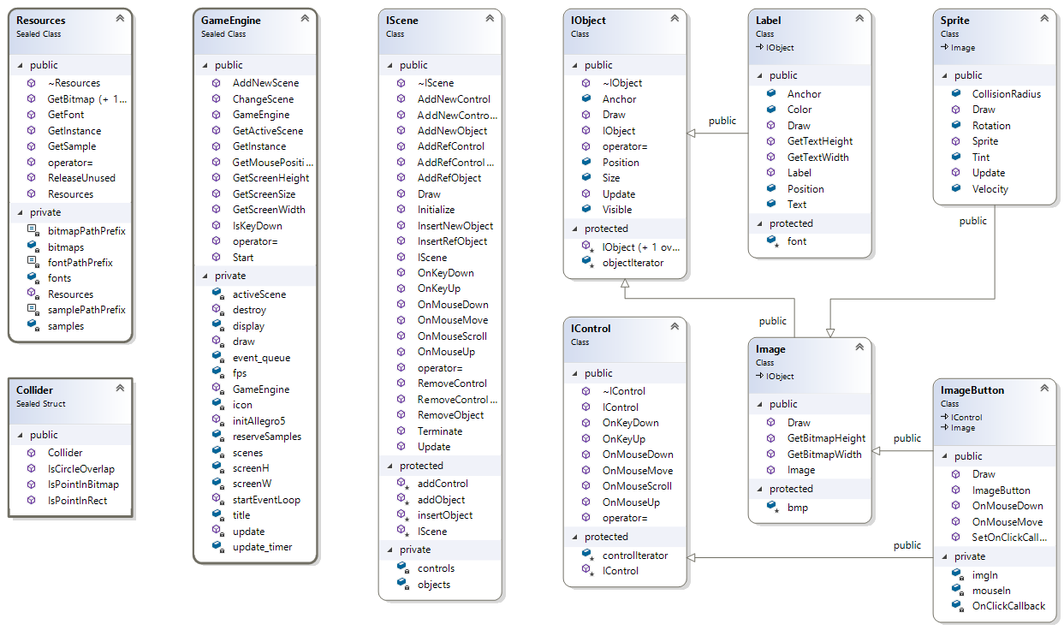
Template Diagram

Slide 28
Notes:
箭頭的意思為繼承

Slide 29
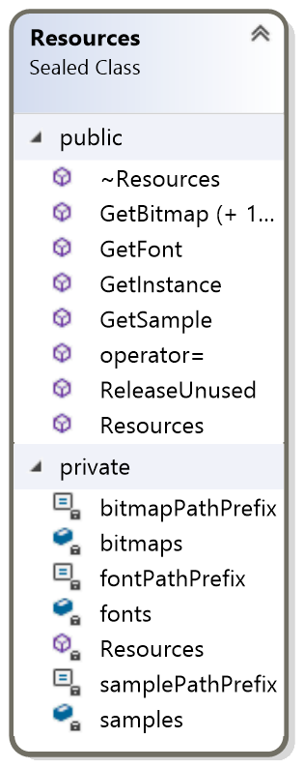
Template: Resources
Engine::Resources
Abstracts all resources loading and destroy.
Resources can be retrieved from this class directly.
讀檔案讀音樂等

Slide 30
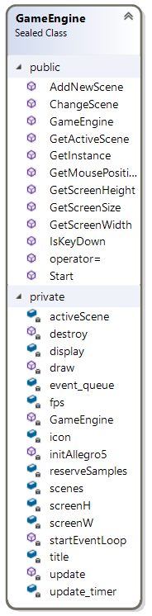
Template: Game Engine
Engine::GameEngine
Abstracts the entire message loop
Manages current scene and scene changes.
處理event loop 、畫圖、處理畫面
Add newScene changeScene會用到最多

Slide 31
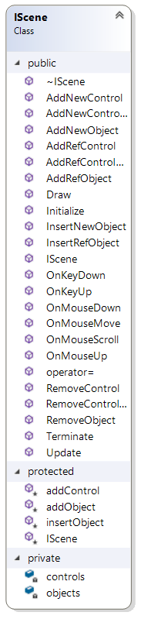
Template: IScene
Engine::IScene
Encapsulates a scene, must be inherited and customized.
Draw and update everything for you.
更新畫面時要做什麼

Slide 32
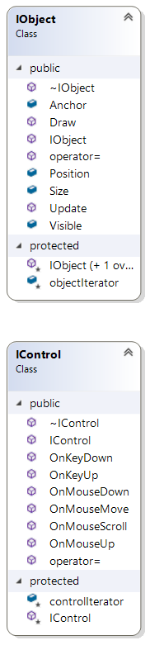
Template: IObject, IControl
Engine::IObject
The base class of everything that can be drawn. 被控制的按鈕
Engine::IControl
The base class of everything that can receive events.

Slide 33
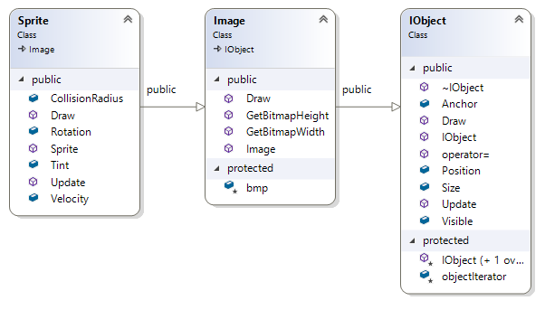
Template: Image, Sprite
Engine::Image : 背景圖片 public Engine::IObject
A simple static image object.
Engine::Sprite : 會動的物件 public Engine::Image
Supports rotation, velocity, tint, and collision radius.

Slide 34
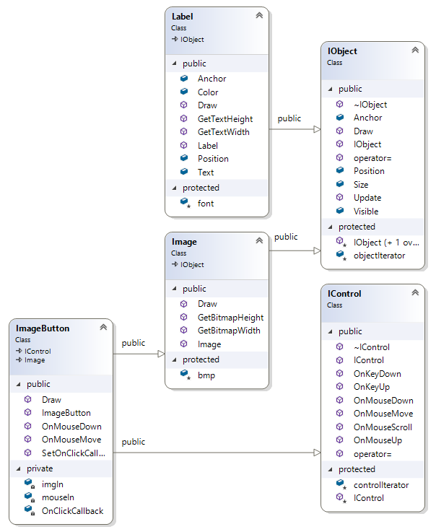
Template: Label, ImageButton
Engine::Label : 顯示自己 public Engine::IObject
A simple static text object.
Engine::ImageButton :
繼承自image and icontrol，eg按按鈕的時候要幹嘛 public Engine::IObject, public Engine::IControl
A clickable button, changes image when mouse move.

Slide 35
Outline
Quick review
Resources
Scenes
Objects & Sprites
Objects & Controls
Template & Code structure
Goal & Grading Policy

Slide 36
Goal
Add starting scene and start button. (1%)
Add 1 new tower, 1 new enemy. (1%)
Enemy path finding. (BFS) (1%)
Add volume control slider. (1%)
Fix WinScene bug, find the cheat hidden in the game. (1%)
Bonus: Continuous stages, and more... (at most +1%)

Slide 37
Grading Policy (1/5)
Add starting scene and start button. (1%)
Button will change image when mouse enter / leave.
Can switch to other scene when button clicked.

Slide 38
Grading Policy (2/5)
Add 1 new tower, 1 new enemy. (1%)
Add 1 new tower that can be placed, and attack enemies.
Add 1 new enemy that can follow the path and die.
Both of them cannot be the same as the ones in the template. They must have different image and different behaviors.
Their behavior must be reasonable, if not sure, we can discuss them in iLMS.

Slide 39
Grading Policy (3/5)
Enemy path finding. (BFS) (1%)
For stage 4, the enemy requires path finding function to move towards our base.
Try to implement a simple BFS counting distances between any block and our base.
Press TAB can launch the debug mode to debug easier.

Slide 40
Grading Policy (4/5)
Add volume control slider. (1%)
In the settings scene, we can control the sound of the music and sound effect.
In the game there are only mute buttons, you should implement a slider control to support easy adjustment.
Each of the BGM and the SFX should have their own slider.
Notes:
空的class，去填就好了

Slide 41
Grading Policy (5/5)
Fix WinScene bug, find the cheat hidden in the game. (1%)
The game crashes when the player wins.
Try to use the knowledge you learned and find out why the game crashes.
Make use of the tools in your IDE:
Stack Trace, Log, Watch variable, Breakpoint (step in / step out)
There is a hidden cheat code hidden in the game, you should DEMO the cheat to get the points.

Slide 42
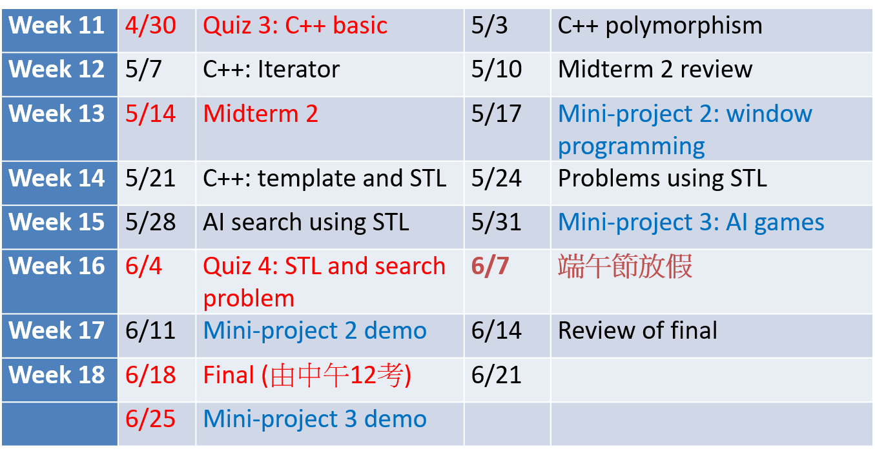
Demo Date
Date: 6/11 (Tuesday)
Time: 1320-1510
Place: 資電館
Grade: 5%

Slide 43
Thanks for your listening

