Slide 1
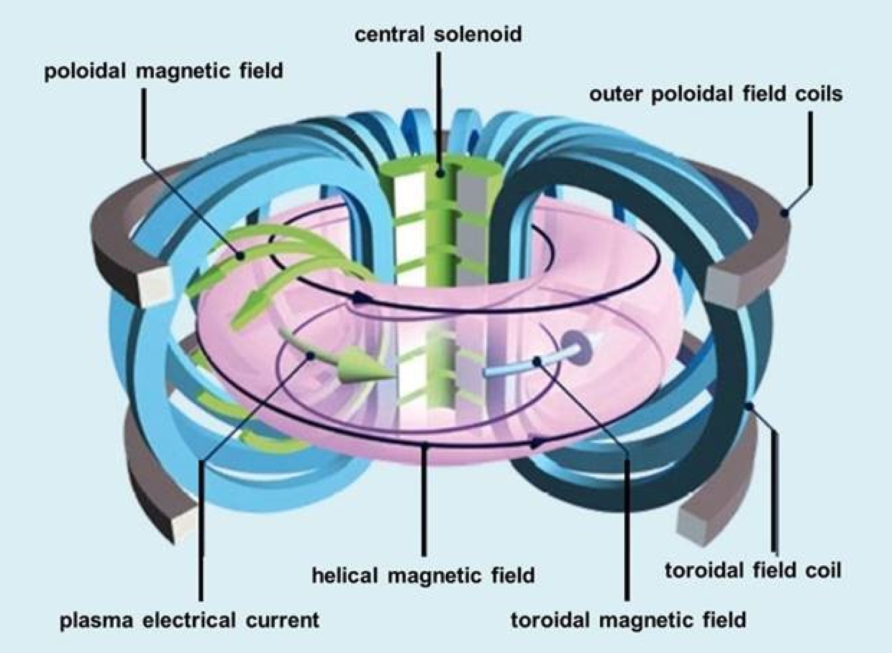
CONFERENCE ON COMPLEX SYSTEMS 2026
Generative AI for Scalable and Structure-Preserving Plasma Simulations
A Complex Systems Approach to Nuclear Fusion Energy
Sarthak Sharma & Matthew Knepley
University at Buffalo (SUNY)
ss694@buffalo.edu
Notes:
Hi everyone, I'm Sarthak Sharma, a PhD student at the University at Buffalo, and this is joint work with my advisor, Matthew Knepley. The picture on the right is a tokamak: a ring of plasma held in place by twisted magnetic fields, and one of the leading designs for a fusion power plant. To design these machines we lean heavily on simulation, and plasma simulation is a hard complex-systems problem. In the next twelve minutes I want to make two points. First, numerical methods that preserve the structure of the physics, its conservation laws, matter more than raw per-step accuracy when you run for millions of steps. Second, a team of AI agents can write and verify these structure-preserving codes for us, and the resulting codes scale on Argonne's Aurora and Polaris supercomputers. Let me start with why plasma is so hard.

Slide 2
CCS 2026 · Sharma & Knepley
Nonlinear
Coupled electromagnetic fields and kinetic particles
Plasma is a hard complex system
Multiscale
10⁶+
From fast gyro-motion to slow confinement times
timesteps per simulation
Tiny errors per step must not pile up over a million steps.
High-dimensional
6D phase space: 3 position + 3 velocity
University at Buffalo (SUNY)
2
Notes:
Why is plasma such a hard complex system? Three reasons. It is nonlinear: the electromagnetic fields push the charged particles, and the particles in turn generate the fields, so the two are tightly coupled. It is multiscale: particles gyrate around magnetic field lines very fast, while the confinement time we actually care about is many orders of magnitude longer. And it is high-dimensional: a kinetic description lives in six-dimensional phase space, three position and three velocity coordinates. Put those together and a single simulation needs a million timesteps or more. That changes what a good numerical method means. A method can be extremely accurate on one step, but if each step leaks a tiny bit of energy or momentum, a million steps later the simulated plasma is no longer physical. That is the problem I turn to next.

Slide 3
CCS 2026 · Sharma & Knepley
Conservation is the problem
Small local error, but invariants drift over millions of steps
Accurate per step is not the same as physical
Standard (RK4)
Conserves phase-space volume, energy, momentum and div B = 0 at the discrete level, by design
Errors add up step after step
Structure-preserving
University at Buffalo (SUNY)
3
Notes:
So conservation is the real problem. The standard workhorse, a classical fourth-order Runge-Kutta method, is designed to make the local error on each step as small as possible, and it does that very well. But it makes no promise about the invariants of the system. Energy and momentum drift a little on every step, and over millions of steps that drift adds up to an answer that is no longer physical. Structure-preserving methods take a different approach. Symplectic and energy-preserving integrators, and constrained transport for the magnetic field, are built so that phase-space volume, energy, momentum, and the divergence-free condition on the magnetic field hold at the discrete level, by design, not by luck or by tiny timesteps. These are the methods we implement in the PETSc library. Next I'll show what that difference looks like on real particle orbits.

Slide 4
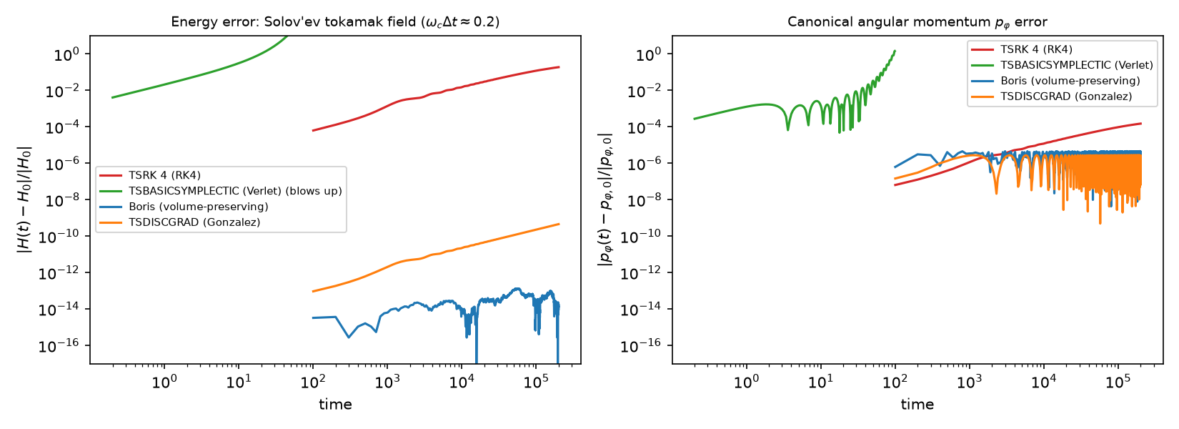
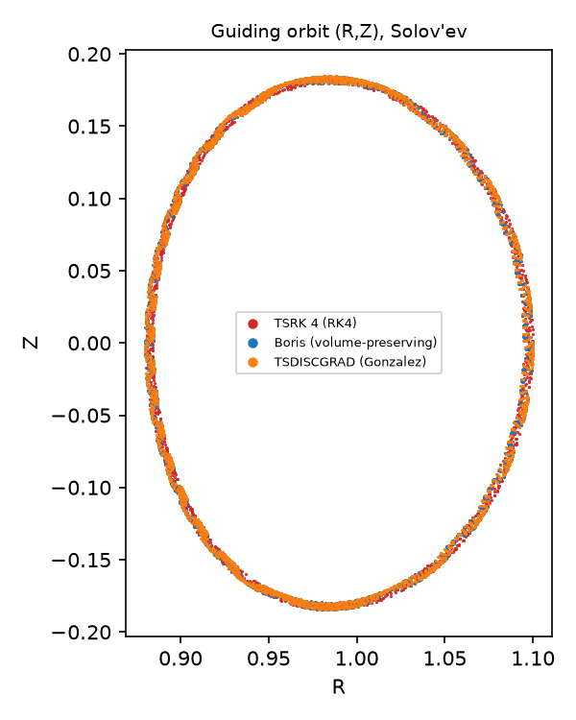
CCS 2026 · Sharma & Knepley
RK4 drifts; structure holds
10⁶ steps in a Solov'ev tokamak field: RK4 energy drifts 19% (52% in uniform B). Boris stays at round-off; TSDISCGRAD at solver tolerance.
100× longer (10⁸ steps): Boris still bounded (energy error 1.2×10⁻¹²); RK4 drifts 28% (67% in uniform B).
University at Buffalo (SUNY)
4
Notes:
Let me start with the simplest test: one charged particle in an analytic Solov'ev tokamak equilibrium, pushed for a million steps, with the gyro-frequency times the time step around 0.2. The left panel is the energy error on a log scale. RK4, in red, is very accurate per step, but its error grows secularly. By the end the energy is off by about 19 percent, and in a uniform field it reaches 52 percent. Boris, in blue, stays at round-off, about 1e-13, because with no electric field it keeps the speed exactly. TSDISCGRAD, in orange, sits near 5e-10, which is set by its nonlinear solver tolerance. The right panel, canonical toroidal momentum, tells the same story, and the inset shows the orbits overlap.
I then ran 100 times longer, 10^8 steps. Boris is still bounded, with an energy error of 1.2e-12 in the Solov'ev field, while RK4 drifts 28 percent there and 67 percent in the uniform field. The 10^8 TSDISCGRAD run did not finish: nonlinear-solver failures kept shrinking its time step, so I make no 10^8 claim for it. Details are on backup slide 14.
The green curve is a surprise, and it is the next slide. Caveat: one particle, one passing orbit.
Source: RESULTS.md section 1 (Solov'ev table) and Phase 4 'Pusher long runs'; figs/pusher_solovev.png, figs/pusher_solovev_orbit.png, figs/pusher_longrun.png.

Slide 5
CCS 2026 · Sharma & Knepley
A trap we found:
wrong structure
10⁶ steps
one charged particle per run, Solov'ev field
Drifts
Blows up
Bounded
RK4
accurate per step, secular energy drift
TSBASICSYMPLECTIC
with v×B, in < 2,000 steps
Boris · TSDISCGRAD
Boris keeps volume; DISCGRAD keeps energy, not volume
The lesson
Method choice must match the Hamiltonian's structure. TSBASICSYMPLECTIC assumes a separable H = T(p) + V(q); v×B breaks that. It is still the right tool for electrostatic Vlasov–Poisson.
University at Buffalo (SUNY)
5
Notes:
Here is a trap we found, and I think it is the most useful lesson for anyone choosing an integrator. PETSc has a method called TSBASICSYMPLECTIC. It is symplectic, so you would expect it to behave like Boris. Instead, in a magnetic field it blows up in under 2,000 steps. The reason is a built-in assumption: it is designed for a separable Hamiltonian, H equals T of p plus V of q. With the v cross B force, the Hamiltonian is not separable in position and velocity, so the method is no longer symplectic, and the phase-volume error becomes order one. In the electrostatic case it works well, which is exactly the Vlasov-Poisson setting of PETSc example ex2. There is also a trade-off between the good methods: TSDISCGRAD conserves energy but not phase volume, while Boris preserves volume. So the method has to match the Hamiltonian's structure.
Source: RESULTS.md section 1 (method table and takeaways).

Slide 6
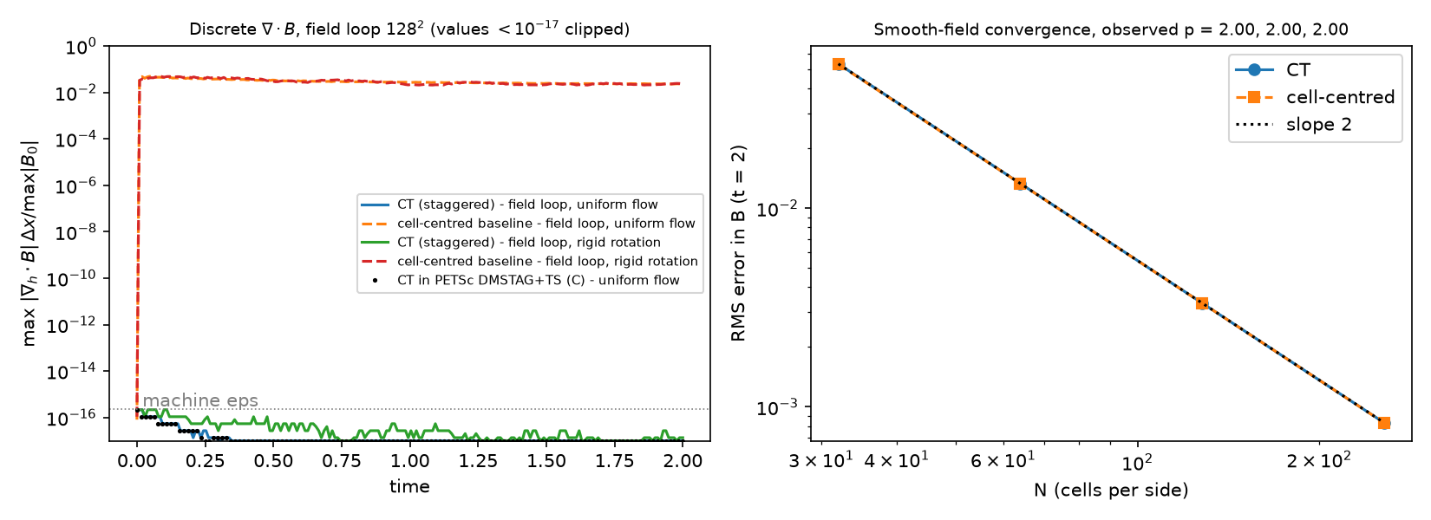
CCS 2026 · Sharma & Knepley
div B = 0 at round-off
Constrained transport on PETSc DMSTAG
max |div B|: 3e-24 with CT vs 5e-2 cell-centred
Both 2nd order (p = 2.00): exact structure costs no accuracy
University at Buffalo (SUNY)
6
Notes:
The same idea applies to fields. A magnetic field must stay divergence-free; a numerical monopole is unphysical and it corrupts the dynamics. Constrained transport stores B on cell faces and updates it from a vector potential on the vertices, so the discrete divergence is zero by construction. I implemented it on PETSc's DMSTAG staggered grid. On the left, the normalised maximum of div B stays near 3e-24, which is round-off, for the whole run, while a cell-centred scheme using the same upwind method jumps to about 5e-2 within the first steps. On the right, both converge at second order, p equals 2.00, so the exact constraint costs no accuracy. A separate numpy version gives the same magnetic energy to seven digits. The caveat: this is two-dimensional kinematic induction, a prescribed flow with no Lorentz-force feedback, and the DMSTAG code has only run serially.
Source: RESULTS.md section 2; figs/ct_divB_convergence.png.

Slide 7
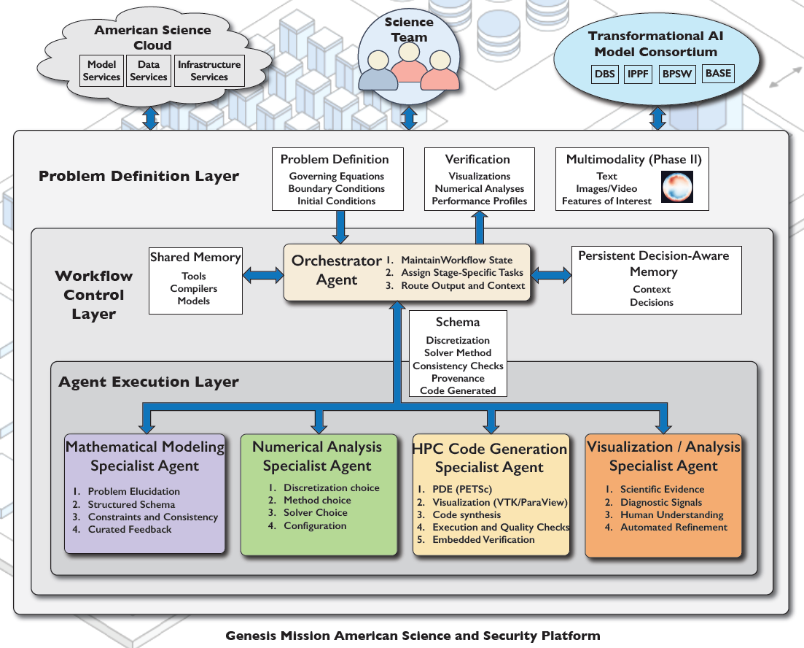
CCS 2026 · Sharma & Knepley
One orchestrator, four specialists
4
specialists: math modeling, numerical analysis, HPC code + execution, visualization / analysis
Built on PETSc MCP servers
Each agent is an MCP server, grounded in PETSc documentation via RAG
gitlab.com/petsc/petsc_mcp_servers
3-layer hierarchy. Figure: McInnes et al., "Automated Problem-to-Solution Generation for PDE-Based Simulation Science."
University at Buffalo (SUNY)
7
Notes:
This is where AI comes in. We built a hierarchical multi-agent system that writes and checks these plasma codes. The design follows the three-layer hierarchy in this figure, from McInnes and colleagues, "Automated Problem-to-Solution Generation for PDE-Based Simulation Science."
At the top, a problem definition layer takes the governing equations and conditions. In the middle, an orchestrator agent keeps the workflow state and routes each task. At the bottom, four specialists do the work: mathematical modeling turns the prompt into a PDE, numerical analysis picks the grid, discretization and integrator, HPC code generation writes and runs PETSc C code, and visualization and analysis reads the output.
Each agent is an MCP server from the PETSc project's petsc_mcp_servers repository, and the agents draw on PETSc documentation through retrieval-augmented generation. Three specialists run today; the visualization and analysis agent is still a design.

Slide 8
CCS 2026 · Sharma & Knepley
Every generated code prints one line
Every code must prove it conserves
VERIFY{ energy drift, momentum drift, div B, finite }
PASS
FAIL
Each invariant has a tolerance. The code agent re-runs until the check passes.
Boris
TSDISCGRAD
CT field: div B 3e-24
RK4: drift 1.5e-2 > 1e-6
TSBASICSYMPLECTIC in a B field: non-finite
University at Buffalo (SUNY)
8
Notes:
Here, verification, not the model's confidence, decides whether a code is accepted. Every generated code must print one VERIFY line in JSON: energy drift, drift of the canonical momentum p-phi, the largest div B, and a finite-values flag. A checker compares each number with its own tolerance, and the code-generation agent loops until the check passes.
We tested this contract on the real pusher runs in the Solov'ev field. Boris and TSDISCGRAD pass. The constrained-transport field solver passes with div B at 3 times 10 to the minus 24. RK4 is rejected: its energy drift of 1.5 times 10 to the minus 2 is far above the tolerance of 10 to the minus 6. TSBASICSYMPLECTIC in a magnetic field is rejected for non-finite output.
One caveat: this was an offline test. We have not yet run the full loop end to end with an LLM.

Slide 9
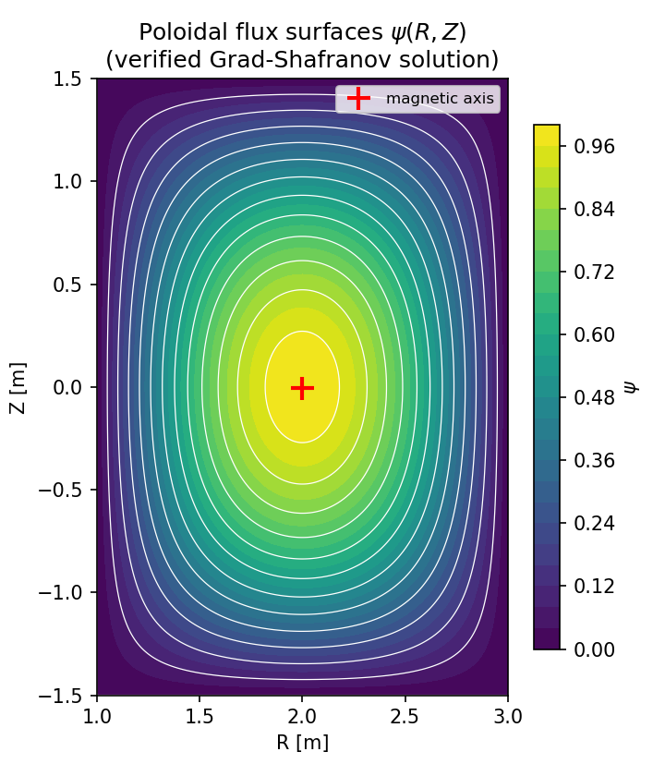
CCS 2026 · Sharma & Knepley
Agent-written solvers that verify
Flux surfaces, agent-generated DMDA+SNES solver
0.2%
Safety factor q vs FreeGS
Grad-Shafranov equilibrium from a plain-language prompt: DMDA+SNES solver at 2nd order (p = 2.00), plus a DMPlex+PetscFE version
ITER-like, NSTX-like and X-point shaped equilibria
University at Buffalo (SUNY)
9
Notes:
Here is an earlier result showing that the pipeline can produce code that verifies. From the plain-language prompt "the Grad-Shafranov equilibrium for the plasma in a tokamak," the agents wrote a 267-line PETSc solver on a structured DMDA grid with SNES. It compiled and ran on one and four MPI ranks as generated, and it converges at second order, p equal to 2.00, against a manufactured solution. The figure shows its flux surfaces. Running the built-in orchestrator end to end also gave a second, converged solver on an unstructured DMPlex mesh with PetscFE.
We then used the exact Cerfon-Freidberg Solov'ev solution to reproduce three shaped equilibria: ITER-like, NSTX-like, and a diverted case with X-points. All three converge at second order, and the safety factor q agrees with the independent FreeGS code to within 0.2 percent. That is the kind of independent check we want every generated code to pass.

Slide 10
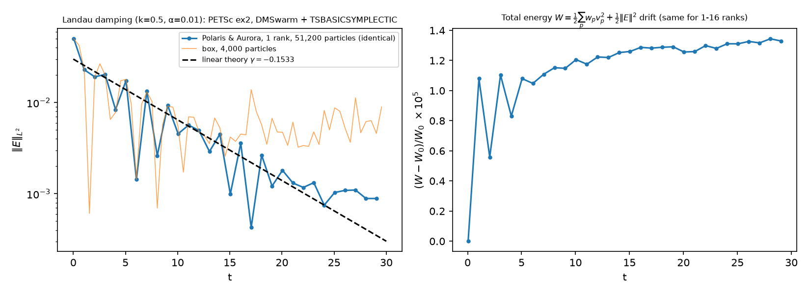
CCS 2026 · Sharma & Knepley
Kinetic plasma on
Aurora & Polaris
01 γ = −0.161
Fitted damping rate (−0.147 in a 6,000-step run); linear theory predicts −0.1533
02 Identical results
Aurora and Polaris agree at any rank count; to 10⁻¹⁴ over 6,000 steps
03 Energy not bounded
Error ~10⁻⁵ over 600 steps, but long runs heat slowly: 0.4% by t = 300
Landau damping, 1D-1V Vlasov–Poisson · PETSc DMSwarm + TSBASICSYMPLECTIC · 600 steps
University at Buffalo (SUNY)
10
Notes:
Next, the kinetic side: particles instead of fluids. I ran PETSc's DMSwarm example ex2, a 1D-1V Vlasov–Poisson particle-in-cell code for Landau damping with k = 0.5, advanced with the TSBASICSYMPLECTIC integrator, on two ALCF machines, Aurora and Polaris.
On the left, the electric field decays. My fitted damping rate is −0.161, against linear theory's −0.1533. A longer 6,000-step run gives −0.147, so the fit is within about five percent either way.
The results are identical on both machines and do not change with the number of MPI ranks. In a 6,000-step run at time step 0.01, Aurora and Polaris agree to 1e-14 in total energy.
On the right, total energy changes by about one part in a hundred thousand over these 600 steps. I want to be clear that this is not bounded: in long runs at time step 0.05 the error is flat near 1e-4 until t of about 70, then grows linearly to 0.4 percent at t = 300, and a coarse 3,200-particle run heats by about 80 percent by t = 3000. That is the known numerical heating of PIC schemes that conserve momentum but not energy, and it is why energy-conserving PIC is my first next step. Backup slide 14 has the plots.
Source: research/results/RESULTS.md, section 3 and Phase 4 'Long-run Landau damping'.

Slide 11
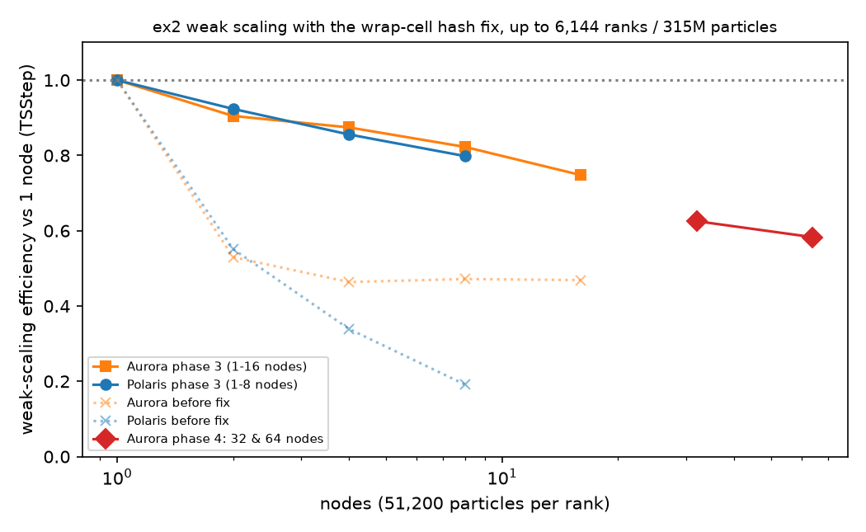
CCS 2026 · Sharma & Knepley
Weak scaling: fixed, then 64 nodes
58%
315 M
efficiency vs 1 node at 64 Aurora nodes (6,144 ranks)
particles at 64 nodes, and no particle lost in any run
12×
75%
faster per step after the fix (Aurora, 16 nodes)
at 16 Aurora nodes (Polaris: 80% at 8 nodes)
Cause: the periodic-wrap rank’s point-location hash spanned the whole domain, so one rank did up to 41× the work. A local ex2 patch fixed it (before: 3% efficiency).
Efficiency vs 1 node (TSStep): 1.00 / 0.90 / 0.87 / 0.82 / 0.75 / 0.63 / 0.58 at 1, 2, 4, 8, 16, 32, 64 nodes.
University at Buffalo (SUNY)
11
Notes:
Then I asked whether it scales. In this weak-scaling test every MPI rank keeps the same work, 256 cells and 51,200 particles, while the domain grows with the rank count. Perfect weak scaling would keep the time per step flat.
At first, efficiency collapsed to about three percent. Profiling showed why: the rank that owns the periodic wrap-around cell sizes its point-location hash box over the whole domain, so it did up to 41 times the work of any other rank, and everyone waited for it. A small local patch to ex2 gives only that rank finer bins. That made a step 12 times faster at 16 Aurora nodes.
After the fix, measured against one full node, Aurora holds 75 percent at 16 nodes, 63 percent at 32 and 58 percent at 64 nodes: 6,144 ranks and 315 million particles. The decline is gradual; going from 32 to 64 nodes costs only 7 percent. Polaris holds 80 percent at 8 nodes. No particle was lost in any run.
Caveats: 1D-1V, 100 steps, CPU only, one run per point, so a few percent of noise is plausible.
Source: research/results/RESULTS.md, Phase 3 Steps A and B, and Phase 4 'Weak scaling extended to 64 Aurora nodes'; phase4/data/phase4_analysis.json.

Slide 12

CCS 2026 · Sharma & Knepley
Takeaways
Next steps
01 Structure-preserving methods keep invariants where RK4 drifts.
02 Conservation checks make AI-generated code verifiable.
03 We fixed a real scaling bottleneck; ex2 now runs on 64 Aurora nodes.
Energy-conserving PIC
long runs show numerical heating
GPU-resident particles
End-to-end LLM agent loop
Aurora beyond 64 nodes
3D and FEEC
ss694@buffalo.edu
Thanks: ALCF Director’s Discretionary allocation (DD_plasma_physics) on Aurora and Polaris, Argonne National Laboratory.
University at Buffalo (SUNY)
12
Notes:
To wrap up, three takeaways. First, structure-preserving methods keep the invariants of the physics, where a standard method like RK4 slowly drifts, and Boris stays bounded even over 10^8 steps. Second, those same conservation checks are what make AI-generated simulation code verifiable: a generated solver either keeps its invariants, or it is rejected. Third, on leadership-class hardware, I measured a real scaling bottleneck, found its cause and fixed it, and the code now runs on 64 Aurora nodes with 315 million particles.
Next, and now backed by my own data, energy-conserving PIC: the long Landau runs show the slow numerical heating that momentum-conserving PIC is known for, so I want particles and field coupled so total energy is conserved. Then particles that live on the GPU instead of the CPU; a full end-to-end loop where the LLM agents generate, run and verify the code; Aurora runs beyond 64 nodes; and a move to 3D with finite-element exterior calculus.
I would be glad to hear from you at ss694@buffalo.edu. This work used an ALCF Director's Discretionary allocation, DD_plasma_physics, on Aurora and Polaris at Argonne National Laboratory. Thank you.
Source: RESULTS.md Phase 4 (weak scaling to 64 nodes; long-run Landau; pusher long runs).

Slide 13
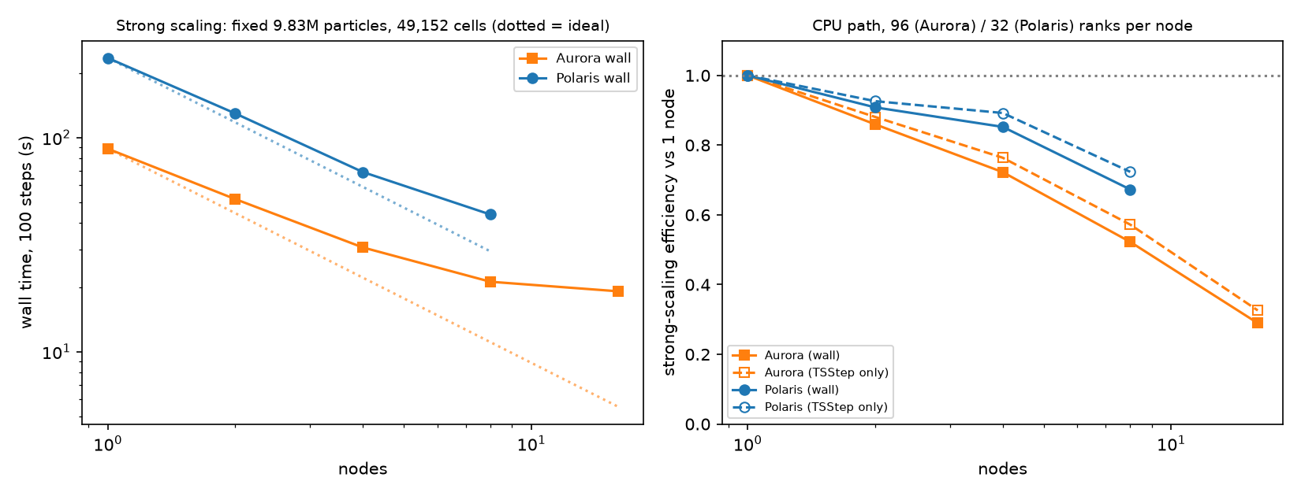
CCS 2026 · Sharma & Knepley
Backup: strong scaling
Fixed problem, more nodes: 9.83 M particles, 100 steps. Aurora 4.63× at 16 nodes (efficiency 0.29): only 32 cells per rank are left. Polaris 5.38× at 8 nodes (0.67).
University at Buffalo (SUNY)
13
Notes:
Backup, if someone asks about strong scaling. Weak scaling, on slide 11, grows the problem with the machine. Strong scaling keeps one fixed problem, here 9.83 million particles on 49,152 cells for 100 steps, and asks how much faster it gets on more nodes.
On Aurora it speeds up 4.63 times at 16 nodes, an efficiency of 0.29 against one node. The reason is simple: at 1,536 ranks each rank has only 32 cells and 6,400 particles left, so communication and fixed costs dominate; going from 8 to 16 nodes gains only 10 percent. Polaris has 32 ranks per node instead of 96, keeps about six times more work per rank, and reaches 5.38 times at 8 nodes, efficiency 0.67. Per node, Aurora is 2.65 times faster than Polaris on this problem. Counting only the time-stepping, Aurora reaches 0.33 and Polaris 0.72.
Source: RESULTS.md Phase 4 'Strong scaling'; phase4/data/strong_scaling.csv; figs/strong_scaling.png.

Slide 14
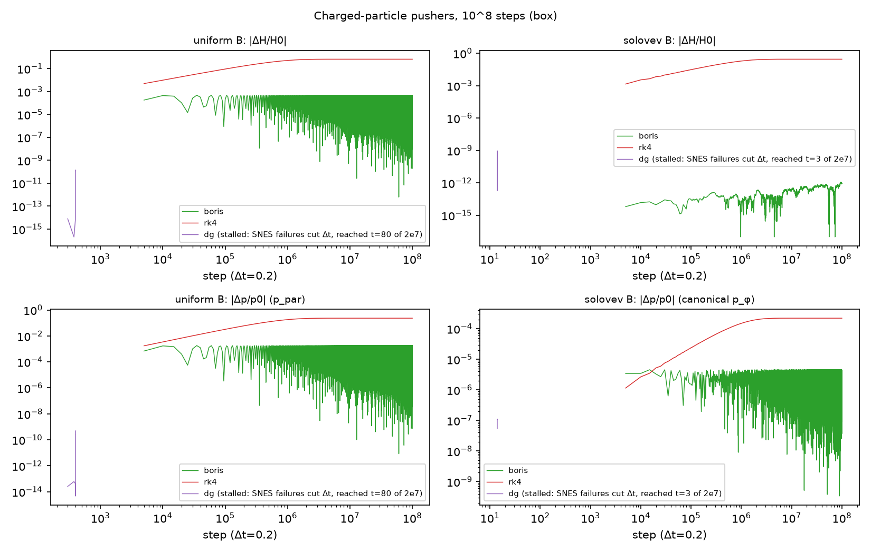
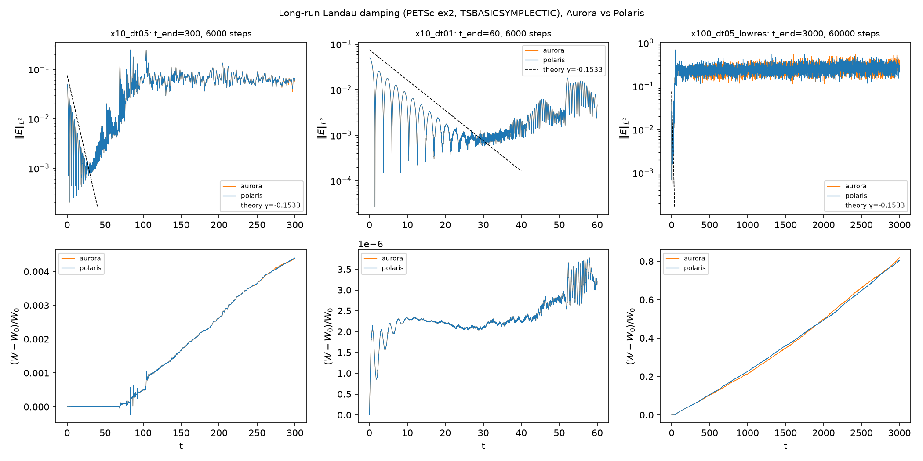
CCS 2026 · Sharma & Knepley
Backup: long-run conservation
Pushers, 10⁸ steps: Boris bounded (Solov'ev energy error 1.2×10⁻¹²). RK4 drifts 28% (Solov'ev) / 67% (uniform B). TSDISCGRAD stalled (solver failures shrank the step), so no 10⁸ result.
Landau PIC, energy not bounded: dt = 0.01 stays at 3.8×10⁻⁶ (Aurora = Polaris to 10⁻¹⁴). dt = 0.05 is flat ~10⁻⁴ to t ≈ 70, then grows to 4.4×10⁻³ at t = 300. 3,200 particles: ~80% heating by t = 3000.
University at Buffalo (SUNY)
14
Notes:
Backup on long runs, because conservation over long times is the whole point.
Left: the particle pushers run 100 times longer than in the main talk, 10^8 steps at time step 0.2. Boris stays bounded: in the Solov'ev field the energy error is 1.2e-12 and the canonical momentum error stays near 5e-6. RK4 drifts 28 percent in Solov'ev and 67 percent in the uniform field. The 10^8 TSDISCGRAD run stalled: its nonlinear solver kept failing and the time step kept shrinking, so it reached only t of about 80 and 3 out of 2e7. Its conservation was excellent where it ran, but I do not claim a 10^8 result for it.
Right: long Landau runs of the ex2 PIC code. At time step 0.01 the energy error stays bounded near 3.8e-6 for 6,000 steps, and Aurora and Polaris agree to 1e-14. At 0.05 it is flat near 1e-4 until t of about 70, after the field has damped into the particle noise, and then grows linearly to 4.4e-3 at t = 300. With only 3,200 particles the heating reaches about 80 percent by t = 3000. That is the known numerical heating of momentum-conserving, non-energy-conserving PIC, so I do not claim bounded energy for ex2; it is the motivation for energy-conserving PIC. The damping-rate fit at 0.05 is −0.147 versus theory −0.1533.
Source: RESULTS.md Phase 4 'Long-run Landau damping' and 'Pusher long runs'; figs/landau_longrun.png, figs/pusher_longrun.png.

