Slide 1
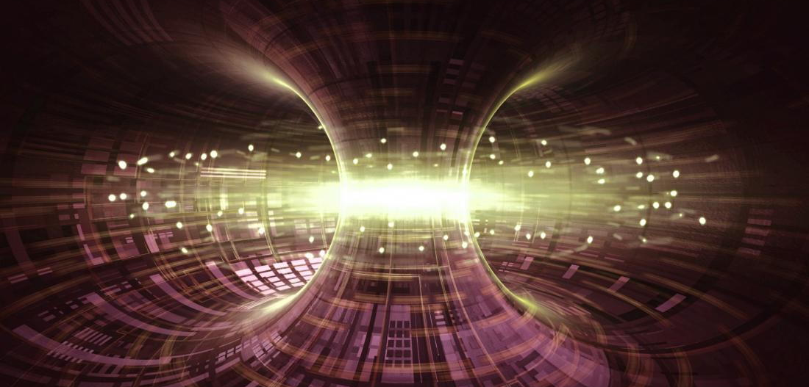


Multi-Agent AI System for PETSc Simulation of Plasma in a Tokamak (for Nuclear Fusion Energy)
July 29, 2026
ANL Learning Off The Lawn
Presenter
Advisors
Dr Junchao Zhang¹, Dr Lois Curfman McInnes¹, Prof Matthew Knepley².
Sarthak Sharma^{1,2}
Intern and PhD student
¹Division of Mathematics and Computer Science, Argonne National Laboratory,
²Computational and Data Sciences, State University of New York at Buffalo.

Slide 2
Contents
Why nuclear fusion energy needs trustworthy simulation
The modeling challenge
The problem: Grad-Shafranov equilibrium
The AI system: 3-layer multi-agent AI pipeline
The AI pipeline in action
AI-agent-generated PETSc solver (excerpt)
Verification
Decision-gate metrics
Fully autonomous: the built-in orchestrator
What we built and contributed
Takeaways and next steps

Slide 3
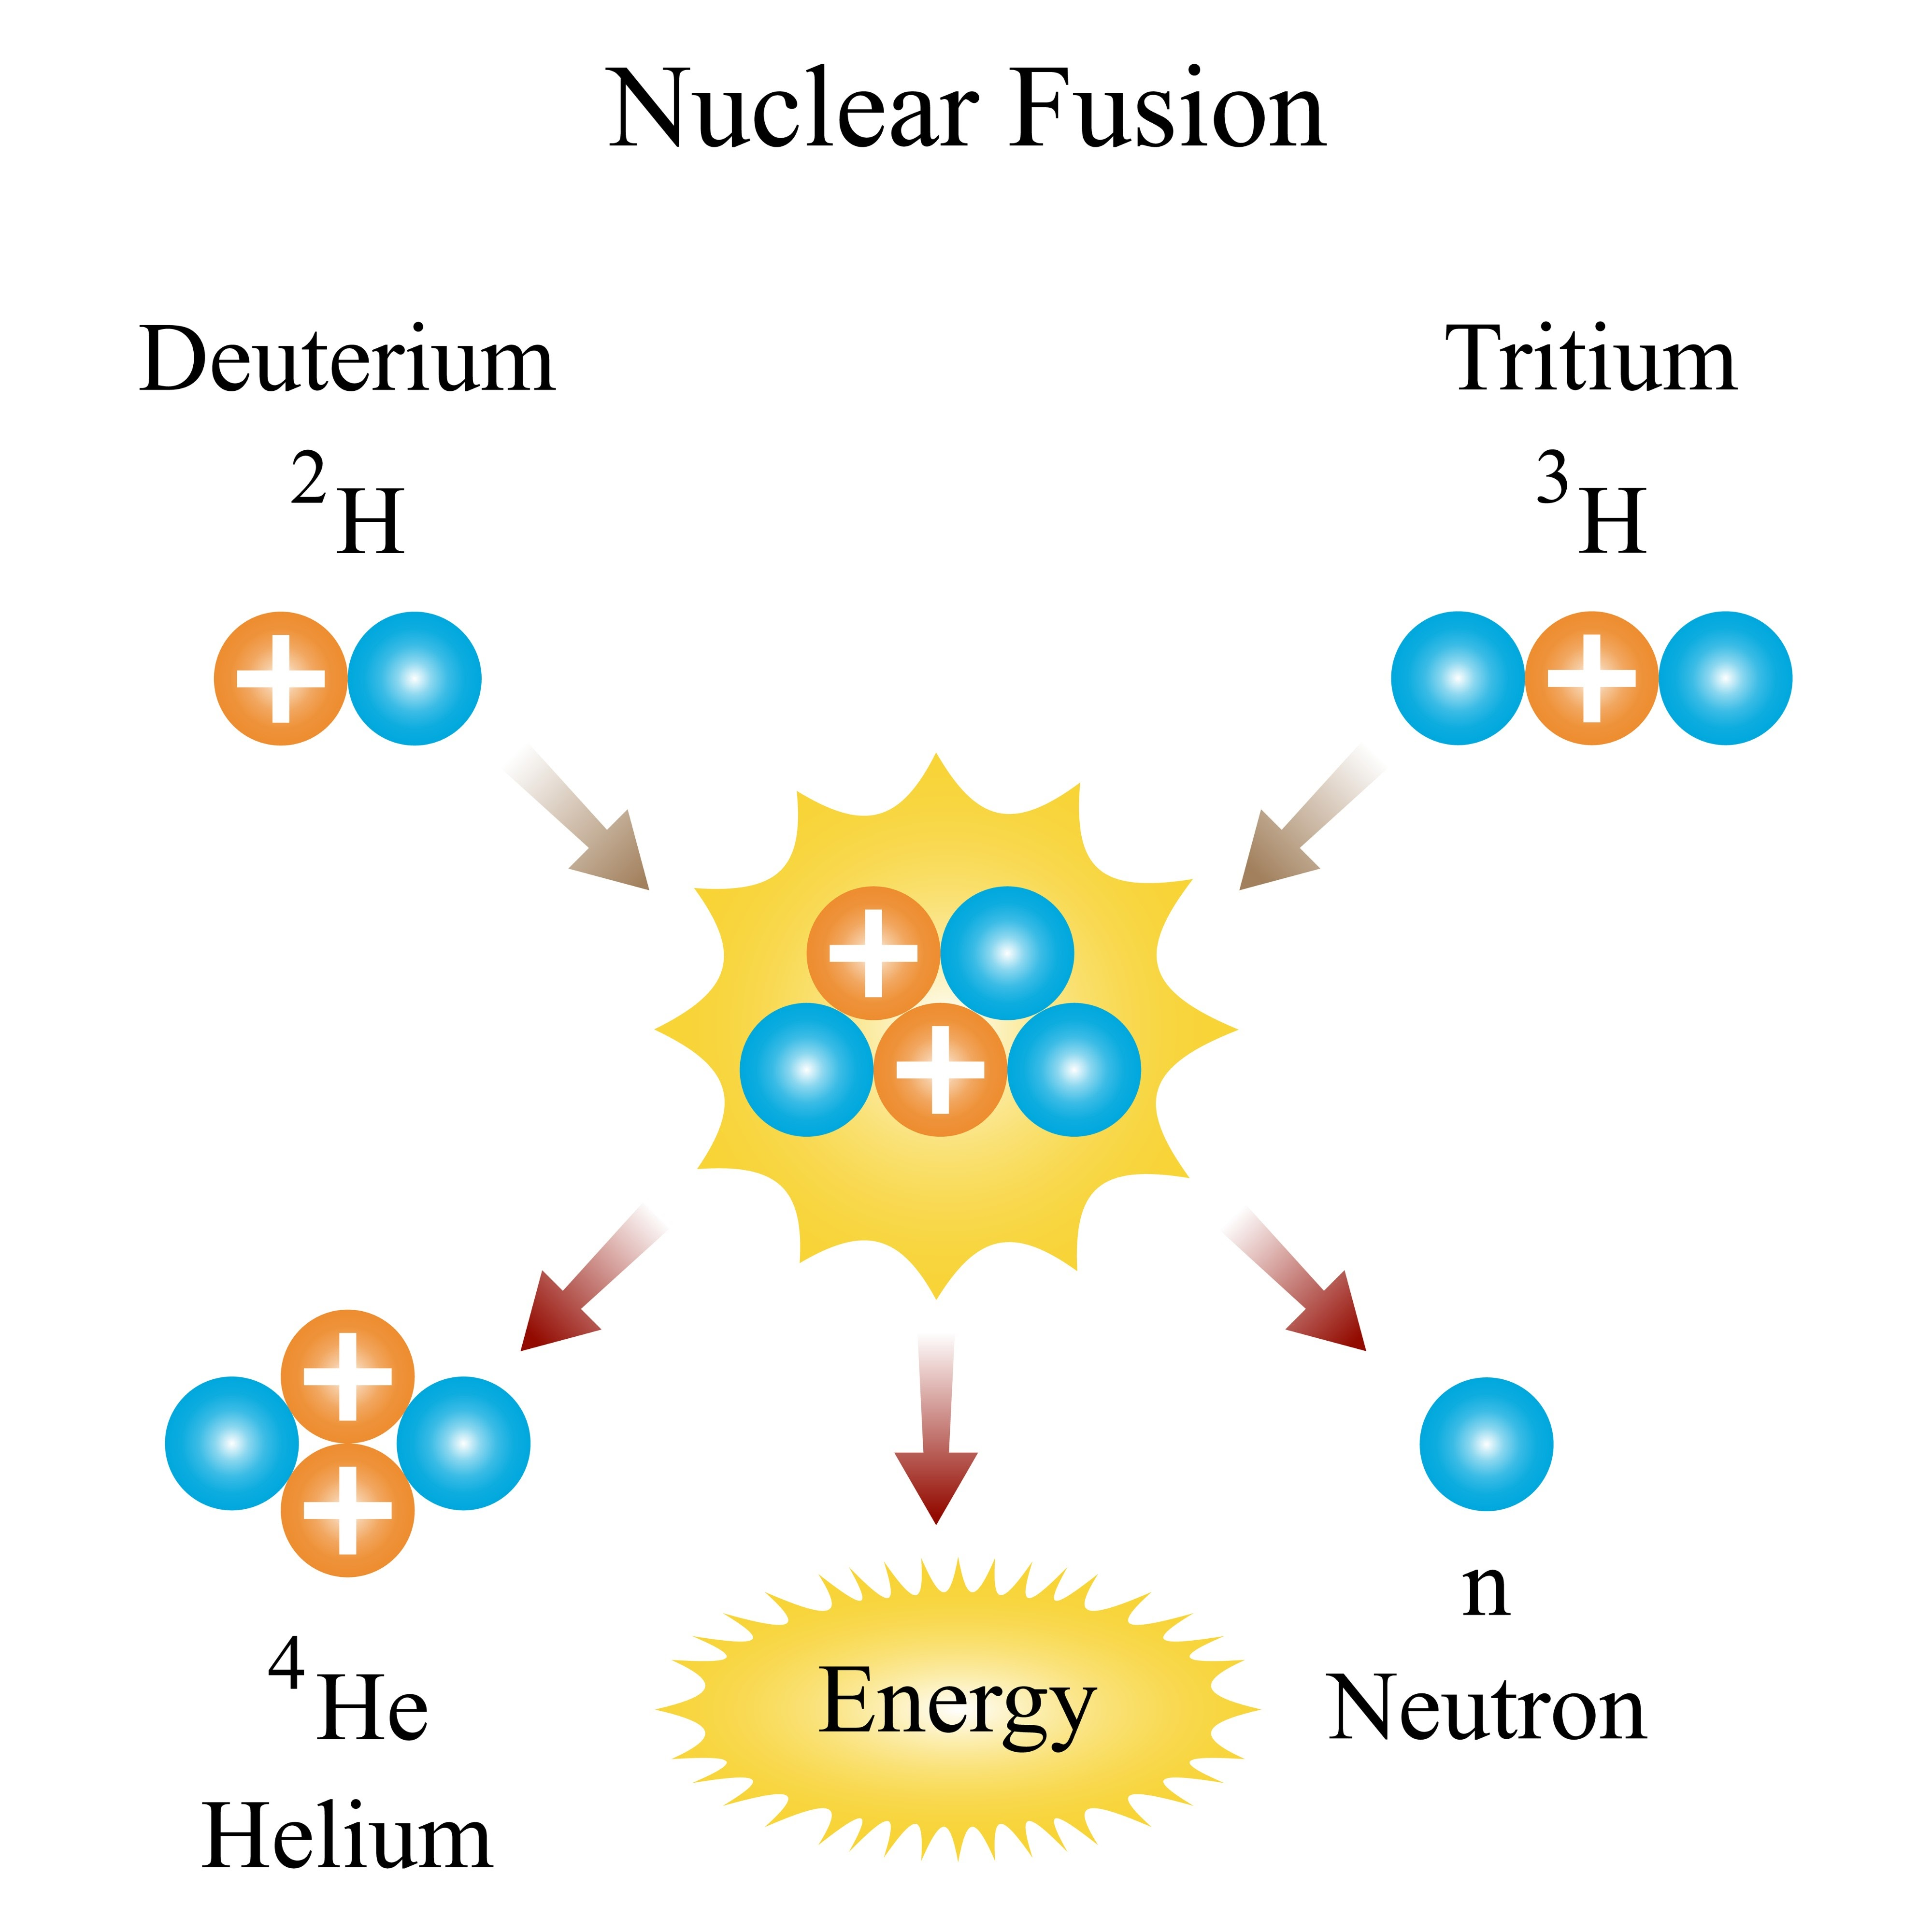
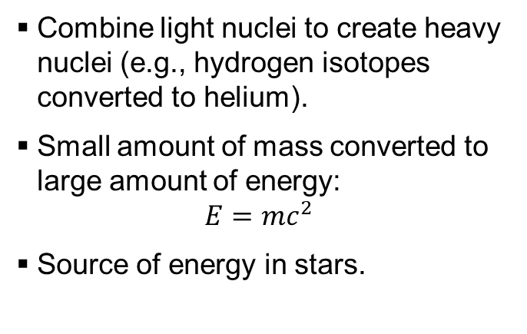
Why nuclear fusion energy needs trustworthy simulation
Nuclear fusion could be a near-limitless clean energy source, if we can solve some challenges.
Combine light nuclei to create heavy nuclei (e.g., hydrogen isotopes converted to helium).
Small amount of mass converted to large amount of energy:
$$E=mc^{2}$$
Source of energy in stars.
Deuterium–tritium fusion

Slide 4
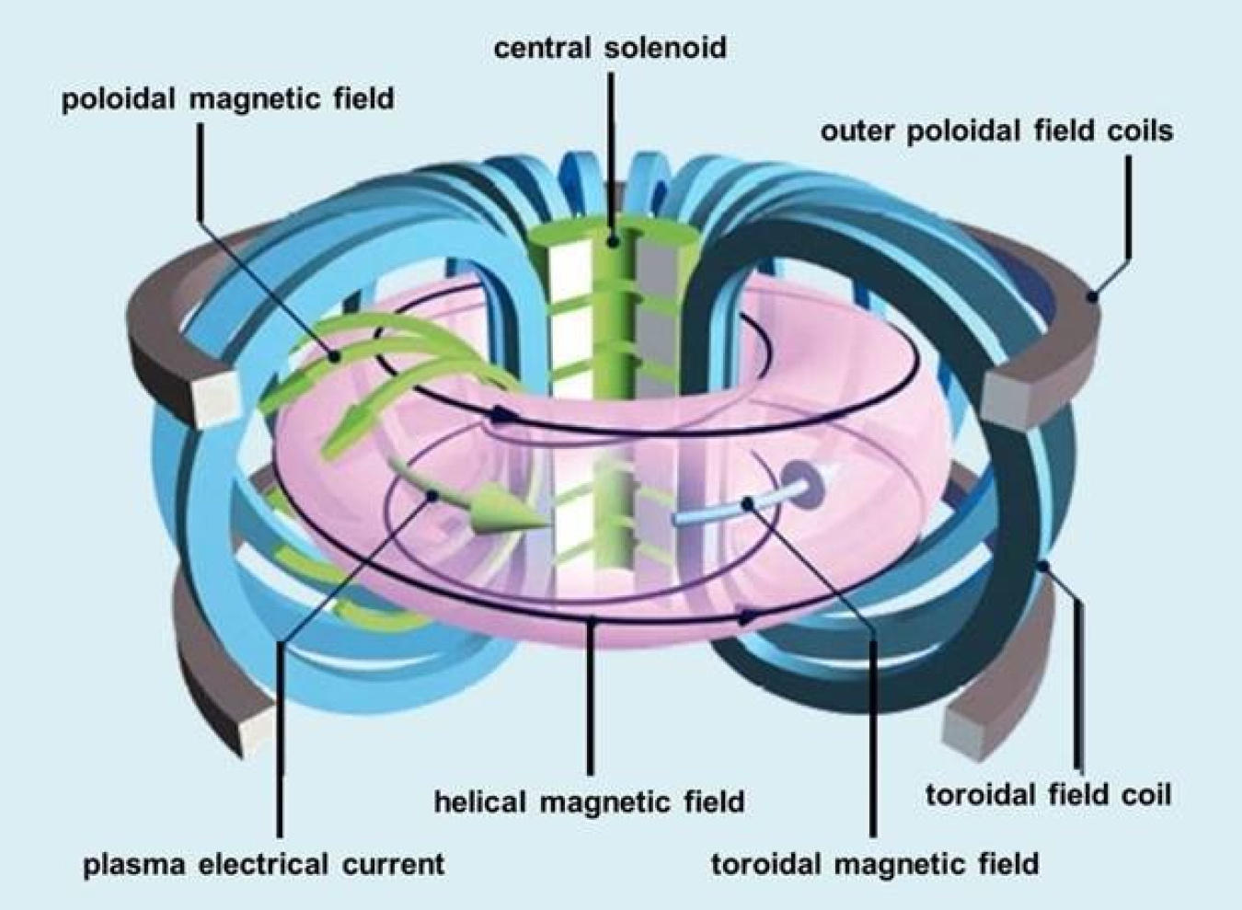
Why nuclear fusion energy needs trustworthy simulation (continued)
Tokamak confines plasma (temperature around 150 million °C) in a magnetic “cage” long enough to fuse.
Accurate and scalable simulations needed before expensive and time-consuming physical experiments.
Simulations must be trustworthy. Plausible-looking wrong answer is worse than no answer.
Tokamak magnetic confinement (U.S. DOE)

Slide 5
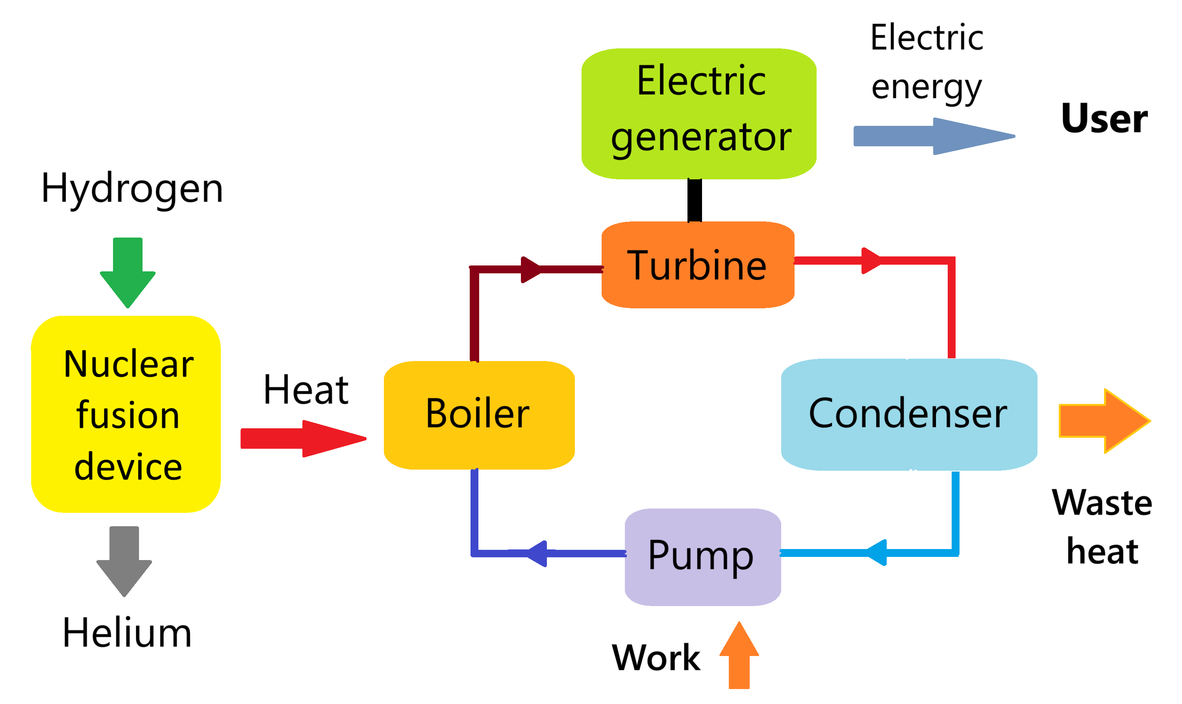
Schematic of a nuclear fusion power plant.

Slide 6
The modeling challenge
Turning fusion physics into correct and fast HPC code needs scarce and implicit expertise.
Numerical methods: Choose grids, discretizations, and solvers that actually converge.
Library: Express it in PETSc (Portable, Extensible Toolkit for Scientific Computation), a library for high-performance computing.
Parallelism: Run on many CPU cores / GPUs.
Verification: Prove that the computed answer is right, not merely plausible.
Question: Can a multi-agent AI system automate this whole path, and can we trust it?

Slide 7
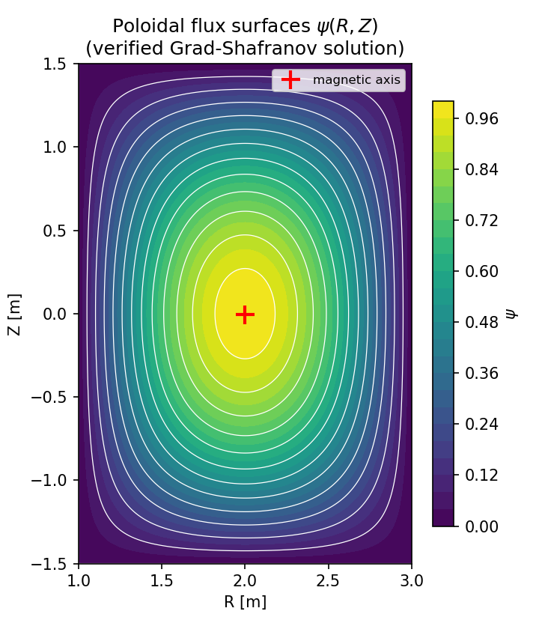
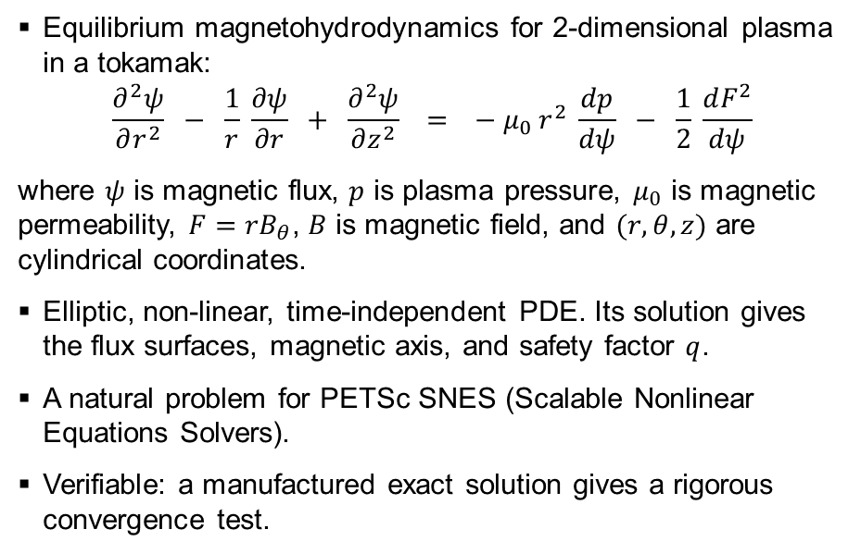
The problem: Grad-Shafranov equilibrium
Axisymmetric ideal-MHD force balance for the poloidal flux $ψ(r,Z)$.
Equilibrium magnetohydrodynamics for 2-dimensional plasma in a tokamak:
$$\frac{∂^{2}ψ}{∂r^{2}} − \frac{1}{r} \frac{∂ψ}{∂r} + \frac{∂^{2}ψ}{∂z^{2}} = − μ_{0} r^{2} \frac{dp}{dψ} − \frac{1}{2} \frac{dF^{2}}{dψ}$$
where $ψ$ is magnetic flux, $p$ is plasma pressure, $μ_{0}$ is magnetic permeability, $F=rB_{θ}$, $B$ is magnetic field, and $(r, θ,z)$ are cylindrical coordinates.
Elliptic, non-linear, time-independent PDE. Its solution gives the flux surfaces, magnetic axis, and safety factor $q$.
A natural problem for PETSc SNES (Scalable Nonlinear Equations Solvers).
Verifiable: a manufactured exact solution gives a rigorous convergence test.
Flux surfaces of the verified solution

Slide 8
The AI system: multi-agent AI pipeline
PETSc Model-Context-Protocol (MCP) agents, coordinated end to end.
Problem definition (Mathematical Modeling): strong / weak form, problem name, time-dependence.
Agent execution (Numerical Analysis): grid, discretization, solver (SNES).
Agent execution (HPC Code Generation): writes, compiles and runs PETSc C programs.
Execution substrate (Compile and Run): make / run on the real machine.
All agents run against Argonne’s Argo gateway (Claude Opus 4.8).
A project-owned driver records every artifact with provenance (reproducible and resumable).

Slide 9
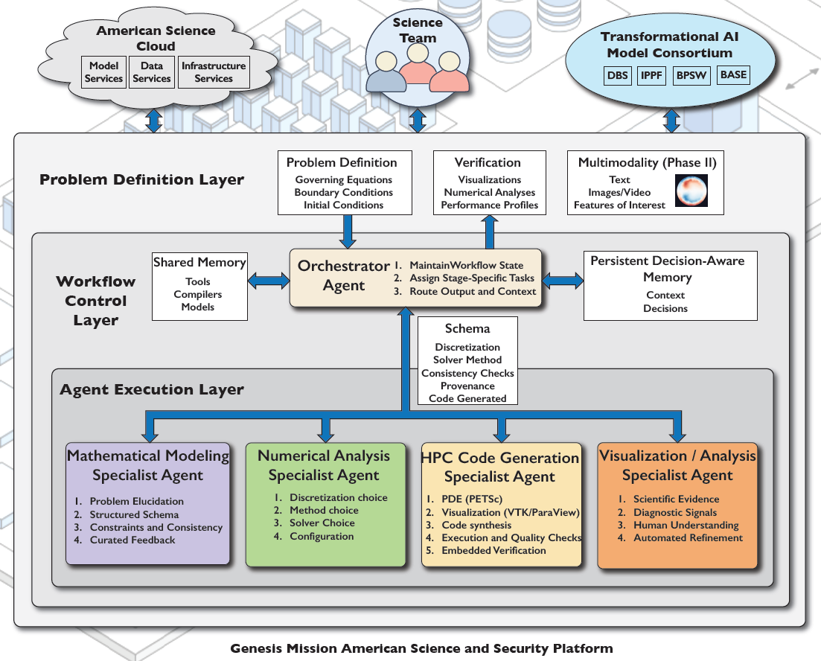

Slide 10
The AI pipeline in action
From one English prompt to a compiled, running solver, with no human edits.
Prompt: “the Grad-Shafranov equilibrium for the plasma in a tokamak.”
Modeling AI agent: identified ‘Grad-Shafranov equation’; time-dependent = False.
Numerical Analysis AI agent: non-linear solve with SNES on a structured grid.
Code Generation AI agent: 267-line PETSc program (DMDA + SNES + true Jacobian).
Compiled and ran on 1 and 4 MPI ranks. No human edits.

Slide 11
AI-agent-generated PETSc solver (excerpt)
A true-Jacobian finite-difference SNES residual, written by the Code Generation AI agent.
static PetscErrorCode FormFunction(SNES snes, Vec X, Vec F, void *ctx){
/* Delta*_h psi = (psi_E-2psi_C+psi_W)/hR^2
- (1/R)(psi_E-psi_W)/(2hR)
+ (psi_N-2psi_C+psi_S)/hZ^2 */
f[j][i] = dRR - dR1/R + dZZ - ForcingF(user,R,Z); /* residual */
}
SNESSetFunction(snes, r, FormFunction, &user);
SNESSetJacobian(snes, J, J, FormJacobian, &user); /* true Jacobian */
SNESSolve(snes, NULL, x);

Slide 12
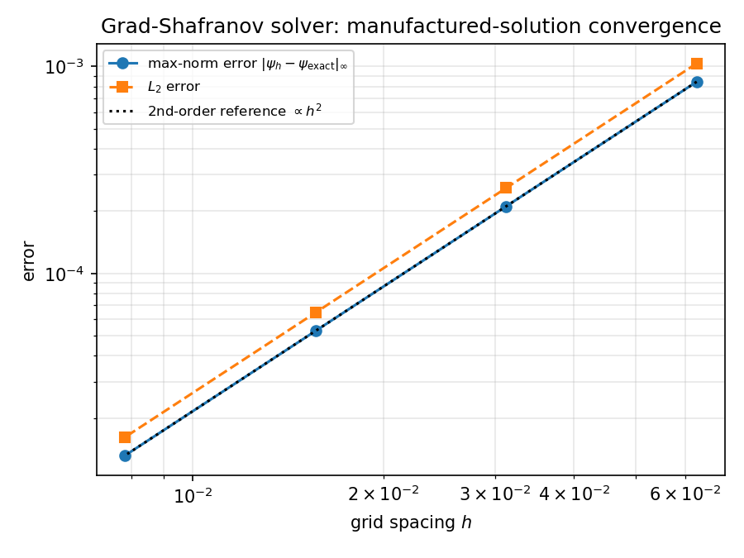
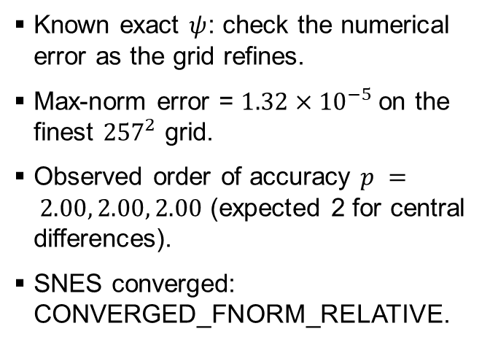
Verification
Method of manufactured solutions: a measured order of accuracy, not just plausible output.
Known exact $ψ$: check the numerical error as the grid refines.
Max-norm error = $1.32×{10}^{−5}$on the finest ${257}^{2}$ grid.
Observed order of accuracy $p = 2.00, 2.00, 2.00$ (expected 2 for central differences).
SNES converged: CONVERGED_FNORM_RELATIVE.
Manufactured-solution convergence

Slide 13
Decision-gate metrics
Correctness, human effort, and efficiency: the numbers behind the demo.
Correctness:
model identified,
C programs compiled and ran,
second-order convergence.
Human effort: 0 lines of solver code hand-written. It was all AI-generated.
Efficiency: total wall-clock ≈ 450.8 seconds; code-gen used 5 tool calls.
model 92.5 seconds,
numerical-analysis 65.5 seconds,
code-generation 292.8 seconds.
Around 23 completions of LLM (large language model) across the whole pipeline.

Slide 14
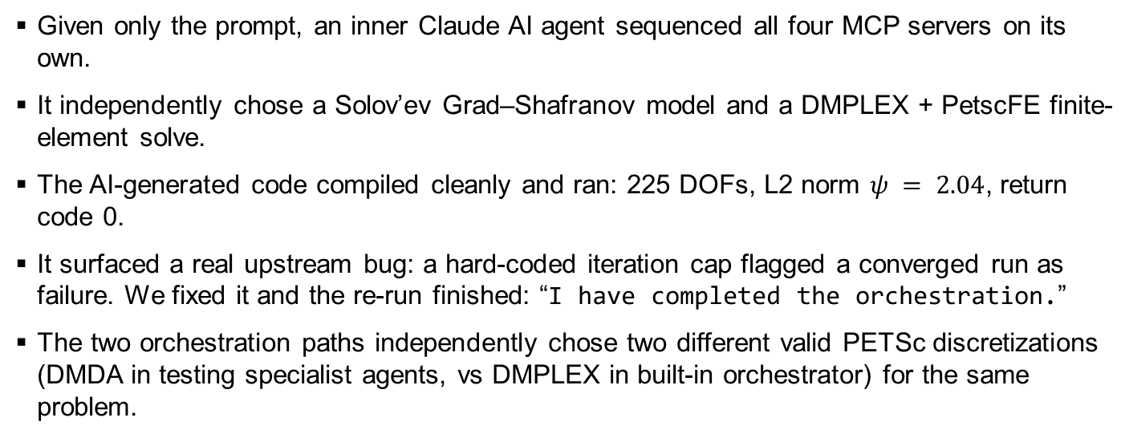
Fully autonomous: the built-in AI orchestrator
The orchestrator AI agent drives all four specialist AI agents itself (no need for a human to micro-manage).
Given only the prompt, an inner Claude AI agent sequenced all four MCP servers on its own.
It independently chose a Solov’ev Grad–Shafranov model and a DMPLEX + PetscFE finite-element solve.
The AI-generated code compiled cleanly and ran: 225 DOFs, L2 norm $ψ = 2.04$, return code 0.
It surfaced a real upstream bug: a hard-coded iteration cap flagged a converged run as failure. We fixed it and the re-run finished: “I have completed the orchestration.”
The two orchestration paths independently chose two different valid PETSc discretizations (DMDA in testing specialist agents, vs DMPLEX in built-in orchestrator) for the same problem.

Slide 15
What we built and contributed
Reusable tooling around the agents, plus fixes contributed back upstream.
A project-owned orchestration driver with full artifact provenance (resumable).
Verification + post-processing (convergence, flux surfaces) and a metrics harness.
Four fixes contributed back to the open PETSc multi-agent system:
CWD-independent server resolution; portable stdio interpreter.
Graceful operation without the documentation / RAG services.
Code-generation and orchestrator loops that reliably capture results.

Slide 16
Takeaways and next steps
A verification-driven multi-agent path from prompt to trustworthy HPC code
A multi-agent AI system generated a correct, verified PETSc fusion-MHD solver from a prompt.
Both the Python driver and the fully-autonomous orchestrator succeeded end to end.
Verification-driven: convergence + exact-solution checks, not just plausible output.
Next: shaped real-machine equilibria (Solov’ev / Cerfon–Freidberg), q-profile, GPU scale-up on ALCF supercomputers such as Polaris and Aurora.
Code + docs: github.com/engineer-scientist/petsc_mcp_servers_tokamak

Slide 17
References
AI coding agent: Claude Code by Anthropic (https://claude.com/product/claude-code)
Automated Problem-to-Solution Generation for PDE-Based Simulation Science, Dr Lois Curfman McInnes, Dr Junchao Zhang, Dr Matthew Knepley, et al (2026).
PETSc MCP Servers, Barry Smith (2026): https://gitlab.com/petsc/petsc_mcp_servers
Grad-Shafronov equation (https://en.wikipedia.org/wiki/Grad-Shafranov_equation).
DoE Explains… Tokamaks: https://www.energy.gov/science/doe-explainstokamaks
PETSc AI: https://petsc-ai.org
Improving Usability and Productivity of PETSc with Agent-Based Workflows, Dr Barry Smith, et al (2026).

Slide 18
Acknowledgements
This work was partially supported by the U.S. Department of Energy (DOE) Office of Science “Distinguished Scientist Fellows” Program.
This work used ANL CELS General Computing Environment: https://help.cels.anl.gov/docs/linux/

