Slide 1
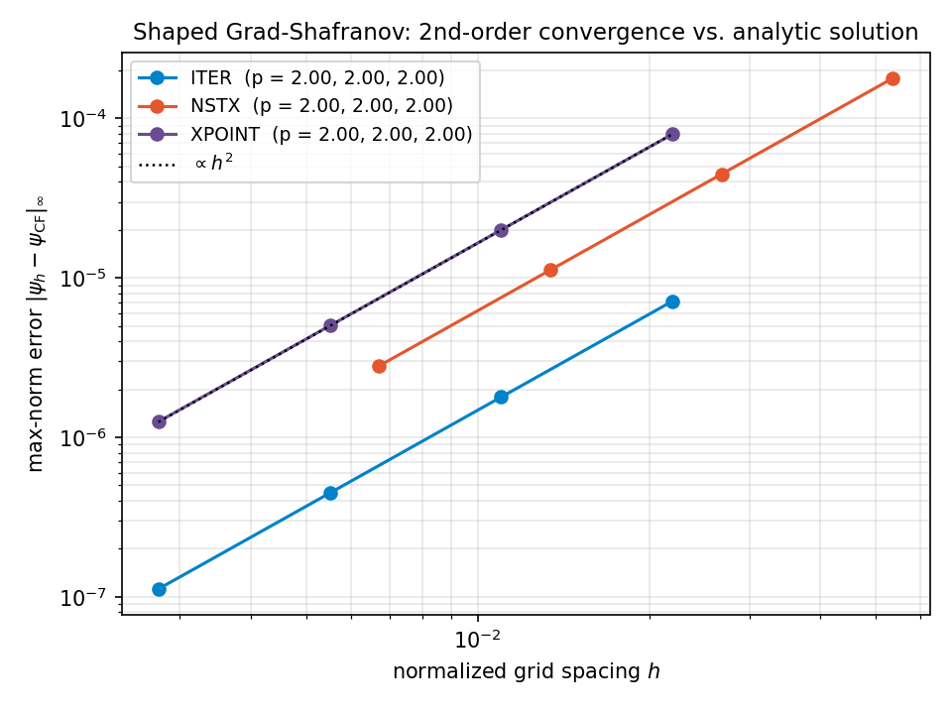
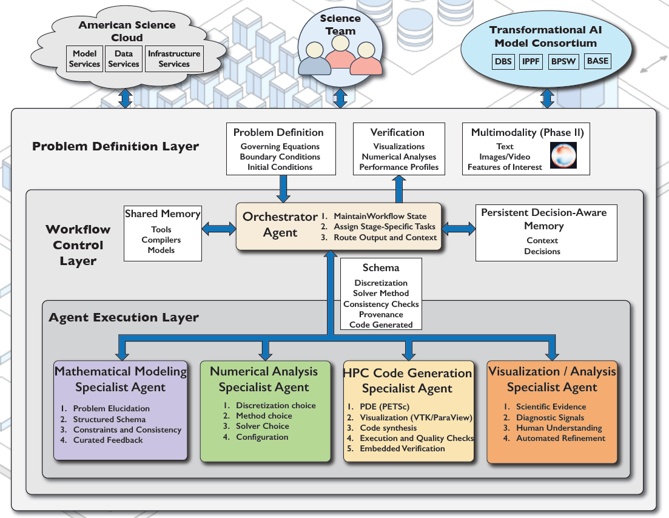
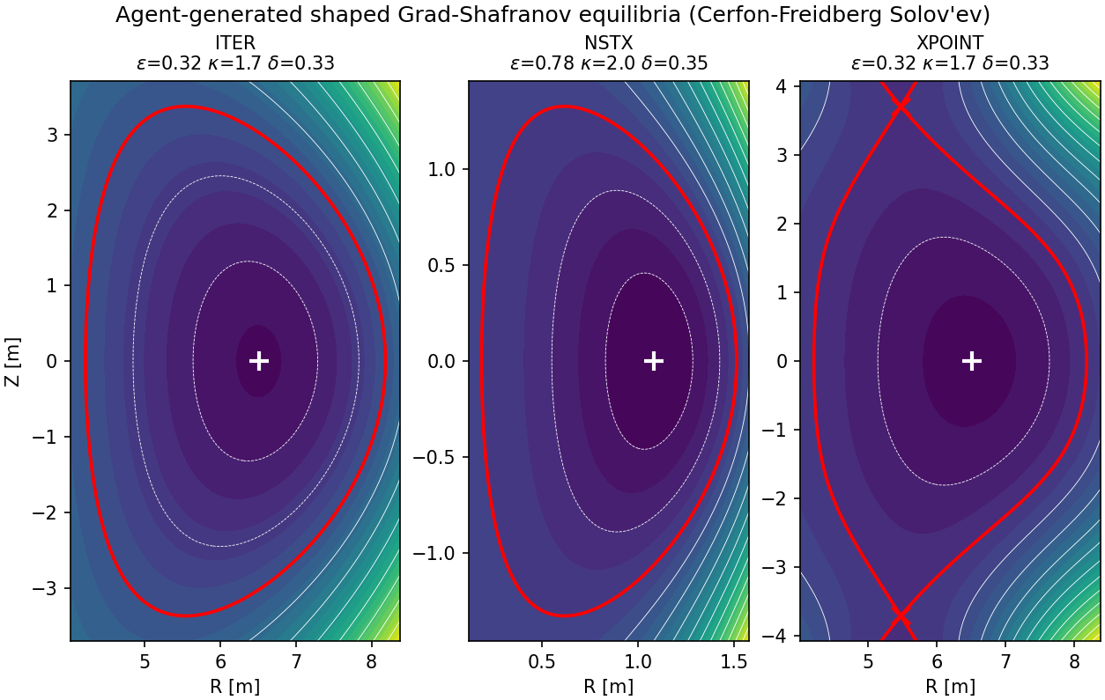
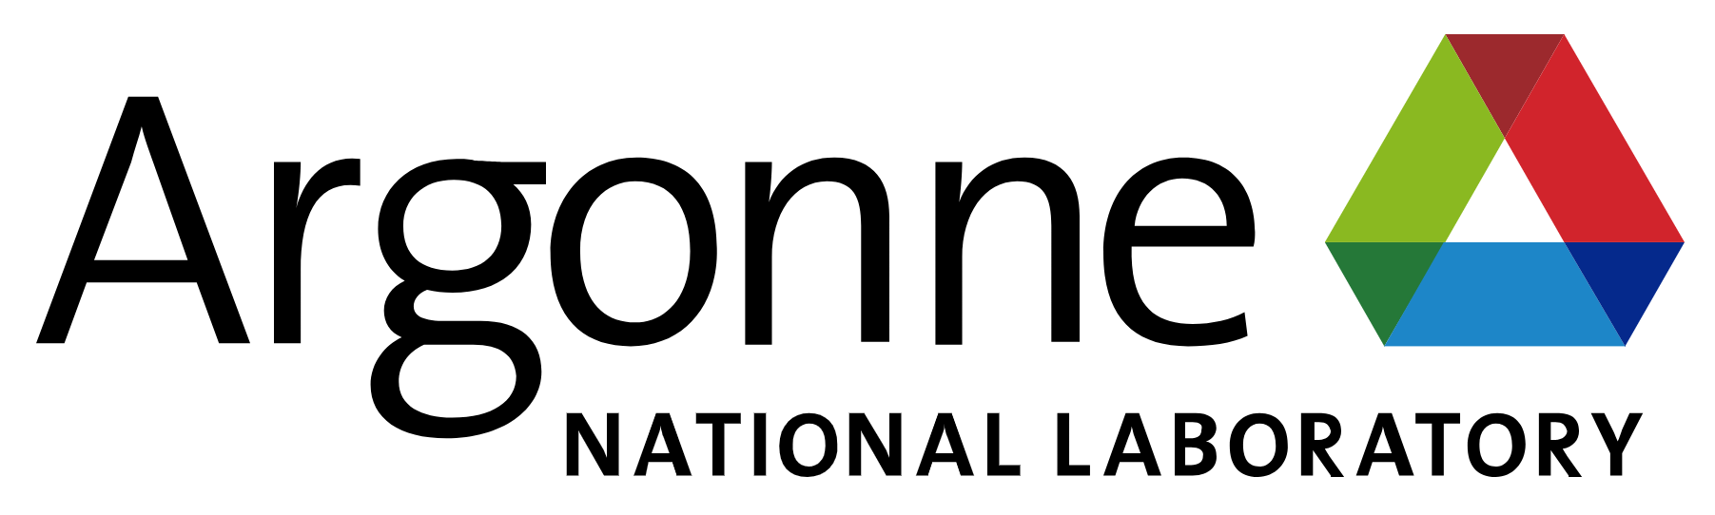


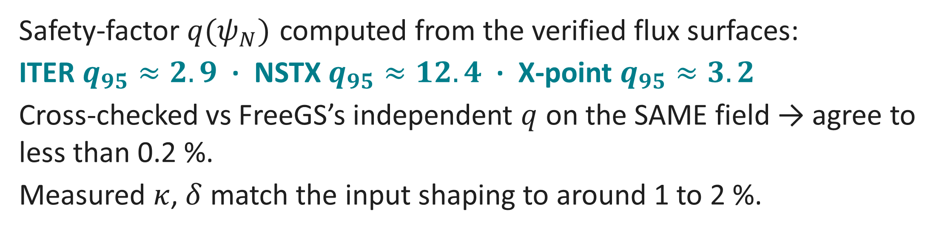

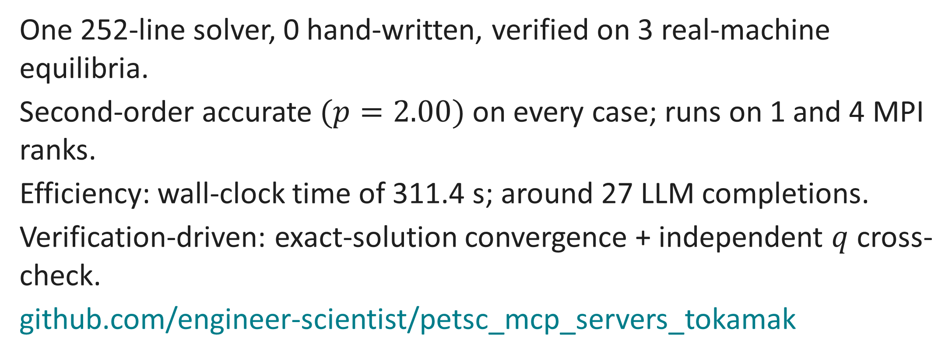
A System of Multiple AI Agents for Automating Tokamak-Plasma Simulation for Nuclear Fusion Energy.
A hierarchical multi-agent PETSc system: from a plain-language prompt to verified, real-machine Grad-Shafranov equilibria.
Sarthak Sharma¹ · Dr Junchao Zhang² · Dr Lois Curfman McInnes² · Prof Matthew Knepley¹ US Research Software Engineering Conference 2026
¹ Computational and Data Sciences, State University of New York at Buffalo ² Division of Mathematics and Computer Science, Argonne National Laboratory
1. Motivation
4. The pipeline in action
7. Verification: second order
Building correct, fast HPC simulation code demands scarce, implicit expertise. Can a system of multiple AI agents automate the path from a plain-language idea to verified code for a real fusion problem?
We answer yes for the tokamak Grad-Shafranov equilibrium, with verification as a first-class deliverable.
HPC library used is PETSc (Portable, Extensible Toolkit for Scientific Computation).
Prompt: “the Grad-Shafranov equilibrium for a tokamak plasma.”
Modeling → ‘Grad-Shafranov equation’, steady.
Numerical Analysis → non-linear ⇒ SNES (Scalable Nonlinear Equations Solvers) on a DMDA (Distributed Management Distributed Array).
Code Generation → one 252-line parametrized PETSc solver.
Compiled and ran on 1 and 4 MPI ranks without any human edits.
2. The problem being solved
5. Generated solver (excerpt)
Axisymmetric ideal-magnetohydrodynamics force balance for the poloidal magnetic flux $ψ(r,z)$:
$$\frac{∂^{2}ψ}{∂r^{2}} − \frac{1}{r} \frac{∂ψ}{∂r} + \frac{∂^{2}ψ}{∂z^{2}} = − μ_{0} r^{2} \frac{dp}{dψ} − \frac{1}{2} \frac{dF^{2}}{dψ}$$
where $p$ is plasma pressure, $μ_{0}$ is magnetic permeability, $F=rB_{θ}$, $B$ is magnetic field, and $(r,θ,z)$are cylindrical coordinates.
Sets the flux surfaces, magnetic axis, plasma shape, and safety factor $q$.
Solov'ev profiles admit an exact solution → a rigorous verification anchor.
/* GS operator (normalized x=R/R0), 2nd-order FD */
DMDACreate2d(...,DMDA_STENCIL_STAR,...,&da);
dxx=(u[j][i+1]-2*u[j][i]+u[j][i-1])/hx2;
dyy=(u[j+1][i]-2*u[j][i]+u[j-1][i])/hy2;
f[j][i]=dxx-dx/x+dyy-((1-A)*x*x+A);
/* Dirichlet BC = analytic CF psi (nonzero) */
f[b]=u[b]-PsiExact(&u,x,y);
SNESSetJacobian(snes,J,J,FormJacobian,&u);
SNESSolve(snes,NULL,X);
Figure 3: Method of manufactured solutions vs the exact Cerfon-Freidberg solution: observed order $p=2.00$for all three machines.
3. The system of multiple AI agents
8. Safety factor and FreeGS cross-check
6. Real-machine equilibria
Safety-factor $q(ψ_{N})$ computed from the verified flux surfaces:
ITER $q_{95}≈2.9$ · NSTX $q_{95}≈12.4$ · X-point $q_{95}≈3.2$
Cross-checked vs FreeGS’s independent $q$ on the SAME field → agree to less than 0.2 %.
Measured $κ$, $δ$ match the input shaping to around 1 to 2 %.
9. Results and conclusions
One 252-line solver, 0 hand-written, verified on 3 real-machine equilibria.
Second-order accurate $(p=2.00)$on every case; runs on 1 and 4 MPI ranks.
Efficiency: wall-clock time of 311.4 s; around 27 LLM completions.
Verification-driven: exact-solution convergence + independent $q$ cross-check.
github.com/engineer-scientist/petsc_mcp_servers_tokamak
Figure 1: A Problem-Definition layer, an Orchestrator agent + shared / persistent memory (Workflow Control), and specialist Modeling / Numerical-Analysis / Code-Generation / Visualization agents (Agent Execution).
Figure 2: One agent-generated solver → ITER, spherical-tokamak (NSTX-like) and diverted double-null (X-point) equilibria. Red = separatrix; × = X-points.
This work was partially supported by the US Department of Energy’s Office of Science “Distinguished Scientist Fellows” Program.
This work used ANL CELS General Computing Environment: https://help.cels.anl.gov/docs/linux/
PETSc AI website: https://petsc-ai.org/

