Slide 1
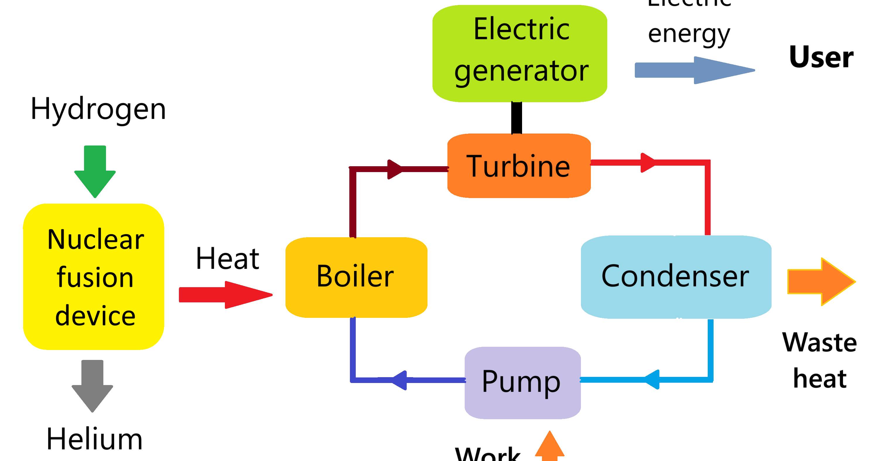
Automated Problem-to-Solution Generation
for a Tokamak Fusion-Plasma Simulation
A hierarchical multi-agent PETSc system — applied and verified
Presenter
Event
Date
[PRESENTER NAME]
Summer 2026 Intern, Argonne National Laboratory
Argonne Summer 2026
Intern Presentation
2026

Slide 2
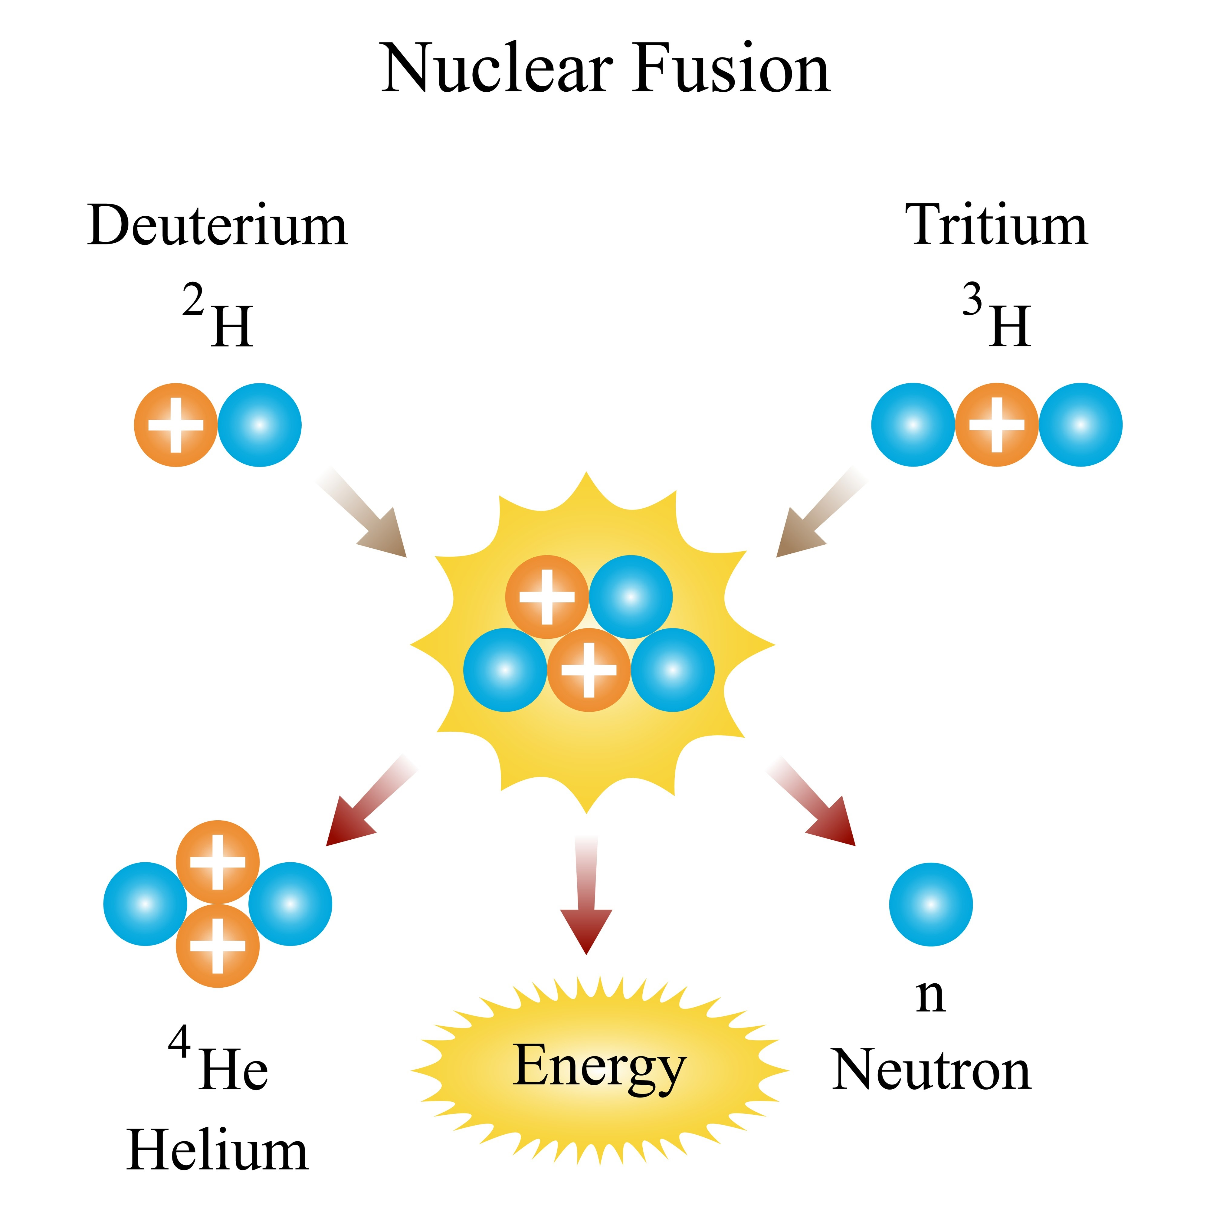
Why fusion energy needs trustworthy simulation
Fusion could be a near-limitless clean energy source — if we can confine the plasma
Fusion fuses light nuclei (deuterium + tritium) to release energy — the reaction that powers the Sun.
A tokamak confines a ~150-million-°C plasma in a magnetic “cage” long enough to fuse.
Getting there is a simulation problem: predict the plasma before building costly hardware.
Simulations must be trustworthy — a plausible-looking wrong answer is worse than none.
Deuterium–tritium fusion

Slide 3
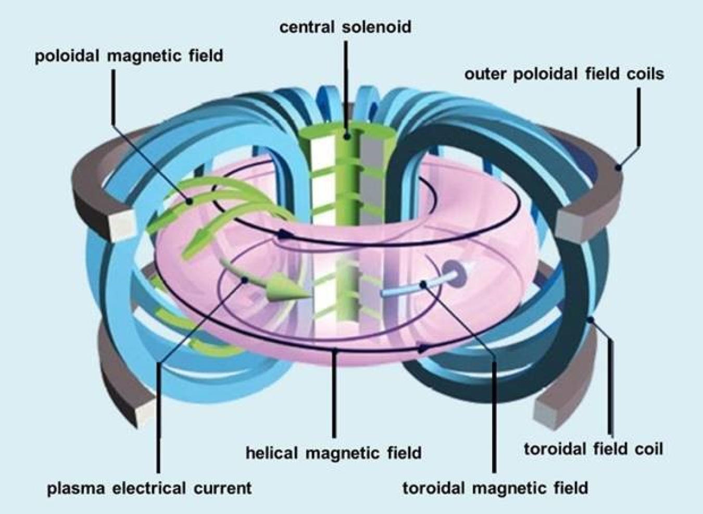
The modeling challenge
Turning fusion physics into correct, fast HPC code needs scarce, implicit expertise
Numerical methods: choose grids, discretizations, and solvers that actually converge.
Libraries & parallelism: express it in PETSc and run on many CPU cores / GPUs.
Verification: prove the computed answer is right, not merely plausible.
Question: can a multi-agent AI system automate this whole path — and can we trust it?
Tokamak magnetic confinement (U.S. DOE)

Slide 4
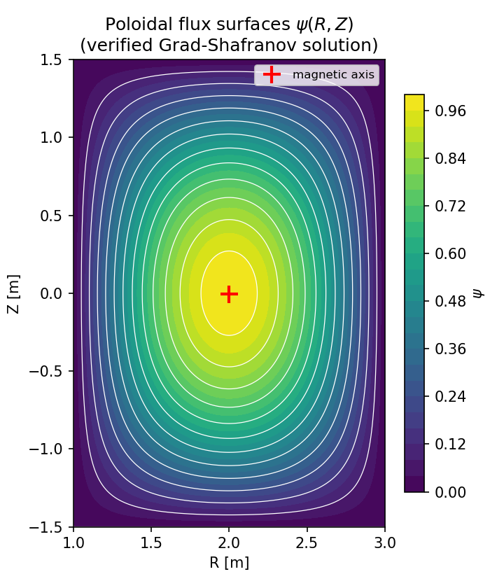
The problem: Grad–Shafranov equilibrium
Axisymmetric ideal-MHD force balance for the poloidal flux ψ(R,Z)
Δ*ψ = −μ₀R² p′(ψ) − F F′(ψ) — elliptic, nonlinear, time-independent.
Its solution gives the flux surfaces, magnetic axis, and safety factor q.
A natural PETSc SNES (nonlinear solver) problem.
Verifiable: a manufactured exact solution gives a rigorous convergence test.
Flux surfaces of the verified solution

Slide 5
The system: a 3-layer multi-agent pipeline
PETSc’s Model-Context-Protocol (MCP) agents, coordinated end to end
Problem definition — Mathematical Modeling agent → strong/weak form, name, time-dependence.
Agent execution — Numerical Analysis agent → grid, discretization, solver (SNES).
Agent execution — HPC Code Generation agent → writes, compiles & runs PETSc C.
Execution substrate — compile-run agent (make / run on the real machine).
All agents run against Argonne’s Argo gateway (Claude Opus 4.8).
A project-owned driver records every artifact with provenance (reproducible, resumable).

Slide 6
The pipeline in action
From one English prompt to a compiled, running solver — with no human edits
Prompt: “the Grad-Shafranov equilibrium for the plasma in a tokamak.”
Modeling agent → identified ‘Grad-Shafranov equation’; time-dependent = False.
Numerical Analysis agent → nonlinear solve with SNES on a structured grid.
Code Generation agent → 267-line PETSc program (DMDA + SNES + true Jacobian).
Compiled and ran on 1 and 4 MPI ranks — no human edits.

Slide 7
The agent-generated PETSc solver (excerpt)
A true-Jacobian finite-difference SNES residual — written by the Code Generation agent
static PetscErrorCode FormFunction(SNES snes, Vec X, Vec F, void *ctx){
/* Delta*_h psi = (psi_E-2psi_C+psi_W)/hR^2
- (1/R)(psi_E-psi_W)/(2hR)
+ (psi_N-2psi_C+psi_S)/hZ^2 */
f[j][i] = dRR - dR1/R + dZZ - ForcingF(user,R,Z); /* residual */
}
SNESSetFunction(snes, r, FormFunction, &user);
SNESSetJacobian(snes, J, J, FormJacobian, &user); /* true Jacobian */
SNESSolve(snes, NULL, x);

Slide 8
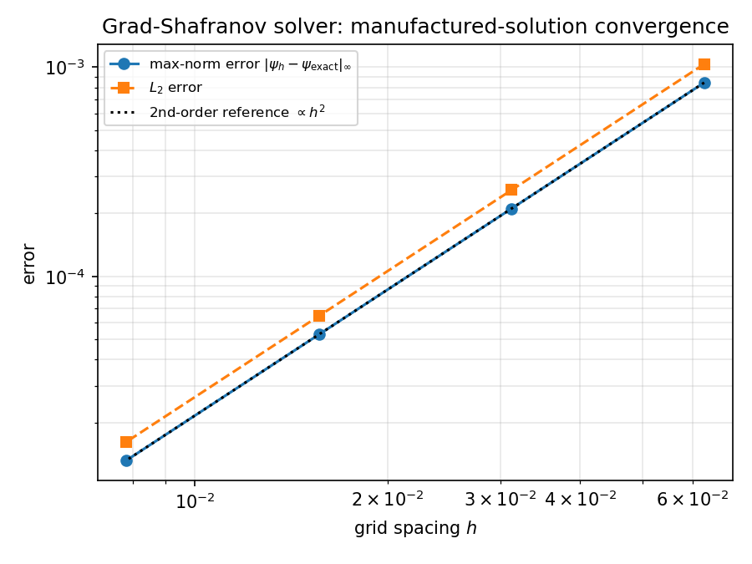
Verification: it is actually right
Method of manufactured solutions — a measured order of accuracy, not just plausible output
Known exact ψ → check the numerical error as the grid refines.
Max-norm error = 1.32e-05 on the finest 257² grid.
Observed order of accuracy p = 2.00, 2.00, 2.00 (expected 2 for central differences).
SNES converged: CONVERGED_FNORM_RELATIVE.
Manufactured-solution convergence

Slide 9
Decision-gate metrics
Correctness, human effort, and efficiency — the numbers behind the demo
Correctness: model identified ✓, compiled & ran ✓, 2nd-order convergence ✓.
Human effort: 0 lines of solver code hand-written — it was generated.
Efficiency: total wall-clock ≈ 450.8 s; code-gen used 5 tool calls.
≈ 23 LLM completions across the whole pipeline.

Slide 10
Fully autonomous: the built-in orchestrator
The shipped LLM orchestrator drives all four agents itself — no Python driver
Given only the prompt, an inner Claude agent sequenced all four MCP servers on its own.
It independently chose a Solov’ev Grad–Shafranov model and a DMPLEX + PetscFE finite-element solve.
The generated code compiled cleanly and ran: 225 DOFs, L2 norm ψ = 2.04, return code 0.
It surfaced a real upstream bug — a hardcoded iteration cap flagged a converged run as failure.
We fixed it and contributed the patch; the re-run finished: “I have completed the orchestration.”

Slide 11
What I built and contributed
Reusable tooling around the agents, plus fixes contributed back upstream
A project-owned orchestration driver with full artifact provenance (resumable).
Verification + post-processing (convergence, flux surfaces) and a metrics harness.
Four fixes contributed back to the open PETSc multi-agent system:
CWD-independent server resolution; portable stdio interpreter
graceful operation without the documentation / RAG services
code-generation and orchestrator loops that reliably capture results

Slide 12
Takeaways & next steps
A verification-driven multi-agent path from prompt to trustworthy HPC code
A multi-agent system generated a correct, verified PETSc fusion-MHD solver from a prompt.
Both the Python driver and the fully-autonomous orchestrator succeeded end to end.
Verification-driven: convergence + exact-solution checks, not just plausible output.
Next: shaped real-machine equilibria (Solov’ev / Cerfon–Freidberg), q-profile, GPU scale-up.
Code + docs: github.com/engineer-scientist/petsc_mcp_servers_tokamak

