Slide 1

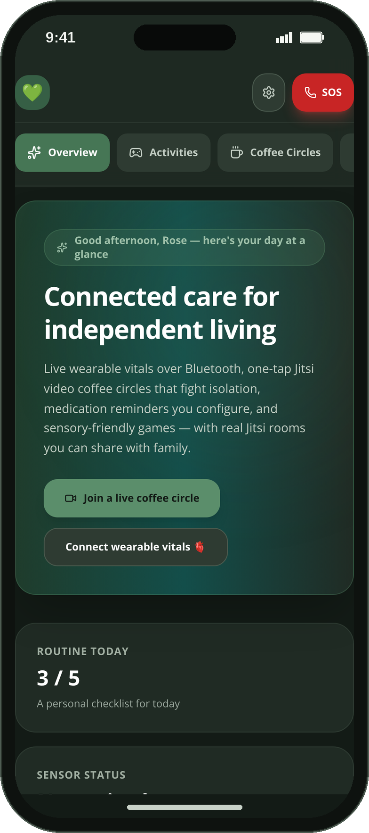
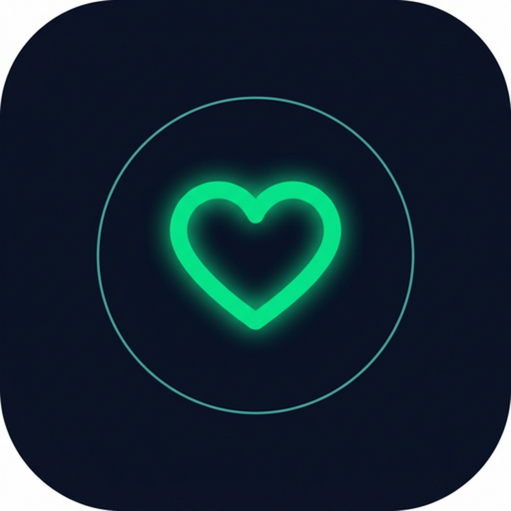
CONGRESSIONAL APP CHALLENGE 2026 · [CA-XX]
CareSphere AI
Connected care for independent living
A privacy-first companion for older adults, autistic people and the families who care for them — real video coffee circles, honest wearable vitals, calm sensory tools and an AI health guide that never leaves the phone.
[Student Name] · [Grade] · [School], [City], CA
Native iOS app (SwiftUI) + installable web app (React PWA)
ISOLATION PREVENTION
AUTISM SUPPORT
SENIOR CARE
NO CLOUD · NO ACCOUNT
github.com/engineer2025-sudo/Care
Notes:
[0:00–0:15] Hi, I'm [NAME], a [GRADE] at [SCHOOL] in [CITY], California. This is CareSphere AI — a privacy-first care companion for older adults, autistic people and the families who look after them, built as a native iPhone app and an installable web app.

Slide 2
THE PROBLEM
Care is getting harder to give — and harder to accept
1 in 4
29%
1 in 31
~50%
adults aged 65+ in the U.S. are socially isolated — a health risk comparable to smoking or obesity.
higher risk of premature death associated with social isolation.
8-year-olds identified with autism — children who grow into autistic adults needing lifelong, respectful support.
of long-term medications are not taken as prescribed.
National Academies (NASEM), 2020
U.S. Surgeon General Advisory, 2023
CDC ADDM Network, 2025
World Health Organization
63 million Americans now care for a family member — nearly 1 in 4 adults.
AARP & National Alliance for Caregiving, 2025
Most "care tech" answers with accounts, cloud dashboards and data collection — exactly what makes many seniors and families hesitate.
Tools designed for autistic users are rare, and almost none combine social connection, routines, real vitals and safety in one calm place that keeps data on the device.
CareSphere AI · Congressional App Challenge 2026
2 / 19
Notes:
[0:15–0:33] One in four older adults is socially isolated — a 29 percent higher risk of early death. One in 31 children is autistic. Half of long-term medications aren't taken as prescribed. And 63 million family caregivers are coping with apps that demand an account and send everything to the cloud.

Slide 3
WHY I BUILT IT
Inspiration — and the four rules I wrote into the code
MY STORY
RULE 1
RULE 2
[Personal hook — e.g. "My grandmother lives alone, far from us. After her fall, every phone call started with the same anxious questions: Did you take your pills? Did you talk to anyone today?"]
I kept seeing the same three gaps:
Isolation. Video calls are the best medicine, but they are buried behind accounts and installs.
Forgotten medication and vitals nobody trusts. Apps that "guess" numbers or show demo data as if it were real.
Nothing built for autistic people. Timers, scores and flashing screens — the opposite of calm.
So I built the app I wished my family had — and wrote its ethics into the code.
Never fabricate
Nothing is sent automatically
Every reading is tagged LIVE BLE or SIMULATED at the source. Cancel a pairing and the card stays blank — no invented numbers, ever.
Visit briefs, caregiver texts and SOS messages always end with a human tap. No push backend, no silent sharing.
RULE 3
RULE 4
Calm by default
Private by architecture
No timers, no scores, no auto-advance. Reduce-motion, high-contrast and A/A+/A++ text sizes are first-class settings.
No account, no server, AES-256-GCM at rest, and an AI guide that runs entirely on the phone.
CareSphere AI · Congressional App Challenge 2026
3 / 19
Notes:
[0:33–0:50] [Your story in one sentence.] I wrote four rules into the code: never fabricate a reading, never send anything automatically, stay calm by default, and keep everything private by architecture.

Slide 4
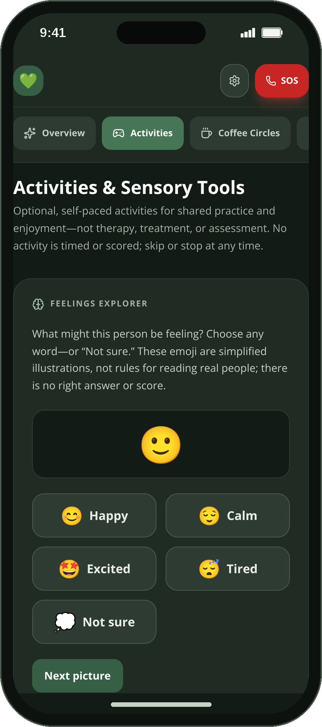
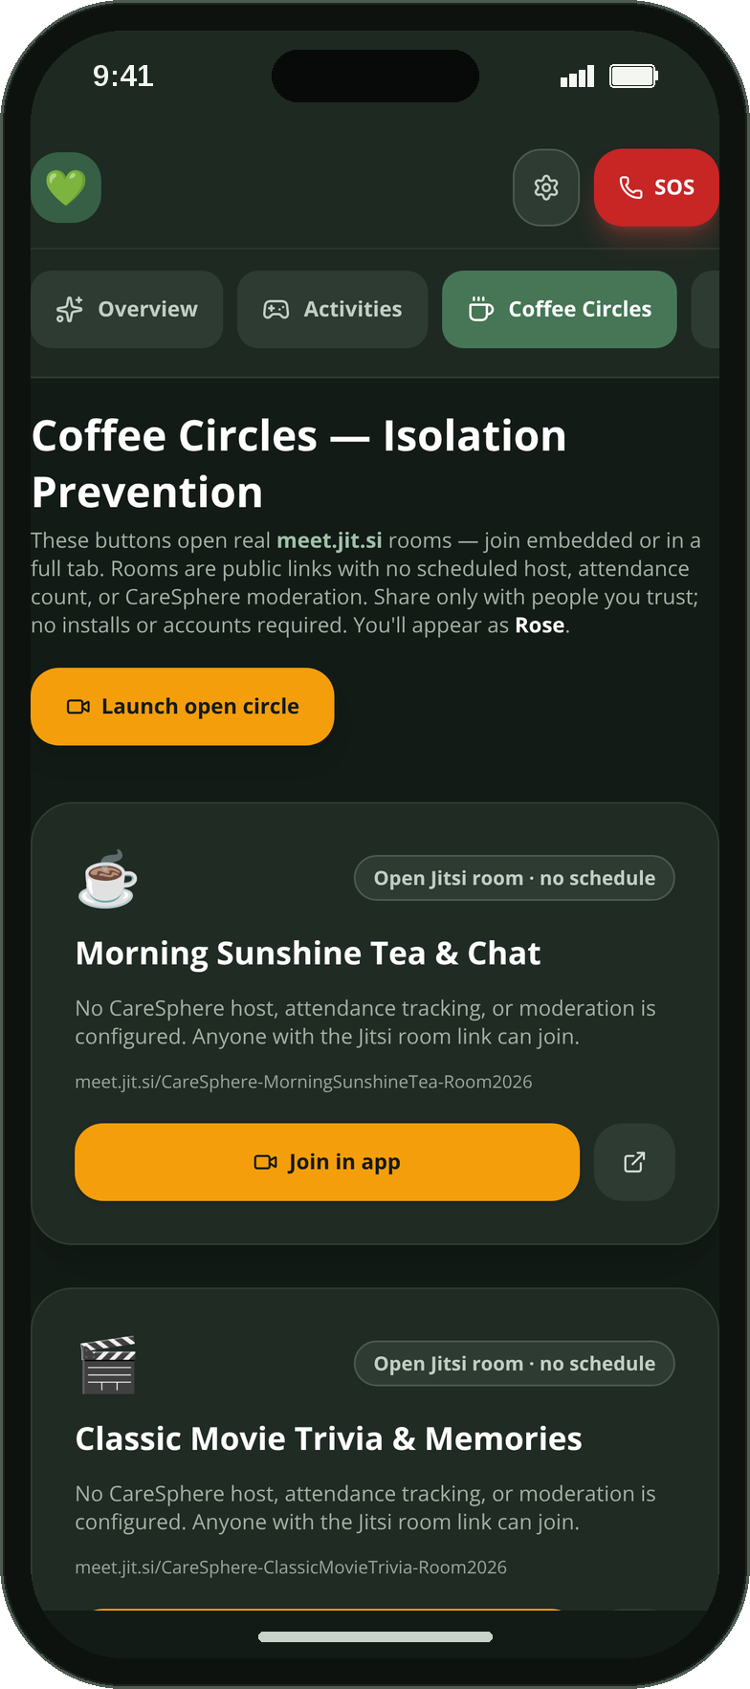
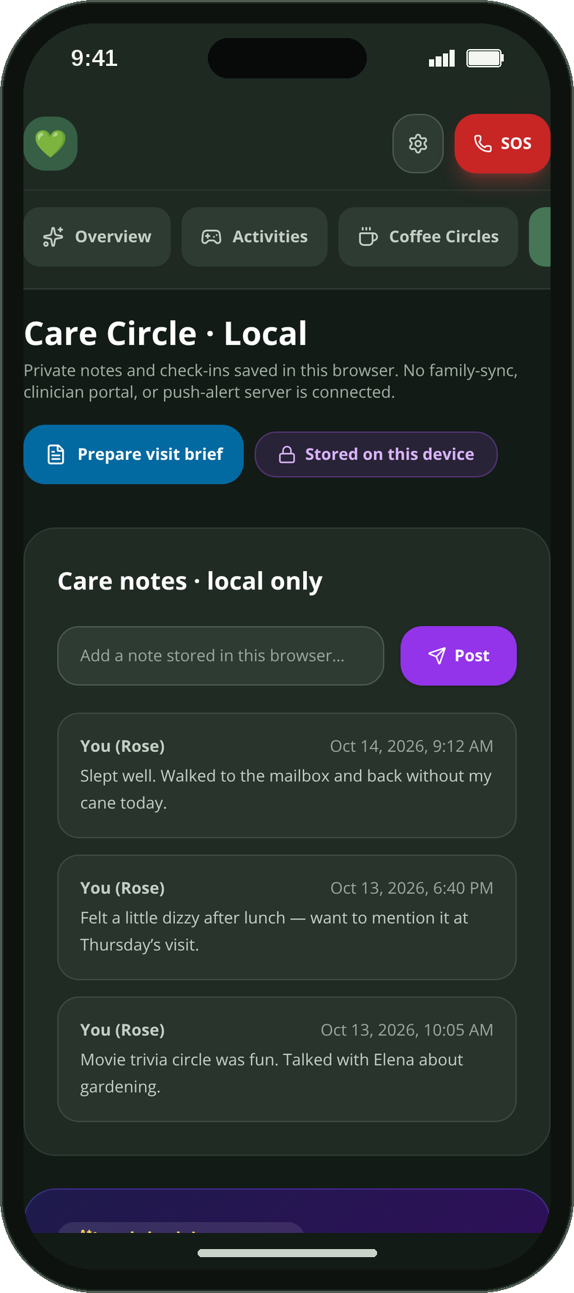
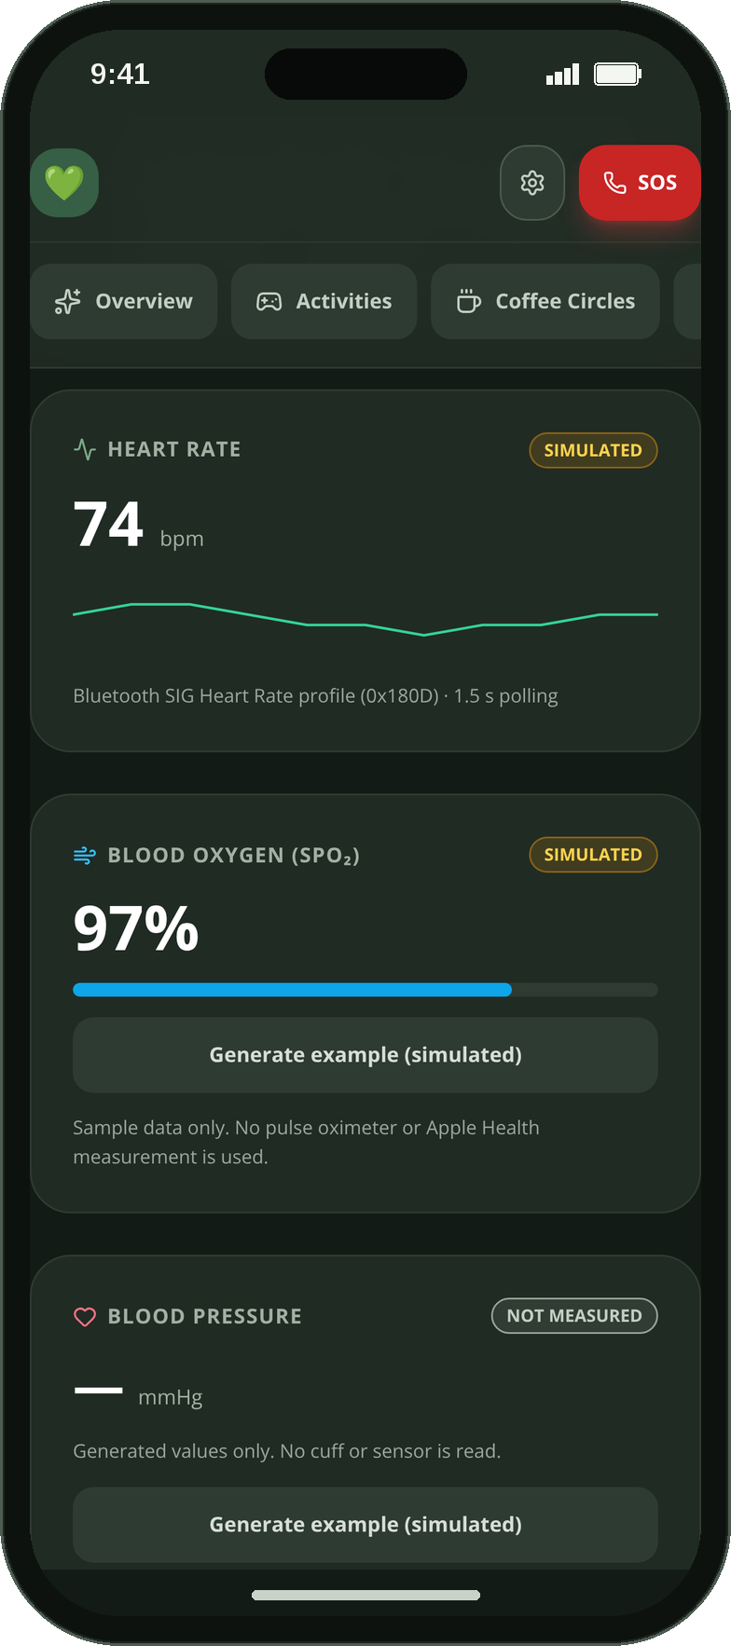
MEET CARESPHERE
NATIVE IOS 16+ (SWIFTUI) + REACT PWA
One calm app, five tabs, two platforms
Overview
Activities
Coffee Circles
Care Circle
Vitals & Telehealth
routines, mood & medication check-ins
sensory & memory tools, breathing
live Jitsi video rooms
care notes & visit brief
Bluetooth HR, SpO₂, CSV export
iPhone adds a sixth tab — Health Guide — plus Face ID lock, HealthKit and system notifications.
CareSphere AI · Congressional App Challenge 2026
4 / 19
Notes:
[0:50–1:02, with slide 5] Five calm tabs — Overview, Activities, Coffee Circles, Care Circle and Vitals — plus an offline Health Guide on iPhone, designed for older adults, autistic teens and adults, and their caregivers.

Slide 5
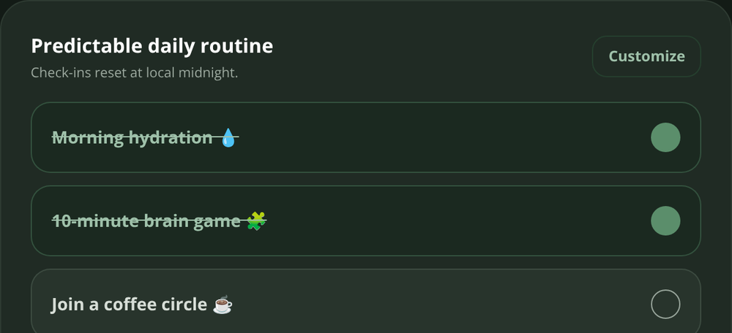
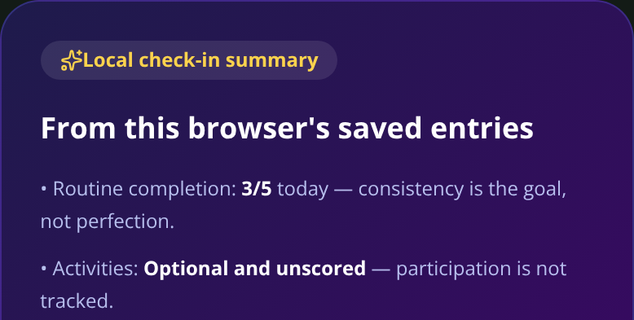
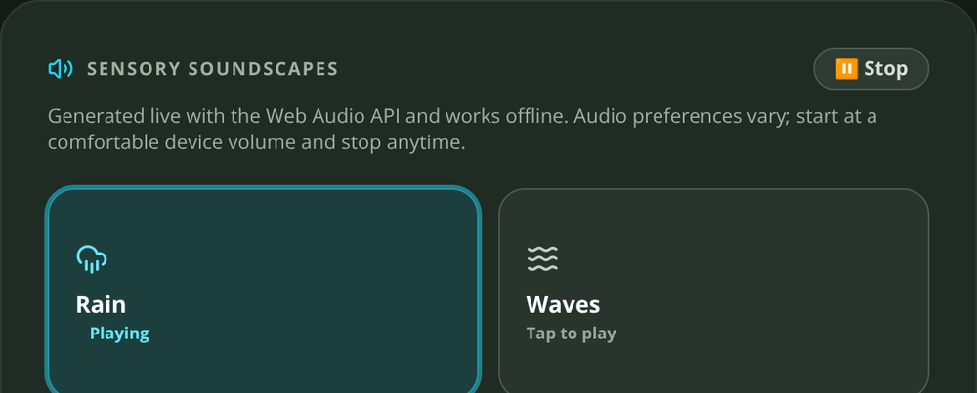
INTENDED AUDIENCE
Built for three groups who are usually served separately
Older adults living independently
Autistic teens and adults
Family caregivers and care teams
Large-text routines (up to 24 items) that reset at local midnight
Daily mood check-in with a 14-day history they choose to share
Medication reminders they configure and confirm themselves
Coffee Circles — scheduled video rooms with real people
Wearable heart-rate on screen, labeled honestly
Predictable layout: one task per screen, no surprises
Untimed, unscored activities: Feelings Explorer, Pattern Recall, Picture Pairs, Picture Story
Four synthesized soundscapes and 4-4-6 guided breathing
"I'm stressed" path that calms first and never auto-alerts anyone
Reduce-motion, high-contrast and theme choices (AASPIRE-informed)
Shared care notes kept on the device, exportable any time
Visit brief with an exact preview before anything is saved
Opt-in support check-in that offers a text, a video room or 911
Source-labeled HR/SpO₂ history and CSV export for appointments
Honest limits: no delivery promises, no diagnosis, no cloud
Design references: AASPIRE Web Accessibility Guidelines for Autistic Web Users (Nicolaidis et al., 2019) · Apple Human Interface Guidelines — Accessibility
CareSphere AI · Congressional App Challenge 2026
5 / 19
Notes:
[0:50–1:02, continued from slide 4] …designed for older adults living independently, autistic teens and adults, and the family caregivers who support them — all in one place, without an account.

Slide 6
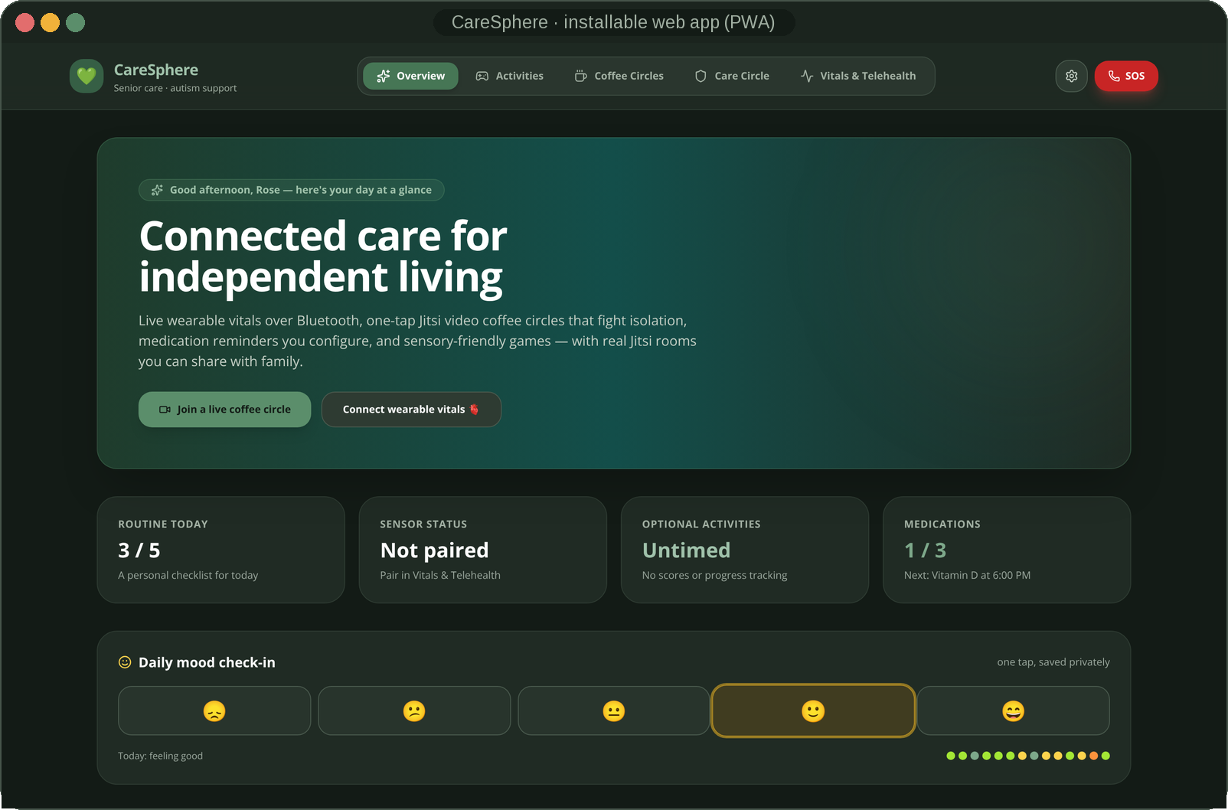
LIVE DEMO
Let's see it in action
WHAT YOU'LL SEE IN THE VIDEO
Overview — mood check-in, tick a routine item
Add a medication → confirm the schedule → spoken reminder toast
Vitals — pair a Bluetooth monitor (or the labeled demo), live sparkline, CSV export
Activities — Pattern Recall, Rain soundscape, 4-4-6 breathing
Coffee Circles — join a real Jitsi room
Care Circle — build a visit brief, preview it, download it
Settings — A++ text, warm-light theme, encryption status
iPhone — ask the offline Health Guide a question
RECORDED ON THE REAL APP — NOTHING STAGED
CareSphere AI · Congressional App Challenge 2026
6 / 19
Notes:
[1:02–1:05] Let me show you. (Switch to the screen recording — 1:05–2:05. Follow the eight-step shot list in VIDEO_SCRIPT.md; call out the LIVE BLE / SIMULATED labels and the "nothing is uploaded" moment in the visit brief.)

Slide 7
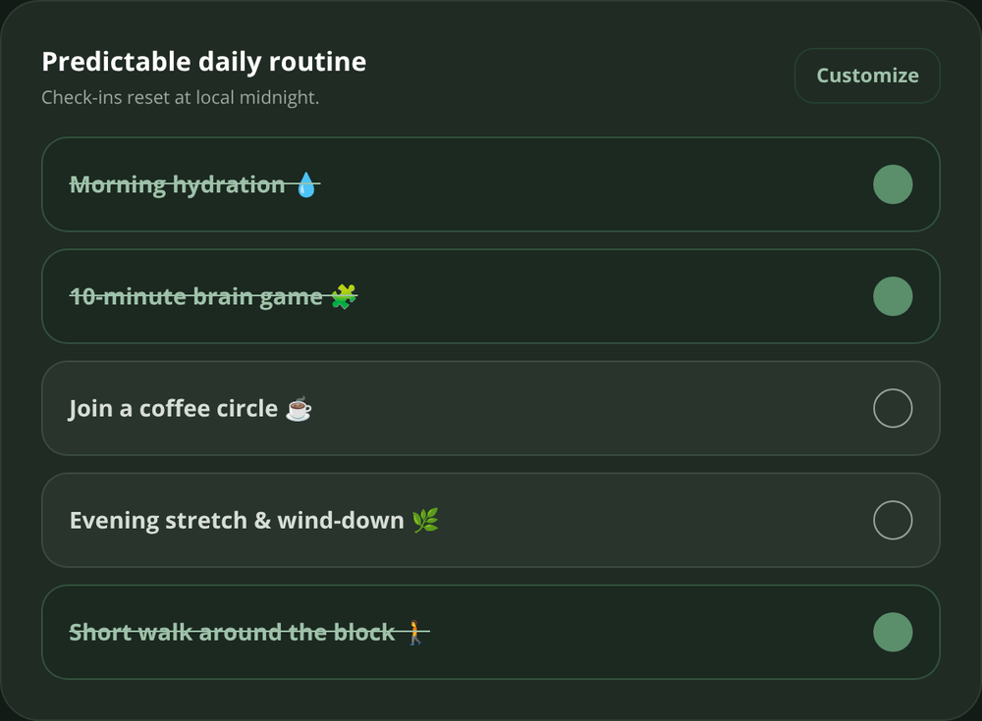
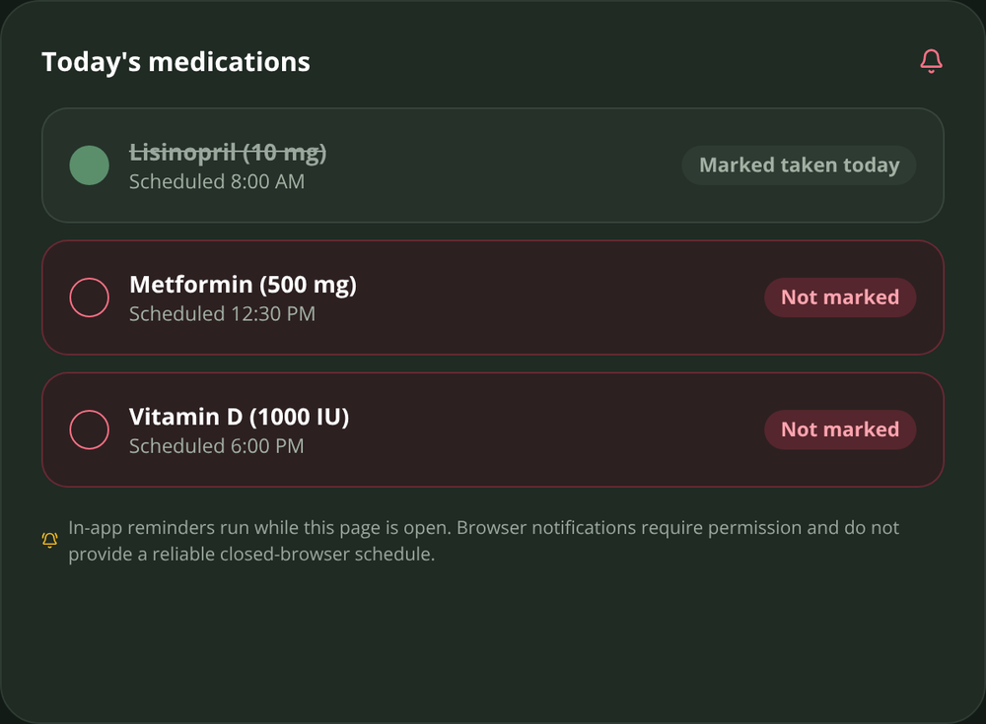
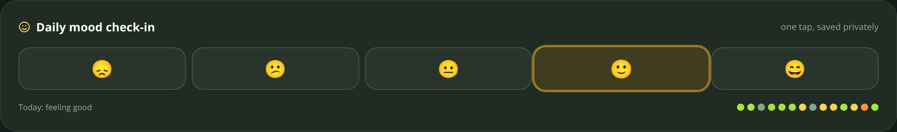
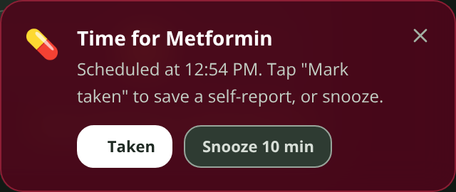
FEATURE · OVERVIEW
Routines, mood and medication — self-reported, local, honest
Up to 24 routine items with a daily progress count; check-ins are keyed to the local calendar day and reset at local midnight — not UTC.
Daily mood 1–5 with a 14-day dot history. Stored only on the device; shared only inside a visit brief you build.
Medication reminders start only after you confirm the schedule. CareSphere never prefills medicines or doses.
The web app checks the schedule every 15 seconds and shows a toast, an optional browser notification and a spoken prompt (Web Speech). iPhone uses UserNotifications so reminders fire even when the app is closed.
"Taken" is recorded as a self-report — the app never claims a dose was verified.
iPhone also shows today's step count from HealthKit (read-only).
Reminder toast: "Taken" saves a self-report, "Snooze" waits 10 minutes.
Paired with an optional browser notification and a spoken prompt.
CareSphere AI · Congressional App Challenge 2026
7 / 19
Notes:
Routines and mood are keyed to the local day. Medication reminders only begin after the user explicitly confirms a schedule; the reminder loop checks every 15 seconds and offers Taken (a self-report) or a 10-minute snooze.

Slide 8
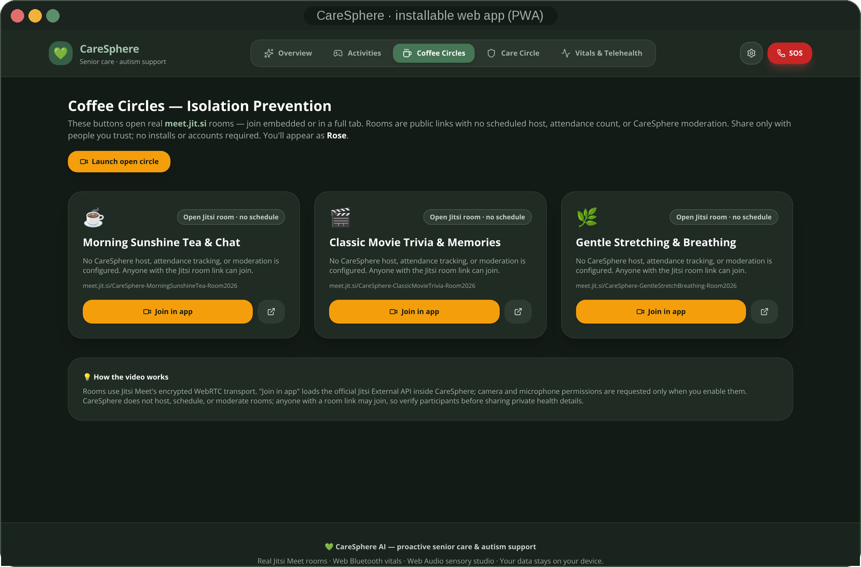
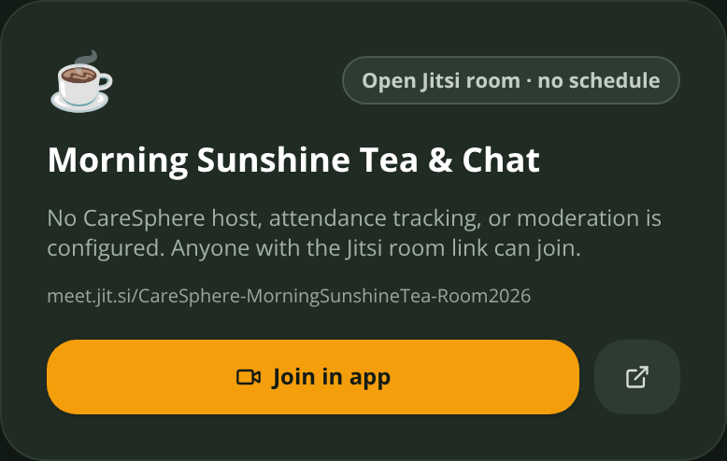
FEATURE · COFFEE CIRCLES
Fighting isolation with real video rooms — no account, nothing to install
Three scheduled circles — Morning Sunshine Tea & Chat, Classic Movie Trivia & Memories, Gentle Stretching & Breathing — plus an open ad-hoc room.
Each circle is a real meet.jit.si room opened through the Jitsi External API on the web and JitsiMeetSDK 13.1 on iPhone — embedded in the app or in a new tab.
Share the link with family; one-tap telehealth room in the Vitals tab for clinician visits.
Honest limit: CareSphere runs no server, so there is no moderator or host — you choose whom to invite.
CareSphere AI · Congressional App Challenge 2026
8 / 19
Notes:
Coffee Circles are real Jitsi Meet rooms — three scheduled themes plus an ad-hoc room — embedded with the Jitsi External API on the web and the native JitsiMeetSDK on iPhone. No account is needed, and the app is honest that it has no moderator because it has no server.

Slide 9
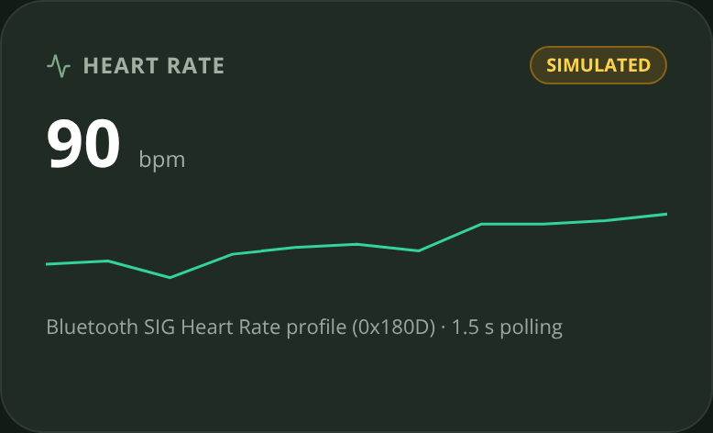
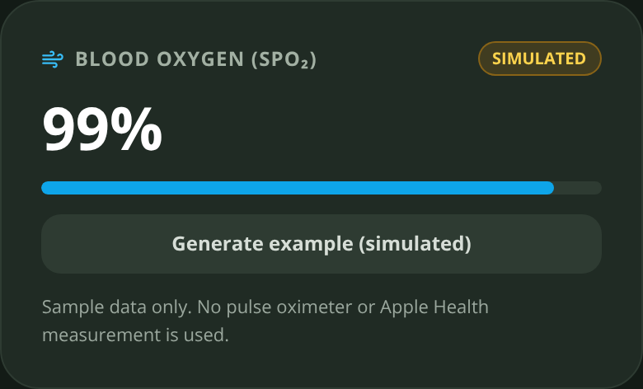
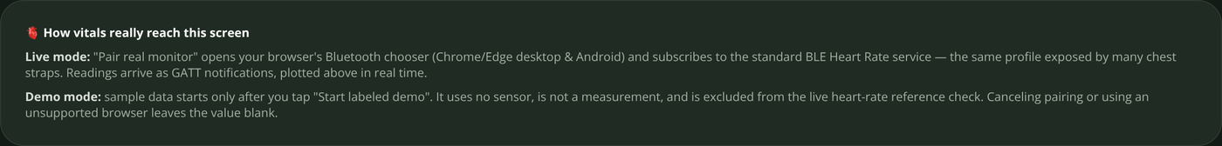
FEATURE · VITALS & TELEHEALTH
Real Bluetooth, honest labels
Web Bluetooth subscribes to the standard Heart Rate service 0x180D / characteristic 0x2A37 and parses the flags byte for 8- or 16-bit BPM.
Live sparkline, SpO₂ and blood-pressure cards. Every value carries a LIVE BLE or SIMULATED chip — and the same label travels into the CSV export.
Cancel the pairing dialog and the card stays blank. Simulated data appears only after you tap "Start labeled demo".
A generation counter discards late notifications from an old connection, so a stale sensor can never paint a new card.
iPhone: CoreBluetooth (including Garmin broadcast HR) plus read-only HealthKit heart rate, SpO₂, blood pressure and workouts, with a Swift Charts trend.
Range check (50–110 bpm) runs on live data only and is informational — not triage.
src/lib/bluetooth.js — Bluetooth SIG Heart Rate Measurement (0x2A37)
const flags = dv.getUint8(0) // bit 0 → 16-bit BPM
const bpm = flags & 0x1 ? dv.getUint16(1, true) : dv.getUint8(1)
CareSphere AI · Congressional App Challenge 2026
9 / 19
Notes:
This is real Web Bluetooth: the app subscribes to the standard heart-rate characteristic and parses the flags byte. Every card is labeled LIVE BLE or SIMULATED, and if you cancel pairing nothing is invented. On iPhone, CoreBluetooth and HealthKit feed the same honest pipeline.

Slide 10
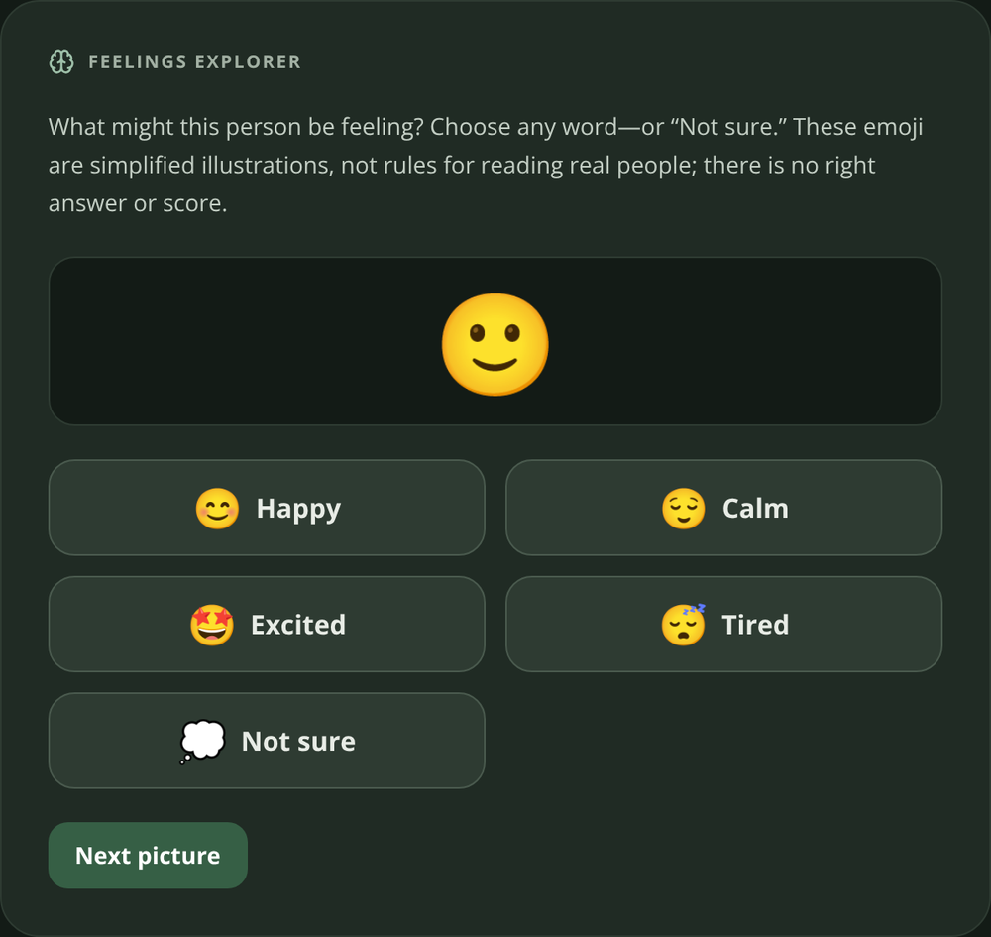
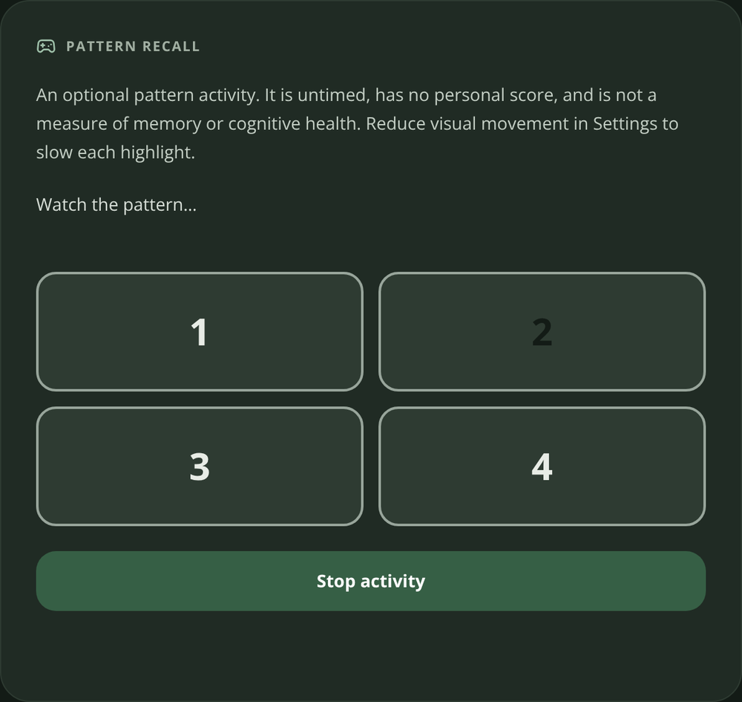
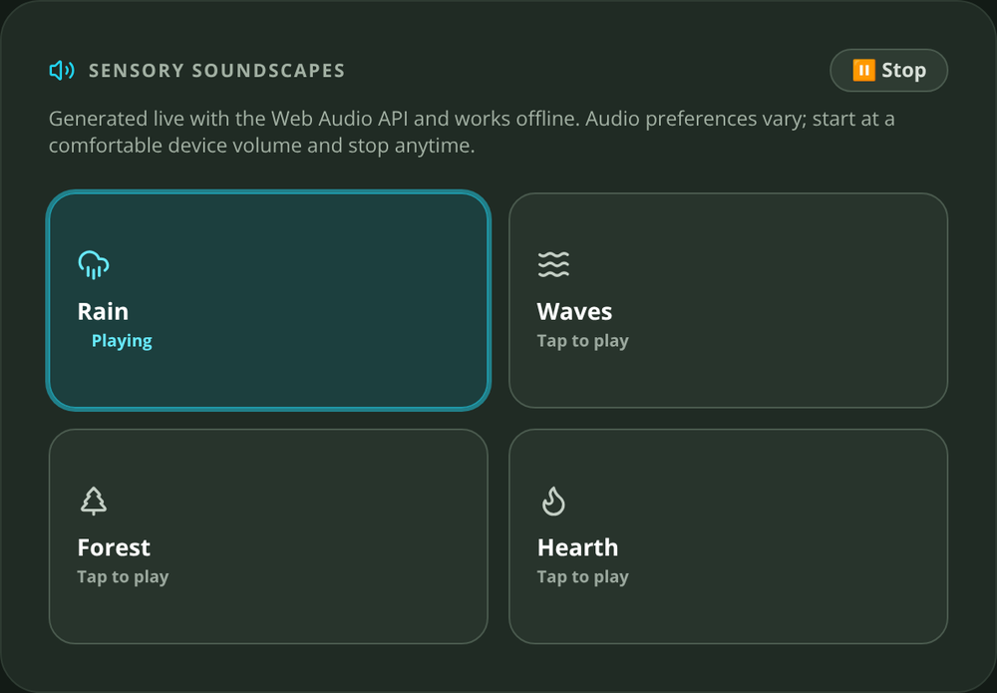
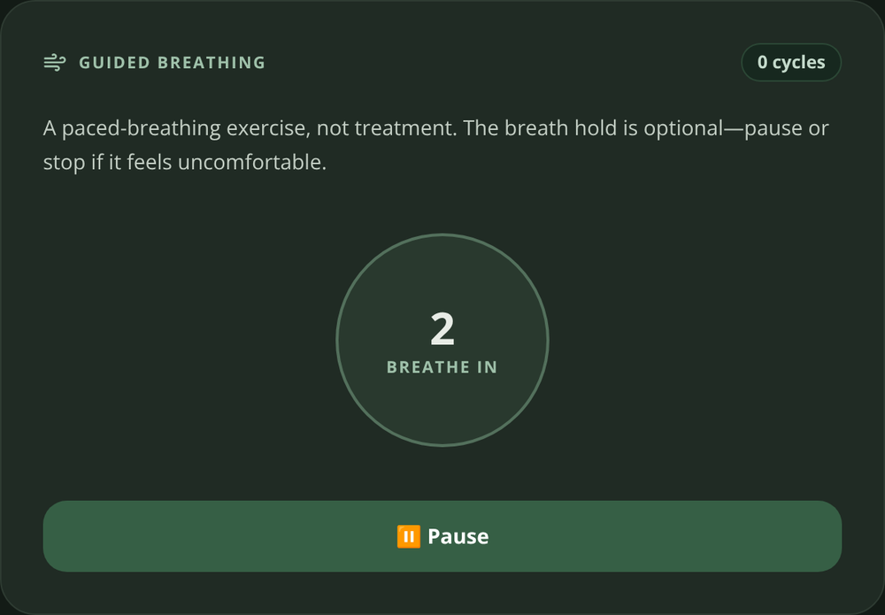
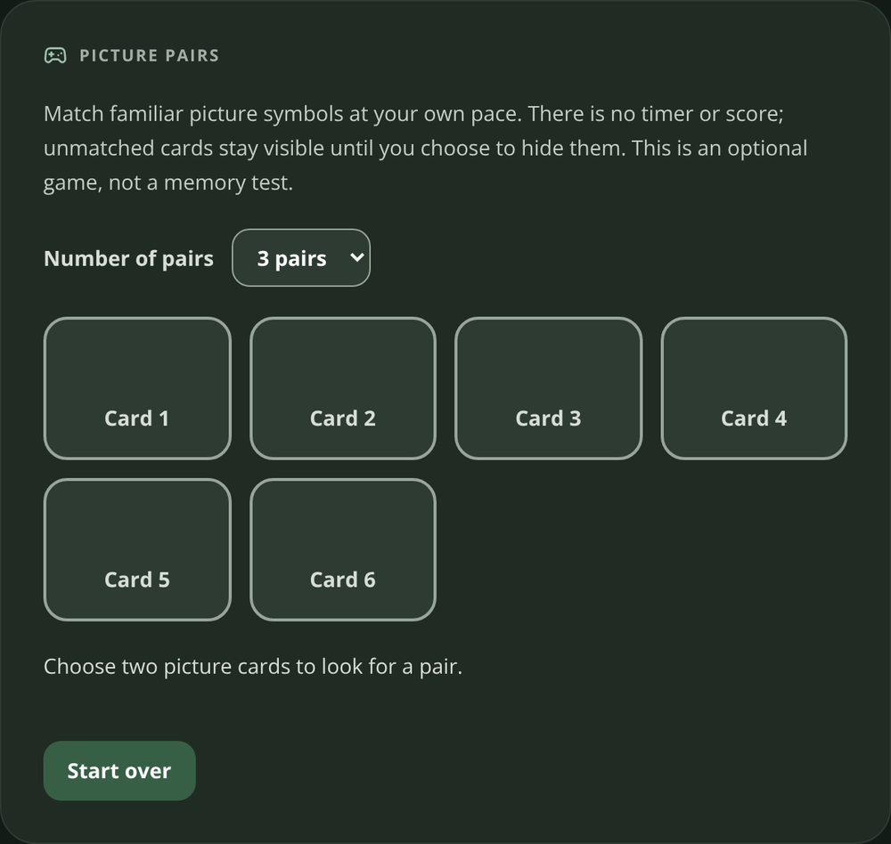
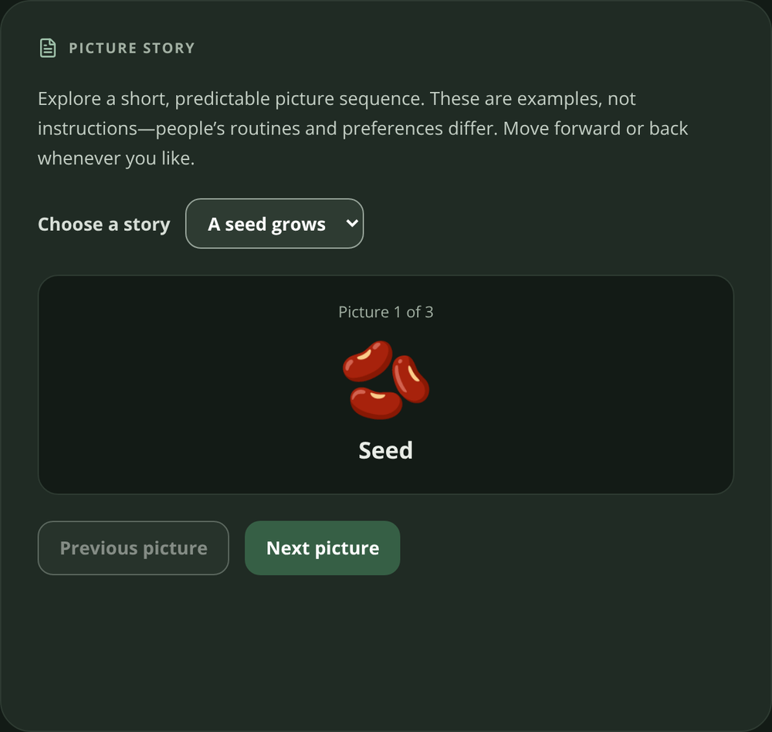
FEATURE · ACTIVITIES (THERAPY & SENSORY)
Sensory and memory tools designed for autistic and older users
Feelings Explorer, Pattern Recall, Picture Pairs, Picture Story — untimed, unscored, no auto-advance, gentle confirmations only.
Four soundscapes — rain, waves, forest, hearth — synthesized live with the Web Audio API: filtered noise beds, slow LFO swells and randomly scheduled birdsong or crackle. Zero audio files; works offline.
Guided 4-4-6 breathing with a soft expanding ring; "reduce visual movement" slows every highlight and animation.
Grounded in AASPIRE guidance: consistent navigation, plain language, multiple palette and contrast choices.
Non-clinical by design — presented as calming and engagement tools, never as therapy outcomes or cognitive measures. On iPhone the same scenes are rendered live by an AVAudioEngine source node.
Picture Pairs
Picture Story
CareSphere AI · Congressional App Challenge 2026
10 / 19
Notes:
Activities are untimed and unscored. The four soundscapes are generated live with the Web Audio API — filtered noise, slow swells, procedural birdsong and crackle — so there are no audio files and everything works offline. The breathing tool uses a 4-4-6 rhythm.

Slide 11
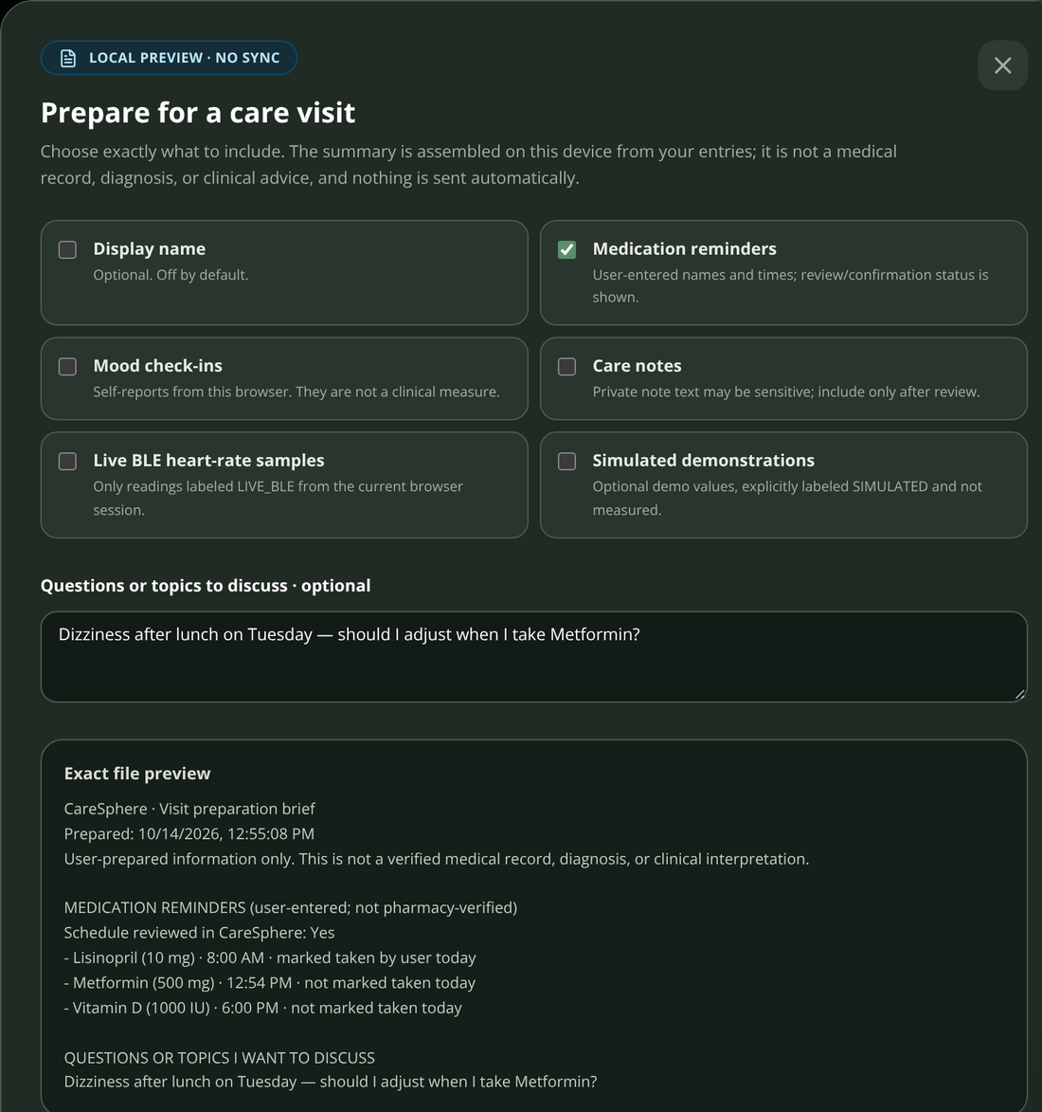
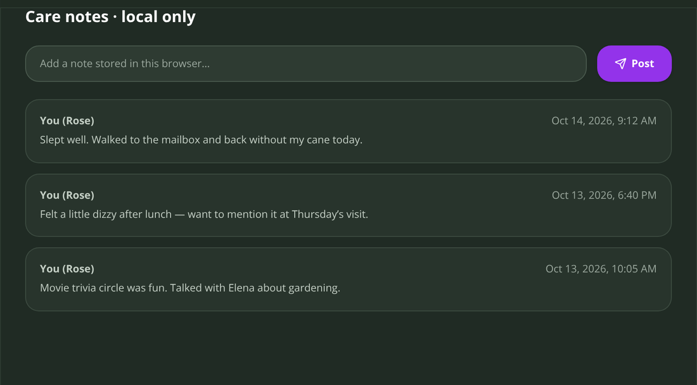
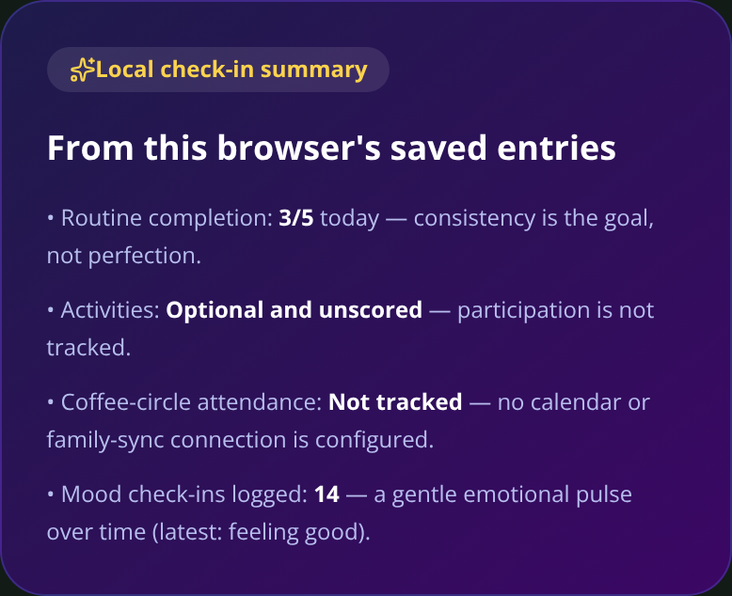
FEATURE · CARE CIRCLE & VISIT PREP
A visit brief the user controls — field by field
Care notes for family and helpers stay on the device — encrypted, exportable, erasable.
Visit brief: tick exactly which fields to include (routines, mood, medication self-reports, notes, vitals) and see the exact text before you save it.
Simulated data is excluded unless you opt in — and then it is clearly labeled as simulated.
Saved as a .txt download on the web; on iPhone it goes through the system share sheet with 7/30/90-day filters.
Nothing is emailed or uploaded. You hand the brief to the clinician yourself.
Not a medical record: the brief says so in its own header.
Care notes and the local check-in summary are computed from this device's entries only — nothing is synced.
CareSphere AI · Congressional App Challenge 2026
11 / 19
Notes:
The visit brief lets the user choose every field, preview the exact text, and save or share it themselves. Simulated data is excluded unless they opt in, and even then it is labeled. Nothing is uploaded anywhere.

Slide 12
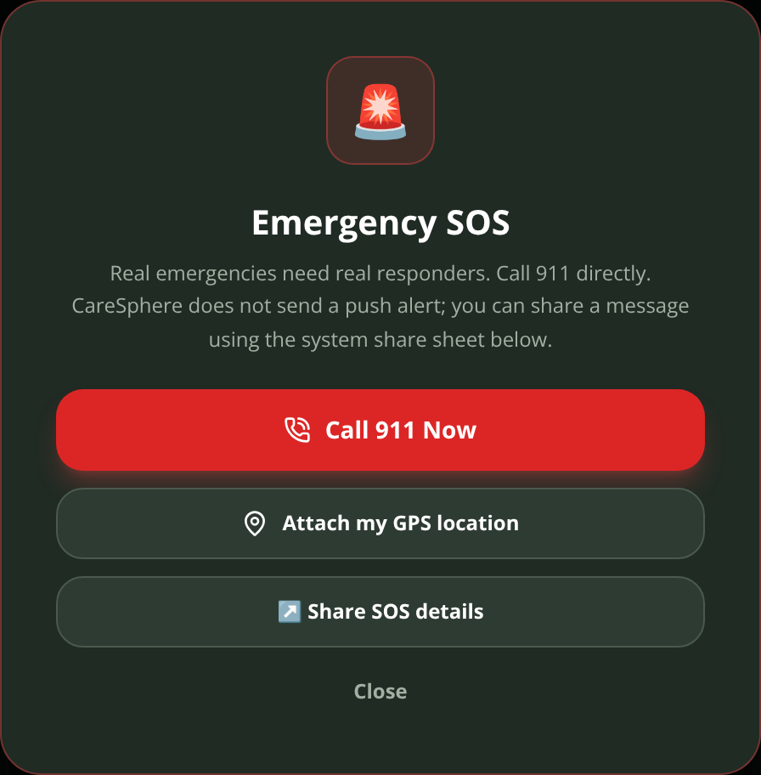
FEATURE · SAFETY
SOS and a support check-in that calms first and never panics
SUPPORT CHECK-IN (iPHONE, OPT-IN) — DETERMINISTIC RULES, NO AI DECIDES
1 · Trigger
2 · Are you moving?
3 · How do you feel?
Live BLE heart rate above 110 bpm for 90 s (15 s gap resets) — or "I'm stressed" — or a flagged Health Guide question.
Exercise or stairs? Then it's expected — the flow ends with a friendly note.
Plain-language options, big buttons, no timer.
4 · Breathe together
5 · Check again
6 · You choose
Three cycles of 4-4-6 paced breathing with a calm ring.
Better? Done. Still struggling? Offer help — never assume.
Text a caregiver (opens Messages — you tap Send), open a private video room, or call 911.
SOS: one-tap tel:911 link, optional GPS coordinates, and a share-sheet message to contacts you pick.
CareSphere never claims a message was delivered — there is no push backend.
Why rules instead of AI? Safety decisions must be explainable and testable. The thresholds, the 30-minute cooldown and the opt-in switch live in plain Swift (CareSupportCoordinator), and the heart-rate trigger only uses live sensor data — never simulated values.
CareSphere AI · Congressional App Challenge 2026
12 / 19
Notes:
Safety is deliberately boring: a deterministic flow. If a live heart-rate stays above 110 for 90 seconds, or the user taps "I'm stressed", the app asks whether they are moving, how they feel, breathes with them, checks again, and only then offers a text, a video room or 911. The user always taps Send.

Slide 13
FEATURE · HEALTH GUIDE (IPHONE)
An AI health guide that never phones home
Your question
Safety gate
Local sources
On-device model
Answer + sources
Typed or dictated. Stays on the phone.
Deterministic phrase check for self-harm or poisoning → crisis resources first, no search, no inference.
MedlinePlus Health Topics XML (NLM) downloaded on request · optional Wikipedia ZIM via a Kiwix server on your private Wi-Fi.
Qwen2.5-1.5B-Instruct, Q4_K_M GGUF (~1.1 GB) run by llama.cpp through LlamaSwift — optional download.
Plain-language answer with source links. Labeled educational — not diagnosis. Read aloud by Kokoro TTS if enabled.
[Drop your iPhone screenshot of the Health Guide tab here — Simulator or device]
Zero cloud calls. There is no API key anywhere in the project; inference is isolated in one Swift actor and the model is freed after each answer to give memory back to the phone.
Everything is optional and checked. The app works without the model, the MedlinePlus library or Kokoro; downloads show their size, GGUF headers are validated and the voice pack is CRC-checked before use.
Reference-first. Matching MedlinePlus topics appear even when no model is installed, so the guide is useful on day one.
ios/CareSphere/Services/LocalAssistantService.swift
contextParameters.n_ctx = 2048 // bounded prompt + answer window
prompt = "<|im_start|>system…<|im_start|>user…<|im_start|>assistant\n" // ChatML
CareSphere AI · Congressional App Challenge 2026
13 / 19
Notes:
The Health Guide answers health questions without the internet. A deterministic safety gate runs first; then MedlinePlus topics and an optional local Wikipedia are searched; then a 1.5-billion-parameter Qwen model runs on the phone itself through llama.cpp. There is no API key in the project.

Slide 14
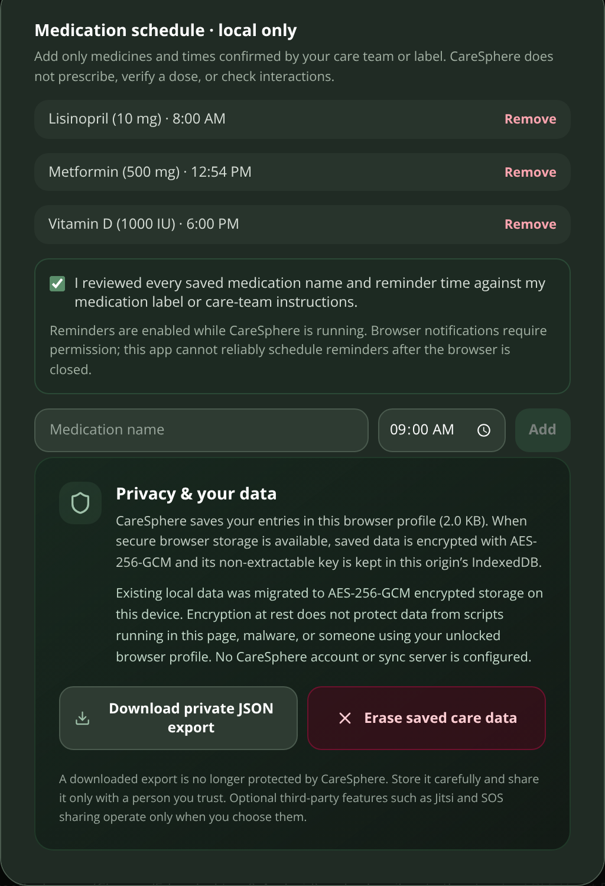
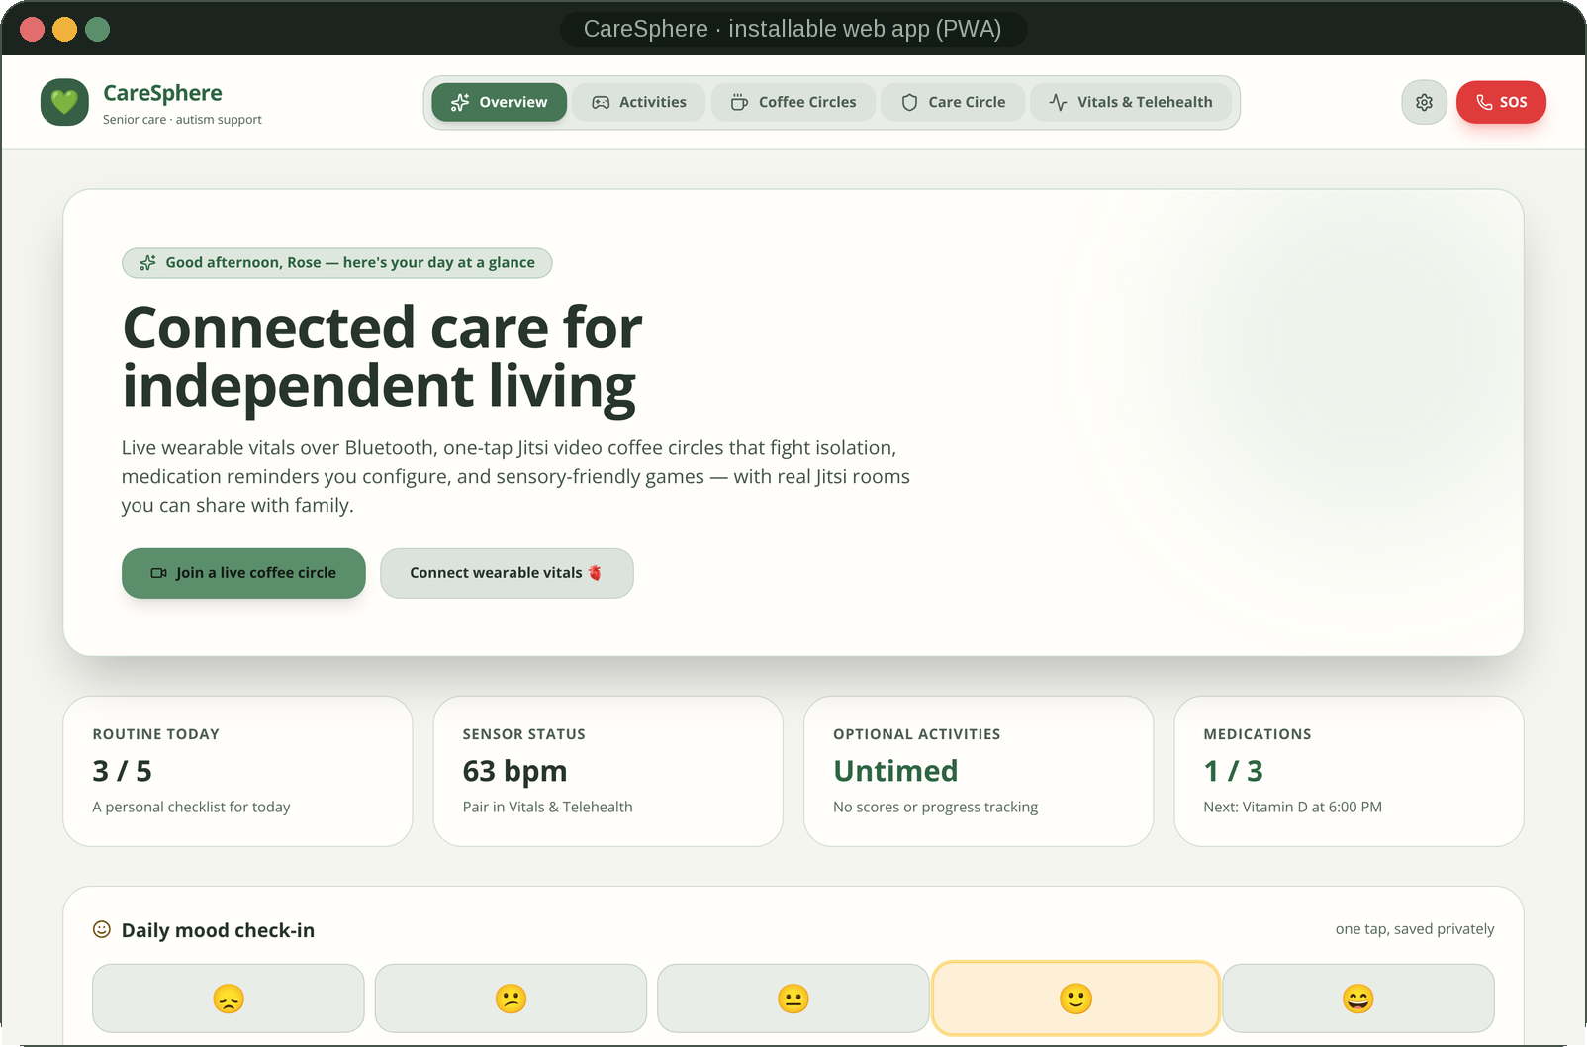
PRIVACY & ACCESSIBILITY
Private by architecture, accessible by default
Privacy
Accessibility
No account. No sync server. No analytics SDK. Nothing to breach.
AES-256-GCM encryption at rest. Web: a non-extractable Web Crypto key stored in IndexedDB. iPhone: a CryptoKit key in the Keychain (this-device-only), Complete File Protection, excluded from backups.
Legacy plaintext data is migrated into the encrypted store automatically, then removed.
Face ID / Touch ID lock with an opaque privacy screen in the app switcher.
Export everything as JSON or erase it — one tap each, in Settings.
Text size A / A+ / A++ on the web; Dynamic Type on iPhone.
Themes: calm charcoal, warm light, or follow the device — plus a high-contrast mode.
Reduce visual movement, spoken reminders, big tap targets.
ARIA roles, focus management and Escape-to-close on the web; VoiceOver labels on iPhone.
CareSphere AI · Congressional App Challenge 2026
14 / 19
Notes:
Everything is encrypted at rest with AES-256-GCM — a non-extractable Web Crypto key on the web and a device-only Keychain key on iPhone. There is no account and no server. Accessibility is built in: three text sizes, warm-light and high-contrast themes, reduced motion and spoken reminders.

Slide 15
HOW IT'S BUILT
Two native-feeling clients, zero servers
Web app (PWA)
iPhone app (Swift)
Engineering practice
React 18 · Vite 8 · Tailwind CSS 3
Web Bluetooth (GATT Heart Rate)
Web Audio soundscapes
Web Crypto AES-256-GCM + IndexedDB
Notifications · Speech Synthesis · Geolocation
Jitsi External API (WebRTC)
Service worker — installable, offline
SwiftUI · iOS 16+ · XcodeGen
HealthKit · CoreBluetooth · Swift Charts
CryptoKit · Keychain · LocalAuthentication
UserNotifications · AVFoundation · MapKit
JitsiMeetSDK 13.1 · ZIPFoundation
llama.cpp (LlamaSwift) — Qwen2.5 1.5B
Sherpa-ONNX — Kokoro TTS
17 automated tests (node:test): storage, CSV escaping, encryption, visit brief
GitHub Actions CI for web and iOS builds
Release gate: manual dispatch + version-matching tag
Docs: encryption, safety flow, accessibility, roadmap
Honest-labeling rules enforced in code, not copy
11,400+
7,741
3,420
17 / 17
2
0
lines of source
Swift · 32 files
JS / JSX / CSS
tests passing
CI workflows
servers · accounts · trackers
CareSphere AI · Congressional App Challenge 2026
15 / 19
Notes:
[2:05–2:17] The web app is React and JavaScript with Web Bluetooth, Web Audio and Web Crypto; the iPhone app is Swift and SwiftUI with HealthKit, CoreBluetooth, CryptoKit and llama.cpp — eleven thousand lines of code, seventeen automated tests, zero servers.

Slide 16
TECHNICAL CHALLENGES
Four problems that took the longest — and how I solved them
CHALLENGE 1
CHALLENGE 2
Making Bluetooth honest
Encrypting data inside a browser
Web Bluetooth delivers GATT notifications asynchronously, so a cancelled pairing or a late callback from an old sensor could leave misleading numbers on screen. I parse the Heart Rate flags byte (8- vs 16-bit BPM), tag each sample LIVE BLE or SIMULATED at the source, and keep a connection generation counter so stale notifications are dropped. Cancelling the chooser never starts a demo stream.
localStorage is plaintext. I rebuilt storage on AES-256-GCM via Web Crypto with a non-extractable key kept in IndexedDB and authenticated data bound to the store name, then wrote a migration that decrypts legacy JSON, re-encrypts it and deletes the plaintext. node:test covers round-trips, tampered ciphertext and weak-key rejection.
CHALLENGE 3
CHALLENGE 4
Running a language model on an iPhone
Soundscapes without audio files
No cloud allowed. I integrated llama.cpp through LlamaSwift, picked Qwen2.5-1.5B Q4_K_M for memory headroom, built the exact ChatML prompt (a missing assistant-prefix newline produced empty answers), grew the token buffer safely, unload the Kokoro voice before loading the model, isolated inference in one actor and release the model after every answer.
Bundled MP3s bloat a PWA and break offline use. Each scene is synthesized in Web Audio: noise buffers through high/low-pass filters, LFO-modulated gain for swells, and randomly scheduled oscillator chirps or band-passed bursts for birdsong and fire crackle — a few kilobytes of code that can play forever.
CareSphere AI · Congressional App Challenge 2026
16 / 19
Notes:
[2:17–2:25] The hardest problem was keeping Bluetooth honest: a late notification from an old sensor could repaint a new card, so I label every sample at the source and drop stale connections with a generation counter.

Slide 17
WHAT MAKES IT DIFFERENT
Complements the tools families already use — and refuses to pretend
WHAT IT DOES
HOW CARESPHERE DIFFERS
Medisafe
Medication schedules, caregiver alerts and interaction checks — cloud account required.
Reminders stay local; no interaction checker, because that needs a licensed drug database and a clinical review.
Apple Health
Secure on-device record with user-controlled sharing.
CareSphere reads HealthKit with permission and labels sources — it never claims to be the clinical record.
MyChart
Official records and visit summaries from a health system.
The visit brief is user-authored prep material and says so in its header.
CaringBridge
Private family update pages with accounts and hosting.
Care Circle has no account or host; family video happens in real Jitsi rooms you invite people to.
The combination is the product: social connection + routines + honest wearable vitals + autism-friendly sensory tools + offline AI guidance + safety — in one calm app with no account, no server and no fabricated data.
What it is not: a medical device, a diagnosis tool, an emergency service or a replacement for a clinician — and it says so on every relevant screen.
CareSphere AI · Congressional App Challenge 2026
17 / 19
Notes:
Existing products each solve one slice — and almost all need an account and a cloud. CareSphere is the combination: connection, routines, honest vitals, autism-friendly tools, offline AI and safety, with no server at all. And it is honest about what it is not.

Slide 18
REFLECTION
What I learned — and what Version 2.0 will add
What I learned
Version 2.0
Honest engineering beats impressive demos. Labeling simulated data and refusing to invent readings shaped the whole architecture.
Accessibility is a design input, not a checkbox — reading the AASPIRE guidelines changed layouts, motion and colour choices early.
Privacy constraints breed creativity. "No cloud" forced me to learn Web Crypto, CryptoKit, llama.cpp and procedural audio.
Two platforms, one promise. Keeping React and SwiftUI behaviour identical (local-midnight resets, labels, exports) taught me to write the rules down first and test them.
Safety logic should be boring. Deterministic, documented flows are easier to review than clever ones.
Co-design sessions with autistic people, people living with dementia, caregivers and accessibility specialists — then iterate.
Real HealthKit and Bluetooth observations inside the visit brief, with 7/30/90-day filters on both platforms.
Non-diagnostic trends (sleep, activity, heart-rate ranges) computed only from real, source-labeled data.
Encrypted backup and restore across devices without a server — a passphrase-protected export file.
On-device VoiceOver and Dynamic Type testing, Spanish localization, and a TestFlight beta.
Deliberately not on the list: cloud sync, a clinician portal or a drug-interaction checker — not without clinical review and a licensed knowledge base.
CareSphere AI · Congressional App Challenge 2026
18 / 19
Notes:
[2:25–2:43] I learned that honest engineering beats impressive demos, and that accessibility is a design input, not a checkbox. Version 2.0 starts with co-design sessions with autistic people, people living with dementia and caregivers, adds real sensor data to the visit brief, and encrypted backup that still needs no server.

Slide 19

Care that stays yours.
CareSphere AI keeps older adults connected, autistic users calm and caregivers informed — without an account, a server or a single fabricated number.
Source code & docs
[Student Name] · [School] · [email@example.com]
github.com/engineer2025-sudo/Care
Thank you — and thank you to the judges and the Congressional App Challenge.
Demo video: [YouTube link]
Install guide: DOWNLOAD.md in the repo
SOURCE ON GITHUB
BUILT WITH SWIFTUI + REACT
MADE IN [CITY], CALIFORNIA
Congressional App Challenge 2026
Notes:
[2:43–2:52] CareSphere AI — care that stays yours. The code and install guide are on GitHub. Thank you.

