Slide 1


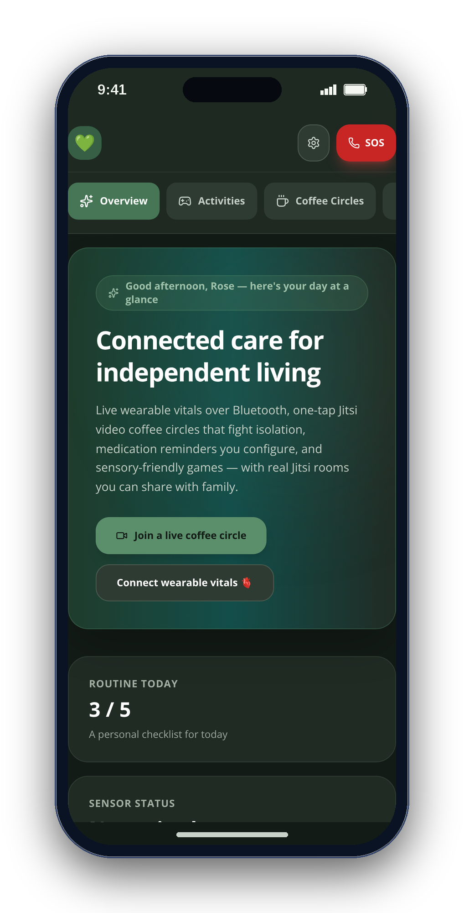
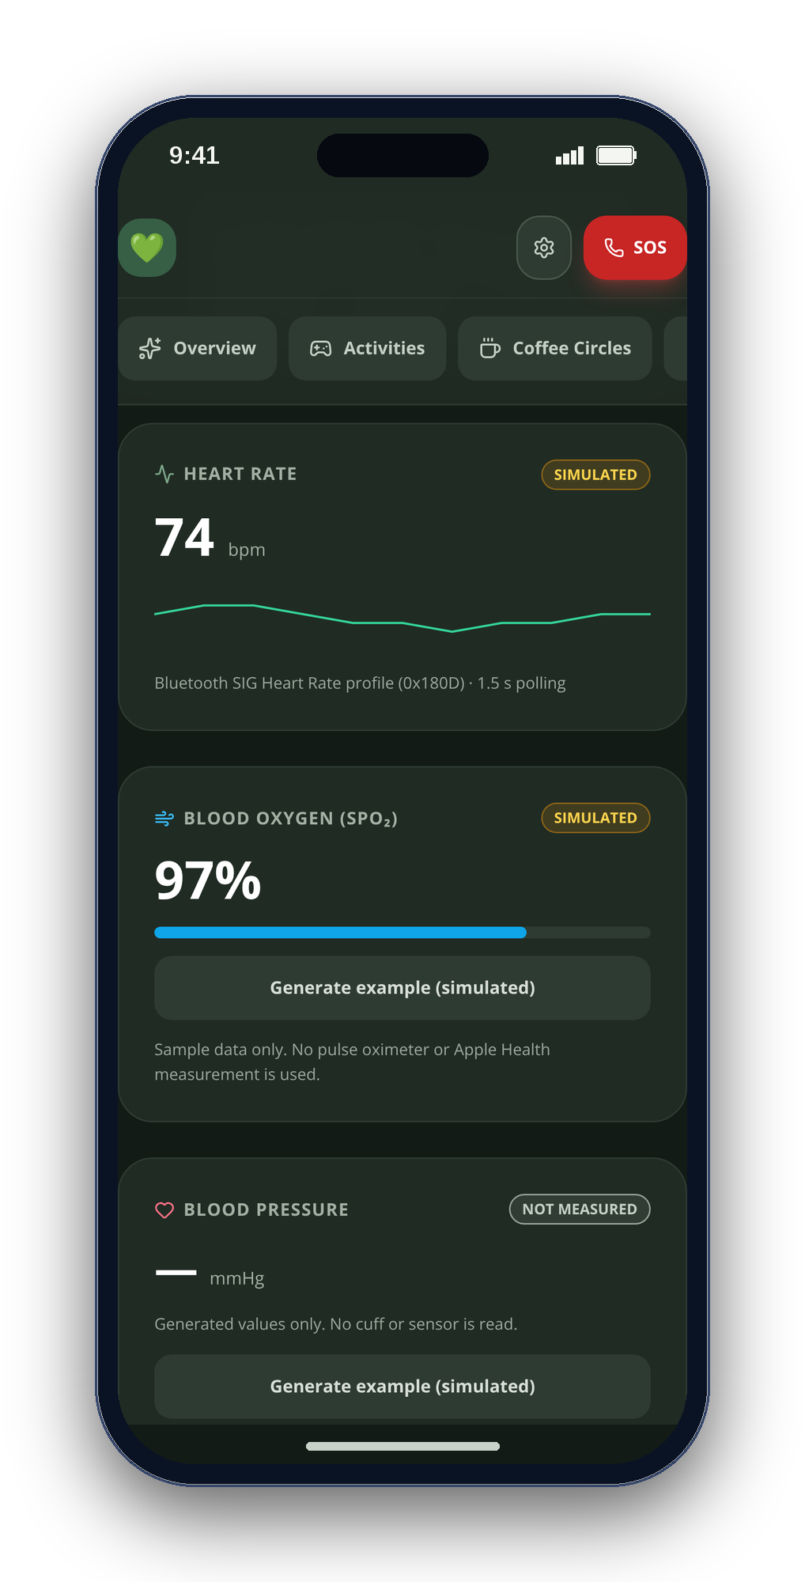
CONGRESSIONAL APP CHALLENGE 2026 · [CA-XX]
CareSphere AI
Connected care for independent living
A private care companion for older adults, autistic people and the families who care for them.
[Student Name]
[School] · [City], California · [email@example.com]
Notes:
[0:00–0:14] Hi, I'm [NAME], a [GRADE] at [SCHOOL] in [CITY], California. This is CareSphere AI — a private care companion for older adults, autistic people and their families, on iPhone and on the web.

Slide 2
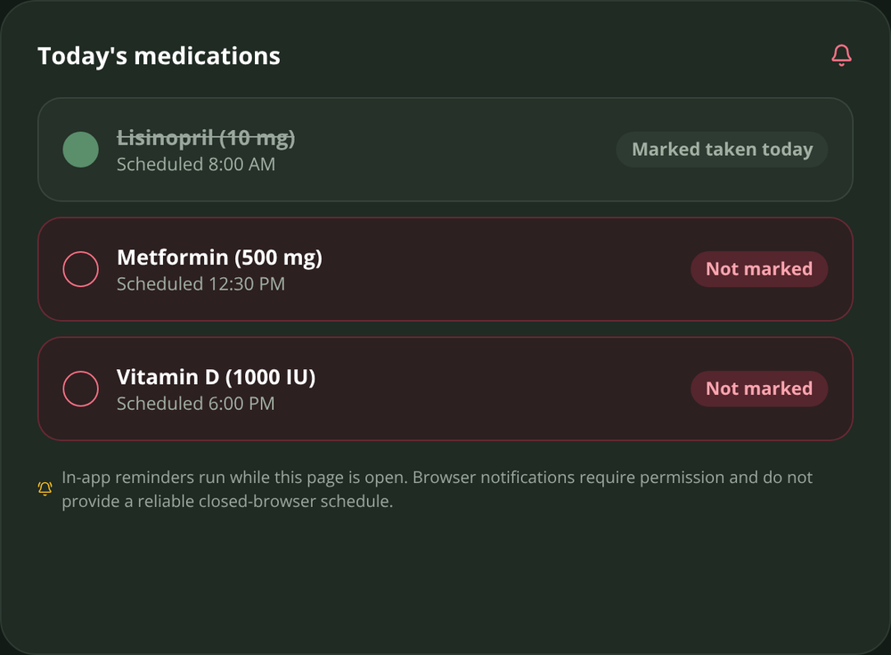
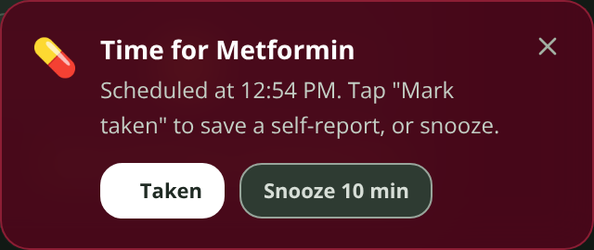
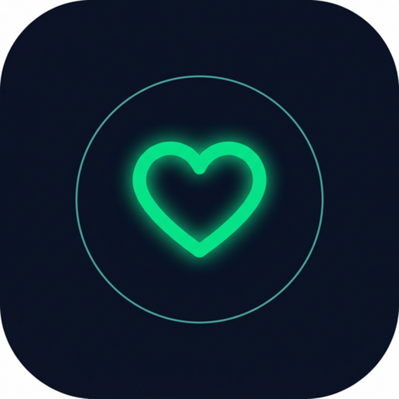
02
WHY I BUILT IT
“
[Your story in one or two sentences — e.g. My grandmother lives alone, and every call started the same way: did you take your pills? did you talk to anyone today?]
— [Student Name], [grade], [School]
So I built the app I wished she had: calm, honest, and private by design.
CareSphere AI
Notes:
[0:14–0:26] (Your story in one sentence — name a specific person, a specific moment. E.g.: My grandmother lives alone, and every call started the same way: did you take your pills? did you talk to anyone today?) So I built the app I wished she had: calm, honest, and private by design.

Slide 3
03
THE PROBLEM
Growing older — or growing up autistic — too often means facing care alone.
1 in 4
1 in 31
50%
older adults are socially isolated
children are autistic
of long-term medicines aren’t taken as prescribed
NASEM · 2020
CDC · 2025
WHO
Behind them: 63 million family caregivers. AARP & NAC, 2025
CareSphere AI
Notes:
[0:26–0:39] One in four older adults is socially isolated — a twenty-nine percent higher risk of early death. One in thirty-one children is autistic. Half of long-term medications aren't taken as prescribed. And sixty-three million family caregivers hold it all together.

Slide 4
04
TODAY
Four apps. Four accounts. Four clouds.
THE NEED
TODAY
CARESPHERE
Medication reminders
Medisafe account · cloud
Overview tab
Video calls
FaceTime account · cloud
Coffee Circles · Jitsi
Health record
MyChart account · cloud
Visit brief · .txt
Family updates
CaringBridge account · cloud
Care Circle notes
Total
4 apps · 4 accounts · 4 clouds
1 app · 0 accounts · 0 clouds
None of the four was designed for autistic users.
CareSphere AI
Notes:
[0:39–0:47] Today a family juggles four apps — four accounts, four clouds — and none of them was designed for autistic users.

Slide 5
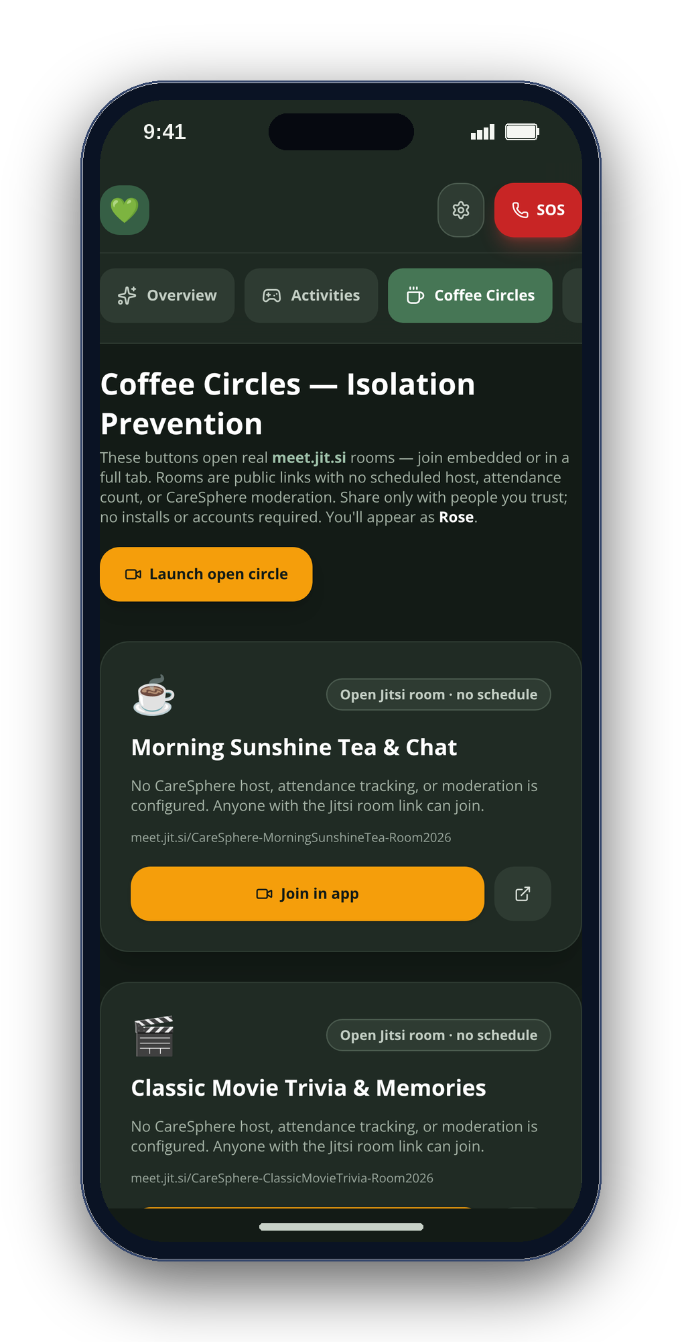
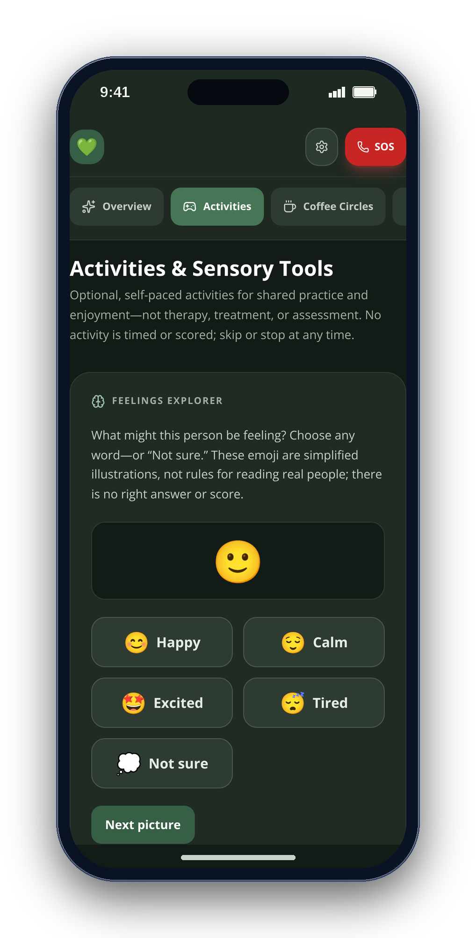
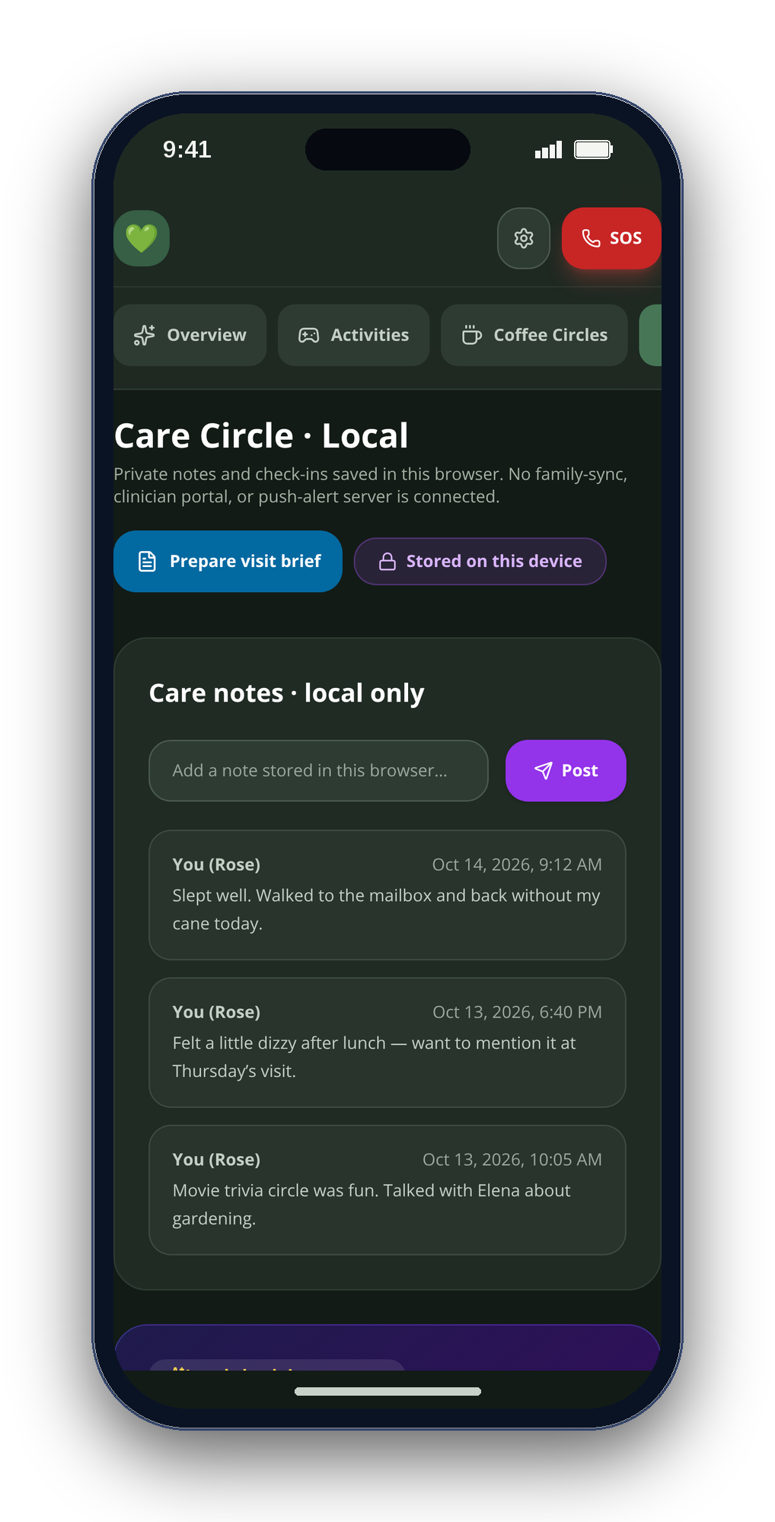
05
THE SOLUTION
One calm app. Five tabs. Zero servers.
OVERVIEW
ACTIVITIES
COFFEE CIRCLES
CARE CIRCLE
VITALS
CareSphere AI
Notes:
[0:47–0:57] CareSphere is one calm app with five tabs — Overview, Activities, Coffee Circles, Care Circle and Vitals — with no server behind any of it.

Slide 6
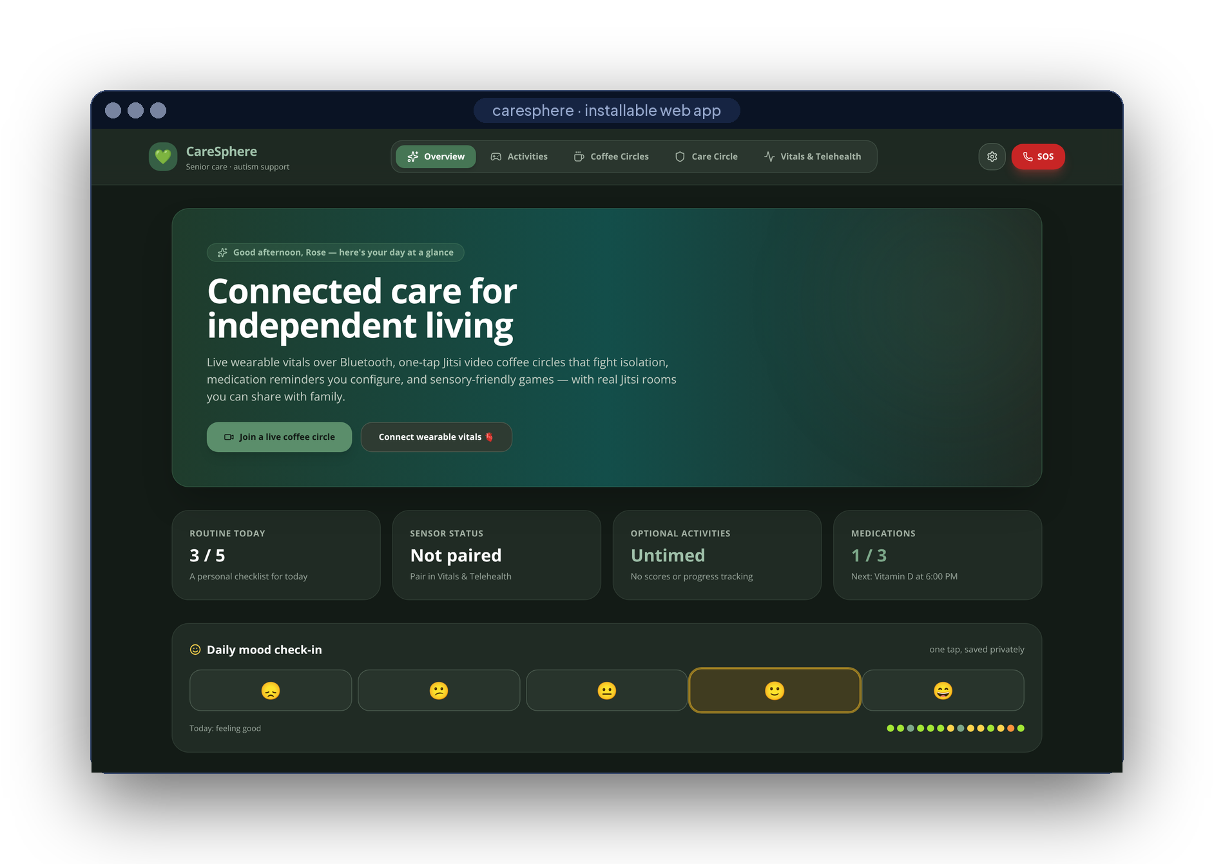
06
LIVE DEMO
Let’s see it.
SIX SHOTS · ONE TAKE
01
Mood check-in & routine
02
Reminder → Taken
03
Pair a sensor · export CSV
04
Pattern Recall · Rain
05
Join a Coffee Circle
06
Build the visit brief
SAME APP · TWO CLIENTS
CareSphere AI
Notes:
[0:57–1:42] Let me show you. (Switch to the screen recording — six shots, see VIDEO_SCRIPT.md: mood check-in and routine; medication reminder and Taken; Bluetooth pairing or the labeled demo plus Export CSV; Pattern Recall and the Rain soundscape; join a Coffee Circle; build and download a visit brief.)

Slide 7
07
WHAT MAKES IT DIFFERENT
Four rules, written into the code.
01
Never fabricate
every reading labeled where it is born
'LIVE_BLE' : 'SIMULATED'
02
Nothing sent automatically
a person always taps Send
navigator.share() · ShareLink
03
Calm by default
no timers, scores or auto-advance
Untimed · No scores
04
Private by architecture
no account, no server, encrypted
'AES-GCM', length: 256
CareSphere AI
Notes:
[1:42–1:53] What makes it different isn't a feature — it's four rules in the code: never fabricate a reading, never send anything automatically, calm by default, private by architecture.

Slide 8
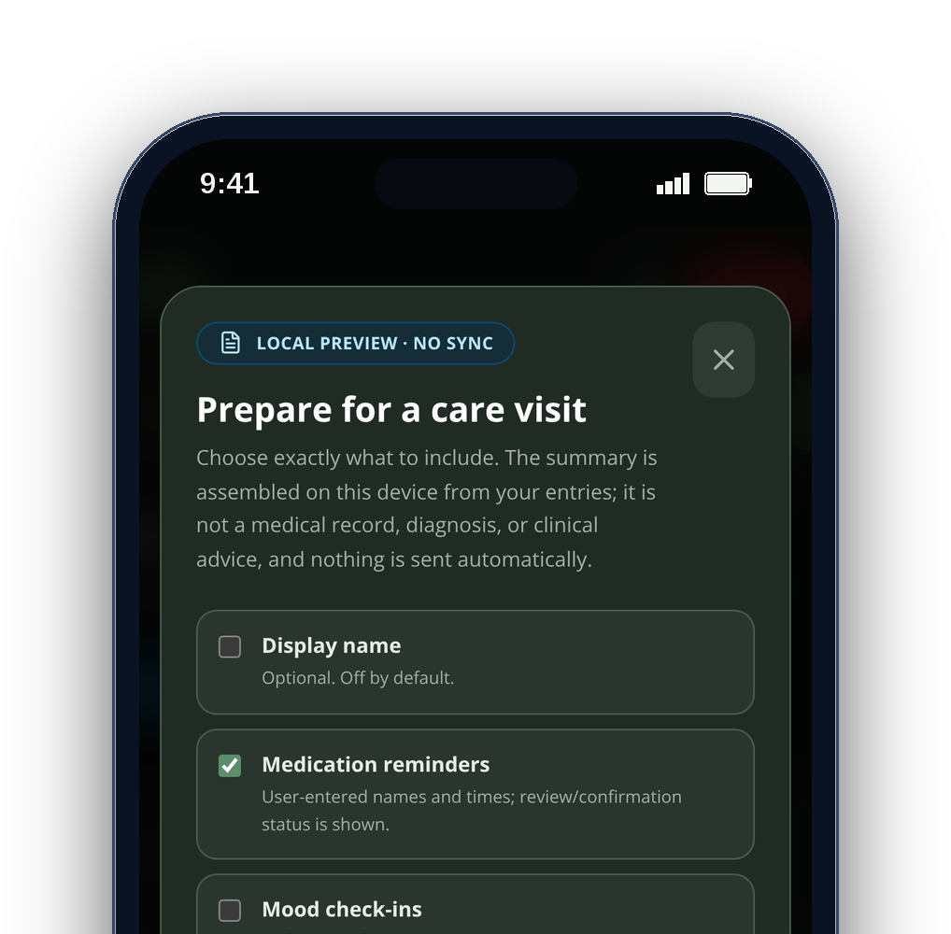
08
WHO IT’S FOR
Built for three people at once.
Older adults
Autistic teens & adults
Family caregivers
routines, reminders, real company
predictable, untimed, sensory-calm
notes and a brief they can trust
CareSphere AI
Notes:
[1:53–2:01] It's built for three people at once: older adults, autistic teens and adults, and the caregivers who support them.

Slide 9
09
PRIVACY
Everything stays on the device.
WHAT LEAVES THE DEVICE
ON THE DEVICE
Live video
only while you are in a Jitsi room
Vitals
Health Guide
Encrypted store
BLE 0x180D · HealthKit, read-only
Qwen2.5-1.5B · llama.cpp, offline
AES-256-GCM · Face ID lock
A visit brief
only when you tap Share
Activities
Visit brief
Coffee Circles
NEVER
Web Audio · untimed, unscored
fields you pick · exact preview
links to real Jitsi rooms
0
0
0
accounts
servers
trackers
CareSphere AI
Notes:
[2:01–2:12] Everything stays on the device: AES-256 encryption, Bluetooth and HealthKit read locally, and a 1.5-billion-parameter model that answers health questions offline. Zero accounts, zero servers, zero trackers.

Slide 10
10
HOW IT’S BUILT
Two clients. One promise. No server.
Web app
JAVASCRIPT
iPhone app
SWIFT
React 18
Vite 8
Tailwind 3
Web Bluetooth
SwiftUI
HealthKit
CoreBluetooth
Web Audio
Web Crypto
installable PWA
CryptoKit
Face ID
llama.cpp
Sherpa-ONNX
Jitsi SDK
11,400+
17 / 17
2
3
lines of code
tests passing
CI pipelines
public releases
CareSphere AI
Notes:
[2:12–2:23] It's React and JavaScript on the web, Swift and SwiftUI on iPhone — Web Bluetooth, HealthKit, CryptoKit and llama.cpp. Eleven thousand lines, seventeen tests, three public releases.

Slide 11
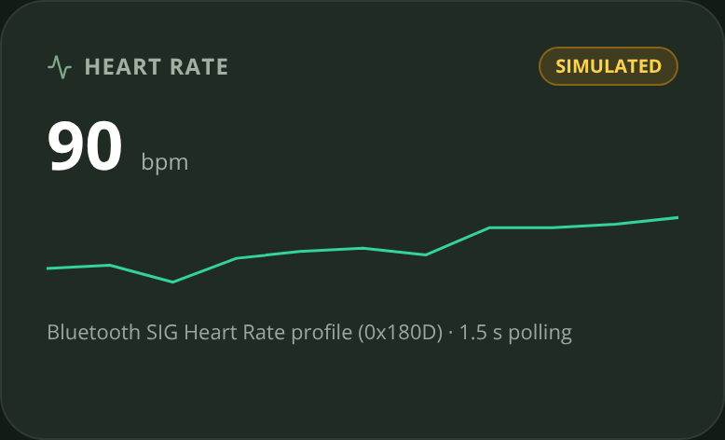
11
HARDEST PROBLEM
Making Bluetooth honest.
Heart-rate notifications arrive late and out of order — a stale sensor could repaint a new card with a wrong number.
src/lib/bluetooth.js · src/App.jsx
const flags = dv.getUint8(0)
const bpm = flags & 0x1
? dv.getUint16(1, true)
: dv.getUint8(1)
if (bpm > 20 && bpm < 250) onReading(bpm)
const source =
hrModeRef.current === 'live'
? 'LIVE_BLE' : 'SIMULATED'
if (generation !==
hrConnectionGenerationRef.current)
return
01
Parse the standard
service 0x180D · flags byte → 8/16-bit BPM
02
Label at the source
each sample is born LIVE or SIMULATED
03
Drop stale sessions
a generation counter ignores old pairings
CareSphere AI
Notes:
[2:23–2:35] The hardest problem was keeping Bluetooth honest: notifications arrive late and out of order, so I label every sample live or simulated at the source and drop stale sessions with a generation counter.

Slide 12
12
WHERE IT STANDS
Six weeks from first commit to v2.2.
First commit
v2.1
Next
repo created
release · Sep 28
co-design → TestFlight
Sep 2
Sep 16
Sep 30
Oct 14
v1.0 + v2.0
v2.2
first public releases
iOS + web, building in CI
NEXT · V2.0 OF THIS ENTRY
THEN
DELIBERATELY NOT
Co-design sessions with autistic people, people living with dementia and caregivers; TestFlight beta.
Sensor history in the visit brief · encrypted backup · Spanish · caregiver-paced reminders.
Cloud sync, a clinician portal or a drug-interaction checker — not without clinical review.
CareSphere AI
Notes:
[2:35–2:47] Version 2.0 starts with co-design sessions with autistic people, people living with dementia and caregivers, then a TestFlight beta and sensor history in the visit brief — still with no server. (Deliberately not planned: cloud sync, a clinician portal or a drug-interaction checker — not without clinical review.)

Slide 13
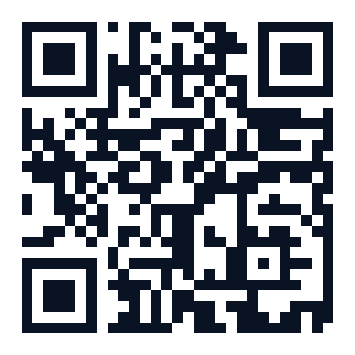
scan for source
Care that stays yours.
Connected, calm and private — with no account, no server and no fabricated number.
TRY THE WEB APP
READ THE CODE
WATCH THE DEMO
github.com/engineer2025-sudo/Care
[Student Name] · [email@example.com] · [School], [City], California
Demo video: [YouTube link]
Notes:
[2:47–2:53] CareSphere AI — care that stays yours. The code and install guide are on GitHub. Thank you.

