Slide 1


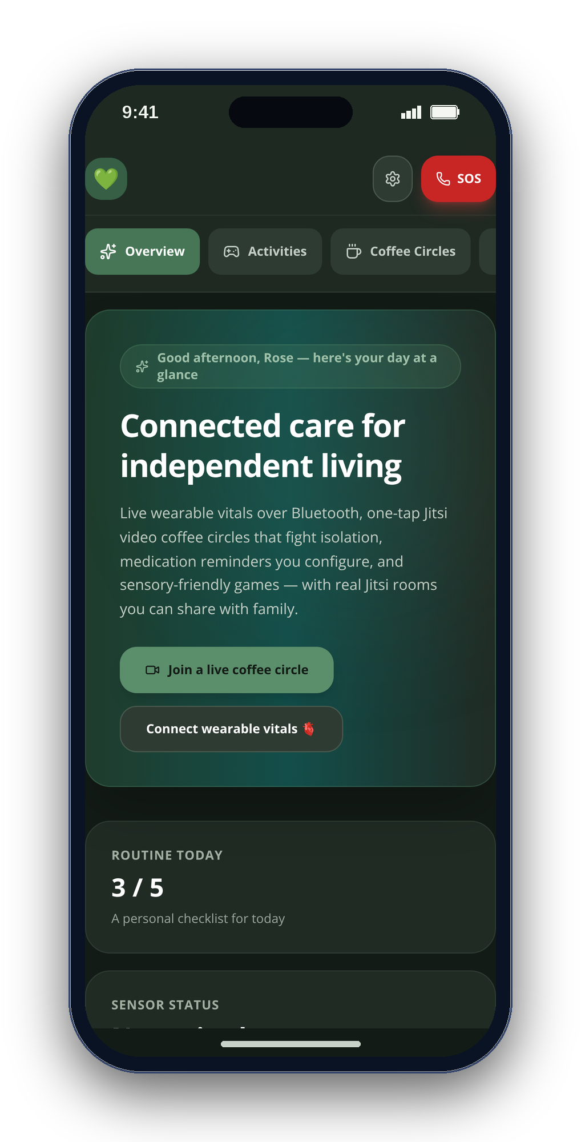
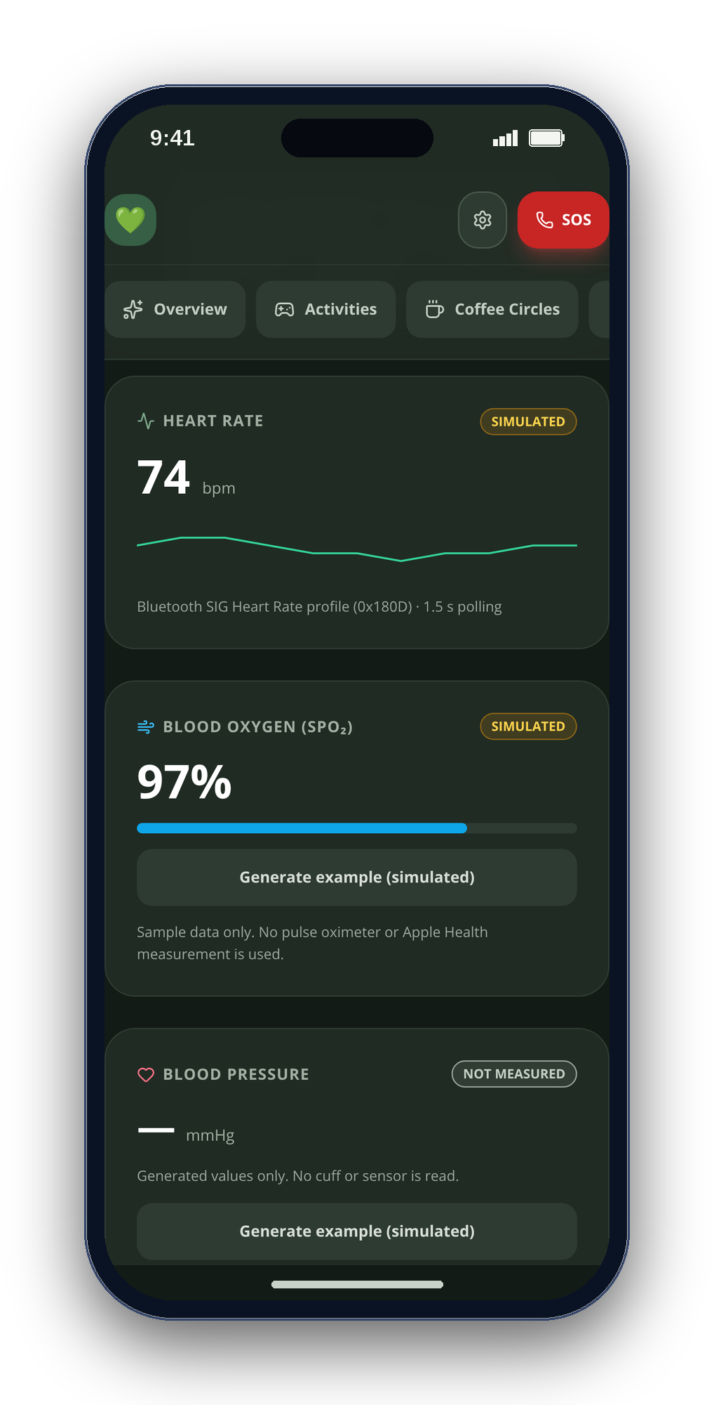
CONGRESSIONAL APP CHALLENGE 2026 · CA-10
CareSphere AI
Connected care for independent living
A private care companion for older adults, autistic people and the families who care for them.
Arnav Kochar
CA-10 · kochar4646@gmail.com
Notes:
I'm Arnav Kochar. CareSphere AI helps older adults, autistic people and their families manage everyday routines, enjoy self-paced activities, connect with others and prepare for care visits.
Real web app screenshots; seeded sample data. No AI-generated imagery. Native iOS features are identified separately. Research does not establish effectiveness of these activities.

Slide 2
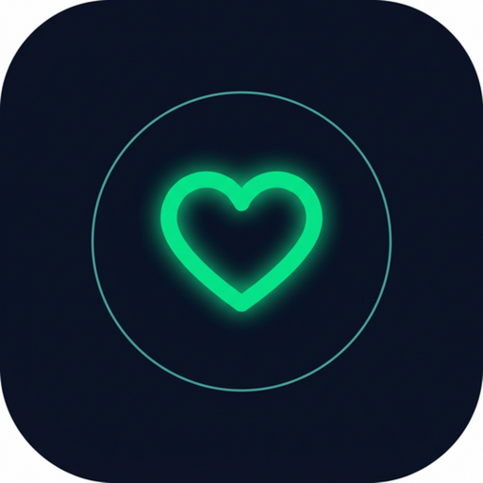
02
WHAT THE APP DOES
Daily support. Play, connect, prepare.
01
Activities & sensory tools
02
Everyday routines
Four self-paced games, breathing and optional soundscapes.
Mood check-ins, daily tasks and medication self-check-ins.
03
Human connection
04
Visit preparation
Coffee Circles open Jitsi video rooms; care notes stay local.
Choose notes and readings for a previewable visit brief.
For older adults, autistic people and the families who support them.
CareSphere AI
Notes:
There are four parts: activities and sensory tools; mood, routines and medication reminders; Coffee Circles for video conversations; and a visit brief built from information you choose. Here is what using them looks like.
Real web app screenshots; seeded sample data. No AI-generated imagery. Native iOS features are identified separately. Research does not establish effectiveness of these activities.

Slide 3
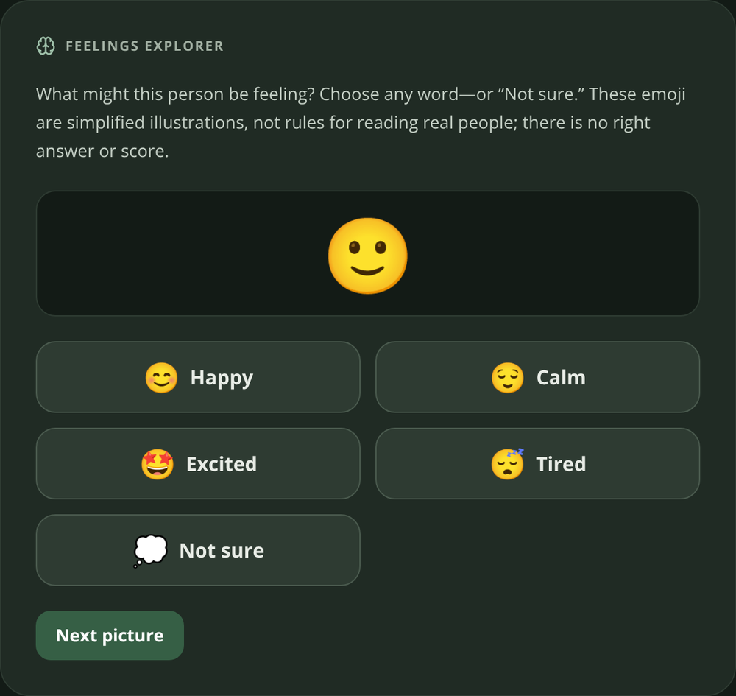
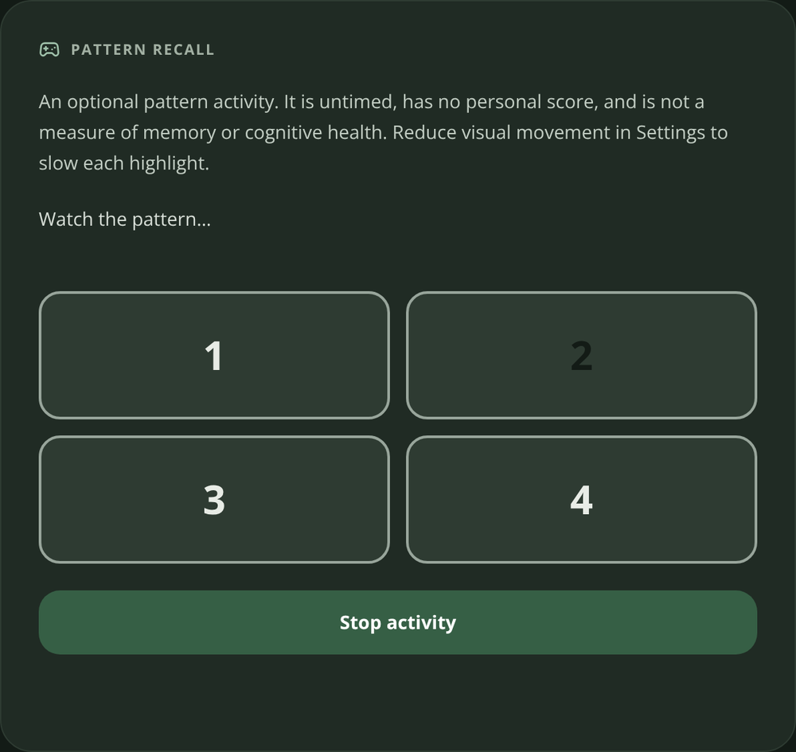
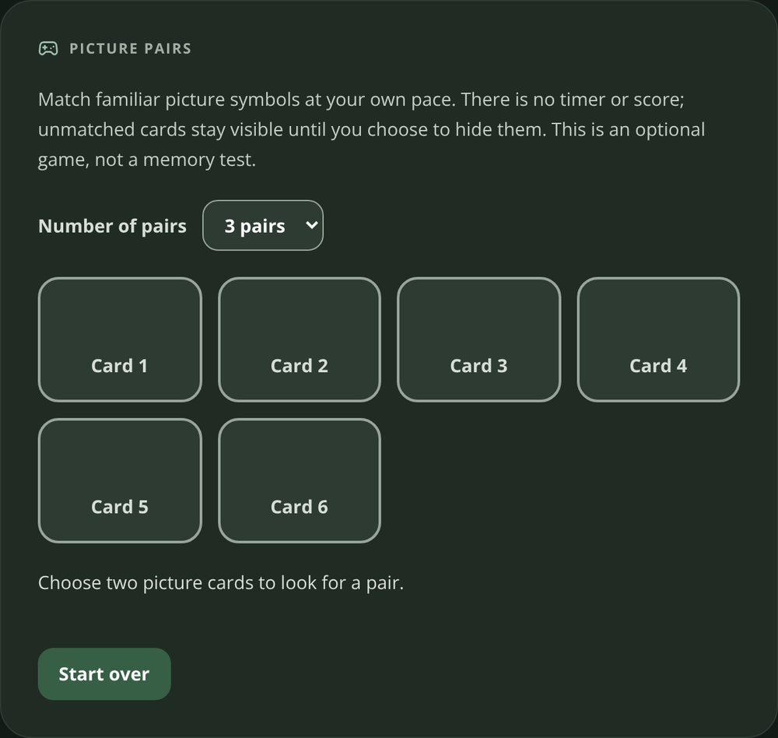
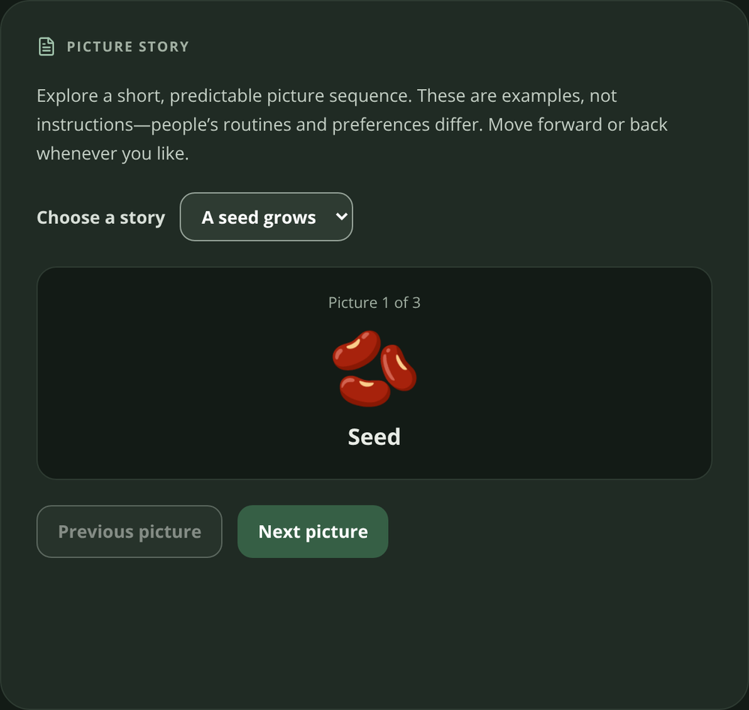
03
CORE FEATURE · GAMES
Four ways to play. At your own pace.
Feelings Explorer
Pattern Recall
Picture Pairs
Picture Story
Choose how you feel.
Watch, then repeat.
Reveal matching cards.
Explore a picture sequence.
No right or wrong answer.
Replay or stop anytime.
No countdown or score.
Advance when ready.
CareSphere AI
Notes:
Activities are a core feature. Feelings Explorer lets you choose a feeling without a right answer. Pattern Recall lets you repeat a sequence. Picture Pairs reveals matching cards, and Picture Story explores a sequence at your pace. These are untimed, unscored activities—not cognitive tests.
Real web app screenshots; seeded sample data. No AI-generated imagery. Native iOS features are identified separately. Research does not establish effectiveness of these activities.

Slide 4
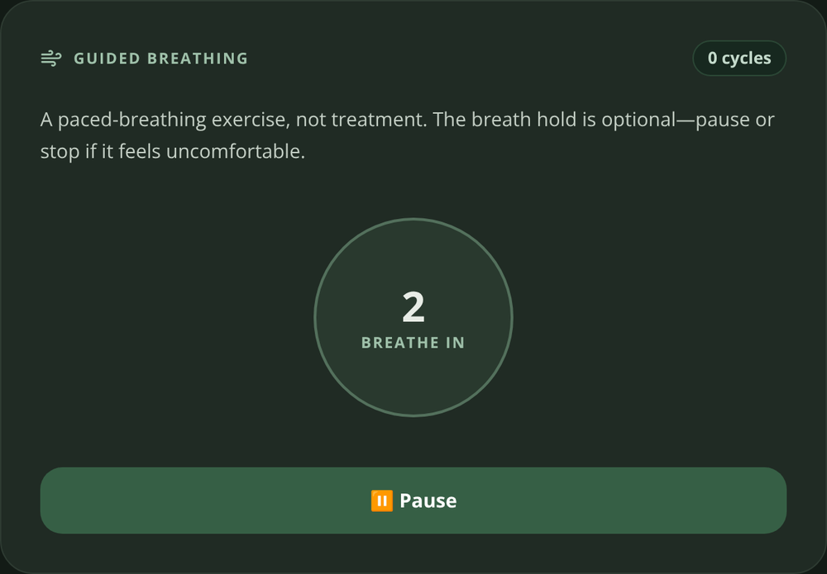
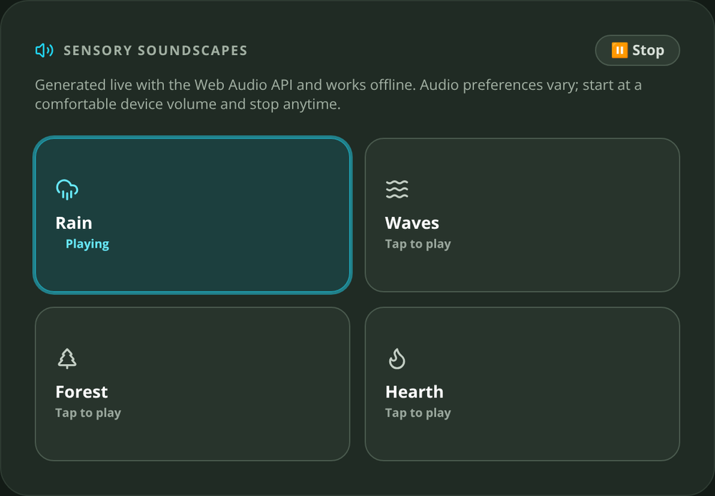
04
CORE FEATURE · SENSORY CHOICE
A quieter experience. On your terms.
Breathing
4 seconds in · 4 hold · 6 out. Start and pause yourself.
Soundscapes
Rain, ocean, forest and hearth. Sound starts only on request.
Accessibility
Text sizes, palette choices, high contrast and reduced motion.
CareSphere AI
Notes:
Breathing follows a four-four-six rhythm. You can start, pause or leave. Four optional soundscapes run through Web Audio. Text size, contrast, palette and motion settings let people choose a comfortable interface.
Real web app screenshots; seeded sample data. No AI-generated imagery. Native iOS features are identified separately. Research does not establish effectiveness of these activities.

Slide 5
05
RESEARCH → DESIGN DECISIONS
Research-informed. Not clinically validated.
AASPIRE · 2019
Predictability and sensory choice
Consistent navigation, palette options, reduced motion.
Game research · 2023 / 2025
Promising findings; varied studies
Optional practice and enjoyment, not treatment.
Evidence boundary
No CareSphere efficacy study
Next: co-design and usability evaluation with intended users.
Sources: Raymaker et al., 2019 · Alahmari et al., 2023 · Liu et al., 2025. Full links in notes.
CareSphere AI
Notes:
AASPIRE accessibility research informed predictable navigation and sensory choices. Game-based research suggests potential in some settings, but studies vary. It does not prove CareSphere works as therapy. These activities are optional practice and enjoyment; co-design and usability evaluation come next.
Real web app screenshots; seeded sample data. No AI-generated imagery. Native iOS features are identified separately. Research does not establish effectiveness of these activities.
Research sources:
https://pmc.ncbi.nlm.nih.gov/articles/PMC6485264/
https://pmc.ncbi.nlm.nih.gov/articles/PMC9809031/
https://pmc.ncbi.nlm.nih.gov/articles/PMC12781649/
Design rationale: docs/activities-and-accessibility.md. Games: src/App.jsx. No clinical or cognitive benefits established for CareSphere.

Slide 6
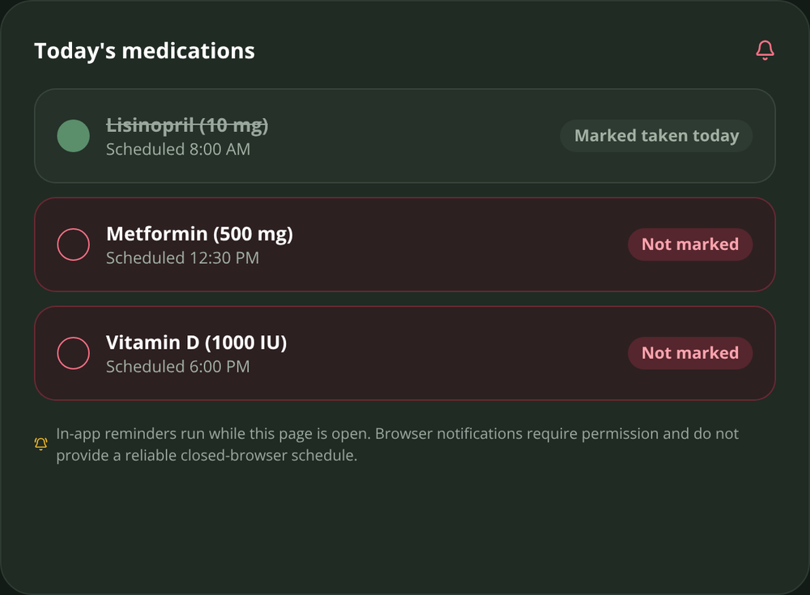
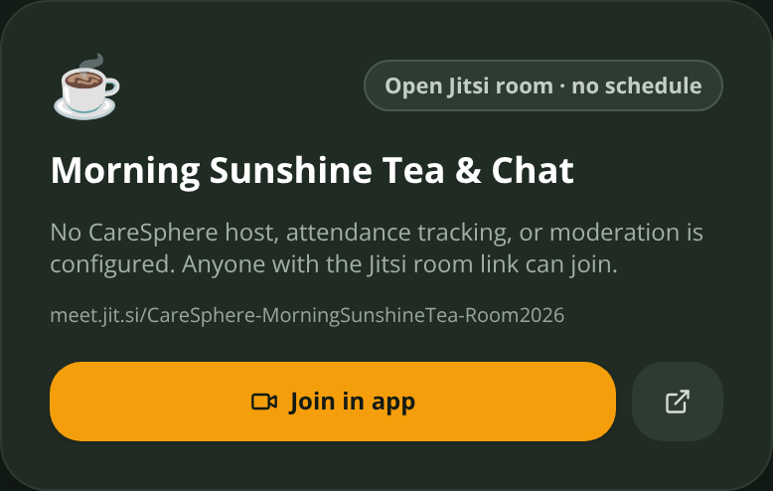
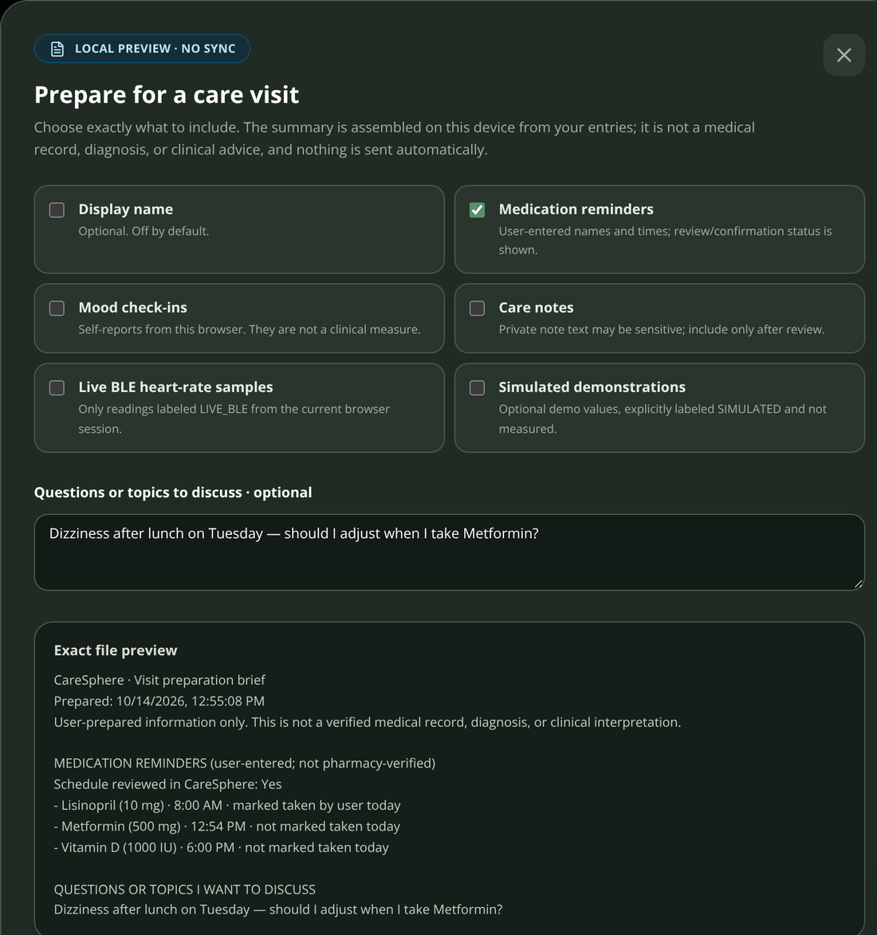
06
BEYOND ACTIVITIES
Remember. Reach someone. Prepare.
Remember
Reach someone
Prepare
Confirm a schedule; mark a reminder taken yourself.
Join a Coffee Circle in a real Jitsi video room.
Select what goes into a visit brief and preview the exact text.
CareSphere AI
Notes:
Routines and medication self-check-ins support the day. Coffee Circles use real Jitsi rooms. Before a visit, users choose what to include in a brief and inspect the exact text. A medication check-in is a self-report, not a verified dose.
Real web app screenshots; seeded sample data. No AI-generated imagery. Native iOS features are identified separately. Research does not establish effectiveness of these activities.

Slide 7
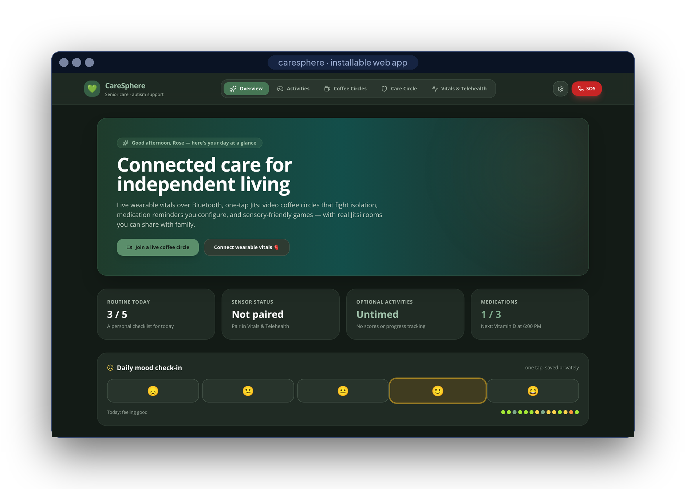
07
LIVE DEMONSTRATION
Show the experience. Not just the screens.
01 · Play
Repeat a pattern; reveal a picture pair.
02 · Choose
Start and stop rain; pause breathing.
03 · Check in
Record a mood and complete a routine.
04 · Prepare
Select fields; preview the visit brief.
CareSphere AI
Notes:
Here I start Pattern Recall, watch the pads, and repeat the sequence. I can replay or stop. In Picture Pairs, I reveal cards without racing a clock. Next I choose rain, then stop it. Breathing also pauses when I choose. Back on Overview, I record a mood and complete a routine. Finally, I select fields for a visit brief and preview the text before downloading it.
Real web app screenshots; seeded sample data. No AI-generated imagery. Native iOS features are identified separately. Research does not establish effectiveness of these activities.

Slide 8
08
PRIVACY
Local care data. You choose what to share.
EXTERNAL CONNECTIONS
ON THE DEVICE
Calls & resources
Jitsi calls and online reference requests
Vitals
Health Guide
Encrypted store
BLE 0x180D · HealthKit, read-only
Qwen2.5-1.5B · llama.cpp, offline
AES-256-GCM · Face ID lock
A visit brief
only when you choose to share
Activities
Visit brief
Coffee Circles
CARESPHERE ARCHITECTURE
Web Audio · untimed, unscored
fields you pick · exact preview
links to real Jitsi rooms
0
0
0
accounts
care backends
trackers
CareSphere AI
REAL WEB-APP CAPTURES · SAMPLE DATA
Notes:
Care data is encrypted locally. Sharing is a deliberate action. Jitsi calls and online references use external services; they are not offline. On iPhone, an optional downloaded model can generate Health Guide answers locally.
Real web app screenshots; seeded sample data. No AI-generated imagery. Native iOS features are identified separately. Research does not establish effectiveness of these activities.

Slide 9
09
HOW IT’S BUILT
Two clients. Local-first care.
Web app
JAVASCRIPT
iPhone app
SWIFT
React 18
Vite 8
Tailwind 3
Web Bluetooth
SwiftUI
HealthKit
CoreBluetooth
Web Audio
Web Crypto
installable PWA
CryptoKit
Face ID
llama.cpp
Sherpa-ONNX
Jitsi SDK
11,400+
17 / 17
2
3
lines of code
tests passing
CI pipelines
public releases
CareSphere AI
REAL WEB-APP CAPTURES · SAMPLE DATA
Notes:
The web app uses JavaScript, React, Vite and Web Audio. The native iPhone app uses Swift and SwiftUI, with HealthKit and CoreBluetooth. Seventeen automated tests cover storage, CSV and visit-brief behavior.
Real web app screenshots; seeded sample data. No AI-generated imagery. Native iOS features are identified separately. Research does not establish effectiveness of these activities.

Slide 10
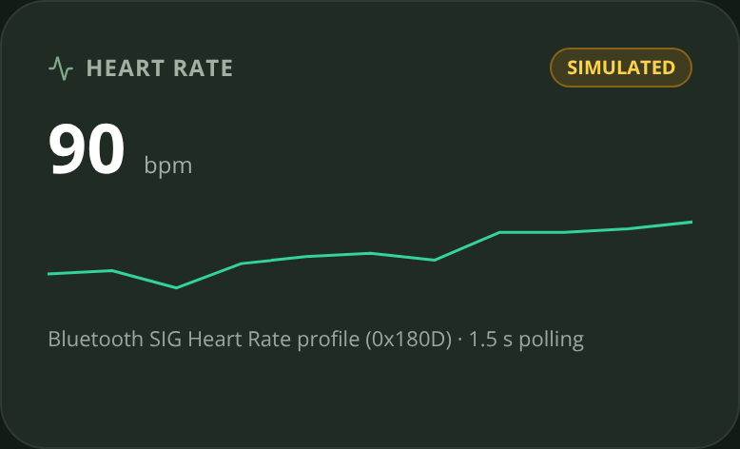
10
HARDEST PROBLEM
Making Bluetooth honest.
Heart-rate notifications arrive late and out of order — a stale sensor could repaint a new card with a wrong number.
src/lib/bluetooth.js · src/App.jsx
const flags = dv.getUint8(0)
const bpm = flags & 0x1
? dv.getUint16(1, true)
: dv.getUint8(1)
if (bpm > 20 && bpm < 250) onReading(bpm)
const source =
hrModeRef.current === 'live'
? 'LIVE_BLE' : 'SIMULATED'
if (generation !==
hrConnectionGenerationRef.current)
return
01
Parse the standard
service 0x180D · flags byte → 8/16-bit BPM
02
Label at the source
each sample is born LIVE or SIMULATED
03
Drop stale sessions
a generation counter ignores old pairings
CareSphere AI
REAL WEB-APP CAPTURES · SAMPLE DATA
Notes:
A difficult coding problem was stale Bluetooth callbacks. A generation counter rejects readings from old connections. Each accepted reading is labeled live or simulated at the source, and that label stays in exports.
Real web app screenshots; seeded sample data. No AI-generated imagery. Native iOS features are identified separately. Research does not establish effectiveness of these activities.

Slide 11
11
WHERE IT STANDS
Built. Tested. Ready for co-design.
First commit
v2.1
Next
repo created
release · Sep 28
co-design → TestFlight
Sep 2
Sep 16
Sep 30
Oct 14
v1.0 + v2.0
v2.2
first public releases
iOS + web, building in CI
NEXT · V2.0 OF THIS ENTRY
THEN
DELIBERATELY NOT
Co-design sessions with autistic people, people living with dementia and caregivers; TestFlight beta.
Apple Health and Bluetooth history in the visit brief, with true source labels · non-diagnostic trends only from real readings.
Cloud sync, a clinician portal or a drug-interaction checker — not without clinical review.
CareSphere AI
REAL WEB-APP CAPTURES · SAMPLE DATA
Notes:
Next are co-design sessions with intended users and caregivers, followed by usability testing and an iPhone beta. Sensor history in visit briefs is planned, not presented as finished.
Real web app screenshots; seeded sample data. No AI-generated imagery. Native iOS features are identified separately. Research does not establish effectiveness of these activities.

Slide 12
12
WHAT THIS PROJECT TAUGHT ME
Trust is a design requirement.
Choice over pressure
Games are untimed and unscored; sound and progression are user-led.
Truth over a polished demo
Sensor values stay labeled LIVE_BLE or SIMULATED, including exports.
Evidence over promises
Research informs design. Usability and health outcomes still need evaluation.
CareSphere AI
Notes:
This project taught me to build for choice, keep demonstrations honest, and distinguish research-informed design from evidence of real-world effectiveness.
Real web app screenshots; seeded sample data. No AI-generated imagery. Native iOS features are identified separately. Research does not establish effectiveness of these activities.

Slide 13

scan for source
Care that stays yours.
Connected, calm and local-first — with real readings or clearly labeled simulation.
EXPLORE THE PROJECT
READ THE CODE
BUILD LOCALLY
github.com/engineer2025-sudo/Care
Arnav Kochar · CA-10 · kochar4646@gmail.com
Explore the source, build instructions and project documentation.
Notes:
CareSphere AI. Everyday support, on your terms. Thank you.
Real web app screenshots; seeded sample data. No AI-generated imagery. Native iOS features are identified separately. Research does not establish effectiveness of these activities.

