Slide 1


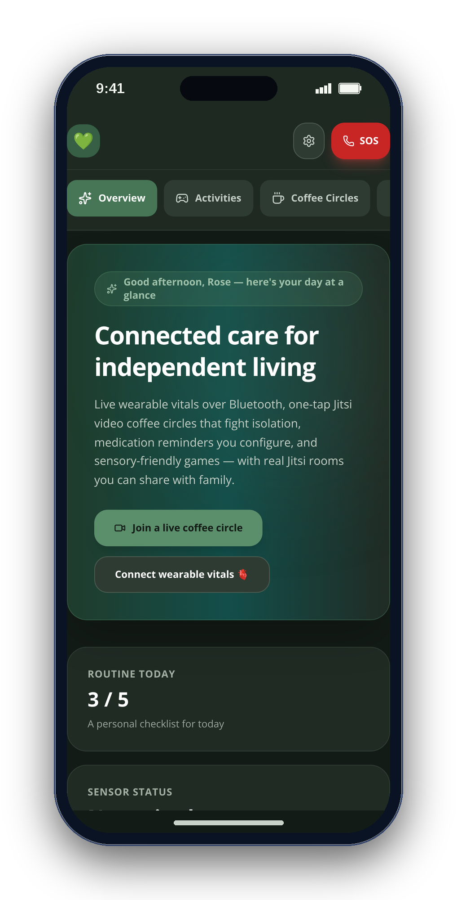
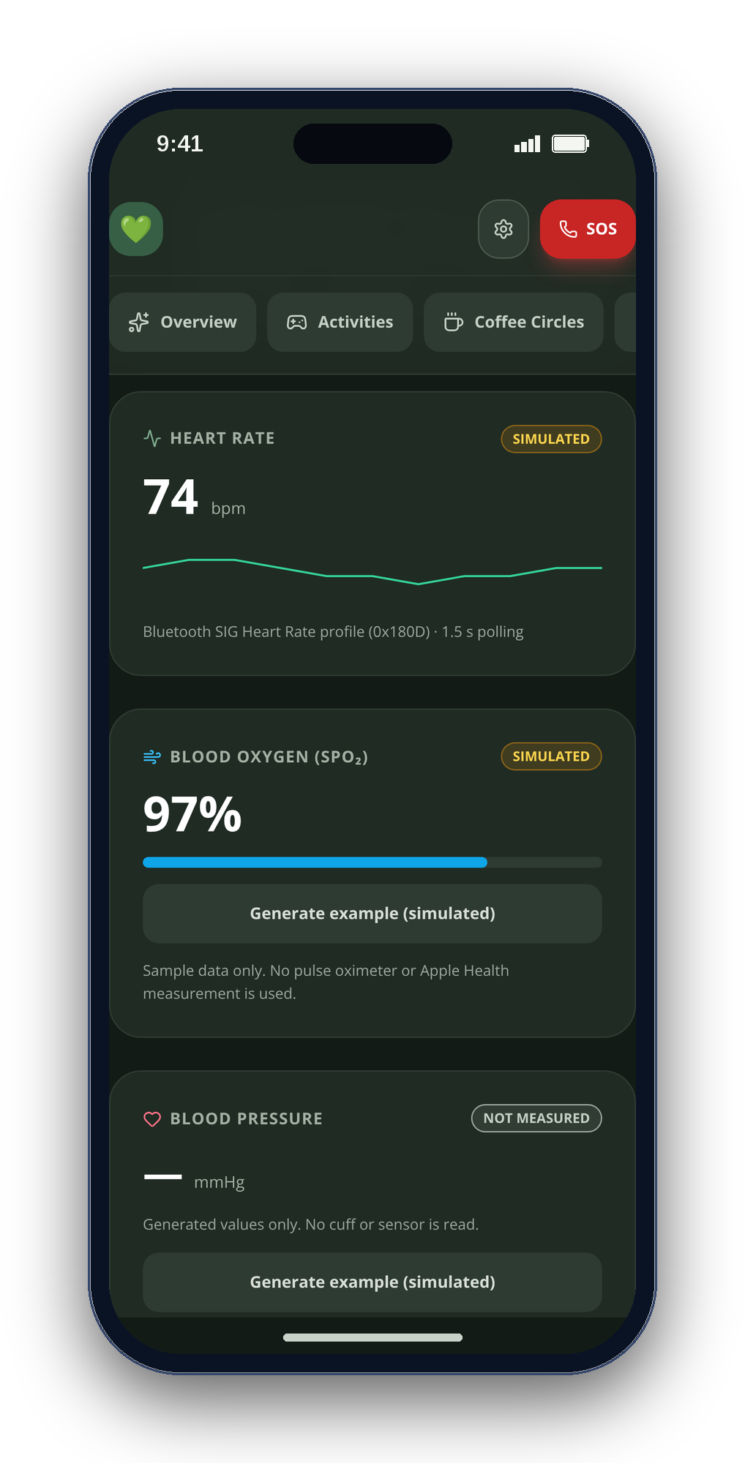
CONGRESSIONAL APP CHALLENGE 2026 · CA-10
CareSphere AI
Connected care for independent living
A private care companion for older adults, autistic people and the families who care for them.
Arnav Kochar
CA-10 · kochar4646@gmail.com
Notes:
[0:00–0:14] Hi, I'm Arnav Kochar, a [GRADE] at [SCHOOL] in [CITY], California. This is CareSphere AI — a private care companion for older adults, autistic people and their families, on iPhone and on the web.
VISUAL PROVENANCE: Real CareSphere web-app screenshots with seeded demonstration data, framed with script-drawn shapes. Not native iOS screenshots. No AI-generated imagery. No claimed user outcomes or clinical validation.
COMBINED DECK: Title. Source: updated deck, slide 1. This is a full presentation/reference deck, not a timed three-minute video. Use VIDEO_SCRIPT_CAC.md for the short submission edit.

Slide 2
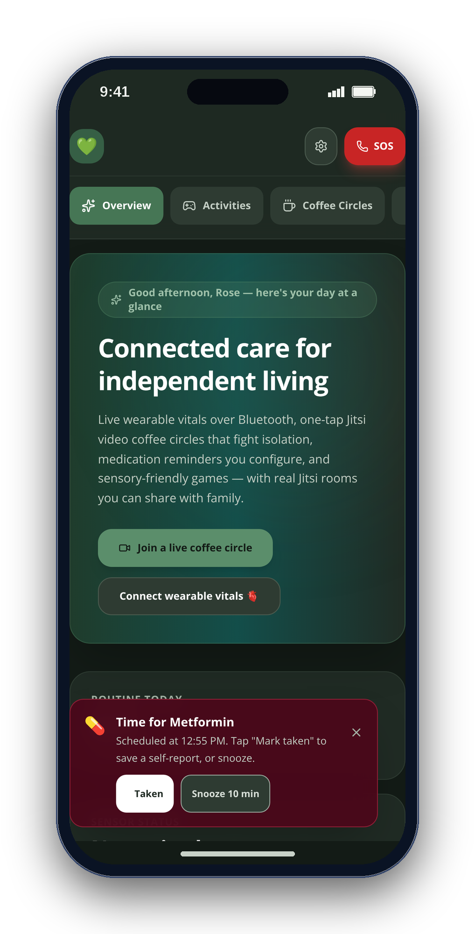
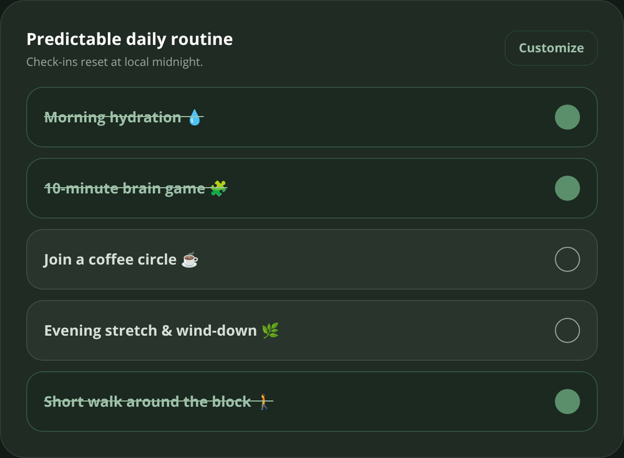
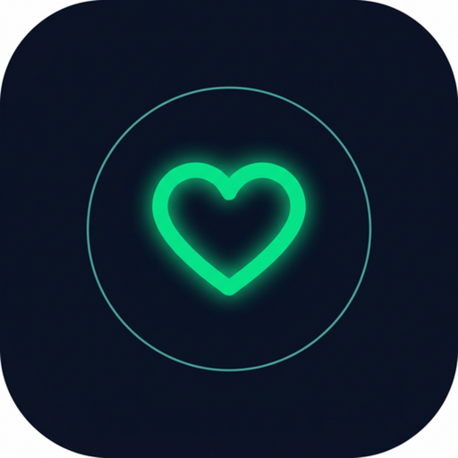
02
THE DESIGN CHALLENGE
Small moments. More independence.
A reminder you can act on.
A routine you can finish.
A person you can reach.
CareSphere brings everyday support together — without making care feel like another task.
CALM · HONEST · PRIVATE
CareSphere AI
REAL WEB-APP CAPTURES · SAMPLE DATA
Notes:
CareSphere was designed around everyday moments: remembering medication, following a routine and reaching someone. Add your own truthful personal motivation when narrating; no personal story has been assumed.
COMBINED DECK: Design challenge. Source: updated deck, slide 2. This is a full presentation/reference deck, not a timed three-minute video. Use VIDEO_SCRIPT_CAC.md for the short submission edit.

Slide 3
03
THE PROBLEM
Growing older — or growing up autistic — too often means facing care alone.
1 in 4
1 in 31
50%
older adults are socially isolated
children are autistic
of long-term medicines aren’t taken as prescribed
NASEM · 2020
CDC · 2025
WHO
Behind them: 63 million family caregivers. AARP & NAC, 2025
CareSphere AI
REAL WEB-APP CAPTURES · SAMPLE DATA
Notes:
[0:26–0:39] One in four older adults is socially isolated — a twenty-nine percent higher risk of early death. One in thirty-one children is autistic. Half of long-term medications aren't taken as prescribed. And sixty-three million family caregivers hold it all together.
VISUAL PROVENANCE: Real CareSphere web-app screenshots with seeded demonstration data, framed with script-drawn shapes. Not native iOS screenshots. No AI-generated imagery. No claimed user outcomes or clinical validation.
COMBINED DECK: Problem. Source: updated deck, slide 3. This is a full presentation/reference deck, not a timed three-minute video. Use VIDEO_SCRIPT_CAC.md for the short submission edit.

Slide 4
04
WHAT THE APP DOES
Daily support. Play, connect, prepare.
01
Activities & sensory tools
02
Everyday routines
Four self-paced games, breathing and optional soundscapes.
Mood check-ins, daily tasks and medication self-check-ins.
03
Human connection
04
Visit preparation
Coffee Circles open Jitsi video rooms; care notes stay local.
Choose notes and readings for a previewable visit brief.
For older adults, autistic people and the families who support them.
CareSphere AI
Notes:
There are four parts: activities and sensory tools; mood, routines and medication reminders; Coffee Circles for video conversations; and a visit brief built from information you choose. Here is what using them looks like.
Real web app screenshots; seeded sample data. No AI-generated imagery. Native iOS features are identified separately. Research does not establish effectiveness of these activities.
COMBINED DECK: Feature overview. Source: cac deck, slide 2. This is a full presentation/reference deck, not a timed three-minute video. Use VIDEO_SCRIPT_CAC.md for the short submission edit.

Slide 5
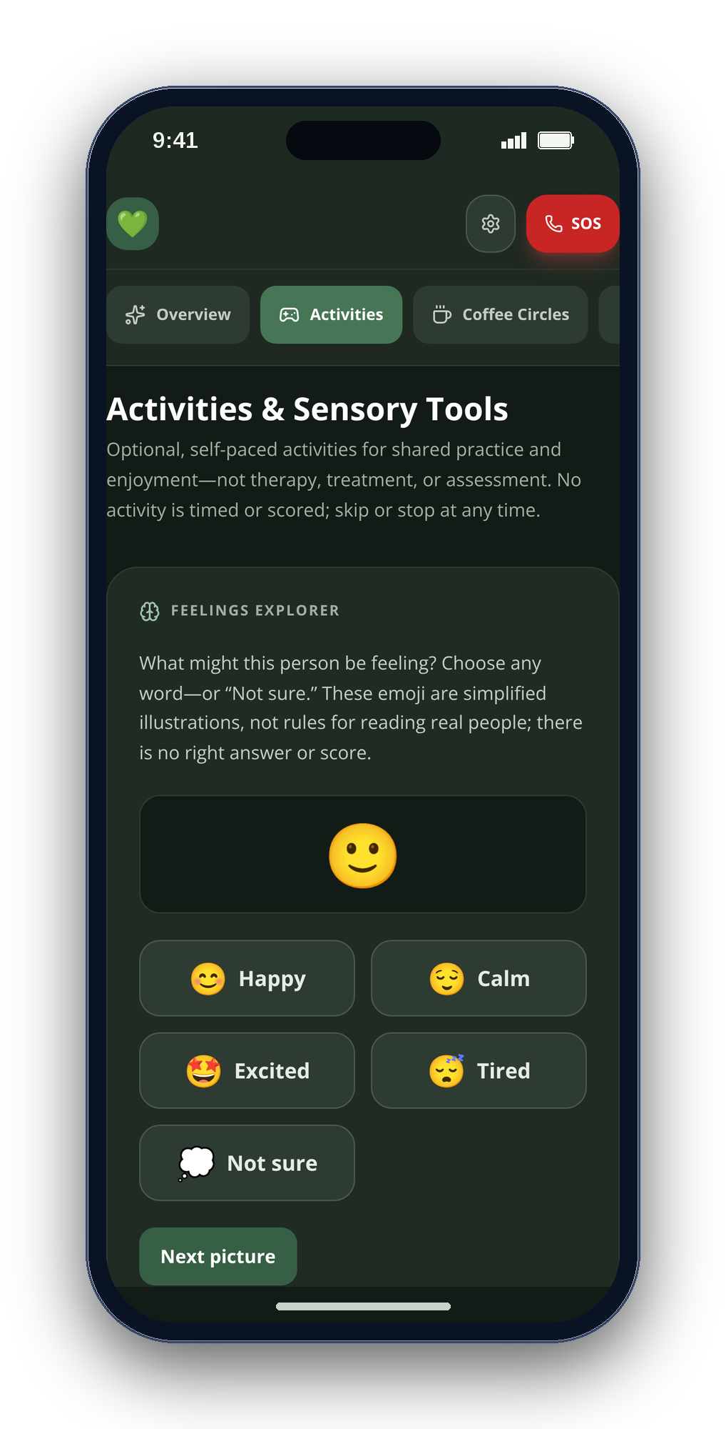
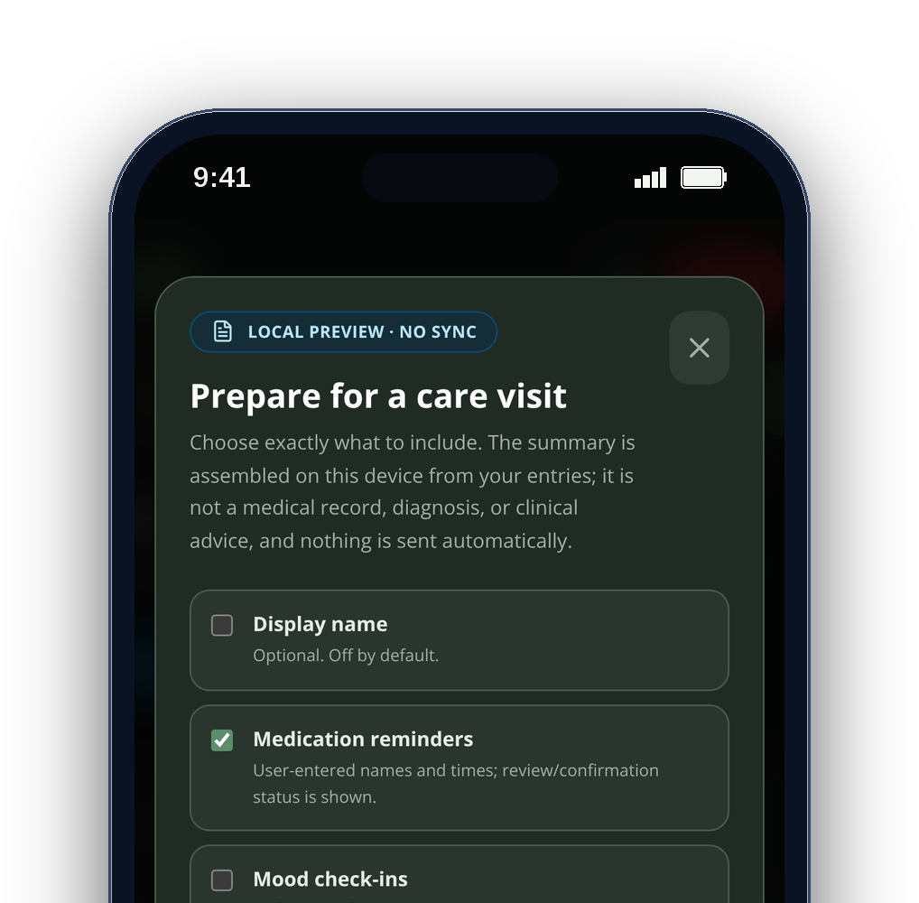
05
WHO IT’S FOR
Built for three people at once.
Older adults
Autistic teens & adults
Family caregivers
routines, reminders, real company
predictable, untimed, sensory-calm
notes and a brief they can trust
CareSphere AI
REAL WEB-APP CAPTURES · SAMPLE DATA
Notes:
[1:53–2:01] It's built for three people at once: older adults, autistic teens and adults, and the caregivers who support them.
VISUAL PROVENANCE: Real CareSphere web-app screenshots with seeded demonstration data, framed with script-drawn shapes. Not native iOS screenshots. No AI-generated imagery. No claimed user outcomes or clinical validation.
COMBINED DECK: Audience. Source: updated deck, slide 8. This is a full presentation/reference deck, not a timed three-minute video. Use VIDEO_SCRIPT_CAC.md for the short submission edit.

Slide 6
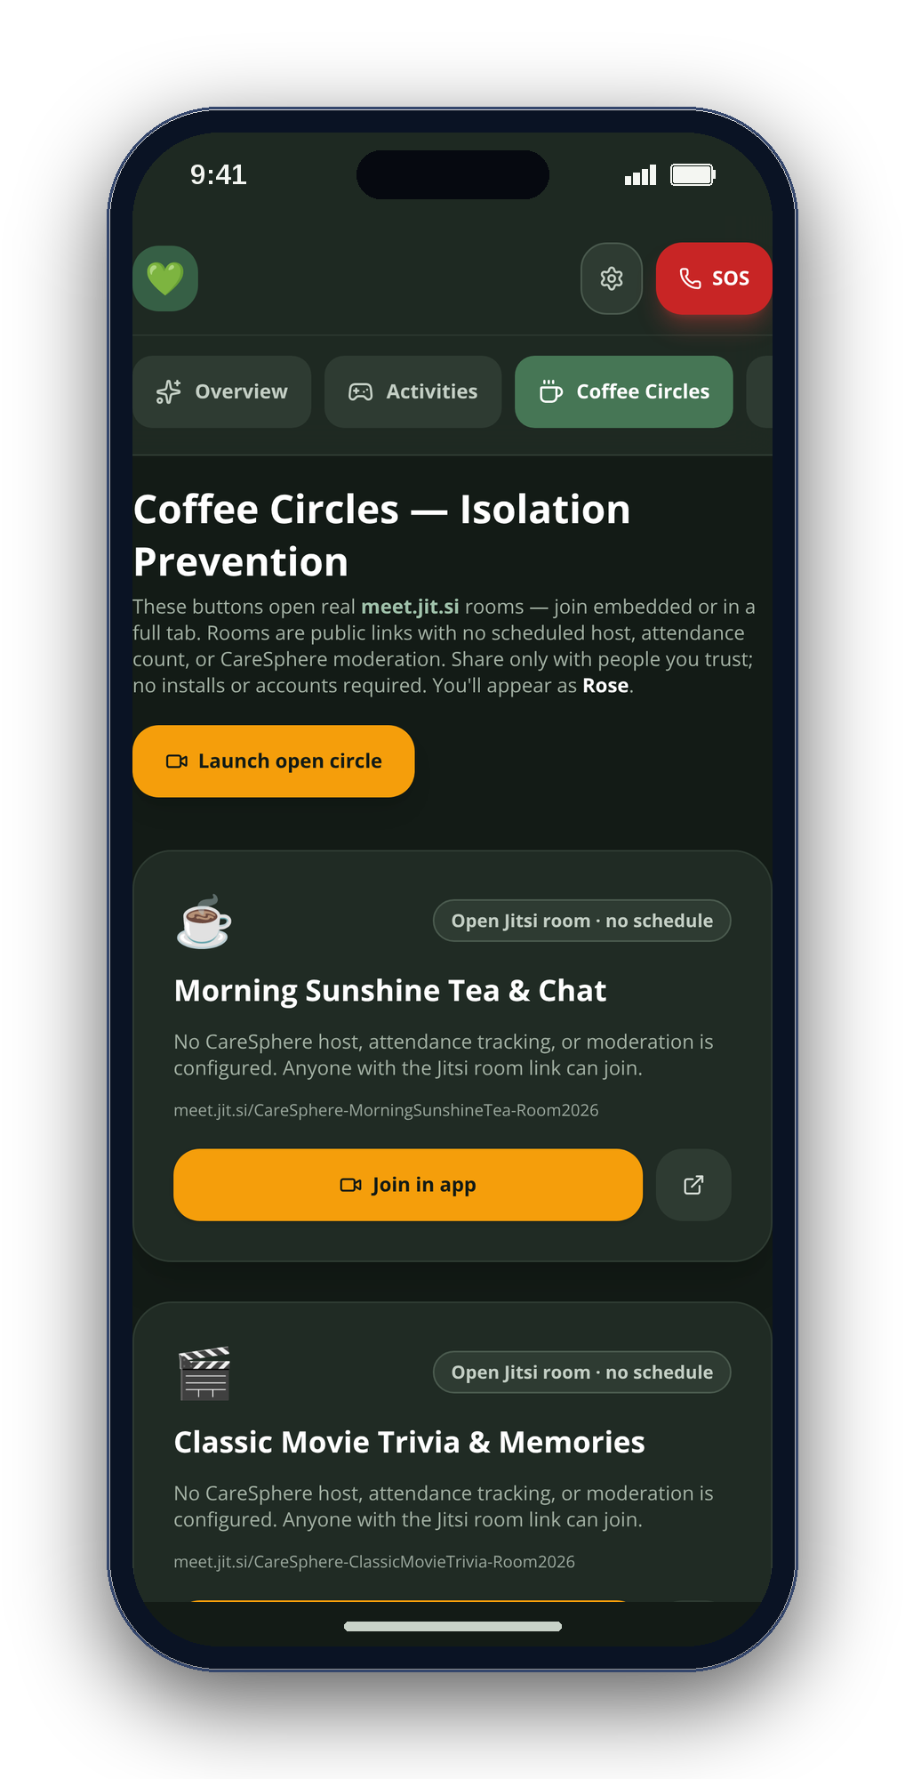
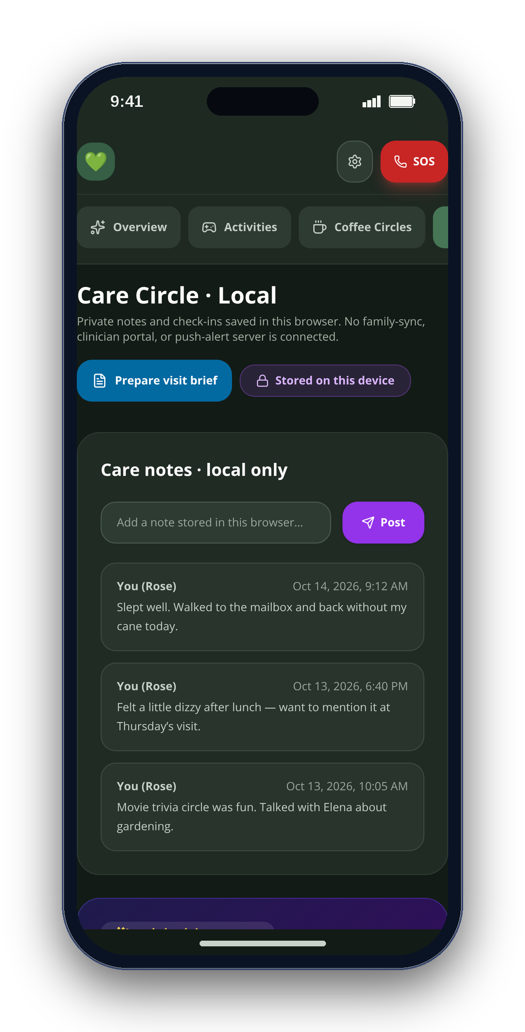
06
THE SOLUTION
One calm app. Five familiar places.
OVERVIEW
ACTIVITIES
COFFEE CIRCLES
CARE CIRCLE
VITALS
CareSphere AI
REAL WEB-APP CAPTURES · SAMPLE DATA
Notes:
[0:47–0:57] CareSphere is one calm app with five tabs — Overview, Activities, Coffee Circles, Care Circle and Vitals — with no server behind any of it.
VISUAL PROVENANCE: Real CareSphere web-app screenshots with seeded demonstration data, framed with script-drawn shapes. Not native iOS screenshots. No AI-generated imagery. No claimed user outcomes or clinical validation.
COMBINED DECK: Five-tab app tour. Source: updated deck, slide 5. This is a full presentation/reference deck, not a timed three-minute video. Use VIDEO_SCRIPT_CAC.md for the short submission edit.

Slide 7
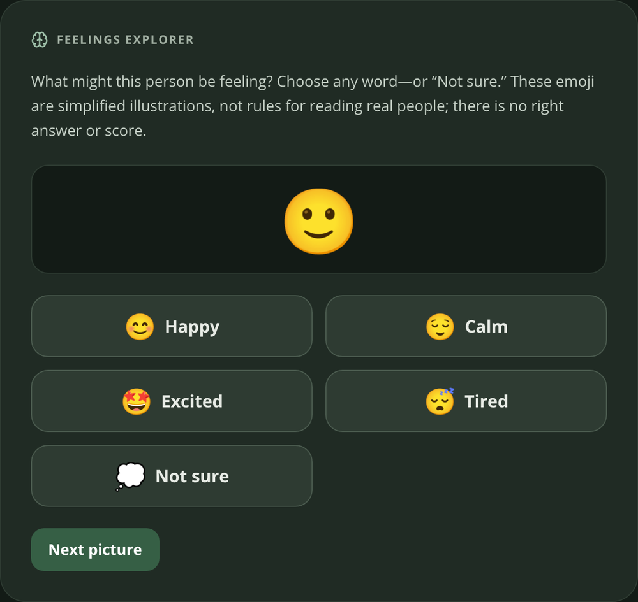
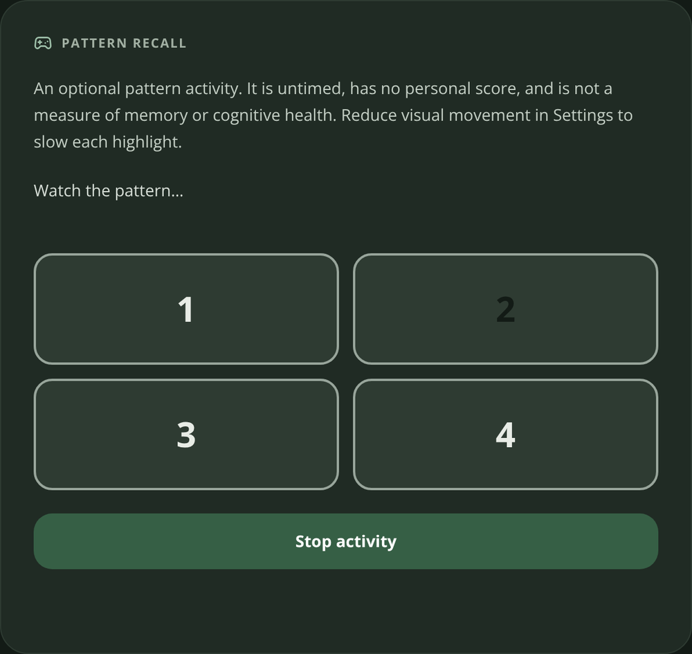
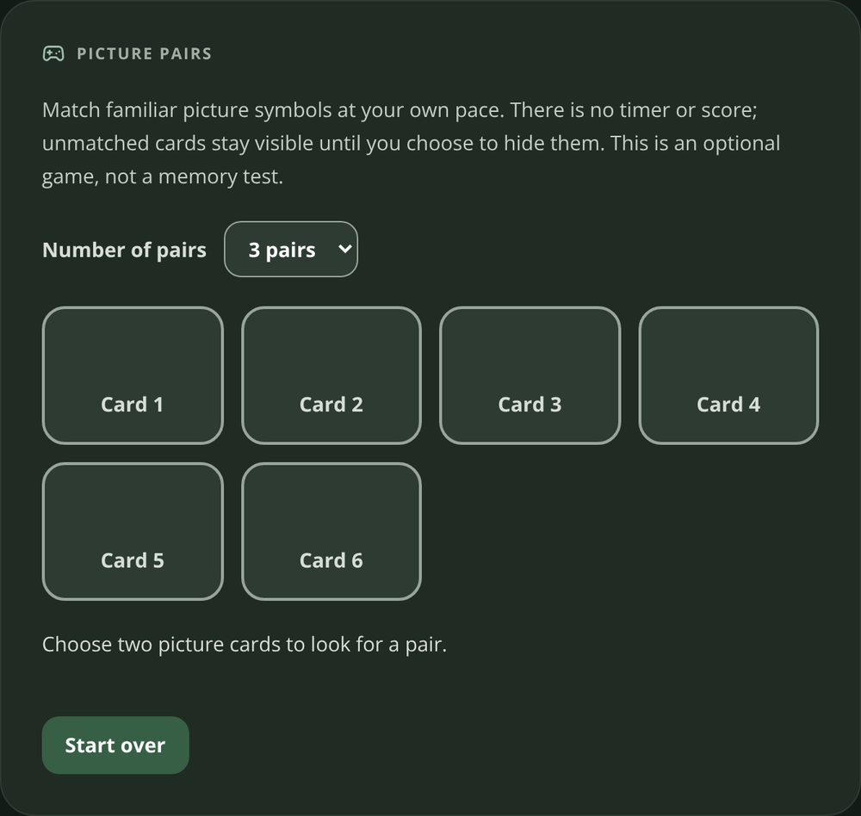
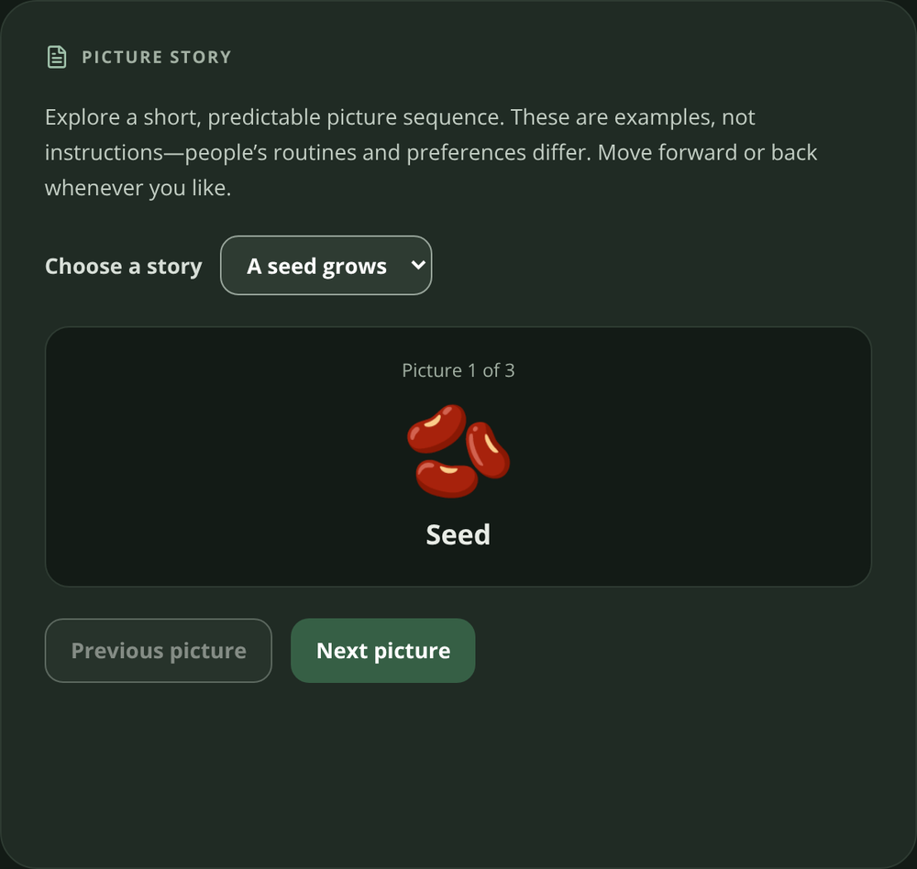
07
CORE FEATURE · GAMES
Four ways to play. At your own pace.
Feelings Explorer
Pattern Recall
Picture Pairs
Picture Story
Choose how you feel.
Watch, then repeat.
Reveal matching cards.
Explore a picture sequence.
No right or wrong answer.
Replay or stop anytime.
No countdown or score.
Advance when ready.
CareSphere AI
Notes:
Activities are a core feature. Feelings Explorer lets you choose a feeling without a right answer. Pattern Recall lets you repeat a sequence. Picture Pairs reveals matching cards, and Picture Story explores a sequence at your pace. These are untimed, unscored activities—not cognitive tests.
Real web app screenshots; seeded sample data. No AI-generated imagery. Native iOS features are identified separately. Research does not establish effectiveness of these activities.
COMBINED DECK: Four games. Source: cac deck, slide 3. This is a full presentation/reference deck, not a timed three-minute video. Use VIDEO_SCRIPT_CAC.md for the short submission edit.

Slide 8
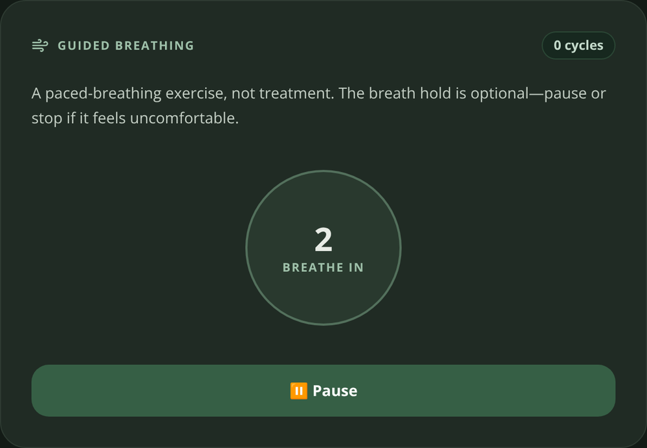
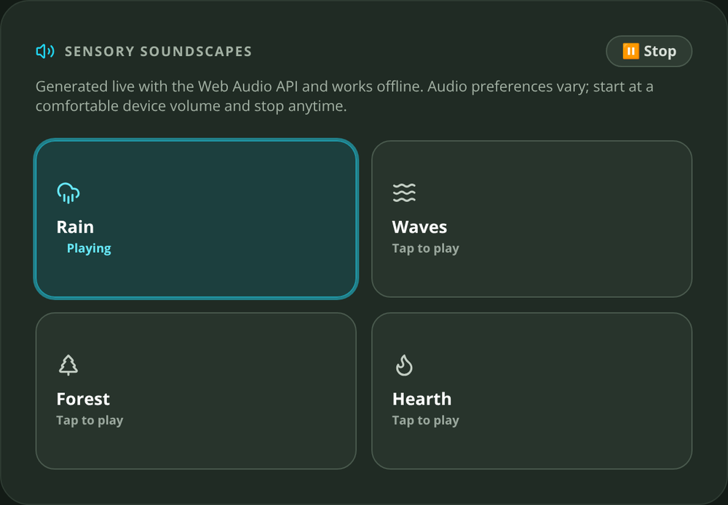
08
CORE FEATURE · SENSORY CHOICE
A quieter experience. On your terms.
Breathing
4 seconds in · 4 hold · 6 out. Start and pause yourself.
Soundscapes
Rain, ocean, forest and hearth. Sound starts only on request.
Accessibility
Text sizes, palette choices, high contrast and reduced motion.
CareSphere AI
Notes:
Breathing follows a four-four-six rhythm. You can start, pause or leave. Four optional soundscapes run through Web Audio. Text size, contrast, palette and motion settings let people choose a comfortable interface.
Real web app screenshots; seeded sample data. No AI-generated imagery. Native iOS features are identified separately. Research does not establish effectiveness of these activities.
COMBINED DECK: Sensory tools and accessibility. Source: cac deck, slide 4. This is a full presentation/reference deck, not a timed three-minute video. Use VIDEO_SCRIPT_CAC.md for the short submission edit.

Slide 9
09
RESEARCH → DESIGN DECISIONS
Research-informed. Not clinically validated.
AASPIRE · 2019
Predictability and sensory choice
Consistent navigation, palette options, reduced motion.
Game research · 2023 / 2025
Promising findings; varied studies
Optional practice and enjoyment, not treatment.
Evidence boundary
No CareSphere efficacy study
Next: co-design and usability evaluation with intended users.
Sources: Raymaker et al., 2019 · Alahmari et al., 2023 · Liu et al., 2025. Full links in notes.
CareSphere AI
Notes:
AASPIRE accessibility research informed predictable navigation and sensory choices. Game-based research suggests potential in some settings, but studies vary. It does not prove CareSphere works as therapy. These activities are optional practice and enjoyment; co-design and usability evaluation come next.
Real web app screenshots; seeded sample data. No AI-generated imagery. Native iOS features are identified separately. Research does not establish effectiveness of these activities.
Research sources:
https://pmc.ncbi.nlm.nih.gov/articles/PMC6485264/
https://pmc.ncbi.nlm.nih.gov/articles/PMC9809031/
https://pmc.ncbi.nlm.nih.gov/articles/PMC12781649/
Design rationale: docs/activities-and-accessibility.md. Games: src/App.jsx. No clinical or cognitive benefits established for CareSphere.
COMBINED DECK: Research-informed design. Source: cac deck, slide 5. This is a full presentation/reference deck, not a timed three-minute video. Use VIDEO_SCRIPT_CAC.md for the short submission edit.

Slide 10
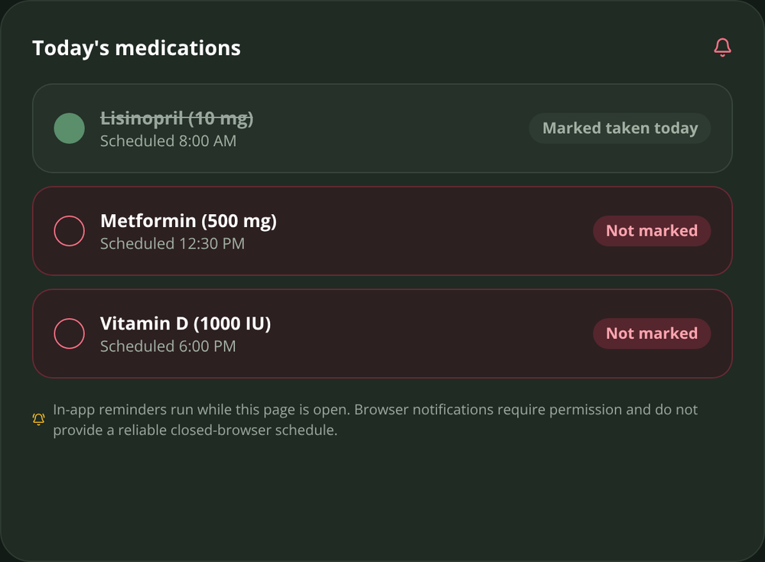
10
EVERYDAY SUPPORT
From a reminder to a real connection.
01 Remember
02 Find a rhythm
03 Reach someone
Medication self-check-ins
Simple daily routines
Coffee Circles via Jitsi
CareSphere AI
REAL WEB-APP CAPTURES · SAMPLE DATA
Notes:
These are actual CareSphere web-app screenshots showing medication self-check-ins, daily routines and Coffee Circles. The displayed entries are sample data. Coffee Circles uses external Jitsi infrastructure; no CareSphere care-data backend is required.
COMBINED DECK: Everyday support screenshots. Source: updated deck, slide 4. This is a full presentation/reference deck, not a timed three-minute video. Use VIDEO_SCRIPT_CAC.md for the short submission edit.

Slide 11
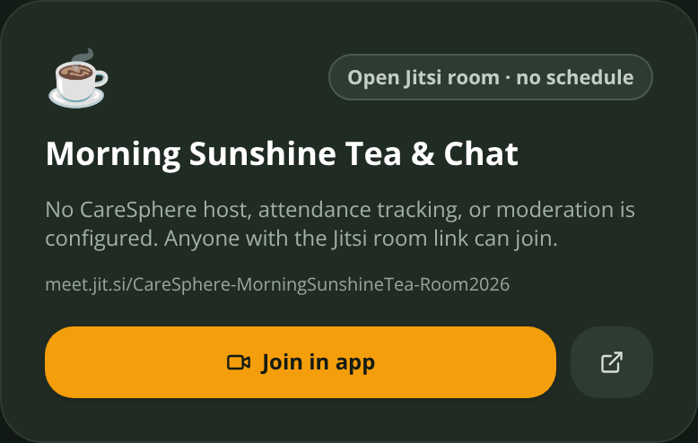
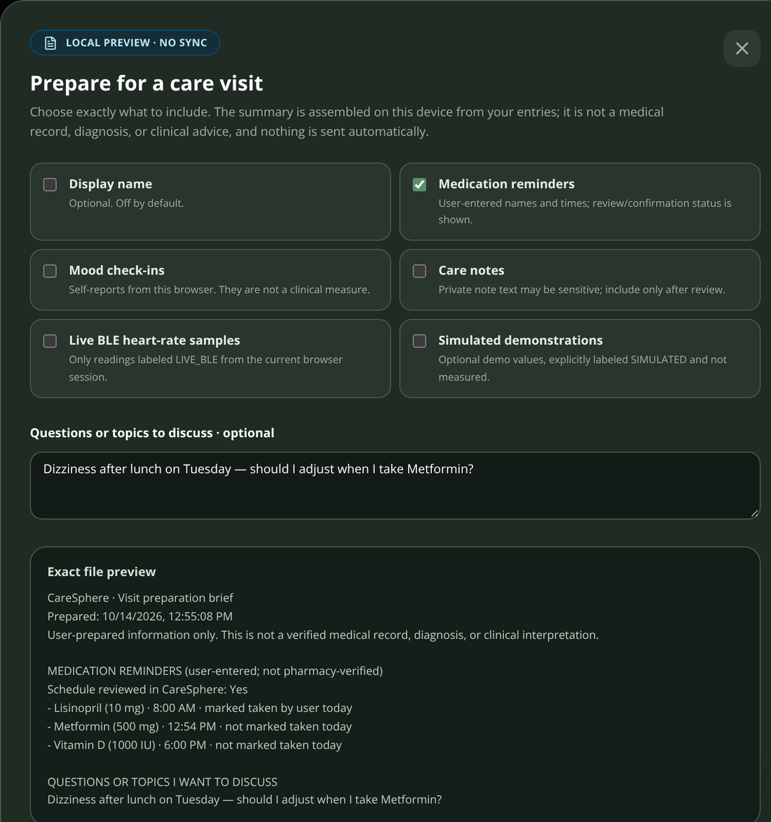
11
BEYOND ACTIVITIES
Remember. Reach someone. Prepare.
Remember
Reach someone
Prepare
Confirm a schedule; mark a reminder taken yourself.
Join a Coffee Circle in a real Jitsi video room.
Select what goes into a visit brief and preview the exact text.
CareSphere AI
Notes:
Routines and medication self-check-ins support the day. Coffee Circles use real Jitsi rooms. Before a visit, users choose what to include in a brief and inspect the exact text. A medication check-in is a self-report, not a verified dose.
Real web app screenshots; seeded sample data. No AI-generated imagery. Native iOS features are identified separately. Research does not establish effectiveness of these activities.
COMBINED DECK: Remember, connect and prepare. Source: cac deck, slide 6. This is a full presentation/reference deck, not a timed three-minute video. Use VIDEO_SCRIPT_CAC.md for the short submission edit.

Slide 12
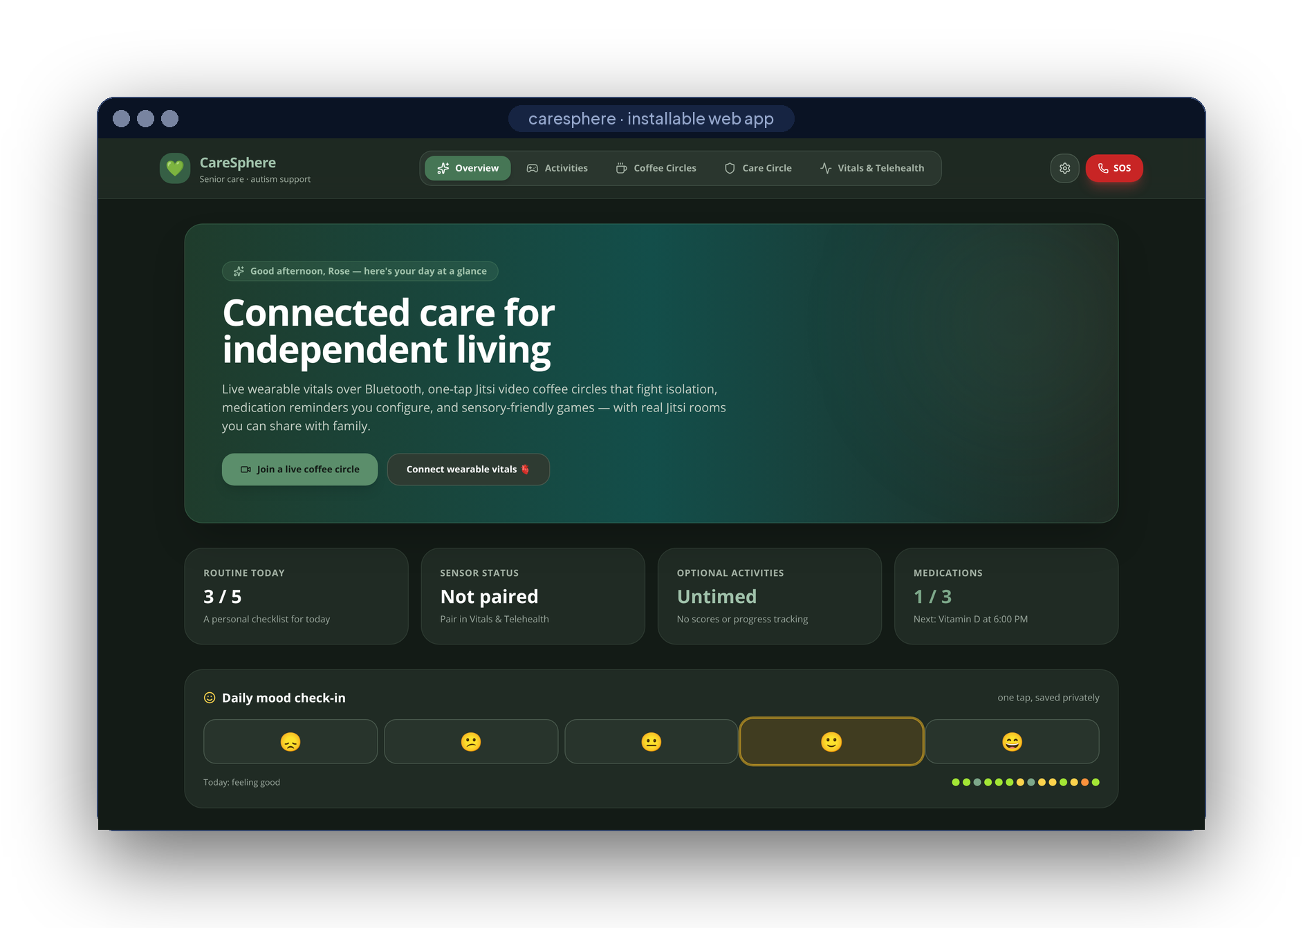
12
LIVE DEMO
Let’s see it.
SIX SHOTS · ONE TAKE
01
Mood check-in & routine
02
Reminder → Taken
03
Pair a sensor · export CSV
04
Pattern Recall · Rain
05
Join a Coffee Circle
06
Build the visit brief
REAL WEB APP · SAMPLE DATA
CareSphere AI
REAL WEB-APP CAPTURES · SAMPLE DATA
Notes:
[0:57–1:42] Let me show you. (Switch to the screen recording — six shots, see VIDEO_SCRIPT.md: mood check-in and routine; medication reminder and Taken; Bluetooth pairing or the labeled demo plus Export CSV; Pattern Recall and the Rain soundscape; join a Coffee Circle; build and download a visit brief.)
VISUAL PROVENANCE: Real CareSphere web-app screenshots with seeded demonstration data, framed with script-drawn shapes. Not native iOS screenshots. No AI-generated imagery. No claimed user outcomes or clinical validation.
COMBINED DECK: Full-app demo overview. Source: updated deck, slide 6. This is a full presentation/reference deck, not a timed three-minute video. Use VIDEO_SCRIPT_CAC.md for the short submission edit.

Slide 13
13
LIVE DEMONSTRATION
Show the experience. Not just the screens.
01 · Play
Repeat a pattern; reveal a picture pair.
02 · Choose
Start and stop rain; pause breathing.
03 · Check in
Record a mood and complete a routine.
04 · Prepare
Select fields; preview the visit brief.
CareSphere AI
Notes:
Here I start Pattern Recall, watch the pads, and repeat the sequence. I can replay or stop. In Picture Pairs, I reveal cards without racing a clock. Next I choose rain, then stop it. Breathing also pauses when I choose. Back on Overview, I record a mood and complete a routine. Finally, I select fields for a visit brief and preview the text before downloading it.
Real web app screenshots; seeded sample data. No AI-generated imagery. Native iOS features are identified separately. Research does not establish effectiveness of these activities.
COMBINED DECK: Feature-focused interaction demo. Source: cac deck, slide 7. This is a full presentation/reference deck, not a timed three-minute video. Use VIDEO_SCRIPT_CAC.md for the short submission edit.

Slide 14
14
WHAT MAKES IT DIFFERENT
Four rules, written into the code.
01
Never fabricate
every reading labeled where it is born
'LIVE_BLE' : 'SIMULATED'
02
Nothing sent automatically
a person always taps Send
navigator.share() · ShareLink
03
Calm by default
no timers, scores or auto-advance
Untimed · No scores
04
Private by architecture
no account, no server, encrypted
'AES-GCM', length: 256
CareSphere AI
REAL WEB-APP CAPTURES · SAMPLE DATA
Notes:
[1:42–1:53] What makes it different isn't a feature — it's four rules in the code: never fabricate a reading, never send anything automatically, calm by default, private by architecture.
VISUAL PROVENANCE: Real CareSphere web-app screenshots with seeded demonstration data, framed with script-drawn shapes. Not native iOS screenshots. No AI-generated imagery. No claimed user outcomes or clinical validation.
COMBINED DECK: Four rules in the code. Source: updated deck, slide 7. This is a full presentation/reference deck, not a timed three-minute video. Use VIDEO_SCRIPT_CAC.md for the short submission edit.

Slide 15
15
PRIVACY
Local care data. You choose what to share.
EXTERNAL CONNECTIONS
ON THE DEVICE
Calls & resources
Jitsi calls and online reference requests
Vitals
Health Guide
Encrypted store
BLE 0x180D · HealthKit, read-only
Qwen2.5-1.5B · llama.cpp, offline
AES-256-GCM · Face ID lock
A visit brief
only when you choose to share
Activities
Visit brief
Coffee Circles
CARESPHERE ARCHITECTURE
Web Audio · untimed, unscored
fields you pick · exact preview
links to real Jitsi rooms
0
0
0
accounts
care backends
trackers
CareSphere AI
REAL WEB-APP CAPTURES · SAMPLE DATA
Notes:
[2:01–2:12] Everything stays on the device: AES-256 encryption, Bluetooth and HealthKit read locally, and a 1.5-billion-parameter model that answers health questions offline. Zero accounts, zero servers, zero trackers.
VISUAL PROVENANCE: Real CareSphere web-app screenshots with seeded demonstration data, framed with script-drawn shapes. Not native iOS screenshots. No AI-generated imagery. No claimed user outcomes or clinical validation.
COMBINED DECK: Privacy and external connections. Source: updated deck, slide 9. This is a full presentation/reference deck, not a timed three-minute video. Use VIDEO_SCRIPT_CAC.md for the short submission edit.

Slide 16
16
HOW IT’S BUILT
Two clients. Local-first care.
Web app
JAVASCRIPT
iPhone app
SWIFT
React 18
Vite 8
Tailwind 3
Web Bluetooth
SwiftUI
HealthKit
CoreBluetooth
Web Audio
Web Crypto
installable PWA
CryptoKit
Face ID
llama.cpp
Sherpa-ONNX
Jitsi SDK
11,400+
17 / 17
2
3
lines of code
tests passing
CI pipelines
public releases
CareSphere AI
REAL WEB-APP CAPTURES · SAMPLE DATA
Notes:
[2:12–2:23] It's React and JavaScript on the web, Swift and SwiftUI on iPhone — Web Bluetooth, HealthKit, CryptoKit and llama.cpp. Eleven thousand lines, seventeen tests, three public releases.
VISUAL PROVENANCE: Real CareSphere web-app screenshots with seeded demonstration data, framed with script-drawn shapes. Not native iOS screenshots. No AI-generated imagery. No claimed user outcomes or clinical validation.
COMBINED DECK: Tools and languages. Source: updated deck, slide 10. This is a full presentation/reference deck, not a timed three-minute video. Use VIDEO_SCRIPT_CAC.md for the short submission edit.

Slide 17
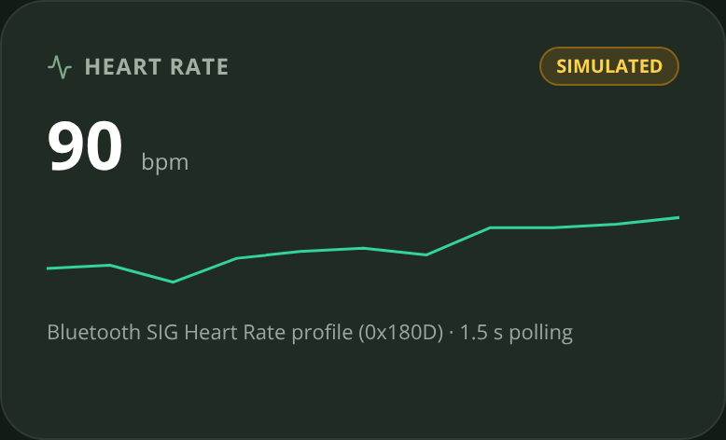
17
HARDEST PROBLEM
Making Bluetooth honest.
Heart-rate notifications arrive late and out of order — a stale sensor could repaint a new card with a wrong number.
src/lib/bluetooth.js · src/App.jsx
const flags = dv.getUint8(0)
const bpm = flags & 0x1
? dv.getUint16(1, true)
: dv.getUint8(1)
if (bpm > 20 && bpm < 250) onReading(bpm)
const source =
hrModeRef.current === 'live'
? 'LIVE_BLE' : 'SIMULATED'
if (generation !==
hrConnectionGenerationRef.current)
return
01
Parse the standard
service 0x180D · flags byte → 8/16-bit BPM
02
Label at the source
each sample is born LIVE or SIMULATED
03
Drop stale sessions
a generation counter ignores old pairings
CareSphere AI
REAL WEB-APP CAPTURES · SAMPLE DATA
Notes:
[2:23–2:35] The hardest problem was keeping Bluetooth honest: notifications arrive late and out of order, so I label every sample live or simulated at the source and drop stale sessions with a generation counter.
VISUAL PROVENANCE: Real CareSphere web-app screenshots with seeded demonstration data, framed with script-drawn shapes. Not native iOS screenshots. No AI-generated imagery. No claimed user outcomes or clinical validation.
COMBINED DECK: Bluetooth coding challenge. Source: updated deck, slide 11. This is a full presentation/reference deck, not a timed three-minute video. Use VIDEO_SCRIPT_CAC.md for the short submission edit.

Slide 18
18
WHERE IT STANDS
Built. Tested. Ready for co-design.
First commit
v2.1
Next
repo created
release · Sep 28
co-design → TestFlight
Sep 2
Sep 16
Sep 30
Oct 14
v1.0 + v2.0
v2.2
first public releases
iOS + web, building in CI
NEXT · V2.0 OF THIS ENTRY
THEN
DELIBERATELY NOT
Co-design sessions with autistic people, people living with dementia and caregivers; TestFlight beta.
Apple Health and Bluetooth history in the visit brief, with true source labels · non-diagnostic trends only from real readings.
Cloud sync, a clinician portal or a drug-interaction checker — not without clinical review.
CareSphere AI
REAL WEB-APP CAPTURES · SAMPLE DATA
Notes:
[2:35–2:47] Version 2.0 starts with co-design sessions with autistic people, people living with dementia and caregivers, then a TestFlight beta and sensor history in the visit brief — still with no server. (Deliberately not planned: cloud sync, a clinician portal or a drug-interaction checker — not without clinical review.)
VISUAL PROVENANCE: Real CareSphere web-app screenshots with seeded demonstration data, framed with script-drawn shapes. Not native iOS screenshots. No AI-generated imagery. No claimed user outcomes or clinical validation.
COMBINED DECK: Progress and next steps. Source: updated deck, slide 12. This is a full presentation/reference deck, not a timed three-minute video. Use VIDEO_SCRIPT_CAC.md for the short submission edit.

Slide 19
19
WHAT THIS PROJECT TAUGHT ME
Trust is a design requirement.
Choice over pressure
Games are untimed and unscored; sound and progression are user-led.
Truth over a polished demo
Sensor values stay labeled LIVE_BLE or SIMULATED, including exports.
Evidence over promises
Research informs design. Usability and health outcomes still need evaluation.
CareSphere AI
Notes:
This project taught me to build for choice, keep demonstrations honest, and distinguish research-informed design from evidence of real-world effectiveness.
Real web app screenshots; seeded sample data. No AI-generated imagery. Native iOS features are identified separately. Research does not establish effectiveness of these activities.
COMBINED DECK: Learning. Source: cac deck, slide 12. This is a full presentation/reference deck, not a timed three-minute video. Use VIDEO_SCRIPT_CAC.md for the short submission edit.

Slide 20

scan for source
Care that stays yours.
Connected, calm and local-first — with real readings or clearly labeled simulation.
EXPLORE THE PROJECT
READ THE CODE
BUILD LOCALLY
github.com/engineer2025-sudo/Care
Arnav Kochar · CA-10 · kochar4646@gmail.com
Explore the source, build instructions and project documentation.
Notes:
[2:47–2:53] CareSphere AI — care that stays yours. The code and install guide are on GitHub. Thank you.
VISUAL PROVENANCE: Real CareSphere web-app screenshots with seeded demonstration data, framed with script-drawn shapes. Not native iOS screenshots. No AI-generated imagery. No claimed user outcomes or clinical validation.
COMBINED DECK: Close. Source: updated deck, slide 13. This is a full presentation/reference deck, not a timed three-minute video. Use VIDEO_SCRIPT_CAC.md for the short submission edit.

