Slide 1


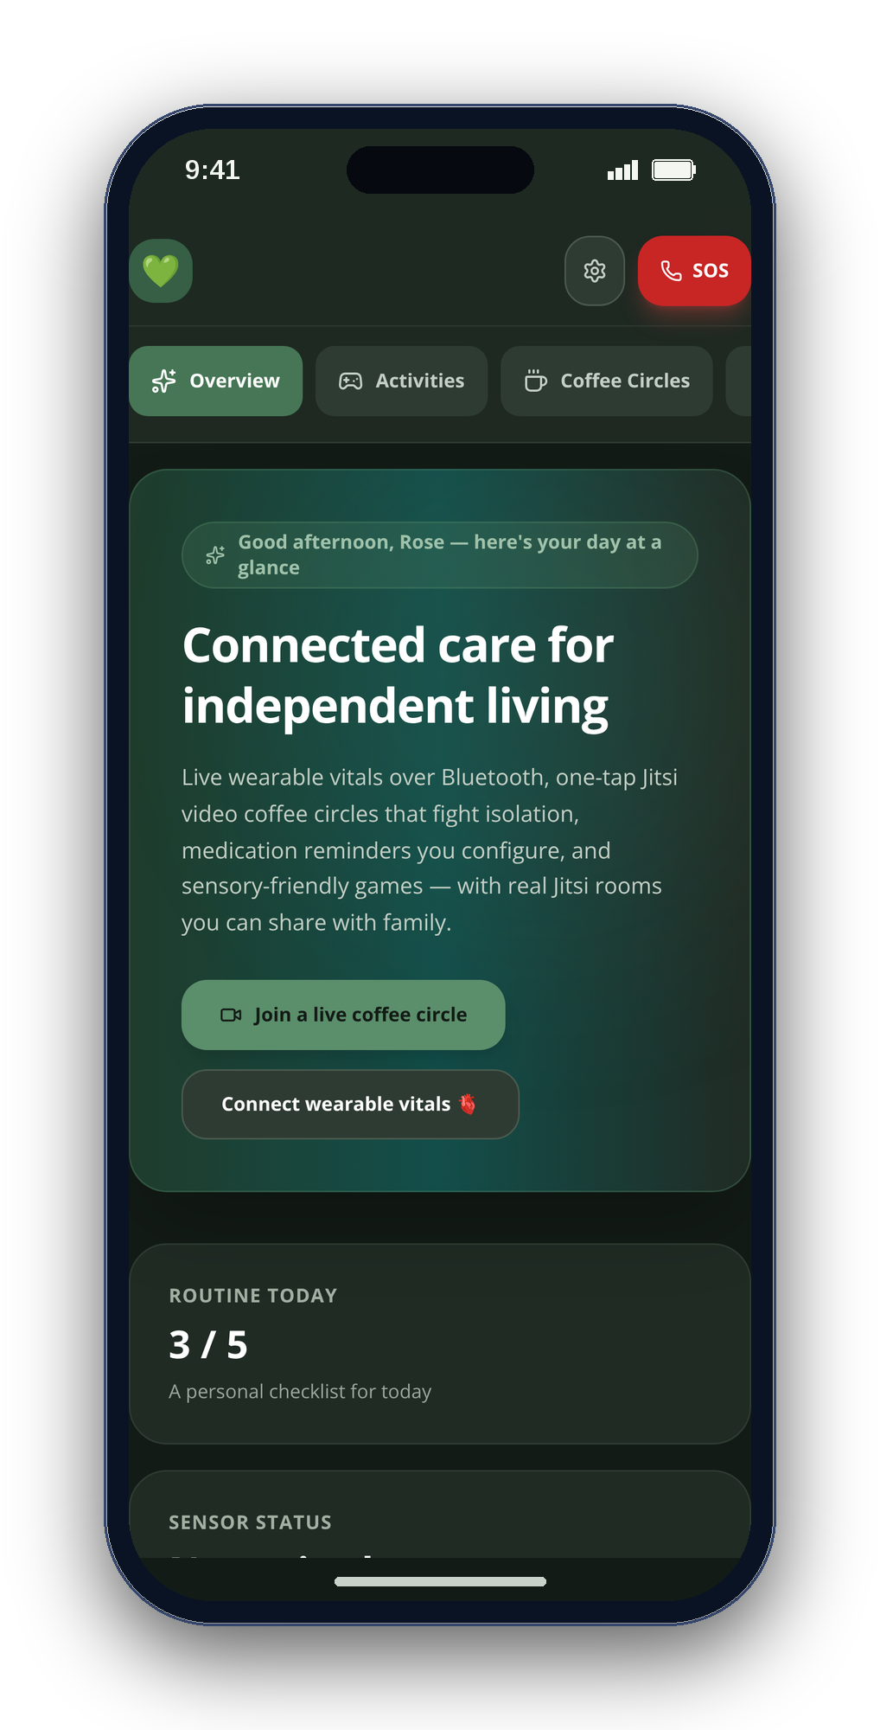
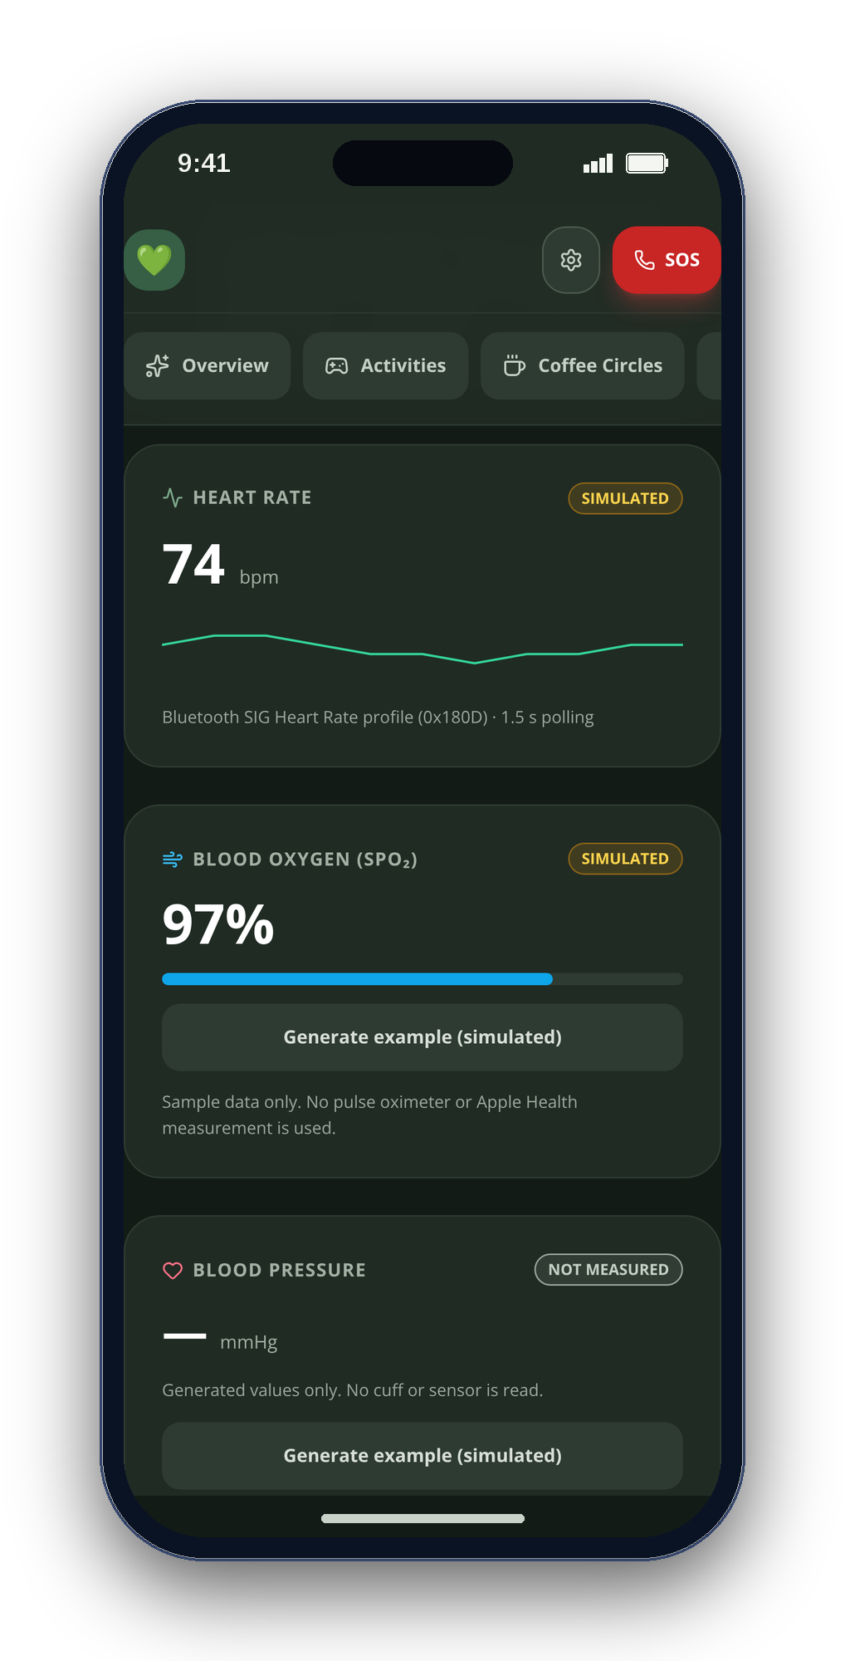
CONGRESSIONAL APP CHALLENGE 2026 · CA-10
CareSphere AI
Connected care for independent living
A private care companion for older adults, autistic people and the families who care for them.
Arnav Kochar
CA-10 · kochar4646@gmail.com
Notes:
[0:00–0:14] Hi, I'm Arnav Kochar, a [GRADE] at [SCHOOL] in [CITY], California. This is CareSphere AI — a private care companion for older adults, autistic people and their families, on iPhone and on the web.
VISUAL PROVENANCE: Real CareSphere web-app screenshots with seeded demonstration data, framed with script-drawn shapes. Not native iOS screenshots. No AI-generated imagery. No claimed user outcomes or clinical validation.

Slide 2
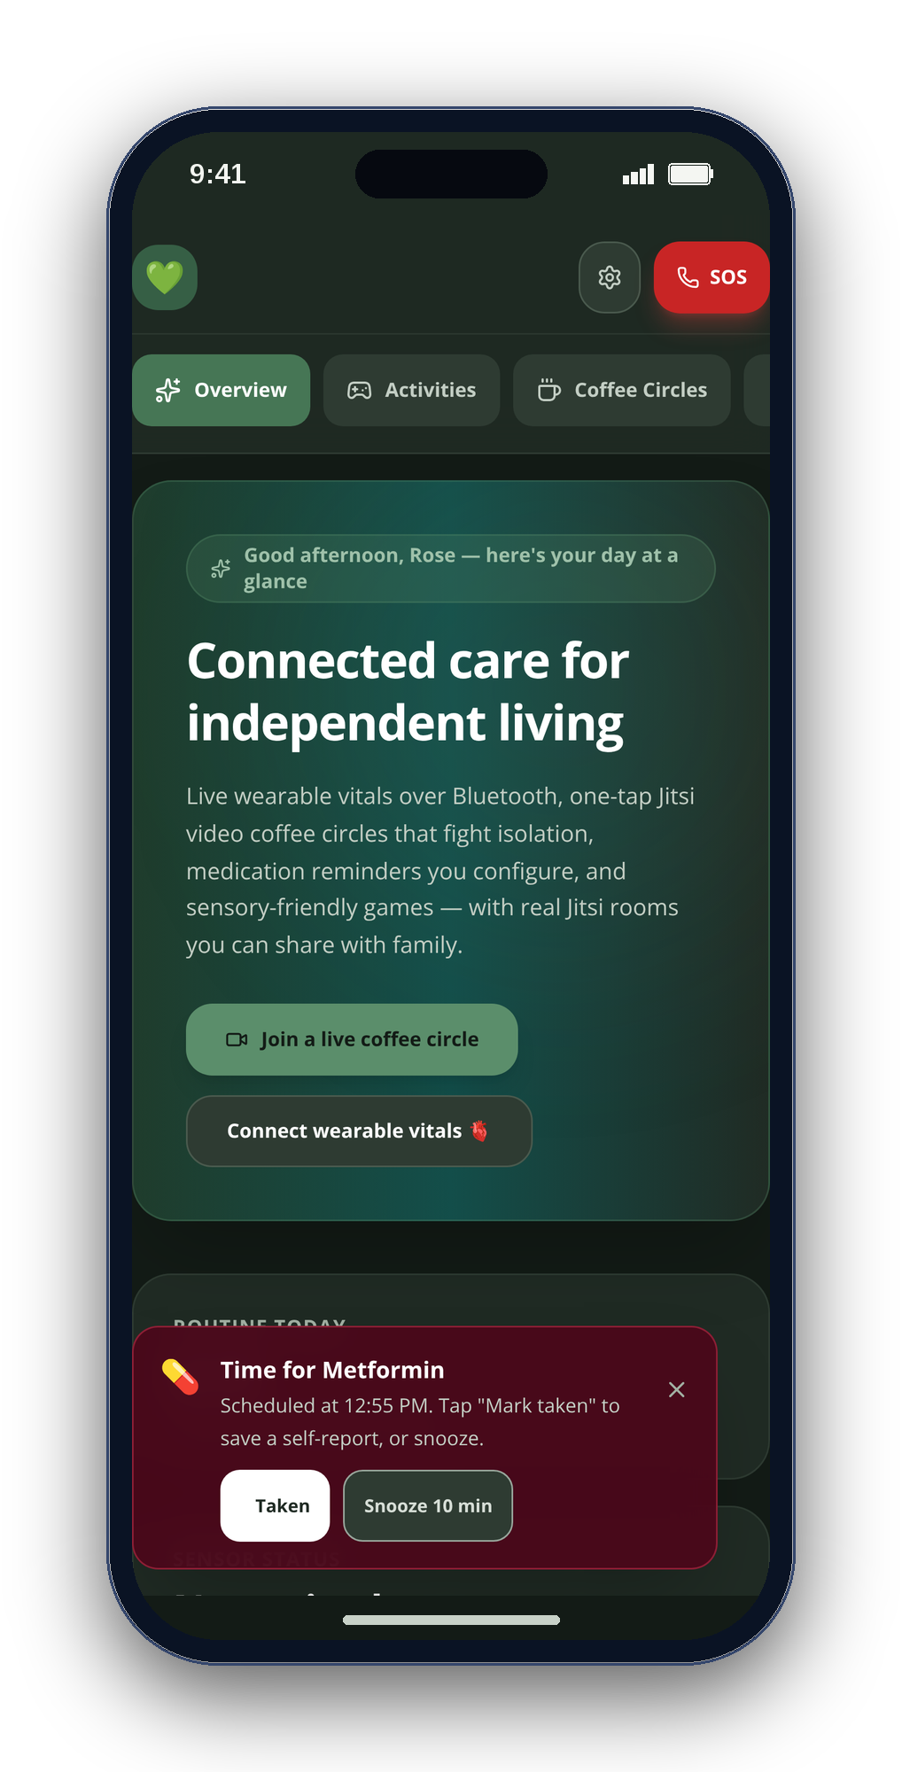
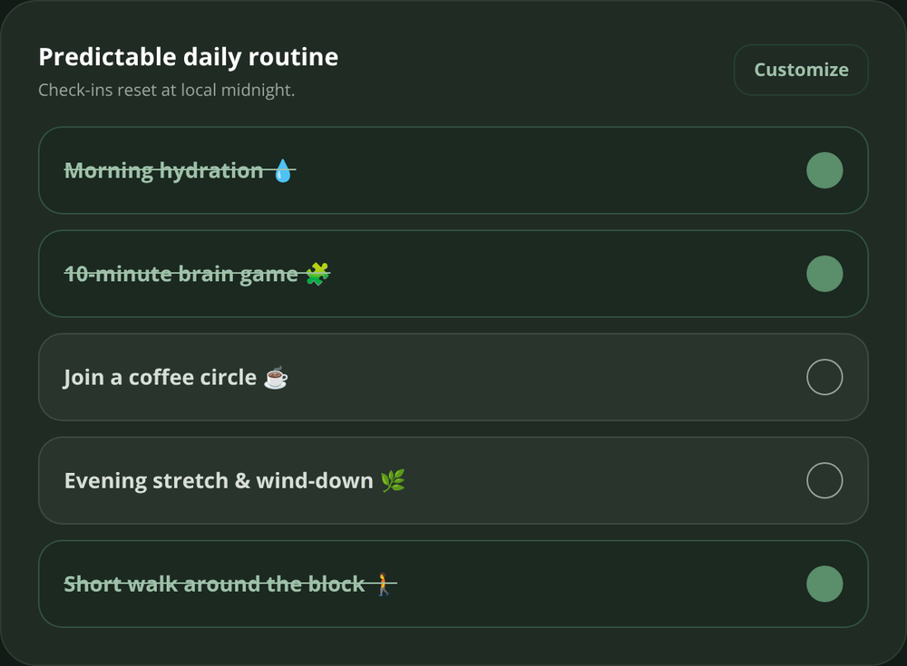
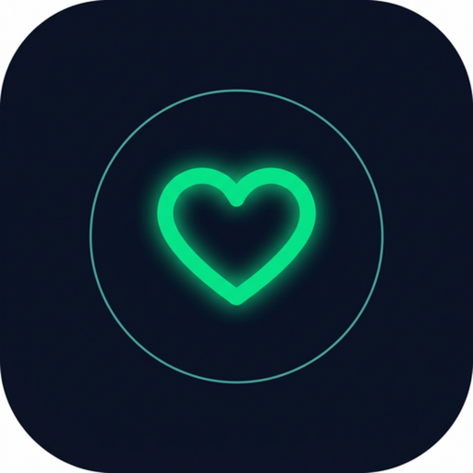
02
THE DESIGN CHALLENGE
Small moments. More independence.
A reminder you can act on.
A routine you can finish.
A person you can reach.
CareSphere brings everyday support together — without making care feel like another task.
CALM · HONEST · PRIVATE
CareSphere AI
REAL WEB-APP CAPTURES · SAMPLE DATA
Notes:
CareSphere was designed around everyday moments: remembering medication, following a routine and reaching someone. Add your own truthful personal motivation when narrating; no personal story has been assumed.

Slide 3
03
THE PROBLEM
Growing older — or growing up autistic — too often means facing care alone.
1 in 4
1 in 31
50%
older adults are socially isolated
children are autistic
of long-term medicines aren’t taken as prescribed
NASEM · 2020
CDC · 2025
WHO
Behind them: 63 million family caregivers. AARP & NAC, 2025
CareSphere AI
REAL WEB-APP CAPTURES · SAMPLE DATA
Notes:
[0:26–0:39] One in four older adults is socially isolated — a twenty-nine percent higher risk of early death. One in thirty-one children is autistic. Half of long-term medications aren't taken as prescribed. And sixty-three million family caregivers hold it all together.
VISUAL PROVENANCE: Real CareSphere web-app screenshots with seeded demonstration data, framed with script-drawn shapes. Not native iOS screenshots. No AI-generated imagery. No claimed user outcomes or clinical validation.

Slide 4
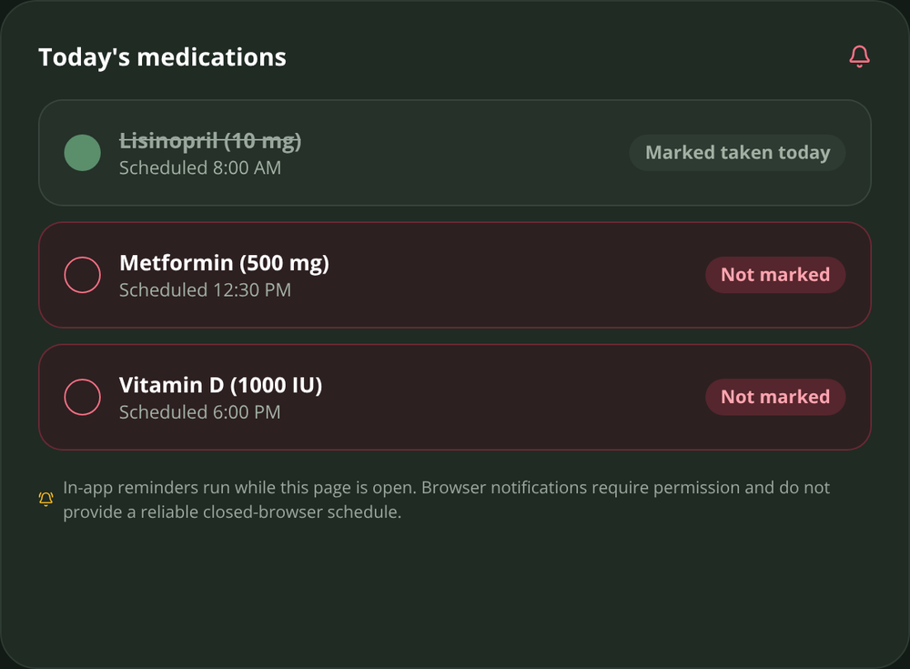
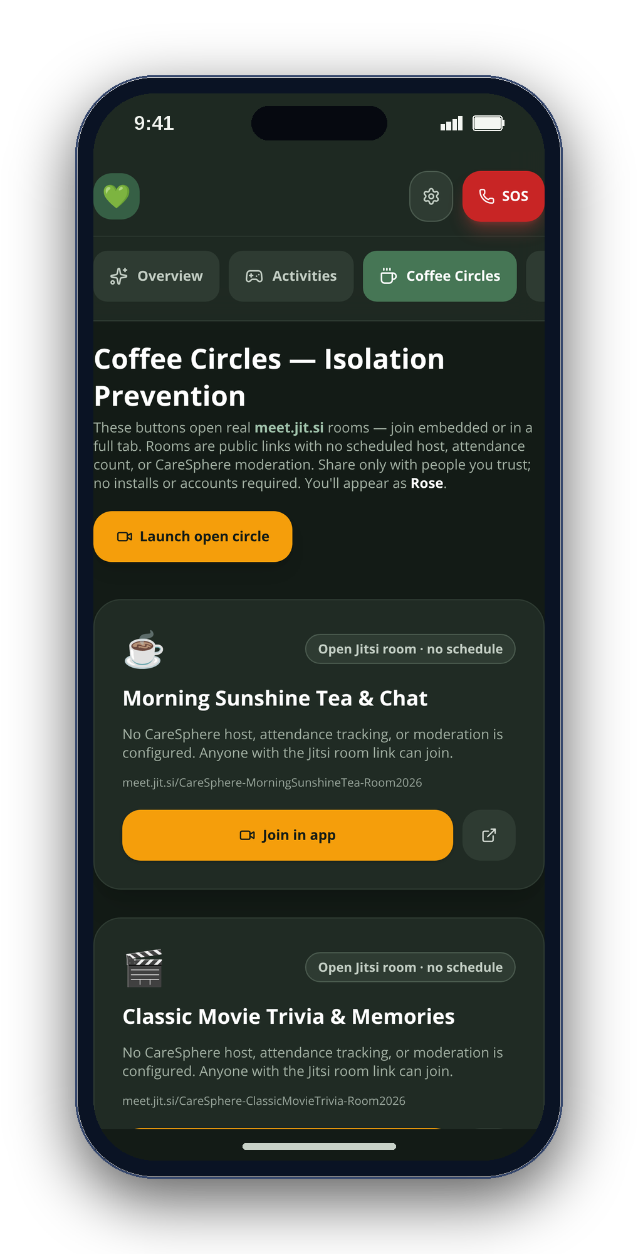
04
EVERYDAY SUPPORT
From a reminder to a real connection.
01 Remember
02 Find a rhythm
03 Reach someone
Medication self-check-ins
Simple daily routines
Coffee Circles via Jitsi
CareSphere AI
REAL WEB-APP CAPTURES · SAMPLE DATA
Notes:
These are actual CareSphere web-app screenshots showing medication self-check-ins, daily routines and Coffee Circles. The displayed entries are sample data. Coffee Circles uses external Jitsi infrastructure; no CareSphere care-data backend is required.

Slide 5
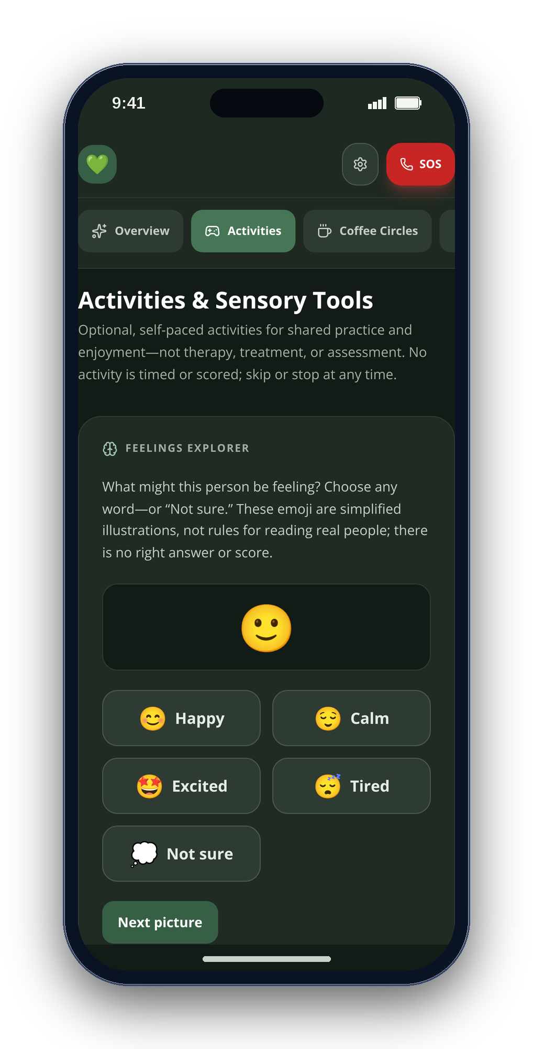
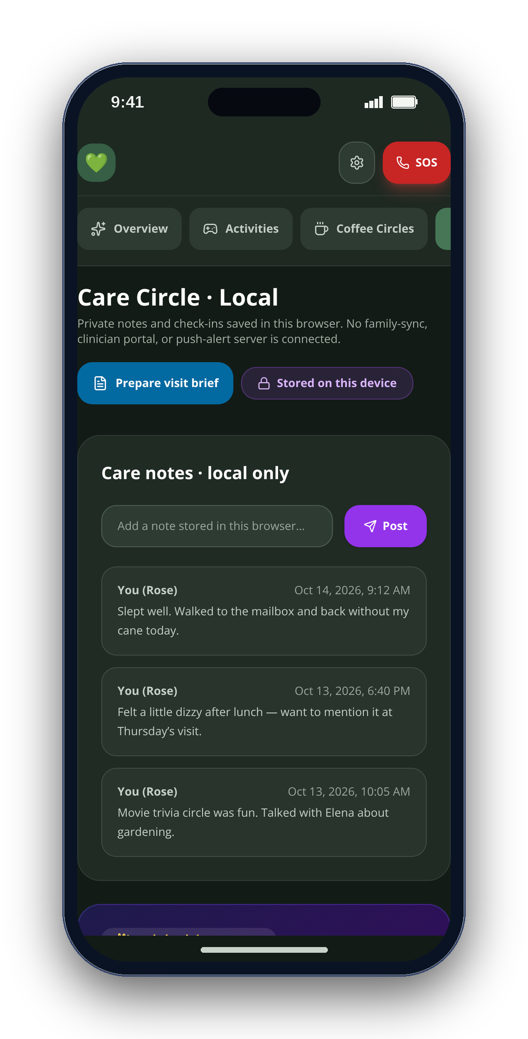
05
THE SOLUTION
One calm app. Five familiar places.
OVERVIEW
ACTIVITIES
COFFEE CIRCLES
CARE CIRCLE
VITALS
CareSphere AI
REAL WEB-APP CAPTURES · SAMPLE DATA
Notes:
[0:47–0:57] CareSphere is one calm app with five tabs — Overview, Activities, Coffee Circles, Care Circle and Vitals — with no server behind any of it.
VISUAL PROVENANCE: Real CareSphere web-app screenshots with seeded demonstration data, framed with script-drawn shapes. Not native iOS screenshots. No AI-generated imagery. No claimed user outcomes or clinical validation.

Slide 6
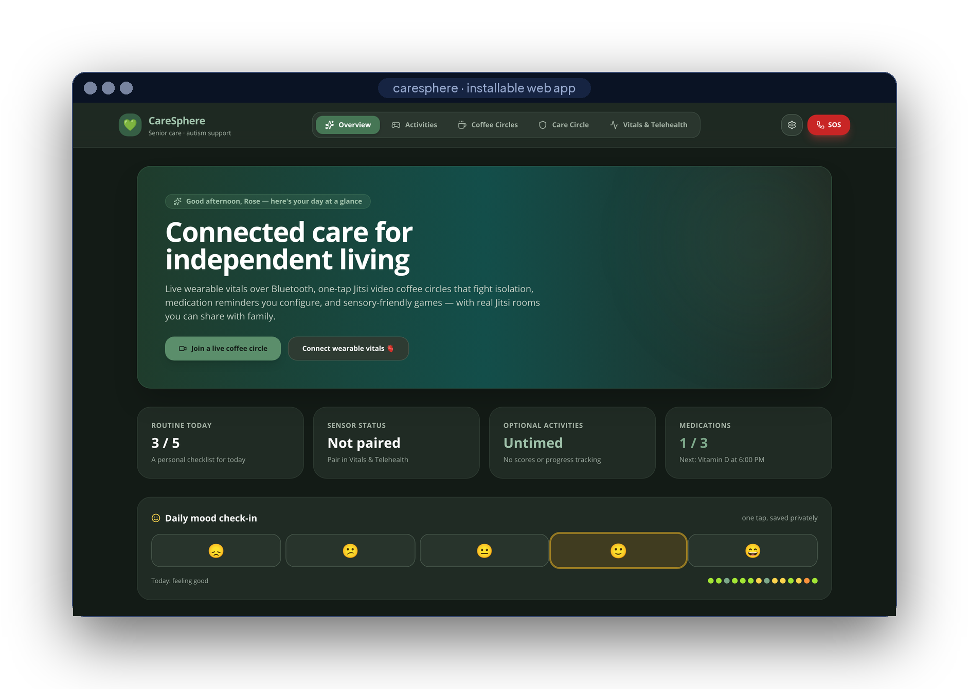
06
LIVE DEMO
Let’s see it.
SIX SHOTS · ONE TAKE
01
Mood check-in & routine
02
Reminder → Taken
03
Pair a sensor · export CSV
04
Pattern Recall · Rain
05
Join a Coffee Circle
06
Build the visit brief
REAL WEB APP · SAMPLE DATA
CareSphere AI
REAL WEB-APP CAPTURES · SAMPLE DATA
Notes:
[0:57–1:42] Let me show you. (Switch to the screen recording — six shots, see VIDEO_SCRIPT.md: mood check-in and routine; medication reminder and Taken; Bluetooth pairing or the labeled demo plus Export CSV; Pattern Recall and the Rain soundscape; join a Coffee Circle; build and download a visit brief.)
VISUAL PROVENANCE: Real CareSphere web-app screenshots with seeded demonstration data, framed with script-drawn shapes. Not native iOS screenshots. No AI-generated imagery. No claimed user outcomes or clinical validation.

Slide 7
07
WHAT MAKES IT DIFFERENT
Four rules, written into the code.
01
Never fabricate
every reading labeled where it is born
'LIVE_BLE' : 'SIMULATED'
02
Nothing sent automatically
a person always taps Send
navigator.share() · ShareLink
03
Calm by default
no timers, scores or auto-advance
Untimed · No scores
04
Private by architecture
no account, no server, encrypted
'AES-GCM', length: 256
CareSphere AI
REAL WEB-APP CAPTURES · SAMPLE DATA
Notes:
[1:42–1:53] What makes it different isn't a feature — it's four rules in the code: never fabricate a reading, never send anything automatically, calm by default, private by architecture.
VISUAL PROVENANCE: Real CareSphere web-app screenshots with seeded demonstration data, framed with script-drawn shapes. Not native iOS screenshots. No AI-generated imagery. No claimed user outcomes or clinical validation.

Slide 8
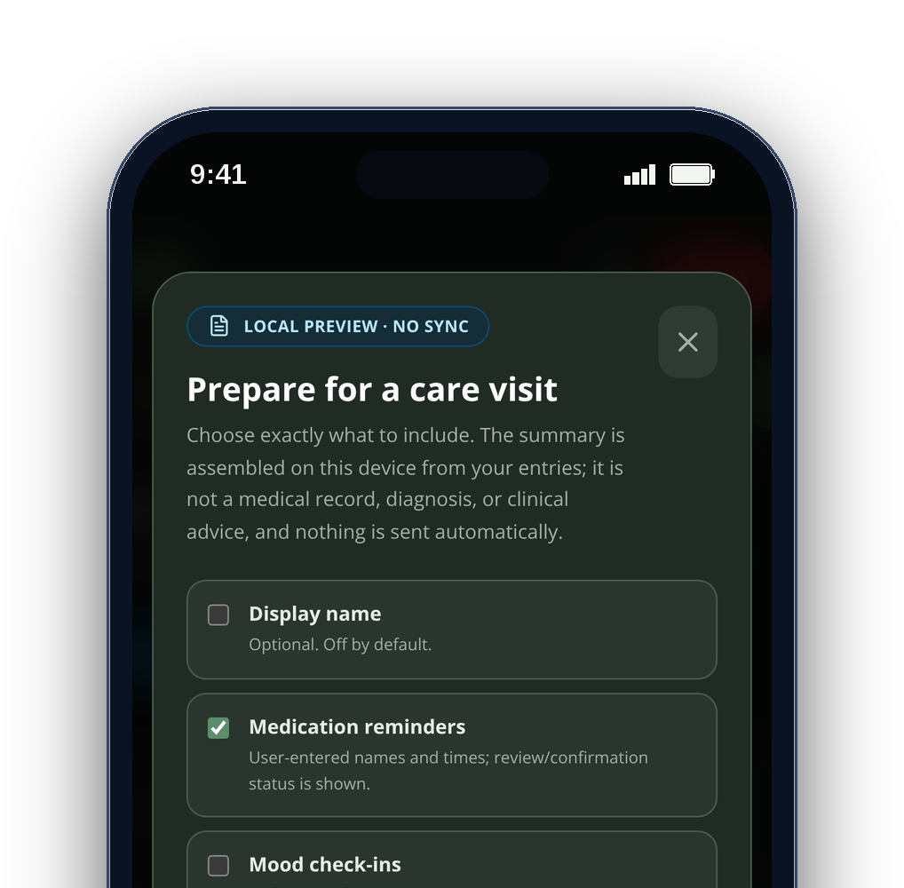
08
WHO IT’S FOR
Built for three people at once.
Older adults
Autistic teens & adults
Family caregivers
routines, reminders, real company
predictable, untimed, sensory-calm
notes and a brief they can trust
CareSphere AI
REAL WEB-APP CAPTURES · SAMPLE DATA
Notes:
[1:53–2:01] It's built for three people at once: older adults, autistic teens and adults, and the caregivers who support them.
VISUAL PROVENANCE: Real CareSphere web-app screenshots with seeded demonstration data, framed with script-drawn shapes. Not native iOS screenshots. No AI-generated imagery. No claimed user outcomes or clinical validation.

Slide 9
09
PRIVACY
Local care data. You choose what to share.
EXTERNAL CONNECTIONS
ON THE DEVICE
Calls & resources
Jitsi calls and online reference requests
Vitals
Health Guide
Encrypted store
BLE 0x180D · HealthKit, read-only
Qwen2.5-1.5B · llama.cpp, offline
AES-256-GCM · Face ID lock
A visit brief
only when you choose to share
Activities
Visit brief
Coffee Circles
CARESPHERE ARCHITECTURE
Web Audio · untimed, unscored
fields you pick · exact preview
links to real Jitsi rooms
0
0
0
accounts
care backends
trackers
CareSphere AI
REAL WEB-APP CAPTURES · SAMPLE DATA
Notes:
[2:01–2:12] Everything stays on the device: AES-256 encryption, Bluetooth and HealthKit read locally, and a 1.5-billion-parameter model that answers health questions offline. Zero accounts, zero servers, zero trackers.
VISUAL PROVENANCE: Real CareSphere web-app screenshots with seeded demonstration data, framed with script-drawn shapes. Not native iOS screenshots. No AI-generated imagery. No claimed user outcomes or clinical validation.

Slide 10
10
HOW IT’S BUILT
Two clients. Local-first care.
Web app
JAVASCRIPT
iPhone app
SWIFT
React 18
Vite 8
Tailwind 3
Web Bluetooth
SwiftUI
HealthKit
CoreBluetooth
Web Audio
Web Crypto
installable PWA
CryptoKit
Face ID
llama.cpp
Sherpa-ONNX
Jitsi SDK
11,400+
17 / 17
2
3
lines of code
tests passing
CI pipelines
public releases
CareSphere AI
REAL WEB-APP CAPTURES · SAMPLE DATA
Notes:
[2:12–2:23] It's React and JavaScript on the web, Swift and SwiftUI on iPhone — Web Bluetooth, HealthKit, CryptoKit and llama.cpp. Eleven thousand lines, seventeen tests, three public releases.
VISUAL PROVENANCE: Real CareSphere web-app screenshots with seeded demonstration data, framed with script-drawn shapes. Not native iOS screenshots. No AI-generated imagery. No claimed user outcomes or clinical validation.

Slide 11
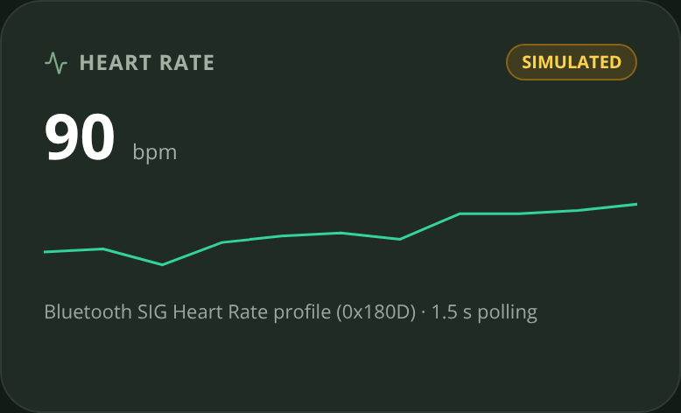
11
HARDEST PROBLEM
Making Bluetooth honest.
Heart-rate notifications arrive late and out of order — a stale sensor could repaint a new card with a wrong number.
src/lib/bluetooth.js · src/App.jsx
const flags = dv.getUint8(0)
const bpm = flags & 0x1
? dv.getUint16(1, true)
: dv.getUint8(1)
if (bpm > 20 && bpm < 250) onReading(bpm)
const source =
hrModeRef.current === 'live'
? 'LIVE_BLE' : 'SIMULATED'
if (generation !==
hrConnectionGenerationRef.current)
return
01
Parse the standard
service 0x180D · flags byte → 8/16-bit BPM
02
Label at the source
each sample is born LIVE or SIMULATED
03
Drop stale sessions
a generation counter ignores old pairings
CareSphere AI
REAL WEB-APP CAPTURES · SAMPLE DATA
Notes:
[2:23–2:35] The hardest problem was keeping Bluetooth honest: notifications arrive late and out of order, so I label every sample live or simulated at the source and drop stale sessions with a generation counter.
VISUAL PROVENANCE: Real CareSphere web-app screenshots with seeded demonstration data, framed with script-drawn shapes. Not native iOS screenshots. No AI-generated imagery. No claimed user outcomes or clinical validation.

Slide 12
12
WHERE IT STANDS
Built. Tested. Ready for co-design.
First commit
v2.1
Next
repo created
release · Sep 28
co-design → TestFlight
Sep 2
Sep 16
Sep 30
Oct 14
v1.0 + v2.0
v2.2
first public releases
iOS + web, building in CI
NEXT · V2.0 OF THIS ENTRY
THEN
DELIBERATELY NOT
Co-design sessions with autistic people, people living with dementia and caregivers; TestFlight beta.
Apple Health and Bluetooth history in the visit brief, with true source labels · non-diagnostic trends only from real readings.
Cloud sync, a clinician portal or a drug-interaction checker — not without clinical review.
CareSphere AI
REAL WEB-APP CAPTURES · SAMPLE DATA
Notes:
[2:35–2:47] Version 2.0 starts with co-design sessions with autistic people, people living with dementia and caregivers, then a TestFlight beta and sensor history in the visit brief — still with no server. (Deliberately not planned: cloud sync, a clinician portal or a drug-interaction checker — not without clinical review.)
VISUAL PROVENANCE: Real CareSphere web-app screenshots with seeded demonstration data, framed with script-drawn shapes. Not native iOS screenshots. No AI-generated imagery. No claimed user outcomes or clinical validation.

Slide 13
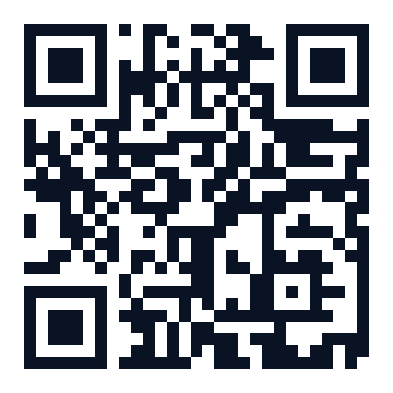
scan for source
Care that stays yours.
Connected, calm and local-first — with real readings or clearly labeled simulation.
EXPLORE THE PROJECT
READ THE CODE
BUILD LOCALLY
github.com/engineer2025-sudo/Care
Arnav Kochar · CA-10 · kochar4646@gmail.com
Explore the source, build instructions and project documentation.
Notes:
[2:47–2:53] CareSphere AI — care that stays yours. The code and install guide are on GitHub. Thank you.
VISUAL PROVENANCE: Real CareSphere web-app screenshots with seeded demonstration data, framed with script-drawn shapes. Not native iOS screenshots. No AI-generated imagery. No claimed user outcomes or clinical validation.

