Slide 1
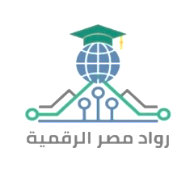


Slide 2
Group: YAT458A_ALX2_DRT1_S1
Submitted by:
Rewaa Ahmed Mohamed Harraz
Rahma youssef salah eldin
Nada Mohi Eldeen Ali
Amr Aly Abdel Aziz Mohamed Kotb
Amr Khaled abdel Mohsen
Abdelrahman Ahmed Saeed
Supervised by: Moemen El Badri

Slide 3
01
Vision VS Mission

Slide 4
Vision
To be the go-to solution for individuals seeking innovative and simple ways to prepare healthy and delicious meals using the ingredients they have, creating joyful and fulfilling food experiences in their daily lives

Slide 5
Mission
To offer innovative and easy-to-follow recipes that enhance users meal experiences, utilizing only the ingredients they have, ensuring health and variety, and bringing happiness and comfort to every meal through personalized food solutions

Slide 6

Direct competitors
Strengths | Weaknesses
Available in Arabic | There is no way to makethe food
product quantity, purchase date and expiration date- | Uncomfortable interface for the eyes
Make a shopping list | Not available on Google Play

Slide 7

Direct competitors
Strengths | Weaknesses
Available in Arabic | Doesn’t give exact recipe tailored for you
Available on Google Play | Too many ads in user interface
Distinctive visual identity | no specific dates for updates
Split meals for children and healthy meals for two people
Drinks and desserts are available
Fan meals are available-
Available food culture countries
You can easily add ingredients
Wanna Cook

Slide 8

Direct competitors
Strengths | Weaknesses
Provides short engaging videos demonstrating cooking steps | Not available in Arabic
Filter recipes by food type | Doesn’t offer the feature of adding available components
Make a shopping list | Inclusion of readily unavailable ingredients

Slide 9



Alternative services
Google assistant | Talabat | Youtube
Provides recipes based on user inquiries | Delivers food when the user is unable to prepare a meal | Contains rich, searchable cooking content.

Slide 10
SWOT analysis
Strengths
Weaknesses
S
W
Providing recipes based on the client's ingredients and tools specifically.
Request missing components from delivery orders Smart IoT fridge notifies your phone when items are running low.
The app shows fridge contents instantly
Limited budget
Lack of a programmer in the team
Poor time Mangement
O
T
Threats
Opportunities
Economic Changes
Rising Costs of Technical Services
Rapid Technological Developments
Competitors analyzed to determine added value. Create strong social media content.
There is a real need for the idea.

Slide 11
02
Bussiness Canvas Model

Slide 12
Product overview
Key Partners
Key Activities
Value Proposition
Customer Relationships
Customer Segments
Channels
Key Resources
Cost Structure
Revenue Streams

Slide 13
Our plans
Key Partners
Key Activities
Value Proposition
- AI technology providers (for NLP and recipe recommendation algorithms)
- Recipe databases and culinary content creators
- Food brands and kitchen appliance companies (for potential sponsorships)
- Grocery delivery services (for affiliate partnerships)
- Marketing agencies and social media influencers
- Personalized and instant recipe suggestions based on user preferences, available ingredients, and dietary needs
- Reduces meal planning time and food waste
- Accessible 24/7 through multiple digital platforms (mobile, web, social media)
- Offers a seamless, fun, and interactive cooking experience
- Development and continuous training of the AI bot
- Integration with databases for updated recipe content
- Marketing and customer acquisition campaigns
- Managing partnerships and business development
- Regular updates based on user feedback and technological advancements

Slide 14
Our plans
Customer Relationships
Customer Segments
Channels
- Self-service through the intuitive AI bot interface
- Personalized user experiences and tailored recipe suggestions
- Building a community through challenges, rewards, and social sharing
- Offering premium support for paid subscribers
- Mobile application (iOS & Android)
- Website platform
- Social media platforms (Instagram, TikTok, Facebook Messenger)
- Email newsletters with curated recipe collections
- Partnerships with grocery delivery services and e-commerce platforms
- Busy professionals seeking quick meal ideas
- Students looking for easy, affordable recipes
- Fitness enthusiasts requiring customized meal plans
- Families needing efficient meal planning solutions
- Home cooks interested in discovering new recipes

Slide 15
Our plans
Key Resources
Cost Structure
Revenue Streams
- AI development team and technical infrastructure (servers, APIs)
- Culinary content (recipes, videos, blogs)
- Marketing and social media teams
- Customer support team
- Financial resources for operational and marketing expenses
- Initial development and continuous improvement of AI technology
- Hosting, servers, and database maintenance
- Content creation and licensing fees
- Marketing campaigns and influencer partnerships
- Salaries and operational expenses
- Customer support services
- Freemium model: free basic features with premium subscription plans for advanced services (meal planning, nutrition tracking)
- In-app advertisements and sponsored recipes
- Affiliate marketing with grocery delivery and kitchen equipment companies
- Selling data insights (in compliance with privacy regulations) for food brands and market researchers

Slide 16

Notes for Financial Focus: - Include estimated startup costs vs. break-even point. - Estimate monthly revenue from premium users and advertisers. - Highlight marketing ROI (return on investment) for digital campaigns. - Consider potential funding rounds or partnerships for scaling.

Slide 17
Content strategy
I-Chef’s Facebook & LinkedIn Digital Marketing Strategy

Slide 18
Our plans
Primary Objectives
Brand Awareness: Position I-Chef as an innovative and valuable resource for food lovers.
Community Building: Establish a strong, interactive audience that trusts the brand.
Thought Leadership: Showcase expertise in food-tech to attract investors, media, and key industry players.
Pre-Launch Engagement: Build anticipation so that when the app is launched, there is already demand.
Content Monetization Potential: Prepare for future monetization through sponsorships, partnerships, and premium content.

Slide 19
FACEBOOK MARKETING STRATEGY

Slide 20
Our plans
Primary Audience:
Busy professionals & parents looking for quick, creative meal ideas
Food enthusiasts who love experimenting with new recipes
Young adults interested in trendy, budget-friendly cooking
Health-conscious individuals looking for nutritional insights
Secondary Audience:
Home cooks who struggle with meal planning
Food bloggers & influencers looking for collaborations
Entrepreneurs & tech enthusiasts interested in food-tech innovations

Slide 21

Key Content Themes

Slide 22
Storytelling (Emotional Connection)
Share relatable kitchen struggles & how I-Chef will solve them.
Example Post: “Tired of cooking the same meals every day? Here’s how I-Chef can help bring creativity back into your kitchen.”
Educational Content (Authority & Value)
“How to store food properly to reduce waste”
“5 kitchen hacks that will save you time”
Interactive & Community-Driven Content
Cooking challenges: “Use only 3 ingredients! What can you cook?”
Polls: “What’s your favorite comfort food?”

Slide 23
Behind-the-Scenes (Brand Transparency & Trust)
Showcase the journey of developing I-Chef.
“Here’s what’s happening behind the scenes as we build the first AI-powered chef in your pocket!”
User-Generated Content (Social Proof & Engagement)
Feature home chefs & food bloggers who engage with I-Chef.
Influencer Collaborations (Virality & Credibility)
Partner with Egyptian food influencers to boost visibility.
Live Cooking Sessions (Real-Time Engagement)
Weekly Facebook Live Q&A sessions with professional chefs.
Example: “Join us LIVE this Friday as Chef Ahmed shares his top meal prep tips!”
Call-to-Action (Engagement & Lead Generation)
“Tag a friend who NEEDS this cooking hack!”
“Comment below and we’ll send you a free meal plan!”

Slide 24
Facebook 3-Month Content Calendar Sample

Slide 25
Week | Monday | Wednesday | Friday | Sunday
1 | Story: "How I-Chef was born" | Poll: "What’s your biggest cooking struggle?" | Live: Cooking Challenge | Share a trending recipe
2 | Kitchen Hack Video | BTS: Building I-Chef | Influencer Collab | Story: A real user’s experience
3 | Quiz: "What’s your cooking personality?" | AI in FoodTech Insight | Live: Chef Q&A | Engagement Post: "Share your best food hack!"

Slide 26
Week | Monday (Storytelling & Education) | Wednesday (Community & Interactive) | Friday (Live & Video Content) | Sunday (Growth & Viral Content)
Week 1 | 🔹 How I-Chef Was Born: The story behind the idea & its vision | 🔹 Poll: "What’s your biggest cooking struggle?" (e.g., time, creativity, health) | 🔹 Live Session: Meet the team – answering questions about I-Chef | 🔹 Trending Recipe Challenge: “Try this dish & tag us!”
Week 2 | 🔹 Relatable Problem: “How many times have you asked ‘What should I cook today?’” (Engagement Post) | 🔹 Quiz: "What’s your cooking personality?" (Casual, experimental, gourmet?) | 🔹 Live Cooking Demo: A chef makes a dish with audience suggestions | 🔹 User-Generated Content: Reposting best dishes from followers
Week 3 | 🔹 Behind the Scenes: “Here’s what we’re working on for I-Chef’s future” | 🔹 Debate Post: "Team Sweet vs. Team Spicy – which do you prefer?" | 🔹 Live AMA (Ask Me Anything): "Everything you want to know about AI in cooking" | 🔹 Feature a food influencer trying out an I-Chef concept

Slide 27
Week 4 | 🔹 Success Story: “Meet Sara, a working mom who struggles with meal planning” | 🔹 Community Post: “What’s the best cooking hack you’ve ever learned?” | 🔹 Live Collab with a Chef: "Quick & easy dinner ideas" | 🔹 Cooking Meme or Fun Fact (Engagement Post)
Week 5 | 🔹 Pain Point Post: “Why do meal plans often fail? Here’s how I-Chef will change that” | 🔹 This or That: "Fried vs. Grilled – what’s your go-to?" | 🔹 Live Poll: "Choose ingredients for our next recipe!" | 🔹 TikTok-style food trend video
Week 6 | 🔹 Founder’s Journey: “Why we started I-Chef & our vision” | 🔹 Challenge: “Cook with only 5 ingredients – tag us!” | 🔹 Live Workshop: “How to make cooking faster & easier” | 🔹 Collab with a Micro-Influencer (Shoutout to their recipe)

Slide 28
Week 7 | 🔹 FoodTech Insights: “How AI is already changing the food industry” | 🔹 Food Confessions: “What’s your weirdest food habit?” | 🔹 Live Interview with a Nutritionist | 🔹 Behind-the-Scenes Video: How we’re building I-Chef
Week 8 | 🔹 Kitchen Hacks: “Top 5 ways to save time while cooking” | 🔹 User Submission Day: Feature best recipe ideas from followers | 🔹 Live Product Update: Sneak peek into I-Chef’s upcoming features | 🔹 Recap of Best Content from the Month
Week 9 | 🔹 Cooking Psychology: “Why do we crave comfort food?” | 🔹 Opinion Post: "What’s your ultimate lazy meal?" | 🔹 Live: Chef’s Tips for Beginners | 🔹 Viral Food Trend Repost
Week 10 | 🔹 Problem-Solution Post: "Struggling with healthy eating? Here’s how I-Chef can help" | 🔹 Fan Feature: "Meet our most engaged follower!" | 🔹 Live Giveaway: "Win a free meal plan from I-Chef!" | 🔹 Quick Hack Video: “Did you know this trick?”
Week 11 | 🔹 Food Myth Busting: "Is freezing food bad for nutrients?" | 🔹 Interactive Game: “Name this dish with emojis” | 🔹 Live Chat with a Food Blogger | 🔹 Major Announcement about I-Chef
Week 12 | 🔹 User Story: "How I-Chef helped Ahmed plan better meals" | 🔹 Community Challenge: "Try cooking in 20 minutes!" | 🔹 Live AMA (Final Pre-Launch Event) | 🔹 “What’s Next for I-Chef?” Post

Slide 29
Pro Tip: Use Facebook Groups to create a community around I-Chef. Example: “The I-Chef Cooking Club” where members share cooking tips & engage with the brand directly.
Facebook Advertising Strategy
Goal: Drive awareness and engagement Best Ad Types:
Video Ads → Show how I-Chef solves problems
Engagement Ads → Boost interaction & community growth
Lead Generation Ads → Collect emails for early app access
Targeting Strategy: Interest-based targeting: Food lovers, home cooks, working professionals Lookalike Audiences: People similar to engaged followers Retargeting: Users who watched videos or interacted with posts

Slide 30
Linkdn MARKETING STRATEGY

Slide 31
Our plans
Audience Persona (Who Are We Targeting?)
Primary Audience:
Tech investors & startup enthusiasts looking for innovation in food-tech.
Food industry professionals interested in AI’s impact on the culinary world.
Secondary Audience:
B2B potential partners (e.g., nutritionists, meal-kit delivery services).
Entrepreneurs & executives who follow startup trends.

Slide 32
Key Content Themes
Thought Leadership Articles
“How AI is Revolutionizing the Food Industry”
“Why the Future of Cooking is Personalized AI”
Behind-the-Scenes Startups Insights
Share the challenges & milestones of building I-Chef.
“Here’s what we learned in our first 6 months of building I-Chef.”
Industry Trends & Research-Based Content
Data-driven reports on food-tech.
Founders’ Personal Branding (Humanizing the Brand)
Team stories, investor insights, and collaboration opportunities.
Networking & Partnerships
Connect with relevant professionals for collaborations.

Slide 33
LinkedIn 3-Month Content Calendar Sample
Week | Tuesday | Thursday
1 | Article: "The Rise of AI in FoodTech" | Founder’s Journey: "Why We Started I-Chef"
2 | Industry Report: "The Future of AI in Cooking" | Case Study: How AI is Used in Global Kitchens
Week | Tuesday (Industry Insights & Thought Leadership) | Thursday (Engagement & Professional Growth)
Week 1 | 🔹 The Future of AI in FoodTech: How Smart Cooking is Evolving | 🔹 Founder’s Story: The challenges of building I-Chef
Week 2 | 🔹 Case Study: How AI is transforming the food industry globally | 🔹 Open Discussion: “What’s one kitchen innovation you wish existed?”
Week 3 | 🔹 Behind-the-Scenes: How we’re developing I-Chef | 🔹 Networking Post: "Tag someone who should join the FoodTech revolution"
Week 4 | 🔹 Infographic: The biggest food-tech trends in 2024 | 🔹 Poll: "Would you trust an AI-powered meal planner?"
Week 5 | 🔹 Success Stories: What food startups are getting right | 🔹 Collaboration Post: “Looking for partners in the food industry”

Slide 34
Week 6 | 🔹 AI vs. Human Chefs: The debate on food innovation | 🔹 Q&A Post: "Ask us anything about I-Chef’s development"
Week 7 | 🔹 Investor Insight: Why FoodTech is the next big industry | 🔹 Networking Post: “Who are the top voices in AI & food tech?”
Week 8 | 🔹 Product Development: “Here’s what we’ve built so far” | 🔹 Recruitment Call: Looking for testers & collaborators
Week 9 | 🔹 Market Research: “How consumer behavior is changing in the kitchen” | 🔹 Live LinkedIn Event: Panel discussion on AI & food trends
Week 10 | 🔹 Data-Backed Article: "The ROI of AI in meal planning" | 🔹 Industry Debate: “What’s more important – convenience or nutrition?”
Week 11 | 🔹 Feature a Startup Mentor: What they think of I-Chef | 🔹 Recap: The biggest lessons from our journey
Week 12 | 🔹 Big Announcement: "What’s next for I-Chef?" | 🔹 Call to Action: “Join our mission to change how people cook”

Slide 35
Final Takeaways & Growth Strategies
Facebook Focus: Build an engaged community that is excited for I-Chef’s launch. LinkedIn Focus: Establish thought leadership & attract potential investors/partners. Cross-Promotion: Repurpose high-performing content between platforms.
Paid Growth Strategy:
Facebook: Engagement ads → Video views ads → Retargeting ads.
LinkedIn: Sponsored articles + InMail campaigns for investor outreach.
By the end of this 3-month plan, I-Chef will have: ✔ A highly engaged audience excited for the launch ✔ Established authority in the food-tech industry ✔ Potential investors, partners, and early adopters

Slide 36
Instgram MARKETING STRATEGY

Slide 37
Our plans
Key Themes:
Showcasing AI-Driven Recipe Innovations:
Creative Recipe Creations
Collaborations with Famous Egyptian Chefs:
User feedback & Content Recycling:
Content Formats:
Feed Posts: Static posts, carousels, reels, and IGTV sessions (3 times per week).
Stories: Daily behind-the-scenes, polls, Q&As, and interactive elements.
Language: All captions and on-screen text in local Arabic with culturally relevant hashtags.

Slide 38
Week | Day | Content type & Details | Stories (Additional Engagement)
1 | Monday | poster: logo and app teaser | rhetorical question about the app
 | Wednesday | reel: launching the app | check out the latest reel
 | Friday | reel: Content recycling and stitch | meal prep difficulties
2 | Monday | Tutorial AI feature & recipe showcase | Quick tutorials; BTS snaps of recipe creation; interactive poll.
 | Wednesday | Content Recycling with Local Twist. | Snippets from original posts with added commentary; opinion poll.
 | Friday | poster: Behind-the-scenes team vibe | Team snapshots; mini-interviews; candid moments.
3 | Monday | poster: fanbase suggestion | Teasers from the collaboration; BTS prep clips; “Ask the Chef”.
 | Wednesday | memes | Quick facts about local trends; interactive quizzes; polls.
 | Friday | Recap & Call-to-Action. | Recap stories; thank-you messages; final poll/Q&A.

Slide 39
Youtube MARKETING STRATEGY

Slide 40
Our plans
Key Themes:
AI-Powered Recipe Demos & Tutorials:
Behind-the-Scenes & Team Vlogs:
Collaborative Series with Famous Egyptian Chefs & Dietitians:
Local Culinary Trends & Cultural Integration:
Content Formats:
Long-Form Videos: 8–15 minute tutorials, vlogs, and interviews (3 times per week).
Shorts & Community Posts: Daily snippets, teasers, and interactive polls to maintain viewer engagement.
Language: Videos and community posts in local Arabic to ensure cultural resonance.

Slide 41
Week | Day | YouTube Video Content | Additional Engagement (Shorts/Community Posts)
1 | Monday | I-chef AI Demo showcasing its features. | Teaser clip on Shorts; community poll.
 | Wednesday | Behind-the-Scenes: Building I-chef. | BTS snippet on Shorts; community poll.
 | Friday | Interview with Famous Egyptian Chef (Part 1). | Teaser clip from the interview; community Q&A.
2 | Monday | I-chef Recipe Demo. | Quick recipe tip on Shorts; poll on which recipe demo to feature.
 | Wednesday | Team Vlog: The Creative Process. | BTS clip on Shorts; community question.
 | Friday | Interview with Famous Egyptian Chef (Part 2). | Highlight snippet on Shorts; community poll.
3 | Monday | Dietitian’s Corner interview. | Teaser clip on Shorts; poll on nutrition tips.
 | Wednesday | Exploring Egyptian Culinary Trends. | Quick local trend fact on Shorts; community poll.
 | Friday | I-chef Highlights recap video. | Recap highlight clip on Shorts; community poll.

Slide 42
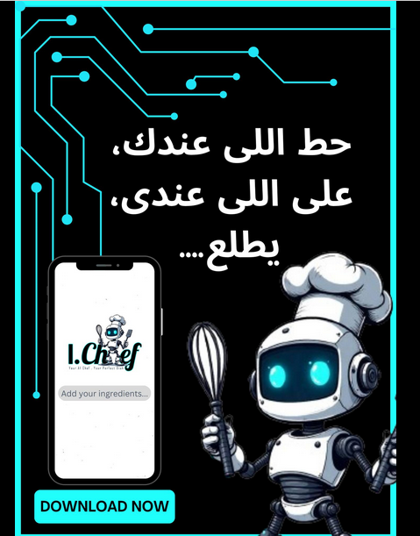
"حط اللي عندك، على اللي عندي، يطلع..." مع تطبيق I.Chef، كل اللي عليك تضيف مكوناتك، ويطلعلك أشهى الوصفات! ذكاء اصطناعي بطعم البيت #Ichef #AIchef #طبخ_ذكي #وصفات_سهلة #تطبيق_الطبخ #ذكاء_اصطناعي #طبخ_بمكوناتك

Slide 43
Reviews
xxxx
xxxx
xxx
xxxxx

Slide 44
Awesome Comments

Slide 45
xxxxxx
xxxxx

Slide 46
03
Market & Competition

Slide 47
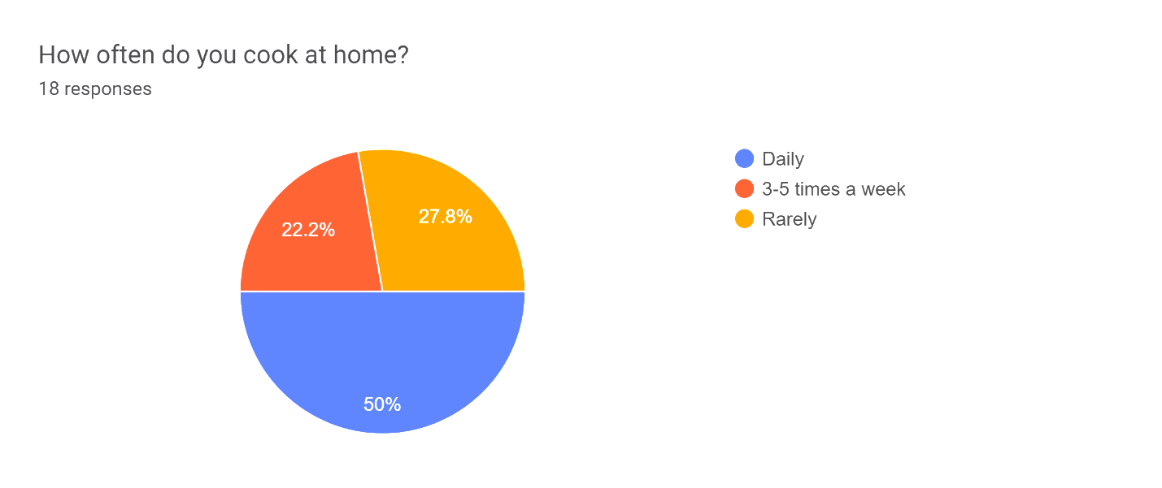

Slide 48
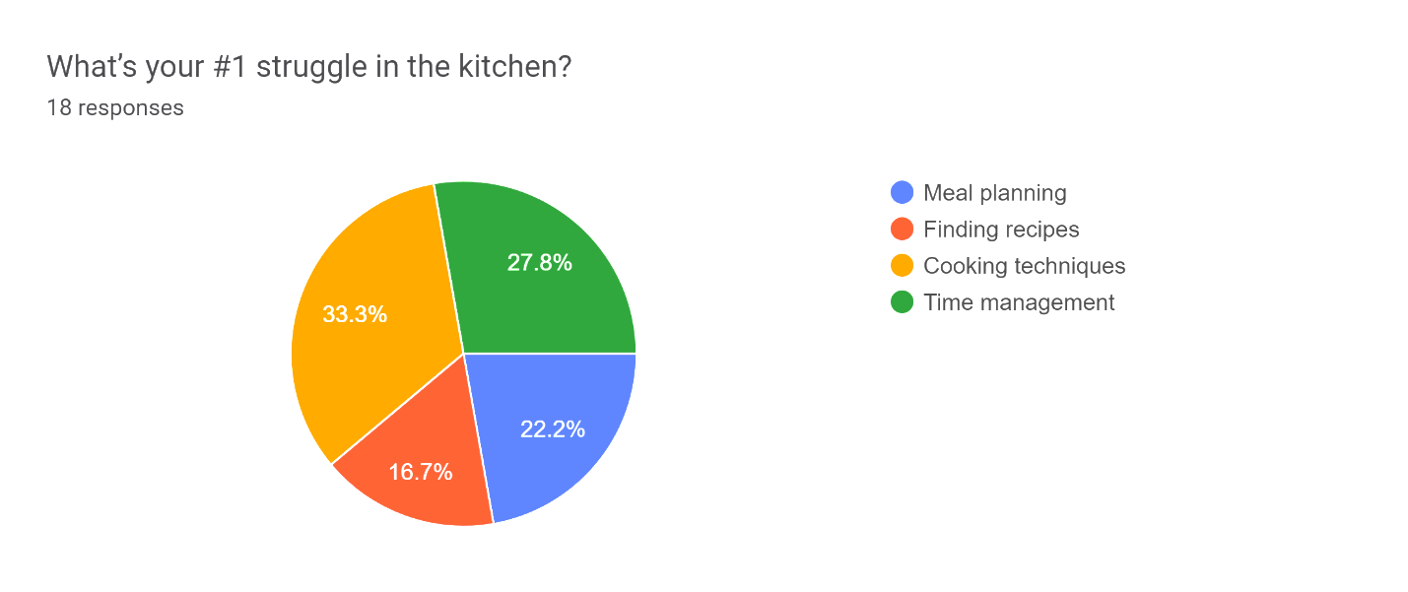

Slide 49
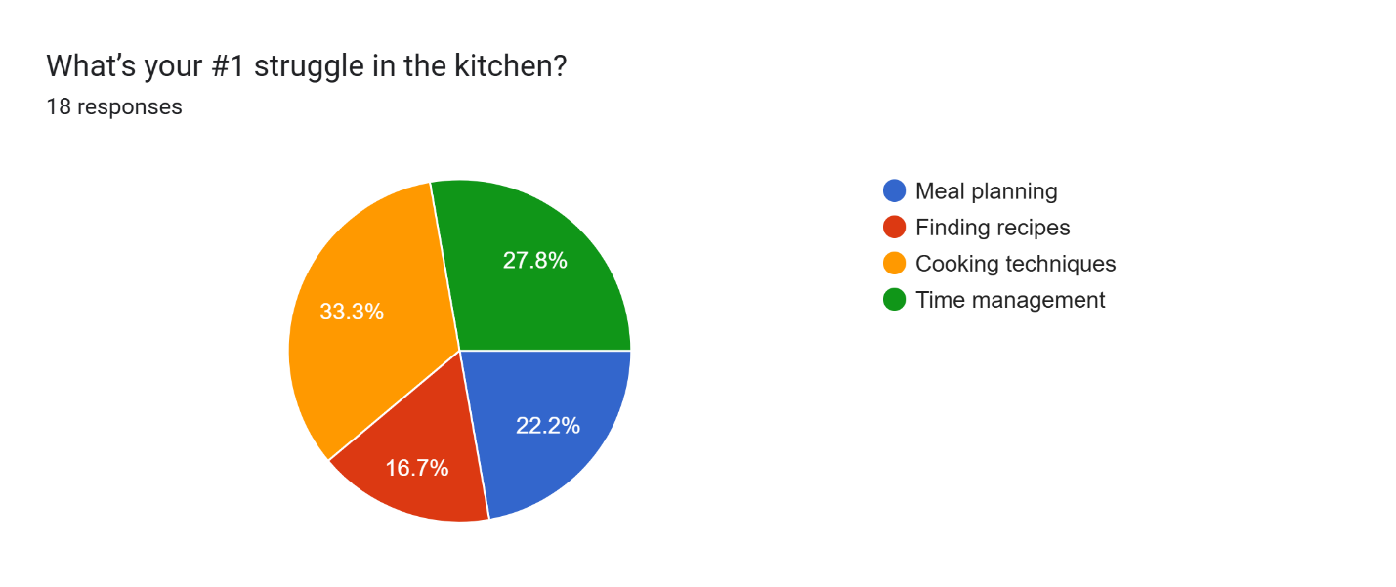

Slide 50
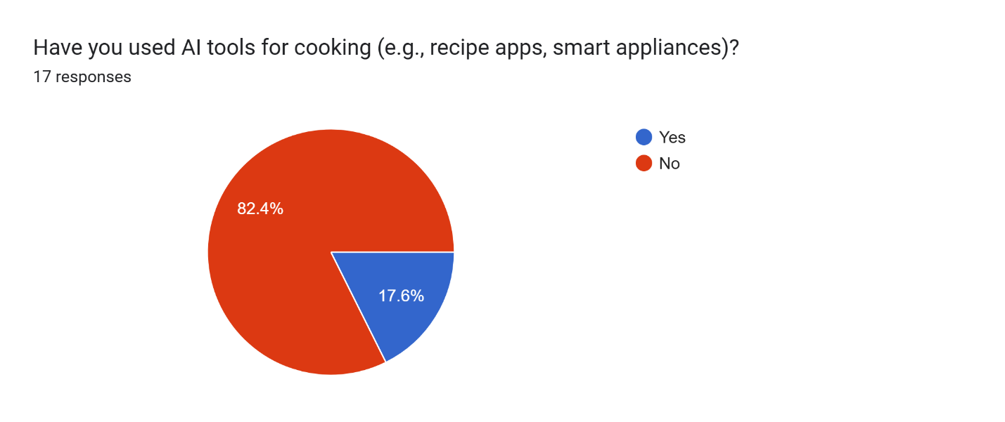

Slide 51
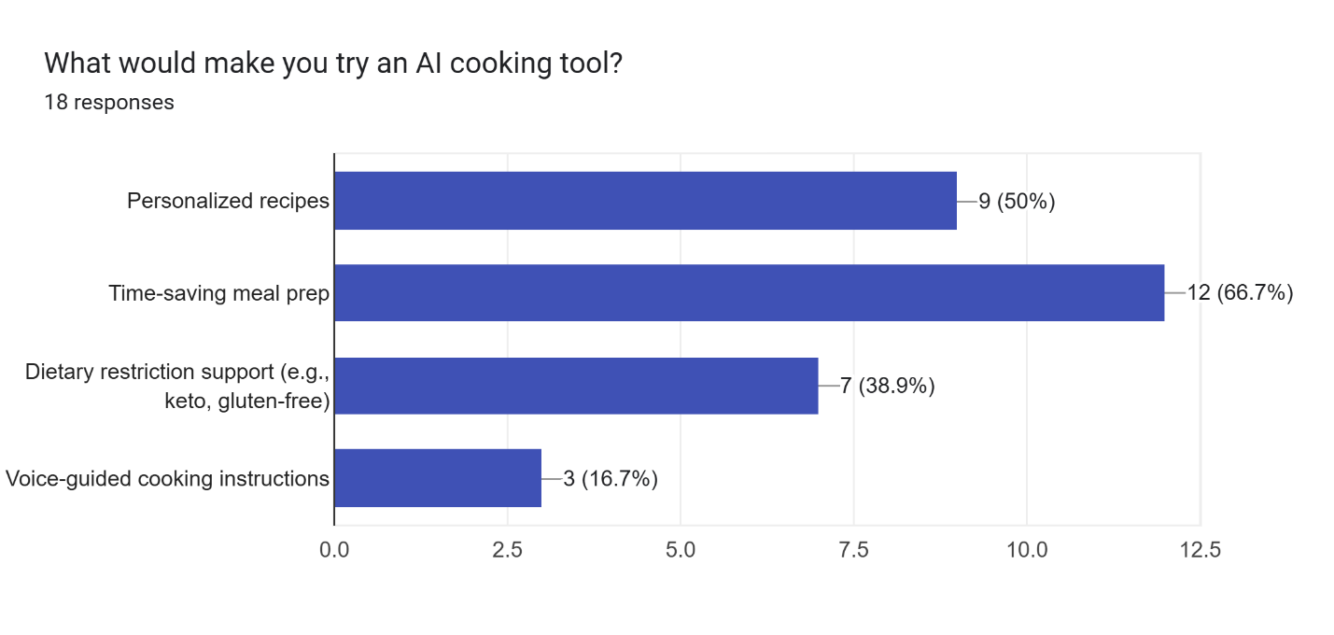

Slide 52
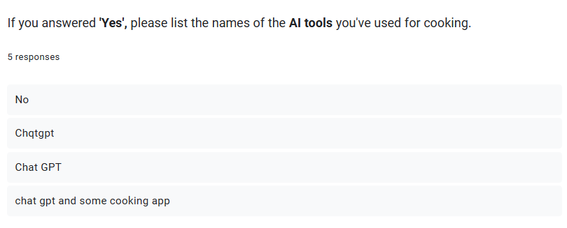

Slide 53
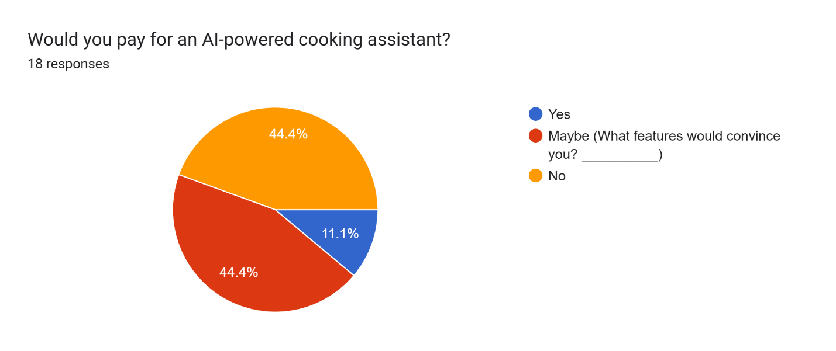

Slide 54
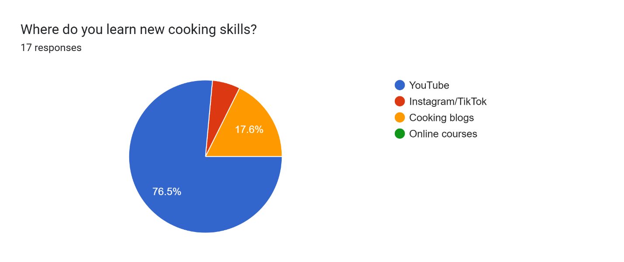

Slide 56
Thanks!

