Slide 1
Hack The Bay
Challenge 2: Data Gaps

Slide 2


AUTHORS
Richard Latham
Data Scientist Booz Allen
Lu Sevier
Data Scientist Booz Allen

Slide 3
Agenda
Overview: Growth of citizen science data
Solution: Visualizing how CMC data compliments CBP data
Next Steps: Analyzing the outcomes of the CMC prioritization report published in 2017

Slide 4
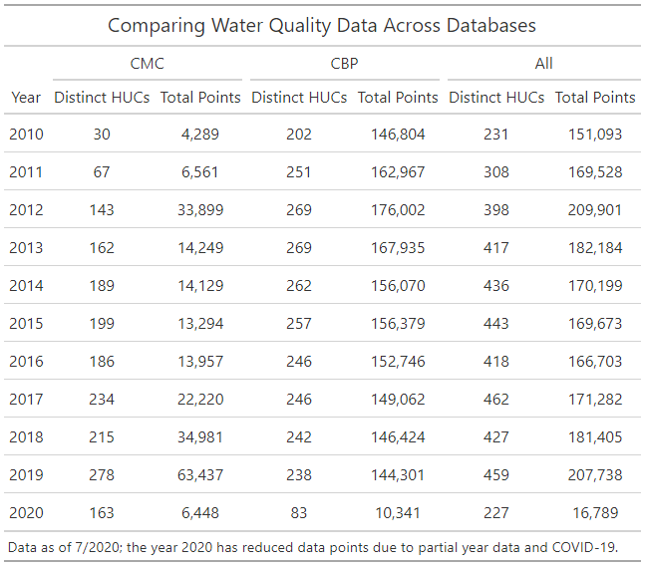
Overview: Data collection in the Chesapeake Bay watershed has exploded in the last 10 years
The combination data from the Chesapeake Bay Program (CBP) and the Chesapeake Bay Monitoring Cooperative (CMC) represented 1,796,495 measurements from 2010-2020
Since 2010, CMC data has increased from 4K points a year to 63K points a year. In 2019, CMC took measurements across 278 distinct HUCs, across 6 states and the District of Columbia.
Since 2010, CBP data has stayed relatively stable, changing from 147K points a year to 144K points a year. In 2019, CBP took measurements across 238 distinct HUCs, across 6 states and the District of Columbia.

Slide 5
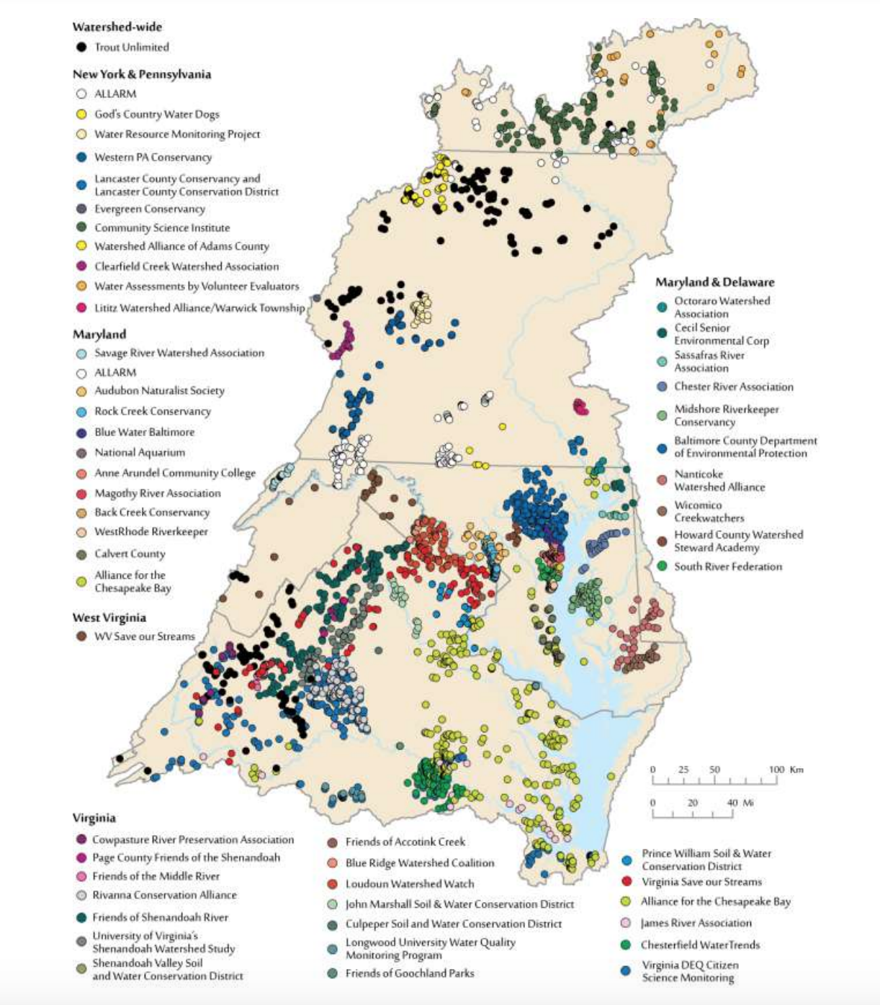
This citizen scientist call to action has increased data collection and united monitoring groups across the watershed.
In 2019, CMCs data represented 30.5% of all water quality data collected in a year.

Slide 6
Visualizing how CMC compliments CBP data

Slide 7
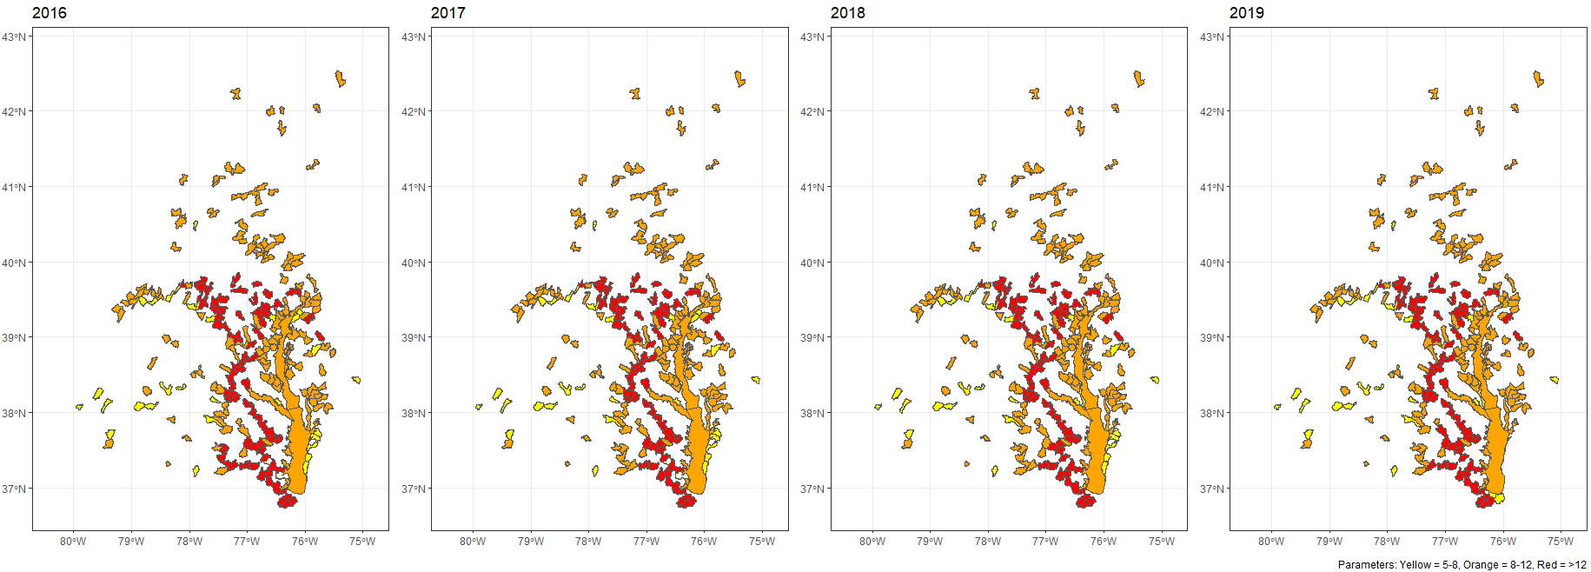
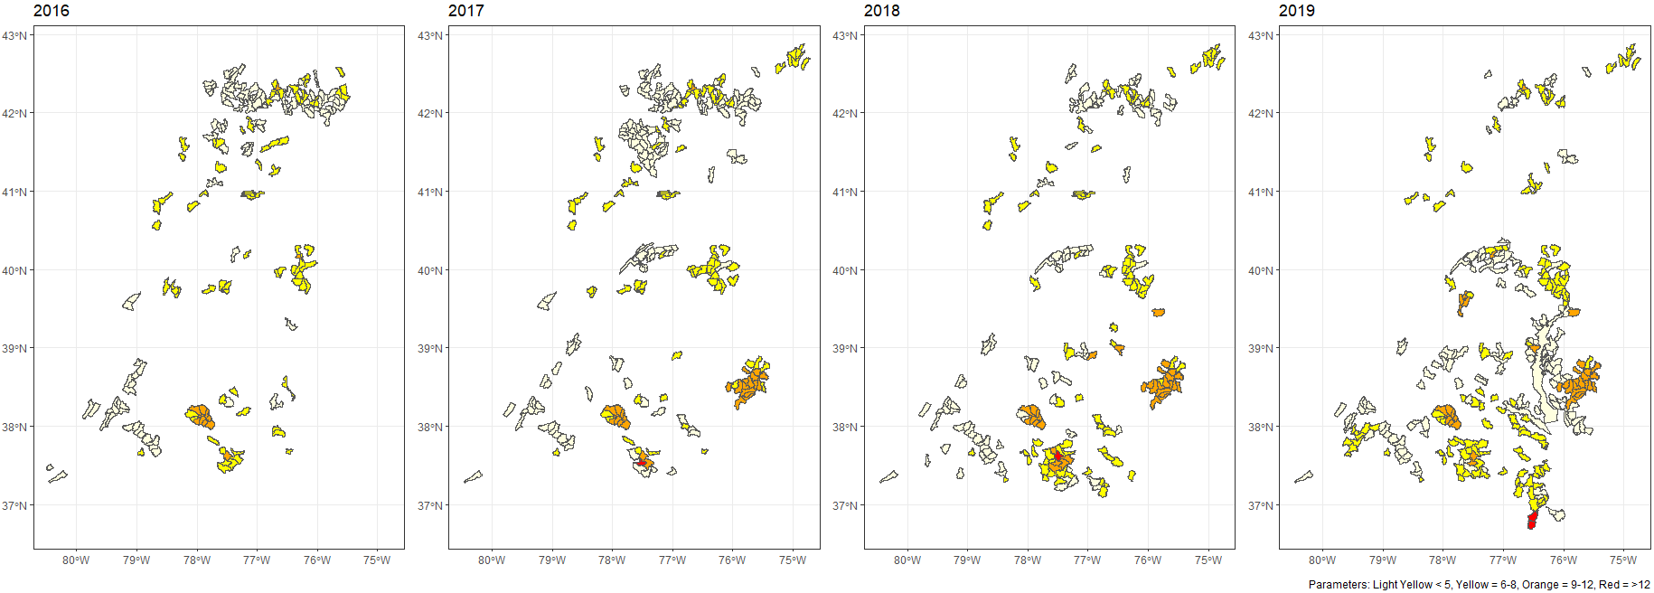
Visualization: CBP has a large diversity of data parameters across 4 years compared to CMC
CBP
CMC

Slide 8
Visualization: The diversity of data parameters of CMC has increased in the past 4 years

Slide 9
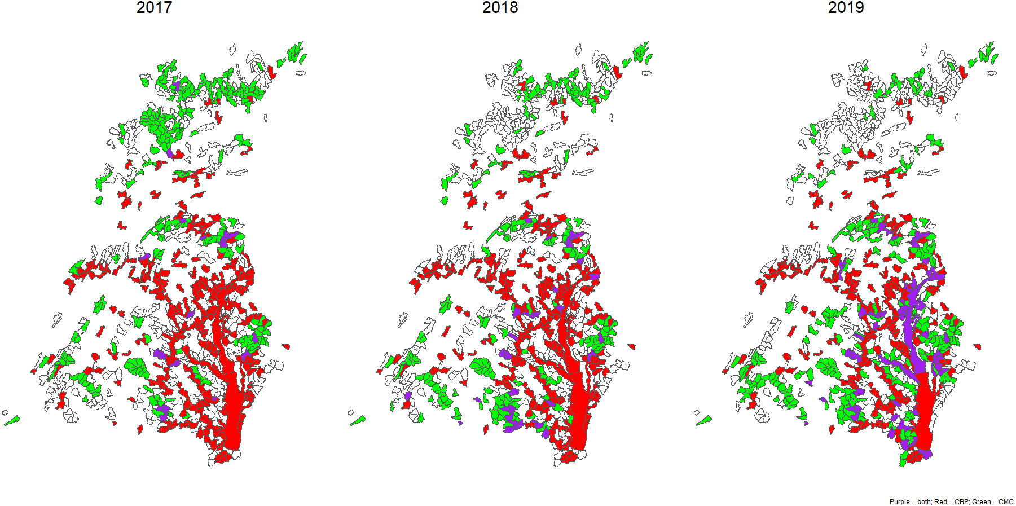
Visualization: CMC data continues to measure water quality in areas that the CBP does not reach

Slide 10
Does CMC data reflect the goals outlined in the 2017 Prioritization report?

Slide 11
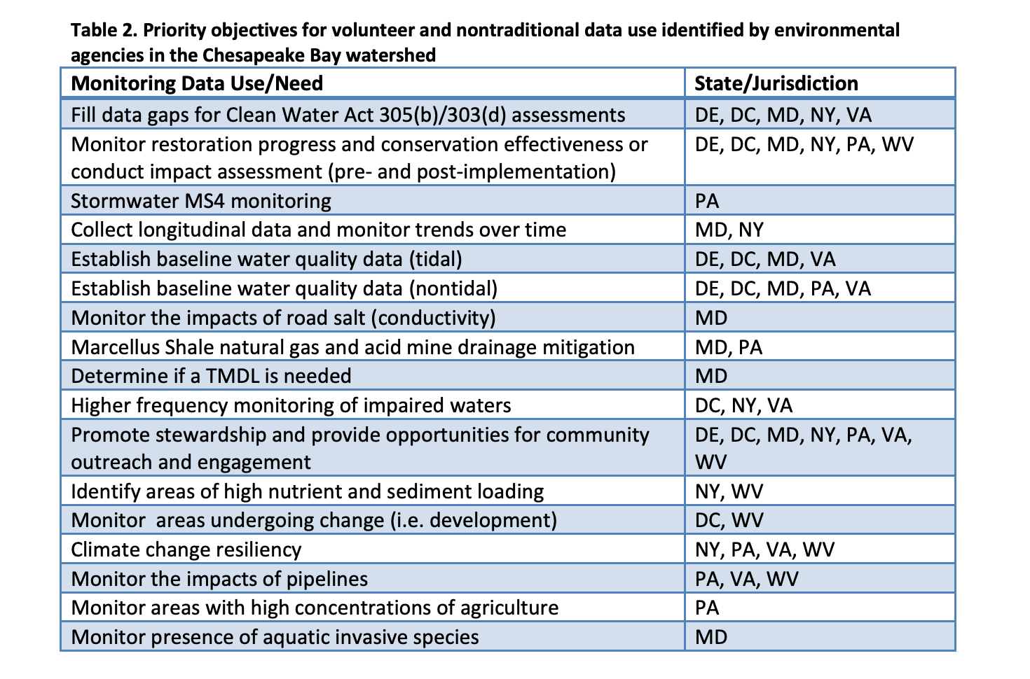
CMC 2017 Prioritization report
The Chesapeake Bay Monitoring Cooperative published a report in 2017 outlining how volunteer and nontraditional monitoring can help fill data gaps in the Chesapeake Bay watershed. The report not only identifies basic monitoring objectives in each state but outlines preliminary plans of action for how local monitoring groups could support state agency environmental measurement efforts.
CMC Prioritization Report, March 2017 - https://www.chesapeakemonitoringcoop.org/wp-content/uploads/2018/08/Prioritization-Report_Final.pdf

Slide 12
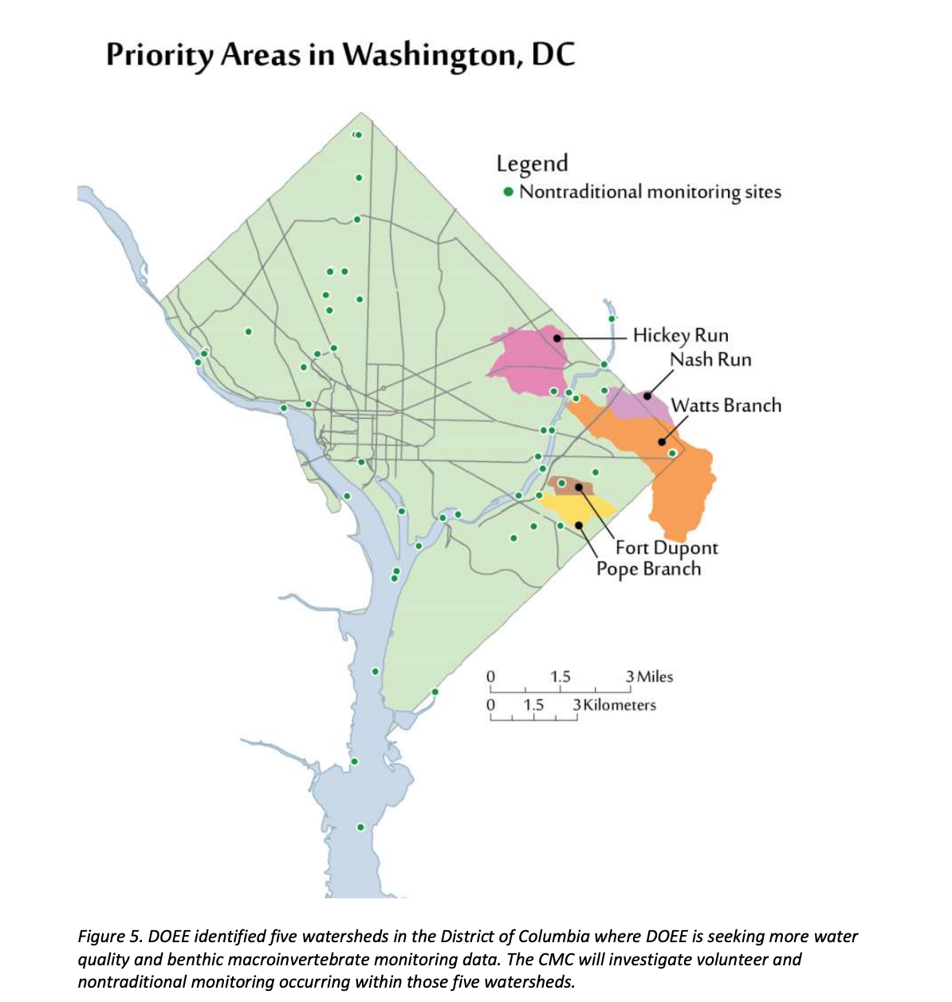
Example: District of Columbia (2017 – 2019)
Department of Energy and Environment (DOEE) is interested in baseline data, such as dissolved oxygen, water temperature, conductivity, pH, and benthic macroinvertebrates. They identified five small watersheds to collect more measurements.
Pope Branch
Nash Run
Hickey Run
Watts Branch
Ft. Dupont

Slide 13
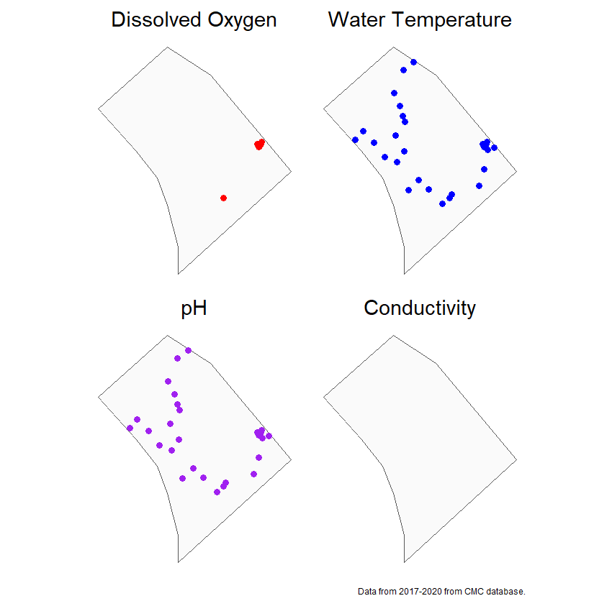
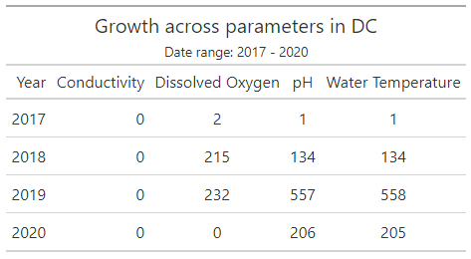
Example: District of Columbia (2017 – 2019)
Since the publishing of the CMC prioritization report, dissolved oxygen, water temperature, pH and water quality measurements have increased in the DMV in line with the requests from the DOEE. Note that the team did not find any measurements for conductivity.

Slide 14
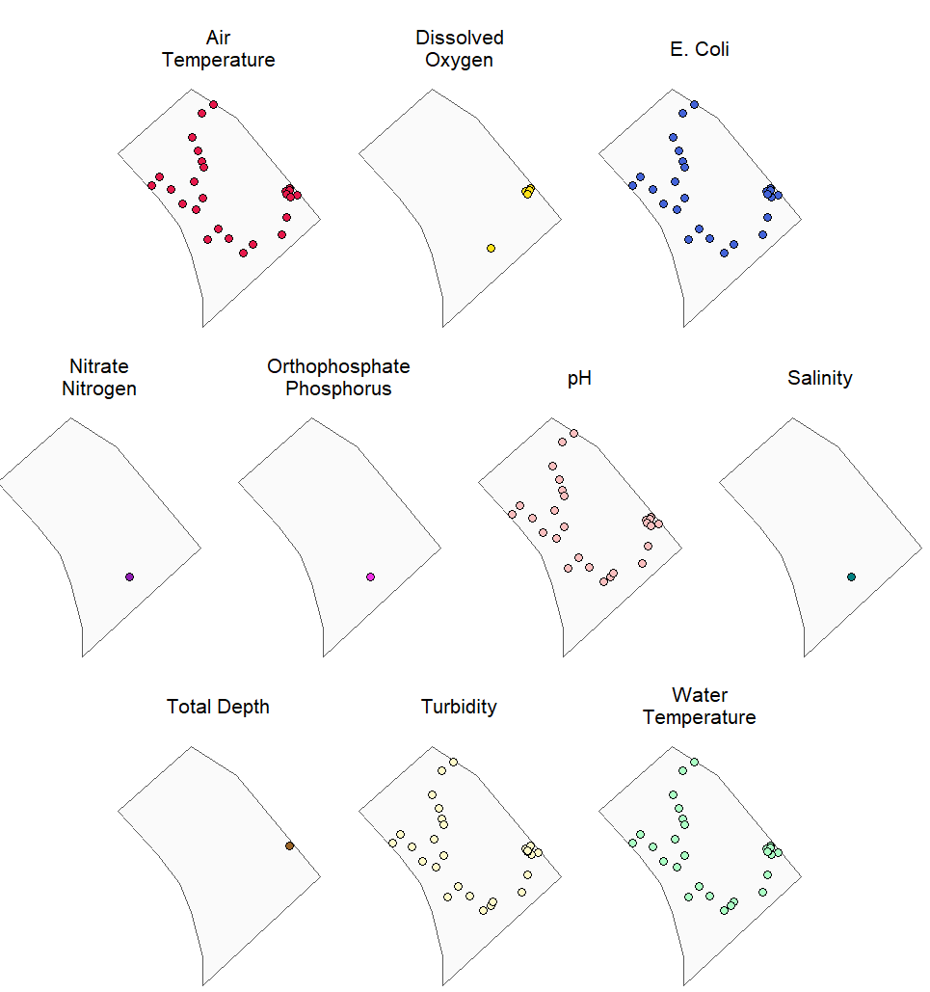
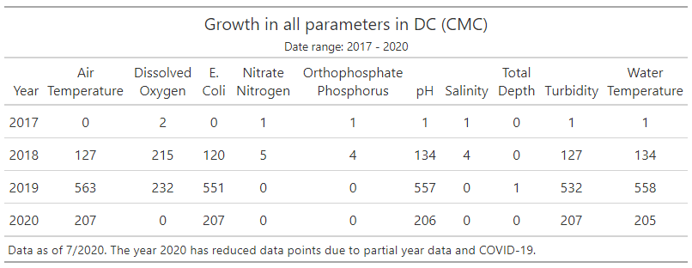
Example: District of Columbia (2017 – 2019)
In these three years, DC has also had an increase in the following variables Air Temperature and Turbidity which may be of help to the DOEE and other environmental measurement efforts.

Slide 15
Next Steps: Prioritization

Slide 16
Recommendations
Replicating this simple data gaps analysis can provide quick answers to the location of data gaps in the watershed and tangible actions. Possible next steps:
Complete a data gap analysis for all listed states the CMC 2017 Prioritization report.
Share the successes. Where has the data met the goals defined in the report? How has data also increased in this region? Thank the monitoring groups responsible for this great work.
Collect feedback from the agencies who requested data to learn about their experience using the data. How did they use the data? Was it at the tier that they were looking for?
Identify data gaps. What data is missing from these regions based on the plan of action defined in the report?
Scale the analysis by creating a dashboard or yearly report to compare data to outcomes of the 2017 Prioritization Report.

