Slide 1
PRISMA
Not necessary, but once per machine could do this:
To create a new prisma database host:
CREATE USER prisma_user WITH PASSWORD ‘prisma_user’ SUPERUSER;
createdb prisma_user;

Slide 2
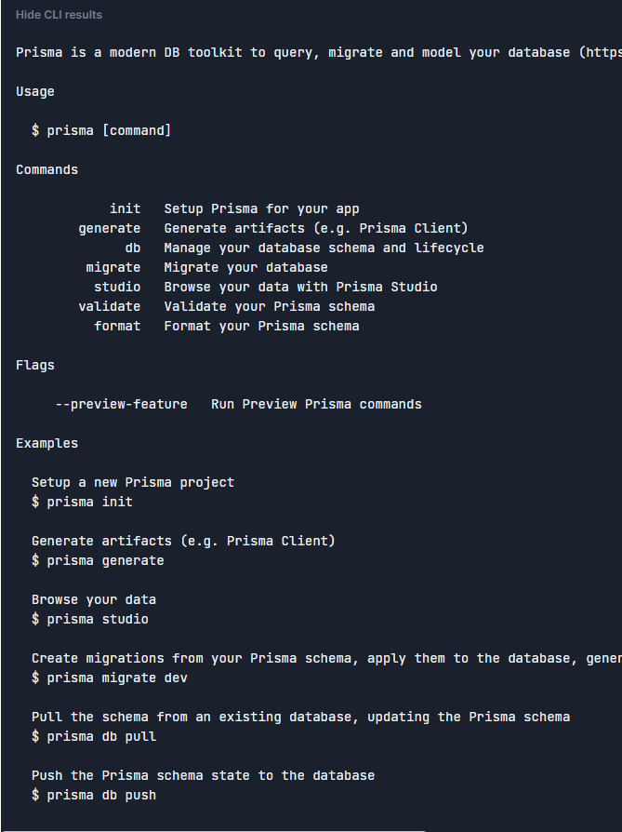
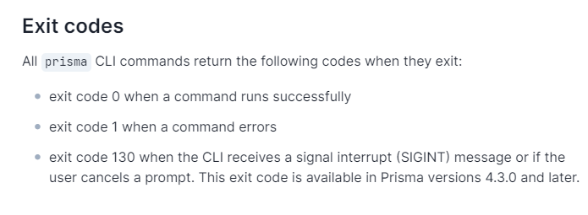
Getting Started
Npm install prisma - - save dev
Npx prisma
Npx prisma init
In Psql terminal:
Create database dbname

Slide 3
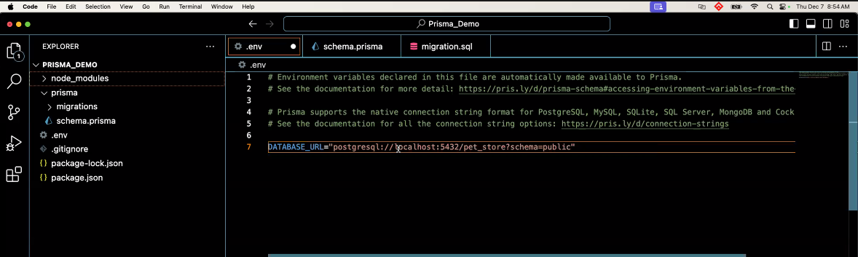
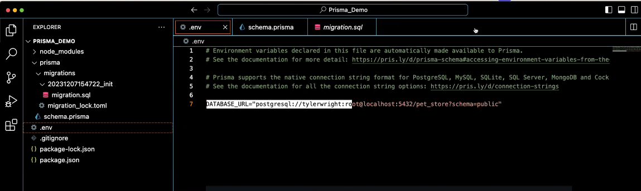
.env file
DATABASE_URL=‘POSTGRESQL:// localhost:5432/blah blah blah’
This connects sets up the connection to your database
Longer if there is a password

Slide 4
If you are working on an existing database
This command will look at existing database and create a schema based on it:
Npx prisma db pull
Baseline database
Npx prisma migrate dev – name init

Slide 5
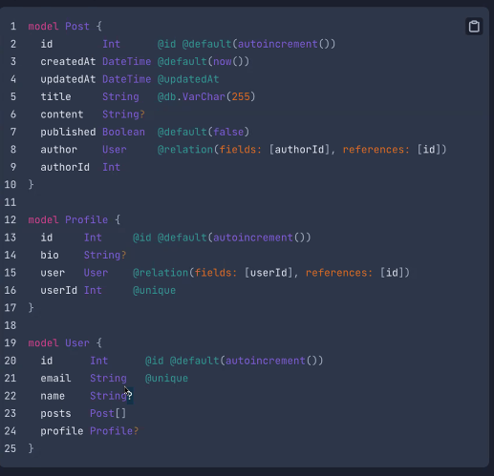
Set up the tables
Set up the tables
Data types (from documentation)

Slide 6
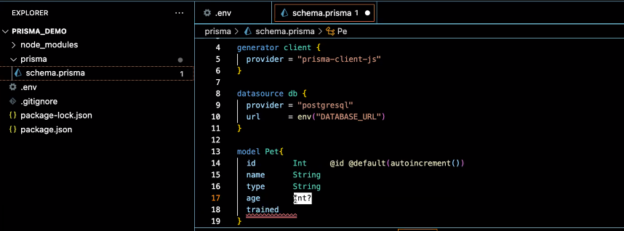
Creating a table
In prisma folder / schema.prisma
To execute this code:
npx prisma migrate dev --name init

Slide 7
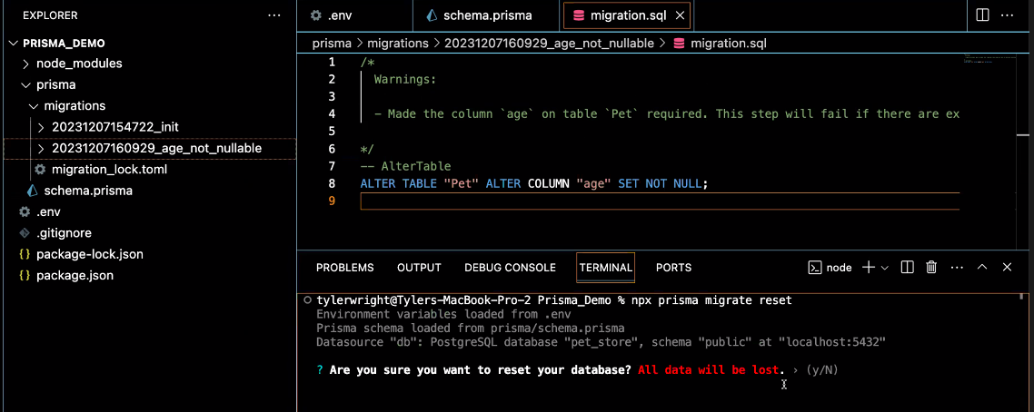
To clear all data and reset the tables:
Npx prisma migrate reset

Slide 8
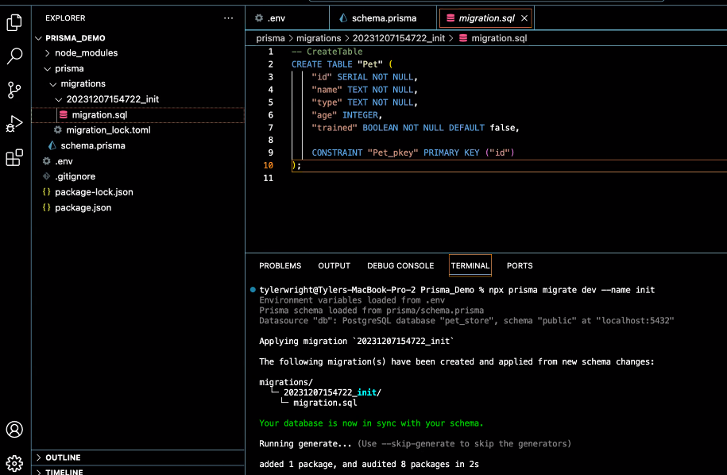
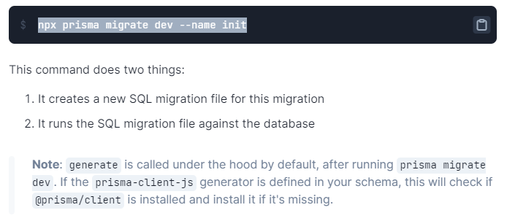
Creates migration folder
Then creates a sql file
Npx prisma migrate dev - -name init
The name is “init” usually done for first migration
Name in lower case use underscores not dashes

Slide 9
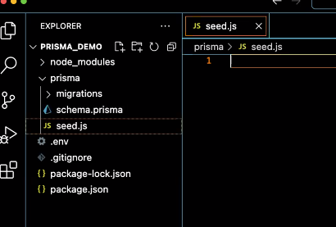
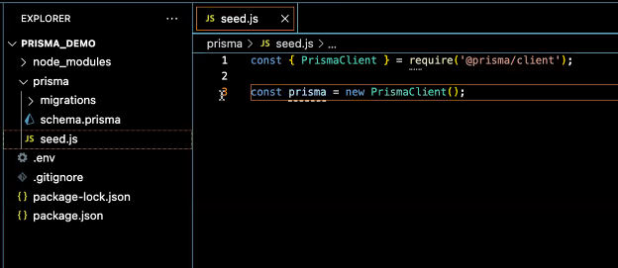
Seed File
Next: install prisma client (may have been done automatically in last step, but run to be sure
Npm install @prisma/client
Next: Create a seed file
Inside seed file:
These two lines are required

Slide 10
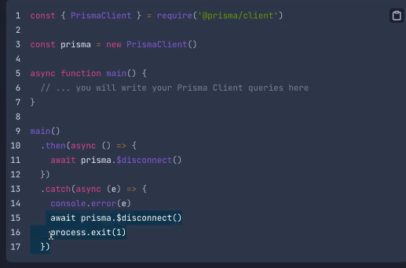
Seed File
const { PrismaClient } = require("@prisma/client")
const prisma = new PrismaClient();
async function main() {
// ... you will write your Prisma Client queries here
Console.log(`seeding the database`)
}
main()
.then(async () => {
await prisma.$disconnect()
})
.catch(async (e) => {
console.error(e)
await prisma.$disconnect()
process.exit(1)
})
In seed file:
Test the connection by running seed in node:
Node prisma/seed.js

Slide 11
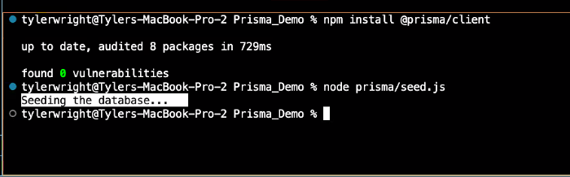

Seed scripts
**can create a script for this in package.json**
This is a reset and seed script

Slide 12
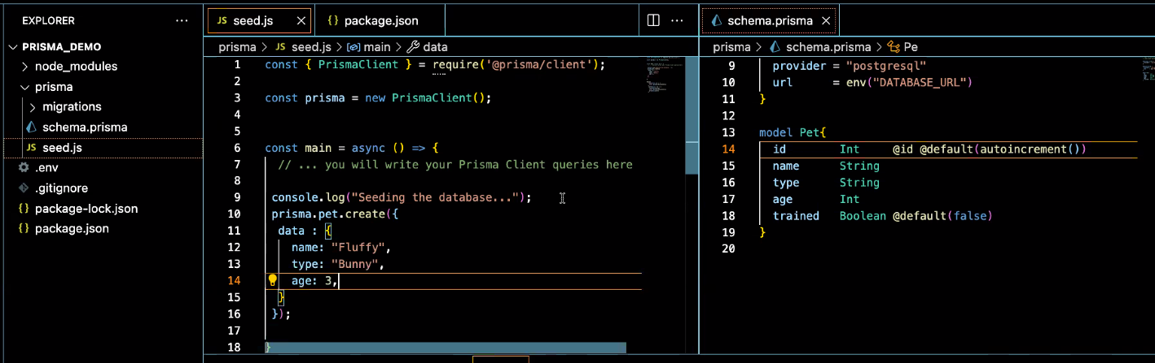
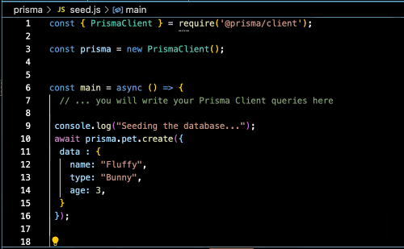
Create data:

Slide 13
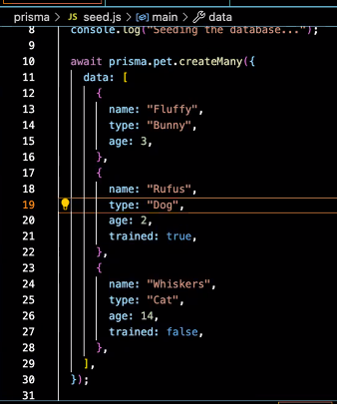
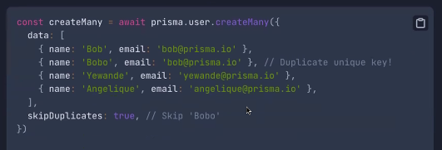
Create data:
Copy paste and change data for quick seed fill
Or do it like this using the createMany command

Slide 14
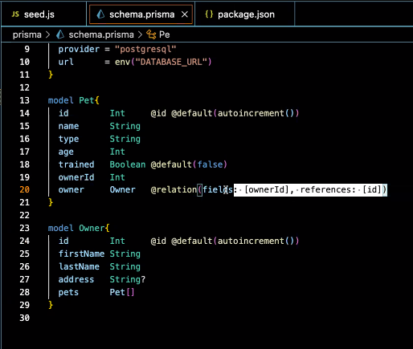
Set up relational data
Set up relational data

Slide 15
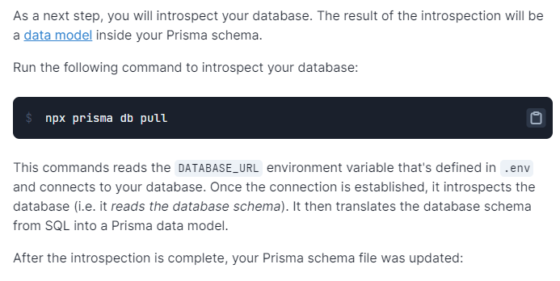
Command “npx prisma studio”
will open a gui on the browser to view your db if you dont have pgadmin or Postico on your machine
If it doesn’t populate, you can try:
npx prisma db pull

Slide 16

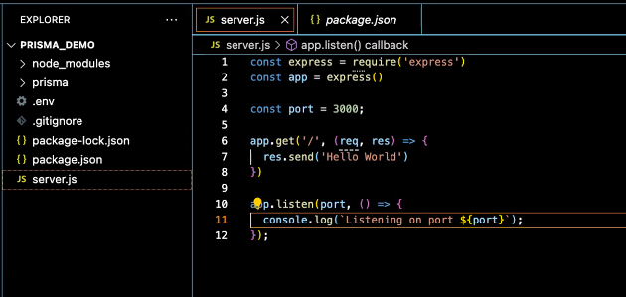

Set up server
Npm install express
Create server.js
Helpful scripts
If anyone runs into that issue of a port in use and youre not sure where it’s running you can run the command “killall node”. Wsl users may have to wait a few seconds to reconnect

Slide 17
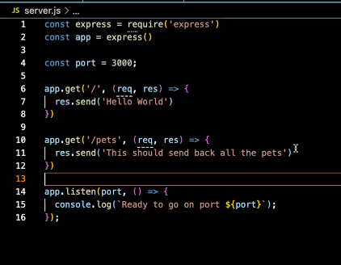
Set up server
Rest api creation

Slide 18
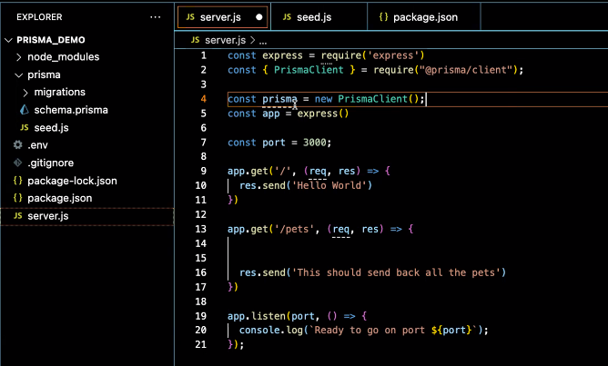
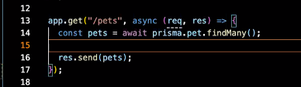
GET
Include prisma code into server.js
Get all the pets

Slide 19
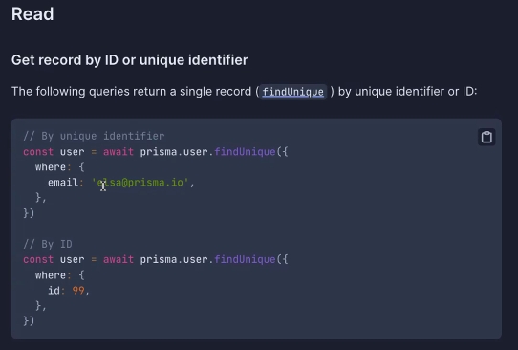
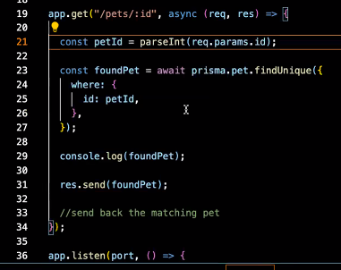
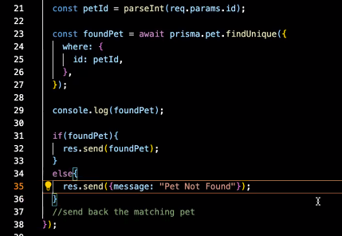
GET
Find one pet by ID
The parseInt() this converts a string to an integer.. Because the param came in as a string
If else for pet not found

Slide 20
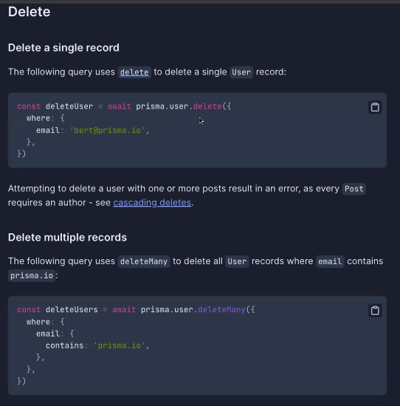
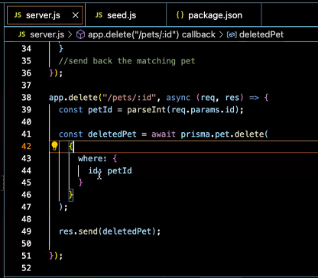
delete

Slide 21
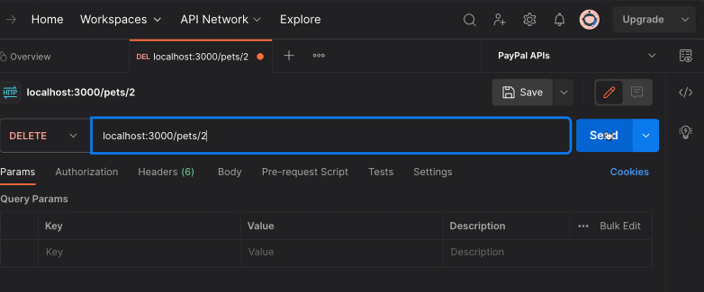
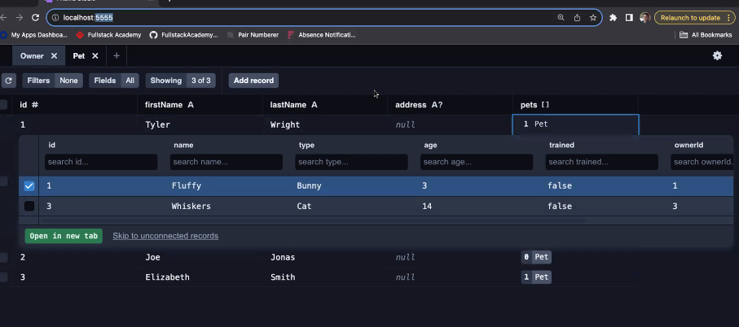
delete
Use postman to test
Use prisma studio to check

Slide 22
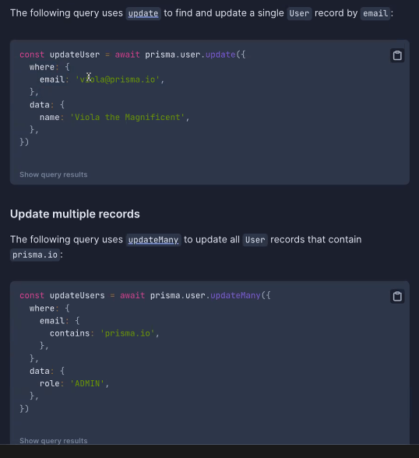
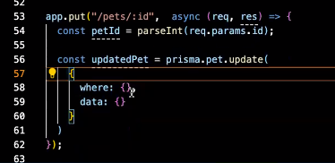
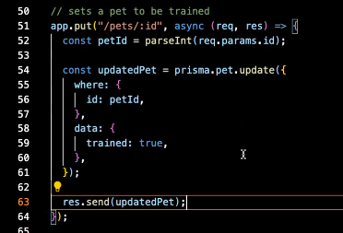
Update (put)
Normally would include information in the body
This is for a Boolean so don’t need middleware
Don’t forget to add await

Slide 23
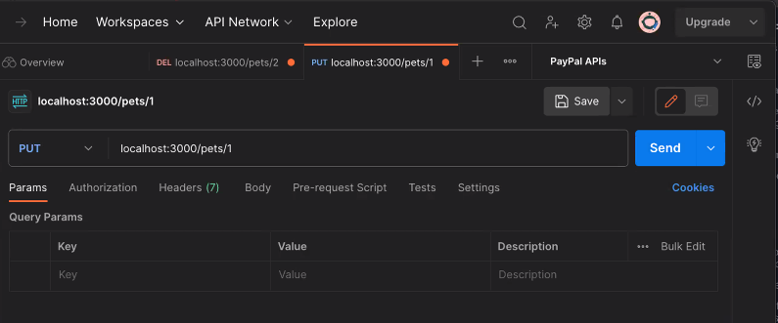
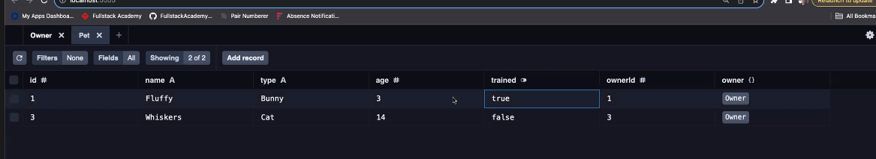
Update (put)
Use postman to test
Use prisma studio to check

