Slide 1

Redux

Slide 2


setup
Install both

Slide 3
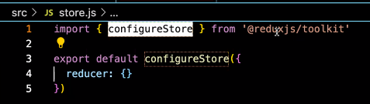
setup
Create file in src folder called store.js
Inside store.js

Slide 4
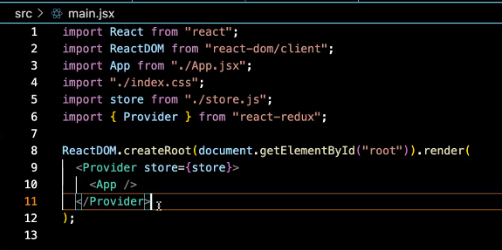
setup
In main.jsx or index.jsx depending on naming convention

Slide 5
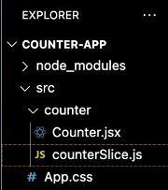

Slices basic beginning
Now start making slice files
Slices will hold all functions that manipulate that particular state

Slide 6
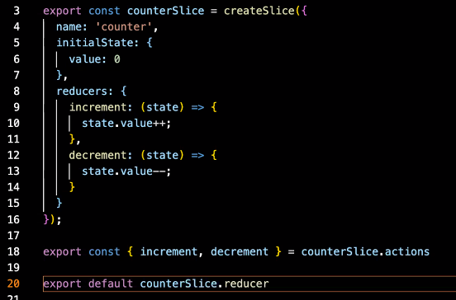

Slices
Initial value for the state
Reducers are things you can do with this particular state
Functions to manipulate the state
Export these 2 items
First line is all actions

Slide 7
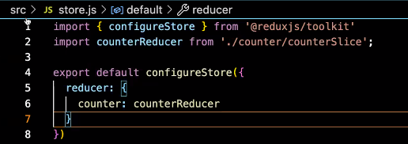
Slices
Import reducers into the store

Slide 8
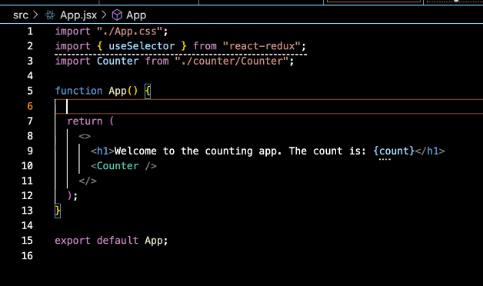
using

Slide 9
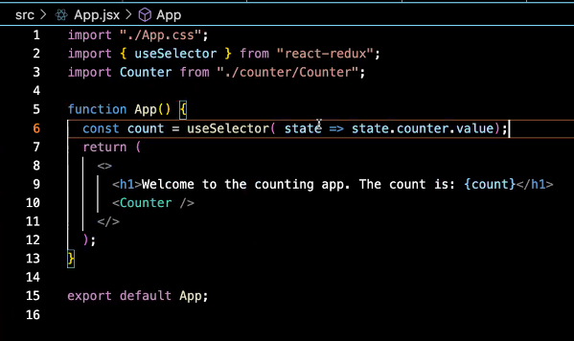
using

Slide 10

using
The import needs to be at the top of each file that uses redux
useSelector for getting a state
useDispatch for affecting a state

Slide 11
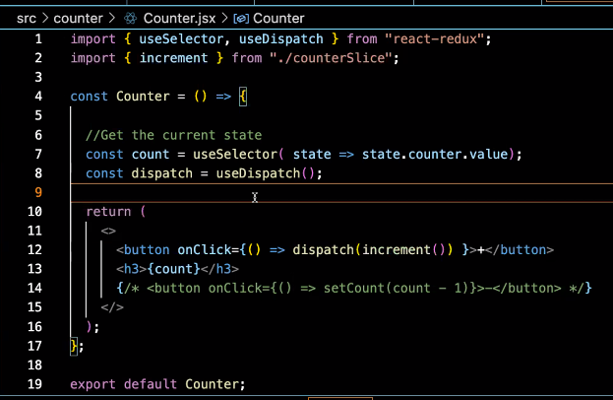
using

Slide 12
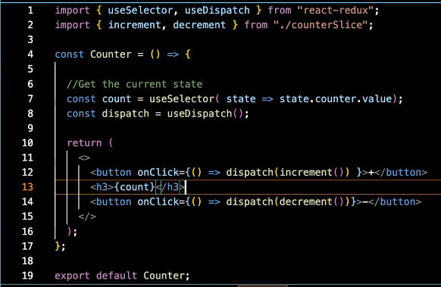
using

Slide 13
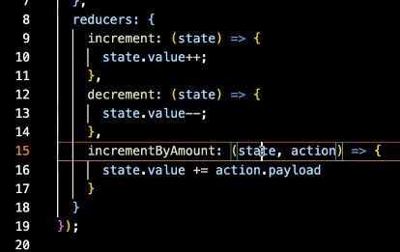
Adding additional functionality to a slice
In the slice file
The action carries a payload (variable)

Slide 14
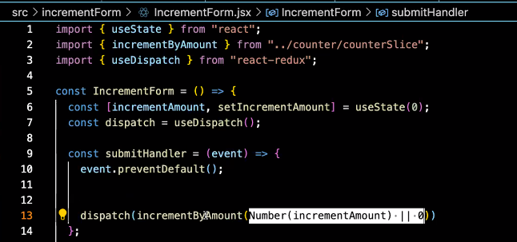
Adding additional functionality to a slice
Sending a variable as a “payload”
This is passing a value to the store

Slide 15
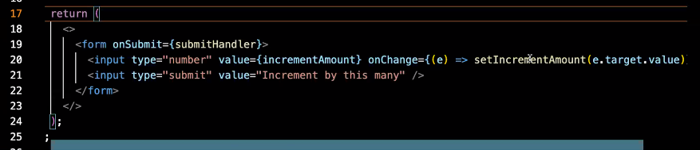
Adding additional functionality to a slice

Slide 16
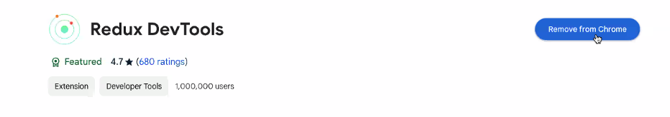
Chrome extension

