Slide 1
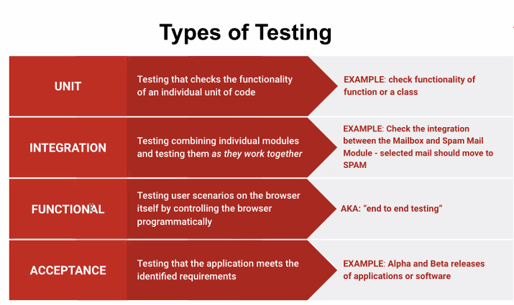
Testing

Slide 2
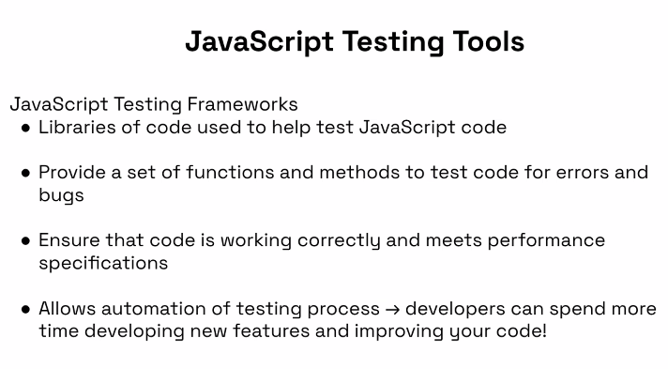
Testing

Slide 3
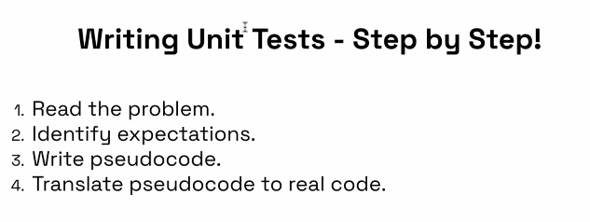
Testing

Slide 4
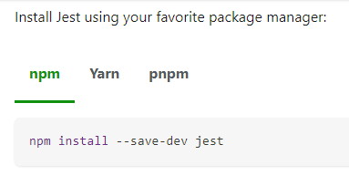
Jest
https://jestjs.io/docs/getting-started
Create file for the test format is:
Filename.test.js
Jest reads the test and knows what to do
Inside this file:
Require the file that is being tested

Slide 5
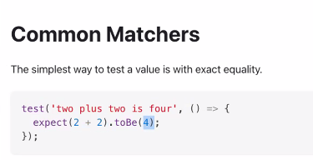
Jest
In the filename.test.js file:

Slide 6
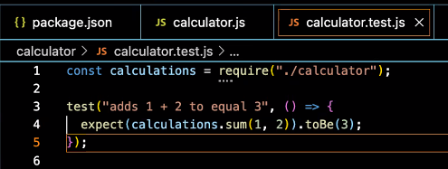
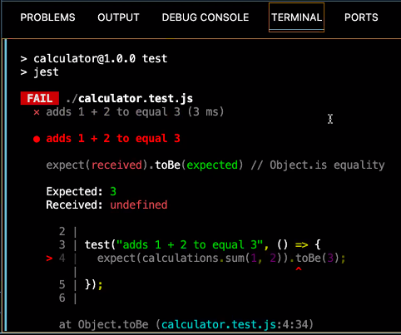
Jest
Example test
Results of the test

Slide 7
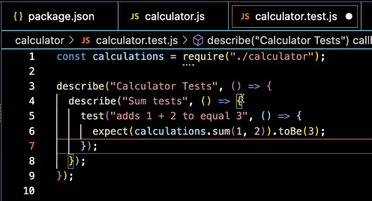
Jest
Nesting to run multiple tests:

Slide 8
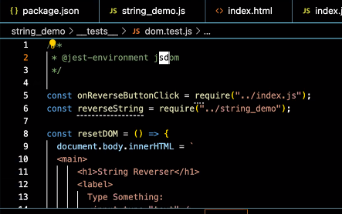
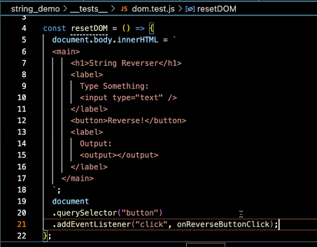
To test an html document

Slide 9
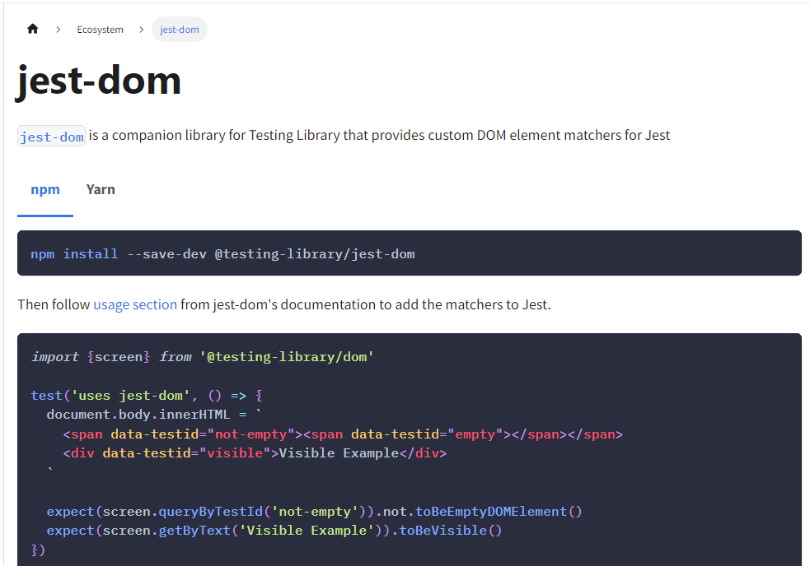
https://testing-library.com/docs/ecosystem-jest-dom/

