Slide 1
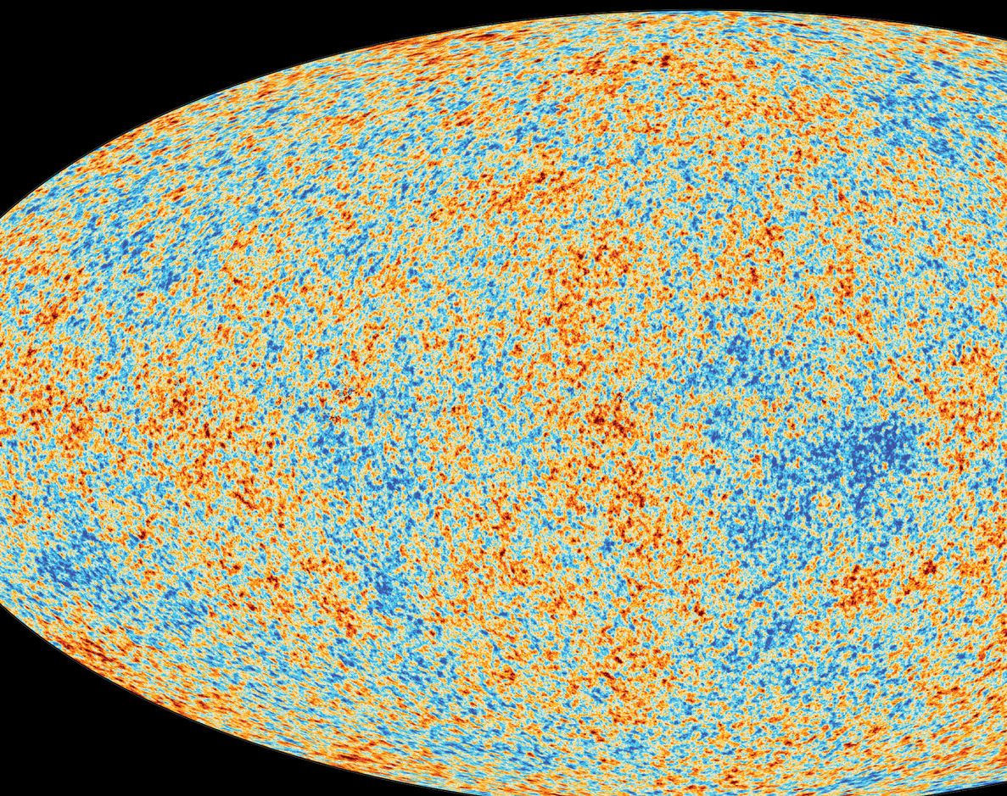
The Age Of The Universe – Data Analysis
Jakub Markiewicz

Slide 2
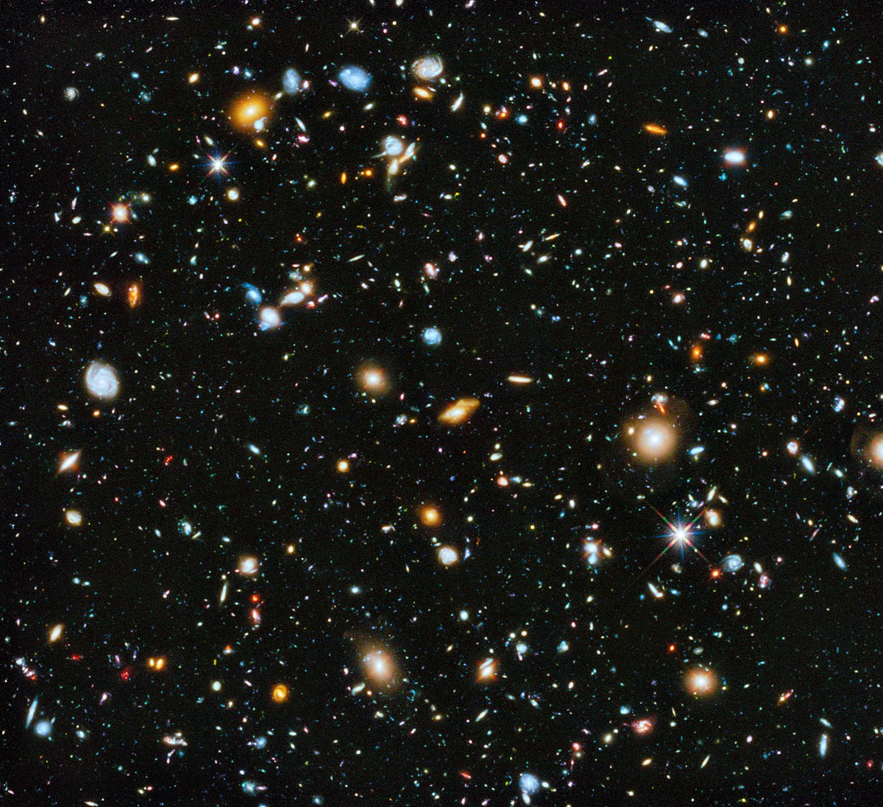
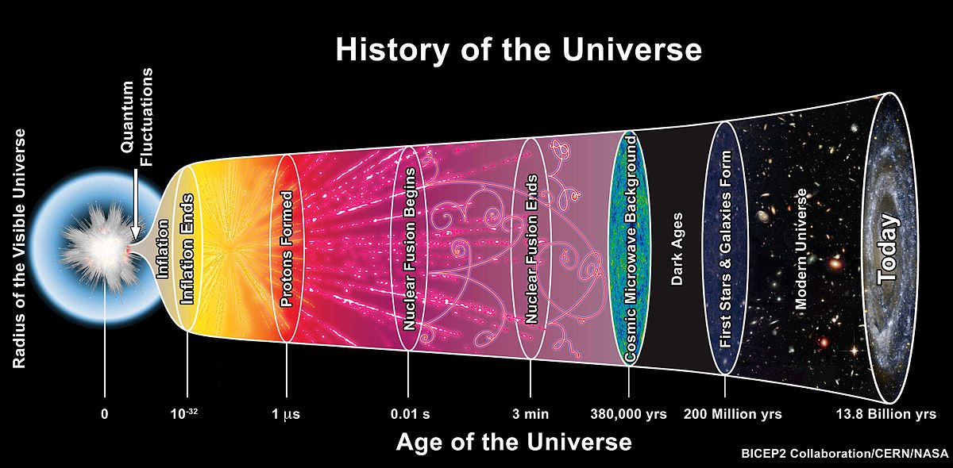
T = 0?
The Big Bang marks the beginning of the universe.
A giant explosion sending matter out into every direction in space.
This is a ‘theory’ for birth of the universe.
What is the evidence?

Slide 3
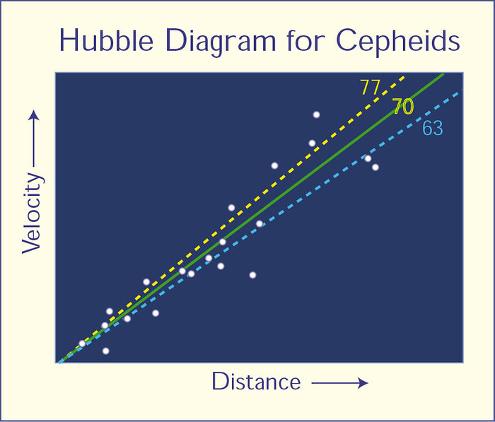
Data
The Hubble graph plots distance and recessional velocity
The further way a cepheid is, the greater its velocity
There is an acceleration. The Universe is expanding.
What can we do this data?
Image from esahubble.org (https://esahubble.org/images/opo9919j/)

Slide 4
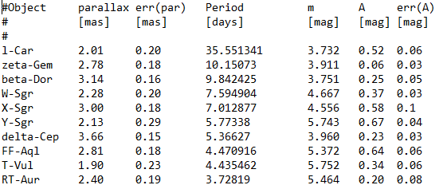

My Analysis
Observed Cepheid Data
To observe the universe is to observe radiation and light.
We must look at the relationship between a Cepheid’s period and absolute luminosity (M).
We have data for parallax, the period, apparent luminosity (m) and the extinction.
Period-Luminosity Relation
Distance Modulus Relation
Relative distance Parallax Relation

Slide 5
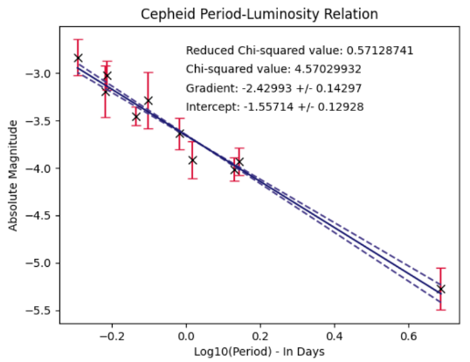
Period-Luminosity Relation
Data is shifted in the x direction to uncorrelate gradient and intercept.
Linear relationship as expected.
We now know the gradient (α) and the intercept (β).
We can apply our findings to a larger set of data in Cepheids in different galaxies.
Period-Luminosity Relation

Slide 6
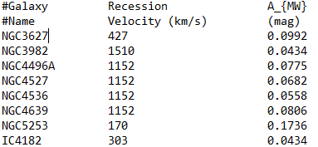
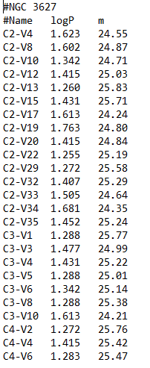
Distance Modulus and Relative Distance
Obtained Data on Different Galaxies
Cepheid Data in NGC3627
Obtaining the relative distance is our next step.
First, we need the distance modulus: μ = m – M
We do this by calculating the absolute magnitude M, using our new Cepheid Data
We know α, β, and logP! This is an easy calculation.
Period-Luminosity Relation

Slide 7


Relative Distance
Distance Modulus Relation
To plot the Hubble graph, we require the relative distance to each galaxy from Earth (point of observation).
We must use our distance modulus relation and rearrange for relative distance.
Remember μ = m – M!
Rearrange for relative distance (d)

Slide 8
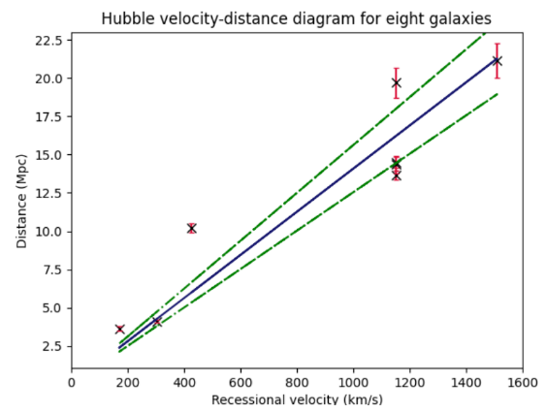
Plotting Hubble’s Constant
Redoing our relative distance analysis for eight different galaxies yields 8 distances.
For these galaxies, we have 8 recessional velocities.
We can plot the Hubble graph!
Hubble’s Constant Relation

Slide 9


Age Of The Universe
Or more visually pleasing:
13.777 +/- 1.7734 billion years
Our age of the universe is the gradient of the graph, 1/$H_{0}$
The age of the universe is . . .
0.014080882783231972 Mpc/(km/s)!

Slide 10
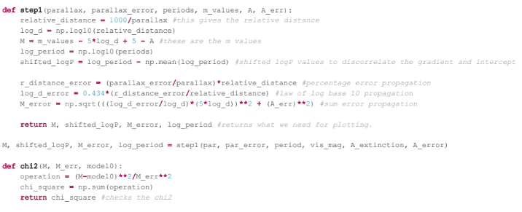
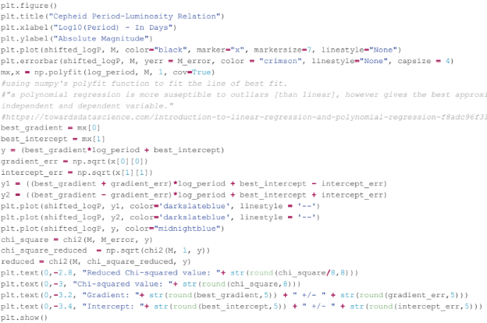
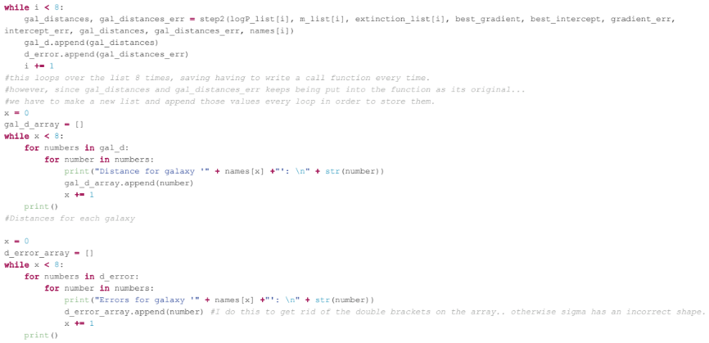
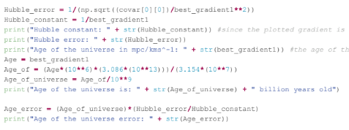
The magic behind data analysis:
Lots of Python

Slide 11
Thank you for listening!

