Slide 1
Tracking NIH Grant
Binfeng(Steve) Xia, Ph.D.
Nov 15, 2017

Slide 2
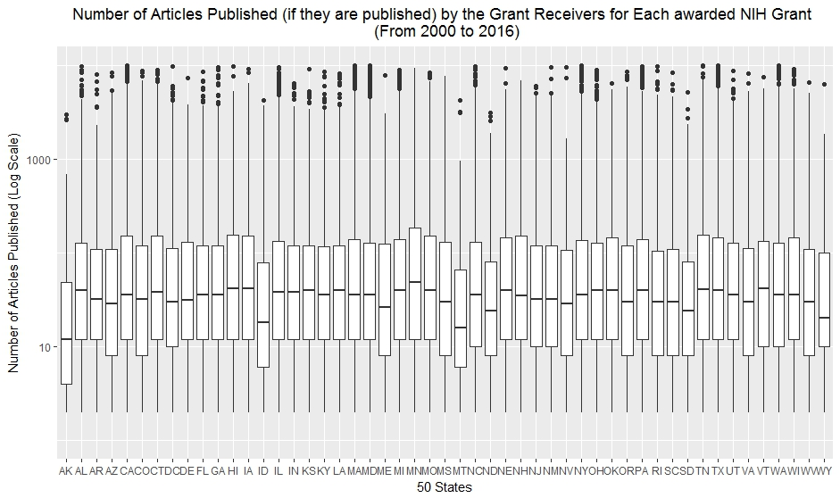
Articles Published by Grant Winners (1) Group by States

Slide 3
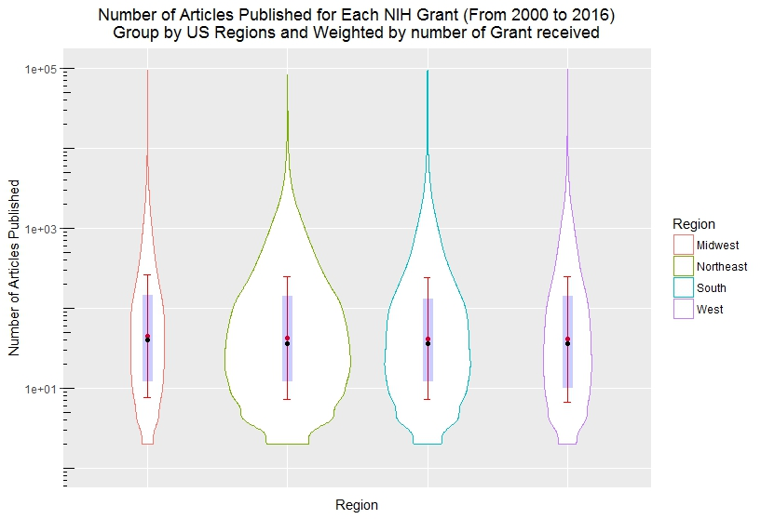
Articles Published by Grant Winners (2) Group by US Regions and basic statistics

Slide 4
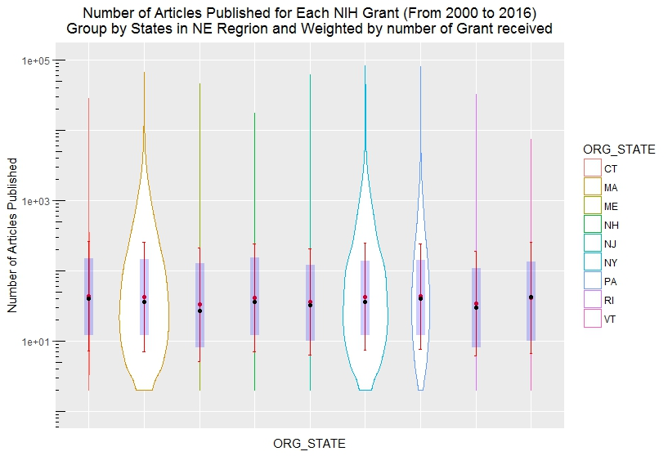
Articles Published by Grant Winners (3) Group by States in US Northeast Region

Slide 5
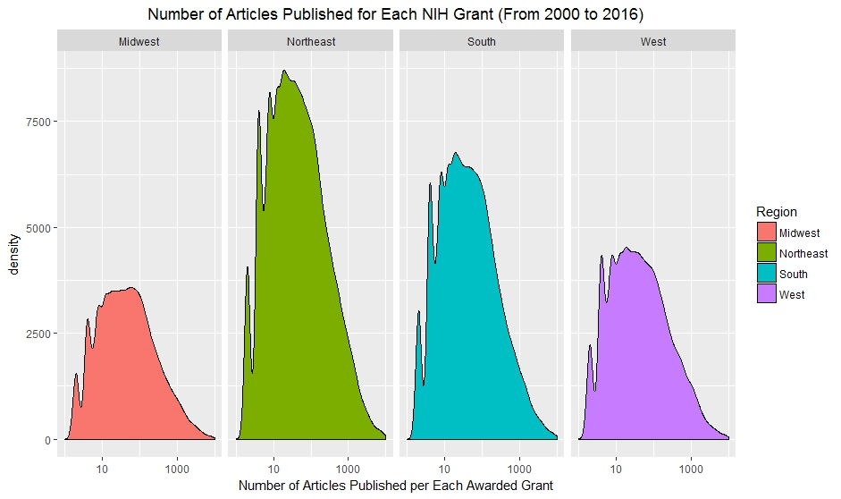
Articles Published by Grant Winners (3) Group by US Regions in Density Plot

Slide 6
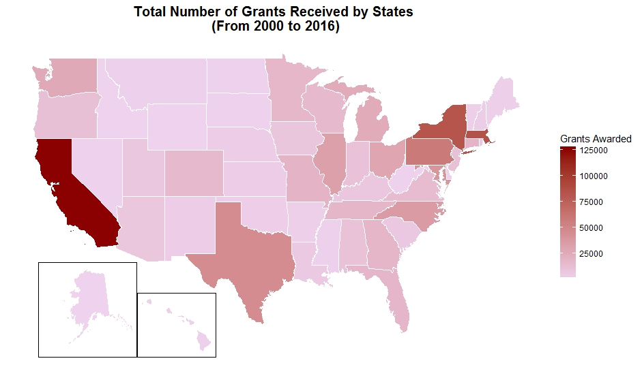
Total Number of Grants Awarded by States

Slide 7
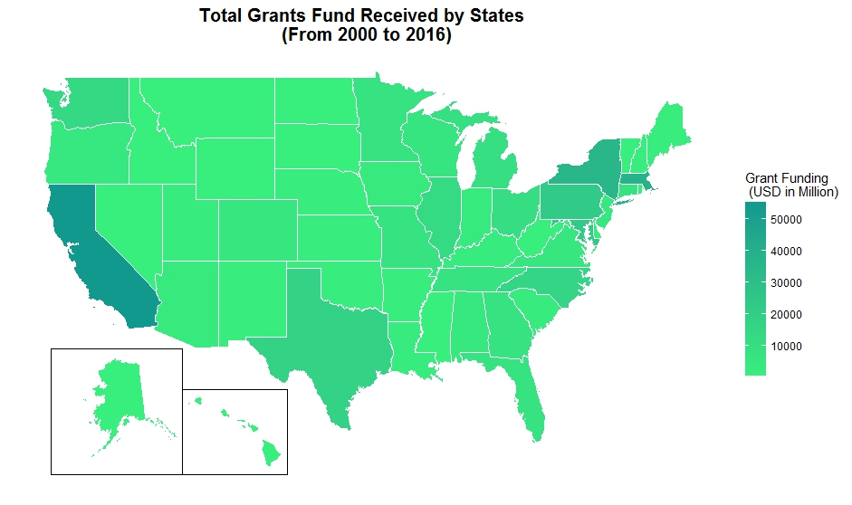
Total Grant Fund (in USD) Received by States

Slide 8
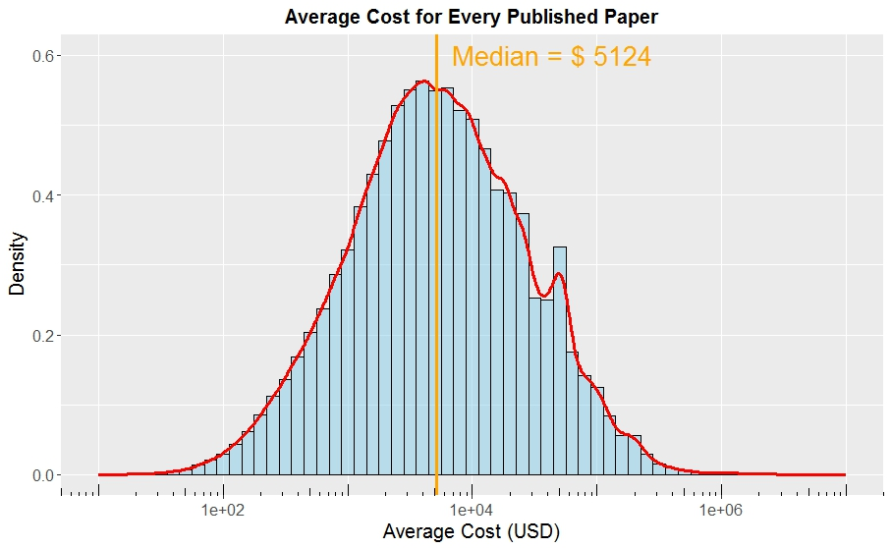
Cost for Publishing Each Paper (USD) in US

Slide 9
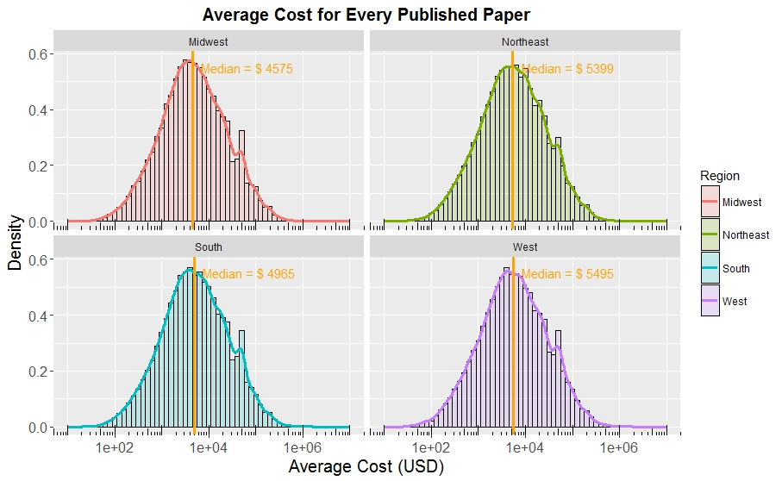
Cost for Published Each Paper in US Regions

Slide 10
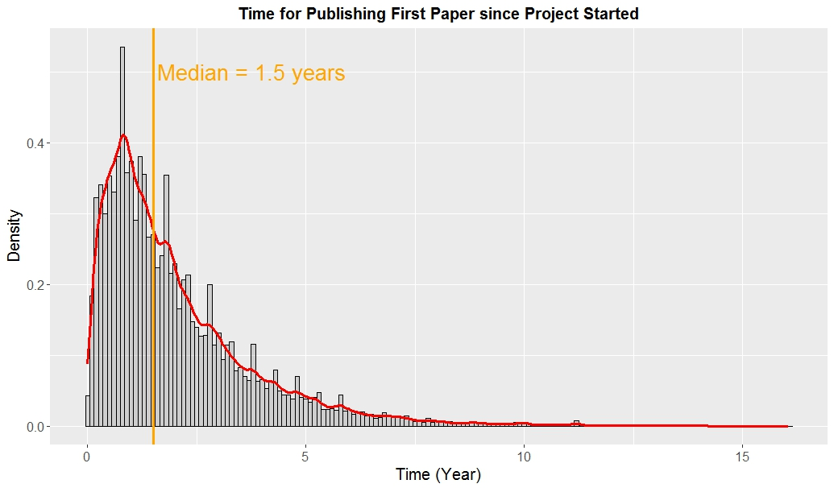
Time needed for Publishing the First Paper since Project Started

Slide 11
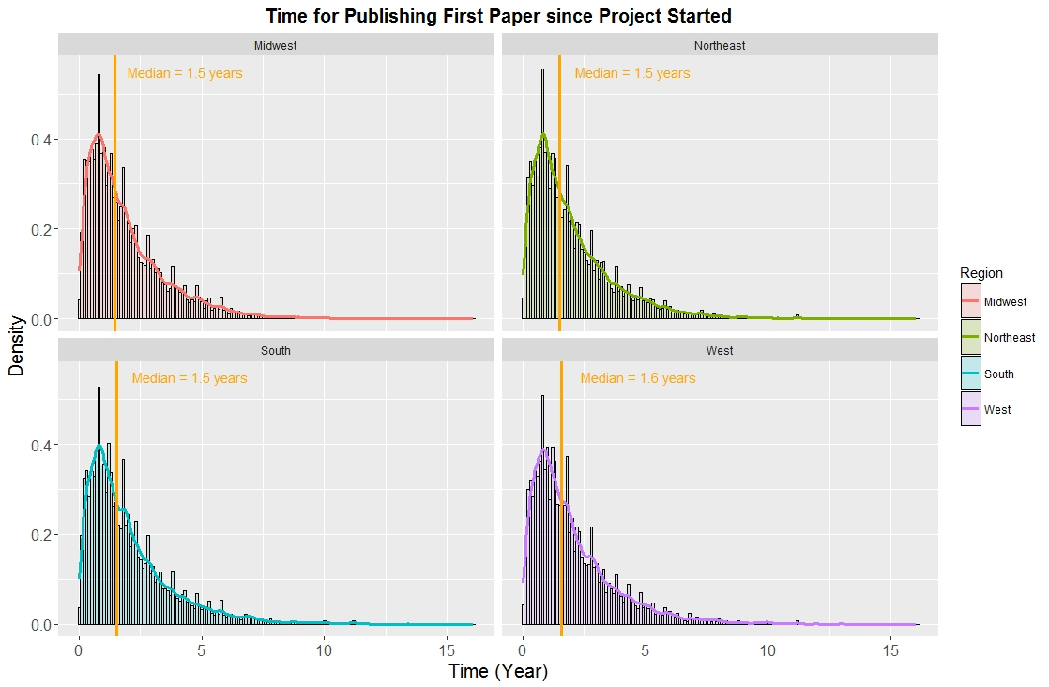
Time needed for Publishing the First Paper since Project Started (Group by US Regions)

