Slide 1
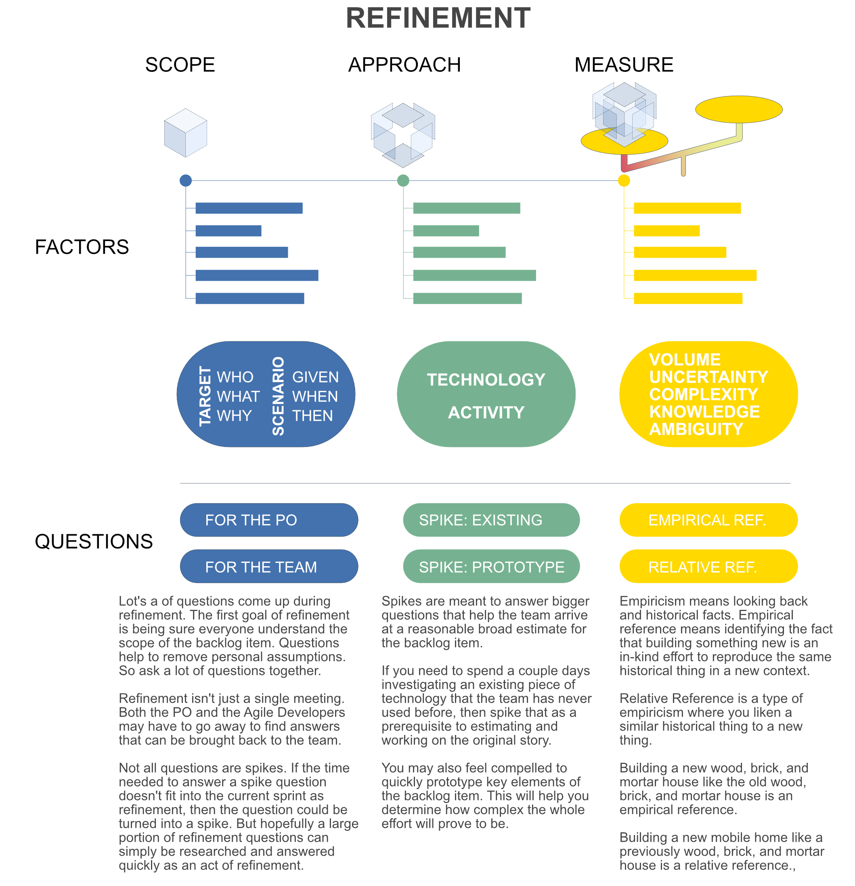
Notes:
Animation 1: In refinement we look at an agenda of product backlog items prioritized by the PO. Goal #1 is to share an understanding of the PBI in terms of what outcome is needed, who needs it, and why, as well as the scenarios of use, also known as acceptance criteria.
Animation 2: Once we understand the product backlog item and it’s scope, the team needed to quickly consider their approach. To do this, they briefly think through the activities they would do to solve the PBI and determine which technologies they might need in order to build the solution. This is not a detailed plan. This is a top-of-mind list of technologies and activities. First, try to nail down the scope as well as you can. That was goal #1. Then considering your approach will help further refine and identify any assumptions you might be making about the scope of the work. That is goal #2. Don’t be in a rush to ideate your approach. Approach is important to identify but nailing a shared understanding of scope is paramount!
Animation 3: By examining the scope and approach for the PBI, the team can measure the approximate effort needed to do the work in a future sprint. Considering the scope and approach factors, the team thinks through the VUCKA factors to decide what sort of effort will be needed. This is goal #3 and the final goal for refining a PBI.
Animation 4: The heart of refinement is in asking and answering questions about scope and approach. The priority is first and foremost Scope.
Animation 5: There will be questions where the PO needs to get answers. For example, writing Acceptance Criteria together often creates questions about the handling of positive and negative scenarios and customer preferences. And there might be questions the Agile Developers need to answer. For example, if the solution includes ingesting some new data, an Agile Developer might need to volunteer to quickly review that data and bring insights back to the team. Hopefully most of these questions and answers can be identified and resolved within the Refinement meeting. But sometimes team members may need to go away, get answers, and bring them back to the next refinement session. If the effort to get answers can fit into the current sprint, then the team members volunteer and do it in the current sprint. If doing the research puts current sprint PBIs in jeopardy of getting completed, then the research turns into a spike prioritized for a coming sprint.
Animation 6: Sometimes big questions come up during the approach discussion. For example, if the team determines they need to use some existing technology they have never used before, they may need to perform some hands-on research and bring those insights back to refinement. Sometimes, those insights might include the need to refactor some existing component in the system, like security, in order to use the new existing technology. In other situations, the team may determine they need to build something altogether new that doesn’t exist at all. Doing that may raise feasibility, performance, or scaling questions that could all be answered in a single Prototype Spike. The prototype doesn’t aim to be a working piece of code, as much as it aims to answer a set of questions with no currently experienced answers. In all cases, spikes always have a goal of answering questions as efficiently as possible rather than creating working solutions able to be deployed.
Animation 7: When it comes to estimating PBIs for an agile team, all techniques use a form of empiricism. Empiricism means looking back at historical facts to consider current challenges. Here are two kinds of measuring and estimating techniques. Empirical Reference means looking at the scope and your approach and finding an instance (or copy) of it in the past. If you built wood, brick, and mortal homes on a concrete slab in the past, and you were asked to do it again in a new location, you could look at a historical Wood, Brick, and Mortar Slab home effort, and base your estimate on a previous parallel model. Relative Reference is an empirical estimation that likens a similar type of thing from the past to a current challenge. If you were asked to build a manufactured mobile home, you could point to a relative reference of a previously built wood, brick, and mortar slab home and talk about the differences to determine how alike or dissimilar the historical effort was to the current challenge.
As a final note, Shop Work estimates are not considered empirical estimation techniques. An example of a shop work estimate is having a standard allocation of hours associated with a kind of work: Interface design = 2 hours or database table = 1.5 hours. These kinds of estimates disregard your understanding of the current scenario or historical past experiences as a team of professionals. They also imply a level of precision in estimating that is far from correct. Agile teams base their measure of PBI effort by comparing current team challenges to known team experiences in their past.

Slide 2
PRINT THIS PAGE FOR QUICK REFERENCE

