Slide 1

CAR DETECTION
Deep Learning model

Slide 2
Model idea
to train a model that can detect whether a car is present in a given picture.

Slide 3
Data collection - keggle
the first data we used contains CAR images split into train (8144 images) and test (8041 images) files (total 16185)
the second data we used contains RANDOM images split into train (6469 images) and test (3489 images) files (total 9958)

Slide 4
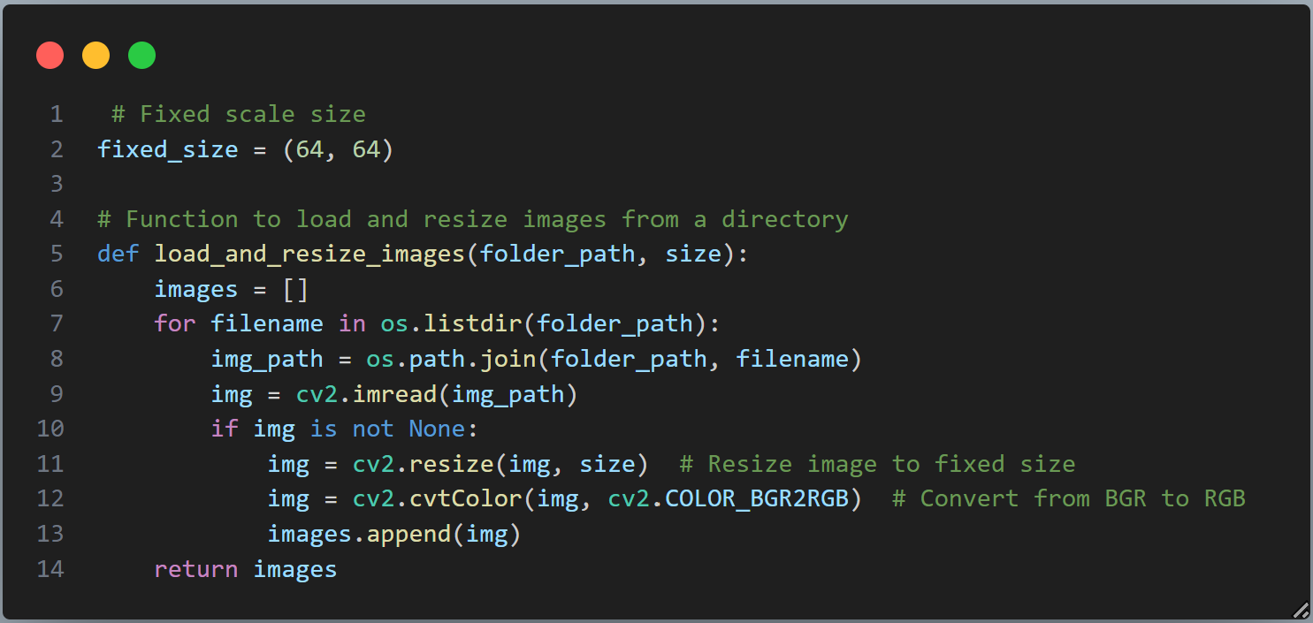
Preprocessing (Image resizing)

Slide 5
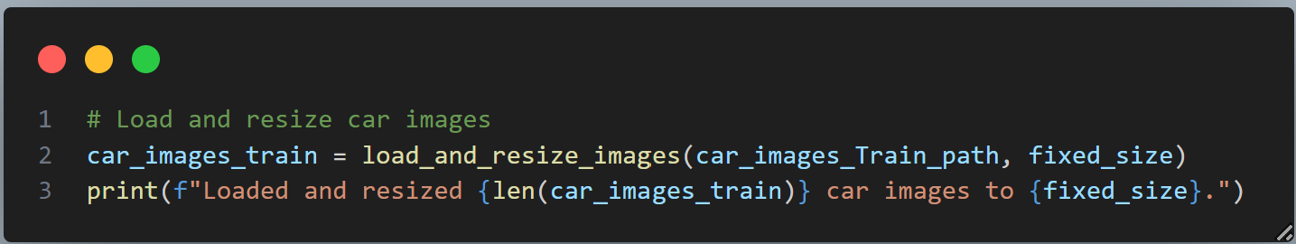
Preprocessing (Image resizing)

Slide 6
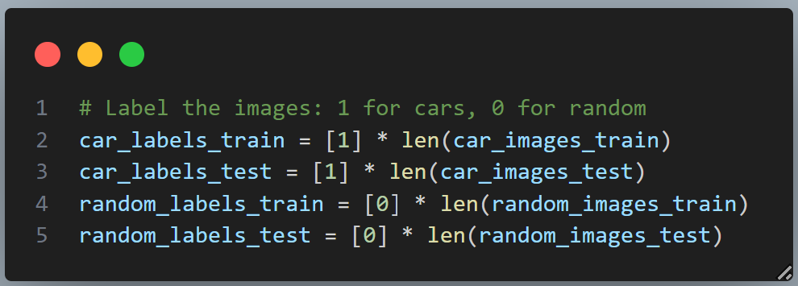
Preprocessing (image labeling)

Slide 7
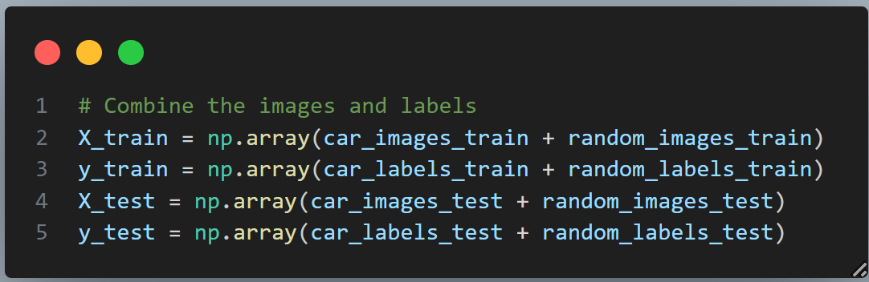
Preprocessing (Data combining)

Slide 8
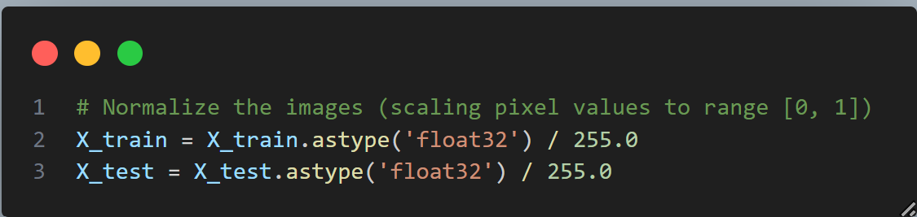
Preprocessing (Normalization)

Slide 9
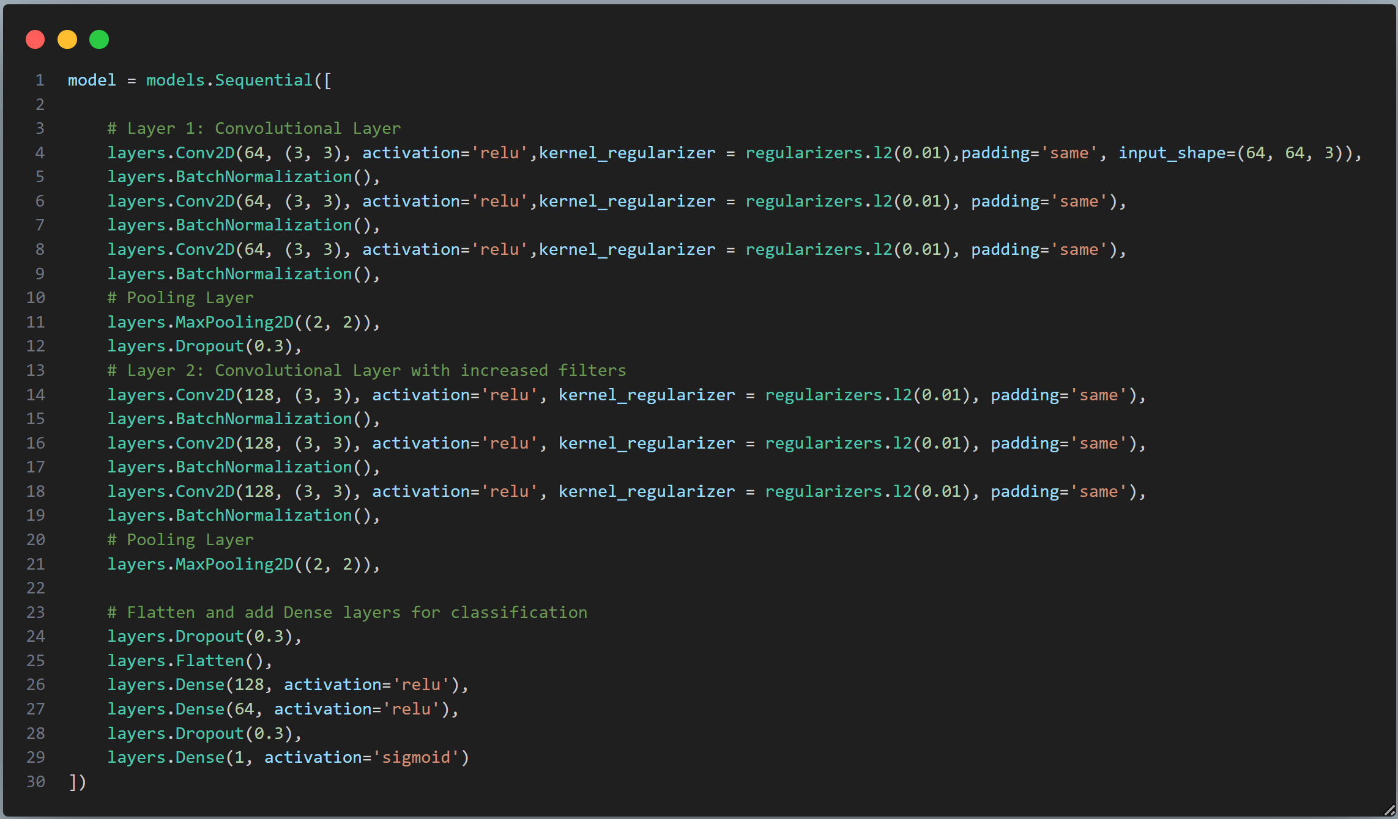
Define & build CNN

Slide 10
Define & build CNN

Slide 11
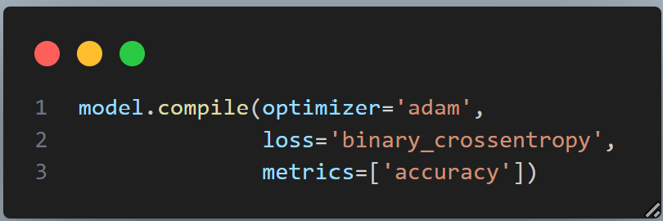
Model Configuration

Slide 12
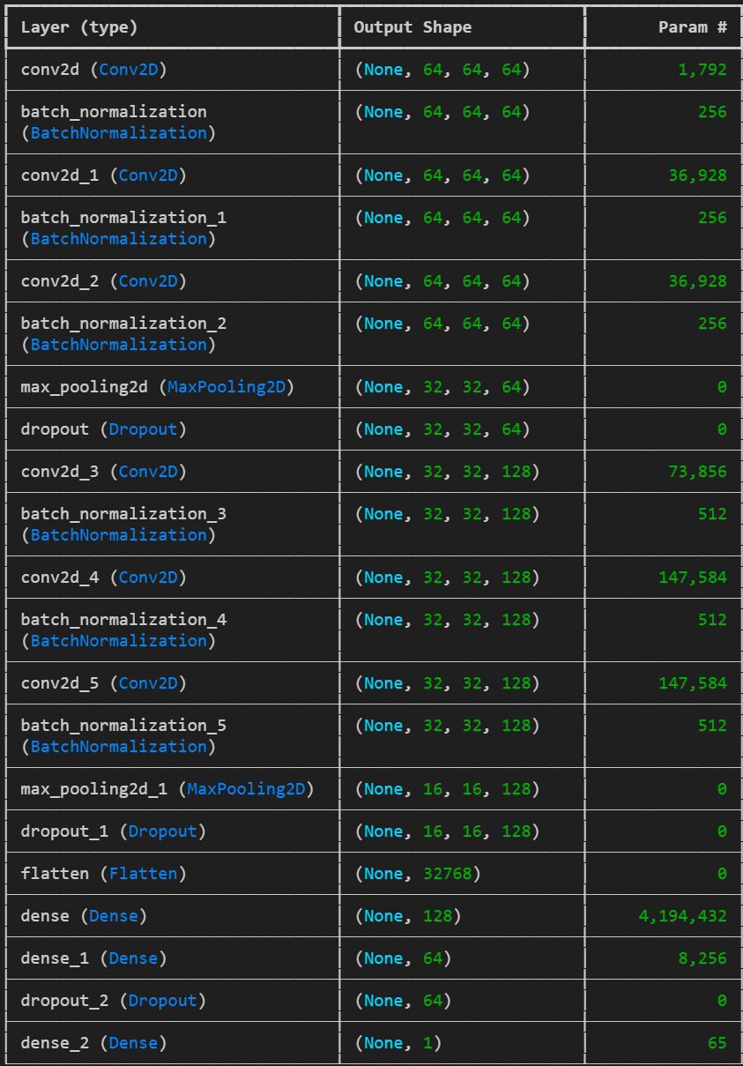
Model Architecture

Slide 13
Model Architechture

Slide 14
Model Architechture

Slide 15
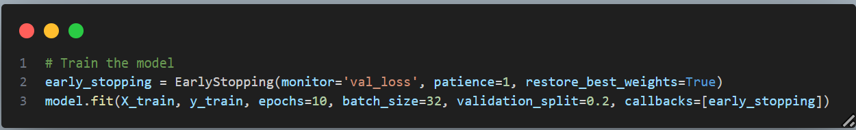
Model Training

Slide 16
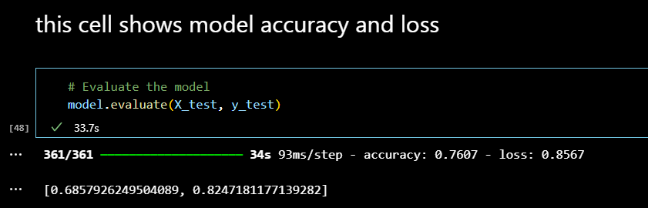
Model Evaluation

Slide 17
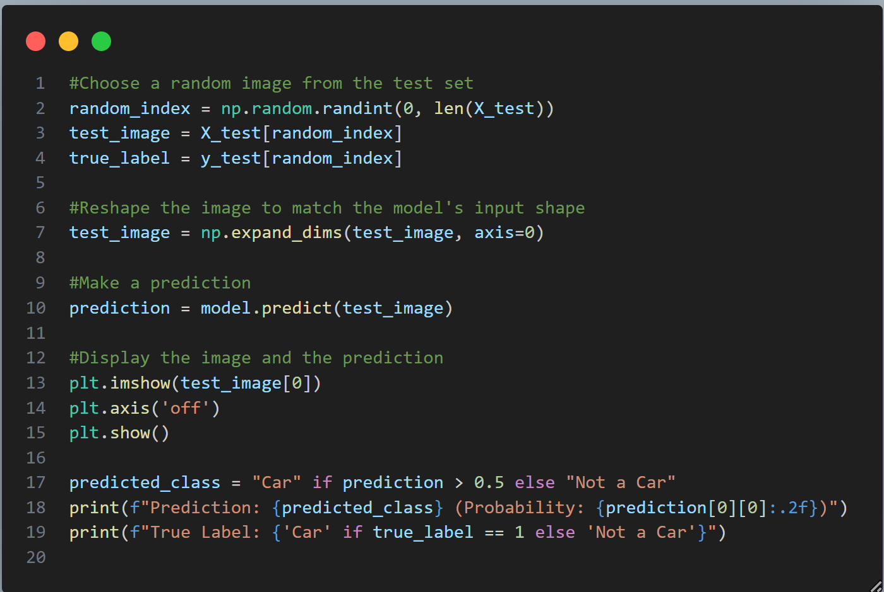
Model Evaluation

Slide 18
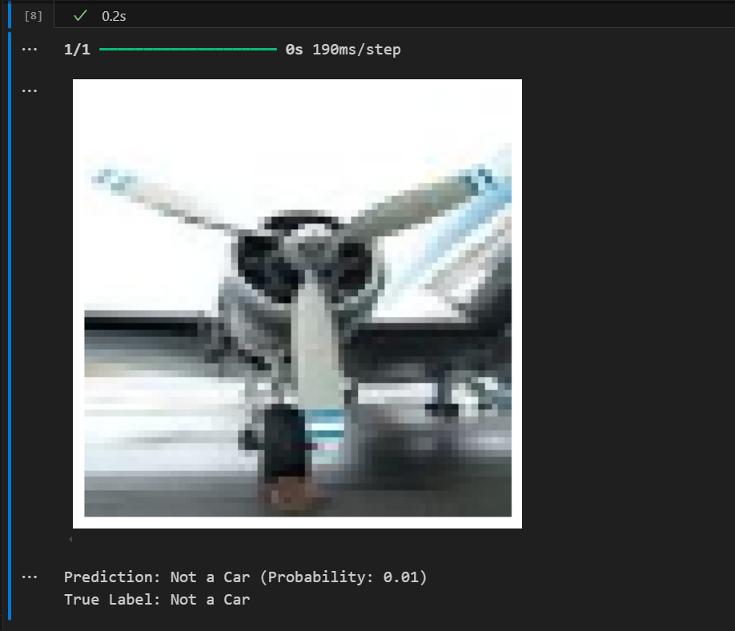
Model Evaluation

Slide 19
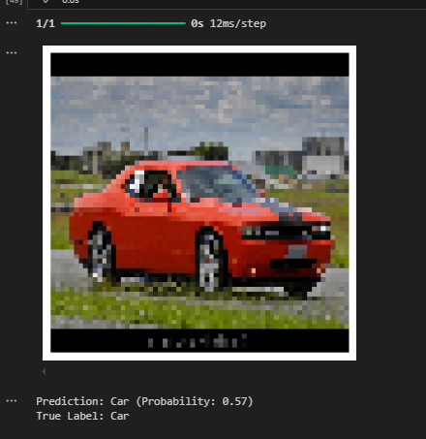
Model Evaluation

