Slide 1



Supervisor Node for
Vehicle Control
By: Luca Inghilterra
November 27, 2023

Slide 2

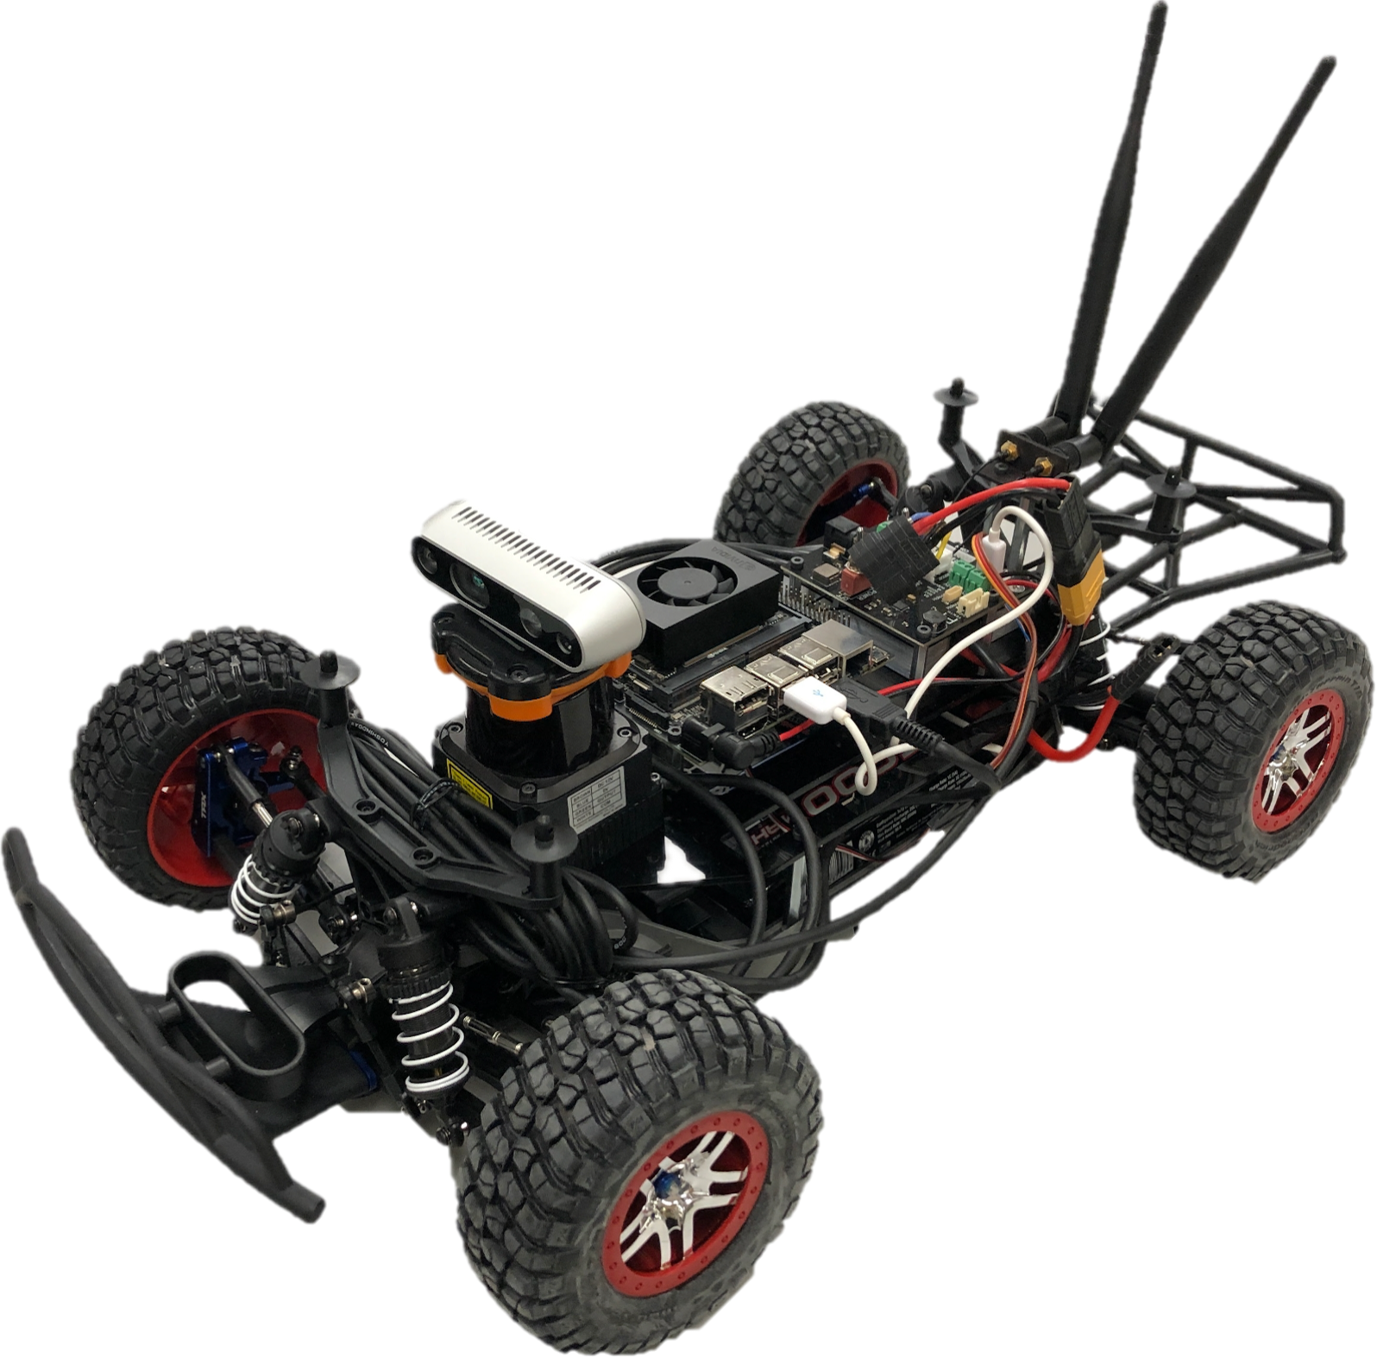
MAIN IDEA
Supervisor Node:
stores the overall health state of the vehicle;
structured as a finite state machine;
implemented using YASMIN library in ROS2 Foxy.

Slide 3
OVER-VIEW
States:
Idle (I)
Manual (M)
Active (A)
Emergency Takeover (ET)
Emergency Stop (ES)
EMERGENCY TAKEOVER
Transitions:
(I) ←→ (M): service callable from the outside
(M) ←→ (A): service callable from the outside
(A) → (ET): a common fault occurs
(ET) → (A): the common fault is resolved
(ET) → (M): service callable from the outside
(A, M, ET) → (ES): a severe fault occurs
(ES) → (ET): the severe fault is resolved, and
the node entered ES state from A or ET
(ES) → (M): the severe fault is resolved, and
the node entered ES state from M
ET > A
ACTIVE
A > ET
ES > ET
A > ES
ET > ES
EMERGENCY STOP
M > A
ET > M
IDLE
A > M
M > ES
M > I
ES > M
MANUAL
I > End
I > M
END

Slide 4
IDLE
Behaviour:
The node is active and awaits signals from the outside.
Implementation:
the transition selection to MANUAL or to END is awaited with the
subscription on supervisor_node/state_selection topic (RELIABLE);
the current state is published on supervisor_node/current_state
topic (RELIABLE,TRANSIENT LOCAL).
EMERGENCY TAKEOVER
ET > A
ACTIVE
A > ET
ES > ET
A > ES
ET > ES
EMERGENCY STOP
M > A
ET > M
IDLE
A > M
M > ES
M > I
ES > M
MANUAL
I > End
I > M
END

Slide 5
MANUAL
Behaviour:
The vehicle is in manual driving mode:
no fault checks are performed in this state;
all driving commands from the primary and secondary stacks are ignored.
Implementation:
the transition selection to ACTIVE or to IDLE is awaited with the subscription on supervisor_node/state_selection topic (RELIABLE);
the manual commands sent to the system are notified to the node with the
subscription on supervisor_node/manual_command topic (RELIABLE);
the drivers responses from sensors or actuators are collected with the
subscription on supervisor_node/general_driver_response topic (RELIABLE, CHECK
LIVELINESS);
the current state is published on supervisor_node/current_state topic
(RELIABLE,TRANSIENT LOCAL).
EMERGENCY TAKEOVER
ET > A
ACTIVE
A > ET
ES > ET
A > ES
ET > ES
EMERGENCY STOP
M > A
ET > M
IDLE
A > M
M > ES
M > I
ES > M
MANUAL
I > End
I > M
END

Slide 6
ACTIVE
Behaviour:
The vehicle is in autonomous driving mode:
fault checks are performed in this state;
control is entrusted to the primary driving stack.
Implementation:
the transition selection to MANUAL is awaited with the subscription on supervisor_node/state_selection topic (RELIABLE);
the control by primary driving stack is simulated sending notifications to the
node with the subscription on supervisor_node/primary_driving_stack topic
(RELIABLE, DEADLINES CHECK);
the drivers responses from sensors or actuators are collected with the
subscription on supervisor_node/general_sensor_or_actuator_driver_response
topic (RELIABLE, LIVELINESS CHECK);
any common fault in this state is simulated with the subscription on the topic
supervisor_node/common_fault (RELIABLE);
the current state is published on supervisor_node/current_state topic
(RELIABLE,TRANSIENT LOCAL).
EMERGENCY TAKEOVER
ET > A
ACTIVE
A > ET
ES > ET
A > ES
ET > ES
EMERGENCY STOP
M > A
ET > M
IDLE
A > M
M > ES
M > I
ES > M
MANUAL
I > End
I > M
END

Slide 7
EMERGENCY TAKEOVER
Behaviour:
The vehicle is in a risky state:
control is entrusted to the secondary driving stack;
Implementation:
the transition selection to MANUAL is awaited with the subscription on supervisor_node/state_selection topic (RELIABLE);
the control by secondary driving stack is simulated sending notifications to the
node with the subscription on supervisor_node/secondary_driving_stack topic
(RELIABLE, DEADLINES CHECK);
the drivers responses from sensors or actuators are collected with the
subscription on supervisor_node/general_sensor_or_actuator_driver_response
topic (RELIABLE, LIVELINESS CHECK);
the current state is published on supervisor_node/current_state topic
(RELIABLE,TRANSIENT LOCAL).
EMERGENCY TAKEOVER
ET > A
ACTIVE
A > ET
ES > ET
A > ES
ET > ES
EMERGENCY STOP
M > A
ET > M
IDLE
A > M
M > ES
M > I
ES > M
MANUAL
I > End
I > M
END

Slide 8
EMERGENCY STOP
Behaviour:
The vehicle is in a risky state:
control is entrusted to the secondary driving stack;
Implementation:
the current state is published on supervisor_node/current_state topic
(RELIABLE,TRANSIENT LOCAL).
EMERGENCY TAKEOVER
ET > A
ACTIVE
A > ET
ES > ET
A > ES
ET > ES
EMERGENCY STOP
M > A
ET > M
IDLE
A > M
M > ES
M > I
ES > M
MANUAL
I > End
I > M
END

Slide 9

Demo time!

