Slide 1








DATA ARCHITECTURE PIPELINES
LAMBDA (l) PIPELINE
BATCH LAYER
DATA SOURCE
DATA LAKE
WAREHOUSE
CLIENTS
SPEED LAYER

Slide 2





DATA ARCHITECTURE
DATA PIPELINES
LAMBDA ARCHITECTURE
CLOUD BASED ON AWS SERVICES (S3, EC2, RDS, ROUTE)
TECHS: AWS, DOCKER, PYTHON, DJANGO, POSTGRE, AIRFLOW
DATA SOURCE
LAKE
(S3-AWS)
RELATIONAL DB SERVICE (RDS-AWS)
CLIENTS
SQL
BANCO DE DADOS (SQL)
PIPELINE
(EC2-AWS)
ETL TOOL
(EC2-AWS)
REST API (EC2-AWS)
FRONT-END

Slide 3
DATA MODELLING FACT & DIMENSION
CUSTOMERS
PLANS
id | corporate_name | city | federal_unit | sector
INT(PK) | CHAR(150) | CHAR (150) | CHAR (2) | Char (150)
1 | Simplest Software LTDA | Joinville | SC | Software
1
id | name
INT(PK) | Char(10)
1 | Brass
1
n
PAYMENTS
id | customer_id | payment_date | plan_id | paid_months | value
INT (PK) | INT | DATE(DD/MM/YYYY) | INT | INT | FLOAT
35 | 244 | 25/04/2019 | 2 | 3 | R$ 300,00
n

Slide 4
DATA MODELLING FACT & DIMENSION
DIMENSION: CUSTOMER
DIMENSION: DATE
DIMENSION:PLAN
id | corporate_name | city | federal_unit | sector
INT(PK) | CHAR(150) | CHAR (150) | CHAR (2) | Char (150)
1 | Simplest Software LTDA | Joinville | SC | Software
id | date | month | year
INT(PK) | Date (YYYY/MM/DD) | INT | INT
1 | 25/04/2019 | 04 | 2019
id | name
INT (PK) | Char(10)
1 | Brass
1
1
1
n
n
FACT: PAYMENTS
VIEW: MONTHLY REC. REVENUE
n
id (PK) | customer (FK) | date (FK) | plan (FK) | value | paid_months
INT (PK) | INT (FK) | INT (FK) | INT | FLOAT | INT
35 | 244 | 443 | 2 | R$ 300,00 | 3
id | customer | MRR | month | year
INT(PK) | INT | FLOAT | INT | INT
1 | 463 | 235.69 | 04 | 2019

Slide 5









DATA ENGINEERING ETL & PIPELINES
CONSUMER
DATA-ORIENTED
DATA ENGINERING
EVENT-ORIENTED
PRODUCER

Slide 6





DATA ARCHITECTURE STRUCTURE-PIPELINES
DATA
INTERNET 2.0
CUSTOMER

Slide 7






DATA ARCHITECTURE STRUCTURE-PIPELINES
DATA ENGINEERING
DATA ARCHITECTURE
DATA MODELLING
DATA PROCESSING (ETL)
DATA FLOW (PIPELINES)
DATABASE MANAGEMENT
DEV-, DATA-, MLOPS & CLOUD COMPUTING

Slide 8
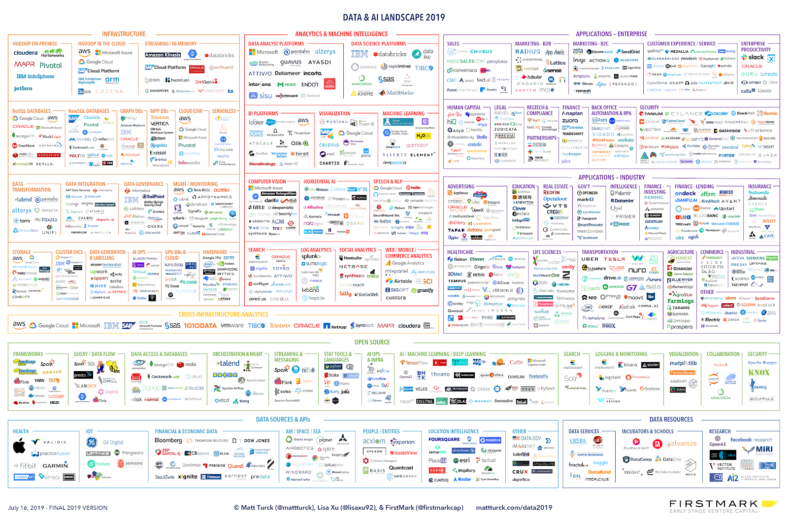
REST API (EC2-AWS)
DATA ARCHITECTURE STRUCTURE-PIPELINES
SQL

Slide 9
DATA ARCHITECTURE STRUCTURE-PIPELINES
DATA WAREHOUSE
DATA LAKE
DATA
SQL REGISTERs
ALL TYPES
SCHEMA
SCHEMA
SCHEMA-LESS
ELASTICITY
RIGID
ELASTIC
SCALABILITY
LOW-LEVEL
HIGH-LEVEL
STRUCTURE
-
-
STRUCTURE
-
-
STRUCTURE
-
-

Slide 10
REST API (EC2-AWS)
DATA ARCHITECTURE STRUCTURE-PIPELINES
ETL TOOL
(EC2-AWS)
DATA PROCESSING
DATA LAKE
DATA PIPELINES
DATA WAREHOUSE
DATA SOURCE
CLIENTS
BANCO SQL)
SQL

Slide 11
REST API (EC2-AWS)
DATA ARCHITECTURE STRUCTURE-PIPELINES
DATA PROCESSING
DATA LAKE
DATA PIPELINES
DATA WAREHOUSE
ETL TOOL
(EC2-AWS)
DATA SOURCE
CLIENTS
BANCO SQL)
SQL

Slide 12
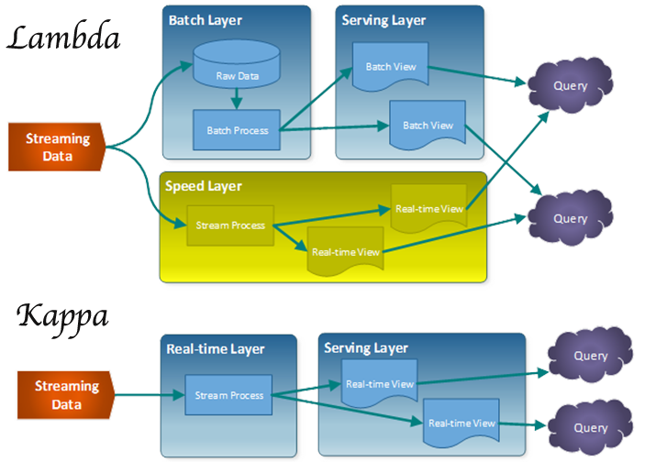
DATA ARCHITECTURE PIPELINES

Slide 13
DATA ARCHITECTURE PIPELINES
LAMBADA (l) PIPELINE
BATCH LAYER
DATA SOURCE
DATA LAKE
WAREHOUSE
CLIENTS
SPEED LAYER

Slide 14
DATA ARCHITECTURE PIPELINES
KAPPA (k) PIPELINE
DATA SOURCE
DATA LAKE
NEAR-REALTIME LAYER
WAREHOUSE
CLIENTS

Slide 15






REST API (EC2-AWS)
DATA MODELLING FACT-DIMENSION
SQL

Slide 16
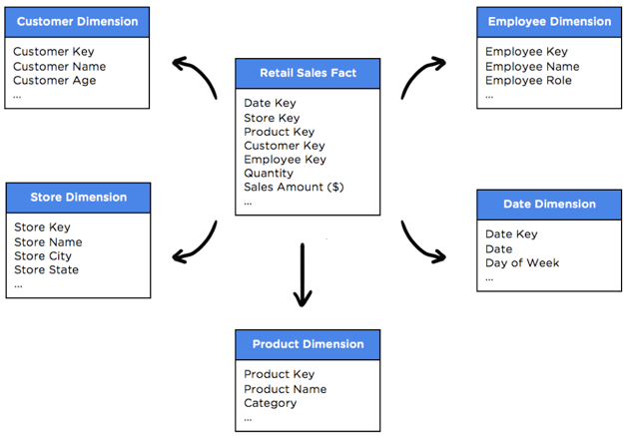
REST API (EC2-AWS)
DATA MODELLING FACT-DIMENSION
SQL

Slide 17
REST API (EC2-AWS)
DATA ARCHITECTURE STRUCTURE-PIPELINES
DATA PIPELINES
DATA GATHERING
DATA STORAGE
GROUP DATA IN TABLES , LAYERS, CUBES
DATA MODELLING
DATA PROCESSING (ETL)
MACHINE LEARNING (TRAIN, VALIDATE, TUNNING)
SQL

