Slide 1
CourtLens
UoA 2026 Datathon - Use Case 3
6 GRAMSS – Team 4

Slide 2
Solution Overview
Ingest NZ District Court PDF documents
Use Agentic AI to extract and structure data
Transform data into star schema
Present insights
Court Data is presented as PDFs, which are not easy to search and extract data from. Our solution automates the extraction and produce insights.

Slide 3
Team Composition
Anchit Sood – Project Coordinator/Cloud Engineer
Engleang Sam – Data Engineer/Solution Designer
Simon Lin – Solution Designer
Radiya Binte Reza – Data Analyst
Gregory Hinds – Analytics Engineer
Hiền Minh Nguyễn - Cloud Engineer

Slide 4
Project Plan
Milestones | Timeline | Status
Kick-off (choose use-case, plan and understand requirements) | 23-Sep, 19:00 | Complete
Build UI | 23-Sep | Complete
Complete GitHub configuration | 24-Sep, 10:00 | Complete
ETL and deployment pipeline | 24-Sep, 10:00 | Complete
Complete Feature to extract from PDF document and convert to structured data | 24-Sep, 15:00 | Complete
Snowflake and dbt implementation | 24-Sep, 19:30 | Complete
Build visualizations and insights | 24-Sep, 20:00 | Complete
Test full process- WORKING DEMO | 24-Sep, 21:30 | Complete
Presentation Completion | 24-Sep, 23:00 | Complete

Slide 5
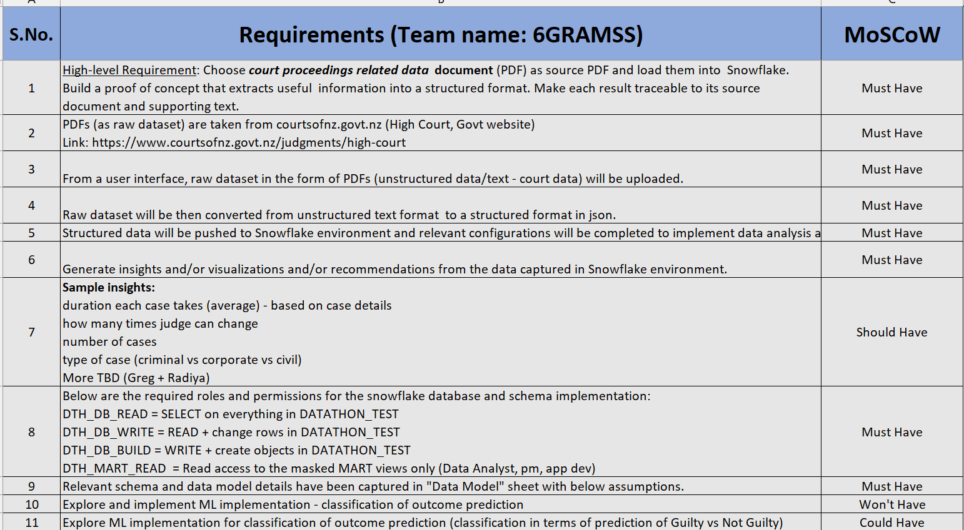
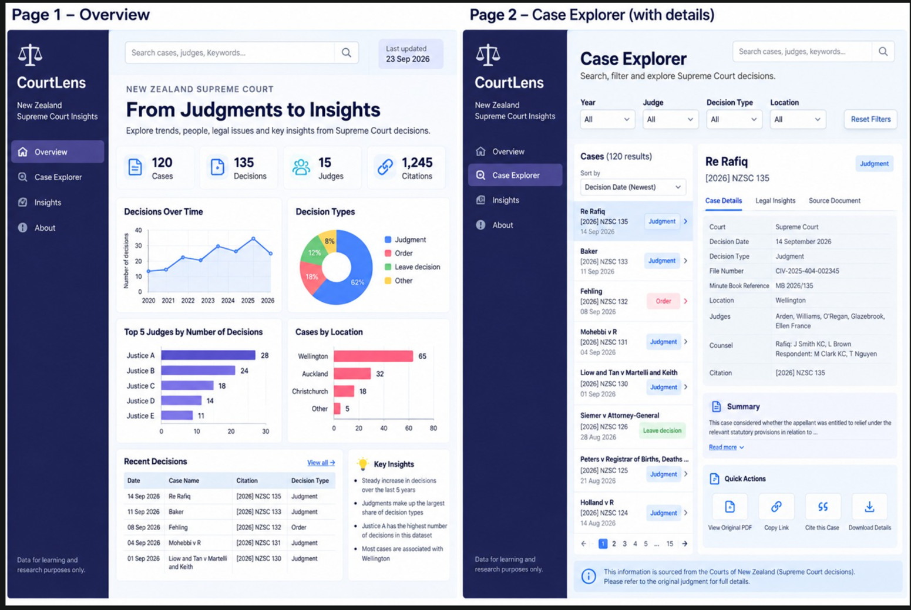
Requirements and Design

Slide 6
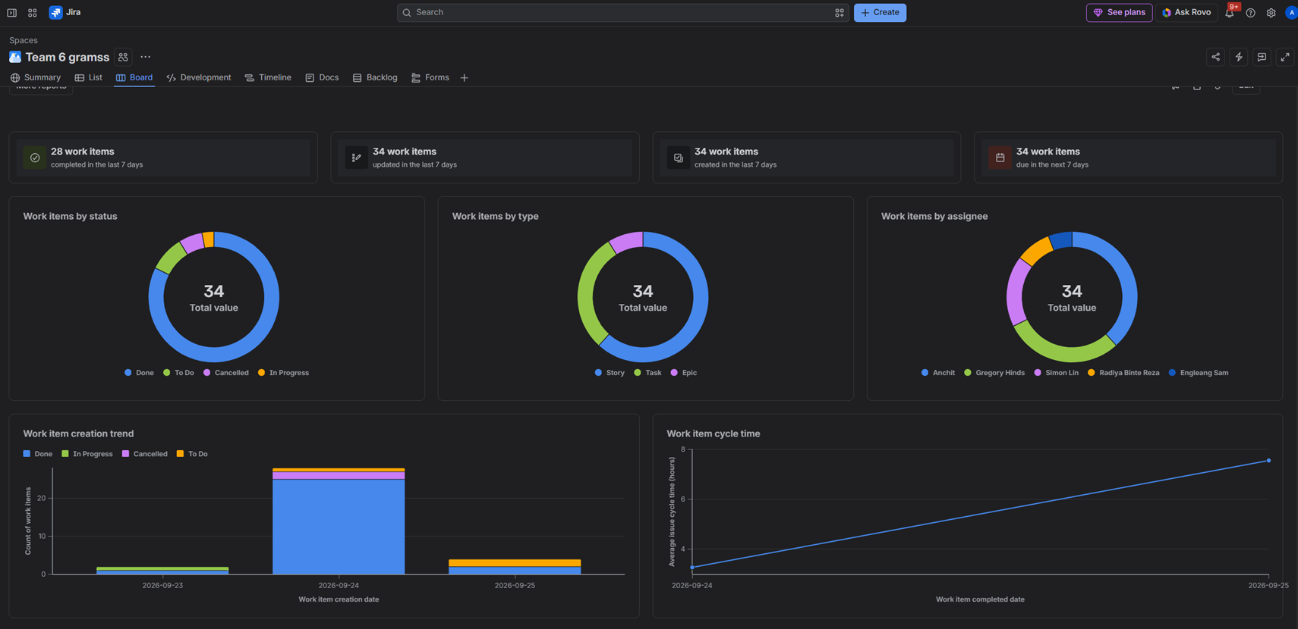
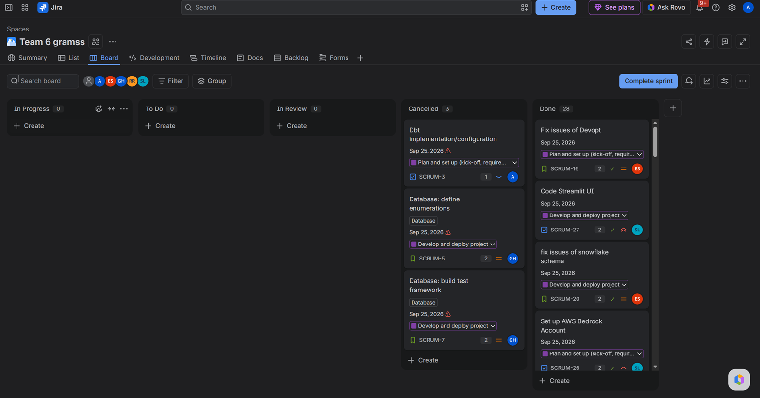
JIRA Board & Scrum Metrics

Slide 7
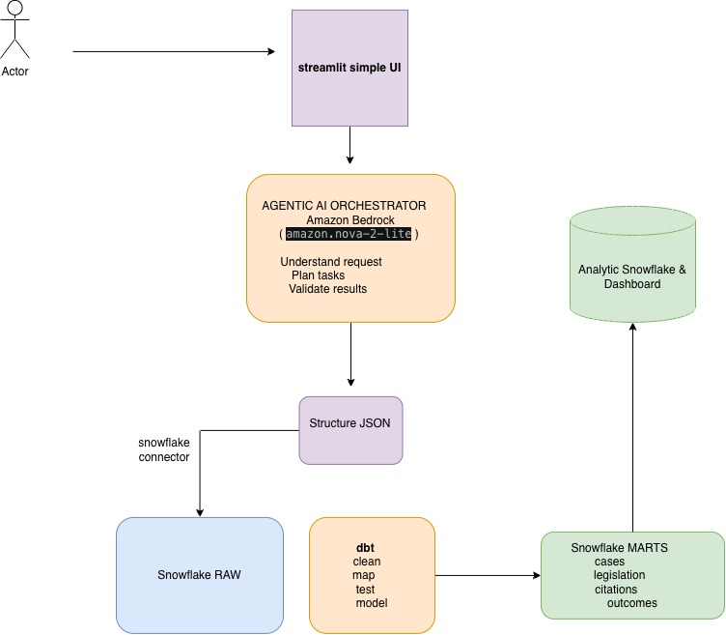
Architecture Overview
https://datathon.someaknea.com

Slide 8
Data Model
Implements a Star Schema for easy querying

Slide 9
Limitations & Challenges
Cannot use Anthropic Model on AWS Trial Account
Only one document type (case NZ) has been extracted
Difficulties of modelling complex data relationships
Agent struggles with long documents
Limited knowledge of Agile/processes in limited time
Network access problems to serve the dashboard outside Snowflake

Slide 10
Future Improvements
& Roadmap
Improvement of extraction to get more data out of the PDFS
  Doesn’t extract Counsels and Parties, multiple hearings in the same Case, and more
  Add more dynamic prompt and agent harness
Improve data modelling to enable more insights
Automatic ingestion of data from published sources
Submission of multiple documents simultaneously
Improve User Interface
  Insights direct to user by email
  Dashboards closer to the submission interface

