Slide 1
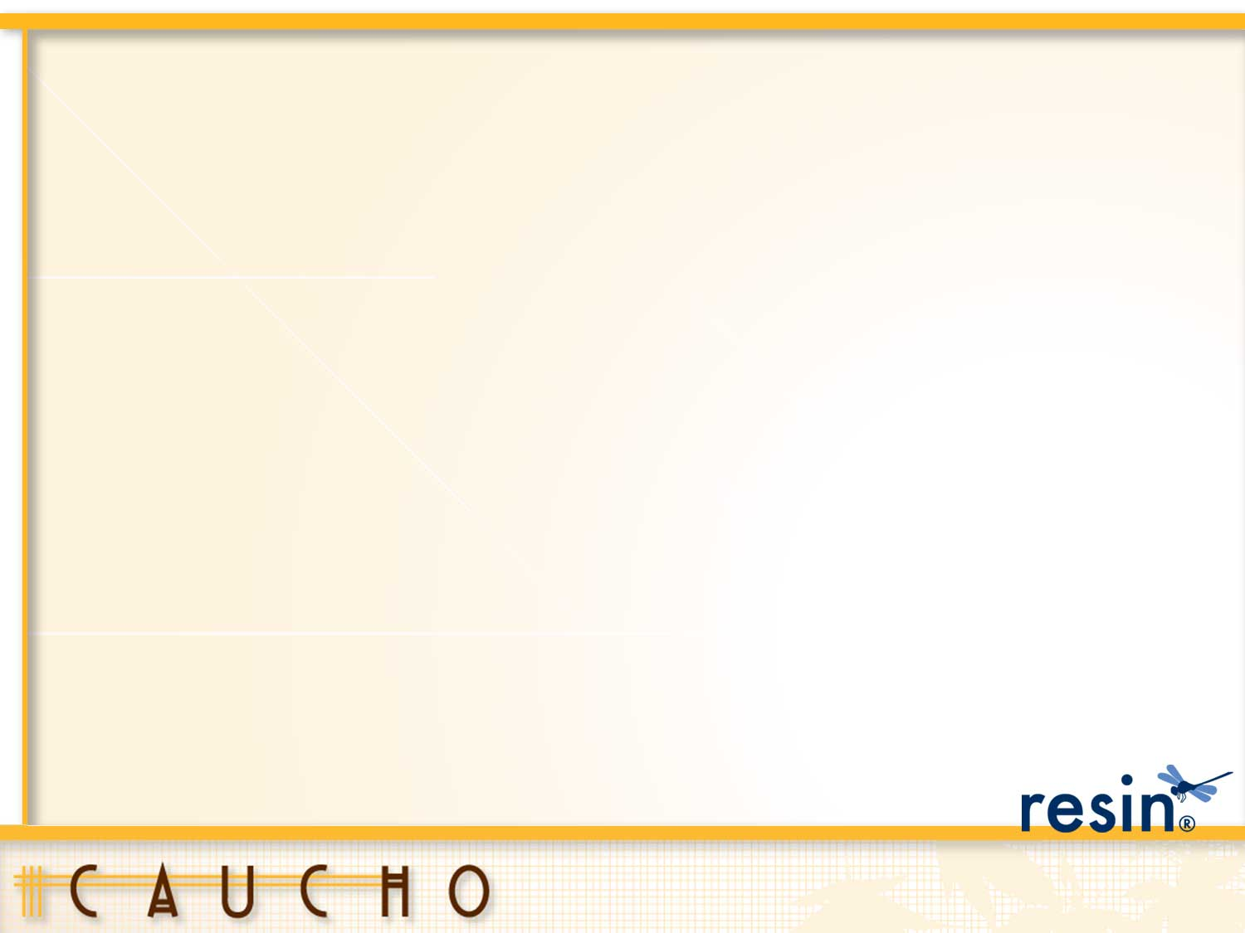
Resin
Lightweight, Open Source
Java EE Appication Server

Slide 2
Resin Overview
high-performance, cloud-optimized Java® application server
Resin® cloud support
third generation clustering,
optimized to run in ec2, IaaS environments
First java app server to support java ee WebProfile®
supports JMS, servlets, JPA, CDI and more
DevOps friendly and cloud ready.
CLI and REST controllable cloud platform
PaaS simplicity with IaaS control

Slide 3
Resin Basics
Older than Tomcat
Used by big companies like Toronto Stock Exchange, Salesforce.com and Conde Nast
Known for its speed, ease-of-use, and small footprint
Java EE Web Profile Certified
Resin Open Source – fast open source, Java EE WebProfile Java Application Server
Resin Pro – adds world class support, health system, clustering, cloud

Slide 4
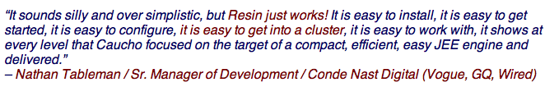



Quotes

Slide 5
Resin Cloud and Clustering
Lightweight, Open Source
Java EE App Server

Slide 6
Cloud Support
Cloud support is Resin’s 3rd generation clustering
Designed for elastic cluster
Ability to add and remove servers from a live cluster
Resin clustering uses Triad server model
Triad is a triple redundant hub
Hub and spoke network
Triad Responsible for load-balancing clustered services
Triad servers also service regular requests
Clustered Services
Load Balancing, Caching, JMS, Clustered Deployment
Added servers enroll automatically in services
Notes:
Resin's cloud support is an extension of its clustering. It is the third generation of Resin clustering, designed for elastic clusters: adding and removing servers from a live cluster.
A triple-redundant hub-and-spoke network is the heart of a Resin cluster. The three servers that form the hub are called the 'triad' and are responsible for reliability and for load-balancing clustered services like caching. All other servers can be added or removed without affecting the shared data.
Services like clustered deployment, caching, JMS, and load-balancing recognize the new server and automatically add it to the service. When you delete a server, the services will adapt to the smaller network.

Slide 7
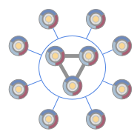
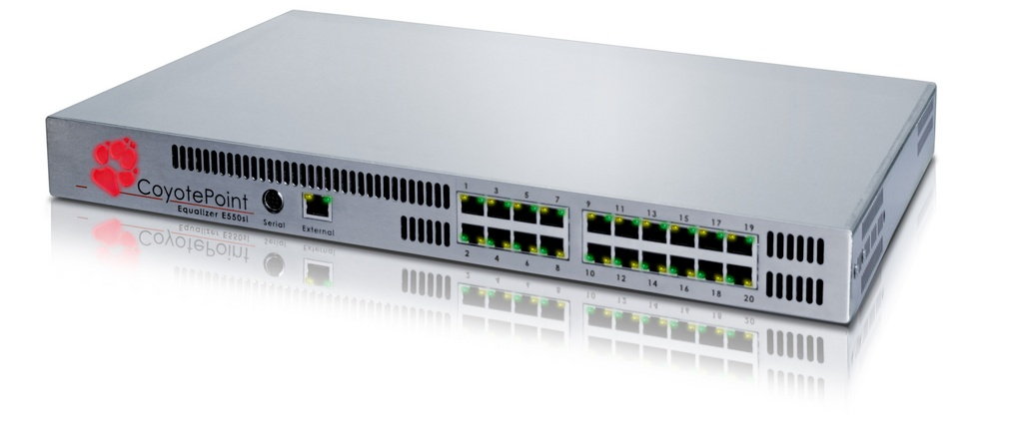
Very Large Cloud
Very large Resin Cloud/Cluster
Pod 1
Pod 1
Pod 1
Pod 1
Pod 1
Pod 1
Pod 1
Pod 1
Pod 1
Pod 1
Pod 1
Pod 1
Pod 1
Pod 5
Pod 1
Pod 1
Pod 0
Pod 5
Pod 10
Pod 15

Slide 8
Resin Clusters
Every server in the cluster serves up requests for the same set of applications
Servers can be load balanced
Servers share queue, session, and object cache data
Cluster Data is replicated for fault tolerance
Load balancer can add/remove servers to distribute the load at runtime (dynamically)

Slide 9
Clustering Overview
Straight-forward elastic-server private cloud
Servers can join and leave
Designed to avoid a lot of headaches associated with other clustering solutions
No massive data shuffling problems
No group splits, simple and reliable
Not overly chatty
Easy to understand and configure, don’t need an army of consultants
Resin prides itself on Operational Predictability
Notes:
Resin's clustering is designed to support a straight-forward elastic-server private cloud: allowing servers to join and leave the cluster while maintaining uptime and reliability without needing configuration changes.

Slide 10
Clustering Feature Overview
To support elastic-server cloud, Resin maintains the following when servers are added and removed:
Data redundancy with a triad hub
Application deployment through a clustered transactional repository
Distributed caching and store for both servlet sessions and JCache caching (and Memcached)
Load balancing to the elastic spoke servers
Distributed management, sensing, and health checks
Elastic JMS message queues
Notes:
To support the elastic-server cloud, Resin maintains the following when servers are added and removed:
Data redundancy with a triad hub.
Application deployment through a clustered transactional repository.
Distributed caching and store for both servlet sessions and JCache caching.
Load balancing to the elastic servers.
Distributed management, sensing, and health checks.
Elastic JMS message queues.

Slide 11
Resin Simple Cluster
Static Triad Servers
Dynamic Spoke servers
Hub
Dynamic
Spoke
Server
A
Dynamic
Spoke
Server
B
Dynamic
Spoke
Server
E
Triad Server 1
Triad Server
2
Spokes Servers are connected to each Triad member
Triad Server
3
Dynamic
Spoke
Server
C
Dynamic
Spoke
Server
D
Dynamic
Spoke
Server
F
Resin HTTP Load balancer
Notes:
You can start out with one sever. Later add two more to do load balancing. Then later add an extra server. Then start adding dynamic instances as needed.

Slide 12
Clustering always there
Clustering is always enabled
Even if you have single server, that server belongs to a cluster
As you add more servers, the servers are added to the cluster
Added servers automatically gain benefits like
clustered health monitoring,
heartbeats,
distributed management,
triple redundancy,
and distributed versioned deployment
Notes:
In Resin, clustering is always enabled. Even if you only have a single server, that server belongs to its own cluster. As you add more servers, the servers are added to the cluster, and automatically gain benefits like clustered health monitoring, heartbeats, distributed management, triple redundancy, and distributed deployment.

Slide 13
Advantages of Clustering
HTTP Load balancing and failover
Elastic servers: adding and removing servers dynamically
Distributed deployment and versioning of applications.
A triple-redundant triad as the reliable cluster hub
Heartbeat monitoring of all servers in the cluster
Health sensors, metering and statistics across the cluster
Clustered JMS queues and topics
Distributed JMX management
Clustered caches and distributed sessions
Notes:
Resin clustering gives you:
HTTP Load balancing and failover.
Elastic servers: adding and removing servers dynamically.
Distributed deployment and versioning of applications.
A triple-redundant triad as the reliable cluster hub.
Heartbeat monitoring of all servers in the cluster.
Health sensors, metering and statistics across the cluster.
Clustered JMS queues and topics.
Distributed JMX management.
Clustered caches and distributed sessions.

Slide 14
Why you need clustering
most web applications start with a single server, at least during development
Later severs get added for increased performance and/or reliability
Developers are familiar with single server deployment
As web application usage grows
Single server can have hardware limitations especially if more than one app is hosted on app server
Hardware limits can occur like chronic high CPU and memory usage etc.
Other resources can be adversely impacted
Notes:
While most web applications start their life-cycle being deployed to a single server, it eventually becomes necessary to add servers either for performance or for increased reliability. The single-server deployment model is very simple and certainly the one developers are most familiar with since single servers are usually used for development and testing (especially on a developer's local machine). As the usage of a web application grows beyond moderate numbers, the hardware limitations of a single machine simply is not enough (the problem is even more acute when you have more than one high-use application deployed to a single machine). The physical hardware limits of a server usually manifest themselves as chronic high CPU and memory usage despite reasonable performance tuning and hardware upgrades.

Slide 15
Server load balancing
Server load-balancing solves scaling problem
lets you deploy a single web app to more than one physical machine
Machines share the web application traffic
Reducing total workload on a single machine and providing better performance from the perspective of the user
load-balancing achieved by redirecting network traffic across multiple machines via a hardware or software load-balancer
Resin supports software load balancer as well as hardware load balancers
Load-balancing increases reliability/up-time
if one or more servers go down for maintenance or due to failure,
other servers can still continue to handle traffic
With a single server application, any down-time is directly visible to the user, drastically decreasing reliability
Notes:
Server load-balancing solves the scaling problem by letting you deploy a single web application to more than one physical machine. These machines can then be used to share the web application traffic, reducing the total workload on a single machine and providing better performance from the perspective of the user. We'll discuss Resin's load-balancing capabilities in greater detail shortly, but load-balancing is usually achieved by transparently redirecting network traffic across multiple machines at the systems level via a hardware or software load-balancer (both of which Resin supports). Load-balancing also increases the reliability/up-time of a system because even if one or more servers go down or are brought down for maintenance, other servers can still continue to handle traffic. With a single server application, any down-time is directly visible to the user, drastically decreasing reliability.

Slide 16
Clustered Deployment
Cluster deployment
Resin's allows deploying web applications to the entire cluster
Allows updating new versions of your application to all servers in cluster
Cluster deployment versioning
Verify that all servers in the cluster are running the same version
When a new version deploys, all servers have an identical copy, then the new app is validated and if successful new app is available on every server in the cluster
clustered deployment is reliable across failures because its built on a transactional version control system (Git)
New servers checks with the cluster (redundant triad) for latest version of applications version
Whenever a server comes up it checks for latest version of applications
Application versions consistent across cluster
Notes:
If your application runs on multiple servers, Resin's clustered deployment helps you updating new versions of your application to all servers, and verify that all servers in the cluster are running the same version. When you deploy a new version, Resin ensures that all servers have an identical copy, validates the application, and then deploys it consistently. The clustered deployment is reliable across failures because its built on a transactional version control system (Git). After a new server starts or a failed server restarts, it checks with the redundant triad for the latest application version, copying it as necessary and deploying it.

Slide 17
Stateful Web Applications
If web applications were stateless, load-balancing alone do the trick for scalability
Many web applications are relatively heavily stateful.
Even very simple web applications use the HTTP session to keep track of current login, shopping-cart-like functionality and so on.
JSF and Wicket heavily use HTTP session a lot
CDI and Seam also have a lot of conversational state stored in HTTP session
When stateful web applications are load-balanced, HTTP sessions are shared across application servers
You can use a sticky session to pin a session to a server
Session state still needs to be shared (replicated) among multiple servers for failover so users don’t lose their session data
With failover of a stateful application, session has to be moved to new server picked by load balancer
Without failover, the user would lose a session when a load-balanced server experiences down-time.
Notes:
If web applications were entirely stateless, load-balancing alone would be sufficient in meeting all application server scalability needs. In reality, most web applications are relatively heavily stateful. Even very simple web applications use the HTTP session to keep track of current login, shopping-cart-like functionality and so on. Component oriented web frameworks like JSF and Wicket in particular tend to heavily use the HTTP session to achieve greater development abstraction. Maintaining application state is also very natural for the CDI (Resin CanDI) and Seam programming models with stateful, conversational components. When web applications are load-balanced, application state must somehow be shared across application servers. While in most cases you will likely be using a sticky session (discussed in detail shortly) to pin a session to a single server, sharing state is still important for fail-over. Fail-over is the process of seamlessly transferring over an existing session from one server to another when a load-balanced server fails or is taken down (probably for upgrade). Without fail-over, the user would lose a session when a load-balanced server experiences down-time. In order for fail-over to work, application state must be synchronized or replicated in real time across a set of load-balanced servers. This state synchronization or replication process is generally known as clustering. In a similar vein, the set of synchronized, load-balanced servers are collectively called a cluster. Resin supports robust clustering including persistent sessions, distributed sessions and dynamically adding/removing servers from a cluster (elastic/cloud computing).

Slide 18
Failover
Static Triad Servers
Dynamic Spoke servers
Hub
Dynamic
Spoke
Server
A
Dynamic
Spoke
Server
B
Dynamic
Spoke
Server
E
Triad Server 1
Triad Server
2
Spokes Servers are connected to each Triad member
Triad Server
3
Dynamic
Spoke
Server
C
Dynamic
Spoke
Server
D
Dynamic
Spoke
Server
F
Resin HTTP Load balancer
Notes:
You can start out with one sever. Later add two more to do load balancing. Then later add an extra server. Then start adding dynamic instances as needed.

Slide 19
Triad Spoke and Hub
Triad based on lessons learned from 13 years of clustering support
Triad is the hub
Triple Redundancy so you perform maintenance on one box while two remain for fault tolerance
Load increases 50% for each remaining server instead of increasing 200% if just using a backup model
Important persistent data is stored and replicated on Triad servers (easy to understand)
Notes:
The triad hub-and-spoke model solves several clustering issues we've discovered over the years. The three primary issues are the need for triple redundancy, managing elastic servers (particularly removing servers), and giving an understandable user model for persistent storage.
Triple redundancy is needed because of server maintenance and load-balancing. When you take down a server for scheduled maintenance, the remaining servers have extra load and they are more vulnerable to a server failure. A triple-redundant hub with one server down for maintenance can survive a crash of one of the two remaining servers. The load is less, too. When one server is down for maintenance, the other two servers share an extra 50% load each. With only a backup system, the extra server would double its load.

Slide 20
Triad Model Advantages
Easier to understand, no magic
Complex models very hard to support with Ops
Triad gives you operational predictability
Triad makes private cloud configuration much simpler
Best combination of centralization, reliability and speed
Centralized responsibilities in hub (called Triad)
Reliability for upgrading and maintenance
Notes:
There are cluster solutions of varying degrees of features, complexity and magic. They range from very expensive to free. There are clustering solutions that rely on custom classloaders, automatic discovery, and self forming group clustering. Then there are clustering solutions that strive to be configurable beyond imagination with 10,000 different options. The ability to understand and implement these clustering solutions can be challenging.
Problems such as group splitting and such can be very hard to diagnose or sometimes even the ability to realize that there is a problem is compromised. The more complex and full of features the clustering solution is, the harder it is to implement correctly.
If your clustering solution has a four hundred page document and the company that supports or produces your clustering solutions has high priced team of consultants, then you have picked a clustering solution that is hard to implement. It does not matter if it is Open Source or commercial clustering either because if you have to pay for consultants and support to implement it, the actual license cost could be mere dust on the scale.
Even if you don’t hire a army of their consultants, more moving parts means more time figuring out which levers to pull and which feature to include. Mistakes can be costly as clustering problems are notoriously hard to diagnose. A simpler solution, that just works, means less moving parts and more ROI. A simpler solutions means you get operational predictability.
Resin clustering takes a different approach. It is built based on the features you need, and nothing else. There is no magic. There is no complex, configurable auto-discovery, or self-forming groups. It is straight forward. It is easy to learn too.
There is an XML file that dictates the topology of your cluster. You can configure a hub, spoke servers and a load balancer. You can configure as little as two servers and the rest of the servers would be dynamic with no further XML configuration needed. Adding additional servers are easy because they just point to the hub and the hub manages the clustering bits. Since our cluster is TCP/IP based, if you can ping a hub server from a new server machine, then you can add that new server machine to the cluster with a command line switch. You don’t need networking engineers teams working with specialized cluster setup consultants to setup a special network just to be able to connect our servers in a cluster. This also makes our clustering solution a perfect fit for public IaaS providers. It just works.
Just because it is simple does not mean there is not a lot of engineering rigor involved. We pained over each byte that gets sent out to reduce the messaging to the bare minimum and data transfer to as small as it can be and no smaller. We push data out to spoke servers so they do not have to always get data from the hub. The data is versioned with hash keys to verify if data changed since last time retrieved. This focus on simplicity makes our clustering model easier to understand and implement. The focus on Resin clustering is simplicity to implement but performance and scalability amped up to the max.
The focus on producing the simplest thing that would work instead of adding every buzzword, neat sound concept is key to our philosophy at Caucho. Caucho is an engineering company not a company led by champagne induced architectural visions of clustering grandeur. This philosophy produces the easiest to configure, easiest to support, very performant clustering solution on the market. We are confident that our solution has the most ROI. Simple. Robust. Fast. Rock Solid clustering.

Slide 21
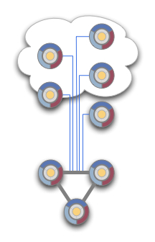
Triad Model
Based on years of experience from developing distributed clustering for a wide variety of user configurations
Refined to a hub-and-spoke model
Interlocking benefits for the dynamically scaling server
When you bring down one server for maintenance, triple redundancy continues to maintain reliability
Elastically add and remove dynamic servers safely without affecting the redundant state
Network processing load-balanced across three servers, eliminating a single point of failure: fault resistant
Your servers scale evenly across the cluster because each new server only needs to speak to the triad, not all servers: reduced chatter and operational predictability
Your large site can split cluster into independent many "pods" of up to 64-servers to maintain scalability
Notes:
After many years of developing Resin's distributed clustering for a wide variety of user configurations, we refined our clustering network to a hub-and-spoke model using a triple-redundant triad of servers as the cluster hub. The triad model provides interlocking benefits for the dynamically scaling server configurations people are using.
When you bring down one server for maintenance, the triple redundancy continues to maintain reliability.
You can add and remove dynamic servers safely without affecting the redundant state.
Your network processing will be load-balanced across three servers, eliminating a single point of failure.
Your servers will scale evenly across the cluster pod because each new server only needs to speak to the triad, not all servers.
Your large site can split the cluster into independent "pods" of less than 64-servers to maintain scalability.

Slide 22
Elastic Spoke Servers
Non-Triad servers are spokes in hub-and-spoke model
'spoke' servers not needed for reliability
Spoke servers don't store
primary cache values,
primary application deployment repository,
queue storage (JMS)
Spoke servers can be added at will
add and remove them without affecting the primary system
Optimized to reduce excessive data shuffling if a server is removed
Notes:
Elastic servers benefit from the hub-and-spoke model because the 'spoke' servers are not needed for reliability. Because they don't store the primary cache values, the primary application deployment repository, or the queue store, it's possible to add and remove them without affecting the primary system. With other network configurations, removing a server forces a shuffling around backup data to the remaining servers.

Slide 23
Triad Servers
Important data that needs to be replicated is always stored in the Triad
Master Queue data, master cache data, master deployment files
Other servers just use Triad
This model is easy to understand
No complex data sharing and copying scheme
Non-Triad servers are more expendable
Triad servers are worth additional reliability attention
Notes:
The triad also gives a simpler user model for understanding where things are stored: data is stored in the triad. Other servers just use the data. Understanding the triad means you can feel confident about removing non-triad servers, and also know that the three triad servers are worth additional reliability attention.

Slide 24
Server Types
Dynamic server
Servers that are elastic
Also described as elastic servers
Does not need a fixed IP
Easy to bring up and down
Static server
Servers that are configured by id and ip address in the resin.xml
First three Static Servers configured are Triad servers
Triad servers also handle normal requests

Slide 25
Elastic Servers with Elastic Cluster Service
Add and remove servers dynamically to the system,
Automatically adjusts the cluster to manage those servers
Deployed applications get pushed to the new server automatically
Distributed caching is notified of the new server
Load balancer updates itself to include the new server
JMS queues update with the new server so the new server can get messages
Cluster administration adds the new server so the new server can for example get health heartbeats from the Triad
Notes:
Resin lets you add and remove servers dynamically to the system, and automatically adjusts the cluster to manage those servers.
Deployed applications pushed to the new server automatically.
Distributed caching updates replicated data with server adds and removes.
Load balancing updates to include the new server or remove the old one.
JMS queues update with the new server.
Administration updates to the new server.

Slide 26
Baseline config
Define 3 static servers in resin.xml
First three are always Triad
Triad servers are always static
Copy resin.xml file to $RESIN_HOME/conf across all server boxes
Attach new servers from command-line
As many as you need
These are Dynamic Spoke Servers
Notes:
The baseline cloud configuration is like a normal Resin configuration: define the three triad servers in your resin.xml, and copy the resin.xml across all servers. You will attach new servers to the cluster when you start it on the command-line. You can still define more servers in the resin.xml, or fewer if you have a small deployment; it's just the basic resin.xml example that uses three servers.

Slide 27
Baseline cluster setup
Define a resin.xml with three static servers as the triad.
Start the triad servers as normal.
Deploy .wars to the triad with the command-line 'deploy' to enable automatic deployment to the new servers.
Install a machine (or VM image) with Resin, your licenses, and the resin.xml.
Start the new Resin server with a --join-cluster command-line option.
The new server will load the applications from the triad and join in any clustered services like load-balancing and caching.
When load drops, stop the new Resin server as usual.
Notes:
Define a resin.xml with three static servers as the triad.
Start the triad servers as normal.
Deploy .wars to the triad with the command-line 'deploy' to enable automatic deployment to the new servers.
Install a machine (or VM image) with Resin, your licenses, and the resin.xml.
Start the new Resin server with a --join-cluster command-line option.
The new server will load the applications from the triad and join in any clustered services like load-balancing and caching.
When load drops, stop the new Resin server as usual.

Slide 28
Basic Configuration
Load increases.
Spin a new server
up
Dynamic
Spoke
Server
A
Dynamic
Spoke
Server
C
Triad Server 1
Triad Server
2
Triad Server
3
Dynamic
Spoke
Server
B

Slide 29
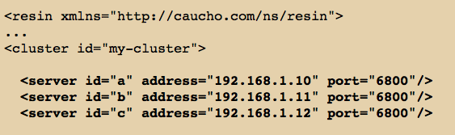
Triad in resin.xml
Define Triad
Spin up a new VM instance and add it to the cluster. It talks to the triad to join.
Spin up a new VM instance and add it to the cluster. It talks to the triad to join.

Slide 30
New server dynamically joining cloud
Spin up a new VM instance and add it to the cluster. It talks to the triad to join.
Dynamic
Spoke
Server
A
Triad Server 1
192.168.1.10
My App.war
Ask for latest
application versions
I am here need apps
Triad Server 2
192.168.1.11
Triad Server 3
192.168.1.12

Slide 31
New server dynamically joining cloud
Spin up a new VM instance and add it to the cluster. It talks to the triad to join.
Dynamic
Spoke
Server
A
Dynamic
Spoke
Server
B
Triad Server 1
192.168.1.10
My App.war
I am here need apps
Triad Server 2
192.168.1.11
Ask for latest
application versions
Triad Server 3
192.168.1.12

Slide 32
Triad with less than three
You can have only one Static server in resin.xml
Configured Server is Triad, but there is no failover, if server goes down, cluster is down
Triad only has one server in it
You can have two Static Servers in resin.xml
Both servers are Triad members
Triad only has two servers in it
You get failover but not as robust as three
Three is the most reliable

Slide 33
Two Triad Server Hub, problem with load
Triad responsibilities of Triad Server 2 goes up 200%
Dynamic
Spoke
Server
A
Down for
maintenance
Triad Server 1
Triad Server
2
Dynamic
Spoke
Server
B
Notes:
The problem with only two members in the Triad is that if one is taken down for maintenance or has a problem then the other server is left to handle all of the Triad responsibilities.

Slide 34
Basic Configuration 1 Triad Server down
Triad responsibility load increases by 50%
For Triad Server 2 and Triad Server 3
Dynamic
Spoke
Server
A
Down for
maintenance
Triad Server 1
Triad Server
2
Triad Server
3
Dynamic
Spoke
Server
B

Slide 35
One Triad Server Hub
Spoke servers in operation continue to work.
Clustering services stop. No new spoke servers can be
Added until Triad Server is back up
Dynamic
Spoke
Server
A
Down for
maintenance
Triad Server 1
Dynamic
Spoke
Server
B
Notes:
You really don’t want the Triad to go down.
This is why you want three servers in your Triad.
Your applications can continue to run even if the Triad is down, but in a degraded fashion.
Spoke servers in operation continue to work.
Clustering services stop. No new spoke servers can be added until Triad Server is back up.
Cache gets out of sync as each member has local copies that are not synchronized to master.
JMS queue only work within a single server instance. Since load balancer uses sticky session, spoke servers are able to continue operation, but there is no failover support for sessions until Triad comes back up. This means a downed server can mean loss of all of the active sessions on that server.

Slide 36
More than 3 static servers
You can have more than 3 static servers
XML file can document all of the static servers ahead of time
clustering administration (cluster heartbeats) let’s you track up time and down time of all static servers
Static servers show up in Topology

Slide 37
Static servers outside of Triad
Static servers can be spoke servers
Static
Spoke
Server
A
Dynamic
Spoke
Server
C
Triad Server 1
Triad Server
2
Triad Server
3
Static
Spoke
Server
B
Dynamic
Spoke
Server
D
Notes:
Any static servers beyond the first three are static spoke servers. If they are out of service, the health system can track down time.

Slide 38
Web Tier full featured
Dynamic load balancer that is cluster/cloud aware
Added servers automatically take load
Features similar to expensive Level 7 Hardware load balancer,
Level 7 is ADC - Application Delivery Controller
HTTP proxy caching similar to Squid
HTTP stack faster than Apache HTTPD

Slide 39
HTTP Load Balancing Easy to add
If traffic increases beyond capacity 1 app server,
Add HTTP load balancer as well as the second application server
The load balancer is in the Resin web-tier used for HTTP load-balancing and HTTP proxy caching
Now you have load balancing and fault tolerance
Two tier topology, with web-tier load balancer and app server tier
Easily system becomes two tier system
Resin can function as web-tier load balancer and app-tier app servers
Easy to setup, same config file as before, just a few XML entries and viola you have a HTTP load balancer
Just add <resin:LoadBalance> tag to forward request to app-tier
A load balanced system in Resin
define the servers to use as the application-tier,
define the servers in the web-tier,
and select which requests are forwarded (proxied) to the backend app-tier servers.
Notes:
Once your traffic increases beyond the capacity of a single application server, your site needs to add a HTTP load balancer as well as the second application server. Your system is now a two tier system: an app-tier with your program and a web-tier for HTTP load-balancing and HTTP proxy caching. Since the load-balancing web-tier is focusing on HTTP and proxy caching, you can usually handle many app-tier servers with a single web-tier load balancer. Although the largest sites will pay for an expensive hardware load balancer, medium and small sites can use Resin's built-in load-balancer as a cost-effective and efficient way to scale a moderate number of servers, while gaining the performance advantage of Resin's HTTP proxy caching.
A load balanced system has three main requirements: define the servers to use as the application-tier, define the servers in the web-tier, and select which requests are forwarded (proxied) to the backend app-tier servers. Since Resin's clustering configuration already defines the servers in a cluster, the only additional configuration is to use the <resin:LoadBalance> tag to forward request to the backend.

Slide 40
HTTP Load Balancing Easy to Scale Out
Small to medium level sites (under 64 servers per application) can use Resin’s load balancer which is cloud/cluster aware
Beyond 64 servers Resin works with hardware load balancers
Divide servers into cluster pods of up to 64 servers
hardware load balancer load balances to Resin load balancers
In effect, hardware load balancer load balances to Resin cluster pods

Slide 41
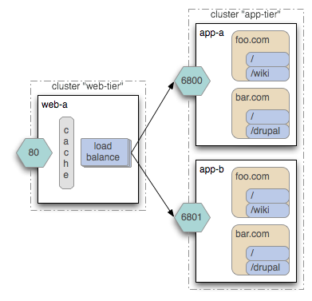
Load Balancer

Slide 42
Resin Cloud/Cluster Aware Load Balancer
Spin up two new virtual machine
Instances with Resin
Dynamic
Spoke
Server
A
Dynamic
Spoke
Server
B
Dynamic
Spoke
Server
E
Triad Server 1
Triad Server
2
Triad Server
3
Dynamic
Spoke
Server
C
Dynamic
Spoke
Server
D
Dynamic
Spoke
Server
F
Resin Web Tier, HTTP Load Balancer with Sticky Session, HTTP Proxy Cache, Faster than Apache HTTPD
Notes:
You can start out with one sever. Later add two more to do load balancing. Then later add an extra server. Then start adding dynamic instances as needed.

Slide 43
Pods for Mass scale out
If you never plan on using more than 64 servers, don’t think about pods
By default a cluster contains 1 pod
A pod is a collection of up to 64 servers
A pod has 1 triad (of up to 3 servers) and up to 61 to 63 static or dynamic servers
Once you go beyond 64, you have to use this configurations <cluster …><pod><server…> … </pod>
Essentially divide servers up
Below 64 you use this <cluster …><server> … </cluster>
This is for cluster communicatoin responsiveness.
Each cluster can have up to 64 pods
Notes:
Because most customers use less than 64, the pod tag is not needed if you have less than 64 combined servers.
We try to keep the most common case as simple to configure as possible.

Slide 44
Resin Cloud Aware Load Balancer Massive Scale Out
Resin pod 1
Resin pod 2
Dynamic
Spoke
Server
A
Dynamic
Spoke
Server
B
Dynamic
Spoke
Server
E
Dynamic
Spoke
Server
A
Dynamic
Spoke
Server
B
Dynamic
Spoke
Server
E
Triad Server 1
Triad Server
2
Triad Server 1
Triad Server
2
Triad Server
3
Dynamic
Spoke
Server
C
Dynamic
Spoke
Server
D
Triad Server
3
Dynamic
Spoke
Server
C
Dynamic
Spoke
Server
D
Dynamic
Spoke
Server
F
Dynamic
Spoke
Server
F
Resin HTTP Load Balancer/ Web Tier
Resin HTTP Load Balancer / Web Tier
Resin Cluster with two pods
If Hardware Load Balancers
Supports 16 Servers.
And, Each Server can be LB for
Cluster with 64 servers
Then 16 * 64 = 1024 servers
Limitation of Cluster 4096 servers 64 * 64
Hardware load balancer
With sticky session support
Notes:
Once you surpass 64, then put a hard load balancer in front and you can have as many cluster pods as you like based on how many your hardware load balancer will allow, i.e., how many ports are there on the load balancer.

Slide 45
Massive scale out: a 20 pod system
Very large Resin cloud/cluster
Pod 1
Pod 1
Pod 1
Pod 1
Pod 1
Pod 1
Pod 1
Pod 1
Pod 1
Pod 1
Pod 1
Pod 1
Pod 1
Pod 5
Pod 1
Pod 1
Pod 0
Pod 5
Pod 10
Pod 15
Notes:
You could have 32 pods with 32 servers or 10 pods with 10 servers, it really depends on the amount of communication the spoke servers to triad servers need. It is more about what type of application you have. When deploying to a large cluster, the app deployment always goes to the first pod. The first pod is the master pod. The first pod’s triad is critical. It is responsible for syncing any needed data to the other pods.

Slide 46
Load Balancer basics
Define servers to use as application-tier
Define servers in web-tier, and select which requests are forwarded (proxied) to the backend app-tier servers
Since clustering configuration already defined, only one additional configuration used forward request to app tier
<resin:LoadBalance>.
Notes:
A load balanced system has three main requirements: define the servers to use as the application-tier, define the servers in the web-tier, and select which requests are forwarded (proxied) to the backend app-tier servers. Since Resin's clustering configuration already defines the servers in a cluster, the only additional configuration is to use the <resin:LoadBalance> tag to forward request to the backend.

Slide 47
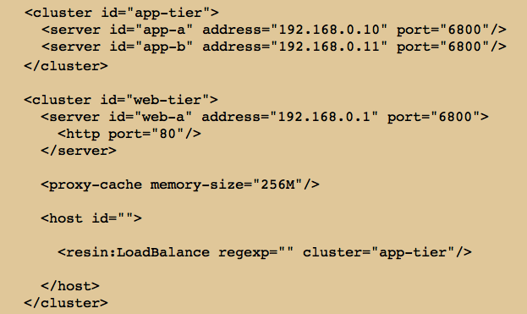
Sample Load Balancer Config
Notes:
In the configuration above, the web-tier cluster server load balances across the app-tier cluster servers because of the cluster attribute specified in the <resin:LoadBalance> tag. The <cache> tag enables proxy caching at the web tier. The web-tier forwards requests evenly and skips any app-tier server that's down for maintenance/upgrade or restarting due to a crash. The load balancer also steers traffic from a single session to the same app-tier server (a.k.a sticky sessions), improving caching and session performance.
Each app-tier server produces the same application because they have the same virtual hosts, web-applications and Servlets, and use the same resin.xml. Adding a new machine just requires adding a new <server> tag to the cluster. Each server has a unique name like "app-b" and a TCP cluster-port consisting of an <IP,port>, so the other servers can communicate with it. Although you can start multiple Resin servers on the same machine, TCP requires the <IP,port> to be unique, so you might need to assign unique ports like 6801, 6802 for servers on the same machine. On different machines, you'll use unique IP addresses. Because the cluster-port is for Resin servers to communicate with each other, they'll typically be private IP addresses like 192.168.1.10 and not public IP addresses. In particular, the load balancer on the web-tier uses the cluster-port of the app-tier to forward HTTP requests.

Slide 48
Load Balancer Setup
app-tier cluster
Triad Hub
app-a
192.168.0.10
app-b
192.168.0.11
Spoke server bus
web-tier cluster
Load Balancer
web-a
192.168.0.1
Notes:
You can start out with one sever. Later add two more to do load balancing. Then later add an extra server. Then start adding dynamic instances as needed.

Slide 49

Load Balancer Setup
app-tier cluster
Triad Hub
app-a
192.168.0.10
app-b
192.168.0.11
web-tier cluster
Load Balancer
web-a
192.168.0.1
Notes:
You can start out with one sever. Later add two more to do load balancing. Then later add an extra server. Then start adding dynamic instances as needed.
Since Resin lets you start multiple servers on the same machine, a small site might start the web-tier server and one of the app-tier servers on one machine, and start the second server on a second machine. You can even start all three servers on the same machine, increasing reliability and easing maintenance, without addressing the additional load (although it will still be problematic if the physical machine itself and not just the JVM crashes). If you do put multiple servers on the same machine, remember to change the port to something like 6801, etc so the TCP binds do not conflict.
In the /resin-admin management page, you can manage all three servers at once, gathering statistics/load and watching for any errors. When setting up /resin-admin on a web-tier server, you'll want to remember to add a separate <web-app> for resin-admin to make sure the <rewrite-dispatch> doesn't inadvertantly send the management request to the app-tier.

Slide 50
Sticky/Persistent Sessions
Sticky session means load balancer has session affinity per server, i.e., if you start your session on one server, session stays on that server
Resin does not replicate sessions by default
With no sticky affinity, load balancer would pick a server pseudo randomly for each request (round robin), if it did, and you logged into server-b on second request you could log into server-c and lose your login from the first request
With session affinity, user will go to server-b as long as long as server-b did not go down, if server-b goes down, then all users on server-b would lose their session unless session replication was turned on
With session affinity and replicated session, users would go to server-b as long as it was up, if it were down, user would get directed to new server, the new server would request the session data for that user from the Triad
Without session affinity and with replicated sessions, sessions would be constantly copied from one server to another
Notes:
To understand what sticky sessions are and why they are important, it is easiest to see what will happen without them. Let us take our previous example and assume that the web tier distributes sessions across the application tier in a totally random fashion. Recall that while Resin can replicate the HTTP session across the cluster, it does not do so by default. Now lets assume that the first request to the web application resolves to app-a and results in the login being stored in the session. If the load-balancer distributes sessions randomly, there is no guarantee that the next request will come to app-a. If it goes to app-b, that server instance will have no knowledge of the login and will start a fresh session, forcing the user to login again. The same issue would be repeated as the user continues to use the application from in what their view should be a single session with well-defined state, making for a pretty confusing experience with application state randomly getting lost!
One way to solve this issue would be to fully synchronize the session across the load-balanced servers. Resin does support this through its clustering features (which is discussed in detail in the following sections). The problem is that the cost of continuously doing this synchronization across the entire cluster is very high and relatively unnecessary. This is where sticky sessions come in. With sticky sessions, the load-balancer makes sure that once a session is started, any subsequent requests from the client go to the same server where the session resides. By default, the Resin load-balancer enforces sticky sessions, so you don't really need to do anything to enable it.

Slide 51
Clustering sessions
load balancing, maintenance and failover should be invisible to your users
Resin replicate user's session data across the cluster
When the load-balancer fails over a request to a backup server, or when you dynamically remove a server, the backup can grab the session and continue processing
From the user's perspective, there was no failure
To make this process fast and reliable, Resin uses the triad servers as a triplicate backup for the user's session.
Notes:
Because load balancing, maintenance and failover should be invisible to your users, Resin can replicate user's session data across the cluster. When the load-balancer fails over a request to a backup server, or when you dynamically remove a server, the backup can grab the session and continue processing. From the user's perspective, nothing has changed. To make this process fast and reliable, Resin uses the triad servers as a triplicate backup for the user's session.

Slide 52
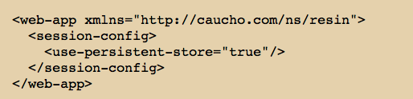
Clustered session setup

Slide 53
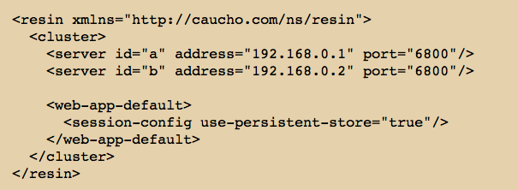
Clustered Session Setup for all webapps

Slide 54
Sessions saved
Sessions can be backed up on every request
Or, Sessions can be backed up when a change is detected (default)
Sessions are not locked for replication

Slide 55
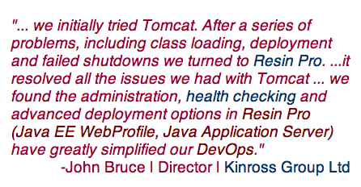
Cloud Optimized, DevOps Friendly

