Slide 1
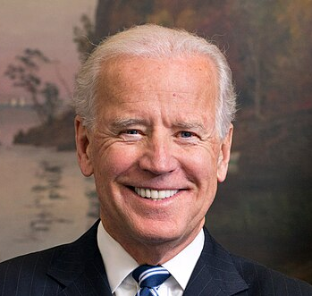
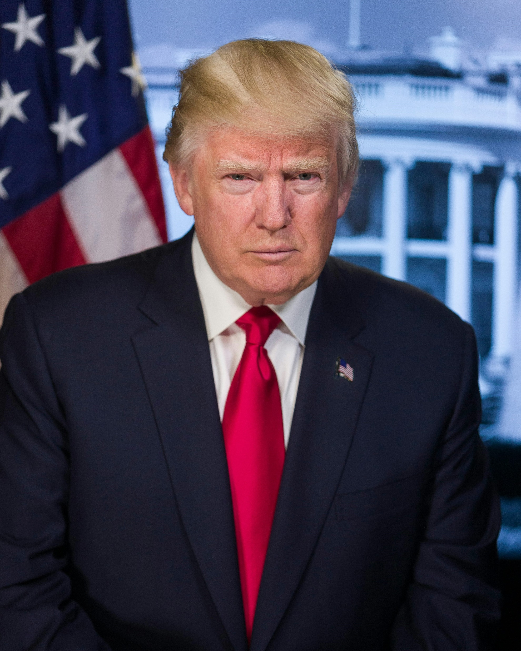
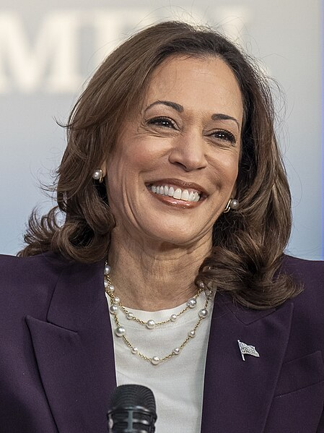

Slide 3
The Presidential Election – an Outdated System?
A English-GFS
Presented by Yiding Ma
23rd october, 2024

Slide 4
What Defines a Successful Democracy?

Slide 5
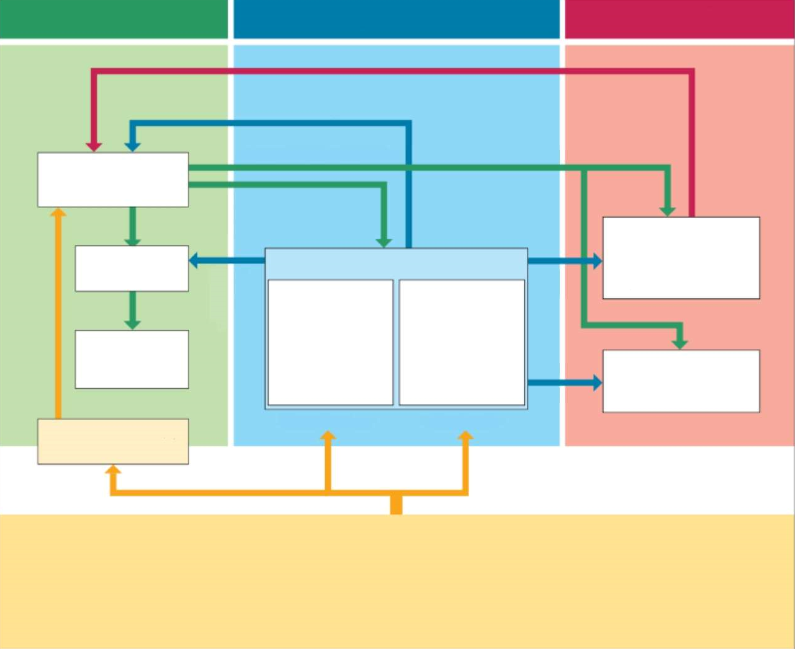
What Defines a Successful Democracy?
“Democracies are characterized, among other things, by respect for human rights, separation of powers, accountability of the government, independence of the courts, legality of the administration, a multi-party system and free, equal and secret elections.”
- Deutscher Bundestag

Slide 6


What Kind of System Does the US Have?
The US is a representative democracy
→ Citizens vote for officials who make decisions on their behalf
I think they want ABC!

Slide 7
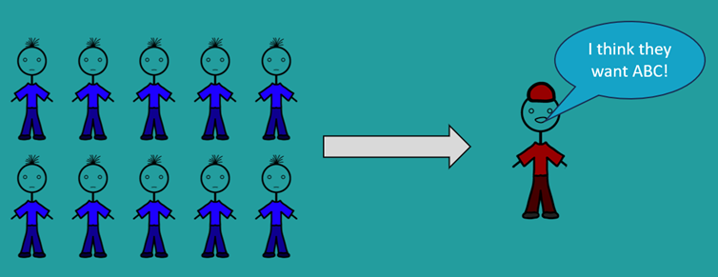

What Kind of System Does the US Have?
By definition: Constitutional Federal Democratic Republic
Constitutional: Government operation based on an constitution¹
Federal: Power is divided between a central government and the individual states, each with its own authority
Republic: Citizens elect representatives who govern
Haha, I won!
^{1:} constitution = Verfassung

Slide 8
Any Questions?
→ Please raise your hands if there ever are any!

Slide 10
Executive
Legislative
Judicial
President
Government
Supreme Court
Senate
2 Senators per State for 6 years
House of Representatives
435 Members for
2 years
Federal (State) Court
538 Electoral Votes
Population eligible to vote
Every 18+ years old American citizen living in one of the 50 states.
23rd Amendment: District of Columbia is eligible to vote in presidential elections

Slide 11
Executive
Legislative
Judicial
President
Government
Supreme Court
Senate
2 Senators per State for 6 years
House of Representatives
435 Members for
2 years
Federal (State) Court
538 Electoral Votes
Population eligible to vote
Every 18+ years old American citizen living in one of the 50 states.
23rd Amendment: District of Columbia is eligible to vote in presidential elections

Slide 12
Executive
Legislative
Judicial
President
Government
Supreme Court
Senate
2 Senators per State for 6 years
House of Representatives
435 Members for
2 years
Federal (State) Court
538 Electoral Votes
Population eligible to vote
Every 18+ years old American citizen living in one of the 50 states.
23rd Amendment: District of Columbia is eligible to vote in presidential elections

Slide 13
32%
68%

Slide 14
The Popular Vote
32%
68%
Winner!

Slide 15
The Popular Vote
32%
68%
Winner!

Slide 16
The Popular Vote
The Electoral College
32%
68%
Winner!

Slide 17
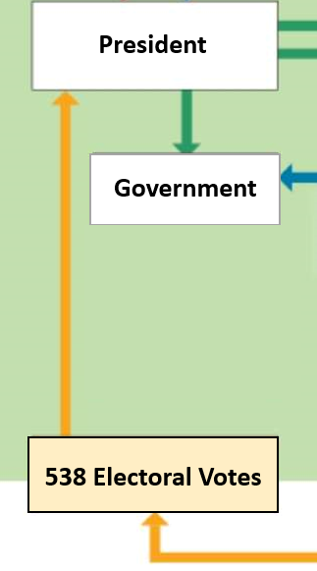
The Electoral College
538 Electoral Votes

Slide 18
The Electoral College
538 Electoral Votes
One vote per Senate seat + Seats in the House of Representatives
2 Votes per State
Rest of the votes distributed equivalent to population
(Washington D.C. has three votes )

Slide 19
The Electoral College
538 Electoral Votes
One vote per Senate seat + Seats in the House of Representatives
2 Votes per State
Rest of the votes distributed equivalent to population
(Washington D.C. has three votes )
Get 270+ electoral votes and you are the president!

Slide 20
The Electoral College
One vote per Senate seat + Seats in the House of Representatives
2 Votes per State
Rest of the votes distributed equivalent to population
(Washington D.C. has three votes )
2 Base Votes + Votes for House of Representative Seats

Slide 21
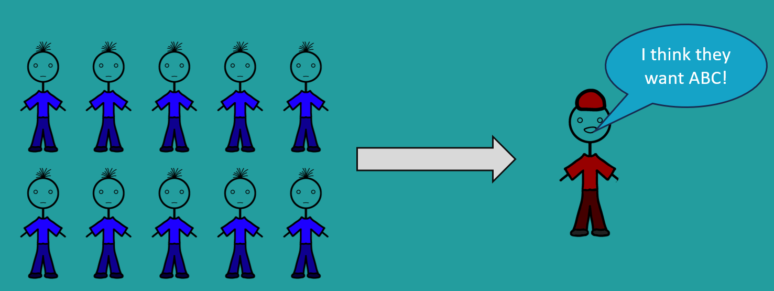
The Electoral College
2 Base Votes + Votes for House of Representative Seats
2 Base Electors + Electors for House of Representative Seats
Elector

Slide 22
Why electors instead of direct votes?
→ Information transfer was hard in 1787
2 Base Votes + Votes for House of Representative Seats
2 Base Electors + Electors for House of Representative Seats
Haha, I won!

Slide 23
Why This
Not this?
The Popular Vote
32%
68%
Winner!
Information transfer was hard
Prevents an domination of few most populated states

Slide 24
Why This
Not this?
The Popular Vote
32%
68%
Winner!
Information transfer was hard
Prevents an domination of few most populated states

Slide 25
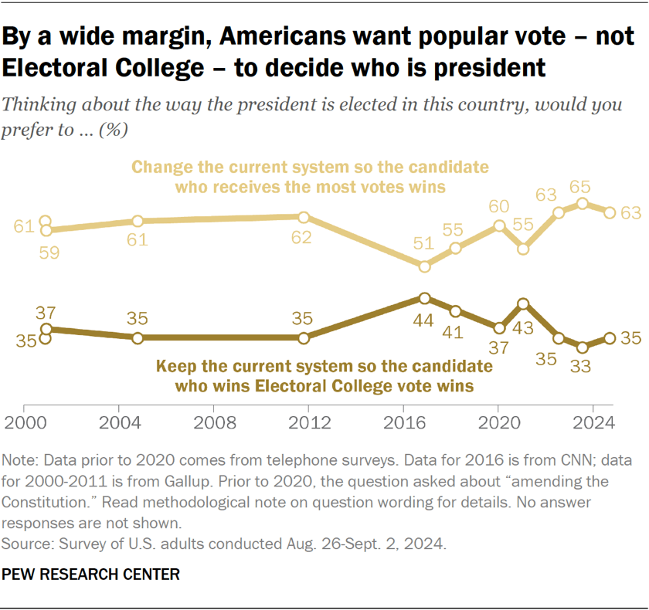
Any Questions?

Slide 26
Any Questions?
Drawbacks of the Electoral College

Slide 27
Drawbacks of the Electoral College
First Past the Post Voting
Also known as “Winner takes it all”
(Exceptions: Maine, Nebraska)
2 + X Votes per State
→ Not everyone votes the same in a state

Slide 28
Drawbacks of the Electoral College
First Past the Post Voting
→ Also known as “Winner takes it all”
20%
18%
24%
17%
21%

Slide 29
Drawbacks of the Electoral College
First Past the Post Voting
→ Also known as “Winner takes it all”
Winner!
24%
Problem 1: Minority Rules

Slide 31
9%
18%
19%
13%
20%
15%
6%

Slide 32
9%
18%
19%
13%
20%
15%
6%

Slide 33
18%
9%
28%
13%
26%
6%
15%

Slide 34
18%
28%
13%
26%
15%

Slide 35
18%
28%
13%
26%
15%

Slide 36
18%
33%
34%
15%

Slide 37
18%
33%
34%
15%

Slide 38
51%
49%

Slide 39
49%
→ Grey voters may change their mind
51%

Slide 40
18%
9%
15%
6%
13%
19%
20%
→ Voting out of fear someone you dislike wins

Slide 41
Gerrymandering

Slide 44
The Spoiler Effect

Slide 45
49%
51%

Slide 46
49%
36%
15%
→ The better Red does, the more it hurts its voters

Slide 47
Quick Summarization
Problems with a “Winner Takes it All” system:
If multiple Candidates run, a minority rules
Over time, a Two-Party system forms, which most don’t agree with
Results can be manipulated by grouping voters
The System, once established, can hardly be broken

Slide 49
The Reality
vs.

Slide 50
= Swing States
The Reality
Two-Party system
vs.

Slide 51
Two-Party system
The Reality
vs.
= Swing States
→ Get all the attention, everyone else gets ignored
(Pennsylvania, Georgia, North Carolina, Michigan, Arizona, Wisconsin, Nevada)
englischgfs.github.io for more info!
Gerrymandering:
US States are divided into districts, which vote individually
Example: Michigan 2012-2020; Republicans always had less than 50% of the votes, but more than half of the State House seats

Slide 52
= Swing States
→ Get all the attention, everyone else gets ignored
The Reality
(Pennsylvania, Georgia, North Carolina, Michigan, Arizona, Wisconsin, Nevada)
englischgfs.github.io for more info!
Gerrymandering:
US States are divided into districts, which vote individually
Example: Michigan 2012-2020; Republicans redrew the district borders in 2012
→ Less than 50% of the votes, more than half of the State House seats
Minority Rules:
Four Instances of Minority Rule in 46 Elections
8,7% Failure Rate
Two Instances of Minority Rule in the 21st Century
33% Failure Rate

Slide 53
The Reality
Unequal votes:
Citizens of smaller States have far more influence
Example: A Voter in Wyoming has 4x as many Electoral Votes per capita than California
Minority Rules
Four Instances of Minority Rule in 46 Elections
8,7% Failure Rate
Two Instances of Minority Rule in the 21st Century
33% Failure Rate
Theoretically possible to become president with less than 25% of all votes

Slide 54
Unequal votes:
Citizens of smaller States have far more influence
Example: A Voter in Wyoming has 4x as many Electoral Votes per capita than California
The Reality
Minority Rules
Four Instances of Minority Rule in 46 Elections
8,7% Failure Rate
Two Instances of Minority Rule in the 21st Century
33% Failure Rate
Theoretically possible to become president with less than 25% of all votes
Faithless Electors
Elected officials are able vote however they want
Happened over 80x in the past

Slide 55
Minority Rules
Four Instances of Minority Rule in 46 Elections
8,7% Failure Rate
Two Instances of Minority Rule in the 21st Century
33% Failure Rate
Theoretically possible to become president with less than 25% of all votes
The Reality
Faithless Electors
Elected officials are able vote however they want
Happened over 80x in the past
Not everyone is allowed to vote
Citizens living in the US territories are not allowed to vote
→ 3,6 million people, more than 4 other States combined

Slide 56
Faithless Electors
Elected officials are able vote however they want
Happened over 80x in the past
The Reality
Quick Recap:
Not everyone is allowed to vote
Citizens living in the US territories are not allowed to vote
3,6 million people, more than 4 other States combined
Most States don’t allow prisoners to vote
→ ~2million people, totaling more than the population of 6 States

Slide 57
The Reality
Not everyone is allowed to vote
Citizens living in the US territories are not allowed to vote
3,6 million people, more than 4 other States combined
Most States don’t allow prisoners to vote
→ ~2million people, totaling more than the population of 6 States
Quick Recap:
This
Not this
The Popular Vote
32%
68%
Winner!

Slide 58
Quick Recap:
Why was it established anyway?
Information transfer was hard in 1787
Compromise between the States
Downside:
Minority Rules
Vote out of fear rather than liking
Lack of Representation (Two-Party system)
Whoever draws the borders has an advantage
It is hard to change such a system (→ it benefits the small States)
Unequal Votes

Slide 59
Quick Recap:
Why was it established anyway?
Information transfer was hard in 1787
Compromise between the States
Downside:
Minority Rules
Vote out of fear rather than liking
Lack of Representation (Two-Party system)
Whoever draws the borders has an advantage
It is hard to change such a system (→ it benefits the small States)
Unequal Votes

Slide 60
The Reality
So… Is the Electoral College still up to Date?
Quick Recap:
Our Definition of a good Democracy:
Downside:
Minority Rules
Vote out of fear rather than liking
Lack of Representation (Two-Party system)
Whoever draws the borders has an advantage
It is hard to change such a system (→ it benefits the small States)
Unequal Votes
Why was it established anyway?
Information transfer was hard in 1787
Compromise between the States

Slide 61
Improvement ideas for the Electoral College:
An Alternate Voting System
or
The „National Popular Vote Interstate Compact“
All Electoral votes of the States participating go to the winner of the Popular vote
Only effective when 270+ Electoral Votes participate in it
→ As of right now: 209/270 reached

Slide 62
Thank you for Listening!
https://englischgfs.github.io/ for the PowerPoint, Outline and Sources!

