Slide 1







DATASET PRESENTATION
Cool Spots Graz
A conflated open POI dataset of urban cooling infrastructure
Mattis | Team 5 | Places of Interest and VGI | Prof. K. Janowicz | University of Vienna | June 2026
Notes:
Hi, I'm presenting my individual dataset: Cool Spots Graz. It is an open point-of-interest dataset that brings together, in one place, the spots in Graz where people can cool down on a hot day. Over the next ten minutes I'll cover the motivation, what's in it, how I built it, how it's licensed, the use case, and a live demo.

Slide 2

Motivation
Graz faces more frequent and intense summer heatwaves.
The City runs an official campaign, „Orte der Abkühlung / Coole Räume“, but it points to only 10 inner-city churches and 3 climate-controlled libraries.
That list is not published as structured open data, and it ignores other free cooling infrastructure: roughly 172 drinking fountains, 88 parks, plus pools, water playgrounds and spray installations.
No single dataset answers a simple resident question.
THE DRIVING QUESTION
“It's 35°C in Graz. Where can I cool down, and which spots are part of the official program?”
13 official spots vs. 291 total cooling spots
Notes:
Graz, like the rest of Austria, is getting hotter. The city already runs an official cooling-spot campaign, but it is tiny: ten churches and three libraries, and it only lives in a news article, not as open data. Meanwhile there are hundreds of fountains, parks and pools that nobody has pulled together. So the question I want to answer is simple: it's 35 degrees, where do I go, and which of those places are official.

Slide 3





The dataset at a glance
291
8
12
13
records (POI)
cooling-spot types
attributes (incl. location)
official “Coole Räume”
Meets the seminar criteria. 50+ records and 4+ attributes including location. Open, interoperable formats: CSV + GeoJSON (WGS84 / EPSG:4326), ready for QGIS and web maps. Documented metadata: source, license, collection method and update strategy.
Notes:
Quick numbers: 289 records, seven types of cooling spot, twelve attributes per record including coordinates, and thirteen of them flagged as official cooling rooms. That comfortably clears the seminar's minimum of fifty records and four attributes. It ships as both CSV and GeoJSON in WGS84, so it drops straight into QGIS or a web map, and it comes with full metadata.

Slide 4








Eight types of cooling spot
Composition of the 291 records, with icons reused from the live map for consistency
172
88
10
8
6
Drinking fountains
Parks & green spaces
Churches
Public libraries
Swimming pools
Trinkbrunnen
Park / Grünraum
Kirchen, cool interiors
Bibliotheken
Schwimmbäder
3
2
2
Water playgrounds
Spray mist cooling
Cultural buildings
Wasserspielplätze
Sprühnebel-Lanzen
Kunsthaus + Graz Museum
Of these, 13 are flagged as official “Coole Räume“ (10 churches + 3 libraries + Kunsthaus + Graz Museum) via the coole_raeume attribute.
Notes:
Eight types in total now: 172 drinking fountains, 88 parks, ten churches, eight libraries, six pools, three water playgrounds, two spray-mist installations, and two cultural buildings added in this version. The Kunsthaus Graz foyer and the Graz Museum Stadtoase courtyard are both listed in the city's official Hitzeaktionsplan as cooling spots. All thirteen official Coole Räume appear as red markers on the map.

Slide 5



How it was built: a conflation pipeline
Conceptualization and collection. Four-plus open sources normalized into one consistent schema
Collect
Normalize
Derive flag
Publish
4+ open sources
via REST & Overpass
map every source onto
one common schema
cross-reference the
official Coole Räume list
CSV + GeoJSON
on GitHub
Sources
Stadt Graz OGD (ArcGIS REST): fountains, libraries, churches. CC BY 4.0
OpenStreetMap (Overpass API): parks and green spaces, filtered by leisure / landuse tags. ODbL 1.0
Grazer Freizeitbetriebe / Holding Graz / Mamilade: pools, water playgrounds, spray-mist installations. CC BY 4.0
Hitzeaktionsplan der Stadt Graz (Version 1.0, June 2025): Kunsthaus Graz (foyer), Graz Museum (Stadtoase). CC BY 4.0
Retrieved 2026-06-12. Built in Python (merge_graz.py), fully re-runnable.
Notes:
The dataset is a conflation of four-plus open sources. The three City of Graz OGD layers via ArcGIS REST, parks from OpenStreetMap via Overpass, pools and spray installations from Freizeitbetriebe and Holding Graz, and in this version two cultural buildings, the Kunsthaus foyer and the Graz Museum Stadtoase, taken from the official Hitzeaktionsplan. Every source is normalized onto the same schema and the whole pipeline is a Python script you can re-run.

Slide 6
Schema and the derived “Coole Räume” flag
Identity
id, name
Where the originality lives
Classification
category, subcategory
The coole_raeume flag is derived by cross-referencing the City's official Hitzeaktionsplan (Version 1.0, June 2025) against the OGD church and library layers, matched by object ID.
Location
lat, lon, address, plz
Access
opening_hours
Provenance
source, license
The novelty is the combination and the derived attribute, not any single source. This satisfies the “new or significant update” requirement.
Derived
coole_raeume (yes / no)
Notes:
Twelve attributes, grouped here: identity, classification, location, access hours, provenance, and one derived field. That derived field, coole_raeume, is where the originality lives. The official list is published in the City's Hitzeaktionsplan (June 2025), so I matched its churches and libraries against the open-data layers by object ID to turn it into a structured yes-no flag. The new contribution is the combination plus that flag, which is exactly what the assignment means by a significant update rather than just re-publishing existing data.

Slide 7


Availability and license
Published openly
License
GitHub repository
github.com/englischmattis-crypto/graz-cool-spots
Live interactive map
hosted via GitHub Pages
Formats
CSV + GeoJSON, plus the Python build scripts and raw source downloads for traceability.
Source licenses:
CC BY 4.0 (Stadt Graz OGD: fountains, libraries, churches; Grazer Freizeitbetriebe: pools; Holding Graz / Mamilade: spray, water playgrounds)
ODbL 1.0 (OpenStreetMap parks)
Combined dataset released under ODbL 1.0 (attribution + share-alike), which respects OpenStreetMap's share-alike requirement for derivative databases.
Full attributions in LICENSE.md.
Notes:
It is published on GitHub: the data as CSV and GeoJSON, the build scripts, and an interactive map on GitHub Pages, with the raw downloads kept for traceability. On licensing: the city layers are CC BY, the OpenStreetMap parks are ODbL. Because ODbL has a share-alike clause for derived databases, the safe and correct choice is to release the whole combined dataset under ODbL, with attribution to both sources. So I picked one clear license that is compatible with every input.

Slide 8


Use case
35°C in Graz: a resident or visitor opens the map, filters by type, and finds the nearest fountain, shaded church, library, or pool.
Official vs. free
Accessibility analysis
Planning & apps
Compare the limited official program (13 spots) against the much larger set of free cooling infrastructure (276 more).
Load CSV / GeoJSON into QGIS to find neighbourhoods far from any official cooling room but close to a fountain or park.
A ready layer for heat-resilience planning or a city app, easy to integrate with other open geodata.
Notes:
The primary use case is the everyday one: it's hot, open the map, filter, find the closest cool place. But the structured flag unlocks more. You can directly compare the thirteen official spots against the hundreds of free ones. You can run a proper accessibility analysis in QGIS to find under-served neighbourhoods. And because it is clean open geodata, it can feed a city app or heat-resilience planning.

Slide 9
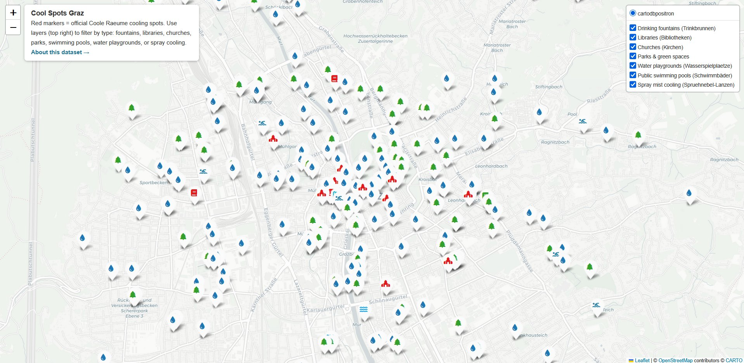
Demo: interactive map
How to read it
Toggle layers (top right) to show or hide each of the seven types.
Red markers mark the official “Coole Räume“.
Click any marker for name, address, source and license.
Built with Leaflet / folium from the same CSV.
LIVE MAP
englischmattis-crypto.github.io/graz-cool-spots
Notes:
And here is the demo. This is the live map built from the same CSV with Leaflet. Each of the seven types is its own toggleable layer in the top right, so you can isolate just fountains, or just the official cooling rooms in red. Clicking a marker shows its name, address, source and license. I'll switch to the live version now and toggle a couple of layers, and zoom into the inner city where the official red markers cluster. (Open the live URL here.)

Slide 10



Legal, ethical and maintenance
Legal
Ethical
Maintenance
All sources openly licensed. Attributions documented. ODbL share-alike respected across the combined database.
Only public infrastructure, no personal data. Supports a climate-vulnerable, public-good use case.
Re-run merge_graz.py against the live OGD and OSM endpoints. Re-check the official Hitzeaktionsplan for Coole Räume changes. Open to community pull requests.
Cool Spots Graz github.com/englischmattis-crypto/graz-cool-spots
Thank you. Questions welcome.
Notes:
Finally, the housekeeping the assignment asks for. Legally it is clean: open sources, documented attribution, ODbL share-alike. Ethically it is low-risk and public-good: only public infrastructure, no personal data, and it serves a climate-vulnerable need. For maintenance, the whole thing rebuilds by re-running one script against the live endpoints, and re-checking the official list, and it is open for community contributions on GitHub. Thank you, happy to take questions.

