Slide 1
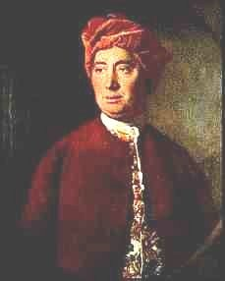
David Hume, 1711-1776
1. Introduction, Theory of Ideas and Conceptual Empiricism
Peter Millican
Hertford College, Oxford

Slide 2
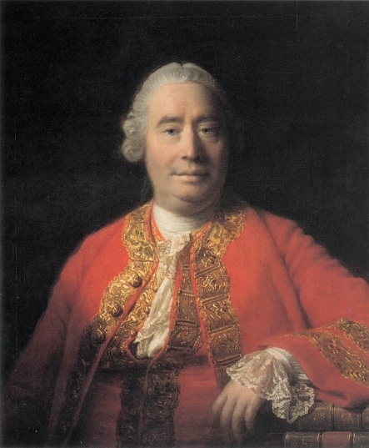
Why Study Hume?
Hume is generally considered the greatest philosopher ever to come from the English-speaking world.
He is also renowned as a brilliant and stylish writer – and noted for his humour, wit, and irony.
He was born in 1711, 100 years after Galileo had ushered in the scientific revolution (1609), 70 years after Descartes’ Meditations (1641) had attempted to create a philosophy founded on scientific reason rather than Aristotelian tradition, and 24 years after Newton’s celebrated Principia (1687) had apparently discovered some of nature’s fundamental mathematical laws.

Slide 3
The Scientific Revolution
Before Galileo’s telescopic discoveries, the Earth was considered the centre of the universe, and Aristotle’s physics was founded on that assumption.
Aristotle (known as “the philosopher”), together with the Bible, had for centuries been accepted as the ultimate authorities about the world and humanity.
But the scientific discoveries of Galileo, Descartes, Kepler, Boyle and Newton seemed to reveal:
A world which is strikingly different from how it superficially appears, contradicting the Aristotelian assumption that we can naturally perceive its ultimate “forms”, …
Yet a world which nevertheless can potentially be well understood by pure reason and mathematical analysis.

Slide 4
“Rationalists” and “Empiricists”
Some notable philosophers (e.g. Descartes, Spinoza, Leibniz) were inspired by this rationalistic ambition, aiming to prove both the existence of God (by the Ontological Argument) and to demonstrate the ultimate nature of the world, largely by a priori deductive reason.
British philosophers – following John Locke – were typically less ambitious, recognising that we cannot understand the world a priori, and settling for probability derived from observation, experiment and conjecture, rather than aspiring to demonstrative certainty.
Yet Locke and others (notably Clarke and Berkeley) continued to base their theories on God, claiming that His existence at least could be known with certainty.

Slide 5
David Hume, “The Great Infidel”
Hume was a major contributor to the “Scottish Enlighten-ment”, a remarkable flowering of intellectual achievement centred on Edinburgh, “the Athens of the North”.
His Treatise of Human Nature (1739-40) was “An attempt to introduce the experimental method of reasoning into moral subjects” – to study human thought and behaviour empirically, avoiding prior assumptions about human nature (e.g. that we are “made in the image of God”).
Despite these constructive aims, he came to notoriously sceptical conclusions about both the existence of God and our capacity to acquire genuine knowledge of physical things (even, perhaps their existence!). Hence he stands significantly apart from previous “empiricists”.

Slide 6
Hume’s Legacy
The profound challenge posed by Hume’s incisive arguments – some of the most famous and influential in the philosophical canon – was recognised by Thomas Reid and Immanuel Kant, his greatest immediate successors. Kant erected his “critical philosophy” in response, opening new directions in philosophy which have persisted (especially in mainland Europe).
Yet history has favoured Hume, especially after new discoveries in modern physics exposed the bankruptcy of Kant’s attempts to vindicate Newton by pure reason.
Hume has also inspired many great scientists, including Charles Darwin and Albert Einstein, who both openly acknowledged his substantial influence on them.

Slide 7
Hume’s influence on contemporary philosophy is also profound, and many of his arguments and positions are still considered highly relevant, not only in epistemology, philosophy of science, and metaphysics, but also in ethics and philosophy of action, aesthetics, philosophy of religion, political theory, and economics (in which he inspired the work of his younger friend Adam Smith).
Hume was strikingly ahead of his time in what we now call cognitive science (and perhaps especially in cognitive science of religion), anticipating lines of enquiry that became mainstream only in recent decades.
Understanding and grappling with “Humean” positions remains of tremendous value, partly because of Hume’s logical acumen, but also his intellectual independence, pioneering new lines of enquiry that previous thinkers had failed to explore because of their reluctance to depart from traditional (and especially religious) assumptions.

Slide 8
Aims of the Lecture Series
The aim is to help you understand Hume’s main epistemological texts and arguments, and compl-ement other resources (described below), by:
Conveying the big picture, to appreciate the overall shape and force of Hume’s theoretical philosophy;
Helping you to take advantage of those other resources to read and understand the texts efficiently, and to focus on their key points;
Highlighting and explaining the main interpretative debates, and why they matter;
Drawing your attention to relevant secondary literature;
Preparing you for the Early Modern examination.

Slide 9
For More Background …
To maximise efficiency towards these aims, we will not here be looking deeply at the historical or biographical background of Hume’s ideas. But for a personal view of these things, you might find it interesting to explore …
For historical context, see the General Philosophy lecture pages at https://www.millican.org/genphil.htm (e.g. 2018 lectures 1 and 2, and lecture 3 as far as 26).
For more systematic coverage and detail, see “Introduction” under “2007” at https://davidhume.org/scholarship/millican.
For biographical context, see Lecture 1 in the 2018 series at https://davidhume.org/teaching/lectures.
For biographical philosophy, see “Hume’s Chief Argument” under “2016” at https://davidhume.org/scholarship/millican.

Slide 10
Hume’s Most Relevant Works
T: A Treatise of Human Nature (1739-40)
Book 1 is on epistemology and metaphysics; Book 2 on the passions (1739); Book 3 on morals was published with a famous Appendix (1740).
A: Abstract of the Treatise (1740)
Summarises the Treatise’s “Chief Argument”.
E: Enquiry concerning Human Understanding
Many editions from 1748 to 1777. More polished than the Treatise, but less comprehensive. Find all Hume’s texts at www.davidhume.org …

Slide 11
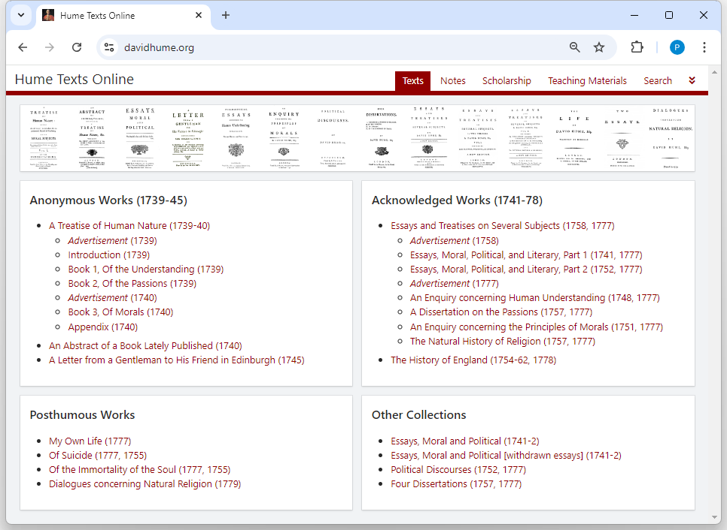
T
E
A

Slide 12
www.davidhume.org
Click on “Texts” to see the menu of texts as shown on the previous .
Click on “Search” to search the texts:

Slide 13
Click on to jump to a specific text reference (e.g. T 1.3.2.11, A 27, or E 4.13).
Click on “Teaching Materials” to find links to:
Previous lectures on Hume (2010, 2011, 2018) together with handouts (including for 2021).
“Outline of Humean Texts”: annotated summaries of some of the most important sections of the Treatise, to aid comprehension and reference.
“Analysis of Hume’s Sceptical Texts” – as above, but focusing on sceptical topics.
“Notes on Particular Topics” – more opinionated discussions of other key topics.
Click on “Scholarship” to find over 50 of my papers on Hume, and handouts from many talks.

Slide 14
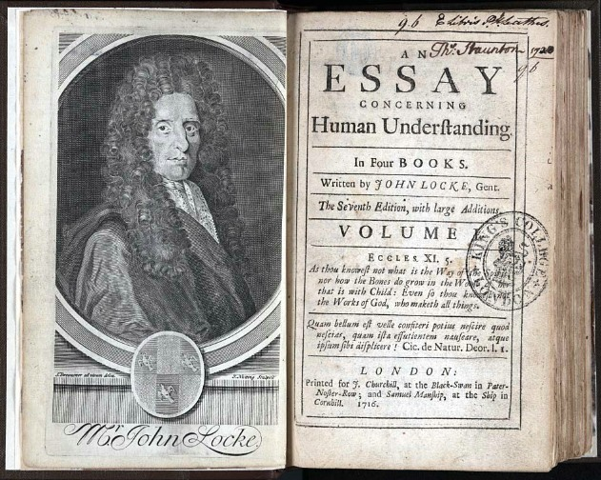
1(a) The Lockean Inheritance

Slide 15
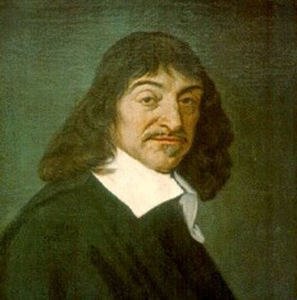
Descartes’s “Way of Ideas”
René Descartes (1596-1650) took all our understanding and knowledge to start from “ideas” in the mind – an internalist perspective that took hold for centuries.
Some ideas he took to be “innate” and divinely implanted (e.g. the ideas of God, and of extension i.e. matter (see M 3 AT 7:37-8; CCB AT 8B:357-61).
Other ideas come through the senses – some of these correspond to real properties of material things (e.g. shape and size); others do not (e.g. colours, sounds, odours, tastes). Locke later called these primary and secondary qualities respectively.

Slide 16
Locke’s Reaction to Descartes
Locke follows Descartes by conceiving mental content in terms of “ideas” (and advocates the primary/secondary distinction), but a principal aim of his Essay concerning Human Understanding (1690) is to deny that any of our ideas are innate.
Book 1 – entitled “Of Innate Notions” – focuses on denying that we have innate principles.
Book 2 – “Of Ideas in general, and their Original” – was probably more influential, purporting to explain how all our ideas are derived from experience, i.e. to establish concept-empiricism.

Slide 17
Two Kinds of “Empiricism”
Distinguish concept-empiricism:
All our ideas derive from experience
(i.e. contra Descartes, there are no innate ideas)
from knowledge-empiricism:
All knowledge of the world derives from experience
(i.e. no “synthetic a priori knowledge”, contra Kant)
Locke is a committed concept-empiricist, but he is not a pure knowledge-empiricist. (Hume is strongly empiricist in both senses.)

Slide 18
What is an “Idea”?
Locke defines an idea as
“whatsoever is the Object of the Understanding when a Man thinks” (Essay I i 8)
This is supposed to include all types of “thinking”, including perception and feeling as well as contemplation. So our ideas include thoughts and sensations, and also “internal” ideas that we get from reflection.

Slide 19
“White Paper” and “Two Fountains”: Sensation and Reflection
“Let us then suppose the Mind to be, as we say, white Paper, void of all Characters, without any Ideas; How comes it to be furnished? … To this I answer, in one word, From Experience … Our Observation employ’d either about external, sensible Objects; or about the internal Operations of our Minds … These two are the Fountains of Knowledge, from whence all the Ideas we have … do spring.” (Essay II i 2)

Slide 20
Ideas on a Mental Stage?
The theory of ideas tends to portray the mind as passive, with mental acts being understood in terms of the activity and qualities of “ideas”:
seeing a tree involves having a visually vivid idea of a tree “in front of the mind”;
thinking about a tree involves having a less vivid idea of a tree;
feeling a pain involves having an idea of a pain;
desiring chocolate involves having a “positively charged” idea of chocolate.

Slide 21
Humean Ideas and Impressions
Hume considers Locke’s usage of “idea” too broad, so adopts different terminology:
An impression is a sensation (e.g. from seeing a blue sky, smelling a flower, or physical pain) or a feeling (e.g. anger, desire, disapproval, envy, fear, love, or pride);
An idea is a thought (e.g. about the sky, or about a pain, or about the existence of God);
A perception is either an impression or an idea. (So Hume uses the word perception to cover everything that Locke calls an idea.)

Slide 22
An Obvious Distinction?
Hume seems to think that the impression/idea distinction is a fairly obvious one, between (roughly) feeling – including both feelings of sensation and of reflection – and thinking:
“I believe it will not be very necessary to employ many words in explaining this distinction. Every one of himself will readily perceive the difference betwixt feeling and thinking.” (T 1.1.1.1)
This indeed seems to be how he mainly thinks of the distinction, but as we’ll soon see, he muddies the waters by seeming to define it in a different way (in terms of “force and vivacity”).

Slide 23
“Sensation” and “Reflection”
Hume follows Locke in calling the two sources of ideas “sensation” and “reflection” (T 1.1.2.1, cf. Essay II i 3-4), but there are differences …
First, whereas Locke takes for granted that we have “sensitive knowledge” of the existence of external objects (Essay IV xi), Hume describes the impressions of sense (e.g. perceptions of colour, taste, smell, bodily pain) as arising “in the soul originally, from unknown causes” (T 1.1.2.1). This suggests from the start a more sceptical attitude towards the senses.

Slide 24
Humean Reflection
Impressions of reflection are “deriv’d in a great measure from our ideas”, particularly the ideas of pleasure or pain that arise when we feel e.g. “heat or cold, thirst or hunger” (T 1.1.2.1).
Thinking or reflecting about pleasures and pains gives rise to “desire and aversion, hope and fear, which may properly be call’d impressions of reflection because deriv’d from it”. Hume also calls these secondary impressions (T 2.1.1.1-2). At T 1.1.6.1 Hume says that impressions of reflection are either passions (e.g. the desire for something) or emotions (e.g. happiness).

Slide 25
“Reflection”: A Contrast with Locke
When Locke discussed ideas of reflection, his focus was very different from Hume’s:
“By REFLECTION ... I ... Mean, that notice which the Mind takes of its own Operations, ... by reason whereof, there come to be Ideas of these Operations in the Understanding.”
“... such are, Perception, Thinking, Doubting, Believing, Reasoning, Knowing, Willing, and all the different actings of our own Minds;” (II i 4)
Locke seems to overlook passions and emotions; Hume is much more interested in these, but seems to overlook mental operations!

Slide 26
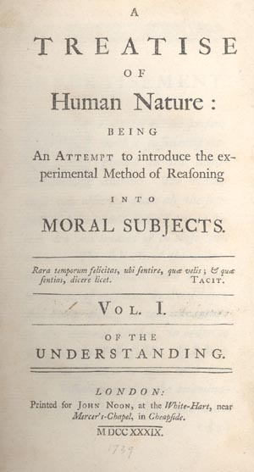
1(b) Hume’s Copy Principle and the Simple/Complex Distinction

Slide 27
Hume’s Conceptual Empiricism: A First Approximation
To a first approximation, Hume’s conceptual empiricism is the claim that all of our ideas (i.e. thoughts) are derived from impressions (i.e. sensations or feelings).
But Hume takes conceptual empiricism more strictly than Locke, insisting (again to a first approximation) that all of our ideas are copies of impressions, which almost exactly resemble the corresponding impressions.

Slide 28
Conceptual Empiricism: Refining the Approximation
Obviously, some of our ideas (e.g. of a unicorn) are not copies of any single impression.
Hume acknowledges this, but wants to insist that all of the content of our ideas is copied from impressions – we might say that ideas are entirely composed of impression-copied content.
His way of dealing with this is to draw a distinction between simple ideas (which are directly copied from simple impressions) and complex ideas (which may be constructed from simple ideas)

Slide 29
Simple and Complex Ideas
At Treatise 1.1.1.2, Hume divides all ideas and impressions into simple and complex:
“Simple perceptions or impressions and ideas are such as admit of no distinction nor separation. The complex are the contrary to these, and may be distinguished into parts.”
Hume writes as though this distinction is really straightforward, but it isn’t! Take, for example, the idea of a red circle: that seems to be a complex idea, but what exactly are the parts, and how many (maybe two: the red colour, and the circular shape, or maybe the size also)?

Slide 30
Spatial Ideas and Atomism
At Essay II v 1 and II viii 9, Locke describes the ideas of space, extension, and figure (i.e. shape) as simple (though II xiii on “the simple modes of space” complicates the story a bit.)
Hume has a much stricter “atomist” view of spatial ideas, taking them to be formed of minima, in much the way that a computer image is formed of individual coloured pixels. T 1.2.1.4 describes how an ink spot can yield a minimal impression.
Extension and figure arise only when we have multiple minima, hence complexity (e.g. T 1.2.3.15).

Slide 31
Hume’s Copy Principle
Hume’s concept-empiricism is expressed in his “first principle” (T 1.1.1.12) which is now commonly known as his Copy Principle:
“that all our simple ideas [i.e. thoughts] in their first appearance are deriv’d from simple impressions [i.e. sensations or feelings], which are correspondent to them, and which they exactly represent.” (T 1.1.1.7)
Hume sees this as a more precise formulation of Locke’s denial of innate ideas (as he makes explicit at Abstract 6 and E 2.9 n. 1).
31

Slide 32
Weaponising the Copy Principle?
The 1748 Enquiry boldly flourishes the Copy Principle as a weapon against bogus ideas:
“When we entertain ... any suspicion, that a philo-sophical term is employed without any meaning or idea (as is but too frequent), we need but enquire, from what impression is that supposed idea derived? And if it be impossible to assign any, this will serve to confirm our suspicion.” (E 2.9)
But in practice, Hume almost always uses it not to dismiss ideas but to clarify them, by tracing them to their impression-source.

Slide 33
Hume’s First Argument for the Copy Principle
There seem to be no counterexamples:
“After the most accurate examination, of which I am capable, I venture to affirm, that the rule here holds without any exception, and that every simple idea has a simple impression, which resembles it; and every simple impression a correspondent idea.” (T 1.1.1.5)
And since the impressions come before the ideas (T 1.1.1.8), they must cause the ideas rather than vice-versa.

Slide 34
Hume’s Second Argument for the Copy Principle
People who lack any particular sense modality always lack also the corresponding ideas:
“wherever by any accident the faculties, which give rise to any impressions, are obstructed in their operations, as when one is born blind or deaf; not only the impressions are lost, but also their correspondent ideas; … likewise where they have never been put in action to produce a particular impression [such as] the taste of a pine-apple …” (T 1.1.1.9)

Slide 35
Problems with Hume’s Arguments
Hume’s first argument doesn’t seem to fit very well with his use of the Copy Principle against opponents:
Suppose someone claims to have an idea which doesn’t derive from a corresponding impression; he will simply deny Hume’s generalisation and hence his argument for the Principle. Bennett (2002, pp. 100-1) presses this sort of objection.
Garrett (1997, pp. 46-8) mounts a defence on Hume’s behalf:

Slide 36
Garrett’s First Defence of Hume
“when [Hume] argues against the existence of a certain (putative) idea, he never argues merely that we do not find such a corresponding impression in experience; he also always argues that no impression could possibly satisfy the requirements we implicitly demand for such a perception.” (1997, p. 49)
So such an idea would not merely contradict the Copy Principle, “It would … require the admission of an entirely distinct representational faculty”, in addition to our (imagistic) imagination.

Slide 37
Responding to Garrett
But the point that “no impression could possibly satisfy the requirements” for serving as the source of a particular idea is double-edged.
Hume’s opponent can point out that the ideas in question – those that are not obviously imagistic and which Hume has to work so hard to explain in imagistic terms (necessary connexion, body, the self etc.) – are precisely the ones for which the Copy Principle is least plausible to start with.
Is it really legitimate to extend an argument which seems plausible in the case of sensory ideas to these more contentious cases?

Slide 38
Hume’s second argument also has problems. It may seem very plausible that a blind man can have no idea of red, for example. But how can Hume know that this is the case? Might it not be that the man has private mental experiences that involve the colour red?
At risk of anachronism, some authors (e.g. Bennett, Dicker) argue that Hume’s point is best understood as being not about private mental experience, but about public meaningfulness. The blind man cannot use the word “red” correctly, and they take this moral to be the real point of Hume’s position (which would thus anticipate twentieth-century “verificationist” philosophy of language).

Slide 39
Garrett’s Second Defence of Hume
Garrett (1997, pp. 46-8) defends Hume more straightforwardly, arguing that although one might not be able to demonstrate to others that one was having a simple idea without a simple impression, the fact that blind and deaf people (etc.) don’t claim to have such ideas can be taken as significant:
“It is a fact, for example, that the blind and the deaf do not report mental images – that is, Humean ‘ideas’ – that are unrelated to any simpler elements previously experienced in sensation or feeling. … The fact that the blind and deaf can and do report aspects of their mental lives but do not report such images is surely some evidence that they do not have them.” (p.46)

Slide 40
Further evidence, Garrett suggests, comes from people whose senses are repaired, who as adults become able to see for the first time. They report new sensations, apparently: sensations that they could not imagine prior to the repair.
Note, however, that this second argument explicitly focuses on ideas that are acknowledged from the start to be sensory, so it doesn’t help in the more contentious cases that are not obviously sensory.
For those ideas (necessity, body, self etc.), Hume’s case for empiricism – like Locke’s – perhaps has to depend on the strength of his specific account of those ideas. Can he actually explain their nature in terms of impression-copy content?

Slide 41
The Missing Shade of Blue
After arguing for the Copy Principle, Hume himself strangely presents a counter-example: the famous “missing shade of blue” (T 1.1.1.10).
He seems, however, to think this isn’t a serious problem for his position, maybe because:
The “new” simple idea is being constructed (by something like blending) from materials that are provided by impressions, so his concept-empiricism isn’t being fundamentally threatened.
The new idea could be derived from sensory exp-erience, even if in this case it hasn’t been – it’s still imagistic (so clearly thinkable on Hume’s view).

Slide 42
“Suppose … a person to have enjoyed his sight for thirty years, and to have become … well acquainted with colours of all kinds, excepting one particular shade of blue, … which [he has never met] with. Let all the different shades of that colour, except that single one, be placed before him, descending gradually from the deepest to the lightest; 'tis plain, that he will perceive a blank, where that shade is wanting, and will be sensible, that there is a greater distance in that place betwixt the contiguous colours, than in any other. [Could he], from his own imagination, … raise up to himself the idea of that particular shade, tho' it had never been conveyed to him by his senses? I believe … he can; and this may serve as a proof, that the simple ideas are not always derived from the correspondent impressions; tho’ the instance is so particular and singular, that [it] … does not merit that for it alone we should alter our general maxim.”
(T 1.1.1.10)

Slide 43
David Hume, 1711-1776
2. Force and Vivacity, Belief, Separability and Association of Ideas
Peter Millican
Hertford College, Oxford

Slide 44
Reminder of Learning Resources
See in particular:
“Overview of Treatise Book 1 Part 1”
“Notes on Hume on Ideas and Impressions”
“Notes on Hume’s Copy Principle”

Slide 45
Last Time ...
We saw how Hume’s conceptual empiricism follows Locke in taking all of our ideas to come through sensation or reflection. However:
Hume’s terminology of impressions and ideas helps to clarify the issue, though we shall soon see problems in his notion of force and vivacity.
Hume takes feelings (not mental operations) to be the paradigmatic objects of ideas of reflection.
Hume’s arguments for his Copy Principle (and his complacent assumption of the simple/ complex distinction) are not entirely convincing.

Slide 46
2(a) Force and Vivacity

Slide 47
Distinguishing Impressions and Ideas
When first introducing his distinction between impressions and ideas, Hume seems to base it mainly on force, vivacity, or liveliness:
“All the perceptions of the human mind resolve themselves into two distinct kinds, which I shall call impressions and ideas. The difference betwixt these consists in the force and liveliness, with which they strike upon the soul, and make their way into our thought or consciousness. Those … which enter with most force and violence, we may name impressions …” (T 1.1.1.1).

Slide 48
Starting from Internalism?
Hume seems to want to define the impression/ idea distinction in terms of their internally perceptible qualities rather than their causes (e.g. whether they’re caused by external objects).
Perhaps, as with his “unknown causes” comment about impressions of sensation (at T 1.1.2.1, slide 23), he wants to remain sceptically non-committal (e.g. about the existence of an external world), and to avoid dogmatic commitments.
But he also has a deeper theoretical motivation, deriving from his theory of belief …

Slide 49
Why Emphasise “Force and Vivacity?”
Hume is looking for a way that ideas can differ from impressions while still having the same content (thus respecting his Copy Principle that ideas are literally copies of impressions).
T 1.3.7.6: “the same idea can only be vary’d by a variation of its degrees of force and vivacity”
Hume emphasises this when developing his theory of belief:
If I believe proposition P, and you don’t, the same ideas must be involved, or it wouldn’t be the same proposition (see discussion at T 1.3.7.3-4 ).

Slide 50
Distinguishing Belief from Mere Conception
Hume’s theory of belief defines it (at T 1.3.7.5) in terms of force and vivacity or “liveliness”, typically derived from an associated impression:
“An opinion, therefore, or belief may be most accurately defin’ed, A lively idea related to or associated with a present impression.”
This liveliness is shared also by memories (T 1.1.3.1, 1.3.5.3 ff.) – “Thus it appears, that the belief or assent, which always attends the memory and senses, is nothing but the vivacity of those perceptions they present.” (T 1.3.5.7)

Slide 51
Looking Ahead to Induction
Hume will later (in T 1.3.6-8) argue that whenever we draw an inference from observed to unobserved matters of fact (what we now call “induction”), we do this by custom or habit.
For example, after seeing A’s repeatedly followed by B’s, our ideas of A and B become associated, and hence when we next see an A, we habitually expect a B to follow.
The vivacity of the sense-impression of A is conveyed by association to enliven our idea of B, and we accordingly expect B to follow.

Slide 52
A “Hydraulic” Theory of Belief
“I wou’d willingly establish it as a general maxim in the science of human nature, that when any impression becomes present to us, it not only transports the mind to such ideas as are related to it, but likewise communicates to them a share of its force and vivacity.” (T 1.3.8.2)
T 1.3.8 gives various “experiments” to illustrate how force and vivacity can be conveyed from impressions to their “associated ideas”, confirming this as a general phenomenon of human nature.

Slide 53
A Hydraulic Theory of Probability
Suppose I toss a six-sided die ...
“When ... the thought is determin’d by the causes to consider the dye as falling and turning up one of its sides, the chances present all these sides as equal, and make us consider every one of them, one after another, as alike probable ... The determination of the thought is common to all; but no more of its force falls to the share of any one, than what is suitable to its proportion with the rest. ’Tis after this manner the original impulse, and consequently the vivacity of thought, arising from the causes, is divided and split in pieces by the intermingled chances.” (T 1.3.11.12)

Slide 54
Doubts about Force and Vivacity
Hume seems to recognise that relying on “force and vivacity” to distinguish impressions from ideas is problematic:
“in sleep, in a fever, in madness, or in any very violent emotions of soul, our ideas may approach to our impressions: [And] it sometimes happens, that our impressions are so faint and low, that we cannot distinguish them from our ideas.” (T 1.1.1.1)
Compare, for example, dreaming of an attack of spiders, with watching paint dry! (But note that a feeling of fear would be a reflective impression, quite separate from the imagined visual ideas.)

Slide 55
There are also other difficulties:
A fictional story can far be more “vivacious”, at least superficially, than a dull historical account (perhaps Hume realised this at T 1.3.10.10, added in 1740?).
Is a change in “force and vivacity” really consistent with preserving the same idea? Suppose our idea of a dull red door acquires more vivacity: couldn’t that become the idea of a bright red door, rather than belief in a dull red door? How can we distinguish between these two outcomes?
Coming to believe something looks more like a change of our attitude to an idea than like a change in the “force and vivacity” of the idea itself (recall the concern expressed in Lecture 1, 20).

Slide 56
These objections tend to assume a straightforwardly phenomenological interpretation of “force and vivacity”:
Phenomenological vivacity or liveliness (e.g. Stroud, 1977)
“The difference betwixt these consists in the degrees of force and liveliness, with which they strike upon the mind, and make their way into our thought or consciousness.” (T 1.1.1.1)
But in defending Hume, scholars have advocated other interpretations of the difference between impressions and ideas, most notably:
Functional or causal force (e.g. Everson, 1988)
“this different feeling I [call] a superior force, or vivacity, or solidity, or firmness, or steadiness. This variety of terms … is intended only to express that act of the mind, which renders realities more present to us than fictions, causes them to weigh more in the thought, and gives them a superior influence on the passions and imagination.” (T 1.3.7.7, cf. E 5.12)

Slide 57
Causal priority (e.g. Landy, 2006)
“Those perceptions, which enter with most force and violence, we may name impressions; and under this name I comprehend all our sensations, passions and emotions, as they make their first appearance in the soul. By ideas I mean the faint images of these in thinking and reasoning; …” (T 1.1.1.1)
Feeling and thinking
“I believe it will not be very necessary to employ many words in explaining this distinction. Every one of himself will readily per-ceive the difference betwixt feeling and thinking.” (T 1.1.1.1)
“there is a considerable difference between the perceptions of the mind, when a man feels the pain of excessive heat, or the pleasure of moderate warmth, and when he afterwards recalls to his memory this sensation, or anticipates it by his imagination. These faculties may mimic or copy the perceptions of the senses; but they never can entirely reach the force and vivacity of the original sentiment.” (E 2.1)

Slide 58
“Force” as Functional?
Functional interpretations are popular with inter-preters who see Hume’s epistemology as largely externalist. For example, Loeb claims that Humean “beliefs are steady dispositions” (2002, p. 65).
Marušić (2010) argues strongly on the other side, citing Hume’s emphasis on feeling as causally key to the functional difference between belief and mere conception (e.g. in paragraphs 7-9 of the Appendix to the Treatise). If this is right, then it looks as though the difference in “feeling” is fundamental to the distinction, and the functional difference cannot be its ground, because on Hume’s principles, a cause is always distinct from its effect.

Slide 59
“The effects of belief, in influencing the passions and imagination, can all be explain’d from the firm conception; and [we need no] recourse to any other principle. These arguments, with [others from the Treatise] … sufficiently prove, that belief only modifies the idea or conception; and renders it different to the feeling, …” (T App 7)
“[There are] two questions of importance, … Whether there be any thing to distinguish belief from the simple conception beside the feeling or sentiment? And, Whether this feeling be any thing but a firmer conception, or a faster hold, that we take of the object?” (T App 8)
“The transition from a present impression, always enlivens and strengthens any idea. When any object is presented, the idea of its usual attendant immediately strikes us, as something real and solid. ’Tis felt, rather than conceiv’d, and approaches the impression, from which it is deriv’d, in its force and influence.” (T App 9)

Slide 60
Is “Force and Vivacity” Univocal?
Hume’s hydraulic theory seems to assume that a single dimension of “force and vivacity” can capture the differences between:
An impression of X (most forceful/vivacious)
A memory of X (between impression and idea)
A belief or expectation of X (a vivacious idea)
Mere contemplation of X (least forceful/vivacious)
Dauer (1999) suggests this implausibility later pushed Hume away from the hydraulic model, which does not feature in the 1748 Enquiry. (beyond a slight hint in a sentence at E 5.20).

Slide 61
Symptoms of Unease?
In the 1740 Appendix, Hume seems to evince some discomfort with his account:
“An idea assented to feels different from a fictitious idea … And this different feeling I endeavour to explain by calling it a superior force, or vivacity, or solidity, or firmness, or steadiness. … ’tis impossible to explain perfectly this feeling or manner of conception. We may make use of words, that express something near it. But its true and proper name is belief, which is a term than every one sufficiently understands …”
(T 1.3.7.7; see also T 1.3.10.10, as noted in 55 above)

Slide 62
Retreating from the Theory
In the Enquiry, Hume retreats from the attempt to define belief as well as the hydraulic theory:
“Were we to attempt a definition of this sentiment, we should, perhaps, find it ... impossible ... Belief is the true and proper name of this feeling; ... It may not, however, be improper to attempt a description of this sentiment; ... I say then, that belief is nothing but a more vivid, lively, forcible, firm, steady conception of an object, than what the imagination alone is ever able to attain.” (E 5.12)
Probable belief, as in the case of a die, arises from “an inexplicable contrivance of nature” (E 6.3).

Slide 63
2(b) The Separability Principle

Slide 64
The “Liberty of the Imagination”
We have already seen that some ideas are complex, and can be divided imaginatively into components:
An apple has a particular colour, taste, and smell, and also a (complex) shape. (cf. T 1.1.1.2)
We can also put ideas together in new ways:
gold + mountain = golden mountain. (E 2.5)
At T 1.1.3.4 Hume refers to this “liberty of the imagination to transpose and change its ideas” as his “second principle”.

Slide 65
The Separability Principle (SP)
Later, that relatively modest “second principle” seems to morph into what is commonly called Hume’s Separability Principle, which has strikingly paradoxical results later in the Treatise:
“We have observ’d [apparently at T 1.1.3.4], that whatever objects are different are distinguishable, and that whatever objects are distinguishable are separable by the thought and imagination. And … these propositions are equally true in the inverse, and that whatever objects are separable are also distinguishable, and that whatever objects are distinguishable are also different.” (T 1.1.7.3)

Slide 66
Arguing for the Separability Principle
Hume’s argument for the Separability Principle is extremely cursory:
“For how is it possible we can separate what is not distinguishable, or distinguish what is not different?” (T 1.1.7.3)
This suggests that he takes the Separability Principle to be almost trivially true, but he will later use it to maintain, for example, that a perception – i.e. an impression or idea – could exist quite independently of any perceiver, which seems both non-trivial and obviously false!

Slide 67
Taking Separability Too Far?
The claim that perceptions could continue to exist when unperceived plays a role in Hume’s discussion of our belief in the external world:
“the appearance of a perception in the mind and its existence seem at first sight entirely the same, … [but] the interruption in the appearance of a perception implies not necessarily an interruption in its existence … [as I shall] explain more fully afterwards. … An interrupted appearance to the senses implies not necessarily an interruption in the existence. The supposition of the continu’d existence of sensible objects or perceptions involves no contradiction.” (T 1.4.2.39-40)
67

Slide 68
The fuller explanation just promised turns out to be a crude application of the Separability Principle to the standard (e.g. Descartes, Chambers) definition of a substance as something which may exist by itself”:
“this definition agrees to every thing, that can possibly be conceiv’d; ... Whatever is clearly conceiv’d may exist; ... every thing, which is different, is distinguishable, and every thing which is distinguishable, is separable by the imagination. My conclusion ... is, that since all our perceptions are different from each other, and from every thing else in the universe, they are also distinct and separable, and may be consider’d as separately existent, and may exist separately, and have no need of any thing else to support their existence. They are, therefore, substances, as far as this definition explains a substance.” (T 1.4.5.5)
68

Slide 69
The same idea then plays a major role in Hume’s discussions of personal identity, in both T 1.4.6 and the 1740 Appendix:
“all our particular perceptions … are different, and distinguishable, and separable from each other, and may be separately consider’d, and may exist separately, and have no need of any thing to support their existence. After what manner, therefore, do they belong to self; and how are they connected with it?” (T 1.4.6.3)
“Whatever is distinct, is distinguishable; and whatever is distinguishable, is separable by the thought or imagination. All perceptions are distinct. They are, therefore, distinguishable, and separable, and may be conceiv’d as separately existent, and may exist separately, without any contradiction or absurdity.” (T App 12)
69

Slide 70
Abandoning the Separability Principle?
The Separability Principle appears to be absent from the 1748 Enquiry concerning Human Understanding, though Garrett (1997, p. 72) claims that it is implicit in passages such as:
“Motion in the second Billiard-ball is a quite distinct event from motion in the first; nor is there any thing in the one to suggest the smallest hint of the other.” (E 4.9)
But there is no general principle enunciated here, and nothing remotely close to the implausibly strong Separability Principle of the sceptical sections of the Treatise.

Slide 71
2(c) Association of Ideas

Slide 72
Locke on the Association of Ideas
Hume sometimes expresses great enthusiasm for the association of ideas (e.g. A 35), but this is in striking contrast to Locke’s attitude:
“[3] this sort of Madness … [4] this … Weakness to which all Men are so liable, ... a Taint which so universally infects Mankind … [5] … there is [a] Connexion of Ideas wholly owing to Chance or Custom; Ideas that in themselves are not at all of kin, come to be so united in some Mens Minds that ’tis very hard to separate them …”
(Locke, Essay II xxxiii 3-5)

Slide 73
Chambers’ Cyclopaedia (1728)
“Association of Ideas, is where two or more Ideas, constantly and immediately follow or succeed one another in the Mind, so that one shall almost infallibly produce the other … Where there is a real Affinity or Connection in Ideas, it is the excellency of the Mind, to be able to collect, compare, and range them in Order, in its Enquiries: But where there is none, nor any Cause to be assign’d for their accompanying each other, but what is owing to mere Accident or Habit; …this unnatural Association becomes a great Imperfection, and is generally speaking, a main Cause of Error, or wrong Deductions in reasoning.”

Slide 74
“Thus the Idea of Goblins and Sprights, has really no more Affinity with Darkness than with Light; and yet let a foolish Maid inculcate these often on the Mind of a Child, and raise them there together, ’tis possible he shall never be able to separate them again so long as he lives, but Darkness shall ever bring with it those frightful Ideas.”
“Such wrong combinations of Ideas, Mr. Lock shews, are a great Cause of the irreconcileable Opposition between the different sects of Philosophy and Religion: … some loose and independent Ideas are by Education, Custom, and the constant Din of their Party, so coupled in their Minds, that they always appear there together: These they can no more separate in their Thoughts, than if they were but one Idea, … This … is the Foundation of the greatest, and almost of all the Errors in the World.” (p. 161)

Slide 75
Hume on the Association of Ideas
Despite “the liberty of the imagination”, there is a pattern to our thoughts:
“all simple ideas may be separated by the imag-ination, and may be united again in what form it pleases … [yet there is] some bond of union among them, some associating quality, by which one idea naturally introduces another” (T 1.1.4.1)
Hume calls this “a gentle force” which explains why languages “so nearly corres-pond to each other” in the complex ideas that are represented within their vocabulary.

Slide 76
Three Principles of Association
Ideas may be associated in three ways:
“The qualities, from which this association arises … are three, viz. resemblance, contiguity in time or place, and cause and effect.” (T 1.1.4.1)
Association is “a kind of Attraction, which in the mental world” has remarkable effects like gravity in the physical world (T 1.1.4.6).
The complex ideas arising from such association “may be divided into Relations, Modes, and Substances” (T 1.1.4.7). Hume then discusses these three categories in turn, in T 1.1.5 and 1.1.6.

Slide 77
Natural and Philosophical Relations
T 1.1.5 starts with a distinction between two senses of the word “relation”. In one sense, we think of things as related when the idea of one naturally leads our thought to the other.
So the “natural relations” are those that correspond to our associative tendencies – resemblance, contiguity, cause and effect.
But when philosophers talk about “relations”, they include any arbitrary “subject of comparison”, even when it doesn’t give rise to association.
We’ll return to Hume’s theory of relations later. For now, we resume our focus on association.

Slide 78
Custom and Induction
As already noted ( 51) Hume will argue in T 1.3.6-8 that all inference to the unobserved depends on custom, by which we expect for the future what we have observed in the past.
So Hume – in contrast to Locke and Chambers –takes a very positive attitude to custom:
“’Tis not, therefore, reason, which is the guide of life, but custom.” (A 16)
“Custom, then, is the great guide of human life. It is that principle alone, which renders our experience useful to us …” (E 5.6)

Slide 79
Custom and Association of Ideas
At T 1.3.7.6, Hume appears to refer to “custom” as “a principle of association”.
Yet there is a big difference between the sort of association that is merely “a gentle force” (T 1.1.4.1) tending to leads our thoughts from one idea to another, and what will later turn out to be custom’s irresistibility (e.g. at T 1.3.9.7, 1.4.1.7 and 1.4.4.1).
There is also another fundamental difference, in that custom involves inference to something unobserved, whereas mere association typically involves flow of a train of thought to something previously observed. Hume is much clearer about this in his Enquiry.

Slide 80
Custom and Association in the first Enquiry
In the Enquiry, Hume treats custom as clearly distinct from association of ideas by causation.
Custom operates when, having previously seen A followed by B repeatedly and then seeing A, I infer (automatically) that B will follow.
Association of ideas by causation operates when, having come to the belief that A and B are causally related, my thought of A leads me to think of B. This will not usually involve any specific inference.

Slide 81
“No one can doubt but causation has the same influence as the other two relations of resemblance and contiguity. Superstitious people are fond of the reliques of saints and holy men, for the same reason, that they seek after types or images, in order to enliven their devotion, and give them a more intimate and strong conception of those exemplary lives, which they desire to imitate.” (E 5.18)
“Suppose, that the son of a friend, who had been long dead or absent, were presented to us; it is evident, that this object would instantly revive its correlative idea, and recal to our thoughts all past intimacies and familiarities, in more lively colours than they would otherwise have appeared to us. This is another phænomenon, which seems to prove the principle above-mentioned [i.e. that the relation of causation gives rise to association of ideas and consequent increase in vivacity].” (E 5.19)

Slide 82
“We may observe, that, in these phænomena, the belief of the correlative object is always presupposed; without which the relation could have no effect. The influence of the picture supposes, that we believe our friend to have once existed. Contiguity to home can never excite our ideas of home, unless we believe that it really exists. Now I assert, that this belief, where it reaches beyond the memory or senses, is of a similar nature, and arises from similar causes, with the transition of thought and vivacity of conception here explained. … it is a satisfaction to find some analogies, by which it may be explained.” (E 5.20)
Thus he argues that custom is an associational principle, “analogous” to association of ideas (E 5.13), but his carefully chosen examples make clear that he is distinguishing, rather than conflating them.

Slide 83
Religion and Association
Although in the Treatise Hume conflates custom and association, he generally sees the former as epistemologically essential, and the latter as often leading to confusion and fallacy. He particularly highlights examples occurring in religion:
T 1.3.8.4 The “mummeries” of Roman Catholicism enhance belief in saints (etc.) by perception of statues and associational resemblance.
T 1.3.8.6 Relics have a similar effect, associated to saints through causation.
T 1.3.9.9 Contiguity enhances the belief of pilgrims to Mecca or the Holy Land.

Slide 84
Hume’s Attitude to Association
Sometimes, Hume seems extremely positive:
Association is “a kind of Attraction, which in the mental world” has remarkable effects like gravity in the physical world (T 1.1.4.6).
“if any thing can intitle the author to so glorious a name as that of an inventor, ’tis the use he makes of the principle of the association of ideas, which enters into most of his philosophy” (A 35)
Hume indeed entirely approves of custom, as “the great guide of human life”. But nevertheless, he retains much of the general suspicion of mere association that we saw in Locke and Chambers.

