Slide 1
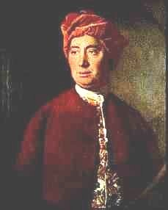
David Hume, 1711-1776
1. Introduction, Theory of Ideas and Conceptual Empiricism
Peter Millican
Hertford College, Oxford

Slide 2
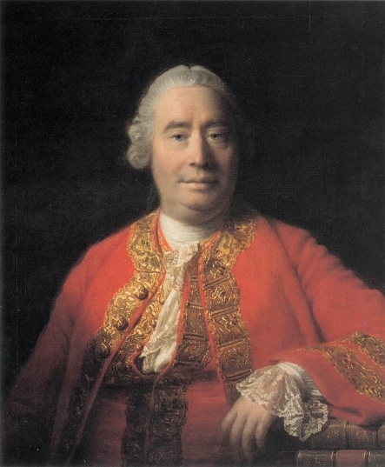
Why Study Hume?
Hume is generally considered the greatest philosopher ever to come from the English-speaking world.
He is also renowned as a brilliant and stylish writer – and noted for his humour, wit, and irony.
He was born in 1711, 100 years after Galileo had ushered in the scientific revolution (1609), 70 years after Descartes’ Meditations (1641) had attempted to create a philosophy founded on scientific reason rather than Aristotelian tradition, and 24 years after Newton’s celebrated Principia (1687) had apparently discovered some of nature’s fundamental mathematical laws.

Slide 3
The Scientific Revolution
Before Galileo’s telescopic discoveries, the Earth was considered the centre of the universe, and Aristotle’s physics was founded on that assumption.
Aristotle (known as “the philosopher”), together with the Bible, had for centuries been accepted as the ultimate authorities about the world and humanity.
But the scientific discoveries of Galileo, Descartes, Kepler, Boyle and Newton seemed to reveal:
A world which is strikingly different from how it superficially appears, contradicting the Aristotelian assumption that we can naturally perceive its ultimate “forms”, …
Yet a world which nevertheless can potentially be well understood by pure reason and mathematical analysis.

Slide 4
“Rationalists” and “Empiricists”
Some notable philosophers (e.g. Descartes, Spinoza, Leibniz) were inspired by this rationalistic ambition, aiming to prove both the existence of God (by the Ontological Argument) and to demonstrate the ultimate nature of the world, largely by a priori deductive reason.
British philosophers – following John Locke – were typically less ambitious, recognising that we cannot understand the world a priori, and settling for probability derived from observation, experiment and conjecture, rather than aspiring to demonstrative certainty.
Yet Locke and others (notably Clarke and Berkeley) continued to base their theories on God, claiming that His existence at least could be known with certainty.

Slide 5
David Hume, “The Great Infidel”
Hume was a major contributor to the “Scottish Enlighten-ment”, a remarkable flowering of intellectual achievement centred on Edinburgh, “the Athens of the North”.
His Treatise of Human Nature (1739-40) was “An attempt to introduce the experimental method of reasoning into moral subjects” – to study human thought and behaviour empirically, avoiding prior assumptions about human nature (e.g. that we are “made in the image of God”).
Despite these constructive aims, he came to notoriously sceptical conclusions about both the existence of God and our capacity to acquire genuine knowledge of physical things (even, perhaps their existence!). Hence he stands significantly apart from previous “empiricists”.

Slide 6
Hume’s Legacy
The profound challenge posed by Hume’s incisive arguments – some of the most famous and influential in the philosophical canon – was recognised by Thomas Reid and Immanuel Kant, his greatest immediate successors. Kant erected his “critical philosophy” in response, opening new directions in philosophy which have persisted (especially in mainland Europe).
Yet history has favoured Hume, especially after new discoveries in modern physics exposed the bankruptcy of Kant’s attempts to vindicate Newton by pure reason.
Hume has also inspired many great scientists, including Charles Darwin and Albert Einstein, who both openly acknowledged his substantial influence on them.

Slide 7
Hume’s influence on contemporary philosophy is also profound, and many of his arguments and positions are still considered highly relevant, not only in epistemology, philosophy of science, and metaphysics, but also in ethics and philosophy of action, aesthetics, philosophy of religion, political theory, and economics (in which he inspired the work of his younger friend Adam Smith).
Hume was strikingly ahead of his time in what we now call cognitive science (and perhaps especially in cognitive science of religion), anticipating lines of enquiry that became mainstream only in recent decades.
Understanding and grappling with “Humean” positions remains of tremendous value, partly because of Hume’s logical acumen, but also his intellectual independence, pioneering new lines of enquiry that previous thinkers had failed to explore because of their reluctance to depart from traditional (and especially religious) assumptions.

Slide 8
Aims of the Lecture Series
The aim is to help you understand Hume’s main epistemological texts and arguments, and compl-ement other resources (described below), by:
Conveying the big picture, to appreciate the overall shape and force of Hume’s theoretical philosophy;
Helping you to take advantage of those other resources to read and understand the texts efficiently, and to focus on their key points;
Highlighting and explaining the main interpretative debates, and why they matter;
Drawing your attention to relevant secondary literature;
Preparing you for the Early Modern examination.

Slide 9
For More Background …
To maximise efficiency towards these aims, we will not here be looking deeply at the historical or biographical background of Hume’s ideas. But for a personal view of these things, you might find it interesting to explore …
For historical context, see the General Philosophy lecture pages at https://www.millican.org/genphil.htm (e.g. 2018 lectures 1 and 2, and lecture 3 as far as slide 26).
For more systematic coverage and detail, see “Introduction” under “2007” at https://davidhume.org/scholarship/millican.
For biographical context, see Lecture 1 in the 2018 series at https://davidhume.org/teaching/lectures.
For biographical philosophy, see “Hume’s Chief Argument” under “2016” at https://davidhume.org/scholarship/millican.

Slide 10
Hume’s Most Relevant Works
T: A Treatise of Human Nature (1739-40)
Book 1 is on epistemology and metaphysics; Book 2 on the passions (1739); Book 3 on morals was published with a famous Appendix (1740).
A: Abstract of the Treatise (1740)
Summarises the Treatise’s “Chief Argument”.
E: Enquiry concerning Human Understanding
Many editions from 1748 to 1777. More polished than the Treatise, but less comprehensive. Find all Hume’s texts at www.davidhume.org …

Slide 11
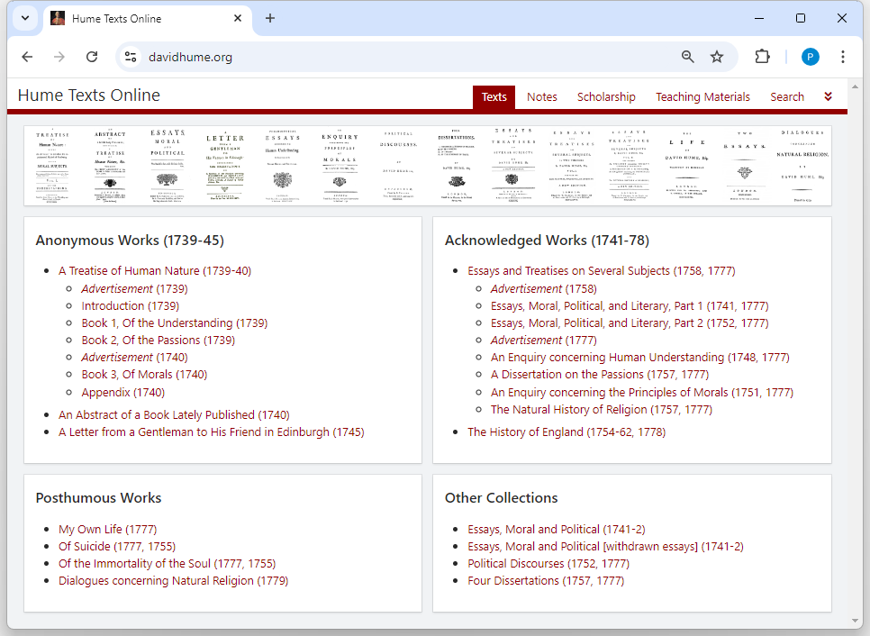
T
E
A

Slide 12
www.davidhume.org
Click on “Texts” to see the menu of texts as shown on the previous slide.
Click on “Search” to search the texts:

Slide 13
Click on to jump to a specific text reference (e.g. T 1.3.2.11, A 27, or E 4.13).
Click on “Teaching Materials” to find links to:
Previous lectures on Hume (2010, 2011, 2018) together with handouts (including for 2021).
“Outline of Humean Texts”: annotated summaries of some of the most important sections of the Treatise, to aid comprehension and reference.
“Analysis of Hume’s Sceptical Texts” – as above, but focusing on sceptical topics.
“Notes on Particular Topics” – more opinionated discussions of other key topics.
Click on “Scholarship” to find over 50 of my papers on Hume, and handouts from many talks.

Slide 14
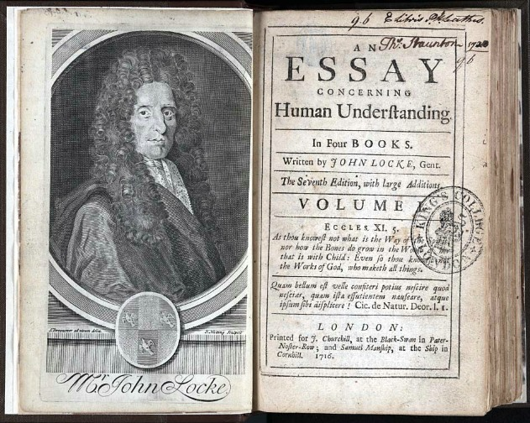
1(a) The Lockean Inheritance

Slide 15
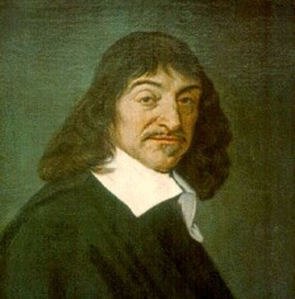
Descartes’s “Way of Ideas”
René Descartes (1596-1650) took all our understanding and knowledge to start from “ideas” in the mind – an internalist perspective that took hold for centuries.
Some ideas he took to be “innate” and divinely implanted (e.g. the ideas of God, and of extension i.e. matter (see M 3 AT 7:37-8; CCB AT 8B:357-61).
Other ideas come through the senses – some of these correspond to real properties of material things (e.g. shape and size); others do not (e.g. colours, sounds, odours, tastes). Locke later called these primary and secondary qualities respectively.

Slide 16
Locke’s Reaction to Descartes
Locke follows Descartes by conceiving mental content in terms of “ideas” (and advocates the primary/secondary distinction), but a principal aim of his Essay concerning Human Understanding (1690) is to deny that any of our ideas are innate.
Book 1 – entitled “Of Innate Notions” – focuses on denying that we have innate principles.
Book 2 – “Of Ideas in general, and their Original” – was probably more influential, purporting to explain how all our ideas are derived from experience, i.e. to establish concept-empiricism.

Slide 17
Two Kinds of “Empiricism”
Distinguish concept-empiricism:
All our ideas derive from experience
(i.e. contra Descartes, there are no innate ideas)
from knowledge-empiricism:
All knowledge of the world derives from experience
(i.e. no “synthetic a priori knowledge”, contra Kant)
Locke is a committed concept-empiricist, but he is not a pure knowledge-empiricist. (Hume is strongly empiricist in both senses.)

Slide 18
What is an “Idea”?
Locke defines an idea as
“whatsoever is the Object of the Understanding when a Man thinks” (Essay I i 8)
This is supposed to include all types of “thinking”, including perception and feeling as well as contemplation. So our ideas include thoughts and sensations, and also “internal” ideas that we get from reflection.

Slide 19
“White Paper” and “Two Fountains”: Sensation and Reflection
“Let us then suppose the Mind to be, as we say, white Paper, void of all Characters, without any Ideas; How comes it to be furnished? … To this I answer, in one word, From Experience … Our Observation employ’d either about external, sensible Objects; or about the internal Operations of our Minds … These two are the Fountains of Knowledge, from whence all the Ideas we have … do spring.” (Essay II i 2)

Slide 20
Ideas on a Mental Stage?
The theory of ideas tends to portray the mind as passive, with mental acts being understood in terms of the activity and qualities of “ideas”:
seeing a tree involves having a visually vivid idea of a tree “in front of the mind”;
thinking about a tree involves having a less vivid idea of a tree;
feeling a pain involves having an idea of a pain;
desiring chocolate involves having a “positively charged” idea of chocolate.

Slide 21
Humean Ideas and Impressions
Hume considers Locke’s usage of “idea” too broad, so adopts different terminology:
An impression is a sensation (e.g. from seeing a blue sky, smelling a flower, or physical pain) or a feeling (e.g. anger, desire, disapproval, envy, fear, love, or pride);
An idea is a thought (e.g. about the sky, or about a pain, or about the existence of God);
A perception is either an impression or an idea. (So Hume uses the word perception to cover everything that Locke calls an idea.)

Slide 22
An Obvious Distinction?
Hume seems to think that the impression/idea distinction is a fairly obvious one, between (roughly) feeling – including both feelings of sensation and of reflection – and thinking:
“I believe it will not be very necessary to employ many words in explaining this distinction. Every one of himself will readily perceive the difference betwixt feeling and thinking.” (T 1.1.1.1)
This indeed seems to be how he mainly thinks of the distinction, but as we’ll soon see, he muddies the waters by seeming to define it in a different way (in terms of “force and vivacity”).

Slide 23
“Sensation” and “Reflection”
Hume follows Locke in calling the two sources of ideas “sensation” and “reflection” (T 1.1.2.1, cf. Essay II i 3-4), but there are differences …
First, whereas Locke takes for granted that we have “sensitive knowledge” of the existence of external objects (Essay IV xi), Hume describes the impressions of sense (e.g. perceptions of colour, taste, smell, bodily pain) as arising “in the soul originally, from unknown causes” (T 1.1.2.1). This suggests from the start a more sceptical attitude towards the senses.

Slide 24
Humean Reflection
Impressions of reflection are “deriv’d in a great measure from our ideas”, particularly the ideas of pleasure or pain that arise when we feel e.g. “heat or cold, thirst or hunger” (T 1.1.2.1).
Thinking or reflecting about pleasures and pains gives rise to “desire and aversion, hope and fear, which may properly be call’d impressions of reflection because deriv’d from it”. Hume also calls these secondary impressions (T 2.1.1.1-2). At T 1.1.6.1 Hume says that impressions of reflection are either passions (e.g. the desire for something) or emotions (e.g. happiness).

Slide 25
“Reflection”: A Contrast with Locke
When Locke discussed ideas of reflection, his focus was very different from Hume’s:
“By REFLECTION ... I ... Mean, that notice which the Mind takes of its own Operations, ... by reason whereof, there come to be Ideas of these Operations in the Understanding.”
“... such are, Perception, Thinking, Doubting, Believing, Reasoning, Knowing, Willing, and all the different actings of our own Minds;” (II i 4)
Locke seems to overlook passions and emotions; Hume is much more interested in these, but seems to overlook mental operations!

Slide 26
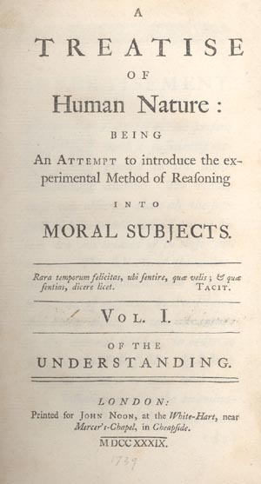
1(b) Hume’s Copy Principle and the Simple/Complex Distinction

Slide 27
Hume’s Conceptual Empiricism: A First Approximation
To a first approximation, Hume’s conceptual empiricism is the claim that all of our ideas (i.e. thoughts) are derived from impressions (i.e. sensations or feelings).
But Hume takes conceptual empiricism more strictly than Locke, insisting (again to a first approximation) that all of our ideas are copies of impressions, which almost exactly resemble the corresponding impressions.

Slide 28
Conceptual Empiricism: Refining the Approximation
Obviously, some of our ideas (e.g. of a unicorn) are not copies of any single impression.
Hume acknowledges this, but wants to insist that all of the content of our ideas is copied from impressions – we might say that ideas are entirely composed of impression-copied content.
His way of dealing with this is to draw a distinction between simple ideas (which are directly copied from simple impressions) and complex ideas (which may be constructed from simple ideas)

Slide 29
Simple and Complex Ideas
At Treatise 1.1.1.2, Hume divides all ideas and impressions into simple and complex:
“Simple perceptions or impressions and ideas are such as admit of no distinction nor separation. The complex are the contrary to these, and may be distinguished into parts.”
Hume writes as though this distinction is really straightforward, but it isn’t! Take, for example, the idea of a red circle: that seems to be a complex idea, but what exactly are the parts, and how many (maybe two: the red colour, and the circular shape, or maybe the size also)?

Slide 30
Spatial Ideas and Atomism
At Essay II v 1 and II viii 9, Locke describes the ideas of space, extension, and figure (i.e. shape) as simple (though II xiii on “the simple modes of space” complicates the story a bit.)
Hume has a much stricter “atomist” view of spatial ideas, taking them to be formed of minima, in much the way that a computer image is formed of individual coloured pixels. T 1.2.1.4 describes how an ink spot can yield a minimal impression.
Extension and figure arise only when we have multiple minima, hence complexity (e.g. T 1.2.3.15).

Slide 31
Hume’s Copy Principle
Hume’s concept-empiricism is expressed in his “first principle” (T 1.1.1.12) which is now commonly known as his Copy Principle:
“that all our simple ideas [i.e. thoughts] in their first appearance are deriv’d from simple impressions [i.e. sensations or feelings], which are correspondent to them, and which they exactly represent.” (T 1.1.1.7)
Hume sees this as a more precise formulation of Locke’s denial of innate ideas (as he makes explicit at Abstract 6 and E 2.9 n. 1).
31

Slide 32
Weaponising the Copy Principle?
The 1748 Enquiry boldly flourishes the Copy Principle as a weapon against bogus ideas:
“When we entertain ... any suspicion, that a philo-sophical term is employed without any meaning or idea (as is but too frequent), we need but enquire, from what impression is that supposed idea derived? And if it be impossible to assign any, this will serve to confirm our suspicion.” (E 2.9)
But in practice, Hume almost always uses it not to dismiss ideas but to clarify them, by tracing them to their impression-source.

Slide 33
Hume’s First Argument for the Copy Principle
There seem to be no counterexamples:
“After the most accurate examination, of which I am capable, I venture to affirm, that the rule here holds without any exception, and that every simple idea has a simple impression, which resembles it; and every simple impression a correspondent idea.” (T 1.1.1.5)
And since the impressions come before the ideas (T 1.1.1.8), they must cause the ideas rather than vice-versa.

Slide 34
Hume’s Second Argument for the Copy Principle
People who lack any particular sense modality always lack also the corresponding ideas:
“wherever by any accident the faculties, which give rise to any impressions, are obstructed in their operations, as when one is born blind or deaf; not only the impressions are lost, but also their correspondent ideas; … likewise where they have never been put in action to produce a particular impression [such as] the taste of a pine-apple …” (T 1.1.1.9)

Slide 35
Problems with Hume’s Arguments
Hume’s first argument doesn’t seem to fit very well with his use of the Copy Principle against opponents:
Suppose someone claims to have an idea which doesn’t derive from a corresponding impression; he will simply deny Hume’s generalisation and hence his argument for the Principle. Bennett (2002, pp. 100-1) presses this sort of objection.
Garrett (1997, pp. 46-8) mounts a defence on Hume’s behalf:

Slide 36
Garrett’s First Defence of Hume
“when [Hume] argues against the existence of a certain (putative) idea, he never argues merely that we do not find such a corresponding impression in experience; he also always argues that no impression could possibly satisfy the requirements we implicitly demand for such a perception.” (1997, p. 49)
So such an idea would not merely contradict the Copy Principle, “It would … require the admission of an entirely distinct representational faculty”, in addition to our (imagistic) imagination.

Slide 37
Responding to Garrett
But the point that “no impression could possibly satisfy the requirements” for serving as the source of a particular idea is double-edged.
Hume’s opponent can point out that the ideas in question – those that are not obviously imagistic and which Hume has to work so hard to explain in imagistic terms (necessary connexion, body, the self etc.) – are precisely the ones for which the Copy Principle is least plausible to start with.
Is it really legitimate to extend an argument which seems plausible in the case of sensory ideas to these more contentious cases?

Slide 38
Hume’s second argument also has problems. It may seem very plausible that a blind man can have no idea of red, for example. But how can Hume know that this is the case? Might it not be that the man has private mental experiences that involve the colour red?
At risk of anachronism, some authors (e.g. Bennett, Dicker) argue that Hume’s point is best understood as being not about private mental experience, but about public meaningfulness. The blind man cannot use the word “red” correctly, and they take this moral to be the real point of Hume’s position (which would thus anticipate twentieth-century “verificationist” philosophy of language).

Slide 39
Garrett’s Second Defence of Hume
Garrett (1997, pp. 46-8) defends Hume more straightforwardly, arguing that although one might not be able to demonstrate to others that one was having a simple idea without a simple impression, the fact that blind and deaf people (etc.) don’t claim to have such ideas can be taken as significant:
“It is a fact, for example, that the blind and the deaf do not report mental images – that is, Humean ‘ideas’ – that are unrelated to any simpler elements previously experienced in sensation or feeling. … The fact that the blind and deaf can and do report aspects of their mental lives but do not report such images is surely some evidence that they do not have them.” (p.46)

Slide 40
Further evidence, Garrett suggests, comes from people whose senses are repaired, who as adults become able to see for the first time. They report new sensations, apparently: sensations that they could not imagine prior to the repair.
Note, however, that this second argument explicitly focuses on ideas that are acknowledged from the start to be sensory, so it doesn’t help in the more contentious cases that are not obviously sensory.
For those ideas (necessity, body, self etc.), Hume’s case for empiricism – like Locke’s – perhaps has to depend on the strength of his specific account of those ideas. Can he actually explain their nature in terms of impression-copy content?

Slide 41
The Missing Shade of Blue
After arguing for the Copy Principle, Hume himself strangely presents a counter-example: the famous “missing shade of blue” (T 1.1.1.10).
He seems, however, to think this isn’t a serious problem for his position, maybe because:
The “new” simple idea is being constructed (by something like blending) from materials that are provided by impressions, so his concept-empiricism isn’t being fundamentally threatened.
The new idea could be derived from sensory exp-erience, even if in this case it hasn’t been – it’s still imagistic (so clearly thinkable on Hume’s view).

Slide 42
“Suppose … a person to have enjoyed his sight for thirty years, and to have become … well acquainted with colours of all kinds, excepting one particular shade of blue, … which [he has never met] with. Let all the different shades of that colour, except that single one, be placed before him, descending gradually from the deepest to the lightest; 'tis plain, that he will perceive a blank, where that shade is wanting, and will be sensible, that there is a greater distance in that place betwixt the contiguous colours, than in any other. [Could he], from his own imagination, … raise up to himself the idea of that particular shade, tho' it had never been conveyed to him by his senses? I believe … he can; and this may serve as a proof, that the simple ideas are not always derived from the correspondent impressions; tho’ the instance is so particular and singular, that [it] … does not merit that for it alone we should alter our general maxim.”
(T 1.1.1.10)

