Slide 1
Writing Readable Code
Style & Structure

Slide 2
Learning Objectives
Be aware of style guides (i.e. PEP8, CPA Style Guide)
Understand how we can use:
    Variable and function names
    Comments
    Consistent formatting
  to improve readability of our code
Practice reading and understanding code.

Slide 3
Why do we care about consistent style?
Improves readability
Well-formatted, consistent code is easier to update, debug, and extend
Team members can easily read and modify each other’s code

Slide 4
Reading and Understanding Code
Most of the code you’ve written so far has been from scratch (i.e. you’ve started with a blank text editor).
In practice, much of the code you write will be adding to an existing code base.
  You may be working with somebody else.
  You may be adding a new feature to some existing code.
  You may be changing existing code to be more efficient
  You may be correcting code written by an AI tool.
Before you can add to pre-existing code, you need to understand what it does, and how it works.
Let’s practice reading some code…

Slide 5
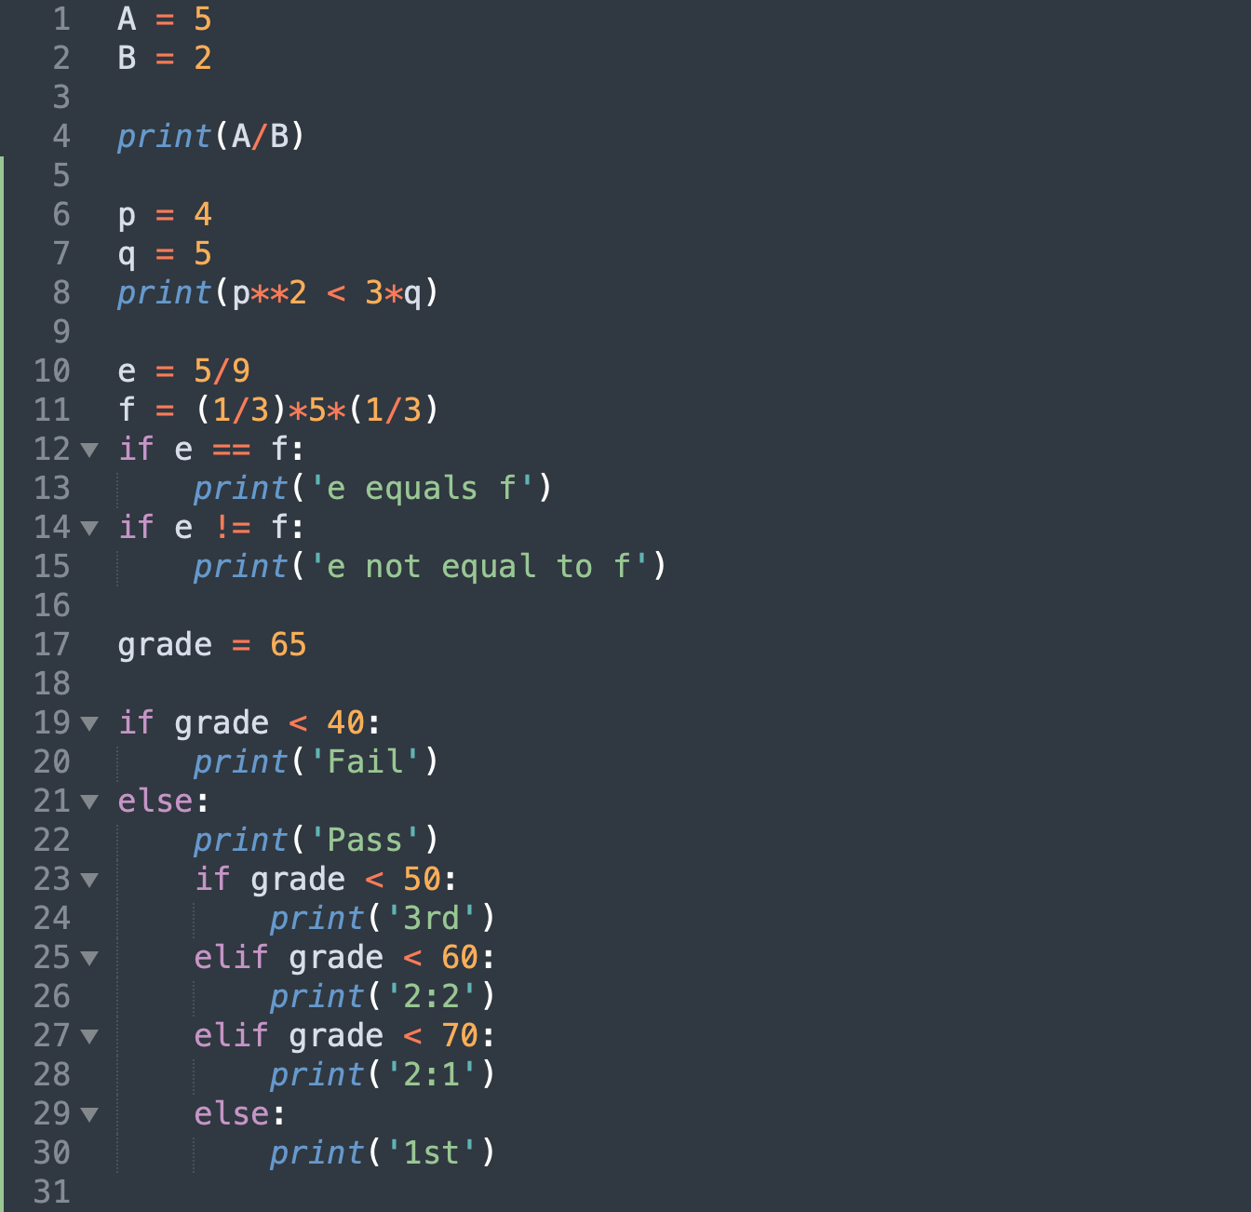
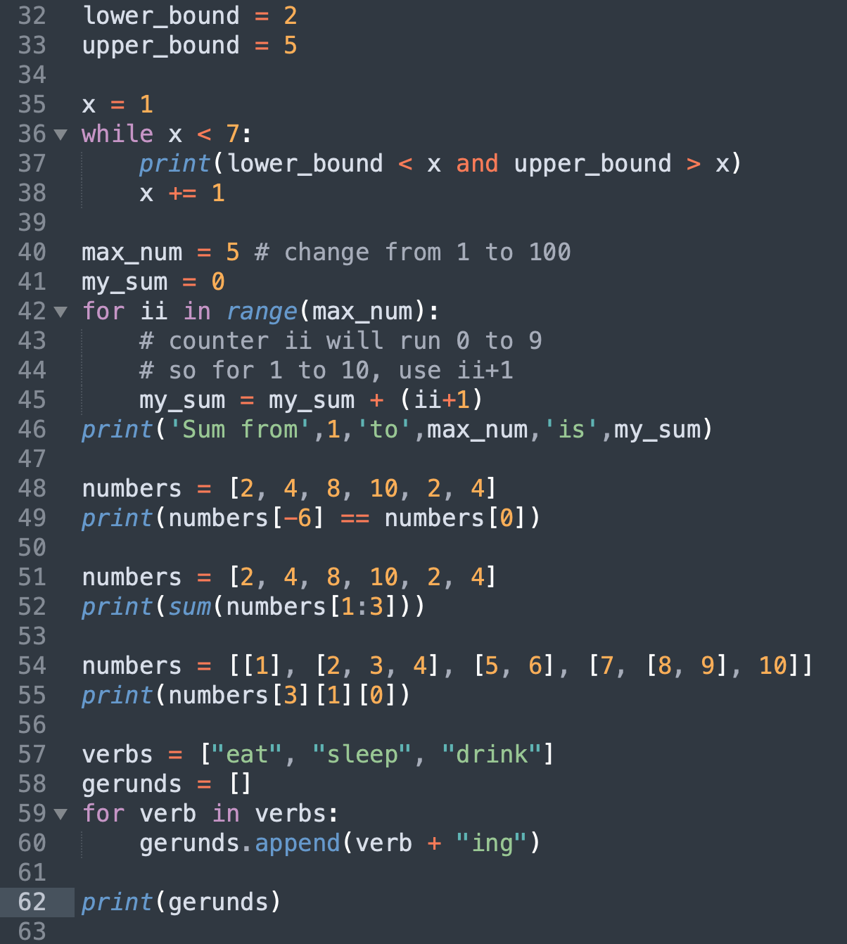
Reading Code Examples 1
1
2
3

Slide 6
Writing Readable Code - consistency
The most important thing is to be consistent- pick a format and stick to it.
PEP 8 is the generally-accepted style guide for Python.
We have outlined a vastly reduced set of style directives – the CPA style guide (available on blackboard).
  Variables
  Constants and magic numbers
  Functions
  Comments
  .py file structure
Your assessments will be marked down for not following the unit style guide!

Slide 8


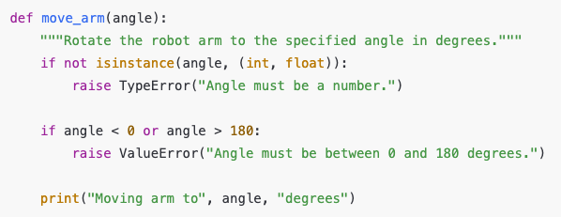
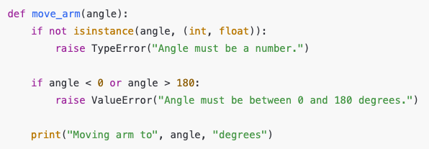

Slide 9
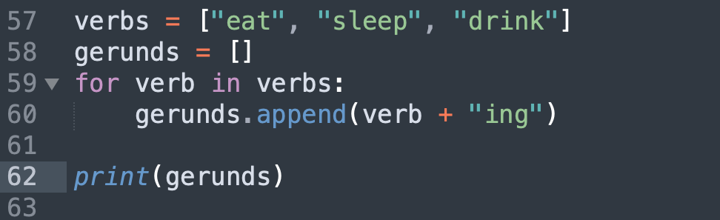
Reading Code Examples 2
4
6
5

Slide 10
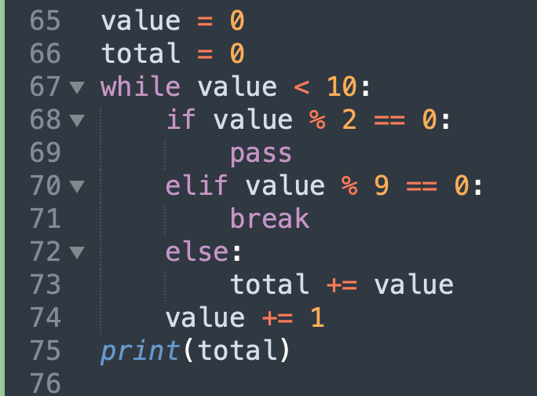
Reading Code Examples

Slide 11
Reading Code Examples
Program counter: 65
Value
0
Int

Slide 12
Reading Code Examples
Program counter: 66
Value
0
Int
Total
0
Int

Slide 13
Reading Code Examples
Program counter: 67
Value
0
Int
Total
0
Int

Slide 14
Reading Code Examples
Program counter: 68
Value
0
Int
Total
0
Int

Slide 15
Reading Code Examples
Program counter: 74
Value
1
Int
Total
0
Int

Slide 16
Reading Code Examples
Program counter: 67
Value
1
Int
Total
0
Int

Slide 17
Reading Code Examples
Program counter: 68
Value
1
Int
Total
0
Int

Slide 18
Reading Code Examples
Program counter: 70
Value
1
Int
Total
0
Int

Slide 19
Reading Code Examples
Program counter: 72
Value
1
Int
Total
0
Int

Slide 20
Reading Code Examples
Program counter: 73
Value
1
Int
Total
1
Int

Slide 21
Reading Code Examples
Program counter: 74
Value
2
Int
Total
1
Int

Slide 22
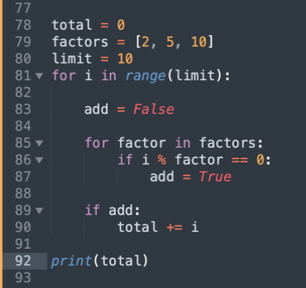
Reading Code Examples

Slide 23
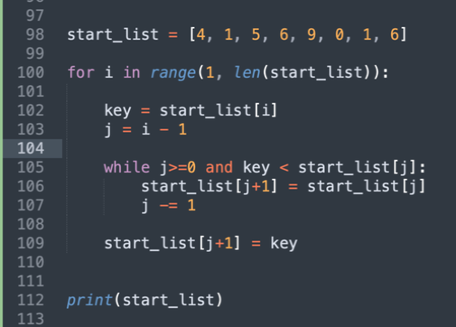
Reading and Understanding Code
For more complex bits of code, you may need to add some print statements to help you understand what’s going on.

Slide 24
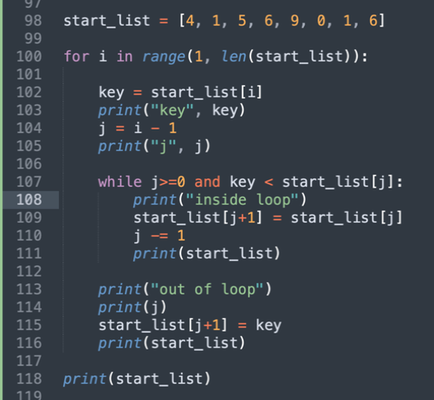
Reading and Understanding Code
For more complex bits of code, you may need to add some print statements to help you understand what’s going on.

Slide 25
Reading and Understanding Code
For more complex bits of code, you may need to add some print statements to help you understand what’s going on.

Slide 26
Writing Readable Code
There are a number of things we can do to make our code easier to read.
  Adding comments
  Using readable variable names
  Using consistent formatting

Slide 27
Writing Readable Code
There are a number of things we can do to make our code easier to read.
  Adding comments
  Using readable variable names
  Using consistent formatting

Slide 28
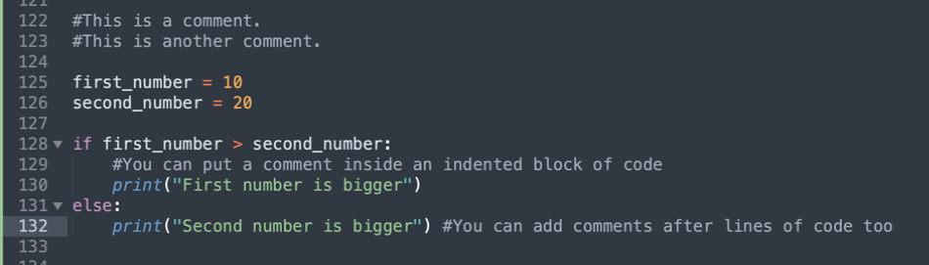
Writing Readable Code - comments
Any line of code that starts with a # will be ignored by the Python interpreter

Slide 29
Writing Readable Code - comments
Any line of code that starts with a # will be ignored by the Python interpreter

Slide 30
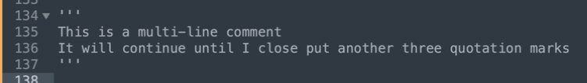
Writing Readable Code - comments
Any line of code that starts with a # will be ignored by the Python interpreter
To create a multi-line comment, use three quotation marks (‘‘‘) instead.

Slide 31
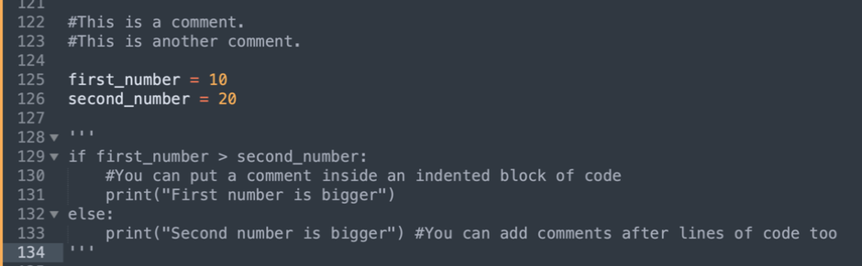
Writing Readable Code - comments
Any line of code that starts with a # will be ignored by the Python interpreter
To create a multi-line comment, use three quotation marks (‘‘‘) instead.
You can also use comments to temporarily remove sections of code that you don’t want to delete- can be really helpful for debugging.

Slide 32
Writing Readable Code - comments
Any line of code that starts with a # will be ignored by the Python interpreter
To create a multi-line comment, use three quotation marks (‘‘‘) instead.
You can also use comments to temporarily remove sections of code that you don’t want to delete- can be really helpful for debugging.
There’s a balance to writing good comments that will come with practice- for now, try to write comments to explain anything that would help “future you”

Slide 33
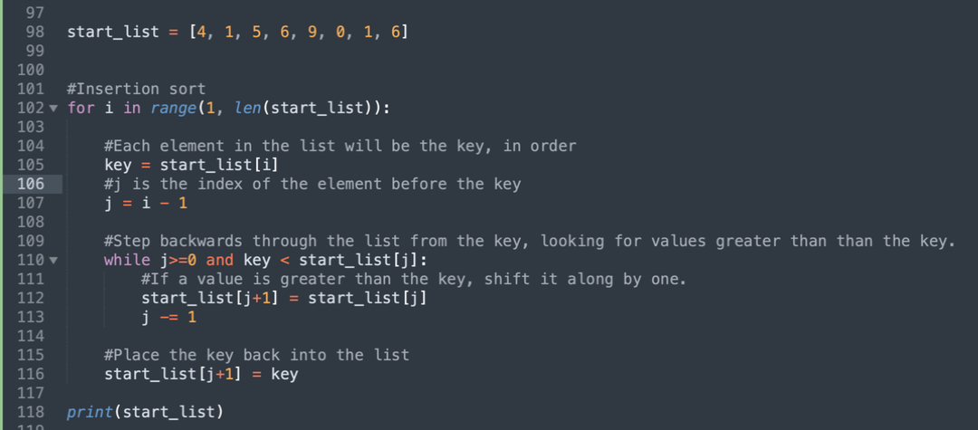
Writing Readable Code - comments

Slide 34
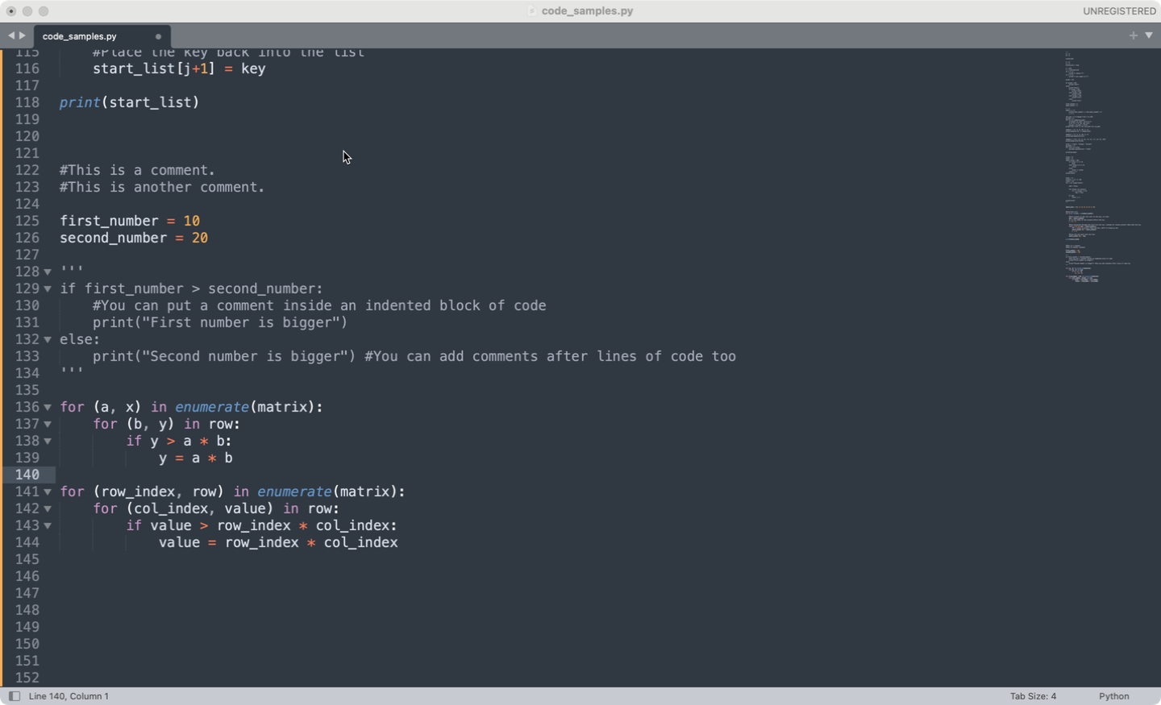
Writing Readable Code – variable names
Variable names should be meaningful and readable
  Don’t use single letters like x, y, z
  Do use English grammar conventions – i.e. plurals for lists
  Do not use Python built-in objects / functions (i.e str, int)

Slide 35
Writing Readable Code – variable names
Variable names should be meaningful and readable
  Don’t use single letters like x, y, z
  Do use English grammar conventions – i.e. plurals for lists
  Do not use Python built-in objects / functions (i.e str, int)

Slide 36
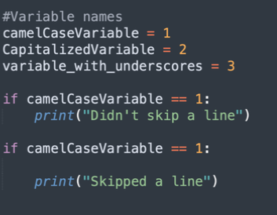
Writing Readable Code - consistency
There’s lots of ways we could choose to write our code

Slide 37
Writing Readable Code - consistency
There’s lots of ways we could choose to format our code
The most important thing is to be consistent- pick a format and stick to it.

Slide 38
The CPA style guide
Variables should be lower case with underscores (_) to separate words. (this_is_an_example).
Variable names should be meaningful and readable.
Code should use comments to help with readability.
Functions should be lower case with underscores (_) to separate words.
Functions should contain docstrings.
Classes should be use capitalized words (i.e RobotClass).

