Slide 1
Algorithms and how a computer executes them
Computer programming and algorithms 25/26
Seminar 1

Slide 2
What do you already know?
What do we mean by the word algorithm?
What do we mean by the word computer program?
Are these the same thing? Are they different? (if so, how?).
Please discuss these questions with the people on your table (~ 5 minutes) and then summarise your answer on menti with code: XXXX

Slide 3
What do you already know?
(Brief review of Menti answers)

Slide 4
Today’s learning objectives
Understand what we mean by the word algorithm.
Practice designing some basic algorithms
Begin to develop a mental model of how a computer can execute an algorithm.

Slide 5
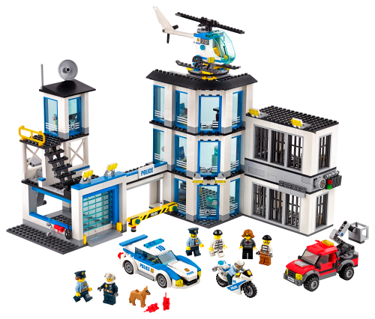
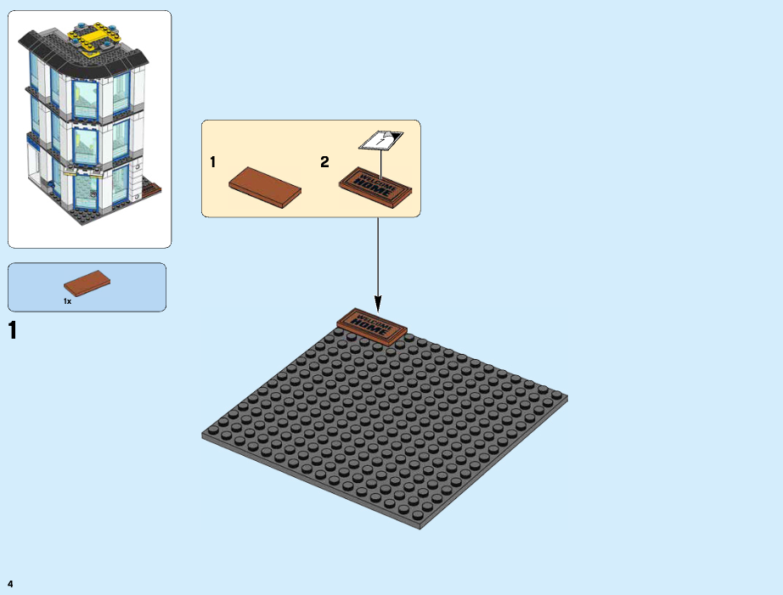
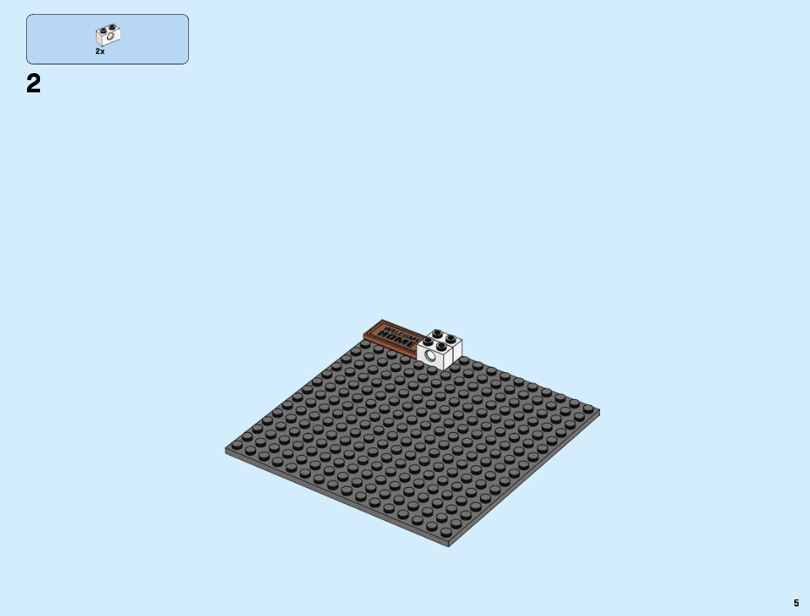
Algorithms
An algorithm is a set of instructions that can be followed to complete a task.
For example, to make a lego model, we follow instructions.

Slide 6
Algorithms
An algorithm is a set of instructions that can be followed to complete a task.
For example, to make a lego model, we follow instructions.
Question: Discuss (2-3 mins) some examples of algorithms you have encountered in your daily lives.
Notes:
Key point: Students are used to encountering algorithms in their daily lives- not exotic or incomprehensible, but in fact mundane and ordinary.

Slide 7
Designing algorithms
In this course, we won’t be following algorithms, but instead designing them.
Typically this means breaking a larger job down into a sequence of smaller steps.
We may do this iteratively- e.g we may need to break some of our “smaller steps” into separate tasks.
Often we will make use of decisions (using some criteria to decide which instruction should be done next) and iteration (repeating an instruction some number of times).
A good algorithm should have:
Clear and unambiguous instructions.
A finite number of steps (more on this later in the course).

Slide 8
Designing algorithms
Example: An algorithm for ???
Show example of repeated breaking down into subtasks. When to stop? Depends on who is executing the algorithm!
Make sure example includes selection and iteration.

Slide 9
Designing algorithms
Let’s write an algorithm for making a ham sandwich.
Notes:
Introduce idea that this will be done by a child- so choice of “stopping” depends on who is executing the steps!

Slide 10
Designing algorithms
Let’s write an algorithm for making a ham sandwich.
How could we generalize this algorithm to make any kind of sandwich?
Notes:
Generalisation allows discussion of algorithms with inputs.

Slide 11
Designing algorithms
In groups, discuss (~10 minutes) and develop algorithms for one the following tasks.
Finding the roots of a quadratic equation.
Finding all primes between two numbers.
Sorting a list of real numbers by size.
Share a summary of your algorithm on Menti, code: XXXX

Slide 12
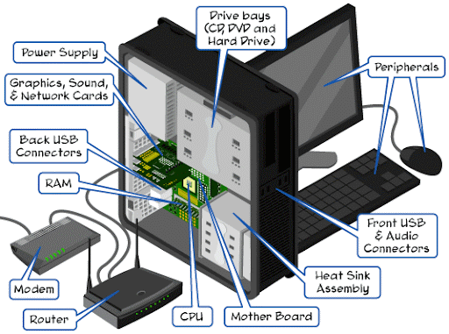
How a computer executes algorithms
A computer consists of a number of separate electronic devices that together can perform a vast number of algorithms.

Slide 13
How a computer executes algorithms
A computer consists of a number of separate electronic devices that together can perform a vast number of algorithms.
Memory (RAM)
Central Processing Unit
Input Devices
Output Devices
Storage
(Hard Drive)

Slide 14
How a computer executes algorithms
A computer consists of a number of separate electronic devices that together can perform a vast number of algorithms.
Input (i.e mouse / keyboard / touchscreen) and output (monitor)
Memory for storing data
A central processing unit “CPU” can electronically perform a limited number of operations.
Memory (RAM)
Central Processing Unit
Input Devices
Output Devices
Storage
(Hard Drive)

Slide 15
How a computer executes algorithms
Memory is used to store information. We can think (for now) of memory as a large number of boxes that can be used to data. Each piece of data stored in memory has:
A name
A value
A data type (integer, string, Boolean, etc).

Slide 16
How a computer executes algorithms
Memory
Memory is used to store information. We can think (for now) of memory as a large number of boxes that can be used to data. Each piece of data stored in memory has:
A name
A value
A data type (integer, string, Boolean, etc).
Memory
Name: a
Value: 3
Type: Integer

Slide 17
How a computer executes algorithms
Memory
Memory is used to store information. We can think (for now) of memory as a large number of boxes that can be used to data. Each piece of data stored in memory has:
A name
A value
A data type (integer, string, Boolean, etc).
Memory
Name: a
Value: 3
Type: Integer
Name: b
Value: 2
Type: Integer

Slide 18
How a computer executes algorithms
A computer consists of a number of separate electronic devices that together can perform a vast number of algorithms.
Memory (RAM)
Central Processing Unit
Input Devices
Output Devices
Storage
(Hard Drive)

Slide 19
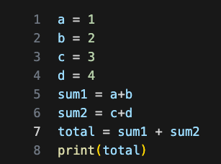
How a computer executes algorithms
A CPU can electronically perform a limited number of instructions. These are:
Read / write data from memory.
Handle input / output.
Basic arithmetic operations (add, subtract, multiply divide).
Comparisons (i.e is value 1 greater than value 2).
A computer program is a list of these instructions. The CPU will execute each instruction in the list sequentially, using a special program counter variable to keep track of which instruction should be executed next.

Slide 20
How a computer executes algorithms
A CPU can execute a limited number of instructions. These are:
Read / write data from memory.
Handle input / output.
Basic arithmetic operations (add, subtract, multiply divide).
Comparisons (i.e is value 1 greater than value 2).
Program
Memory
Program Counter: 1

Slide 21
How a computer executes algorithms
A CPU can execute a limited number of instructions. These are:
Read / write data from memory.
Handle input / output.
Basic arithmetic operations (add, subtract, multiply divide).
Comparisons (i.e is value 1 greater than value 2).
Program
Memory
Program Counter: 2
a: 1

Slide 22
How a computer executes algorithms
A CPU can execute a limited number of instructions. These are:
Read / write data from memory.
Handle input / output.
Basic arithmetic operations (add, subtract, multiply divide).
Comparisons (i.e is value 1 greater than value 2).
Program
Memory
Program Counter: 3
a: 1
b: 2

Slide 23
How a computer executes algorithms
A CPU can execute a limited number of instructions. These are:
Read / write data from memory.
Handle input / output.
Basic arithmetic operations (add, subtract, multiply divide).
Comparisons (i.e is value 1 greater than value 2).
Program
Memory
Program Counter: 8
d: 4
a: 1
sum1: 3
b: 2
sum2: 7
c: 3
total: 10

Slide 24
How a computer executes algorithms
A CPU can execute a limited number of instructions. These are:
Read / write data from memory.
Handle input / output.
Basic arithmetic operations (add, subtract, multiply divide).
Comparisons (i.e is value 1 greater than value 2).
A computer program is a list of these instructions. The CPU will execute each instruction in the list sequentially, using a special program counter variable to keep track of which instruction should be executed next.
The program counter can be written to like any other piece of memory- this allows us to perform selection and iteration.

Slide 25
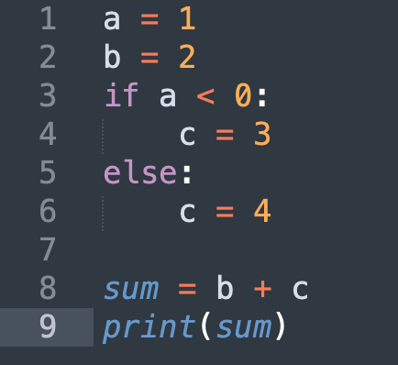
How a computer executes algorithms
The program counter can be written to like any other piece of memory- this allows us to perform selection and iteration.
Program
Memory
Program Counter: 3
a: 1
b: 2

Slide 26
How a computer executes algorithms
The program counter can be written to like any other piece of memory- this allows us to perform selection and iteration.
Program
Memory
Program Counter: 6
a: 1
b: 2

Slide 27
How a computer executes algorithms
The program counter can be written to like any other piece of memory- this allows us to perform selection and iteration.
Program
Memory
Program Counter: 7
a: 1
b: 2
c: 4

Slide 28
How a computer executes algorithms
The program counter can be written to like any other piece of memory- this allows us to perform selection and iteration.
Program
Memory
Program Counter: 8
sum: 6
a: 1
b: 2
c: 4

Slide 29
How to write computer algorithms
To write a computer algorithm we should:
Understand the task we are trying to perform
Break the task down into smaller steps, until each step is something that can be performed by a computer.
Write some computer code that has encodes this set of sequences in a format the CPU can understand.

Slide 30
How to write computer algorithms
To write a computer algorithm we should:
Understand the task we are trying to perform
Break the task down into smaller steps, until each step is something that can be performed by a computer.
Write some computer code that has encodes this set of sequences in a format the CPU can understand.
To do this, we must write our code in a particular programming language. In this course, we use Python. Early programmers had no choice but to use machine code, which uses binary to specify both data and the instruction to perform.

Slide 31
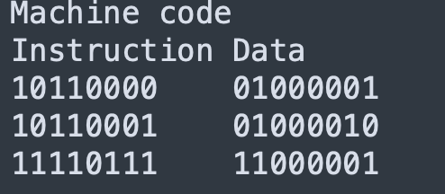
How to write computer algorithms
To do this, we must write our code in a particular programming language. In this course, we use Python. Early programmers had no choice but to use machine code, which uses binary to specify both data and the instruction to perform.

Slide 32
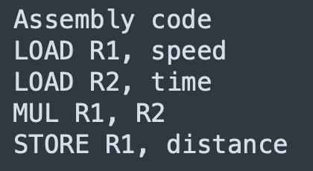
How to write computer algorithms
To do this, we must write our code in a particular programming language. In this course, we use Python. Early programmers had no choice but to use machine code, which uses binary to specify both data and the instruction to perform.
This was very tedious, and so people developed assembly language (and tools for translating assembly into machine code).

Slide 33
How to write computer algorithms
To do this, we must write our code in a particular programming language. In this course, we use Python. Early programmers had no choice but to use machine code, which uses binary to specify both data and the instruction to perform.
This was very tedious, and so people developed assembly language (and tools for translating assembly into machine code).
Assembly is still tedious to write, so people developed higher-level programming languages like Python that let us write code that looks a bit more like English.

Slide 34
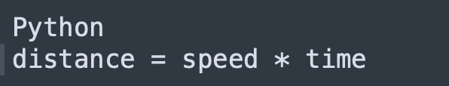
How to write computer algorithms
Assembly is still tedious to write, so people developed higher-level programming languages like Python that let us write code that looks a bit more like English.

Slide 35
How to write computer algorithms
Assembly is still tedious to write, so people developed higher-level programming languages like Python that let us write code that looks a bit more like English.
Although Python looks like English, it is not. Valid Python must follow a specified pattern (syntax). One of your main jobs in this course is to learn what to recognise what is and isn’t valid Python syntax. A second main job is to understand the semantics Python i.e what instructions does a line of Python correspond to.

