Slide 1
Computer Programming and Algorithms
Portfolio Exercise 2 – Class Level Feedback

Slide 2
Main points
About half of you got this exercise correct
Lots of you explored using functions within your code – well done!
There was some confusion about what the question was asking you to do
There was some confusion about how to use functions – we will practice more this week.

Slide 3
Functions
The following two slides each have a section of code that was submitted by a CPA student for their portfolio exercise.
Both submissions generate the correct result, but I prefer one over the other.
Which piece of code do you think is better? Why?
Share your answers on menti.com with code 8756 1676

Slide 4
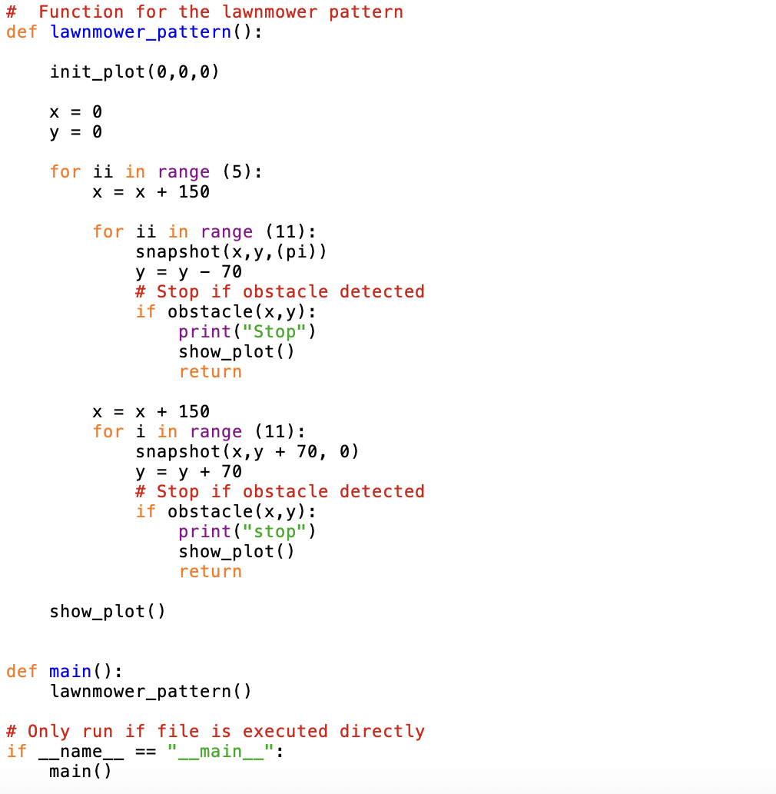
Code sample 1

Slide 5
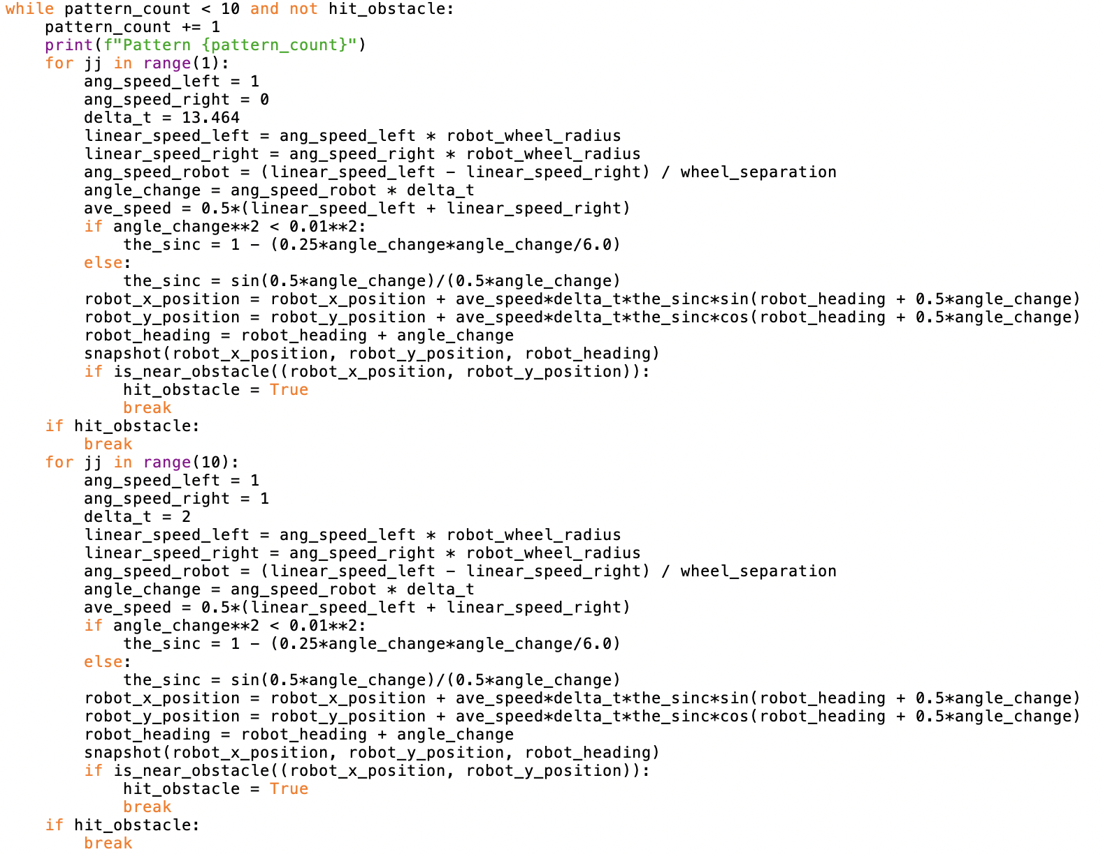
Code sample 2

