Slide 1
Computer Programming and Algorithms
Portfolio Exercise 1 – Class Level Feedback

Slide 2
Main points
Most of you got this exercise correct- well done!
Mistakes fell into one of three classes:
Small misinterpretations of what we were asking – don’t’ worry too much about this! With time, experience and feedback, this will get easier.
Incorrect derivation of the kinematic equations – again, don’t worry too much about this. We’re more interested in coding that maths here.
Incorrect calculations due to operator precedence – i.e not using brackets to ensure the correct sequence of operations is performed.
For those who did get it correct, remember that we also need to think about the readability of your code. We’ll cover this fully in a future seminar, but do think carefully about e.g. what you call your variables.

Slide 3
If-then-else structure
The following two slides each have a section of code that was submitted by a CPA student for their portfolio exercise. Both submissions appear to be correct, but I prefer one submission to the other.
Which piece of code do you think is better? Why?
Discuss this with someone in your group and then share your answers on menti.com with code 4341 5972

Slide 4
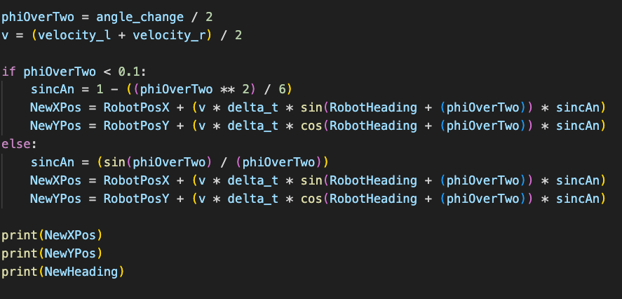
Code sample 1

Slide 5
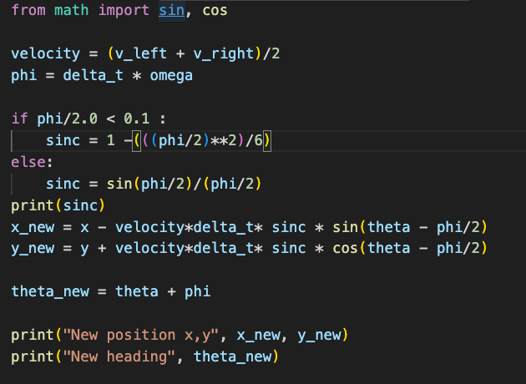
Code sample 2

