Slide 1
Computer Programming and Algorithms 25-26
Welcome Back

Slide 2
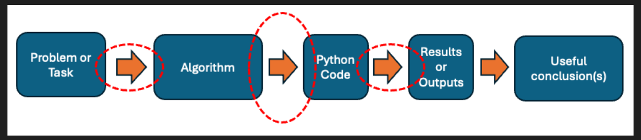
Why are we here?

Slide 3
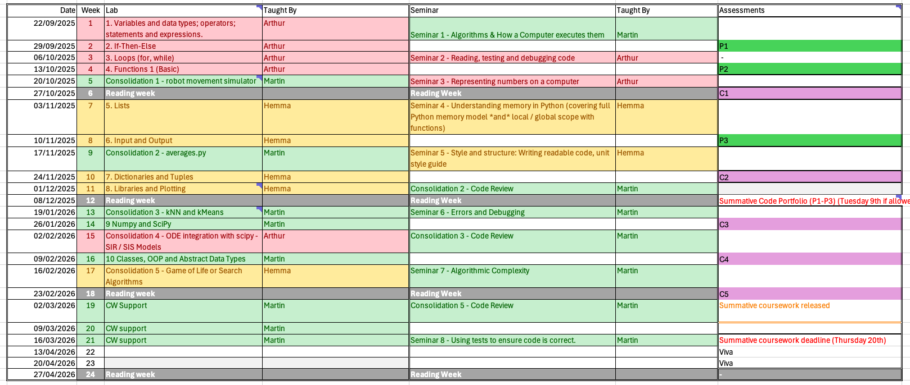
What will we do in TB2?

Slide 4
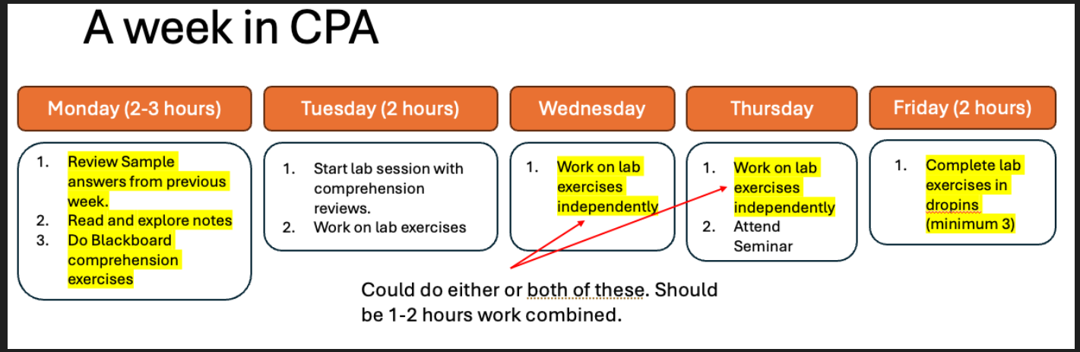
How is TB2 different to TB1?
More consolidation exercises, less new things to learn.
  TB1 work for CPA was often pre-lab
  In TB2, we’ll expect you to spend less time before the lab, and more time finishing exercises from the lab.

Slide 5
Portfolio Exercise 4 – Class Level Feedback
Most of you got this exercise correct- well done!
Three commons mistakes:
Code runs without error but doesn’t pass the tests – Make sure to check all test cases as these may not all be covered in an arbitrary run of your program
Incorrect order of arguments in function heading (50% marking penalty)
detect_obstacles function not included in solution

Slide 6
How is TB2 different to TB1?
More consolidation exercises, less new things to learn.
  TB1 work for CPA was often pre-lab
  In TB2, we’ll expect you to spend less time before the lab, and more time finishing exercises from the lab.

Slide 7
Portfolio Exercise 4 – Class Level Feedback
Most of you got this exercise correct- well done!
Three commons mistakes:
Code runs without error but doesn’t pass the tests – Make sure to check all test cases as these may not all be covered in an arbitrary run of your program
Incorrect order of arguments in function heading (50% marking penalty)
detect_obstacles function not included in solution

Slide 8
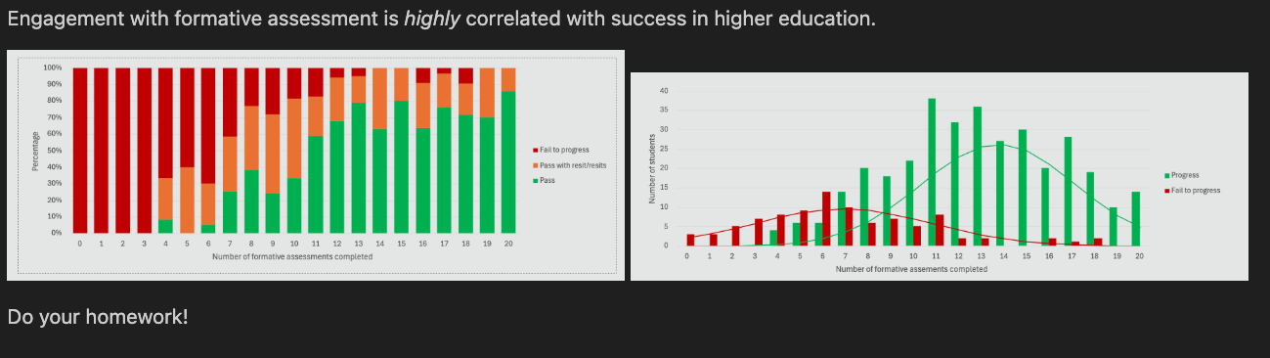
How to succeed in CPA

Slide 9
What will we do in TB2?

