Slide 1
Writing Readable Code
Style & Structure

Slide 2
Learning Objectives
Be aware of style guides (i.e. PEP8, CPA Style Guide)
Understand how we can use:
    Variable and function names
    Comments
    Consistent formatting
  to improve readability of our code
Practice reading and understanding code.

Slide 3
Why do we care about consistent style?
Improves readability
Well-formatted, consistent code is easier to update, debug, and extend
Team members can easily read and modify each other’s code

Slide 4
Reading and Understanding Code
Most of the code you’ve written has been from scratch
In practice, much of the code you write will be editing an existing code base.
  Working in a team
  Adding a new feature to some existing code
  Refactoring existing code to be more efficient
  Correcting code written by an AI tool
Before you can edit code, you need to understand what it does, and how it works.
Let’s practice reading some code…

Slide 5
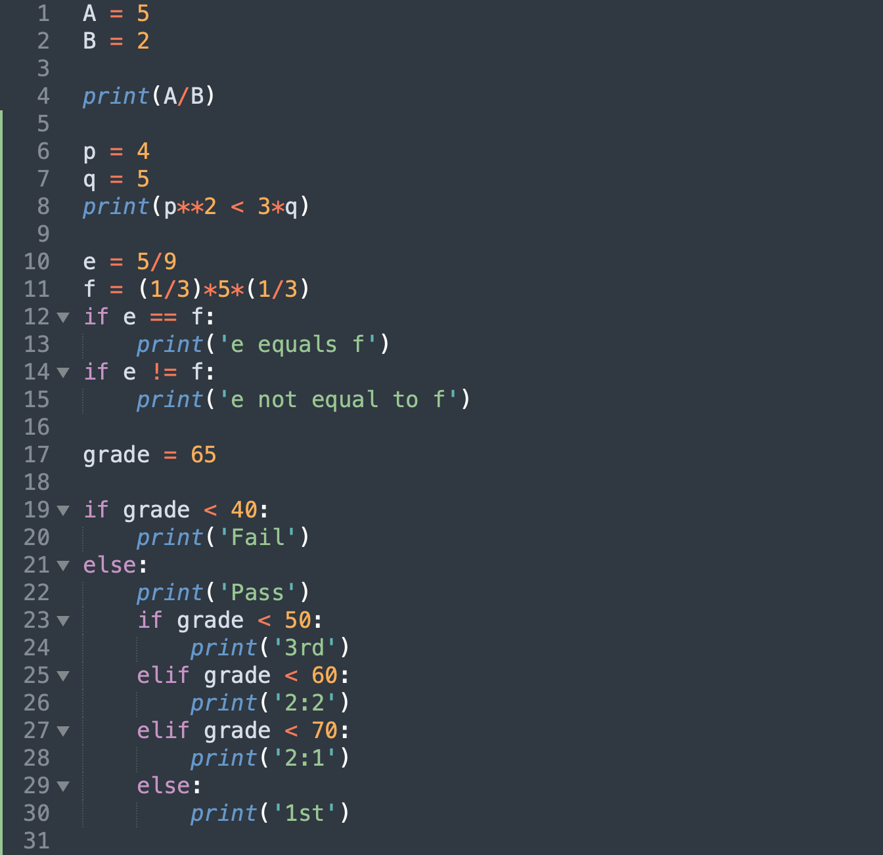
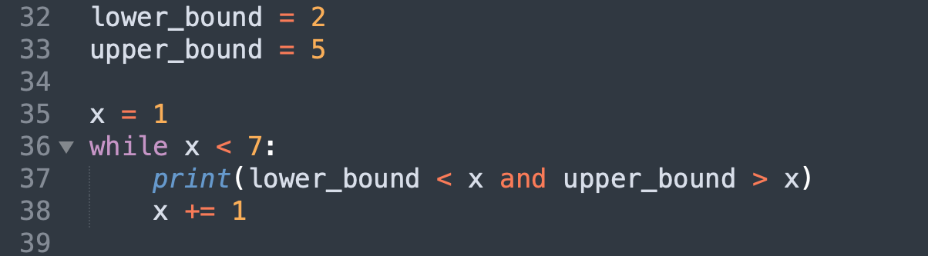
Reading Code Examples
1
2
3

Slide 6
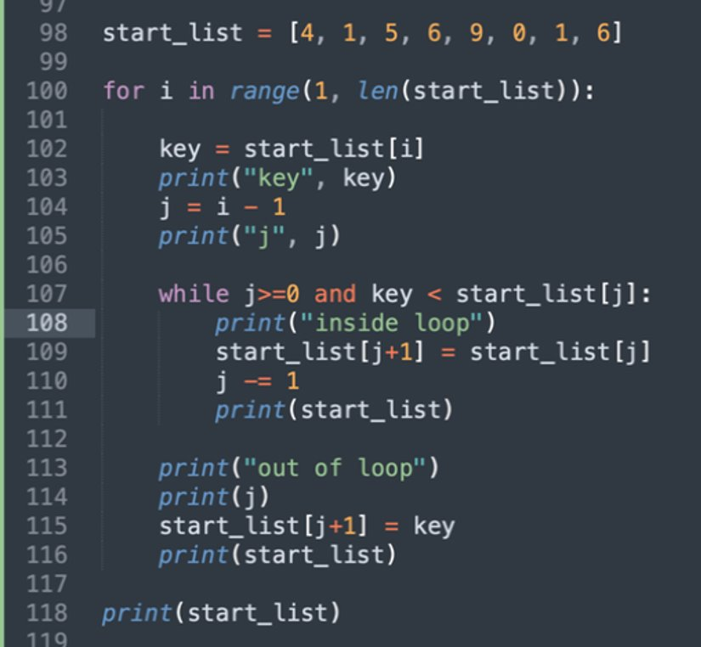
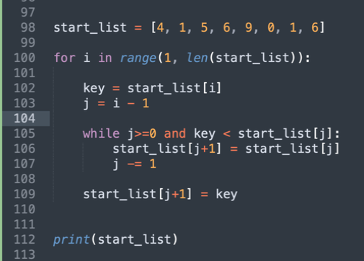
Reading and Understanding Code
For more complex bits of code, adding print statements can help you to understand what’s going on.

Slide 7
Writing Readable Code - consistency
The most important thing is to be consistent- pick a format and stick to it.
PEP 8 is the generally-accepted style guide for Python.
We have outlined a vastly reduced set of style directives – the CPA style guide (available on blackboard).
  Variables
  Constants and magic numbers
  Functions
  Comments
  .py file structure
Your assessments will be marked down for not following the unit style guide!

Slide 8
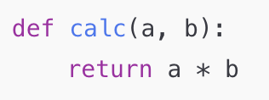
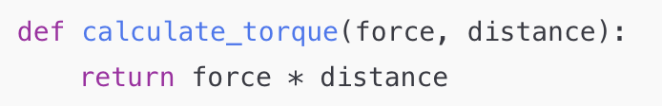
1.Variables
Must have a descriptive name
Must use lower case with underscores to separate words
Must not be single letters (i, j, k)
❌
✅
Hard to tell what a and b represent
The code is self-explanatory without comments

Slide 9
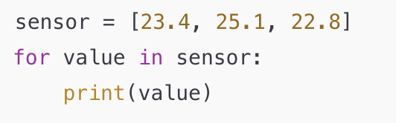
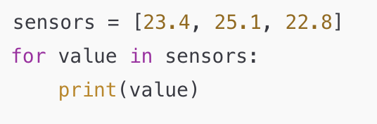
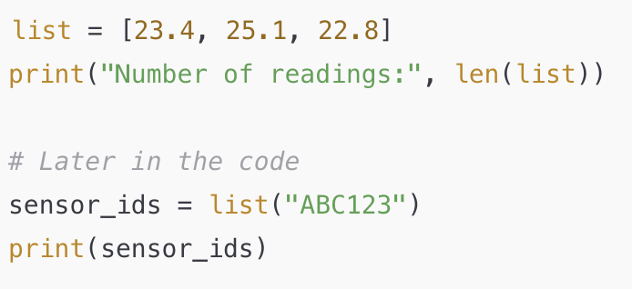
1.Variables
  Do use English grammar conventions (i.e. plurals for lists) for clarity of meaning
  Do not use Python built-in object / function names (i.e str, int)
❌
✅
Overwrites Python’s built-in 'constructor' functions which breaks common functionality

Slide 10
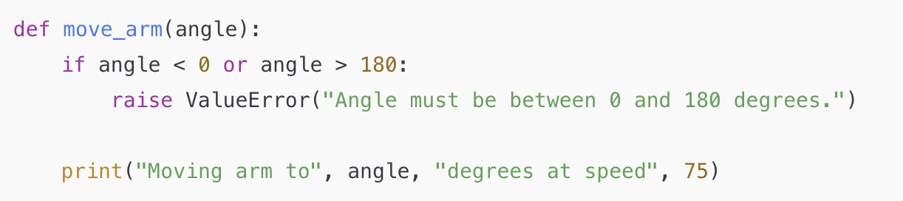
2.Constants and magic numbers
All constants must be defined as variables.
Your code should not contain ‘magic numbers’
❌
Magic numbers (0, 180, and 75) make editing the code more susceptible to error

Slide 11
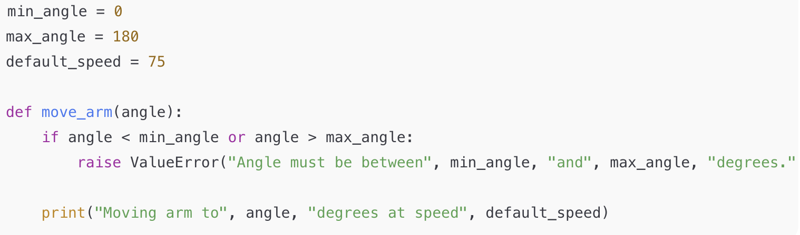
2.Constants and magic numbers
All constants must be defined as variables.
Your code should not contain ‘magic numbers’
✅
Code is more readable
Only need to edited in one, easy to find, place if constant values needs modifying

Slide 12
3.Functions
Must have a descriptive name
Must use lower case with underscores to separate words
Should include a docstring.
  Short functions – can be a single line comment explaining what the function does
  Longer functions – should be a multi-line comment, defining inputs, outputs, what the function does, and how it does it.

Slide 13
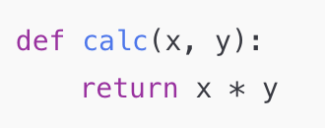
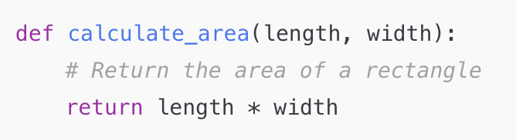
3.Functions
❌
✅
Name isn’t descriptive.
No comment or docstring.
Hard to tell what the function does.
Descriptive, lowercase name with underscores.
Short, clear comment explains what it does.
Concise and readable.

Slide 14
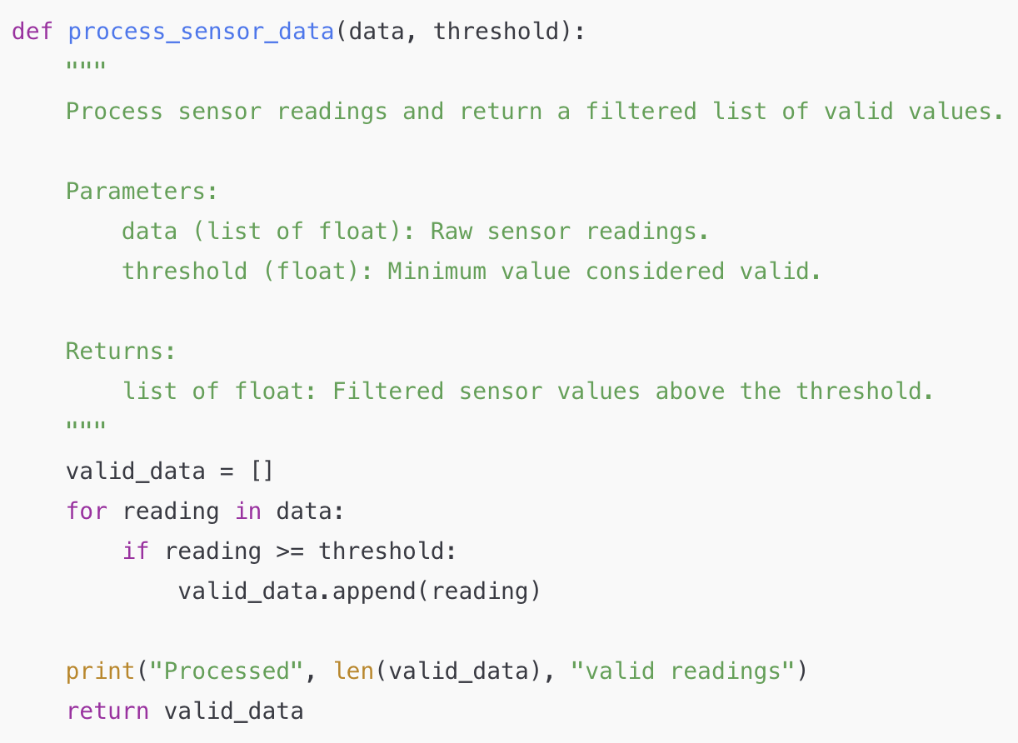
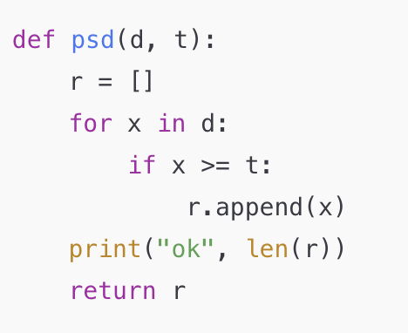
✅
❌
Function name is not descriptive.
Variable names (d, t, r, x) are not descriptive.
No docstring or comment explaining purpose, inputs, or outputs.
Print statement gives no meaningful context.
Code works, but isn’t readable or maintainable.
Function and variable names are descriptive.
Variable names (d, t, r, x) are not descriptive.
Docstring explains purpose, inputs, outputs.
Print statement gives context.

Slide 15
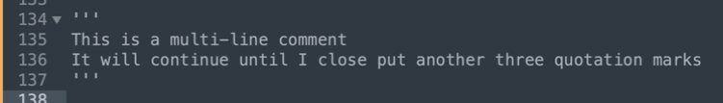
4.Comments
Comments should be used throughout your code to support readability.
Any line of code that starts with a # will be ignored by the Python interpreter
To create a multi-line comment, use three quotation marks (‘‘‘)instead.
If the variable / function naming makes it clear what is going on, then we don’t need a comment.
You can also use comments to temporarily remove ("comment out") sections of code that you don’t want to delete- this can be really helpful for debugging.

Slide 16
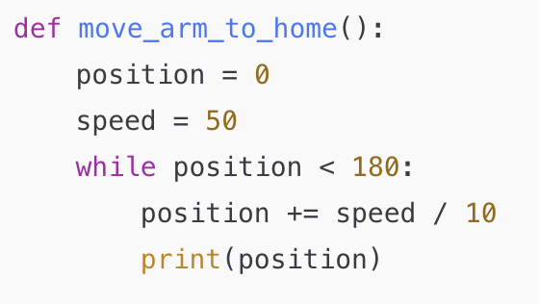
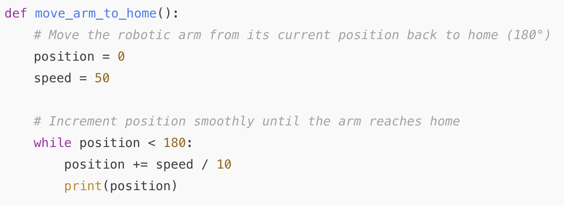
4.Comments
❌
Hard to tell what the function does.
✅
Comments explain why and what, not how.
Leaves simple, self-explanatory lines uncommented.
Improves readability without redundancy.
Write comments to explain your code to a “future you”

Slide 17
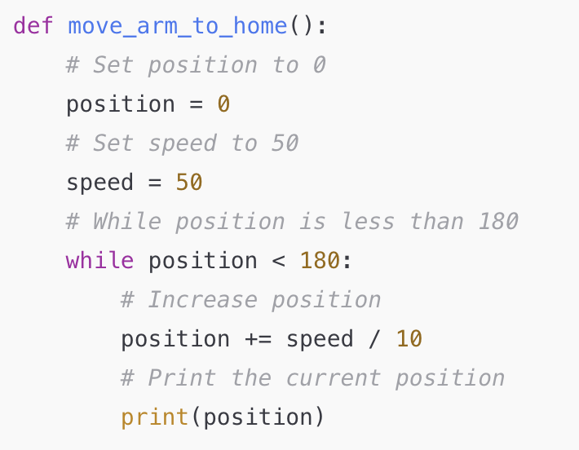
4.Comments
Every line is commented, even when the code is self-explanatory.
Harder to read, not easier.
❌
We will sometimes use 'too many' comments in our code examples to help with teaching

Slide 18
.py file structure
Your code should adhere to the expected structure for a python file:
  Imports
  Constant definitions
  Function definitions
  Main function

Slide 19
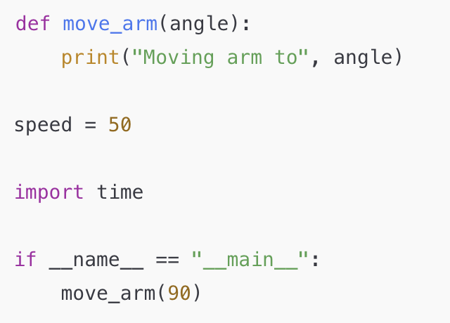
.py file structure
❌
  Imports​
  Constant definitions​
  Function definitions​
  Main function
The structure isn’t predictable or maintainable.

Slide 20
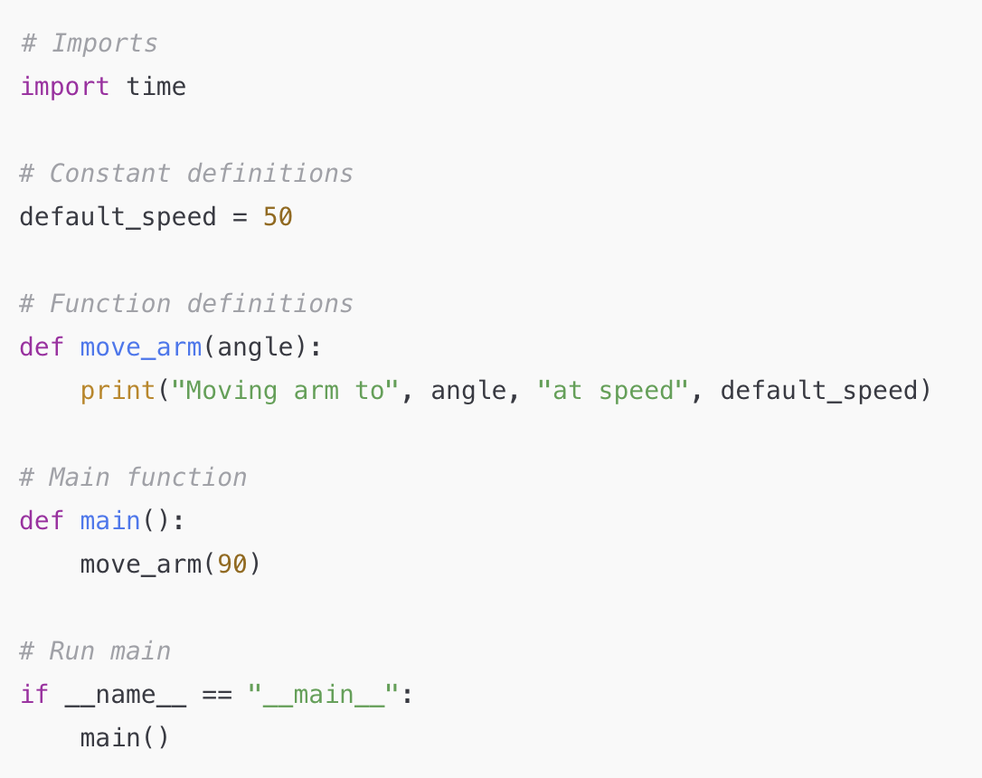
.py file structure
✅
  Imports​
  Constant definitions​
  Function definitions​
  Main function
Follows the standard, expected order.
Easy for anyone to navigate the file.
Keeps constants and logic organized.

Slide 21
Summary - The CPA style guide
Variables should be lower case with underscores (_) to separate words. (this_is_an_example).
Variable names should be meaningful and readable.
Code should use comments to help with readability.
Functions should be lower case with underscores (_) to separate words.
Functions should contain docstrings.
Classes should be use capitalized words (i.e RobotClass).

Slide 22
Discussion activity
Discuss the code examples in your tables:
Are function and variable names descriptive and meaningful?
Are comments sparse/helpful/redundant?
Are docstrings used to explain functions?
Is the file structure following the recommended order?
How could you improve readability?
How might you structure or comment it better?

Slide 23
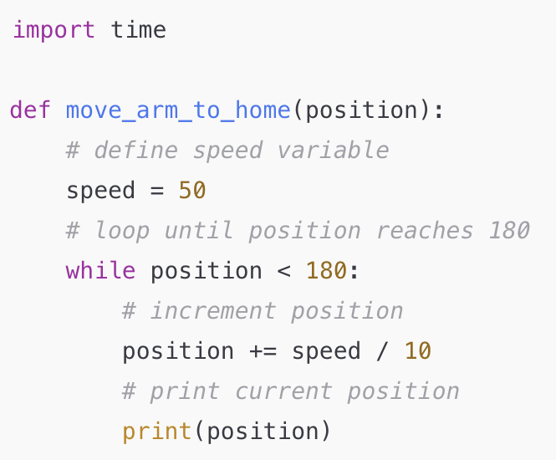
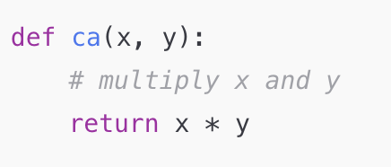
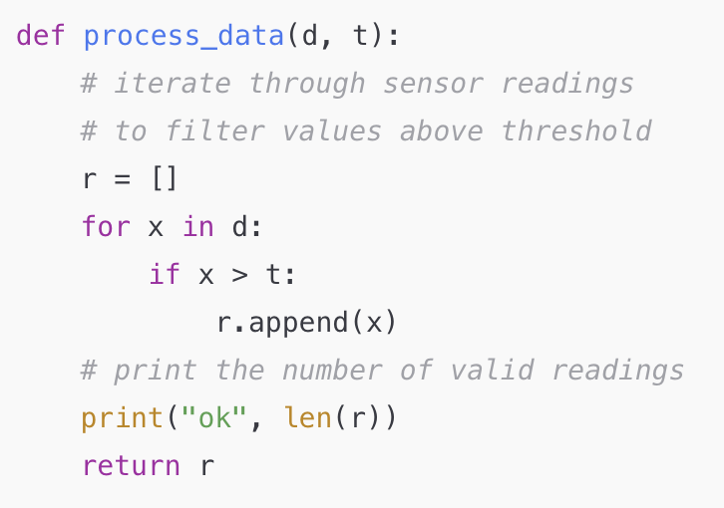
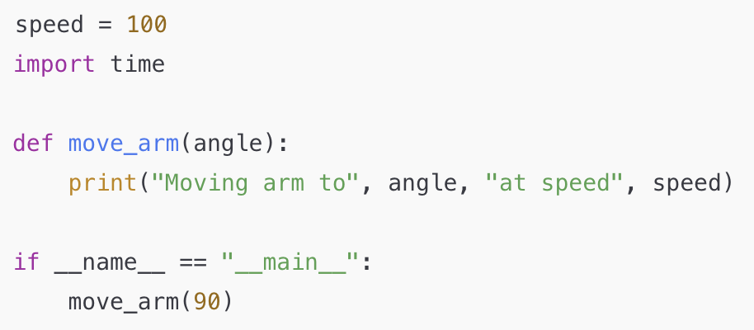
Are function and variable names descriptive and meaningful?
Are comments sparse/helpful/redundant?
Are docstrings used to explain functions?
Is the file structure following the recommended order?
How could you improve readability?
How might you structure or comment it better?
3
1
4
2

