Slide 1
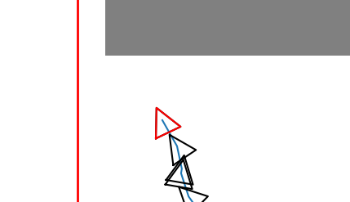










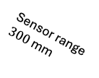









$0$radians
$+\frac{π}{4}$ radians
$−\frac{π}{4}$ radians
Sensor range
$300$mm
$$P_{2}$$
$$Q_{1}$$
$$Q_{2}$$
$$Q_{1}$$
$$Q_{2}$$
$$P_{2}$$
$$Q_{2}$$
$$P_{1}$$
$$Q_{2}$$
$$P_{1}$$
intersecting
not intersecting
B
$$P_{2}$$
B
C
$$Q_{1}$$
C
$$Q_{1}$$
$$P_{2}$$
C
B
$$P_{1}$$
A
A
A
$$P_{1}$$
overlapping
not overlapping
clockwise
counter-clockwise
colinear

Slide 2
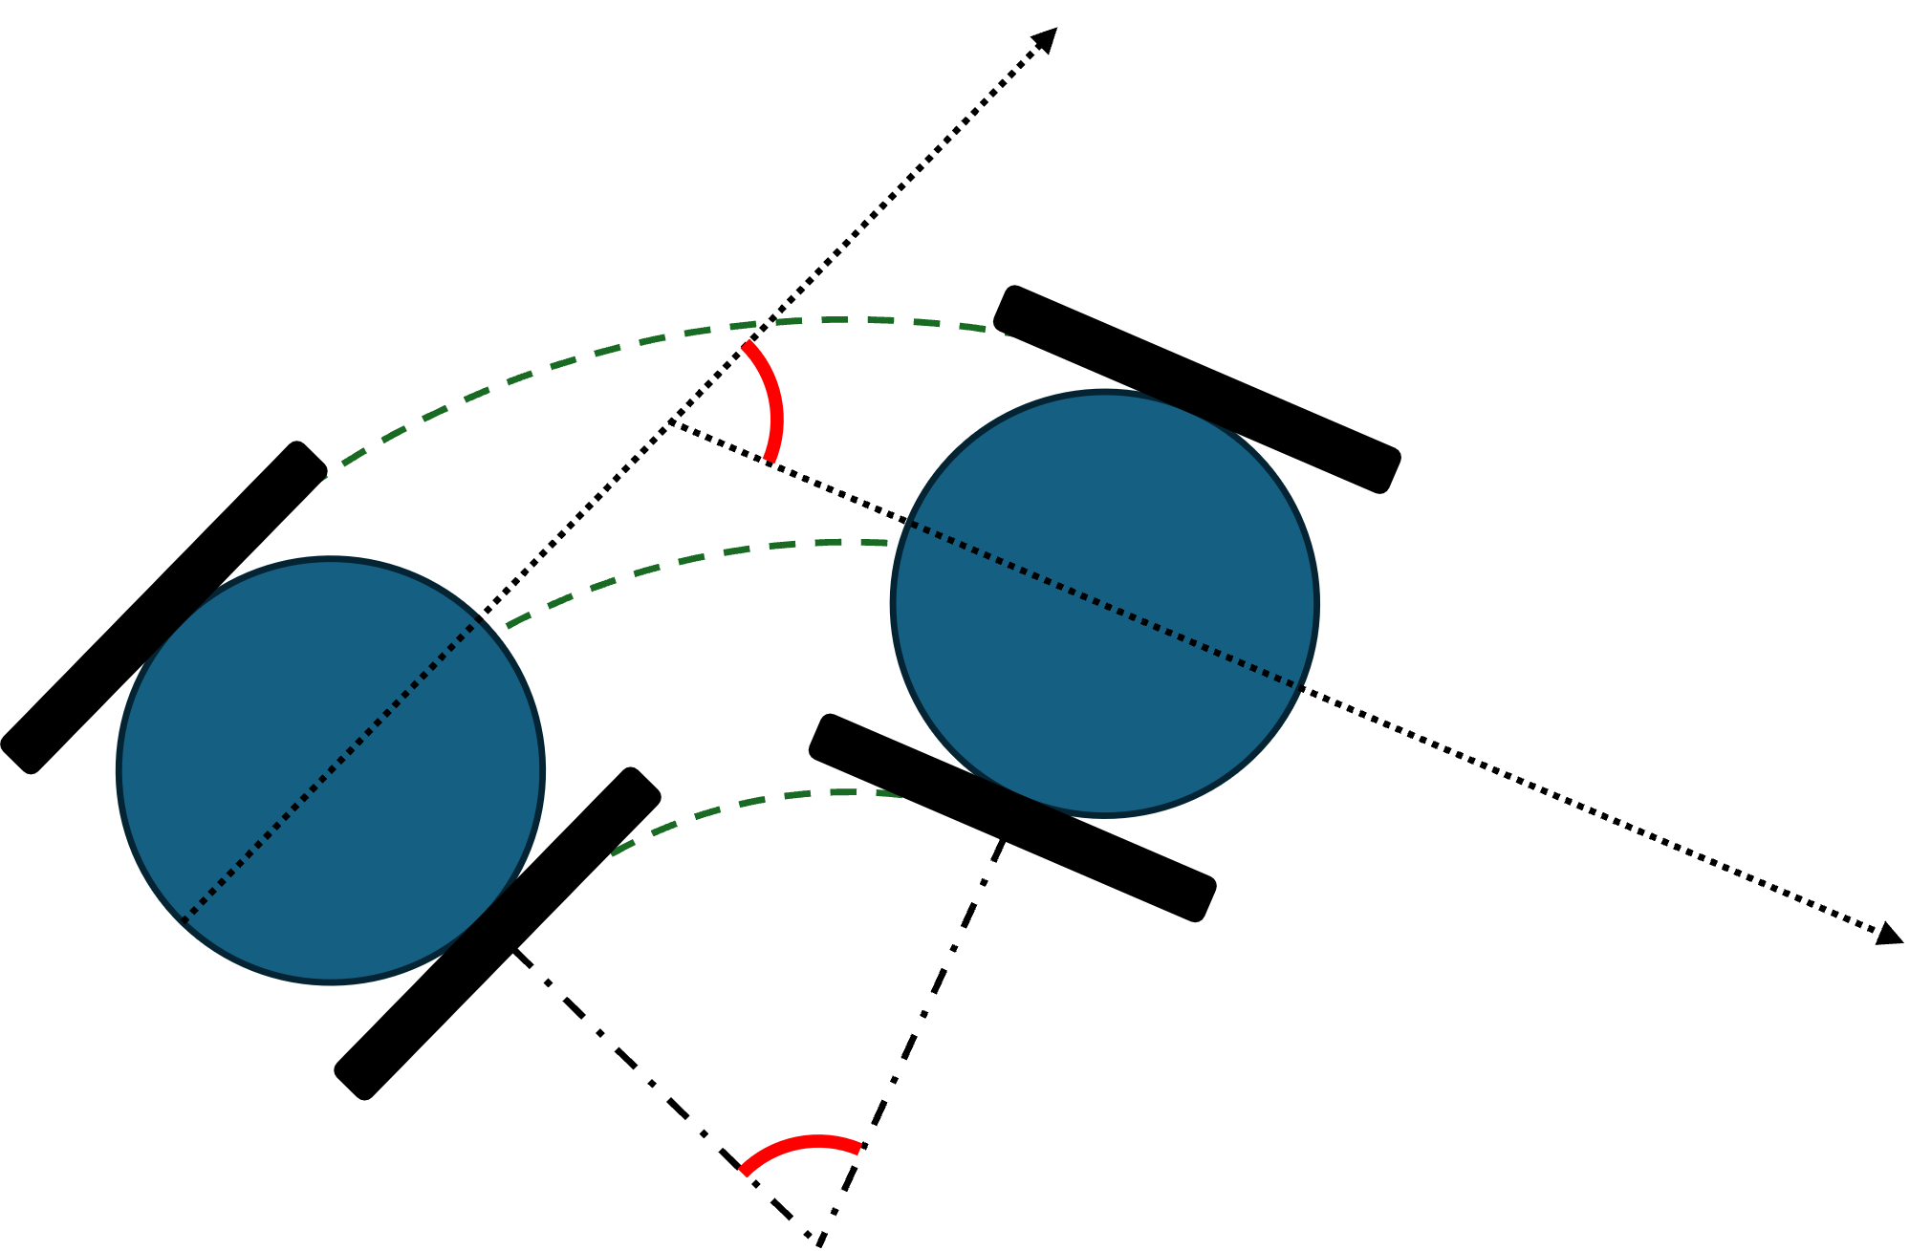
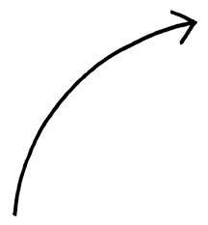


$$v_{wheel}$$
r
$$ω$$

Slide 3
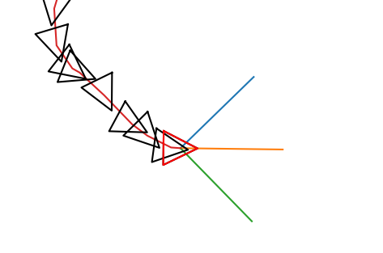
Sensor 1
Sensor 2
Sensor 3

Slide 4
0 | 1 | 2 | 3
Rosie | Marvin | Robby | Eve

