Slide 1
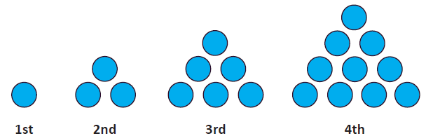
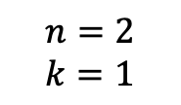
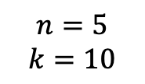
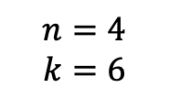
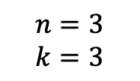
$$n=2$$
$$k=1$$
$$n=3$$
$$k=3$$
$$n=4$$
$$k=6$$
$$n=5$$
$$k=10$$

Slide 2
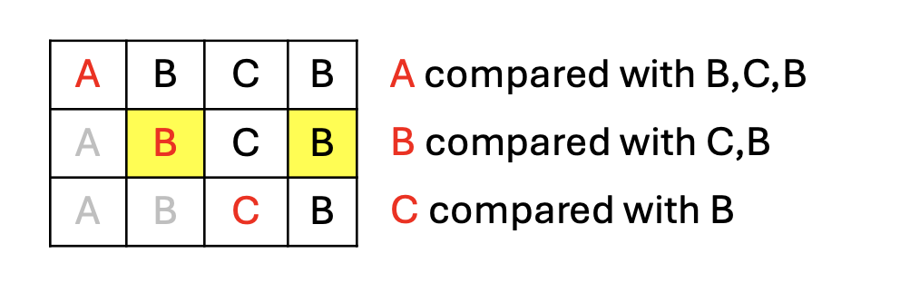
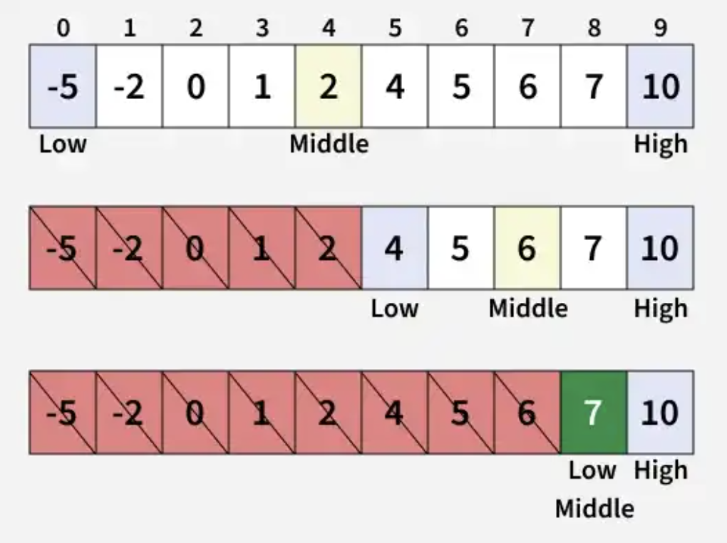
 | A | B | C | B
A
B
C
B
A | B | C | B
A | B | C | B
A | B | C | B
A compared with B,C,B
B compared with C,B
C compared with B

