Slide 1
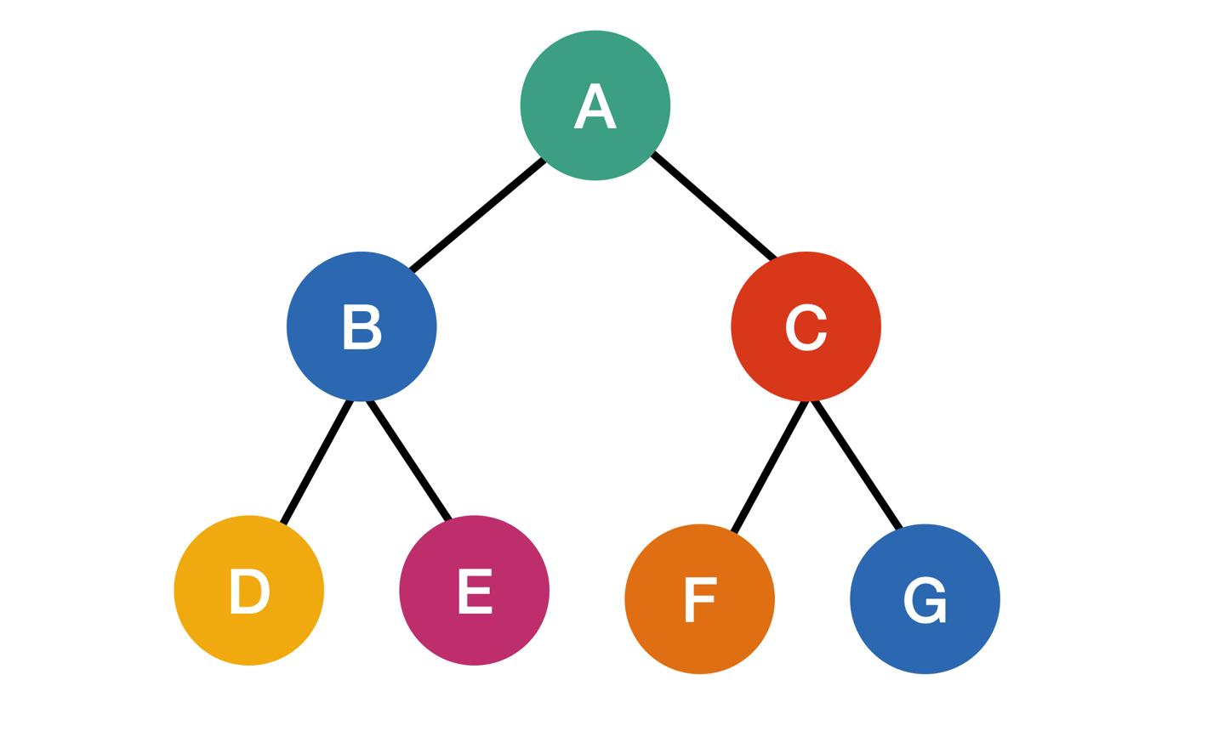

Slide 2
A
A
2.4
1.2
E
E
0.4
1.6
2.1
D
D
B
B
0.5
3.5
1.8
C
C

Slide 3
Glenby
5
27
35
Alden
20
Alden
20
12
8
Brinford
12
8
Brinford
15
15
10
10
Dunvor
Dunvor
Fenwick
Fenwick
6
6
24
32
24
32
41
Caster
41
Caster
5
5
Elwick
Elwick

Slide 4
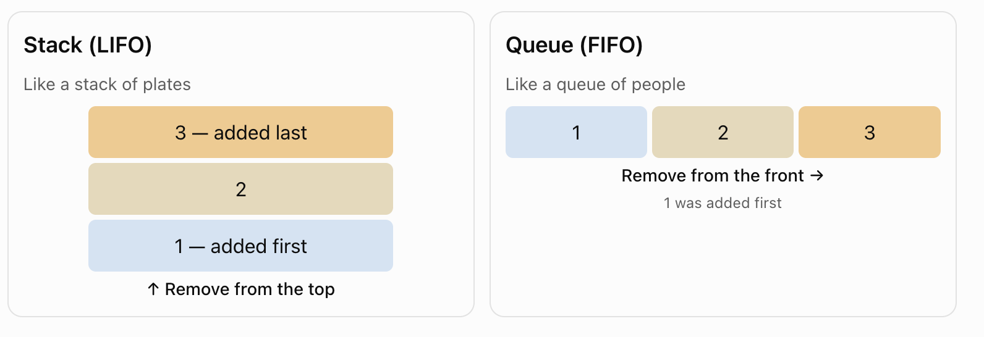

Slide 5
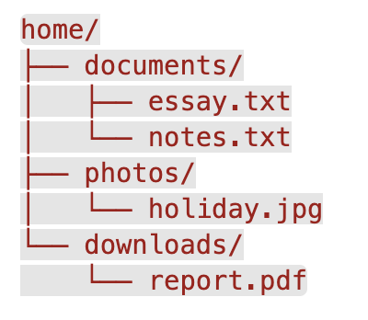
home
documents
photos
downloads
notes.txt
essay.txt
holiday.jpg
report.pdf

Slide 6
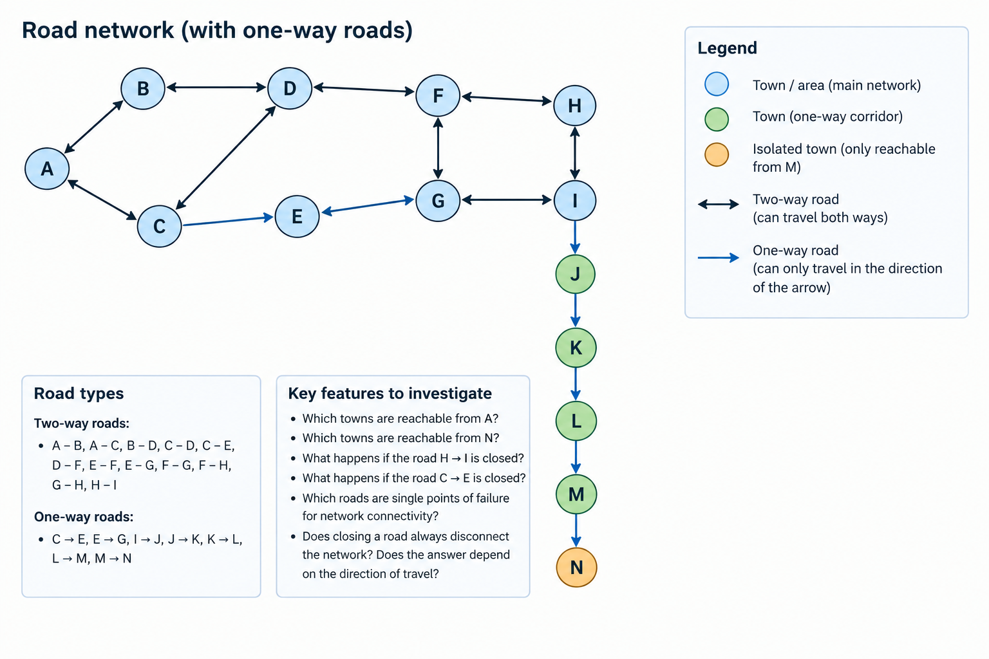

Slide 7
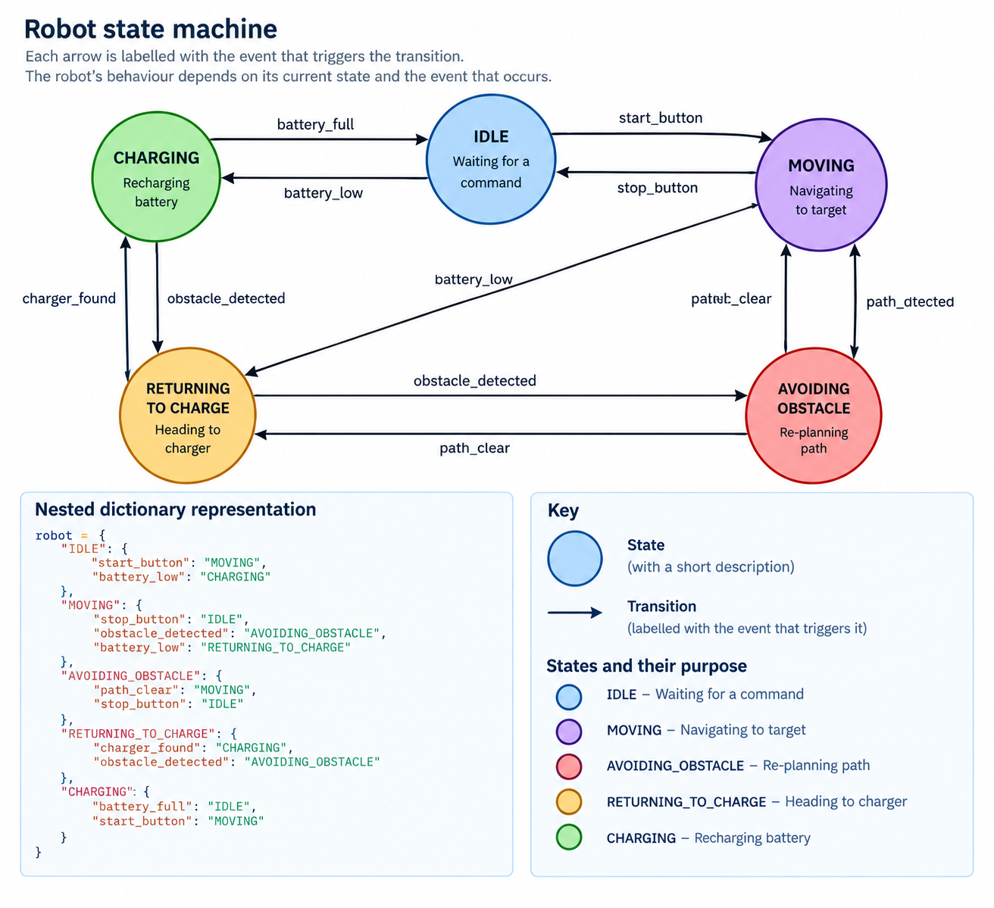

Slide 8
Charging
Idle
Moving
Returning
to
charge
Avoid
obstacles

