Slide 1
Algorithms and how a computer executes them
Computer programming and algorithms 26/27
Seminar 1

Slide 2
What do you already know?
What do we mean by the word algorithm?
What do we mean by the word computer program?
Are these the same thing? Are they different? (if so, how?).
Please discuss these questions with the people on your table (~ 5 minutes) and then summarise your answer on Menti with code: 4154 2054
Notes:
~ 5 mins

Slide 3
Today’s learning objectives
Understand what we mean by the word algorithm.
Begin to develop a mental model of how a computer can execute an algorithm.

Slide 4
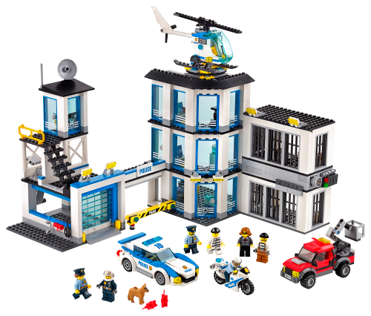
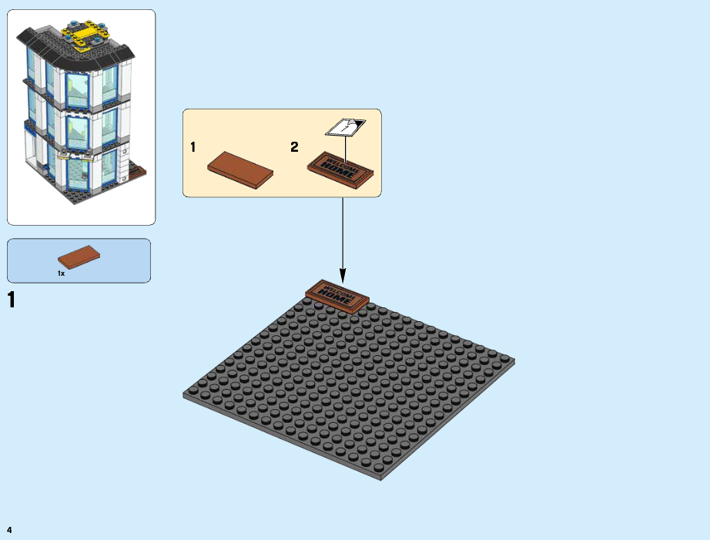
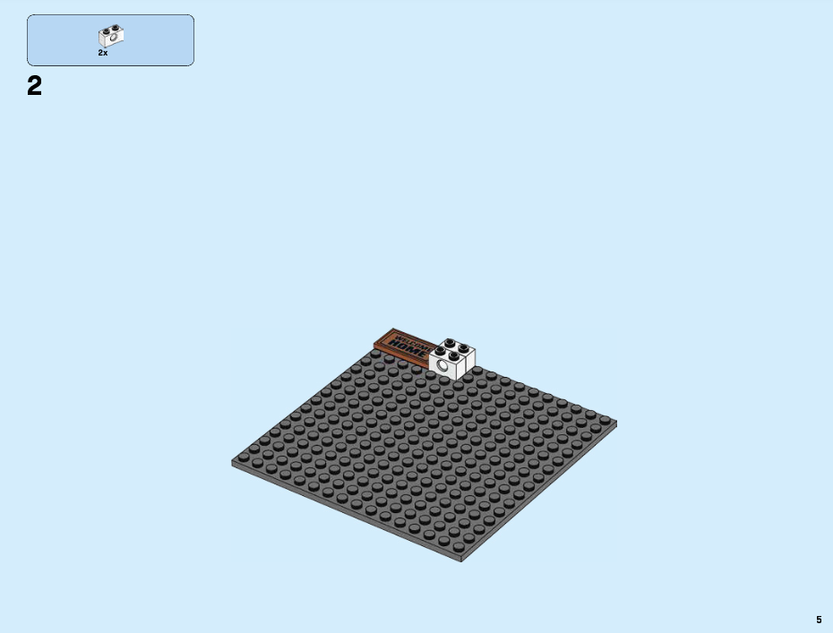
Algorithms
An algorithm is a set of instructions that can be followed to complete a task.
For example, to make a Lego model, we follow instructions.

Slide 5
Algorithms
An algorithm is a set of instructions that can be followed to complete a task.
For example, to make a Lego model, we follow instructions.
Notes:
Key point: Students are used to encountering algorithms in their daily lives- not exotic or incomprehensible, but in fact mundane and ordinary.

Slide 6
Designing algorithms
In this course, we won’t just be following algorithms, but also designing them.
Typically, this means breaking a larger job down into a sequence of smaller steps.
  We may do this iteratively- e.g we may need to break some of our “smaller steps” into separate tasks.
  Often we will make use of decisions (using some criteria to decide which instruction should be done next or whether we should continue / stop) and iteration (repeating an instruction some number of times).

Slide 7
Designing algorithms
Example: An algorithm for making a cup of tea.

Slide 8
Designing algorithms
Example: An algorithm for making a cup of tea.
Fill kettle with water
Turn on kettle
Put teabag in cup
Add milk
If kettle has boiled then pour water into cup.
Wait for tea to steep
Remove teabag

Slide 9
Designing algorithms
Example: An algorithm for making a cup of tea.
Has kettle boiled?
Fill kettle with water
Turn on kettle
Put teabag in cup
No
Wait 30 seconds
Make tea
Yes
Has tea steeped?
Tea is made
Add milk
Remove teabag
Yes
Pour water into cup
No
Wait 10 seconds

Slide 10
Designing algorithms
Example: An algorithm for making a cup of tea.
Has kettle boiled?
Fill kettle with water
Turn on kettle
Put teabag in cup
No
Wait 30 seconds
Make tea
Yes
Has tea steeped?
Remove milk from fridge
Open fridge
Remove teabag
Yes
Pour water into cup
Pour milk into cup
Put milk back into fridge
No
Tea is made
Wait 10 seconds

Slide 11
Designing algorithms
Example: An algorithm for making a cup of tea.
Boil kettle
Put teabag in cup
Pour water into cup
Add milk
Make tea
Tea is made

Slide 12
Designing algorithms
In this course, we won’t just be following algorithms, but also designing them.
Typically, this means breaking a larger job down into a sequence of smaller steps.
  We may do this iteratively- e.g we may need to break some of our “smaller steps” into separate tasks.
  Often we will make use of decisions (using some criteria to decide which instruction should be done next) and iteration (repeating an instruction some number of times).
Q: When do we stop breaking things down into smaller steps?

Slide 13
Designing algorithms
In groups, discuss (~5 minutes) and develop an algorithm for the following task:
I have an unsorted list of numbers: [0, 4, 5, 1, 8, 7, -1]. You are only allowed to look at one number at a time. How can I find the highest and lowest numbers in my list?
Share a summary of your algorithm on Menti, code: 4154 2054
Notes:
~ 25 mins to get to this point

Slide 14
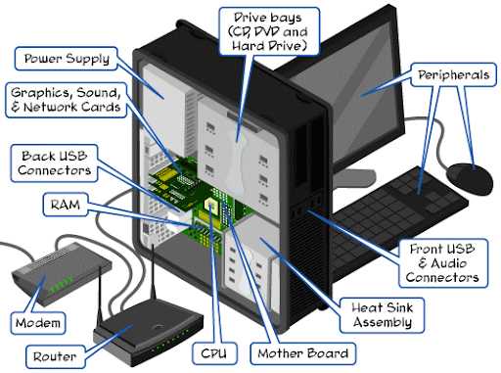
How a computer executes algorithms
A computer consists of a number of separate electronic devices that together can perform a vast number of algorithms.

Slide 15
How a computer executes algorithms
A computer consists of a number of separate electronic devices that together can perform a vast number of algorithms.
Memory (RAM)
Central Processing Unit
Input Devices
Output Devices
Storage
(Hard Drive)

Slide 16
How a computer executes algorithms
A computer consists of several separate electronic devices that together can perform a vast number of algorithms.
  Input (i.e mouse / keyboard / touchscreen) and output (monitor)
  Memory for storing data
  A central processing unit “CPU” can electronically perform a limited number of operations.
Memory (RAM)
Central Processing Unit
Input Devices
Output Devices
Storage
(Hard Drive)

Slide 17
How a computer executes algorithms
Memory is used to store information. We can think (for now) of memory as a large number of boxes that can be used to store data. Each piece of data stored in memory has:
  A name
  A value
  A data type (integer, string, Boolean, etc).

Slide 18
How a computer executes algorithms
Memory is used to store information. We can think (for now) of memory as a large number of boxes that can be used to store data. Each piece of data stored in memory has:
  A name
  A value
  A data type (integer, string, Boolean, etc).
Memory
Name: a
Value: 3
Type: Integer

Slide 19
How a computer executes algorithms
Memory is used to store information. We can think (for now) of memory as a large number of boxes that can be used to store data. Each piece of data stored in memory has:
  A name
  A value
  A data type (integer, string, Boolean, etc).
Memory
Name: a
Value: 3
Type: Integer
Name: b
Value: 2
Type: Integer

Slide 20
How a computer executes algorithms
A computer consists of a number of separate electronic devices that together can perform a vast number of algorithms.
Memory (RAM)
Central Processing Unit
Input Devices
Output Devices
Storage
(Hard Drive)

Slide 21
How a computer executes algorithms
A CPU can electronically perform a limited number of instructions.

Slide 22
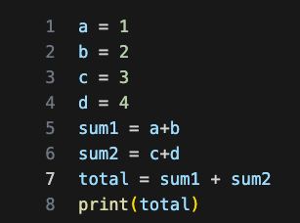
How a computer executes algorithms
A CPU can electronically perform a limited number of instructions. These are:
  Read / write data from memory.
  Basic arithmetic operations (add, subtract, multiply, divide).
  Comparisons (i.e is value 1 greater than value 2).
  Handle input / output.

Slide 23
How a computer executes algorithms
A CPU can electronically perform a limited number of instructions. These are:
  Read / write data from memory.
  Basic arithmetic operations (add, subtract, multiply, divide).
  Comparisons (i.e is value 1 greater than value 2).
  Handle input / output.
A computer program is a list of these instructions. The CPU will execute each instruction in the list sequentially, using a special program counter variable to keep track of which line should be executed next.

Slide 24
How a computer executes algorithms
A CPU can execute a limited number of instructions. These are:
  Read / write data from memory.
  Basic arithmetic operations (add, subtract, multiply, divide).
  Comparisons (i.e is value 1 greater than value 2).
  Handle input / output.
Program
Memory
Program Counter: 1

Slide 25
How a computer executes algorithms
A CPU can execute a limited number of instructions. These are:
  Read / write data from memory.
  Basic arithmetic operations (add, subtract, multiply, divide).
  Comparisons (i.e is value 1 greater than value 2).
  Handle input / output.
Program
Memory
Program Counter: 2
a: 1

Slide 26
How a computer executes algorithms
A CPU can execute a limited number of instructions. These are:
  Read / write data from memory.
  Basic arithmetic operations (add, subtract, multiply, divide).
  Comparisons (i.e is value 1 greater than value 2).
  Handle input / output.
Program
Memory
Program Counter: 3
a: 1
b: 2

Slide 27
How a computer executes algorithms
A CPU can execute a limited number of instructions. These are:
  Read / write data from memory.
  Basic arithmetic operations (add, subtract, multiply, divide).
  Comparisons (i.e is value 1 greater than value 2).
  Handle input / output.
Program
Memory
Program Counter: 8
d: 4
a: 1
sum1: 3
b: 2
sum2: 7
c: 3
total: 10

Slide 28
How a computer executes algorithms
A CPU can execute a limited number of instructions. These are:
  Read / write data from memory.
  Basic arithmetic operations (add, subtract, multiply, divide).
  Comparisons (i.e is value 1 greater than value 2).
  Handle input / output.
A computer program is a list of these instructions. The CPU will execute each instruction in the list sequentially, using a special program counter variable to keep track of which instruction should be executed next.
The program counter can be written to like any other piece of memory- this allows us to perform selection and iteration.

Slide 29
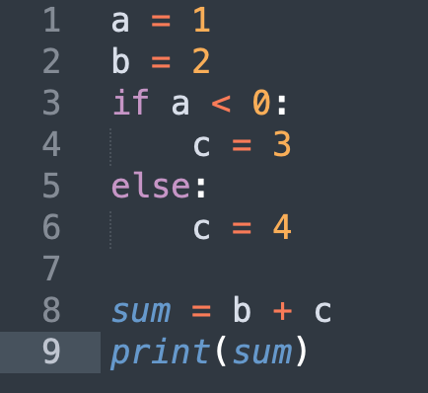
How a computer executes algorithms
The program counter can be written to like any other piece of memory- this allows us to perform selection and iteration.
Program
Memory
Program Counter: 3
a: 1
b: 2

Slide 30
How a computer executes algorithms
The program counter can be written to like any other piece of memory- this allows us to perform selection and iteration.
Program
Memory
Program Counter: 6
a: 1
b: 2

Slide 31
How a computer executes algorithms
The program counter can be written to like any other piece of memory- this allows us to perform selection and iteration.
Program
Memory
Program Counter: 7
a: 1
b: 2
c: 4

Slide 32
How a computer executes algorithms
The program counter can be written to like any other piece of memory- this allows us to perform selection and iteration.
Program
Memory
Program Counter: 9
sum: 6
a: 1
b: 2
c: 4

Slide 33
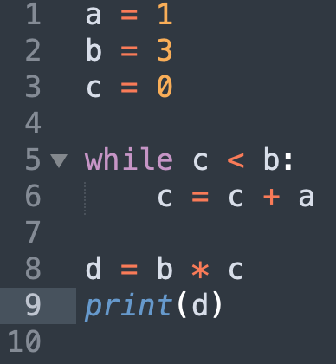
How a computer executes algorithms
Exercise: What will be stored in memory after the following piece of code executes? Don’t forget the program counter!
Program
Memory

Slide 34
How a computer executes algorithms
A CPU can execute a limited number of instructions. These are:
  Read / write data from memory.
  Basic arithmetic operations (add, subtract, multiply divide).
  Comparisons (i.e is value 1 greater than value 2).
  Handle input / output.
One line of Python code may require multiple instructions to be carried out.
Q: How many ‘instructions’ are executed in this piece of code?
Program
Memory
Program Counter: 8
d: 4
a: 1
sum1: 3
b: 2
sum2: 7
c: 3
total: 10

Slide 35
How to write computer algorithms
To write a computer algorithm we should:
Understand the task we are trying to perform
Break the task down into smaller steps, until each step is something that can be performed by a computer.
Write some computer code that encodes this set of instructions in a format the CPU can understand.

Slide 36
How to write computer algorithms
To write a computer algorithm we should:
Understand the task we are trying to perform
Break the task down into smaller steps, until each step is something that can be performed by a computer.
Write some computer code that encodes this set of instructions in a format the CPU can understand.
To do this, we must write our code in a particular programming language. In this course, we use Python. Early programmers had no choice but to use machine code, which uses binary to specify both data and the instruction to perform.

Slide 37
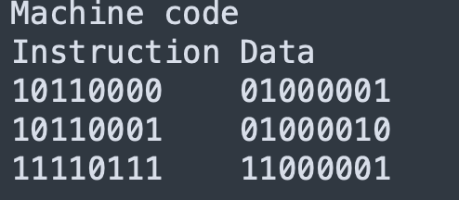
How to write computer algorithms
To do this, we must write our code in a particular programming language. In this course, we use Python. Early programmers had no choice but to use machine code, which uses binary to specify both data and the instruction to perform.

Slide 38
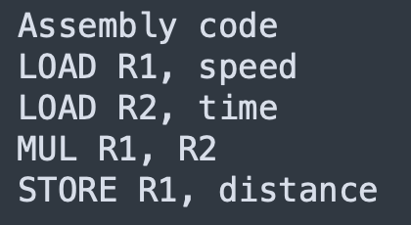
How to write computer algorithms
To do this, we must write our code in a particular programming language. In this course, we use Python. Early programmers had no choice but to use machine code, which uses binary to specify both data and the instruction to perform.
This was very tedious, and so people developed assembly language (and tools for translating assembly into machine code).

Slide 39
How to write computer algorithms
To do this, we must write our code in a particular programming language. In this course, we use Python. Early programmers had no choice but to use machine code, which uses binary to specify both data and the instruction to perform.
This was very tedious, and so people developed assembly language (and tools for translating assembly into machine code).
Assembly is still tedious to write, so people developed higher-level programming languages like Python that let us write code that looks a bit more like English.

Slide 40
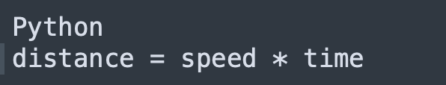
How to write computer algorithms
Assembly is still tedious to write, so people developed higher-level programming languages like Python that let us write code that looks a bit more like English.

Slide 41
How to write computer algorithms
Assembly is still tedious to write, so people developed higher-level programming languages like Python that let us write code that looks a bit more like English.
Although Python looks like English, it is not. Valid Python must follow a specified pattern (syntax), or you’ll get an error. One of your main jobs is to understand the semantics of Python syntax i.e how will a line of Python code change the state (i.e memory) of the computer?

Slide 42
How to write computer algorithms
Although Python looks like English, it is not. Valid Python must follow a specified pattern (syntax), or you’ll get an error. One of your main jobs is to understand the semantics of Python syntax i.e how will a line (or series of lines) of Python code change the state (i.e memory) of the computer?
Program
Memory
Program Counter: 8
d: 4
a: 1
sum1: 3
b: 2
sum2: 7
c: 3
total: 10

