Slide 1


Monitor Temperature and Analytics using Salesforce
Submitted By:
Munish Goyal
11702024
B.tech Ece Final Year

Slide 2
Overview
It is an IoT-based project.
Measuring temperature and humidity.
Sending measured data to the Salesforce cloud server.
Analysis of data
Sending reports of data to the user as an email.
Also, sending email alerts if critical temperature

Slide 3
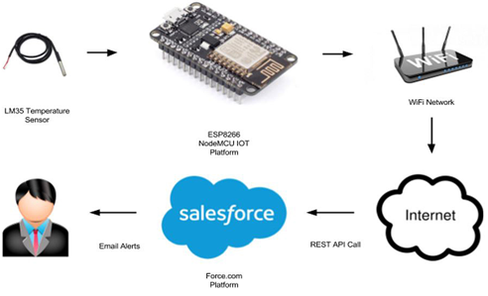
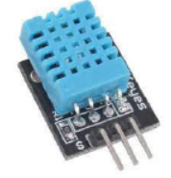
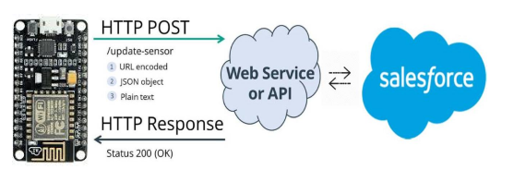
Functionality of Project

Slide 4
What is Salesforce?
Salesforce is cloud-based software i.e. Software as a Service that helps organizations to effectively streamline their sales and marketing operations.
SaaS means no need to install the software or server to work on. Users can simply sign-up in Salesforce.com and can start running the business instantly.
Salesforce provides feature-rich solutions for marketing, sales, services, partner management and community management.
It supports multi-tenancy i.e. one common application for multiple groups or clients

Slide 5
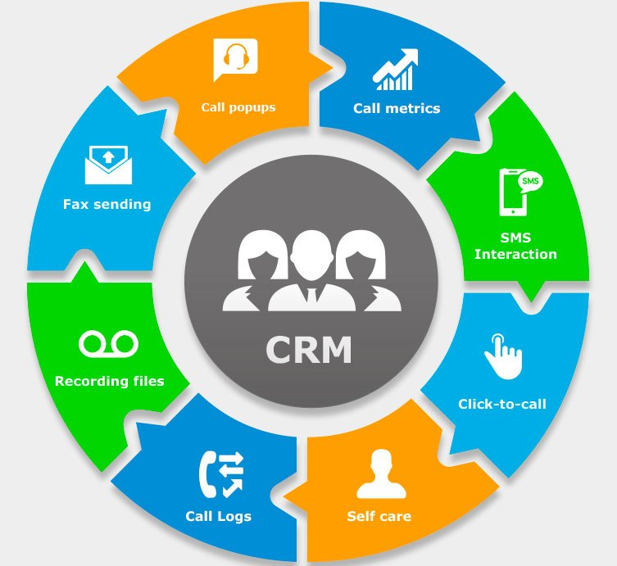
CRM(Customer Relationship Management)
It is a software to manage all the customer and company's interactions.
It contains and manages all the customer-related information.
The software keeps all the interactions done with customers.
It also allows us to track and manage the sales, marketing, and prospects given to customers.
Before Salesforce, CRM solutions were hosted on a company’s own server which means more cost and time.

Slide 6
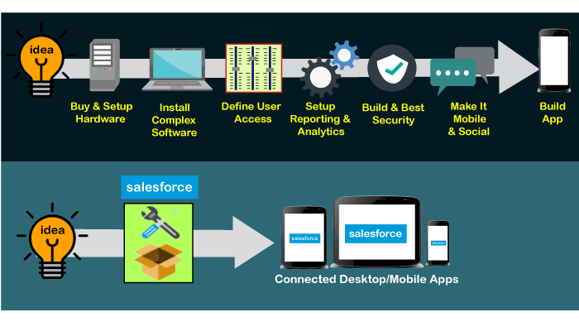
Why Salesforce?
No need to install any software. Just focus on building the apps.
It is Cloud-based CRM platform so any user can access it from anywhere using the internet.
Any business start-up can choose Salesforce for building apps or run business, as it is so affordable with lots of capabilities.
Easy integrations with any third-party applications.
The development cost is also very less.

Slide 7
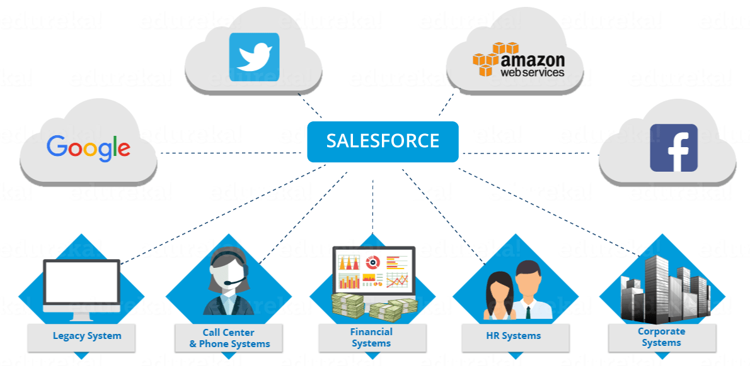
Companies using Salesforce
Today, there are multiple big brands, and new start-ups who are using the Salesforce platform as CRM software and for other services. Below is the list of some popular companies that are using Salesforce for their businesses:
Coco-Cola Enterprise (CCE)
HCL Technologies
Pizza Hut
L'Oréal
American Express
Nikon Instrument
Sony

Slide 8
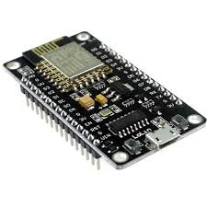
What is an ESP8266?
The ESP8266 is a System on a Chip consisting of a micro controller unit and a Wi-Fi transceiver.
We can program it like any normal Arduino using the Arduino IDE and also with Python Language.
Also, Wi-Fi communication is there so we can connect to the Internet, host a web server with real web pages.
It can also fetch data from internet using API’s.
It is a very user friendly and low cost device to provide internet connectivity to your projects.
The module can work both as a Access point (can create hotspot) and as a station (can connect to Wi-Fi)

Slide 9
Temperature Sensor DHT11
DHT11 is a Humidity and Temperature Sensor, which measure the surrounding air.
DHT11 can be interface with any microcontroller like Arduino, Raspberry Pi, etc.
DHT11 is a low cost sensor with high reliability and long term stability.
The temperature range of DHT11 is from 0 to 50 degree Celsius with a 2-degree accuracy.
Humidity range of this sensor is from 20 to 80% with 5% accuracy.
The sampling rate of this sensor is 1Hz.
DHT11 is small in size with operating voltage from 3 to 5 volts.
The maximum current used while measuring is 2.5mA.

Slide 10
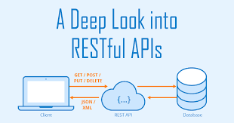
RESTful APIs
An Application Programming Interface(API) is a set of programming code that enables data transmission between one software product and another. It also contains the terms of this data exchange.
API allows two applications to talk to each other.
RESTful APIs are REST Architecture based Web Services.
These make use of HTTP protocols as a medium of communication between client and server.
A client sends a message in form of a HTTP Request and the server responds in the form of an HTTP Response.

Slide 11
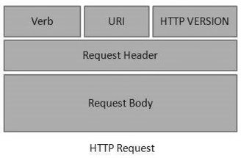
HTTP Request
HTTP is used to structure request and responses for effective communication between a client and a server.
The message that is sent by a client to a server is what is known as an HTTP request.
HTTP requests work as the intermediary transportation method between a client/application and a server.
There are various HTTP request methods like GET, POST, PUT, DELETE.

Slide 12
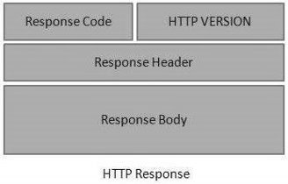
HTTP Response
HTTP Response is the server’s information as a result of the client’s request.
It acts as an acknowledgment that the performance of the requested action is successful.
In case there is an error in carrying out the client’s request, the server responds with an error message.
HTTP responses come as plain text formatted in either JSON or XML format.

Slide 13
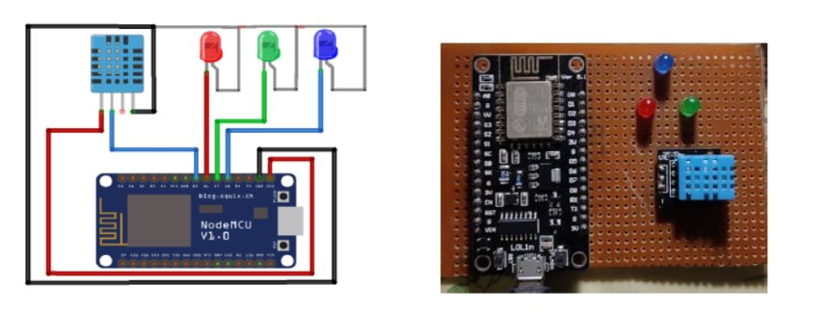
Circuit Diagram

Slide 14
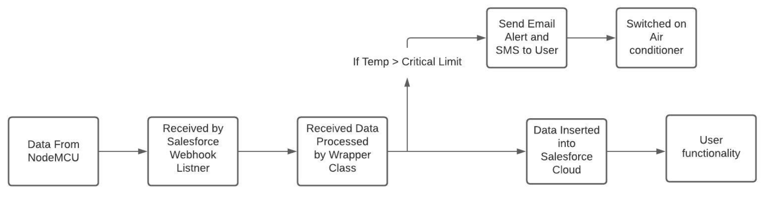
Project Functionality
The Monitor Temperature and Analysis can be divided into three parts:
Sending Data to the Cloud (IoT Platform)
Monitoring and Analysis of Data (Salesforce Cloud Platform)
User Functionality

Slide 15
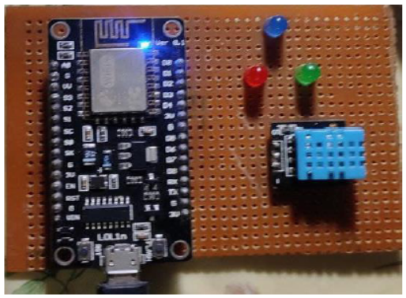
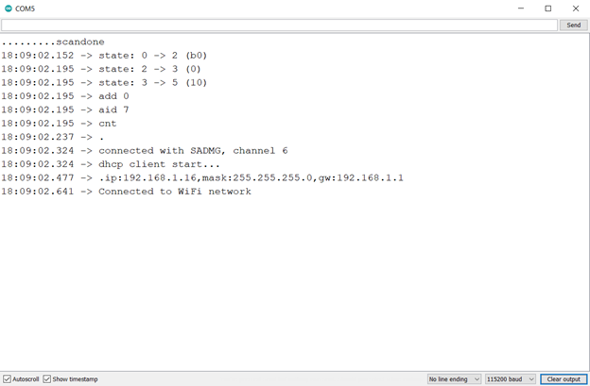
Working
Finding Wi-Fi Connection
Connected to Wi-Fi

Slide 16
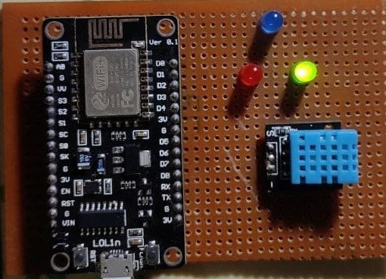
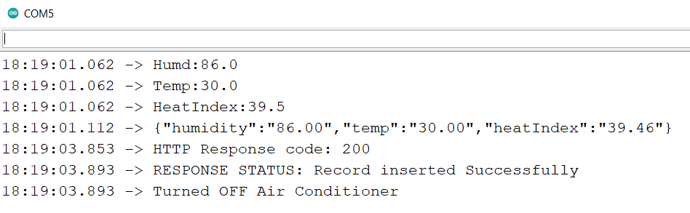
Sending Data to Salesforce
Delay for 5 minutes

Slide 17
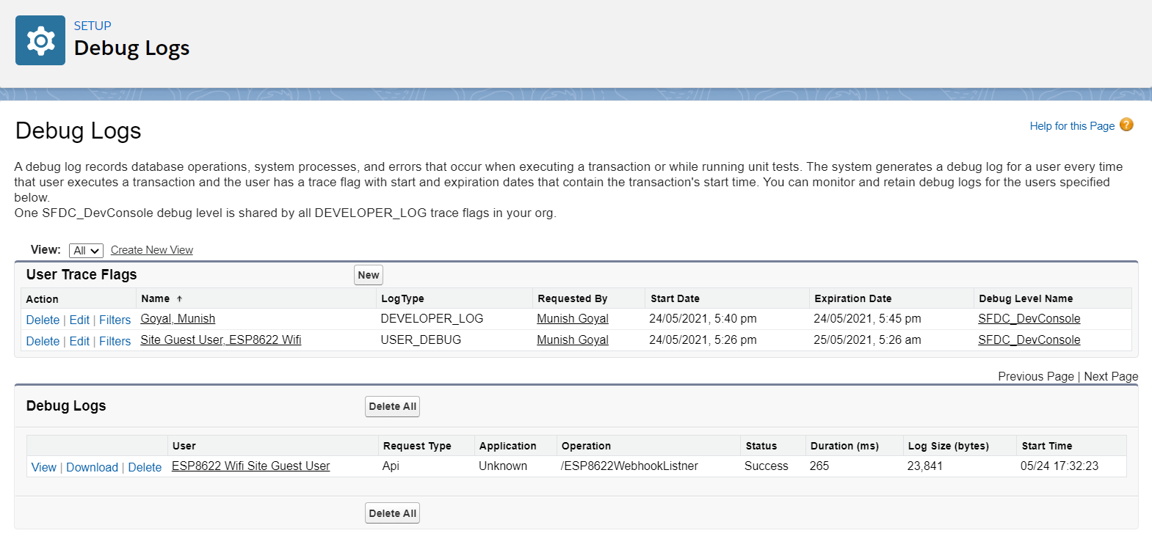
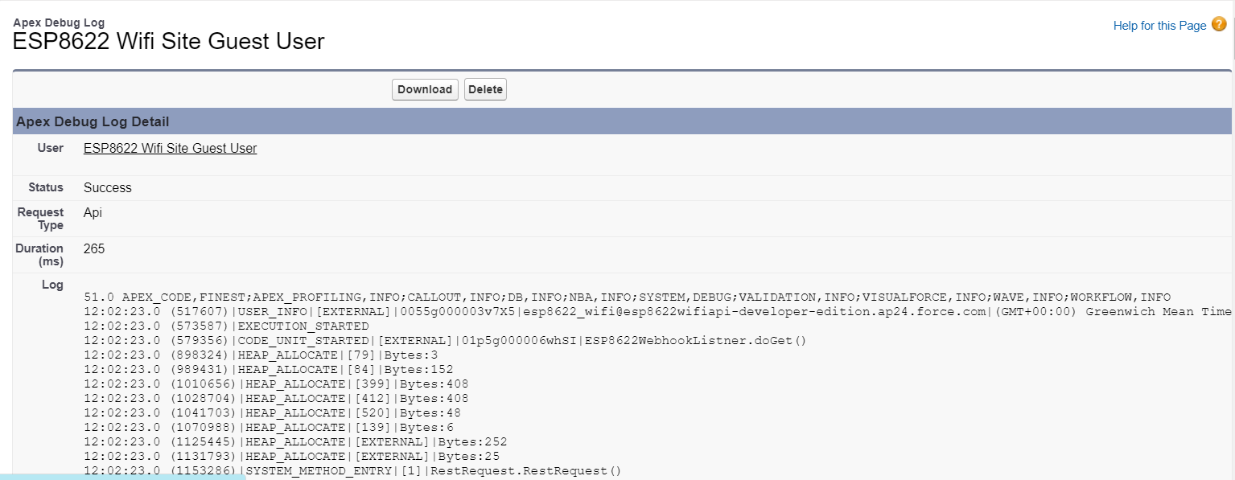
Salesforce Debug Logs

Slide 18
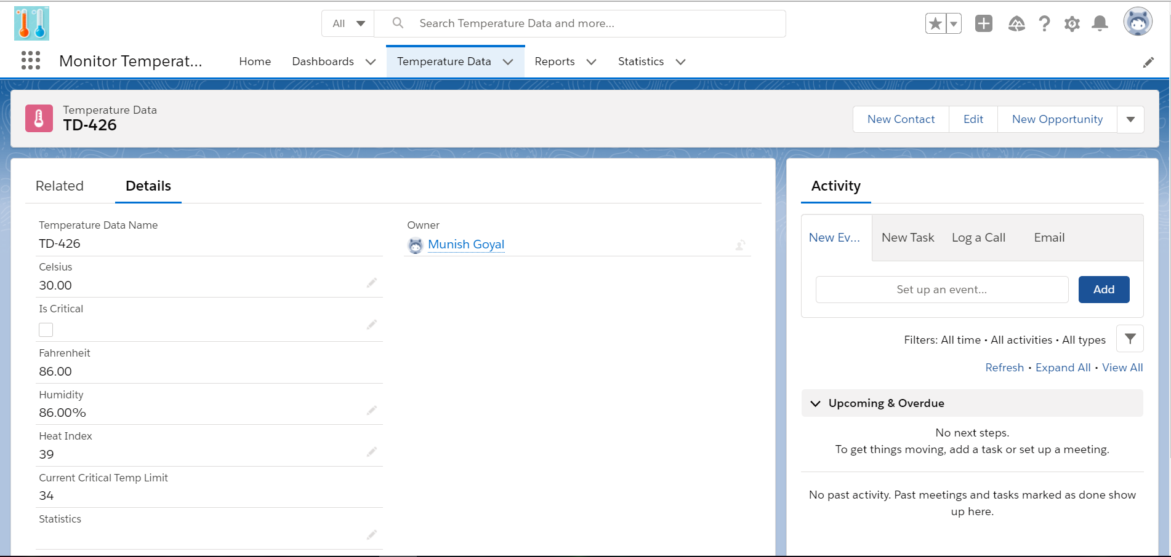
Salesforce Record Inserted

Slide 19
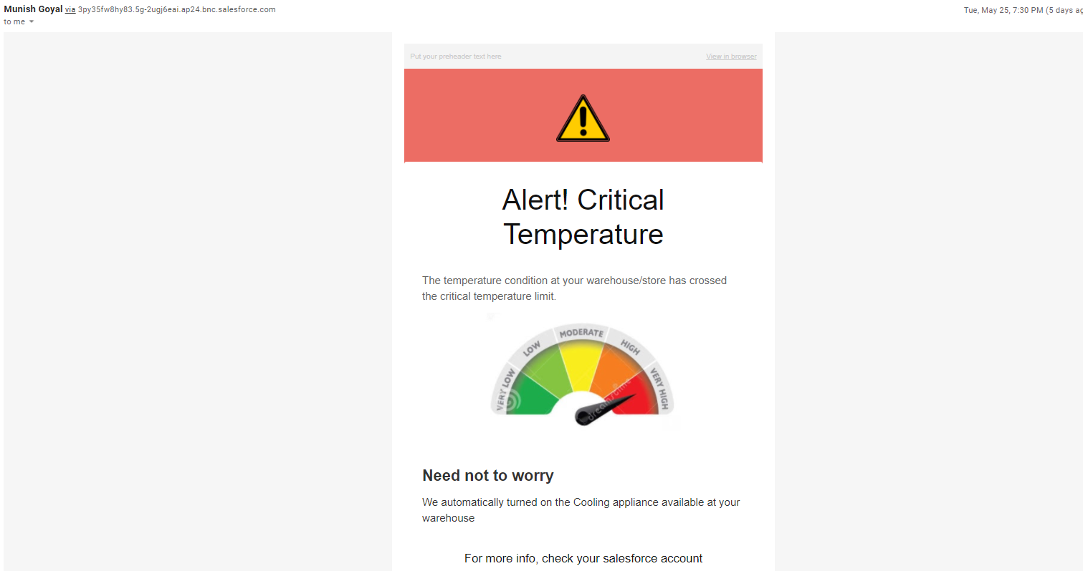
If critical temperature, sent email alert.

Slide 20
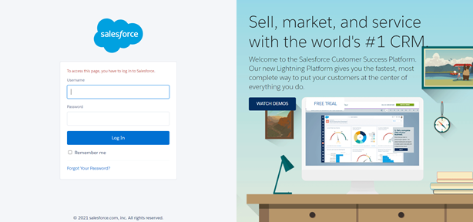
What user can do?

Slide 21
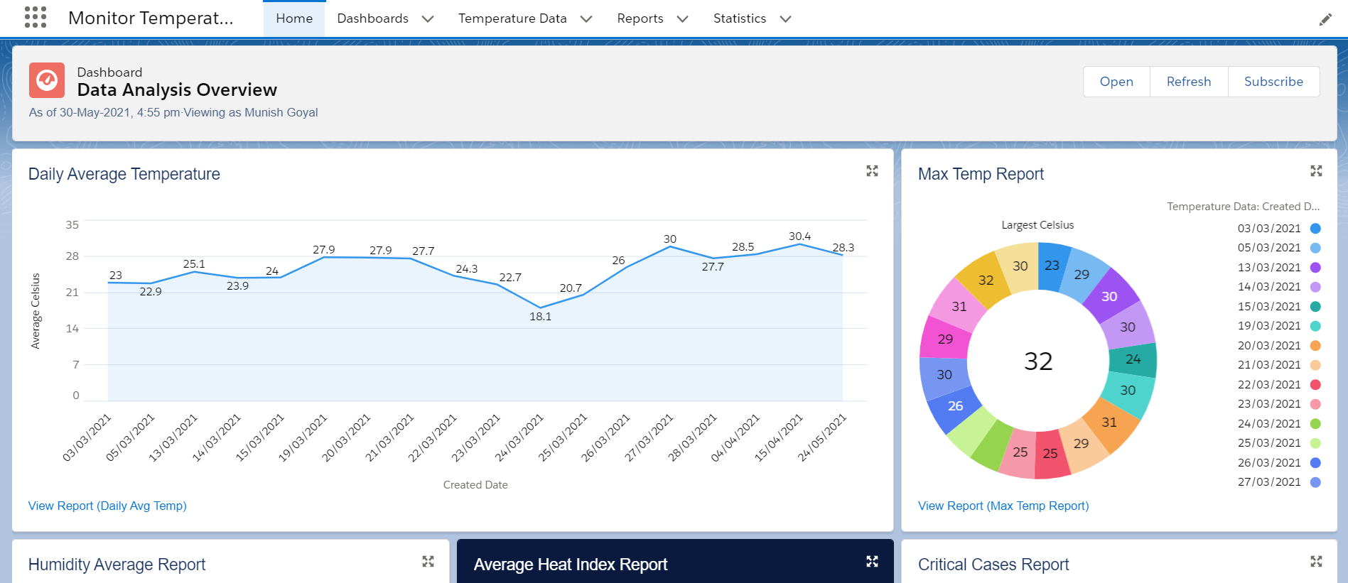
Home Page

Slide 22
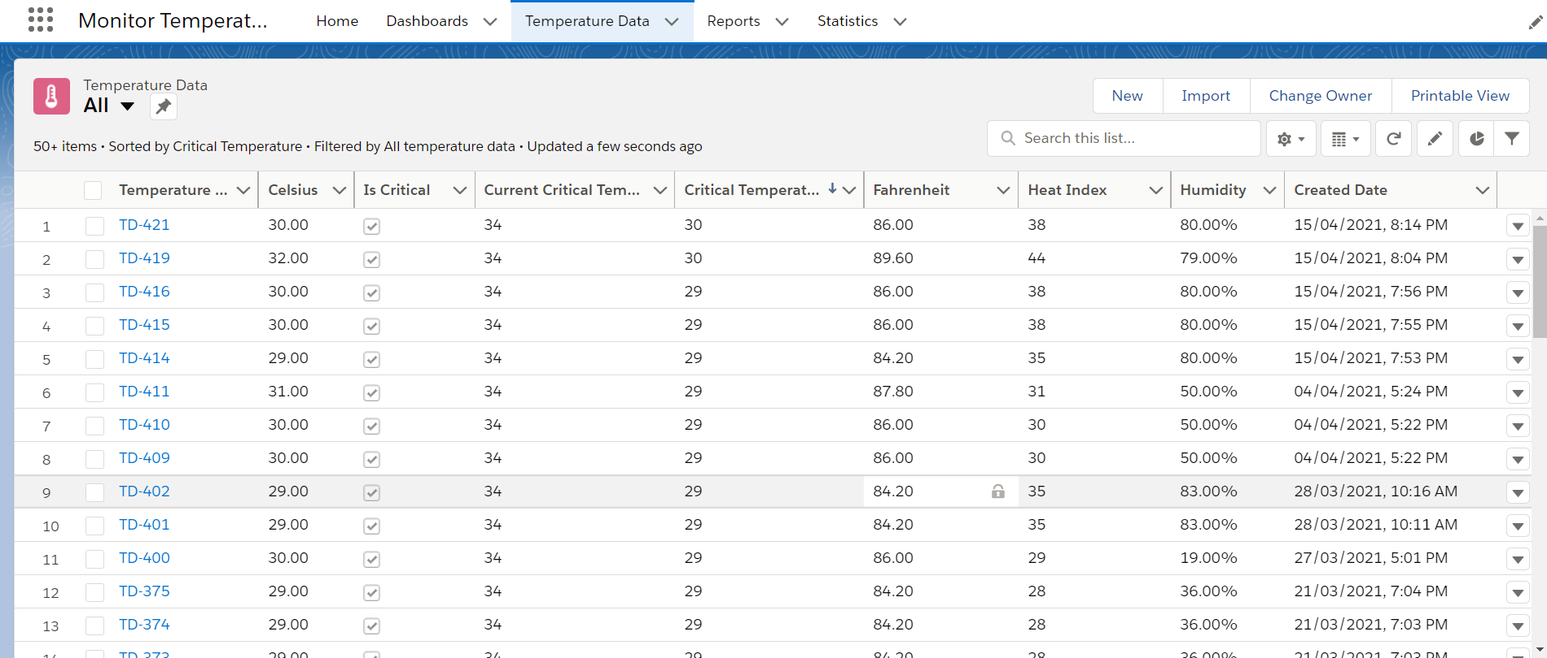
Manage Records Data

Slide 23
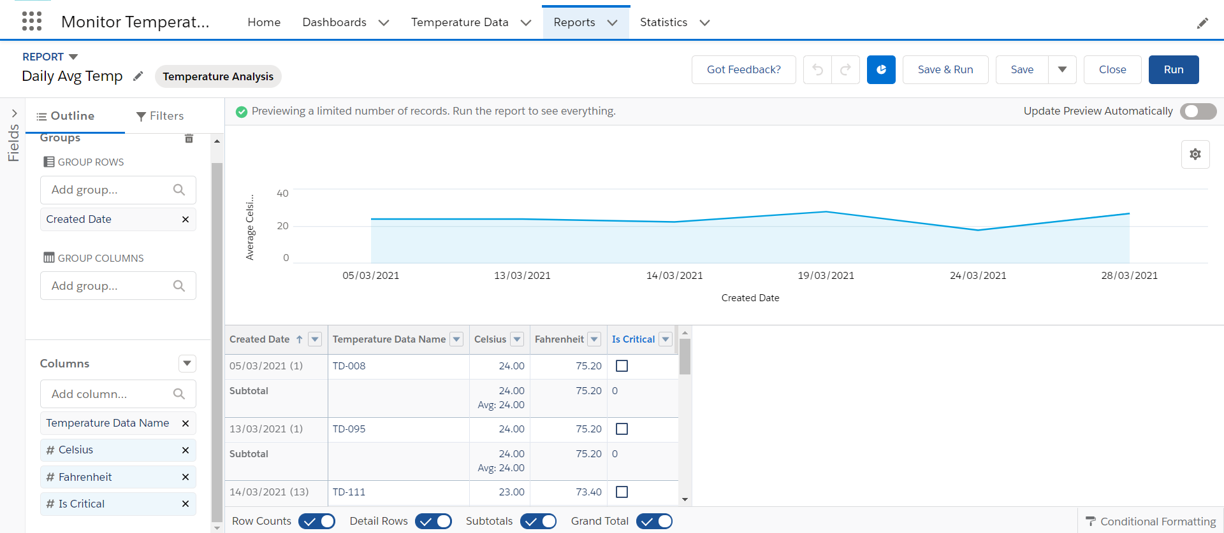
Create new report

Slide 24
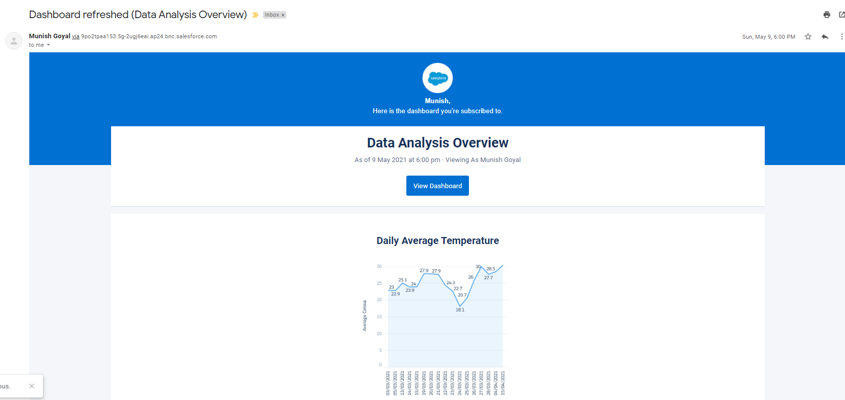
Subscribe to Dashboard

Slide 25

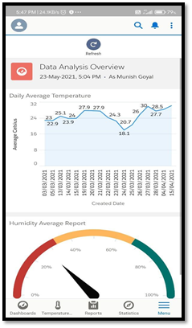
Salesforce Mobile App
User can manage all data from his/her mobile.
Also, User can get analytics of data.

Slide 26
Thank You

