Slide 1
Generalization Beyond Overfitting
Mohammadreza Ghofrani

Slide 2
Generalization Beyond Overfitting
In some cases even after model is overfitted to the data, it is possible for model to generalize!
For Example:
Double Descent Phenomena
Grokking Phenomena

Slide 3
What is Double Descent Phenomena?

Slide 4
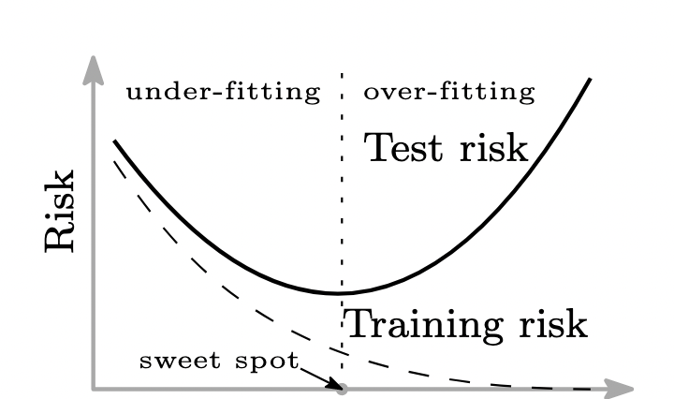
Underfitting and Overfitting
Model Parameters

Slide 5
What if we go further?

Slide 6
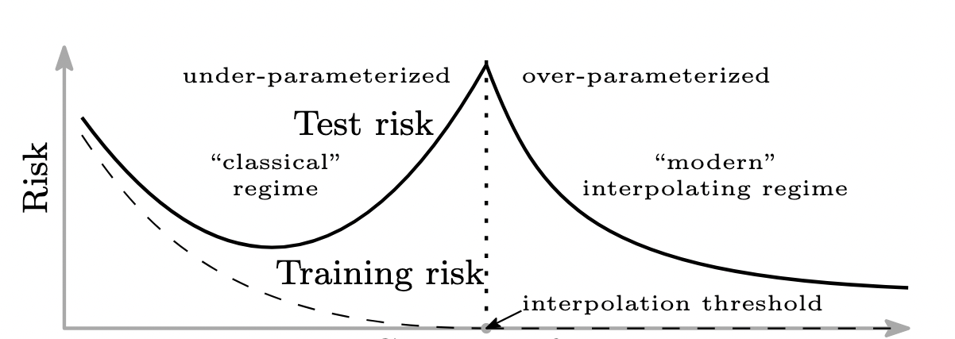
Going Further…
Model Parameters

Slide 7

This is known as Double Descent phenomena

Slide 8
Are There Any Examples?

Slide 9
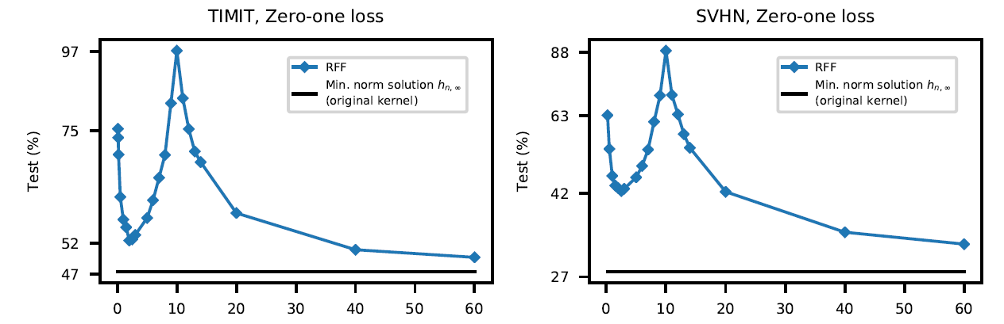
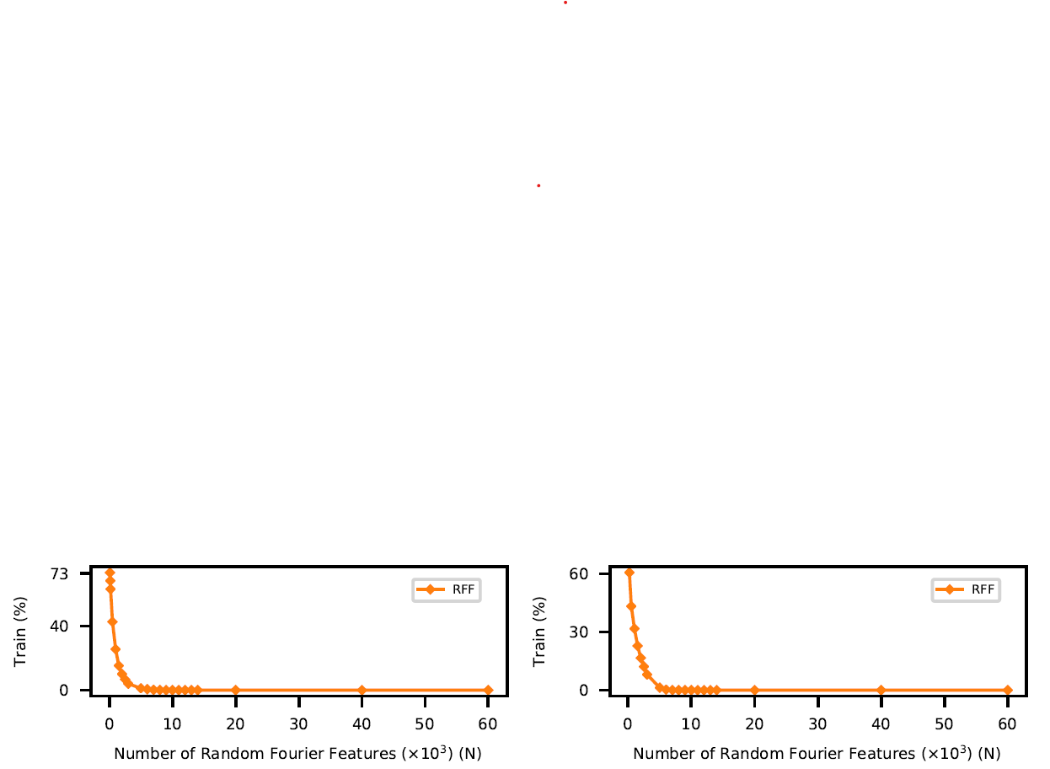
Real World Examples (1)
Random Fourier Feature

Slide 10
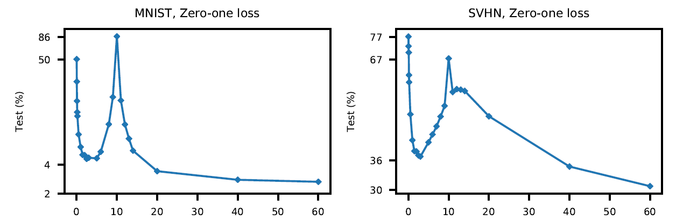
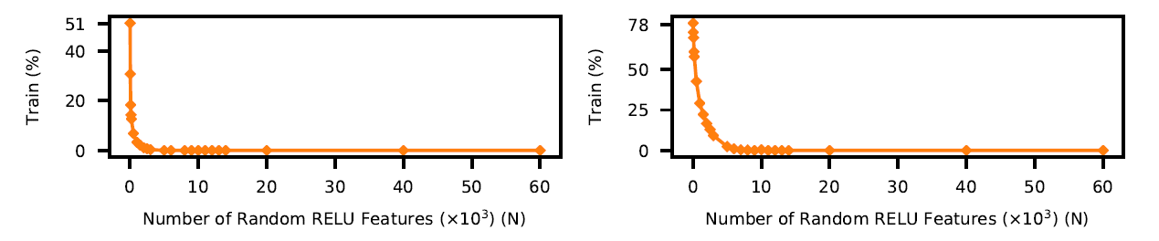
Real World Examples (2)
Random ReLU Model

Slide 11
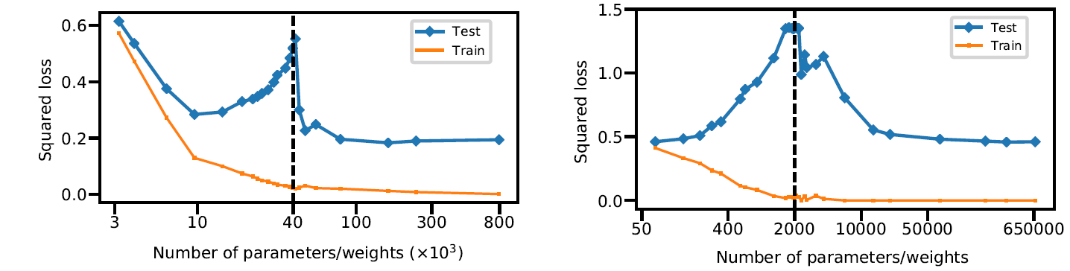
Real World Examples (3)
Fully Connected
Neural Network

Slide 12
So Where Is This Happening?

Slide 13
when the number of parameters is roughly equal to the number of samples, we can observe the double descent phenomena.

Slide 14
Evaluating (1)
Random ReLU Model
Number of Samples: 10^4
Number of Parameters: 10^4
Observed Threshold: 10^4

Slide 15
Evaluating (2)
Random Fourier Feature
Number of Samples: 10^4
Number of Parameters: 10^4
Observed Threshold: 10^4

Slide 16
But Why?

Slide 17
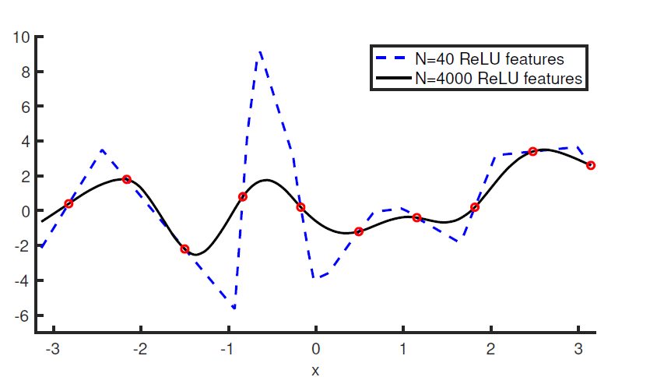
And The Reason

Slide 18
Is This a Solution For All Problems?

Slide 19
Pros & Cons
- Is this applicable?
+ Yes! But if you have a huge processing capacity.
- So this is not useful.
+ Maybe! But research could bring us a new vision of how neural networks learn.

Slide 20
Is This Only Phenomena?

Slide 21
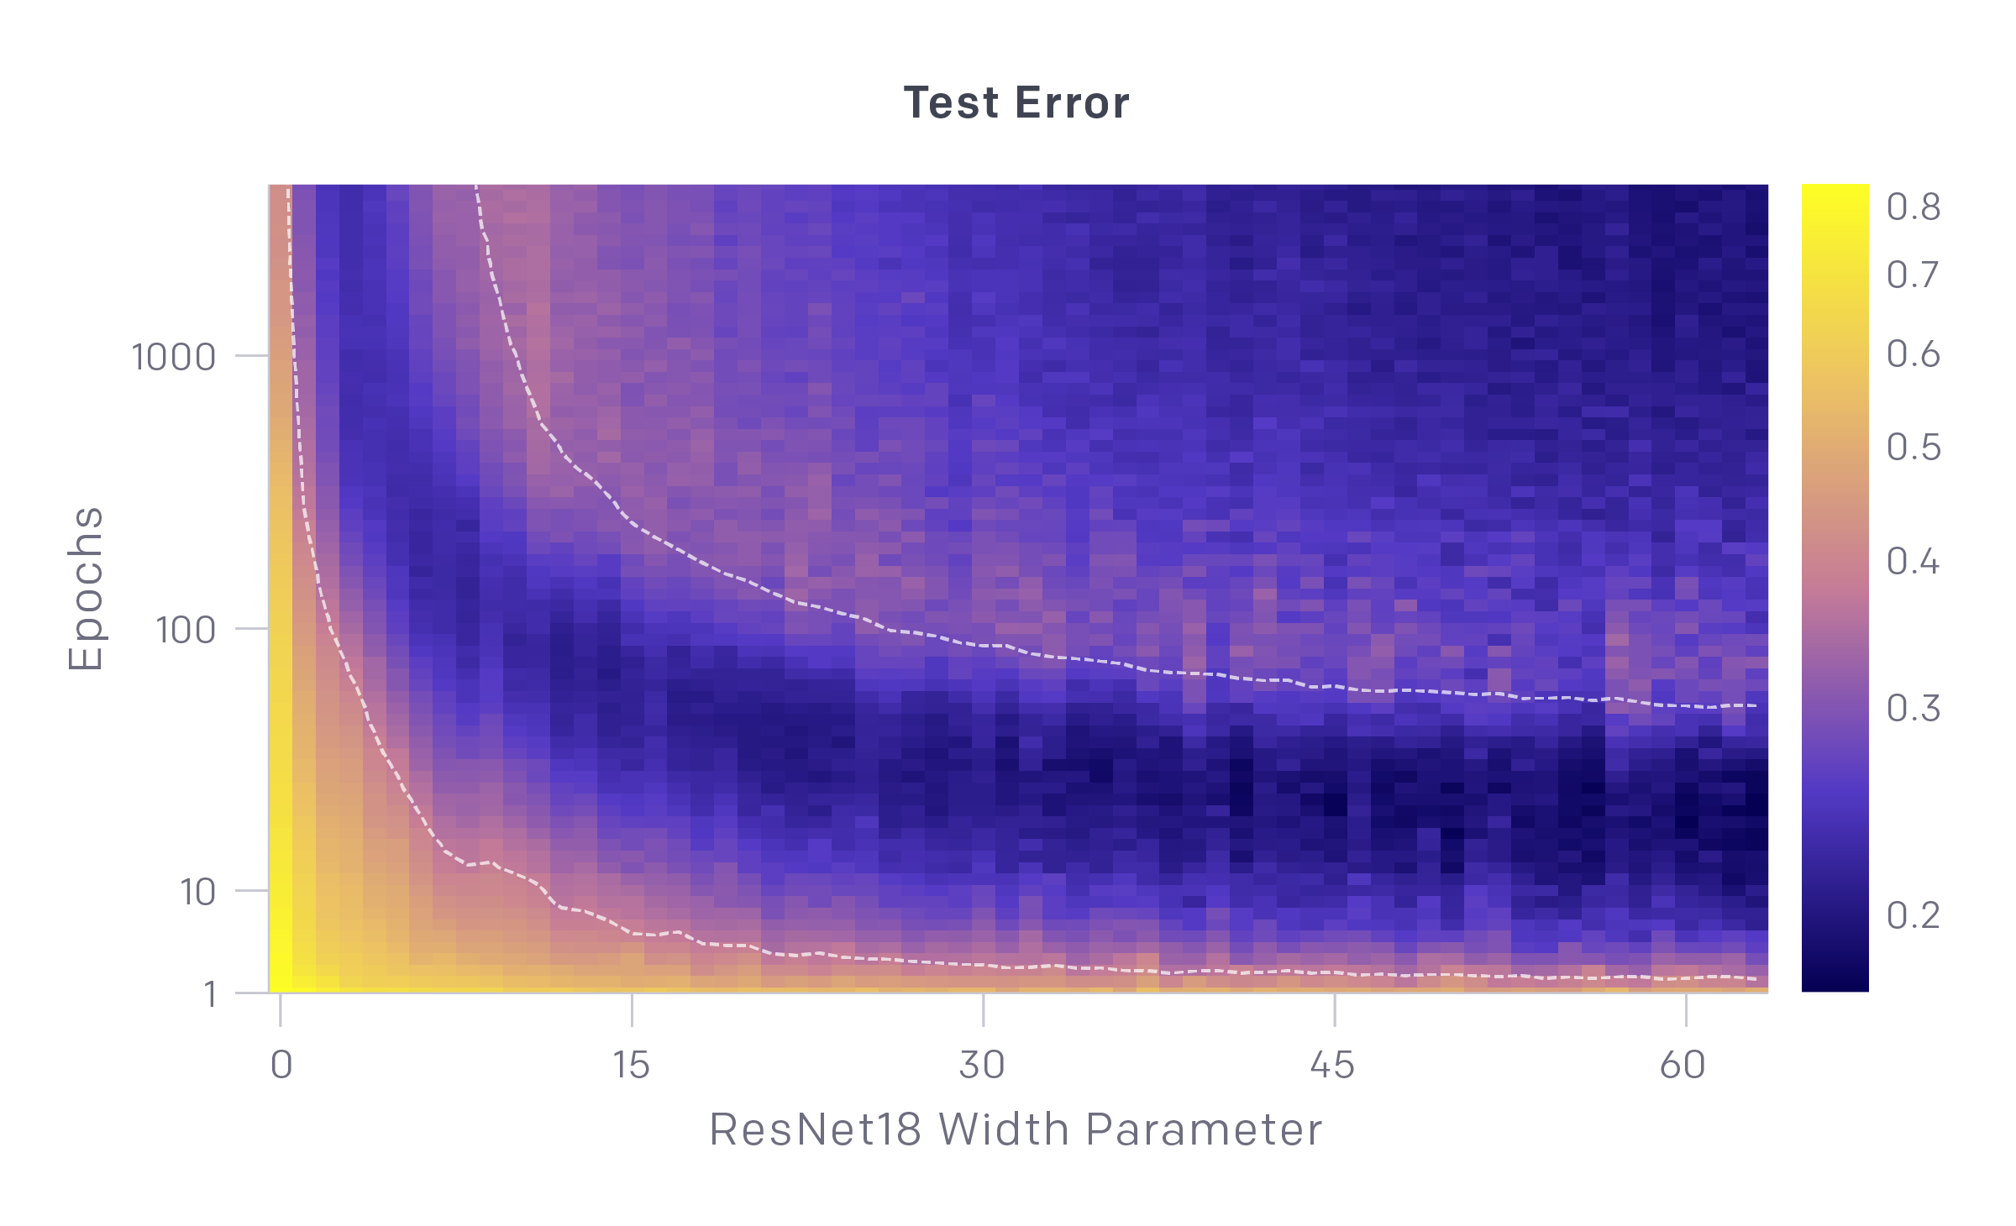
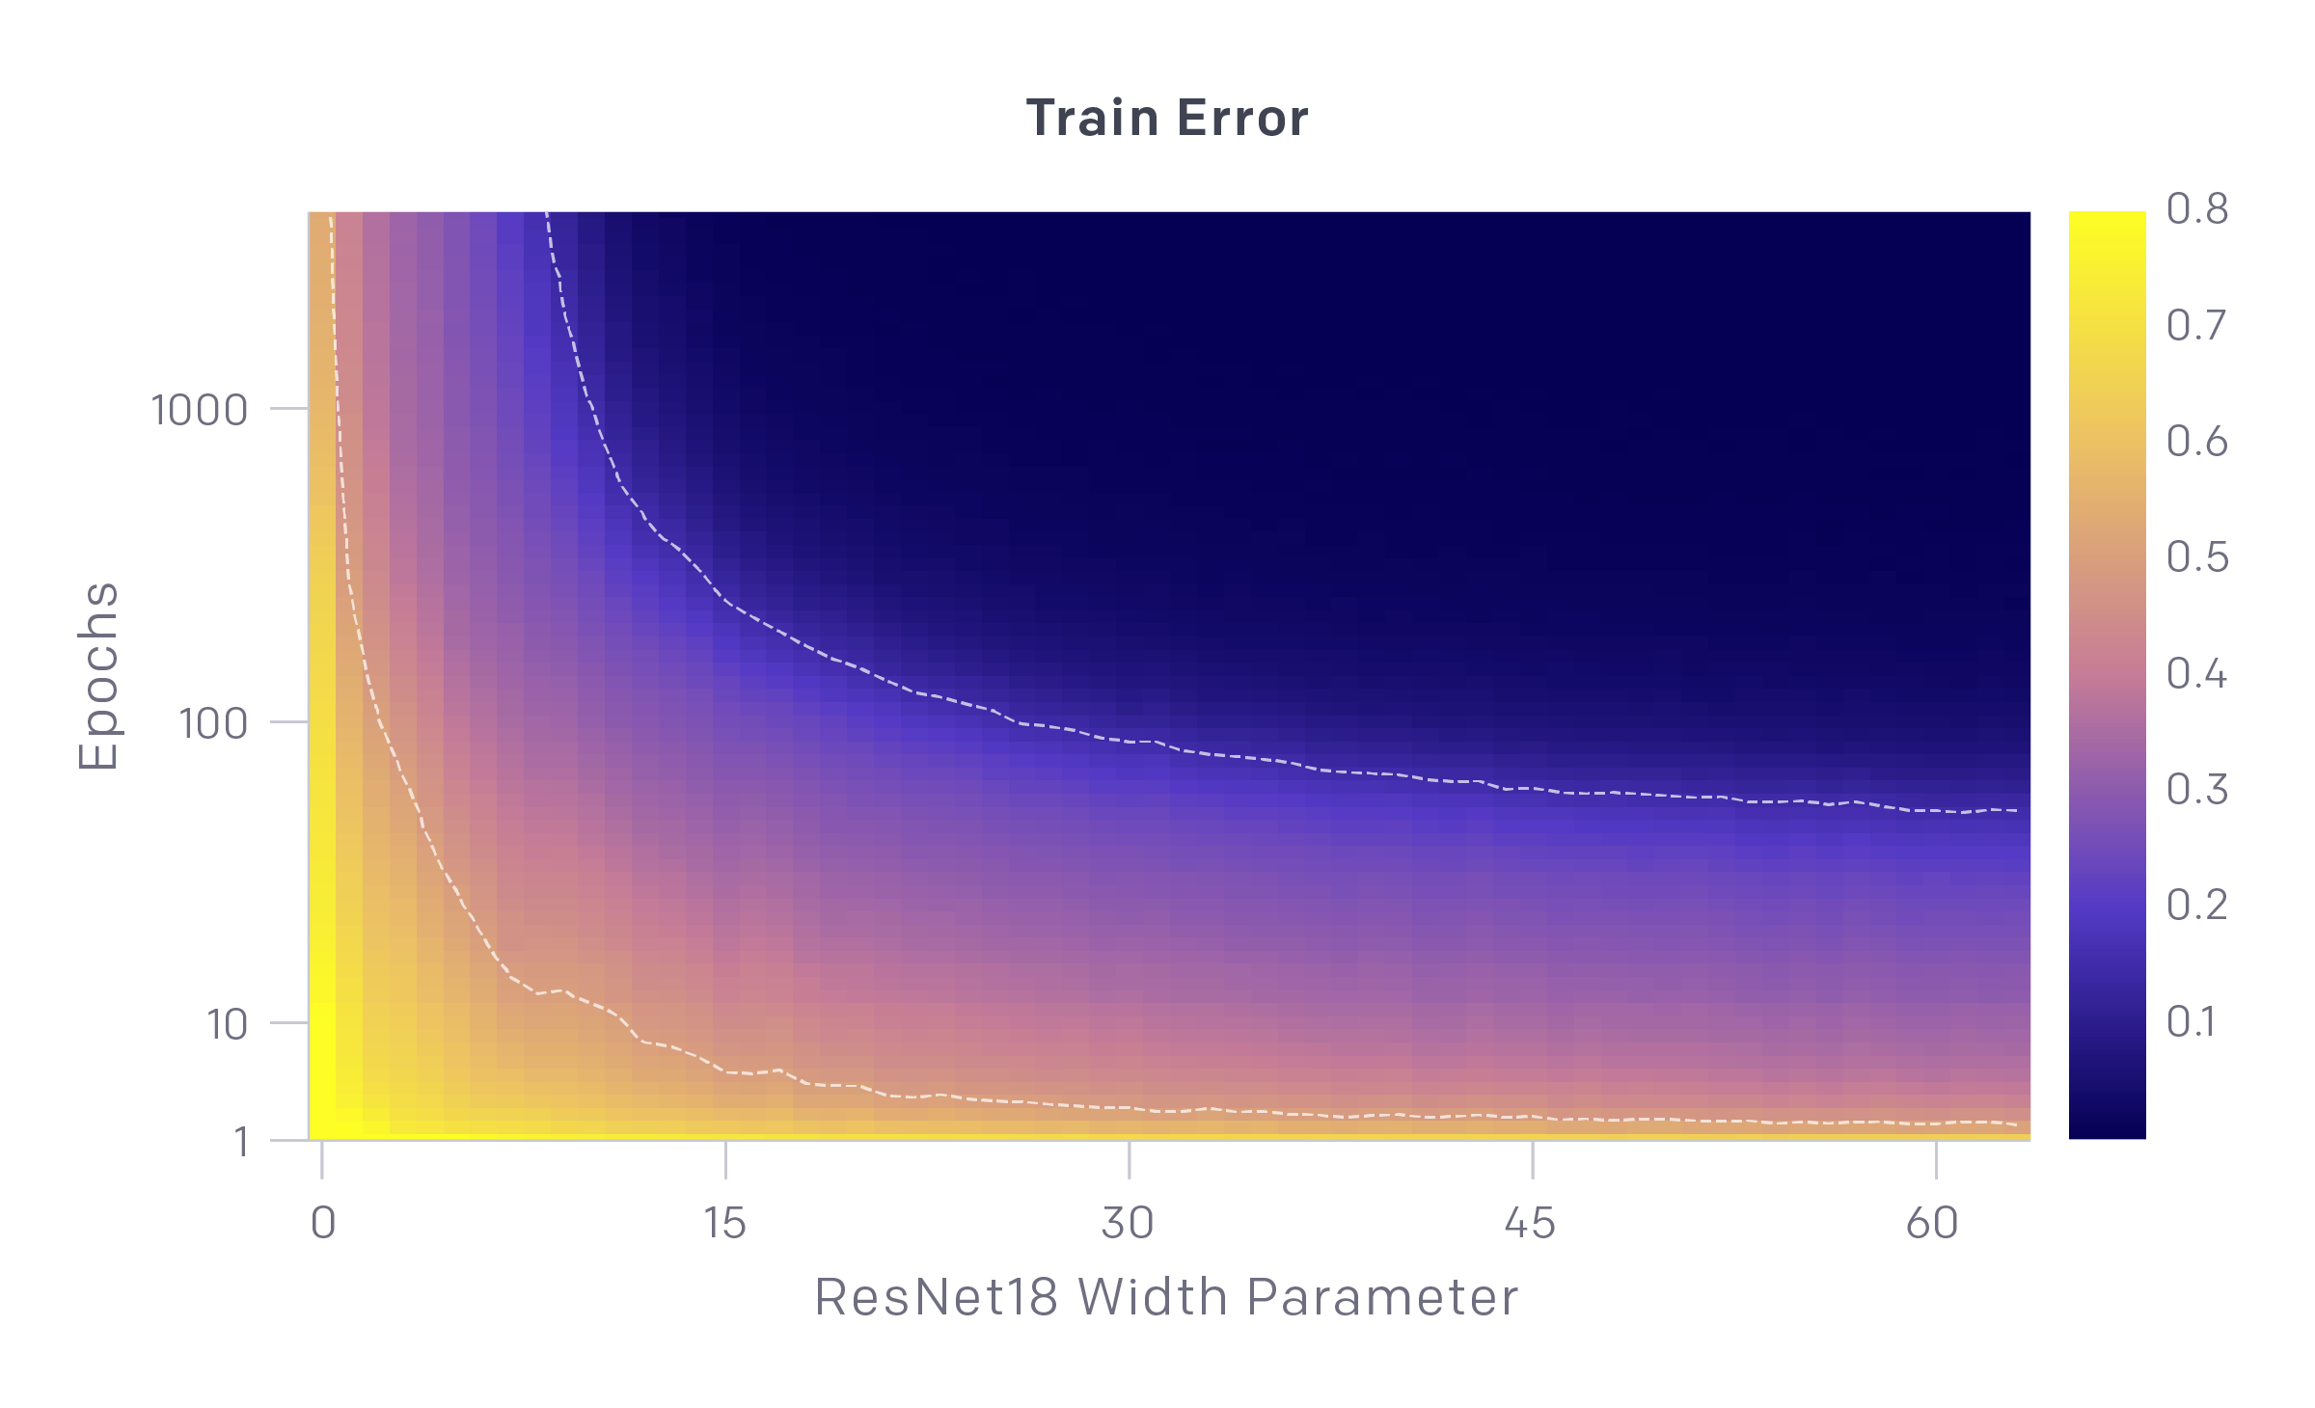
Epoch-wise Double Descent

Slide 22
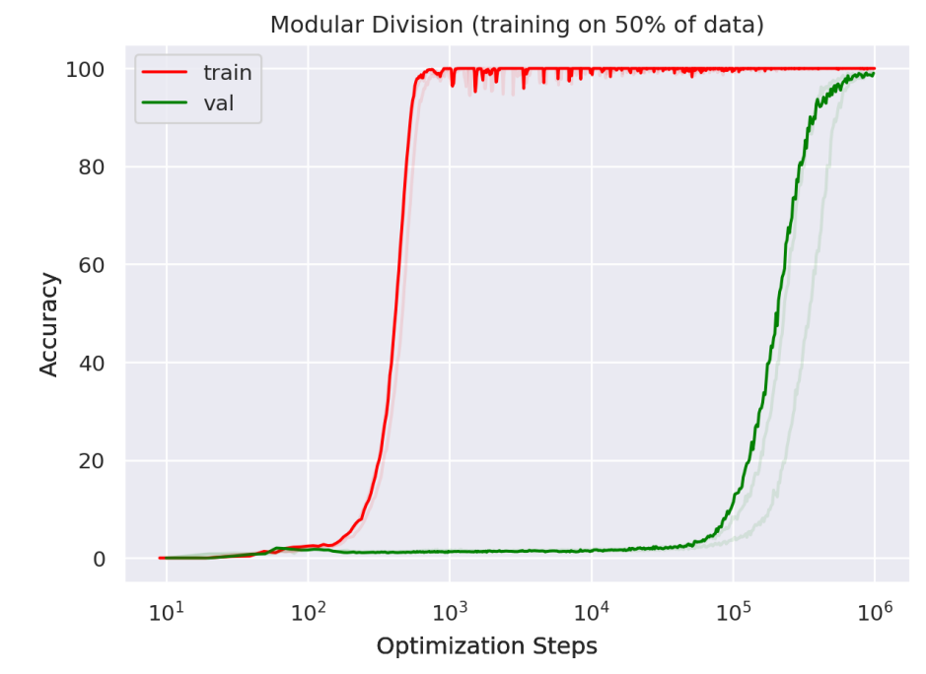
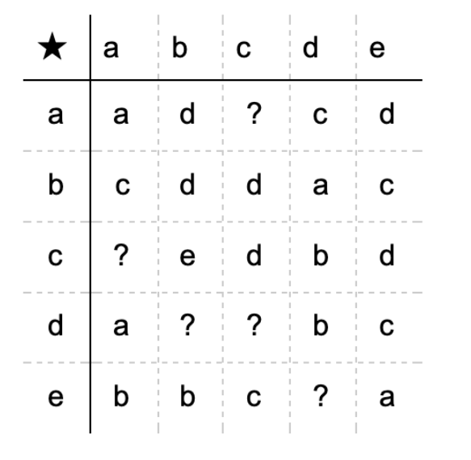
Grokking

Slide 23
Finally Refrences

Slide 24
Refrences
M. Belkin, D. Hsu, S. Ma, en S. Mandal, “Reconciling modern machine-learning practice and the classical bias trade-off”, Proceedings of the National Academy of Sciences, 2019.
P. Nakkiran, G. Kaplun, Y. Bansal, T. Yang, B. Barak, en I. Sutskever, “Deep Double Descent: Where Bigger Models and More Data Hurt”, arXiv [cs.LG]. 2019.
A. Power, Y. Burda, H. Edwards, I. Babuschkin, en V. Misra, “Grokking: Generalization Beyond Overfitting on Small Algorithmic Datasets”. arXiv [cs.LG] 2022. Web.
https://medium.com/mlearning-ai/double-descent-8f92dfdc442f

Slide 25
Thanks!
Any questions ?

