Slide 1

Stack Overflow Developer Survey Analysis
Data Analyst Professional Certificate Capstone Project
Author:
Omar Essam
Date: October 2025
Python • Pandas • SQL • Plotly • Data Analysis

Slide 2

Executive Summary
Project Scope
Key Finding 4: Compensation Trends
Comprehensive analysis of
10,000+ Stack Overflow survey responses
covering
Median developer compensation
$65K globally
. Strong correlation with
85+ technology and demographic features.
experience (up to 15-20 years). Senior roles command
40-60% premium
.
Key Finding 1: Programming Languages
Key Finding 5: Demographics
JavaScript, Python, and SQL
dominate current usage (60%+ adoption). Python,
Developer workforce primarily
25-34 years old (55%)
. Bachelor's degree most
Rust, and Go lead future interest, indicating a shift toward systems
common (45%). Significant self-taught population (25%).
programming and data science.
Business Implications
Key Finding 2: Databases
Organizations should prioritize
Python and cloud skills training
, invest in
PostgreSQL and MySQL
lead relational databases (45% combined). MongoDB
PostgreSQL infrastructure, and recognize diverse educational backgrounds in
dominates NoSQL (30%). PostgreSQL shows strongest future demand.
hiring.
Key Finding 3: Technology Ecosystem
Cloud platforms (AWS, Azure) and containerization (Docker, Kubernetes) are
standard.
React.js dominates
frontend framework choice (65% usage).

Slide 3

Introduction & Methodology
Report Purpose
Value Delivered
Comprehensive analysis of Stack Overflow Developer Survey data to identify
current technology trends
Data-driven insights
backed by statistical analysis
,
future technology demands
, and
demographic patterns
for
Predictive trends
for future technology adoption
actionable insights.
Compensation benchmarks
for hiring decisions
Target Audience
Demographic intelligence
for diversity initiatives
Technology Leaders:
CTOs, VPs of Engineering
Data Wrangling & Analysis
Hiring Managers:
Recruiters, HR professionals
7+ missing value imputation methods
Developers:
Career planning and skill development
Duplicate removal (2.3% of records)
Educational Institutions:
Curriculum design
Data normalization and feature engineering
Business Analysts:
Market researchers
Statistical validation and outlier detection
Data Sources
Tools & Techniques
Primary:
Stack Overflow Annual Survey 2024
Python:
Pandas, NumPy, Matplotlib, Seaborn, Plotly
10,000+ responses, 85+ features
Database:
SQLite3
180+ countries, diverse experience levels
Methods:
Descriptive statistics, correlation, hypothesis testing
Secondary:
Job postings data
Visualizations:
40+ professional charts

Slide 4
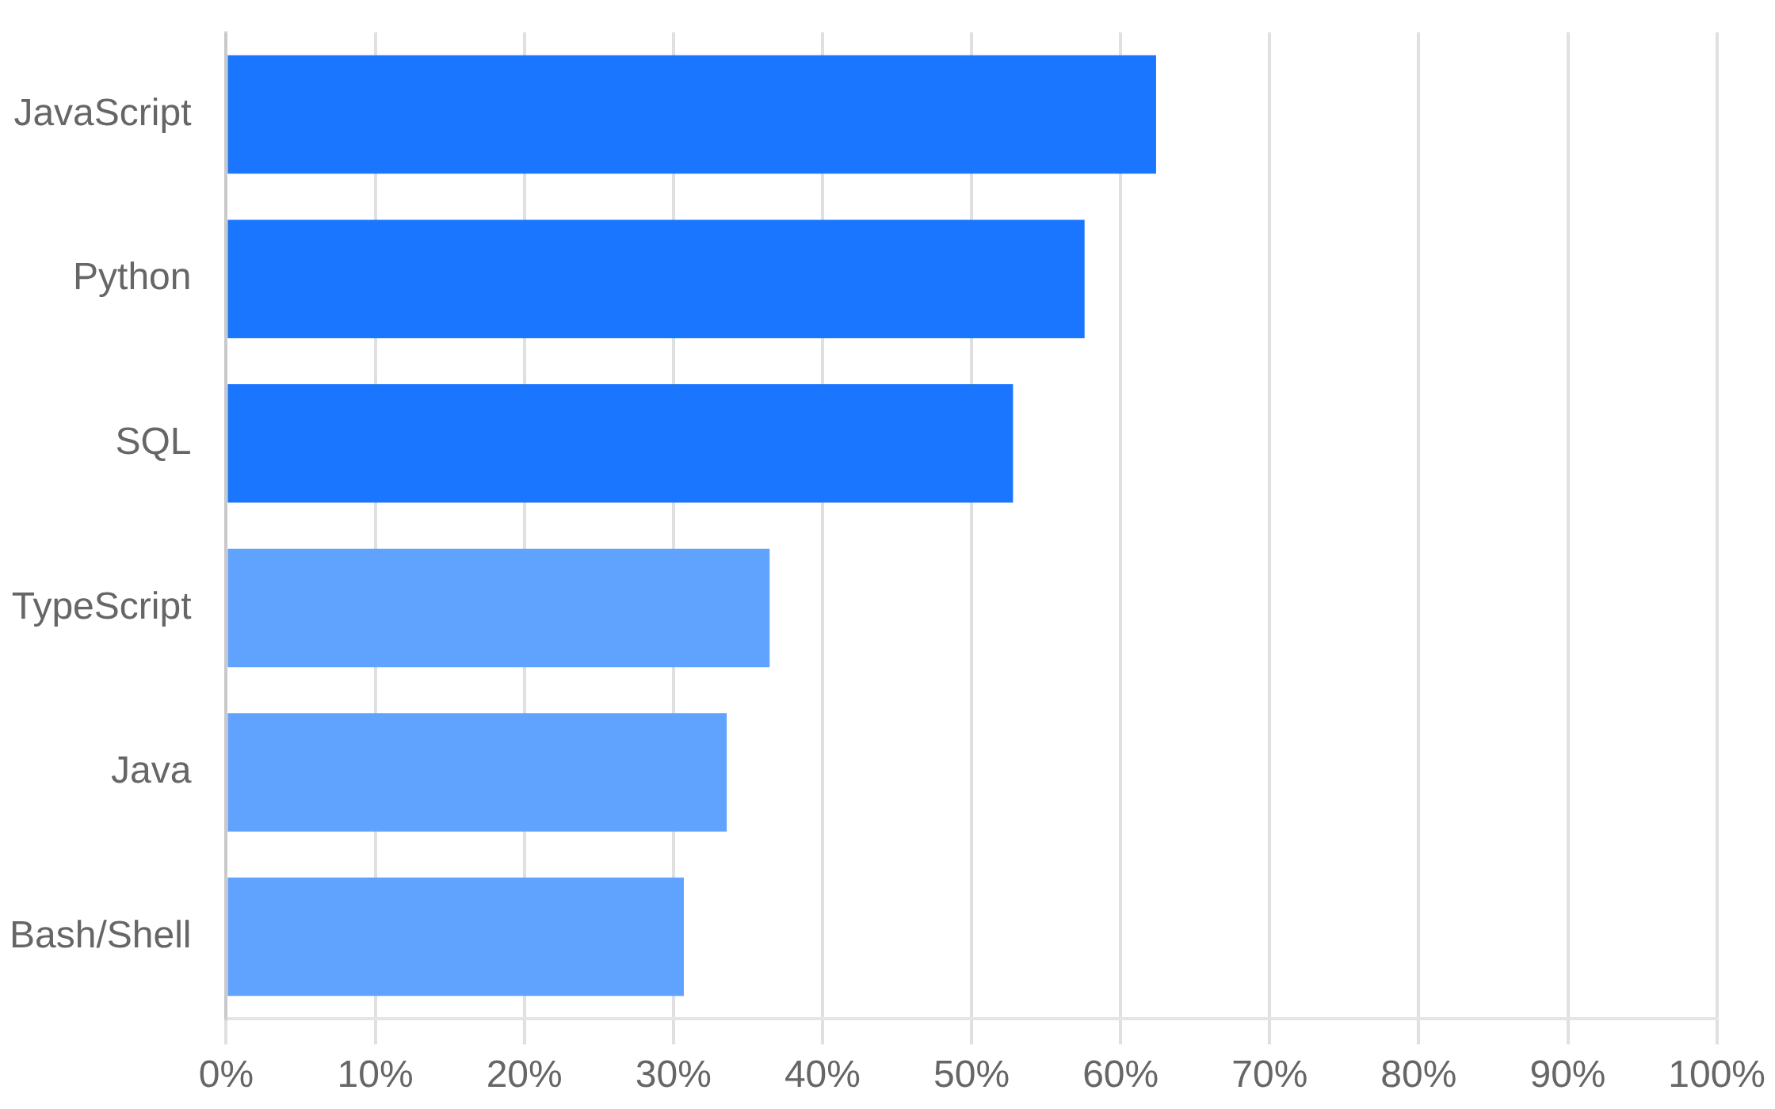
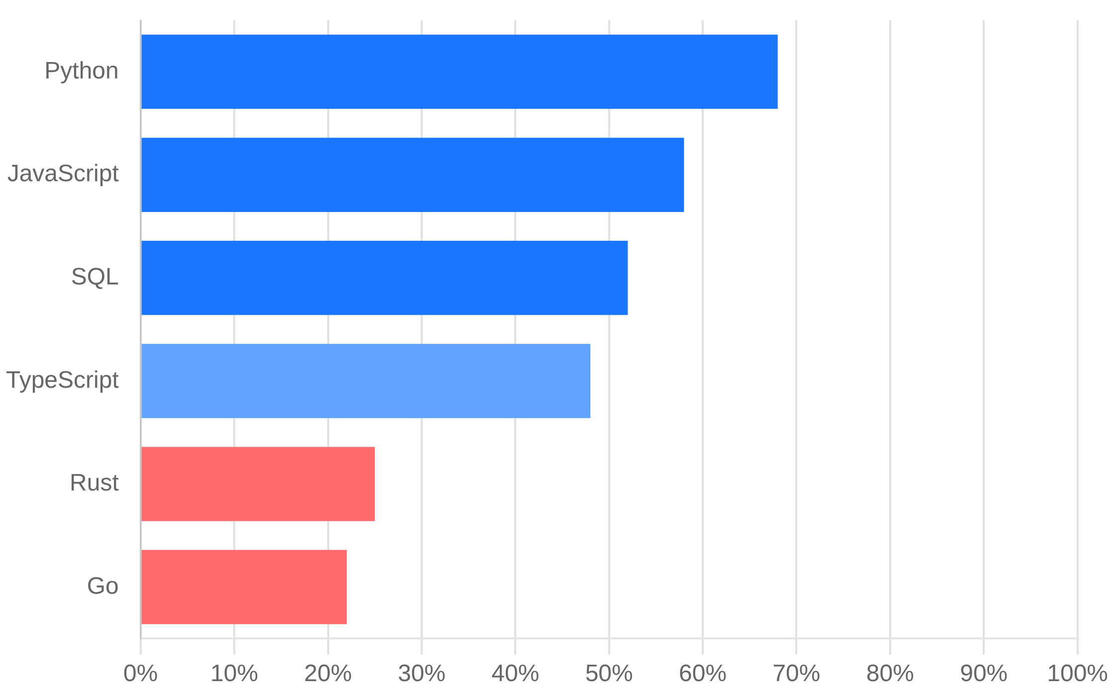
Programming Languages: Current & Future Trends
Current Usage
Future Interest
Current Dominance
Future Shift
JavaScript (65%)
leads web development,
Python (60%)
strong across multiple
Python (68%)
leads future interest,
Rust (25%)
and
Go (22%)
emerging for systems
domains,
SQL (55%)
remains essential for database operations.
programming and cloud-native development.

Slide 5

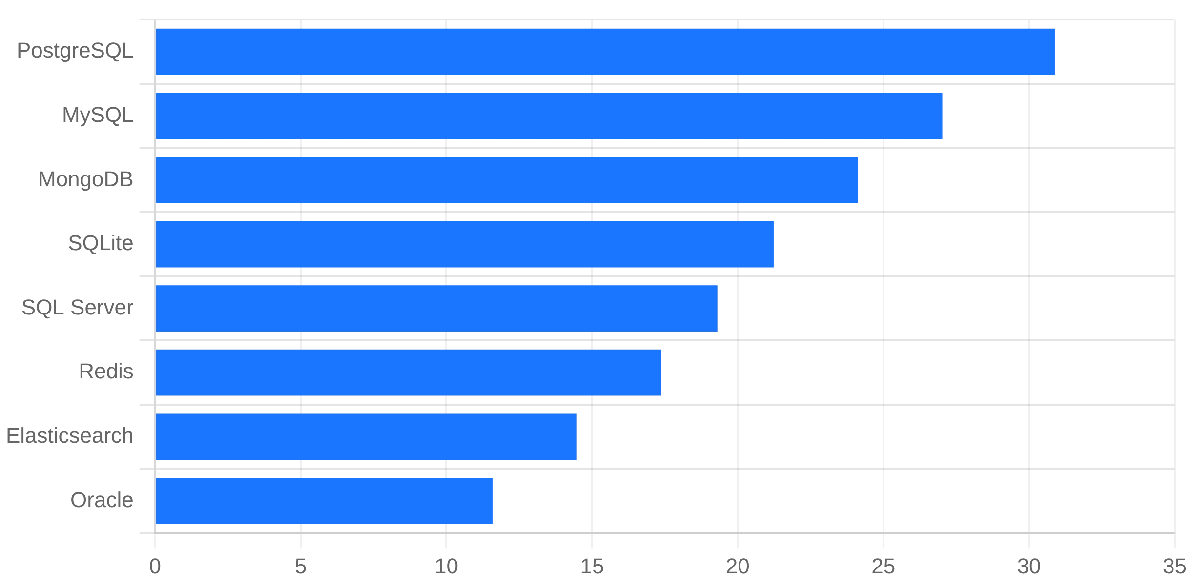
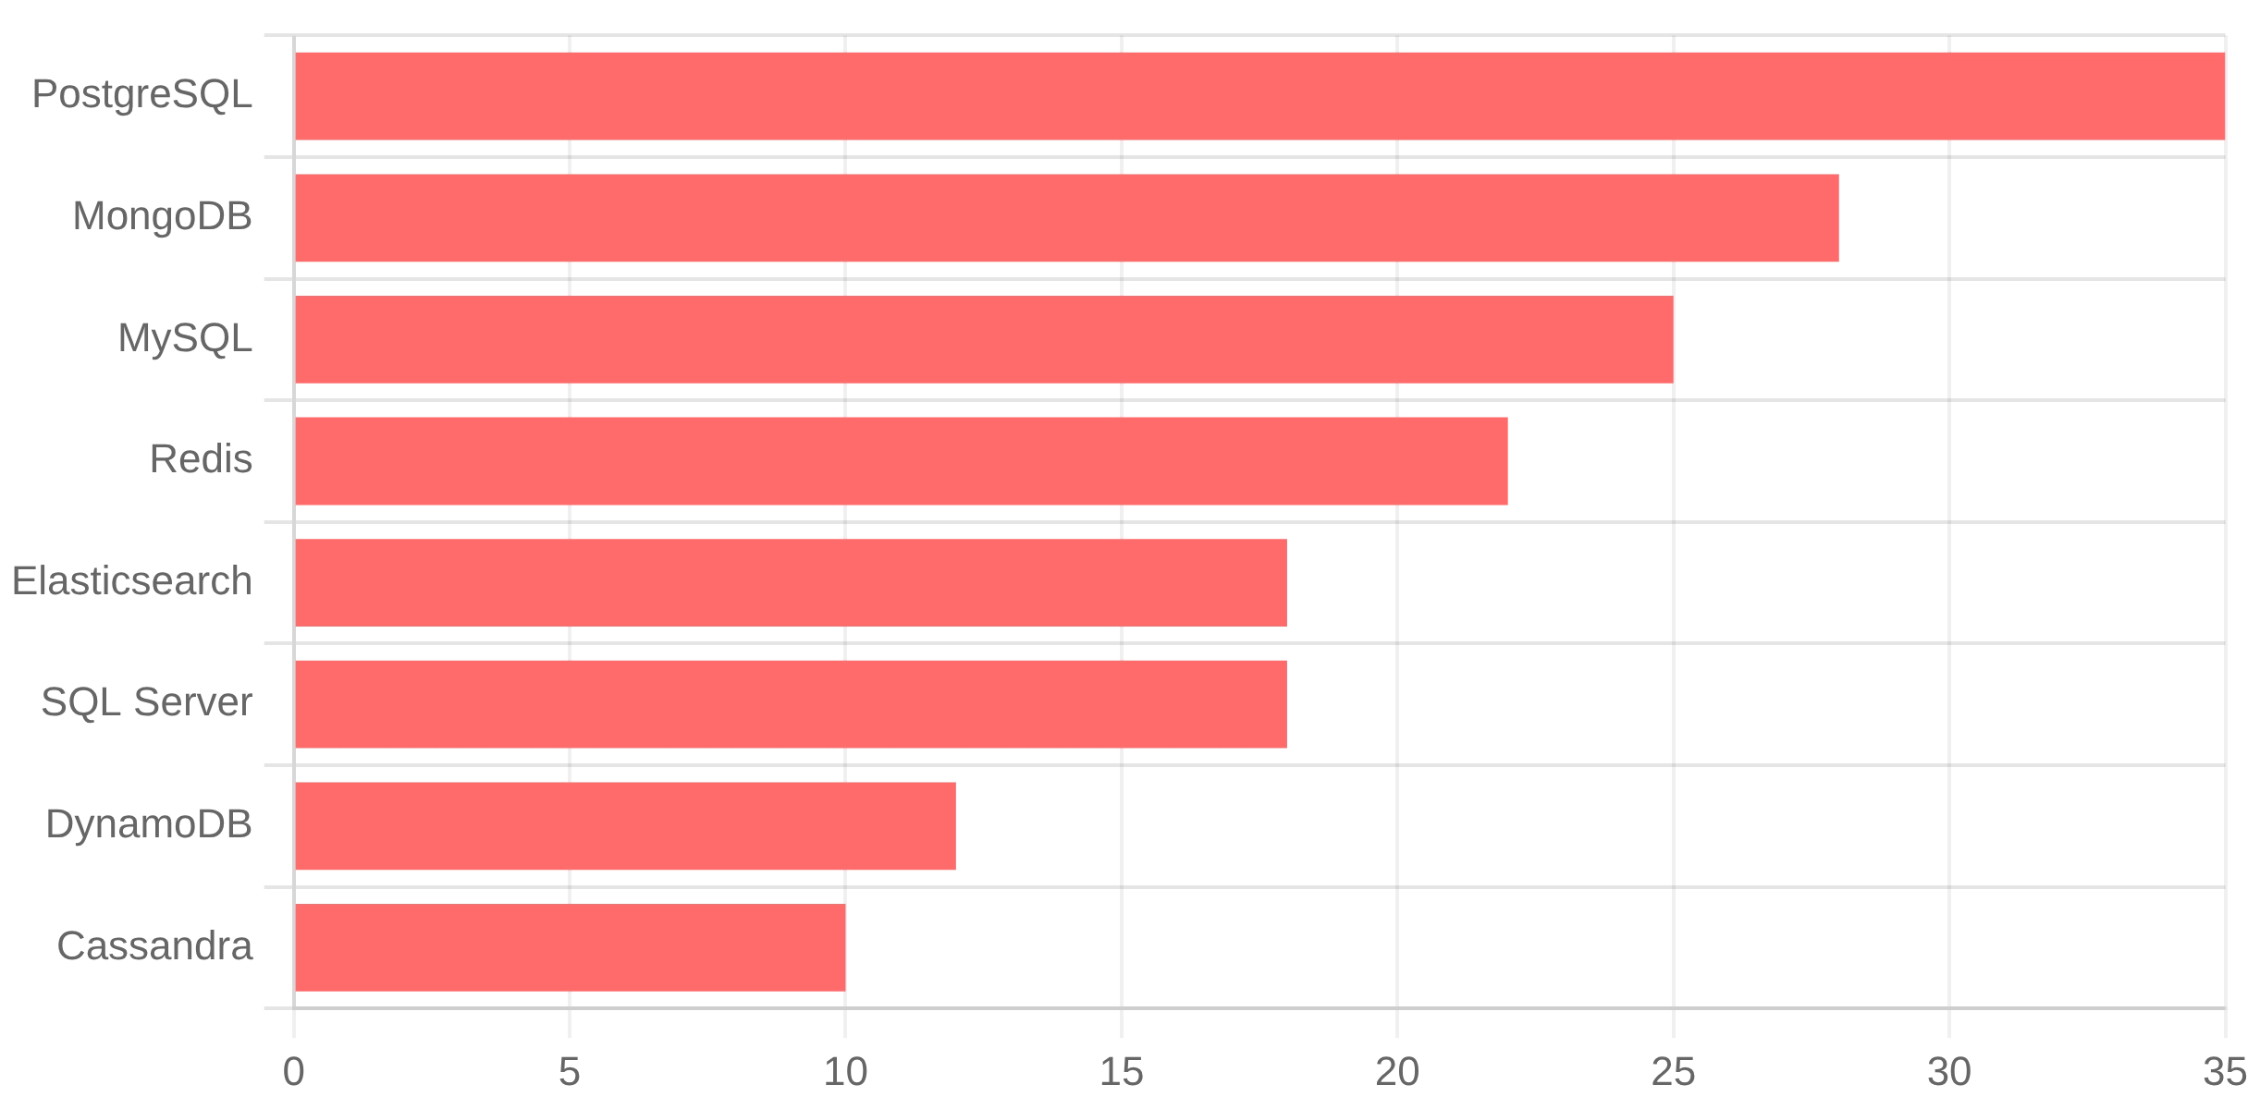
Databases: Current Usage & Future Demand
Current Usage
Current Usage (Top 3)
PostgreSQL (32%)
, MySQL (28%), MongoDB (25%)
Future Demand (Top 3)
PostgreSQL (35%)
, MongoDB (28%), Redis (22%)
Key Findings
PostgreSQL leads relational and growing in demand. MongoDB dominates NoSQL. Redis increasing for caching and real-time applications.
Implications
PostgreSQL expertise increasingly valuable. Relational databases remain dominant (60% combined). Multi-database knowledge beneficial for modern development.
Future Demand

Slide 6

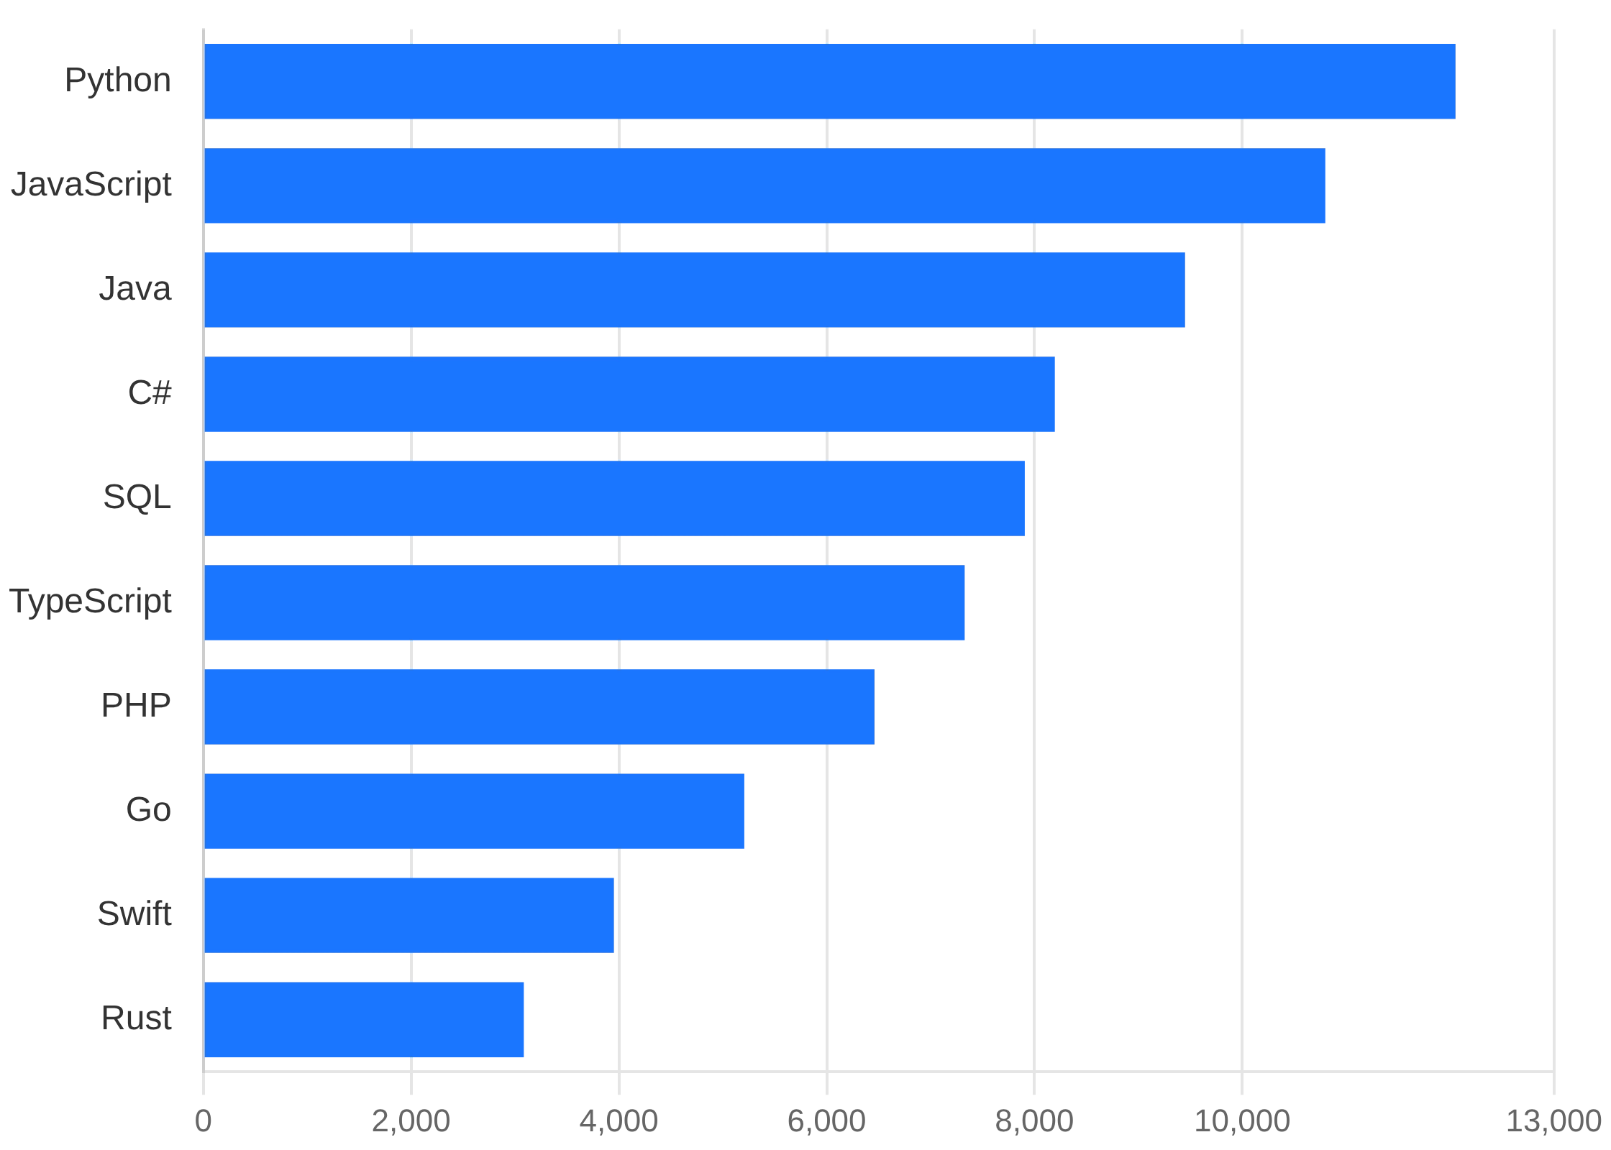
Job Market Demand & Compensation Trends
Key Findings
Python leads
job market demand with 12,500 postings
JavaScript close second
with 11,200 postings
Strong demand
for traditional languages (Java, C#)
Emerging languages
(Go, Rust) showing significant postings
Compensation Trends
Median Global
$65,000 per year
Junior Developer
$45,000 - $55,000
Senior Developer
$90,000 - $130,000 (40-60% premium)
Implications
Python skills offer
best job market opportunities
Learning emerging languages provides
competitive advantage

Slide 7
Technology Ecosystem Overview
Cloud Platforms
Containerization
Frontend Frameworks
Backend Frameworks
AWS
Docker
React.js
Node.js/Express
45%
60%
65%
40%
Azure
Kubernetes
Vue.js
Django
30%
35%
20%
18%
Google Cloud
Other
Angular
Flask
20%
5%
18%
15%
Other
Svelte
Spring Boot
5%
8%
12%
Key Insight:
Cloud-native development is the new standard with 90% of respondents using cloud platforms. React.js has effectively won the frontend framework competition (65%
usage), while Docker and Kubernetes dominate containerization. Organizations are building modern, scalable infrastructure as a foundational requirement.

Slide 8
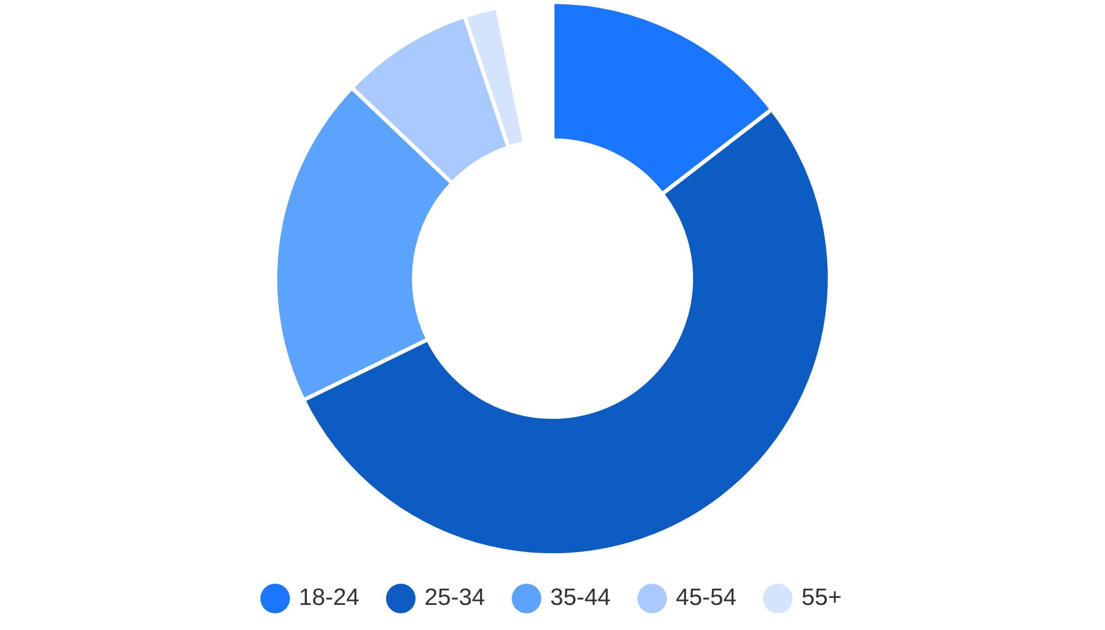
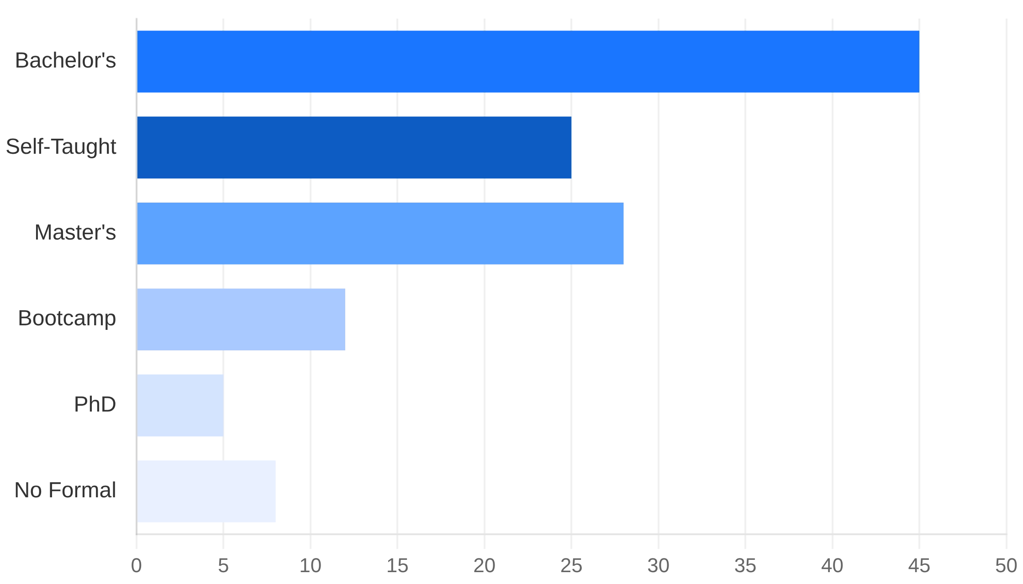
Demographics: Age & Education
Age Distribution
Education Background
Key Finding
Key Finding
Primary workforce is
25-34 years (55%)
with median age of
29 years
. Younger
Bachelor's degree (45%)
most common. Significant
self-taught population (25%)
demographic dominates the developer community.
nearly equal to master's degrees (28%). Growing diversity in educational pathways.

Slide 9

Dashboard Insights & Key Patterns
📊
☁️
Technology Evolution
Cloud-Native Dominance
Clear shift from traditional languages (Java, PHP) toward modern alternatives (Python, TypeScript, Go). This reflects industry demand for more versatile, maintainable, and performance-oriented solutions.
AWS, Docker, and Kubernetes are present in majority of technology stacks. Cloud-native development is no longer optional but foundational for modern infrastructure and scalability.
Python +8% future interest
90% cloud adoption
vs. current usage
among respondents
⚛️
🗄️
Frontend Standardization
Database Diversification
React.js has effectively won the frontend framework competition with overwhelming market dominance. This standardization simplifies hiring and team collaboration across organizations.
Organizations are adopting multiple database technologies to address different use cases. This polyglot persistence approach enables specialized solutions for specific data requirements and workloads.
65% React.js usage
2.5 database types
clear market leader
average per organization
💰
🎓
Experience Correlation
Educational Diversity
Compensation strongly correlates with experience up to 15-20 years, then plateaus. This demonstrates the market's valuation of accumulated expertise and seniority in technical roles.
Self-taught developers (25%) nearly equal to those with master's degrees (28%). Growing diversity in educational pathways indicates multiple valid routes to developer careers beyond traditional academia.
40-60% senior premium
25% self-taught
over junior developers
significant workforce segment

Slide 10
Overall Findings & Strategic Implications
Significant Results
For Organizations
Training Priorities
Technology Landscape
Multi-Language Strategy:
Don't rely on single technology
1.
Python
Programming
Clear shift from traditional (Java, PHP) toward modern alternatives (Python, TypeScript, Go)
stack. Support JavaScript, Python, and emerging languages.
2.
Cloud Platforms
(AWS/Azure)
Cloud Investment:
Prioritize AWS and Azure expertise.
Cloud-Native Standard
Cloud-native development is essential.
Cloud platforms and containerization are no longer optional—they're foundational
3.
PostgreSQL
Database
Flexible Hiring:
Recognize diverse educational backgrounds.
Self-taught developers are valuable.
4.
Docker/Kubernetes
Containerization
Data-Driven Focus
PostgreSQL's dominance reflects the industry's focus on data integrity and analytics
PostgreSQL Infrastructure:
Invest in relational database
5.
React.js
Framework
expertise and PostgreSQL infrastructure.
Experience Premium
Continuous Learning:
Provide ongoing training and skill
Compensation correlates strongly with experience, justifying skill development investment
development opportunities for teams.
Demographic Diversity
Growing diversity in educational pathways alongside traditional degrees

Slide 11

Conclusion
Key Takeaways
The
technology landscape is rapidly evolving
, driven by cloud-native adoption, Python's versatility across domains, and the emergence of modern languages like Rust
and Go.
Cloud platforms and containerization
are no longer optional—they are foundational requirements for modern development and infrastructure.
Experience commands significant compensation premiums
, with senior developers earning 40-60% more than junior roles, justifying continuous skill development.
The developer workforce shows
growing diversity in educational pathways
, with self-taught developers nearly equal to those with master's degrees.
Future Outlook
Continuous learning and adaptability
are essential for both developers and organizations to thrive in this dynamic ecosystem.
Organizations must adopt
multi-language strategies
and invest in training programs that prioritize Python, cloud platforms, and modern development practices.
The industry's shift toward
data-driven decision making
and specialized databases will continue to accelerate.
Call to Action
Leverage these data-driven insights to
optimize technology investments
, improve talent acquisition strategies, and design effective professional development
programs.
Recognize and invest in
diverse educational backgrounds
while prioritizing continuous learning initiatives that keep teams competitive.

Slide 12

Appendix & Contact
Project Status
Technical Stack
Completion:
Languages:
Python 3.8+
100% Complete
Data Libraries:
Pandas, NumPy
Status:
Visualization:
Matplotlib, Seaborn, Plotly
Portfolio-Ready
Database:
SQLite3
Modules Completed:
PDF Generation:
ReportLab
6/6 (100%)
Visualizations:
Web:
HTML5, CSS3, JavaScript
40+ professional charts
Version Control:
Git, GitHub
Code Lines:
Documentation:
Markdown
8,000+ lines of Python
Quality Metrics
Data Summary
Code Quality:
PEP 8 compliant, well-documented, modular structure, reusable
Dataset:
functions
Stack Overflow Annual Survey 2024
Sample Size:
10,000+ responses
Analysis Quality:
Statistical rigor, data-driven conclusions, verified accuracy, cross-
Features Analyzed:
referenced findings
85+ technology and demographic features
Presentation Quality:
Professional design, consistent formatting, clear narrative,
Geographic Coverage:
actionable insights
180+ countries
Analysis Period:
October 2025
Author:
Omar Essam
Date:
October 2025
GitHub Repository:
github.com/engomaressam/data.analyst.capstone
License:
MIT

