Slide 1
Internship Information Session
School of Engineering
October 25, 2022

Slide 2
Why do an internship?

Slide 3
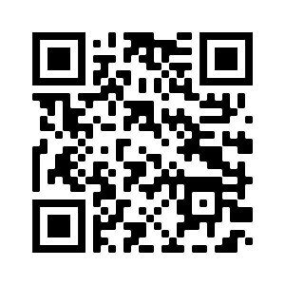
https://engr-advising.github.io/
Internship Policy
“Finding an Internship”
Internship Proposal Template
Internship Registration Form
Later today: these slides + recording of this presentation!

Slide 4
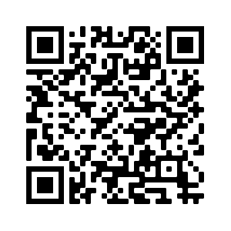
Career Services Website
Important dates
Access to Purple Briefcase (job postings)

Slide 5
Career Services BAND
Announcements and events
Job postings

Slide 6
Internship Requirement
Option 1:
Two 3-credit internships
Option 2:
One 6-credit internship
ENGR 524: Industrial Internship I
40 8-hour work days (not 8 weeks)
Must include application of engineering analysis
ENGR 524: Extended Internship in Engineering
60 8-hour work days (not 12 weeks)
Must include application of engineering analysis and design techniques
You must have finished your junior year
ENGR 534: Industrial Internship II
40 8-hour work days (not 8 weeks)
Must include application of engineering analysis and design techniques

Slide 7
Internship Process
Apply for Internships
Interview for Internships
Get Internship!
Get Approval for Internship
Complete the Internship
Write Internship Report

Slide 8
Apply for Internships
Prepare to Apply
Prepare resume (text and PDF)
Find Internships
Indeed.com
Apply for Internships
Keep spreadsheet of all applications
Determine your requirements
Purple Briefcase
Individual companies’ websites
Linkedin.com
Respond promptly and professionally

Slide 9
Interview for Internships
Where to go for help
Career Services
How to Prepare
Review your own resume!
The Interview
Dress professionally
Links in “Finding an Internship” document
Be on time
Bring a small notebook + pen
List examples of projects and work you’ve done
Internship Coordinator (Kimberly Baclig)

Slide 10
Get Internship!
Offer Letter
Required Forms
Pay (there should be pay!)
I-9 (ID + approval to work)
Role
Dates and hours
Supervisor
W-4 (taxes)

Slide 11
Get Approval for Internship
Prepare Proposal + Registration Form
Get Advisor Approval
Get External Supervisor Approval
Get Department Chair Approval
Proposal template and form are provided
Do this first in case of edits
They’ll make sure job description is accurate
They’ll make sure it meets requirements
They may send it to the chair themselves
Send back to your advisor
They should evaluate you at the end
Use info from job posting + offer letter

Slide 12
Department Chairs
School of Engineering
Dean: Dr. Winfrey
Naval Architecture & Marine Engineering Department
Chair: Dr. Burke
Mechanical & Facilities Engineering Department
Chair: Dr. Fridline
Electrical Engineering Department
Chair: Dr. Kump

Slide 13
Complete the Internship
Do Your Job
Show up on time and prepared.
Keep a Daily Log
This is a required section of your internship report, and it helps you write the report!
Collect Work Product
Collect examples of your work (if possible)
Look for opportunities to help.
Pay attention, ask questions.
Blueprints, drawings, pictures
Calculations, spreadsheets
Reports, correspondence
Get Evaluated
Your external supervisor should evaluate you
Can use whatever template they prefer
Should include details about what tasks you did and how well you performed them
Can send directly to your advisor is they prefer
Can be typed or handwritten – brain dump at the end of each day.

Slide 14
Write the Report
Front Matter
Title Page
Body
Introduction (description of company and brief overview of your job)
Discussion (detailed explanation of the work you did)
Table of Contents
Executive Summary (standalone overview of report)
Appendices
Daily work log
Evaluation
Signed copy of internship proposal
Others as necessary

Slide 15
How to Write a Good Report
Demonstrate that you did 3 or 6 credits of engineering work.
Show
Drawings, calculations, notes, photographs, engineering reports, engineering correspondence.
Tell
Describe the work you did. What the goal was, what your responsibilities were, what you did (specifically, and in technical detail), what the outcome was.
Organize
Choose an order/arrangement that makes sense: chronological, by project, by location, something else?
Make it Look Professional
Let Word or Google Docs do the hard work of sections, headings, captions, etc. Don’t make your table of contents by hand.

Slide 16
Questions about this process?
Apply for Internships
Interview for Internships
Get Internship!
Get Approval for Internship
Complete the Internship
Write Internship Report

Slide 17
Breakout Q&A Sessions
Mechanical Engineering
Mike Aversa: Precipart Corporation
Victoria Feeney: Leviton Manufacturing, R&S United Services
Facilities Engineering
None (Sorry!)
Electrical Engineering
Demetri Gatanas: Metropolis Electric, MG Engineering
Rakad Davod: PJS Electric
Naval Architecture
Bridget Stack: Amentum/NAVSEA

