Slide 1

“Torture the data and it will confess to anything”
— Ronald Coase —

Slide 2
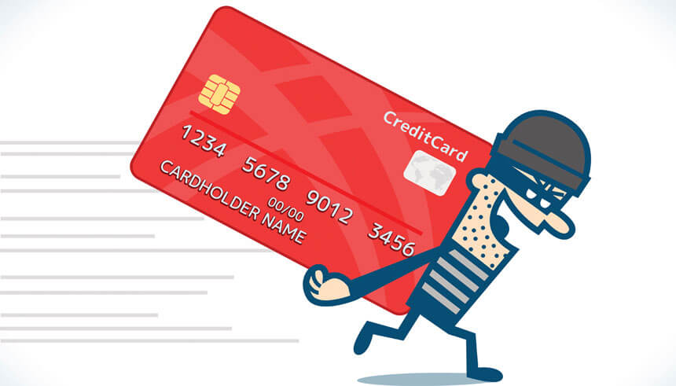
Credit Card Fraud Analysis
Presented by Muhammad Taha

Slide 3
Credit Card Fraud
Credit card fraud is a form of identity theft that involves an unauthorized taking of another's credit card information for the purpose of charging purchases to the account or removing funds from it.

Slide 4
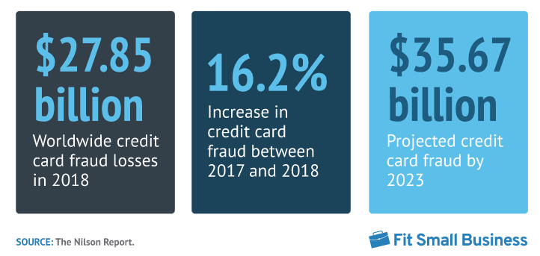
Global Credit Card Fraud Losses
7 Eye-opening Credit Card Fraud Statistics: https://fitsmallbusiness.com/credit-card-fraud-statistics/
Notes:
7 Eye-opening Credit Card Fraud Statistics: https://fitsmallbusiness.com/credit-card-fraud-statistics/

Slide 5
Credit Card Fraud Dataset

Slide 6
Credit Card Fraud Dataset
Credit card transaction dataset containing legitimate and fraud transactions
Duration Jan 2019 - Mar 2020
Covers credit cards of 1000 customers doing transactions
Pool of 800 merchants
Link to Dataset: https://www.kaggle.com/datasets/kartik2112/fraud-detection?datasetId=817870
Notes:
This is a credit card transaction dataset containing legitimate and fraud transactions from the duration Jan 2019 - Mar 2020. It covers credit cards of 1000 customers doing transactions with a pool of 800 merchants.
Link to Dataset: https://www.kaggle.com/datasets/kartik2112/fraud-detection?datasetId=817870

Slide 7
Credit Card Fraud Dataset
Data Source: Kaggle
Rows: 1 million+
Columns: 24 columns
Significant Columns: Transaction date & time, Merchant and its category, Card owner, City, State, Date of Birth, Job Title, Fraud Amount and is_fraud

Slide 8
Business Task

Slide 9
Business Task
“Minimize fraud transactions to increase the revenue”

Slide 10
How to minimize Fraud Transactions?
1
Exploratory Data Analysis
Explore fraud habits of fraudsters to train systems to prevent from fraudulent transactions
2
RFM Analysis
Categorize fraudsters into different levels on the basis of RFM value

Slide 11
Data Transformations

Slide 12
Data Transformations
Filter the fraud transactions in 2019
Split date_time column into day, date, month, year and hour column
Introduce new columns (city_state, age)and remove redundant columns from the data set (card owner and merchant longitude and latitude)

Slide 13
Exploratory Data Analysis

Slide 14
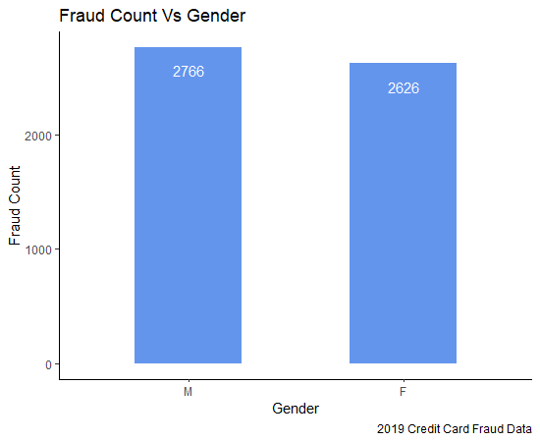
Frauds Vs Gender
Male and Female have made almost same number of fraud transactions

Slide 15
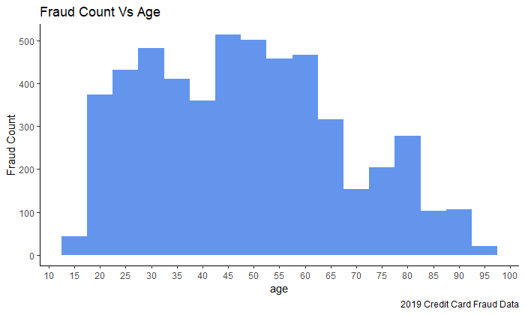
Frauds in Different Age Groups
People between 20 to 65 age group generally have higher tendency to make fraud transaction

Slide 16
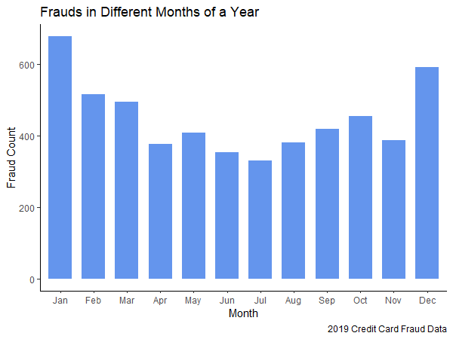
Frauds in Different Months of a Year
December and January are top months w.r.t fraud count

Slide 17
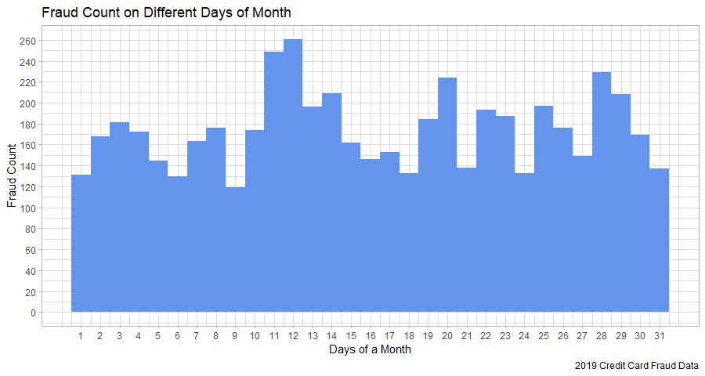

Slide 18
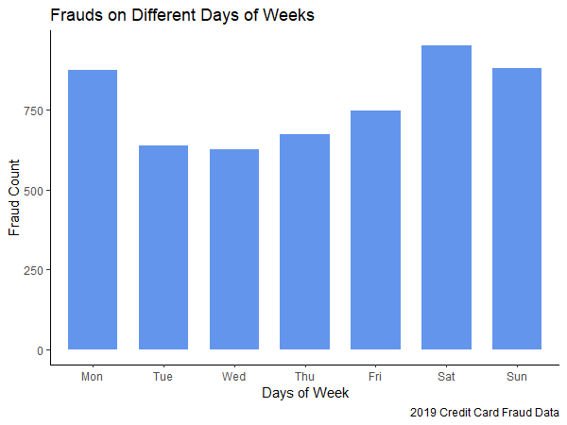
Frauds in Different Days of a Week
Saturday, Sunday and Monday have higher fraud count than other days

Slide 19
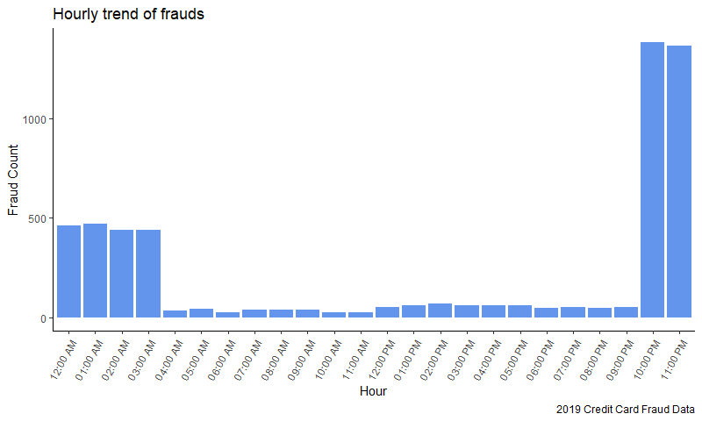
Hourly Trend of Frauds
Approximately all (10 out of 12) frauds were made between 10 PM to 4 AM

Slide 20
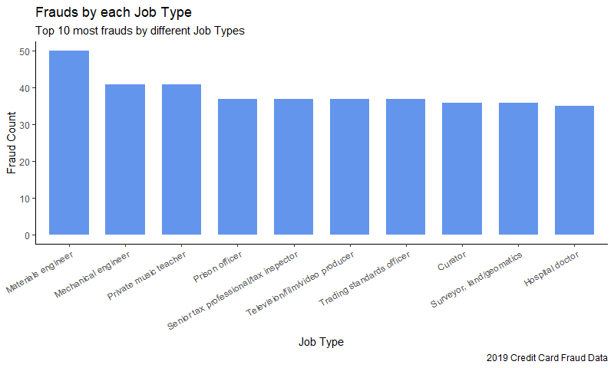
Fraud Vs Job Title

Slide 21
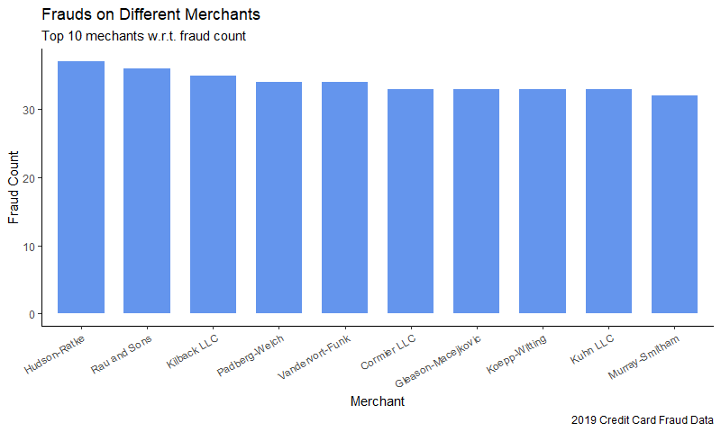
Frauds Vs Merchants

Slide 22
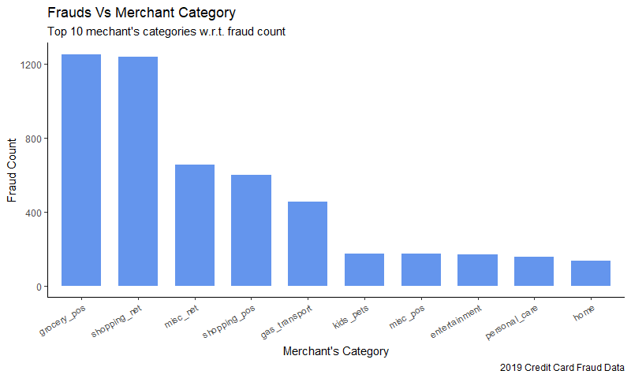
Frauds Vs Merchant Category
Frauds on Online stores and Grocery POS were made more than any other merchant category

Slide 23
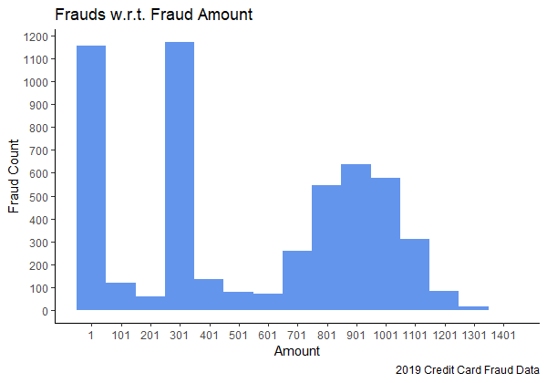
Frauds in different Range of Amount
Generally more frauds were made between 1$ to 100$, 300$ to 400$ and 700$ to 1200$

Slide 24
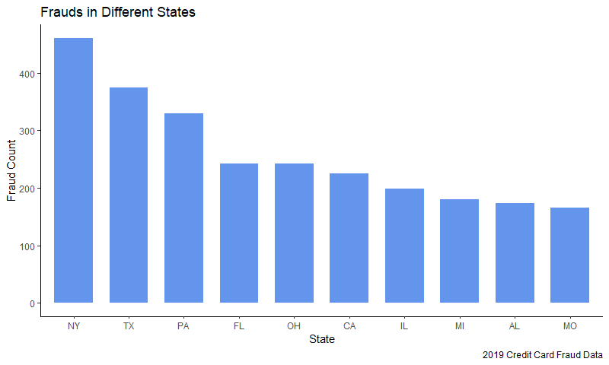
Top states w.r.t Fraud Count

Slide 25
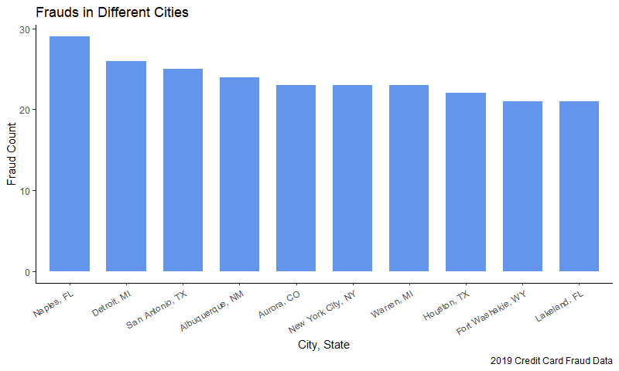
Top Cities w.r.t Fraud Count

Slide 26
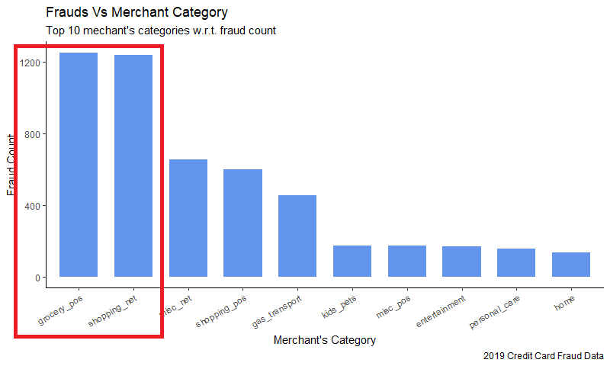
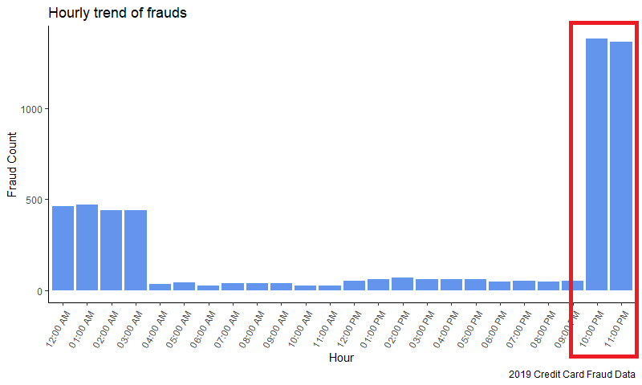
Low Hanging Fruit

Slide 27
Frauds at Grocery POS

Slide 28
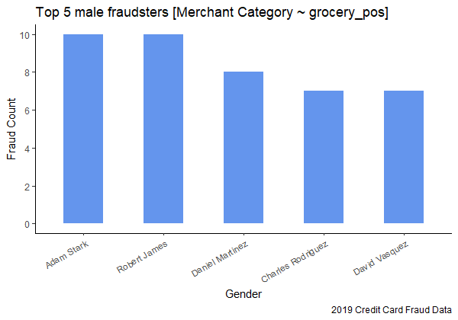
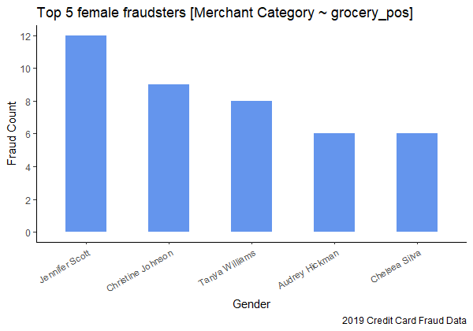
Top Fraudsters at Grocery POS
Block Credit Cards

Slide 29
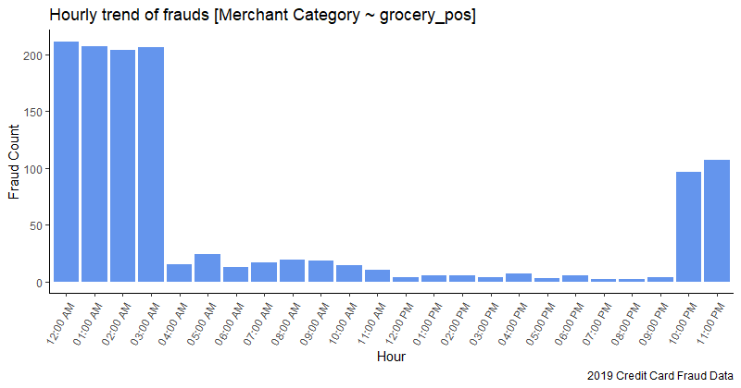
Hourly Trend of Frauds at Grocery POS
Generally more frauds at Grocery POS were made between 12 AM to 4 AM

Slide 30
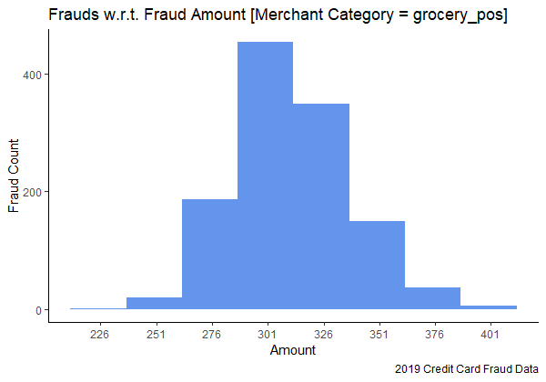
Fraud Amount Range at Grocery POS
Almost all frauds at Grocery POS were made between 275$ to 375$ range

Slide 31
Recommendations
Keep special checks on the transactions at grocery store between 12 AM to 4 AM between the fraud amount range of 275$ to 375$

Slide 32
Frauds in Online Shopping

Slide 33
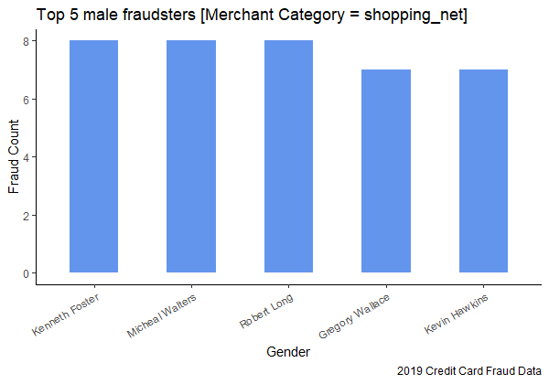
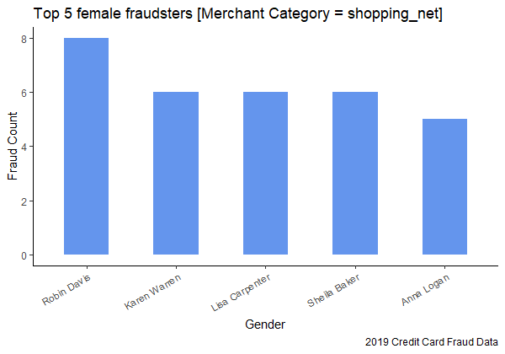
Top Fraudsters in Online Shopping
Block Credit Cards

Slide 34
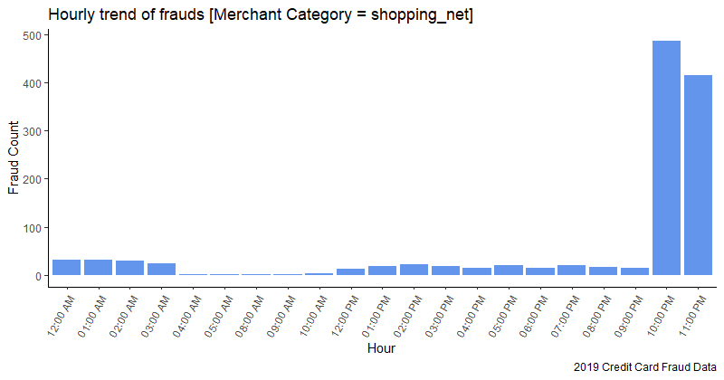
Hourly Trend of Frauds in Online Shopping
Almost all frauds at Online store were made between 10 PM to 12 AM

Slide 35
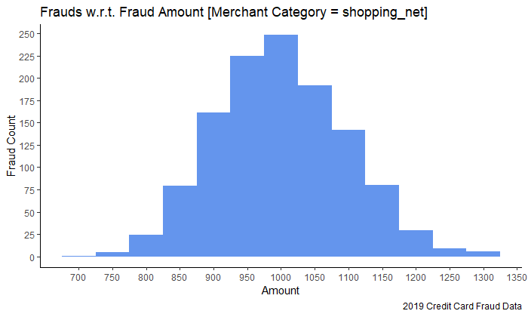
Fraud Amount Range in Online Shopping
Almost all frauds at Online Store were made between 850$ to 1150$ range

Slide 36
Recommendations
Keep special checks on the transactions at grocery store between 12 AM to 4 AM between the fraud amount range of 275$ to 375$
Keep special checks on the transactions at online store between 10 PM to 12 PM between the fraud amount range of 850$ to 1150$

Slide 37
Frauds Between 10 to 12 PM

Slide 38
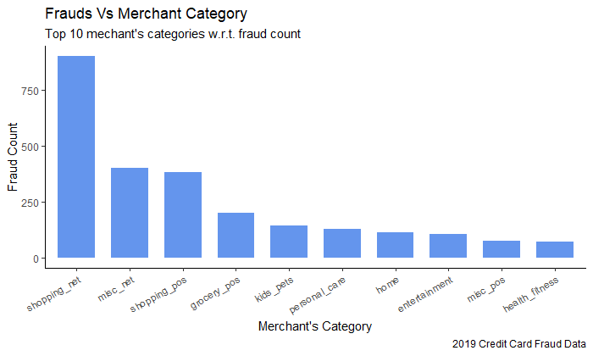
Top Fraudulent Merchant Categories b/w 10 to 12 PM
A lot of frauds between 10 to 12 PM were made at online stores

Slide 39
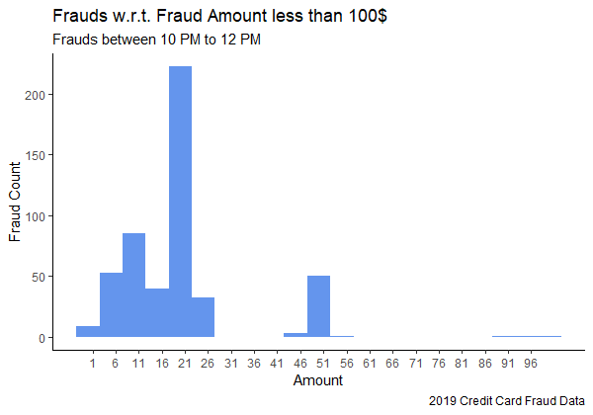
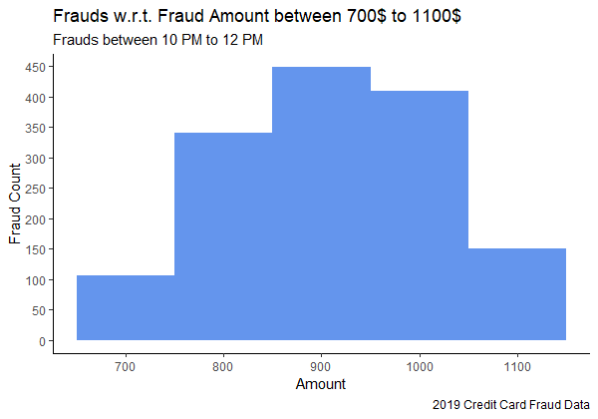
Fraud Amount Range b/w 10 to 12 PM

Slide 40
Recommendations
Keep special checks on the transactions at grocery store between 12 AM to 4 AM between the fraud amount range of 275$ to 375$
Keep special checks on the transactions at online store between 10 PM to 12 PM between the fraud amount range of 850$ to 1150$
Keep special checks on the transactions between 10 PM to 12 PM at online stores between the fraud amount range of 10$ to 25$ and 700$ to 1100$

Slide 41
RFM Analysis

Slide 42
RFM Analysis
RFM analysis is used categorize customers by scoring them in three categories:
Recency: How recent a customer has done last fraud transaction
Frequency: Total fraud transactions a customer has made
Monetary: Total amount of fraud transaction made by a customer

Slide 43
RFM Analysis
Customer | RFM Score | Category
Alicia Morales | 555 | Critical
Brianna Wilson | 145 | Critical
Jessica Werner | 541 | Moderately Critical
Emily Hall | 442 | Moderately Critical
Amber Lewis | 211 | Non Critical

Slide 44
Recommendations
Keep special checks on the transactions at grocery store between 12 AM to 4 AM between the fraud amount range of 275$ to 375$
Keep special checks on the transactions at online store between 10 PM to 12 PM between the fraud amount range of 850$ to 1150$
Keep special checks on the transactions between 10 PM to 12 PM at online stores between the fraud amount range of 10$ to 25$ and 700$ to 1100$
Block customers having critical RFM score and warn customers having moderately critical RFM score

Slide 45
Further Advancements
Create Dashboard
Predict whether a transaction is fraud or legit in a real time
Dive deeper into the data to extract more insight about fraud transactions i.e. perform more complex EDA

Slide 46
Thank you!!!
Any Questions?

