Slide 1

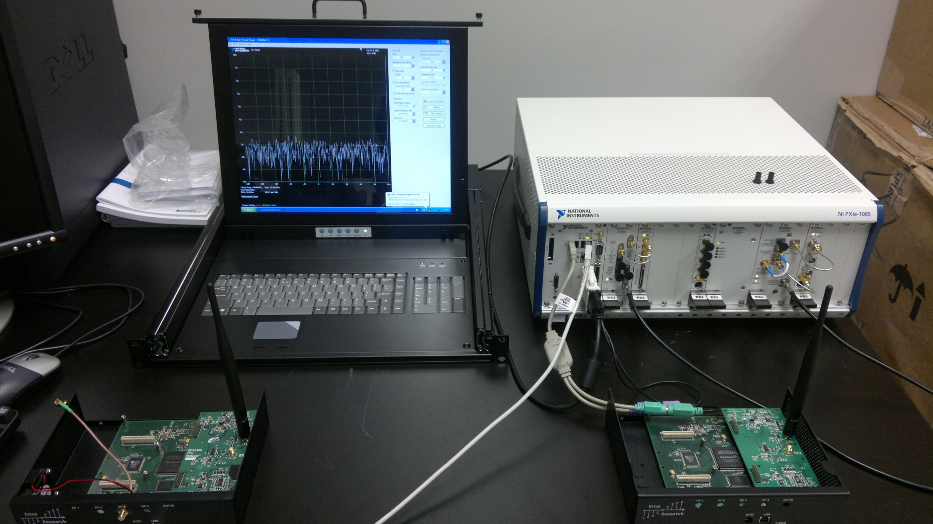
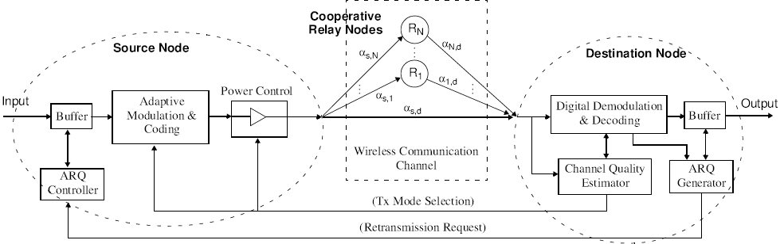
Analysis & Optimization of Cooperative Cognitive Relay Radio Networks Olabiyi Oluwatobi Advisor : Dr. Annamalai Center of Excellence for Communication Systems Technology Research (CECSTR) ARO Center for Battlefield Communications (CeBCom) Department of Electrical & Computer Engineering , Prairie View A &M University, TX 77446,USA
Abstract
In order to analyze and optimize cooperative cognitive relay radio networks, efficient algorithms are required to evaluate the signal transmission and primary user detection performances. Here we develop novel techniques of analyzing the signal transmission and detection performance in cooperative cognitive relay networks. Some of the metrics employed include (i) average symbol error rate (ASER) for signal transmission performance; and (ii) probability of false alarm; (iii) probability of detection; (iv) probability of miss-detection; (v) receiver operating characteristics (ROC) (vi) area under the receiver operating curve (AUC) for signal detection performance. We analyzed the effect of different communication channels parameters on these metrics and how to improve them by the use of different diversity systems and variable degrees of freedom. For most of the metrics, new methods involving the moment generating functions (MGF) were developed. We conclude that these metrics improve with increase in number of diversity branches and with improvement in channel characteristics. However, the metrics become worse with increase in degree of freedom.
Methodology
The following are the developed analytical framework for cooperative cognitive relay networks.
Average symbol error rates
B. Probability of false alarm
C. Probability of detection
D. Area under receiver operating curve
C. Receiver Operating Characteristics
Fig. 4 Receiver operating characteristics (ROC) for MRC diversity in cooperative cognitive relay networks with .
D. Area Under Receiver Operating Curve
Fig. 5 Complimentary area under ROC curve consisting of N relays (N=0,1, 2, 3).
Introduction
Why Cooperative Cognitive Relay Wireless Communications?
To overcome the practical implementation issue of packing many antenna elements in small-sized terminals (e.g., mobile handsets, sensor nodes).
Built-in a flexible communication strategy for ensuring the connectivity and network stability needed in terms of throughput, latency, and error rates (QoS requirements).
Improve the range, rate & robustness of BLOS/OTH communication links without increasing Tx power, thereby improving platform endurance (longer battery life) with enhanced LPI/LPD capability.
Improve the range of energy detection and spectrum opportunity through cooperation amongst cognitive relay.
Prior Work
Extensive research on analysis of ASER mostly limited to Rayleigh and independent and identically distributed Nakagami-m fading channels which does not depict practical scenario.
“Although the performance of energy detector has been well research in literature, most research work has be limited to non-cooperative system.
Simulation of ASER for practical scenario is time consuming and expensive, therefore simple and efficient analytic framework is required for system analysis
the art of relay-based spectrum detection or sensing in CRNs has not yet been fully explored
Limitations of existing results/framework
M Alouini & Hasna [Trans. Com., Nov’03] & Anghel & Kaveh [Trans. Com., Sep’04] : Exact ASER over Rayleigh fading channel
Tallubra et. al. [Globecome ’09 & ‘10]: these are the only existing literature on relay-based spectrum sensing and their analysis is limited to Rayleigh fading channel.
Objective
Develop a simple analytical framework based on the approximate MGF method to evaluate ASER of cooperative relay networks.
Develop an efficient analytical framework to model the performance of relay-based energy detector (used for signal detection in cognitive radio networks) and use the framework to study the effect of change in channel and system parameters on the performance.
Amplify-and-Forward Cooperative Diversity
Transmission-TDMA: Sensing:
Phase 1: S transmits, R₁, R₂, …, R_{N} listen Phase 1: R₁, R₂, …, R_{N} senses the signal of S
Phase 2: Phase 2:
Time Slot 2: R₁ transmits, D listens Time Slot 2: : R₁ amplifies the signal and transmits, D listens
….. …..
Time Slot (N+1): R_{N} transmits, D listens Time Slot (N+1): R_{N} amplifies the signal and transmits, D listens
denotes the instantaneous SNR between node j and node k
Conclusions
Our simple analytical framework for ASER analysis give close approximation to the exact and it’s easier to implement. In fact, it is able to give results for Rice channel for which exact expression does not exits.
The algorithm for detection / sensing performance of cooperative cognitive relay system is more efficient than existing algorithms that requires complicated contour integral and cannot be generalized to different types of channels. In stead, our algorithm requires infinite summation term that is less complex and converges quickly.
Our algorithm on AUC is the most simplified form of AUC analytical framework that exist in literature, thereby giving closed form solution that could be easily applied to different fading channels and diversity systems.
Future Work
All the above algorithms will be implemented on software defined cognitive radio with setup shown below:
‘
A. Average Symbol Error Rates
Fig. 2 Average symbol error rate reduces as the channel fading index increases. Our approximate method gives good result.
B. Probability of Detection
Fig. 3 Performance of SLC and MRC diversity systems with and without direct sensing.
System Model
Fig. 1. Illustration of a cooperative network with cognitive relays.
References
[1] O. Olabiyi, S. Alam, A. Annamalai, “Accurate Approximations of Error Rates for Cooperative Non-Regenerative Relay Systems over Generalized Fading Channels,” Submitted to IEEE IWCMC 2011 Conference reviews (No. 1569404823).
[2] O. Olabiyi, S. Alam, O. Odejide, A. Annamalai, “Analysis of Cooperative Relay-Based Energy Detection of Unknown Deterministic Signals in Cognitive Radio Networks,” Submitted to IEEE SARNOFF 2011 Conference reviews (No. 1569411779).
[3] O. Olabiyi, S. Alam, O. Odejide, A. Annamalai, “Simplified Analysis of Area under the ROC Curve of Energy Detectors over Generalized Fading Channels,” Submitted to IEEE SARNOFF 2011 Conference reviews (No. 1569429263).
Acknowledgement
This research work is supported in part by funding from the National Science Foundation (NSF),US Air Force Research Lab (ARFL) and Army Research Office (ARO)

