Slide 1

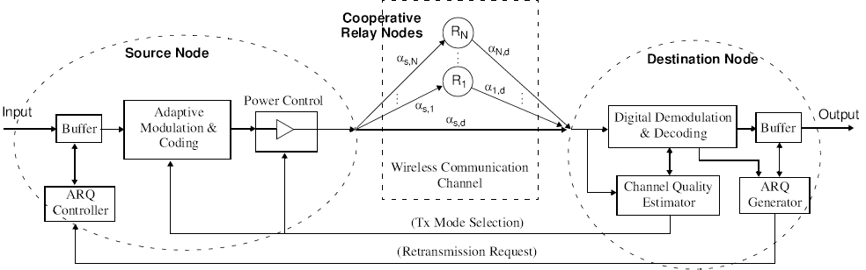
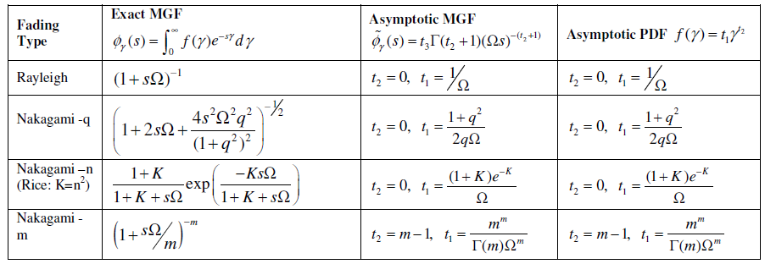
Efficient Evaluation of Error Rates in Non-regenerative Cooperative Relay System Olabiyi Oluwatobi Advisor : Dr. A. Annamalai ARO Center for Battlefield Communications (CeBCom) Center of Excellence for Communication Systems Technology Research (CECSTR) Department of Electrical and Computer Engineering Prairie View A&M University, TX 77446,USA
Introduction
‘
‘
‘
Why Cooperative diversity network system?
To overcome the practical implementation issue of packing many antenna elements in small-sized terminals (e.g., mobile handsets, sensor nodes).
Built-in a flexible communication strategy for ensuring the connectivity and network stability needed in terms of throughput, latency, and error rates (QoS requirements).
Improve the range, rate & robustness of beyond-line-of-sight (BLOS), over-the- horizon (OTH) and on-the-move (OTM) communication links without increasing Tx power, thereby improving platform endurance (longer battery life) with enhanced Lower Probability of Intercept (LPI) /Lower Probability of Detection (LPD) capability.
Fixed transmission methods that are designed to provide the required QoS in the ‘worst-case’ are inefficient when better channel conditions prevail.
Conclusion
Developed a novel approach for efficient performance evaluation of error rates in CAF system.
First we developed an exponential-type approximation for the CEP over a wide range of digital modulation schemes.
Then, develop a novel asymptotic analysis of CAF networks over generalized fading channels (including mixed fading).
Our approach gives closed-form solution for all modulation schemes and fading channels as long as the MGF exist.
Our approach is more accurate than the modified RCG method at lower SNR regime and at higher values of fading severity index.
It is less complex to program and evaluate when compared to the bounding technique and exact expressions (when available).
Fig. 1: A “cooperative-diversity network” with adaptive source transmission techniques.
‘
‘
‘
TABLE I Exact and approximate CEP for Coherent Modulation techniques
Modulation | Exact CEP | Approx. CEP
M-PSK
BPSK |  | a = 0.1669, b = 1.0493
QPSK |  | a = 0.4113, b= 0.5423
8-PSK | M = 8 | a = 0.4682, b = 0.153
16-PSK | M = 16 | a = 0.5008, b = 0.0405
32-PSK | M = 32 | a = 0.6736, b = 0.0115
M-QAM
4-QAM |  | a = 0.4113, b= 0.5423
8-QAM | M = 8 | a = 0.4552, b = 0.2305
16-QAM | M = 16 | a = 0.6253, b = 0.1061
32-QAM | M = 32 | a = 0.6678, b = 0.0516
64-QAM | M = 64 | a = 0.7922, b = 0.0257
Binary Non-Orthogonal FSK |  | a = 0.1913, b = 0.6483
Differentially Encoded BPSK |  | a = 0.3335, b = 1.0492
Differentially Encoded QPSK |  | a = 0.6763, b = 0.5251
Objective
Fig. 2: ASER of BPSK signal over i.i.d. Nakagami-m channel (m = 1 and 3) and Rician (K=0 and 3) respectively with single CAF relay system.
develop an efficient method of evaluating the error rates of non-regenerative cooperative relaying system by employing novel techniques.
Represent the conditional error probability of common digital modulation techniques by desirable exponential form.
Develop a very tight asymptotic approximations for the moment generating function of harmonic mean SNR.
‘
‘
Future Research Direction
The area of analysis of error rates of non-regenerative cooperative relaying system has been receiving lots of attention in recent years
Over 20 papers (conference and journal) has be written in search of efficient analysis method.
Efficient error rates analysis will provide insight to the system performance and helps system level analysis e.g., optimum power allocation and cross-layer system design “
The solution to this fundamental problem will help the committee of IEEE 802.16 standard in their finalization as cooperative relay has been proposed in the draft standard of WiMAX.
It will aid the feasibility of implementation of cooperative relaying system in military communications.
Problem statement
The average symbol error rates (ASER) of transmitted signal requires the averaging of the conditional error probability (CEP) over the probability distribution function (pdf) of signal-to noise-ratio (SNR).
However, the effective SNR include the harmonic mean of SNR of source-relay and relay-destination links shown in Fig. 1. Therefore, obtaining the pdf of effective SNR of different relay fading channels becomes a major challenge.
Limitations of existing results/framework
Alouini & Hasna [Trans. Com., Nov’03] & Anghel & Kaveh [Trans. Com., Sep’04] : Exact ASER over Rayleigh fading channel
Alouini & Hasna [Trans. Com., Nov’04] : Exact ASER over independent and identically distributed (i.i.d.) Nakagami-m fading channels.
Ribeiro, Cai & Giannakis [Trans. Com., May’05]: Asymptotic ASER for general cooperative links (mainly BPSK transmission over i.i.d. Rician channels) .
Nechiporenko et al [Trans. WCom., Apr’09]: Capacity of Rayleigh fading cooperative systems under adaptive transmission. They developed bounds for effective harmonic mean SNR over Rayleigh fading channels
Annamalai et al [PIMRC’10]: Tight Bounds on the Ergodic Capacity of Cooperative Analog Relaying with Adaptive Source Transmission Techniques . Developed bounds for effective harmonic mean SNR over Nakagami-m fading channels.
Annamalai et al [Unpublished]: Tight Bounds on the Ergodic Capacity of Cooperative Analog Relaying with Adaptive Source Transmission Techniques over Rice Channels . Developed bounds for effective harmonic mean SNR over Rice fading channels.
Our closed-form expressions for ASER may be further exploited for the following system-level optimization:
Optimal power allocation problem in cooperative relay networks
Link-adaptive CAF network design
‘
Acknowledgement
Fig. 3: ASER of BPSK signal over i.n.d. Nakagami-m channel (m = 1 and 3) and Rician (K=0 and 3) respectively with 2-relay, 2-hop CAF relay system.
This work is supported in part by funding from the NSF 0931679 and the US Air Force Research Laboratory (Contract #FA8750-09-1-0151). The views and conclusions contained in this document are those of the authors, and should not be interpreted as representing the official policies, either expressed or implied, of the AFRL or the US Government.
‘
The values of a and b obtained for different digital modulation scheme are listed in Table 1 and 2.
Approximate asymptotically the MGF of harmonic mean SNR to obtain
Derive the final closed form expression the ASER
The MGF of different fading channels are in Table 3. Therefore, our proposed approach can be employed to analyze not only the performance of identical fading channels but also of non-identical and mixed fading channels.
M.O. Hasna, M. S. Alouini, “End-to-End Performance of Transmission Systems with Relays over Rayleigh-Fading Channels,” IEEE Transactions on Communications, vol. 2, pp. 1126–1131, Nov. 2003.
Z. Wang, G. Giannakis, “A Simple and General Parameterization Quantifying Performance in Fading Channels,” IEEE Transactions on Communications, vol. 45, pp. 1389–1398, Aug. 2003.
P. A. Anghel, M. Kaveh “Exact Symbol Error Probability of a Cooperative Network in a Rayleigh-Fading Environment,” IEEE Transactions on Communications, vol. 3, pp. 1416–1421, Sep. 2004.
Weifeng Su, K. S. Ahmed and K. J. Ray Liu, “Cooperative Communication Protocols in Wireless Networks: Performance Analysis and Optimum Power Allocation,” Wireless Personal Communication, vol. 44, 2008, pp. 181-217.
M.O. Hasna, M. S. Alouini, “Harmonic Mean and End-to-End Performance of Transmission Systems With Relays,” IEEE Transactions on Communications, vol. 52, pp. 130–135, Jan. 2004.
A Ribeiro, X. Cai, G. Giannakis “Symbol Error Probabilities for General Cooperative Links,” IEEE Transactions on Communications, vol. 4, pp. 1264–1273, May. 2005.
Y. Ma, Z. Wang, and S. Pasupathy, “Asymptotic Performance of Wireless Communications with Generalized Selection Combining,” Proc. IEEE GLOBECOM’03, 2003, pp. 1679-1683.
T. Nechiporenko, K. Phan, C. Telllambura, and H. Nguyen, “Capacity of Rayleigh Fading Cooperative Systems under Adaptive Transmission,” IEEE Trans. Wireless Communications, vol. 8, April 2009, pp. 1626-1631.
S. Ikki and M. Ahmed, “Performance Analysis of Cooperative Diversity Wireless Networks over Nakagami-m Fading Channels,” IEEE Communication Letters, vol. 11, pp. 334-336, April 2007.
A. Annamalai, B. Modi, R. Palat and J. Matyjas, “Tight Bounds on the Ergodic Capacity of Cooperative Analog Relaying with Adaptive Source Transmission Techniques,” Proc. IEEE PIMRC’10, pp. 18-23.
A. Annamalai and B. Modi, “Tight Bounds on the Ergodic Capacity of Cooperative Analog Relaying with Adaptive Source Transmission Techniques over Rice Channels” Unpublished work .
N. Laneman, D. Tse, and G. Wornell, “Cooperative Diversity in Wireless Networks: Efficient Protocols and Outage Behaviour,” IEEE Trans. Info. Theory, vol. 50, pp. 3062-3080, Dec.2004.
M. K. Simon and M. S. Alouini, Digital Communication over Fading Channels, 2nd ed., New Jersey: John Wiley & Sons, 2005.
‘
TABLE 2 Exact and approximate CEP for Non-coherent and Differentially Coherent Modulation techniques
Reference
Modulation | Exact CEP | Approx. CEP
M-FSK
M-DPSK
2-DPSK
4-DPSK | M = 4 | a = 0.2491, b= 0.3185
8-DPSK | M = 8 | a = 0.5382, b = 0.0838
16-DPSK | M = 16 | a = 0.5955, b = 0.0214
32-DPSK | M = 32 | a = 0.7511, b = 0.0064
‘
‘
Discussion
The obtained closed form expression for ASER were computed and the result were compared to other existing results and the following were the observation:
Fig. 2 shows the performance of our approach in i.i.d. fading environment.
Our approach performs better than any existing bounds or asymptotic method across SNR and fading channel distributions .
Our result is within the limit of upper and lower bounds but closer to the upper bound. In fact after rigorous derivations, we have shown that our approach is an approximation of the resulting ASER from the upper bound of harmonic SNR .
Our result performs better than the modified RCG method as the value of fading index m increases which agrees with the result obtained for non-cooperative system.
At low SNR, our method gives the best performance when compared to other existing methods
Fig. 3 depicts the performance analysis in independent and non-identically distributed (i.n.d.) fading environment.
No exact analysis exist for this case. We can only compare to existing bounds and approximation.
Our method and the bounds follows the curve of the ASER throughout the range of SNR while the RCG (‘Modified’) method does not at low SNR values.
‘
Methodology
Novel techniques are used to come up with an efficient method of evaluating the error rates of non-regenerative cooperative relaying system
the ASER of any communication system is given by
effective SNR of a 2-hop cooperative amplify-and-forward (CAF) i.e., non-regenerative diversity system with N relays is given by
where
represent the CEP (first term of the ASER integral expression) in desirable exponential form
TABLE 3 Exact and asymptotic formulas for the MGF and PDF of stochastic fading channels

