Slide 1
Lecture 01
System integration architecture
Engr. Anees ur Rahman Khattak
Email: aneeskhattak085@gmail.com
Skype: anees.software
1

Slide 2
Outline
2
Grading Policy
Academic Honesty
Introduction to the Course
The Evaluation of Enterprise Architecture
Summary & Readings
2

Slide 3
Grading Policy
Classification
Assignments, project and presentation | 20 %
Quizzes | 15 %
Mid-term Exam | 25%
Final-term Exam | 40 %
Total | 100
3

Slide 4
Academic Honesty
Your work in this class must be your own
If students are found to have collaborated excessively or to have cheated (e.g. by copying or sharing answers during an examination), all involved will at a minimum receive grades of
“0” for the first violation
Further violations will result in failure in the course
4

Slide 5
Few Things to Remember
Attendance will be taken with in 15 minutes at the start of class
Students are allowed to enter into class with in 3 0 minutes at the starting of class
Zero tolerance policy on attendance, discipline of class during
lectures!
Assignments must be submitted on time, no late submissions
In case of copied assignment both parties will be given zero!
Projects, Presentation, Quizzes, Assignments, Class participation are very important.
Don’t miss your Classes, Quizzes, Presentations, Assignments and Projects!
5

Slide 6
1. Course Outline
Enterprise Architecture (EA) and Enterprise Engineering (EE). Balanced Scorecard and Strategy Maps (BSSM). Using Strategy Analysis (SA). Governance Analysis Using EA. Enterprise Architecture Methods. Using Business-Driven Data Mapping for Integrated Data. Strategic Modeling for Rapid Delivery of EA. Strategic Alignment, Activity and Workflow Modeling, and Business Rules. Using Business Normalization for Future Business Needs. Menu Design, Screen Design, Performance Analysis, and Process Modeling. Enterprise Application Integration Concepts. Enterprise Portal Technologies for Integration. Web Services for Real-Time Integration. Service Oriented Architecture for Integration. Managing and Delivering EA. Future Directions in EA and Integration.
6

Slide 7
Preface
Need to transform today’s inflexible business environment to an agile enterprise that can change direction rapidly has never been greater.
Yet the structures, processes, and systems that we have today are inflexible: They are incapable of rapid change.
More computer hardware, or software, or packages, or staff, or outsourcing is not the solution. They are part of the problem.
This is not a computer problem. It is a business problem!
Needed methods and technologies that enable senior managers— together with their planners, business managers, business experts, and IT staff—to work together to achieve business change, with each group contributing its specific expertise.

Slide 8
Evolution of Enterprise Architecture
Enterprise architecture was developed by John Zachman while with IBM in the 1980s, after observing the building and airplane construction industries and the IT industry.

Slide 9
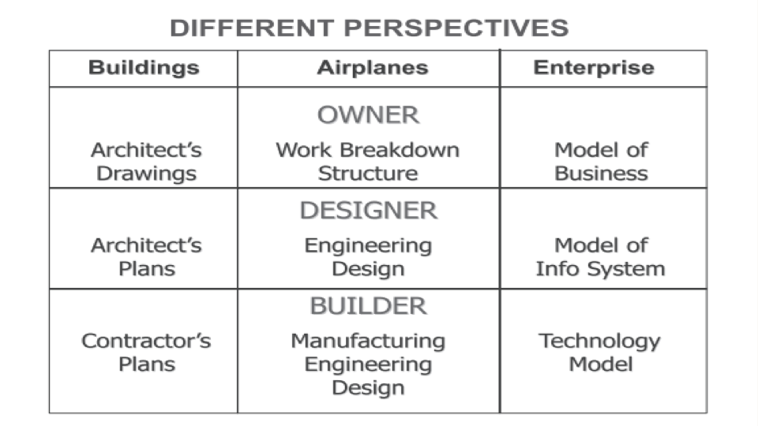
2. Web engineering…
Web engineering is the study of the process, used to create high quality Web-based applications
Web engineering draws heavily on the principles and management activities found in software engineering processes
Web engineering extends Software Engineering to Web applications

Slide 10
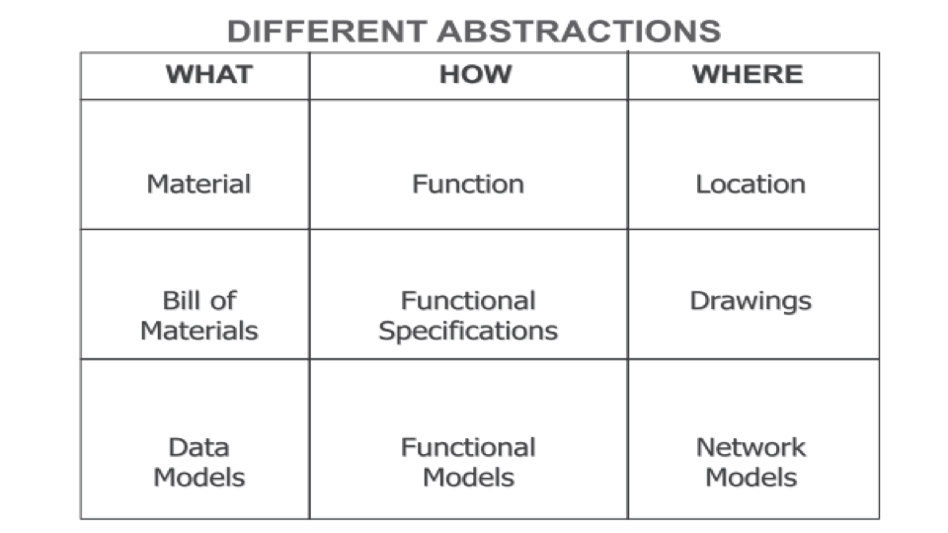
2. Web engineering…
The application of systematic and quantifiable approaches to cost-effective analysis, design, implementation, testing, operation, and maintenance of high-quality web applications

Slide 11
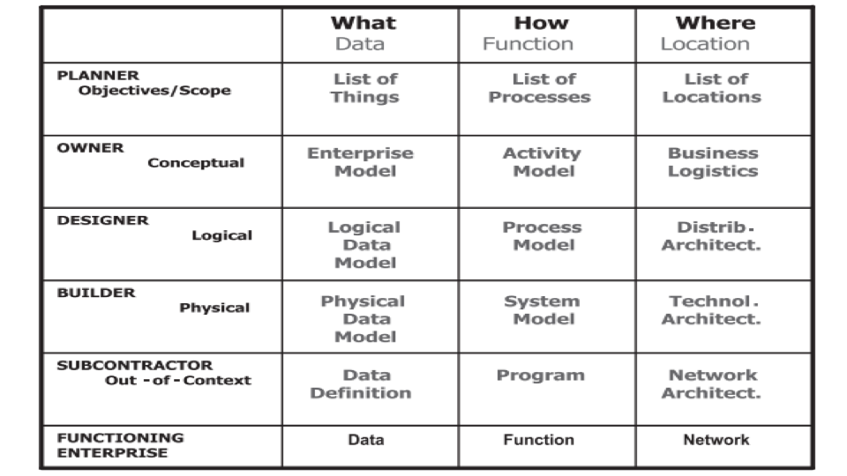
3. Web applications
WWW has massive and permanent influence on our lives
Economy, Industry, education, healthcare, entertainment
Why?
global and permanent
Comfortable and uniform access

Slide 12
3. Web applications…
WWW started as an informational medium
Evolved into application medium
Interactive, data intensive services
Distinguishing factors
How it is used?
Technologies and standards for development

Slide 13
1.3 Books & Resources
1. Read and Prepare givenHandouts
Chapter-1, Topic 1.1 : Enterprise Architecture for Integration: Rapid Delivery Methods and Technologies by Clive Finkelstein

Slide 14
Thank you

